Slide 1
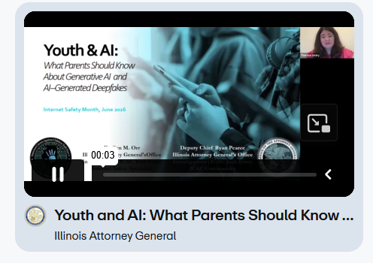
Youth and AI: What Parents Should Know
About Generative AI and AI-Generated Deepfakes
From the Illinois Attorney General’s Office
June 2026—Internet Safey Month
https://vimeo.com/showcase/9108960?video=1205598654

