Slide 1



Semiconductor Career Exploration
Mr. English

Slide 2
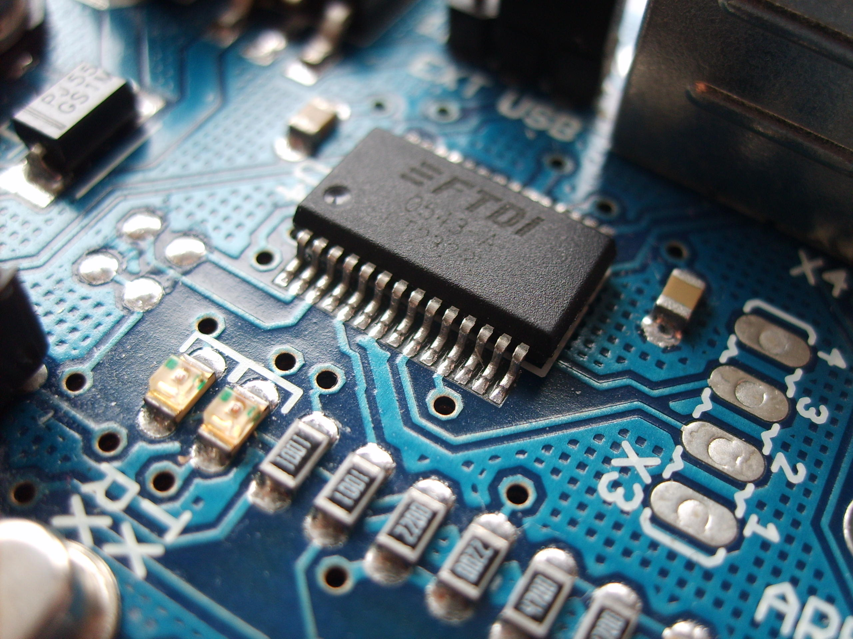
Modern Electronic Era
Since the 1970’s we have grown increasingly depended on electronic devices
Every we interact with millions of electronic circuits
The future of modern electronics is changing as we reach the limit of what’s technologically possible

Slide 3
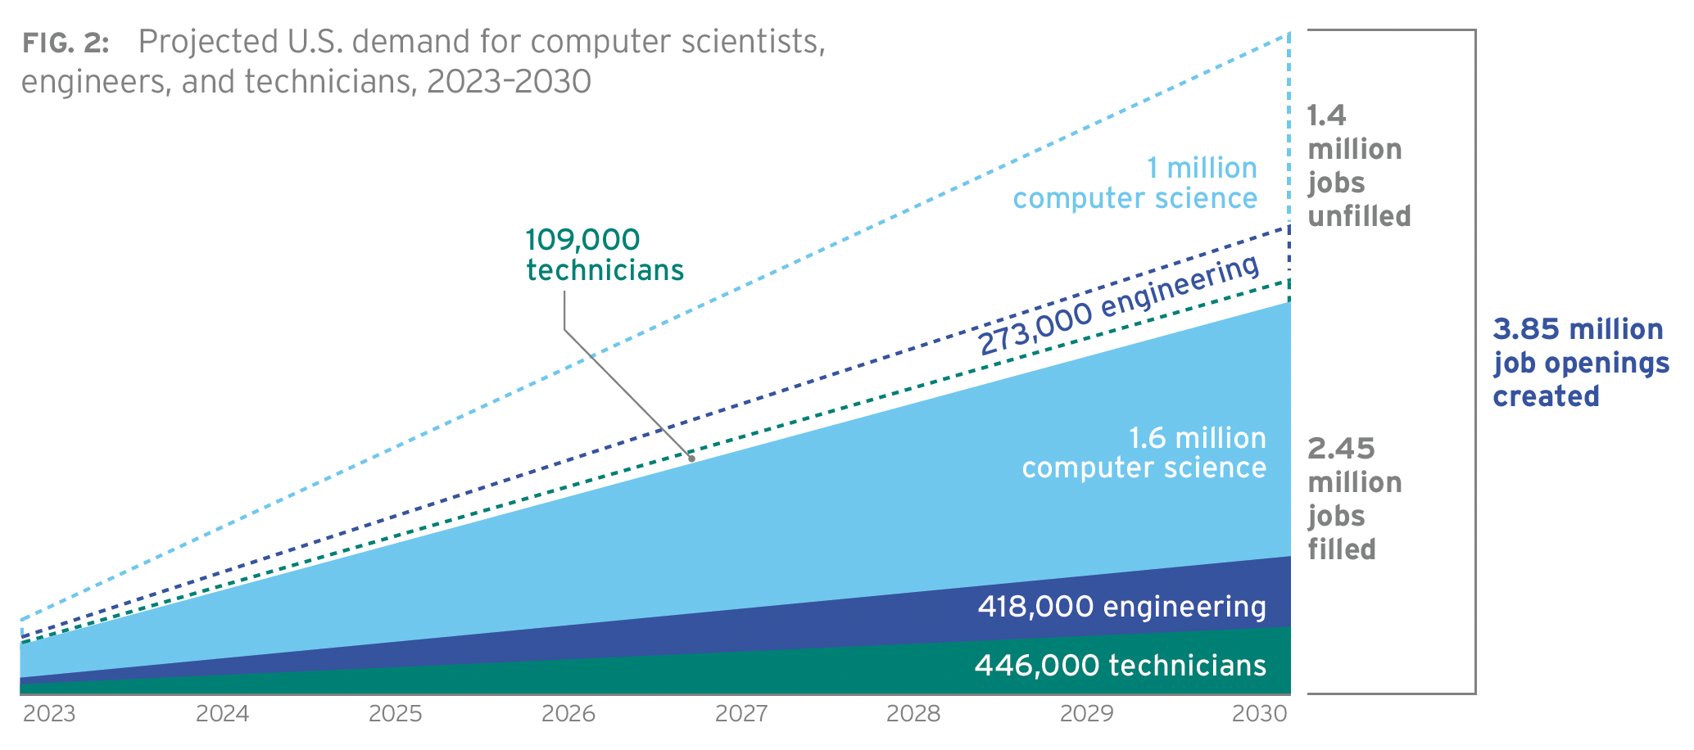
Need for more workers
The need for skill trades workers in the semiconductor industry continues to grow
Technicians
Engineers
Computer Scientists

Slide 4

Skills and Traits
Basic understanding of Science
Hand tool skills
Mathematics
Electronics
Teamwork

Slide 5
Certifications
Special certifications available for jobs
Advanced degrees for certain jobs
Can get higher paying jobs

Slide 6

SALARIES AND BENEFITS
Some of the highest paying salaries
Stock options
Ability to transition to higher paying jobs
T1 to T2 to T3 etc

