Slide 1
Workplace Safety
Seminconductor 100

Slide 2


OSHA
OSHA, the Occupational Safety and Health Administration, is a U.S. government agency that ensures safe and healthy working conditions by setting and enforcing standards, providing training, and investigating hazards across various industries

Slide 3
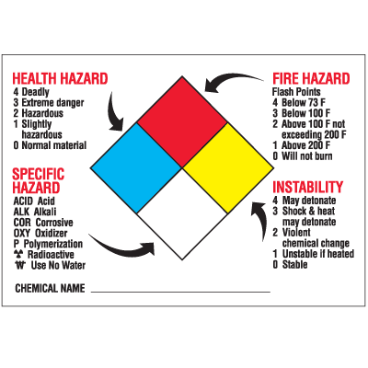
HAZCOM
HAZCOM, or the Hazard Communication Standard, is a set of regulations by the Occupational Safety and Health Administration (OSHA) requiring employers to inform employees about the hazards of chemicals in the workplace.

Slide 4
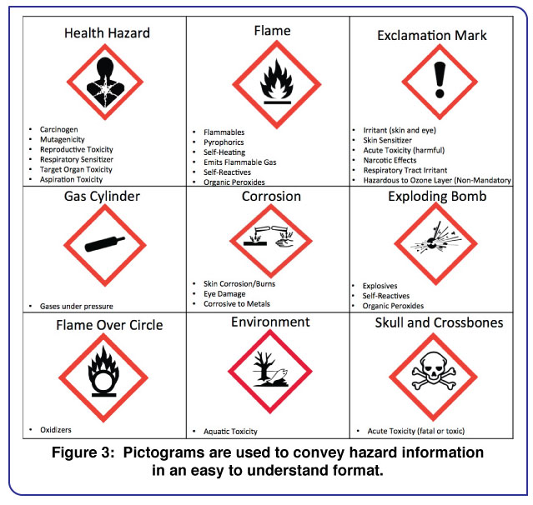
SDS
SDS stands for Safety Data Sheet, a document provided by chemical manufacturers that details the properties and potential hazards of a chemical substance. SDSs provide crucial information for the safe handling, storage, and use of chemicals, as well as emergency procedures for spills, fires, or exposure.

Slide 5
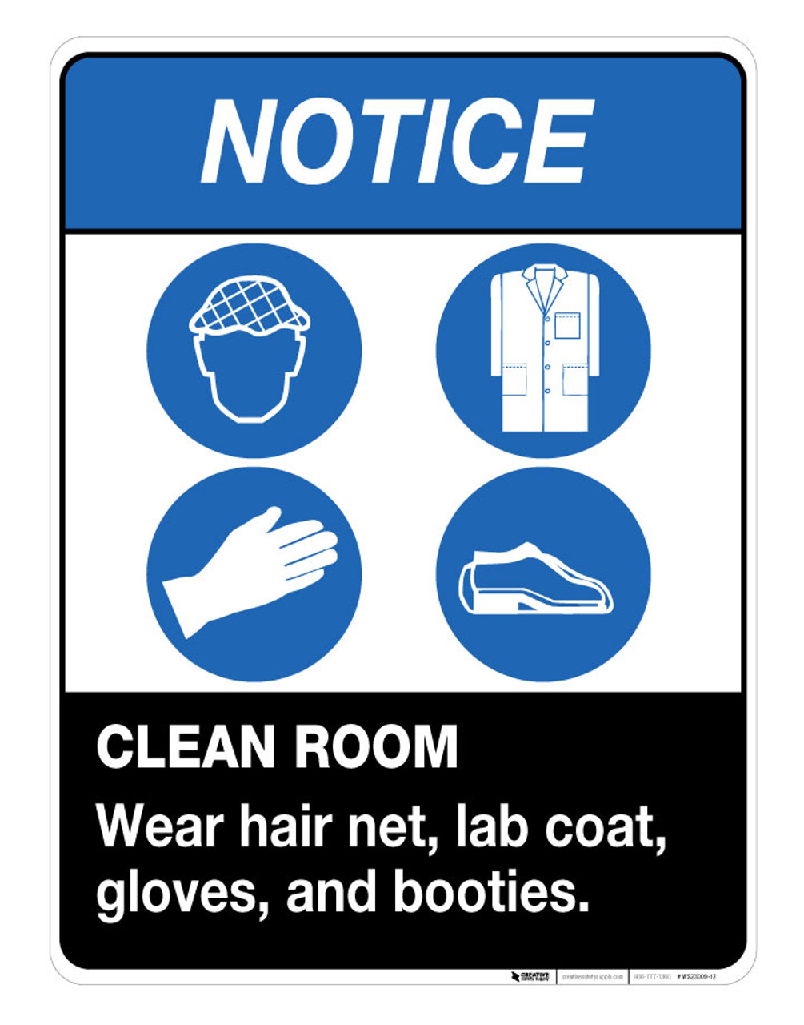

PPE
PPE, or Personal Protective Equipment, is protective clothing or gear worn to minimize exposure to various hazards, protecting the wearer from injury, illness, or infection.

Slide 6

Hand Tool Safety
The practice of preventing hand injuries while using hand tools by selecting the right tool for the job, maintaining tools in good condition, using appropriate personal protective equipment (PPE) like gloves and eye protection, and following safe work practices such as not using tools for
unintended purposes and
not leaving tools unattended in hazard areas.

Slide 7

Power Tool Safety
Power tool safety involves following general precautions such as wearing appropriate personal protective equipment (PPE), maintaining tools and work areas, ensuring tools are grounded or double-insulated, and using them only for their intended purpose

Slide 8


LOTO
LOTO stands for Lockout/Tagout, a crucial safety procedure that protects workers from the dangers of unexpected equipment startup during maintenance or repair. It involves physically isolating and de-energizing machinery from its power source, securing it with a lock, and attaching a tag to warn others that it is out of service.

Slide 9
General Workplace Safety
General workplace safety rules include wearing appropriate Personal Protective Equipment (PPE), maintaining a clean and organized workspace, using equipment and tools properly, understanding and following emergency procedures, and reporting hazards and accidents immediately to ensure a safe environment for everyone.
Be smart, think before you act, workplace safety is EVERYONE’S responsibility.

