Slide 1
Fire Safety and Extinguishers
Semiconductor 100

Slide 2
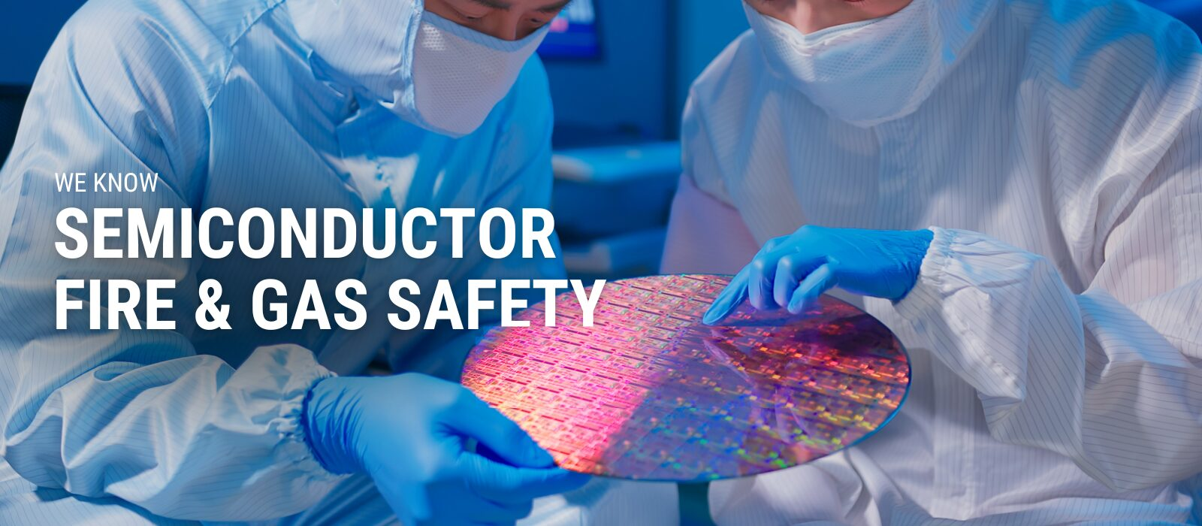
Fire Safety

Slide 3
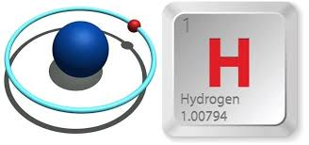
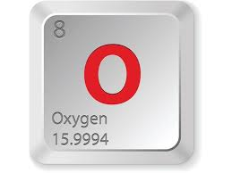
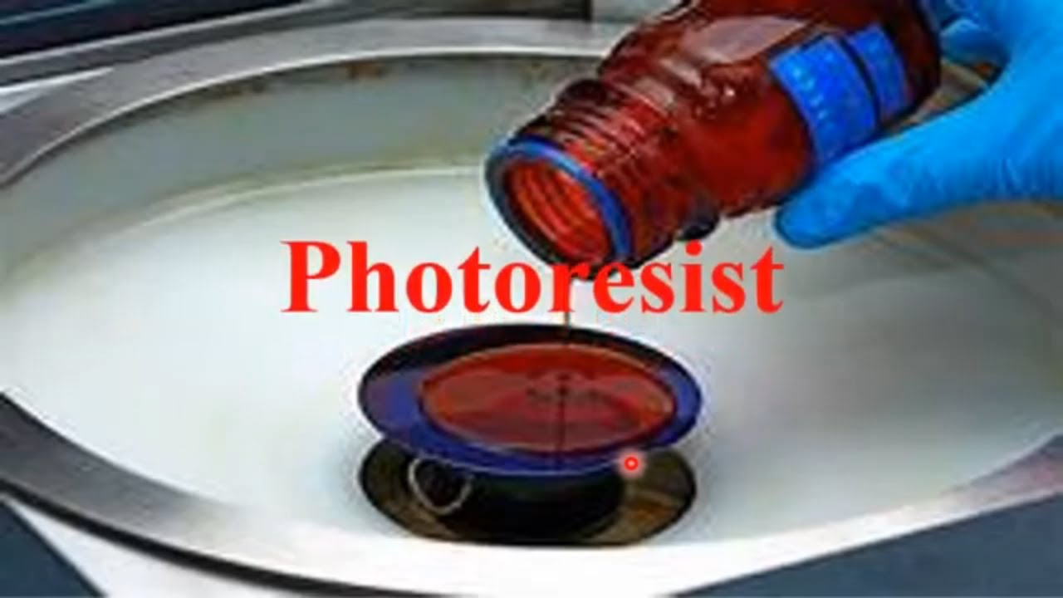
Fire Safety
Flammable Gases
  Hydrogen
  Oxygen
  Silane
Flammable Liquids
  Photoresist
  Solvents

Slide 4
Fire Safety in the Lab
Types of Air Pressure
  Negative- Draws air into the space from outside of the room
  Positive- Pushes all air out of the space to make it “clean
    This is where the name “Cleanroom” comes from
What type of air do we have in our classroom? Why?

Slide 5
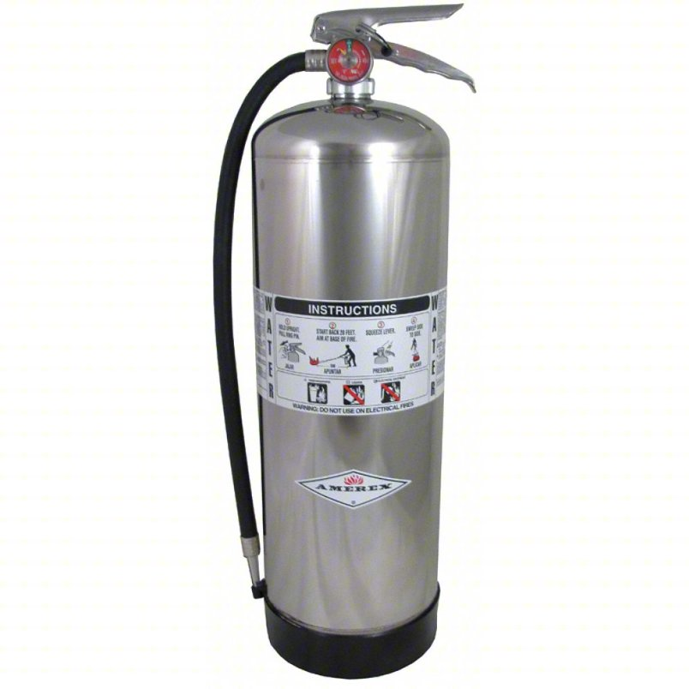
Fire Extinguishers
Type A- Water, this is good for substances like wood, paper and some plastics

Slide 6
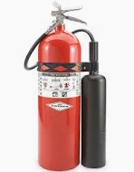
Fire Extinguishers
Type B- Dry Chemical, is used on fires involving flammable liquids and gases. These fires are fueled by substances that are highly volatile and spread easily.

Slide 7
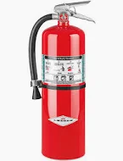
Fire Extinguishers
Type C- Wet Chemical, used for electrical fires involving energized equipment, appliances, or wiring. The "C" designation means the extinguishing agent is non-conductive, which is crucial for safely putting out electrical fires without risking electric shock.

Slide 8
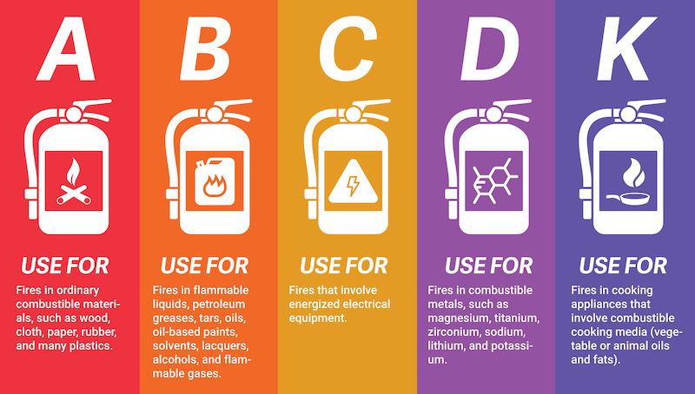
Other Types

