Slide 1
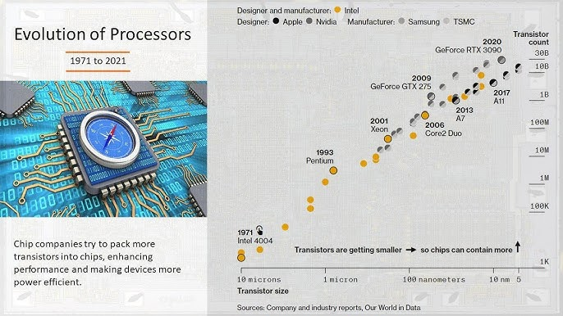
The History of Microchips: From the 4004 to Today
Semiconductor 100

Slide 2
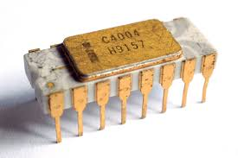
The Humble Beginnings: The Intel 4004
Release: The world's first commercial microprocessor, released by Intel in 1971.
Original Purpose: Designed for a Busicom calculator.
Transistor Count: A groundbreaking 2,300 transistors.
What it Solved: Replaced multiple integrated circuits with a single chip, simplifying design and reducing cost.
Key Figures: Federico Faggin, Ted Hoff, Stan Mazor (Intel) and Masatoshi Shima (Busicom).

Slide 3
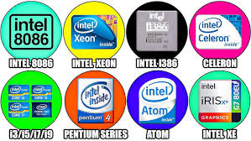
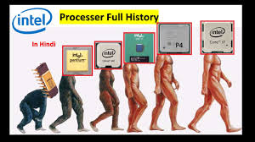
Powering the Personal Computer
The First 16-bit: The Intel 8086 processor, which launched the x86 family.
Iconic Chip: A version of this, the Intel 8088, was famously used in the first IBM PC.
Moore's Law: A key driver of progress. Named after Gordon Moore, it predicts the number of transistors on a chip will double approximately every two years.
Era of Advancement: The shift to Very-Large-Scale Integration (VLSI) allowed for millions of transistors on a single chip.
Performance Leaps: The 1990s Pentium introduced new features like pipelining to increase performance.

Slide 4
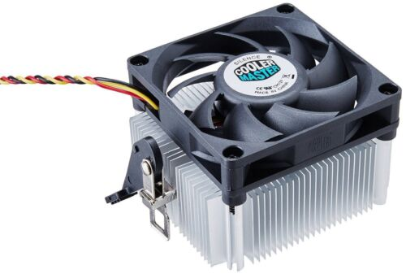
Modern Microchips: Multi-Core and Specialization
Multi-Core Processors: A CPU core is a processing unit. Modern chips have multiple cores to handle more tasks simultaneously, leading to faster performance.
Key Players: Intel is still a giant, but companies like AMD (Advanced Micro Devices), NVIDIA, and others are major competitors.
Demand Drivers: Demand for new chips is driven by smartphones, data centers, artificial intelligence, and gaming.
Specialized Chips:
GPUs (Graphics Processing Units): Originally for graphics, now crucial for AI and machine learning.
Neuromorphic Chips: Designed to mimic the human brain, used for cognitive computing.

Slide 5
What's Next? Overcoming Physical Limits
Physical Limits: Shrinking transistors is becoming physically difficult due to atomic-level constraints.
Innovative Solutions:
Chiplet Technology: Building powerful processors by combining smaller, specialized "chiplets" instead of one large chip.
Photonics: The use of light (photons) instead of electricity to transmit data, offering faster speeds and less heat.
Endless Innovation: The history of the microchip shows a constant push to find new ways to improve performance, power, and efficiency.

Slide 6
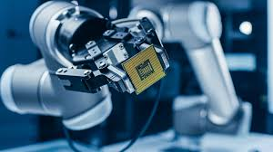

Reflections
Summary: The history of the microchip is a story of continuous innovation, from the first steps with a simple calculator chip to the powerful, specialized processors that enable our modern world.

