Slide 1
HOW TO PROPERLY WASH YOUR HANDS
Help to prevent the spread of Covid-19 and other respiratory infections
Wash your hands
regularly for at
least 20 seconds
Cough and sneeze
into your elbow or
into a tissue
Avoid direct contact
and keep a safe
distance (6’)
Stay home if
you are not
feeling well
Thank you for doing everything in your power
to help us all stay safe and healthy.

Slide 2
IF YOU ARE NOT
FEELING WELL…
IN CASE OF SYMPTOMS:
Sore Throat
Fever (from 100.4°F or higher)
New Cough
New Shortness of Breath
New Loss or Decrease in Sense of Smell
Diarrhea (abnormal for you)
DO NOT COME TO WORK,
CONTACT YOUR PHYSICIAN
Please if you are not feeling well, stay home for your
safety and the safety of others.

Slide 3
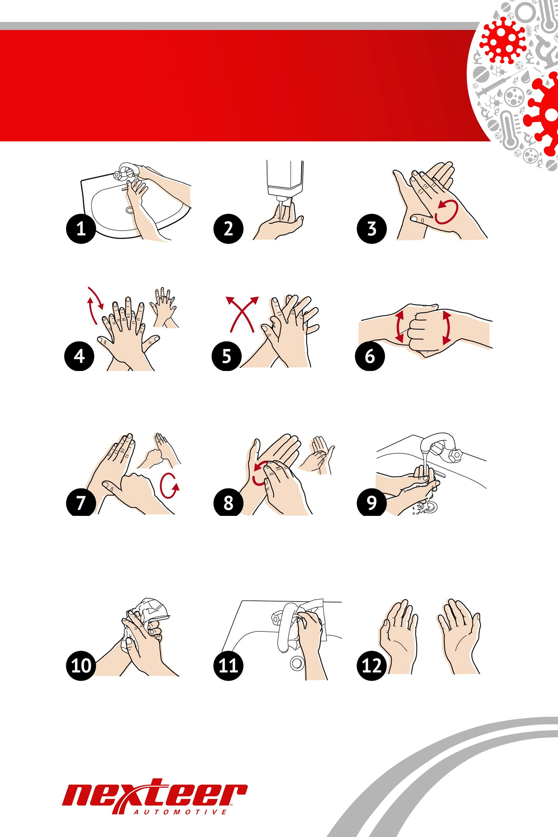
HOW TO PROPERLY WASH YOUR HANDS
Wet hands with water
Apply enough soap to cover all hand surfaces
Rub hands palm to palm
Right palm over left dorsum with interlaced fingers and vice versa
Palm to palm with fingers interlaced
Backs of fingers to opposing palms with fingers interlocked
Rotational rubbing of left thumb clasped in right palm and vice versa
Rotational rubbing, backwards and forwards with clasped fingers of right hand in left palm and vice versa
Rinse hands with water
Dry hands thoroughly with a single use towel
Use towel to turn off tap
Hands are now safe
Thoroughly wash for at least 20 seconds or sing
Happy Birthday twice to ensure your hands are clean.

