Slide 1
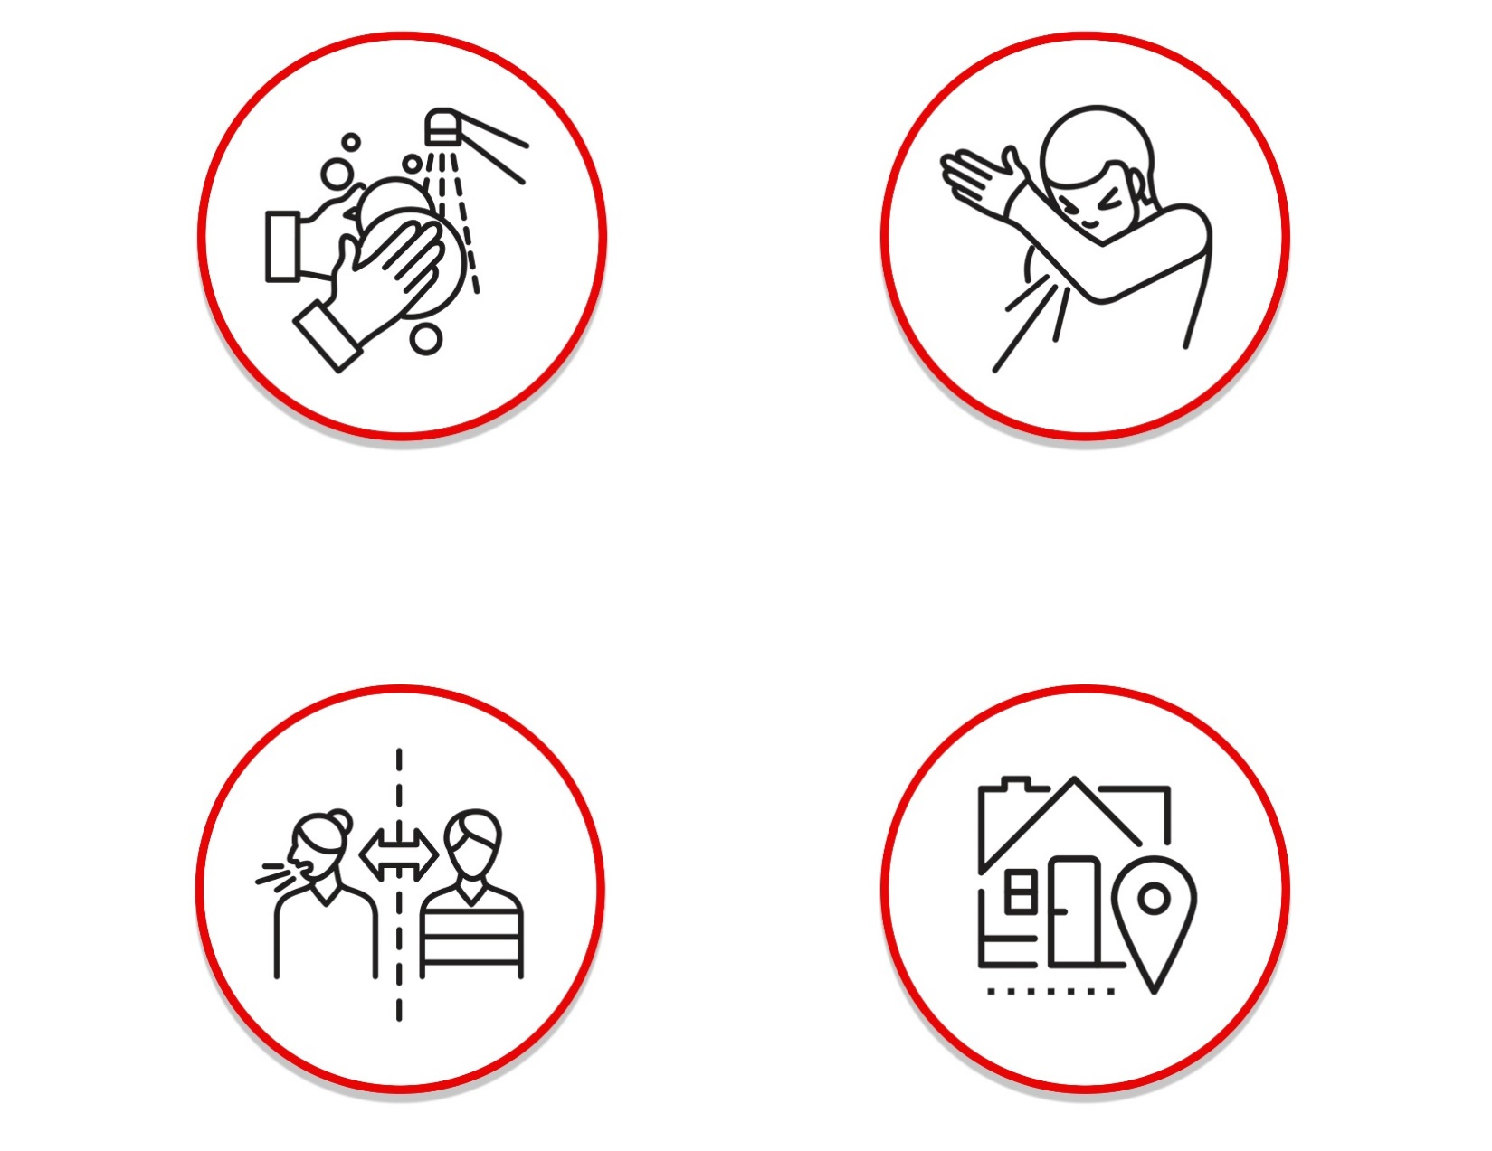
HELP TO PREVENT THE
SPREAD OF COVID-19
Help to prevent the spread of Covid-19 and other respiratory infections
Wash your hands
regularly for at
least 20 seconds
Cough and sneeze
into your elbow or
into a tissue
Avoid direct contact
and keep a safe
distance (6’)
Stay home if
you are not
feeling well
Thank you for doing everything in your power to help us all stay safe and healthy.

Slide 2
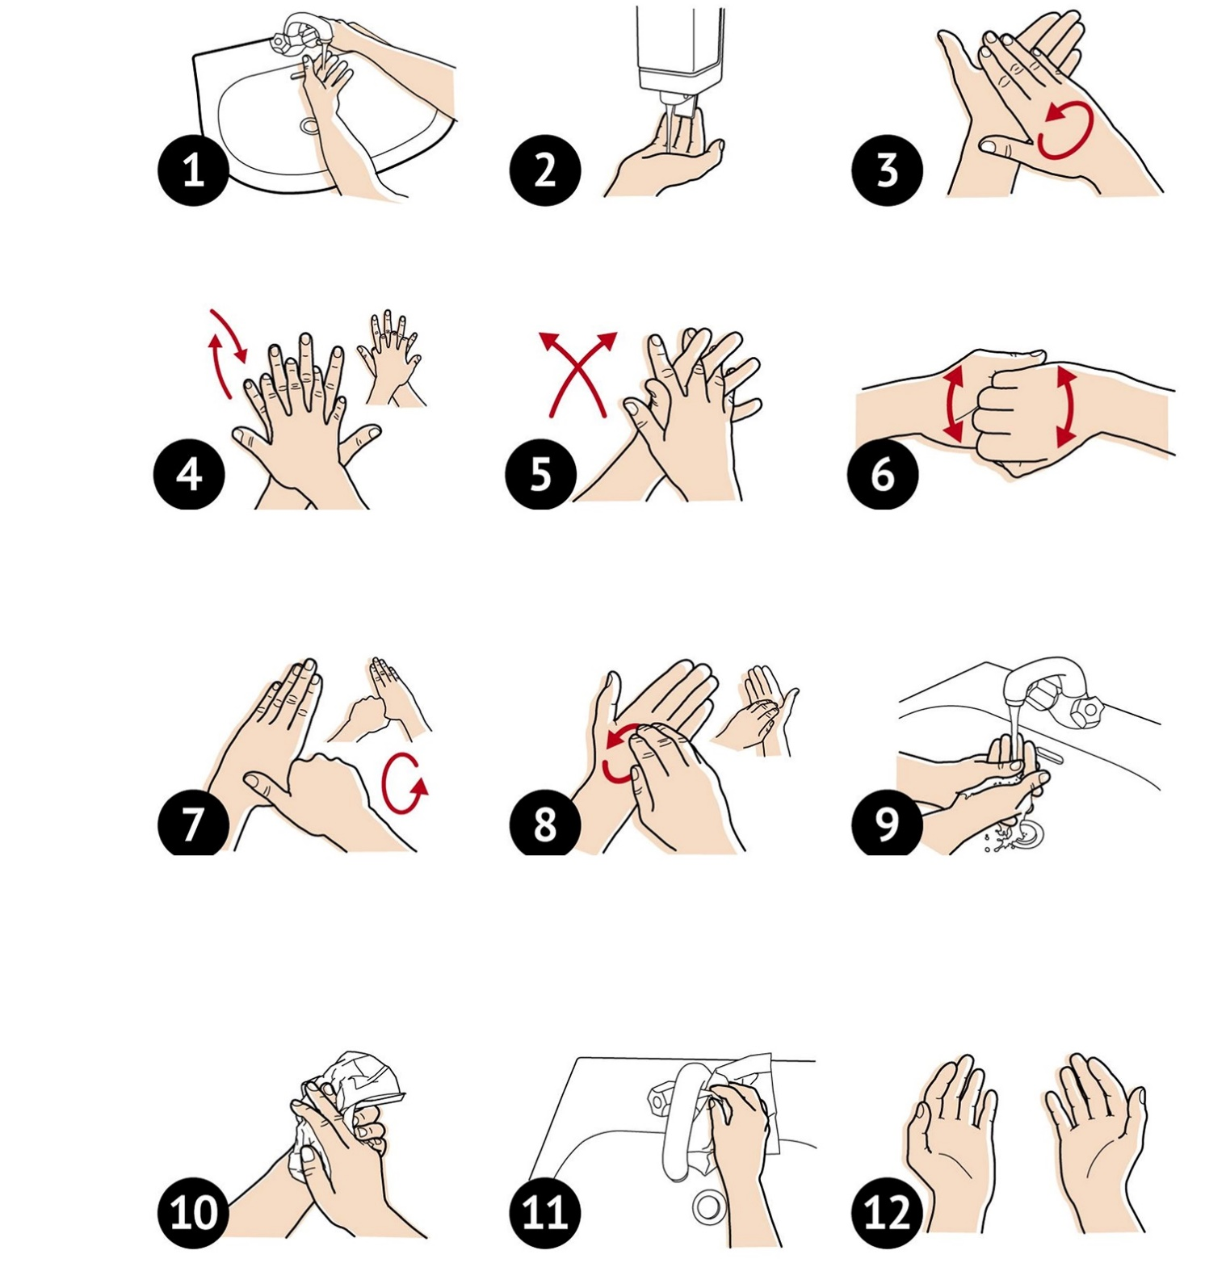
HOW TO PROPERLY
WASH YOUR HANDS
Wet hands with water
Apply enough soap to cover all hand surfaces
Rub hands palm to palm
Right palm over left dorsum with interlaced fingers and vice versa
Palm to palm with fingers interlaced
Backs of fingers to opposing palms with fingers interlocked
Rotational rubbing of left thumb clasped in right palm and vice versa
Rotational rubbing, backwards and forwards with clasped fingers of right hand in left palm and vice versa
Rinse hands with water
Dry hands thoroughly with a single use towel
Use towel to turn off tap
Hands are now safe
Thoroughly wash for at least 20 seconds or sing Happy Birthday twice to ensure your hands are clean.

Slide 3
IF YOU ARE NOT
FEELING WELL…
DO NOT COME TO WORK,
CONTACT YOUR PHYSICIAN
TAKE YOUR SELF-ASSESSMENT EVERY DAY
Even if you don’t come to work, take your self-
assessment to report your symptoms
IN CASE OF SYMPTOMS:
Sore Throat
Fever (from 100.4°F or higher)
New Cough
New Loss or Decrease in Sense of Smell
New Shortness of Breath
Diarrhea (abnormal for you)
Please if you are not feeling well, stay home for your safety and the safety of others.

Slide 4
SOCIAL DISTANCING
TIPS
Keep a distance of 6 feet from other people
Avoid physical contact such
as hand shakes and hugging
Avoid going to crowded
places
Avoid contact with
anyone who is sick
Remember we are all in this together.

Slide 5
HOW TO PROPERLY
WEAR A MASK
Wash hands or use sanitizer immediately before putting on PPE
With the nose portion at the top, put your fingers through the ear loops, position the mask over your nose and mouth. Place the ear loops around the ears.
Pull the mask from the top and bottom to fully open the folds of the mask, and adjust the mask around the face.
If mask has nose wire, gently form (do not pinch) the nose wire over the bridge of the nose, and make any final
adjustment.
HOW TO REMOVE MASK:
DO NOT touch the front of the mask
Grasp mask by ear loops to pull off
Wash mask or discard, if disposable, in
waste container
Wash hands or use sanitizer immediately
Use safe practices to protect yourself and limit the spread of COVID-19.

Slide 6
HOW TO WASH YOUR
CLOTH FACE MASK
Cloth face masks should be routinely washed depending on the frequency of use.
WASHING MACHINE
Tossing your face masks in a hot-water laundry cycle is a great way to sanitize them. Your detergent will disintegrate the virus and leave your face mask ready for another use.
HOT WATER AND BLEACH SOLUTION
Soak your face masks for five minutes in a solution of one teaspoon of bleach for every quart of hot water. To make sure you get rid of any leftover bleach, rinse it under a tap for 10 to 15 seconds.
BOILING
An easy way to sanitize your face masks is to let them sit in boiling water for five minutes. It’s as simple as that. Avoid boiling the same mask more than 10 times to prevent damage.
Please contact HR with any concerns prior to returning to work.

Slide 7
SOCIAL DISTANCING
MEETING ROOMS
Limit face-to-face meetings whenever possible
Create a visual standard for the meeting room that demonstrates
appropriate social distancing
Display visual standard prominently & ensure distances are respected
No personal objects are to be left in the room after the end of the meeting
Allow time between meetings, avoid scheduling back-to-back
Wipe the table and electronic controls with disinfectant prior to the
next meeting
Keep a safe distance, remember we are all in this together.

Slide 8
FACE COVERING
FAQS
Are facial coverings or face masks required?
Yes, facial coverings are mandatory until further notice.
Are there any exceptions for not wearing a facial covering or face mask?
Yes, but they are very few and far between. Assume you should always be wearing a mask to keep yourself and your co-workers as safe as possible.
Are facial coverings or face masks required if I am by myself in an enclosed office with a single entrance door?
No, facial coverings or face masks are not required if you are in your personal office or a room, by
yourself, with only a single entrance door that is closed. The door must be closed, and you must be by yourself. If at any point someone else enters the room or your door is open then a mask is immediately required. This enclosed area applies to only your own personal space. Conference rooms and medical
facilities will require masks be worn at all times.
Are facial coverings or face masks required while I am eating my lunch or drinking?
No, facial coverings or face masks are not required to be worn while eating your lunch or drinking. Facial coverings or face masks must only be removed while eating and drinking. They must be put back on
immediately following. While you are eating, please continue to be cautious with your mask since you have been wearing it all day. Fold your mask when you take it off so that the part touching your face is folded to the inside to help keep it clean. Please do not place directly on tables or counters. Consider using a napkin or hand towel.
Do I need to wear my facial covering or face mask if I am outside, or entering/exiting the
facility?
Yes, if you are within 6 feet of another employee. If you are outside and by yourself, then the facial
covering or facemask could be removed as long as no other employee is within 6 feet. Prior to entering the facility door or turnstile, masks must be on securely covering your mouth and nose.
What happens if I see someone not wearing a mask?
We would encourage you to first “Speak up” and ask the employee to put on their facial covering or mask to avoid spreading the virus. Any unresolved incident should be documented and escalated to the appropriate supervisor with further guidance from Human Resources.
Keep a safe distance, remember we are all in this together.

Slide 9
FACE COVERINGS
REQUIRED UNTIL FURTHER NOTICE
In consideration of your health and safety as you return to work, we will now require the
use of a face covering to enter the site.
MINIMUM REQUIREMENTS - (CDC guidelines as of 4/20/2020)
Cloth face coverings should—
1. fit snugly but comfortably against the side of the face
2. be secured with ties or ear loops
3. include multiple layers of fabric
4. allow for breathing without restriction
be able to be laundered and machine dried
OPTIONS AVAILABLE
Note that face coverings must cover nose and mouth:
Knit tube • N95 from home
Surgical mask • Homemade mask
Soft black re-usable cloth mask
CARE FOR FACE COVERINGS
Re-useable masks (black cloth, knit tube or homemade cloth)- wash daily after use
Surgical: replace daily
OPTIONS AVAILABLE
Due to the rapidly evolving situation, face coverings may have been communicated as voluntary but are now deemed a requirement of site entry. This requirement will be re-visited in approximately 30 days and re-evaluated based on risk factors related to current COVID-19 data.
Please contact HR with any concerns prior to returning to work.

Slide 10
VISITOR
REQUIREMENTS
The safety of our employees, supplier partners, customers, families and visitors remain our overriding priority. Access is limited to any external customers or visitors on the complex based on the COVID-19 pandemic. Prior approval required by host.
RESTRICTED VISITORS ONLY
All visitors are required to complete the mandatory self-assessment questionnaire
prior to entering the complex.
If you have any of the following symptoms do not enter the building:
Visitors must have an escort and are required to wear a facial covering or face
mask at all times.
Sore Throat
Fever (from 100.4°F or higher)
New Cough
New Loss or Decrease in Sense of Smell
New Shortness of Breath
Diarrhea (abnormal for you)
Please if you are not feeling well, stay home for your safety and the safety of others.

Slide 11
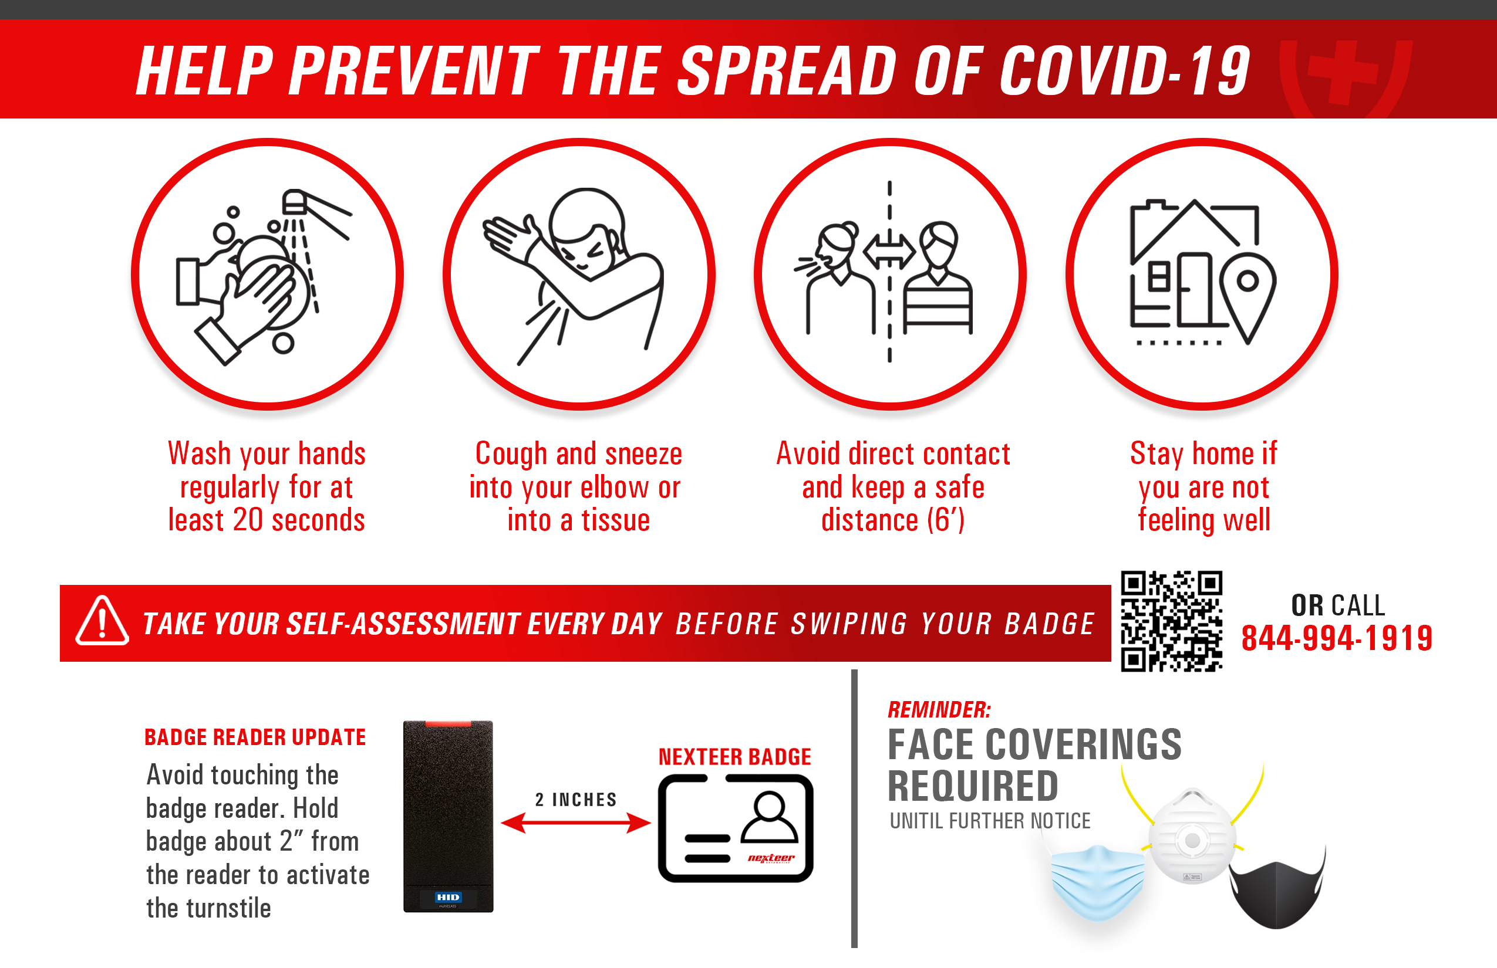
WELCOME
BACK
POSTCARD
FRONT
ADD LOGO HERE
POSTCARD
BACK
ADD QR/PHONE

Slide 12
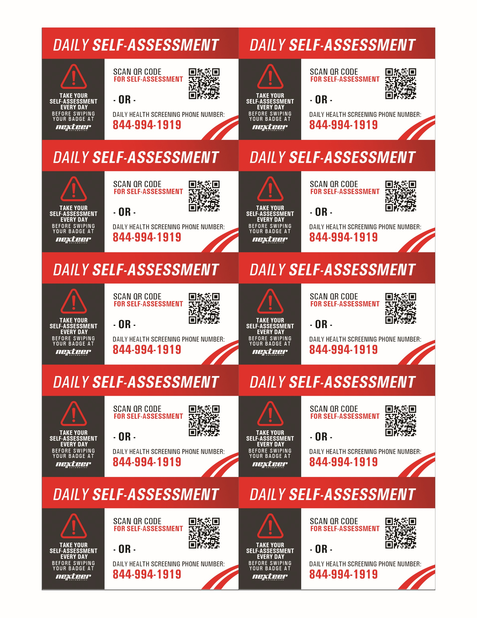
Example
Business Card Reminder
and Magnet
given to all employees
QR
CODE
QR
CODE
PHONE NUMBER
PHONE NUMBER
QR
CODE
QR
CODE
PHONE NUMBER
PHONE NUMBER
QR
CODE
QR
CODE
PHONE NUMBER
PHONE NUMBER
QR
CODE
QR
CODE
PHONE NUMBER
PHONE NUMBER
QR
CODE
QR
CODE
PHONE NUMBER
PHONE NUMBER

Slide 13
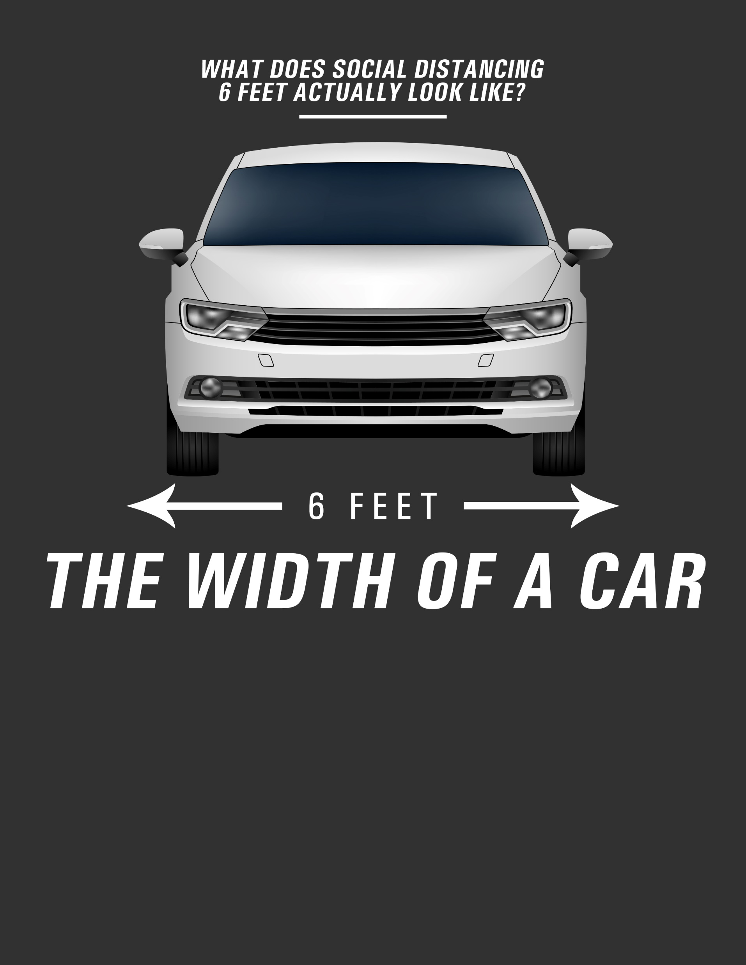
Think of the width of your car when
trying to gauge an appropriate distance.
The average large sedan is a little more
than 6 feet wide.

Slide 14
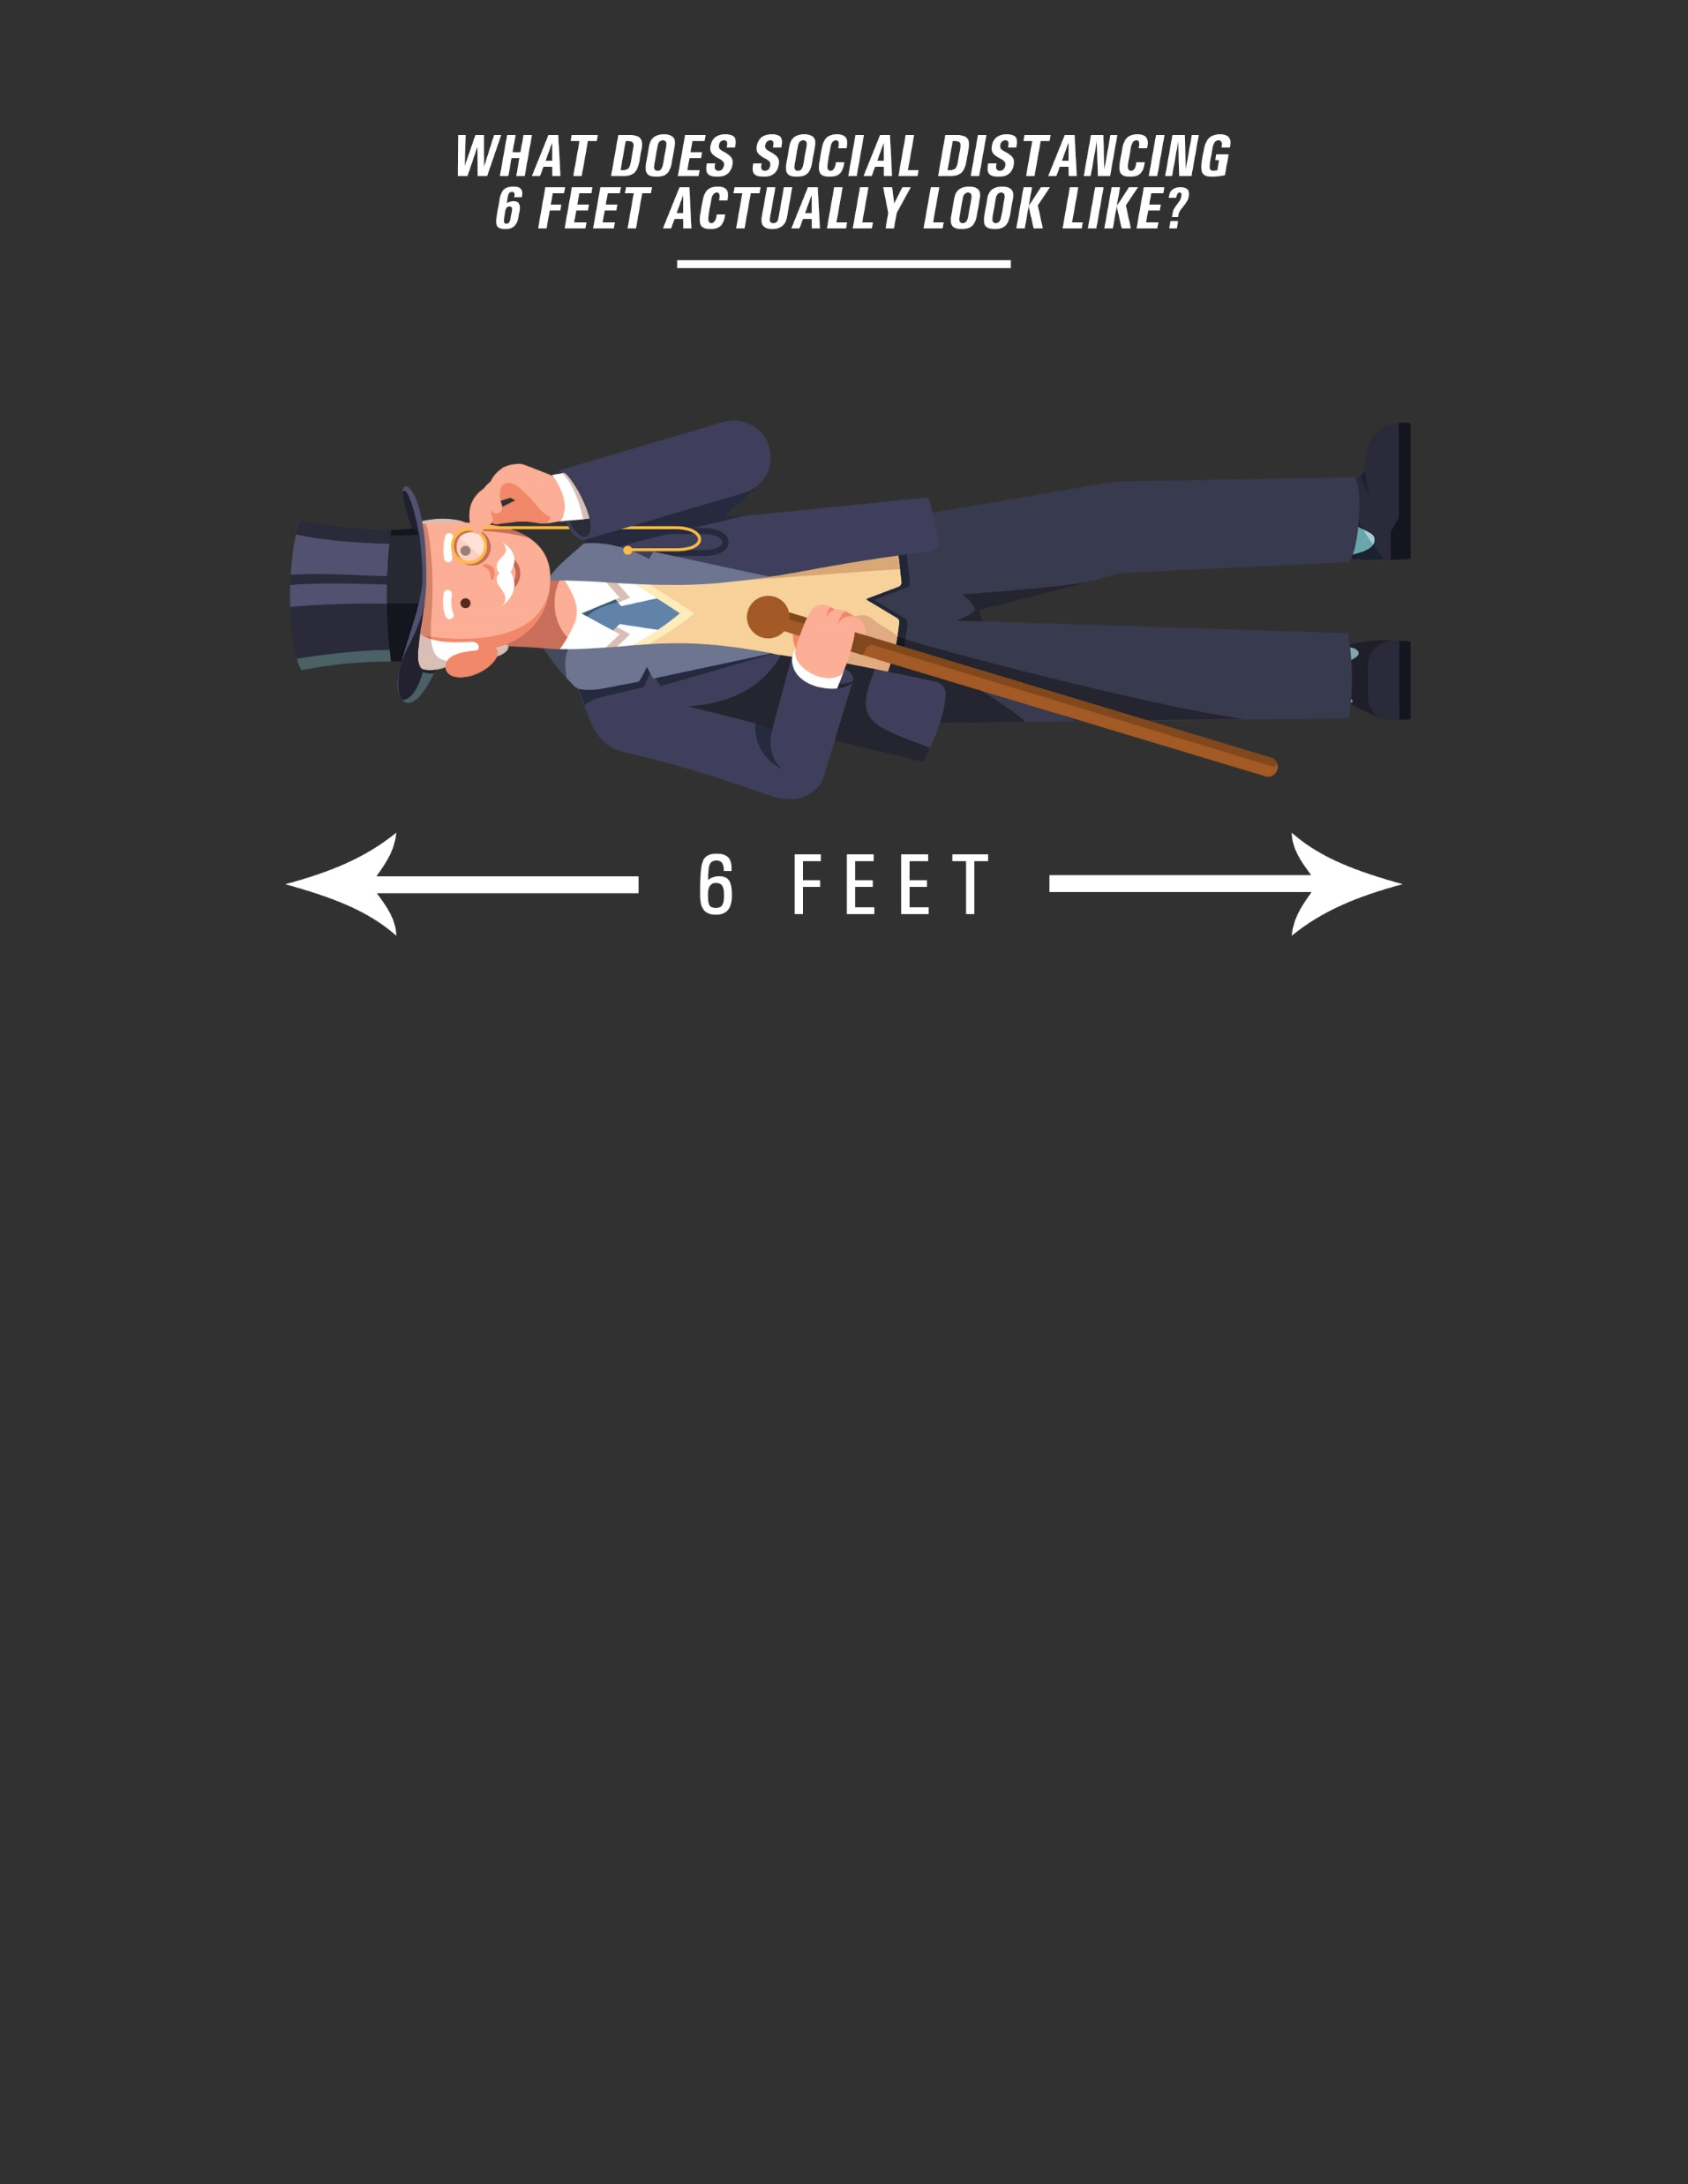
A MAN WEARING
A TOP HAT
A man of average height stands at
5 feet 9 inches tall -- if that man wears
a top hat, he'd be just over the distance
we're advised to keep from others.

Slide 15
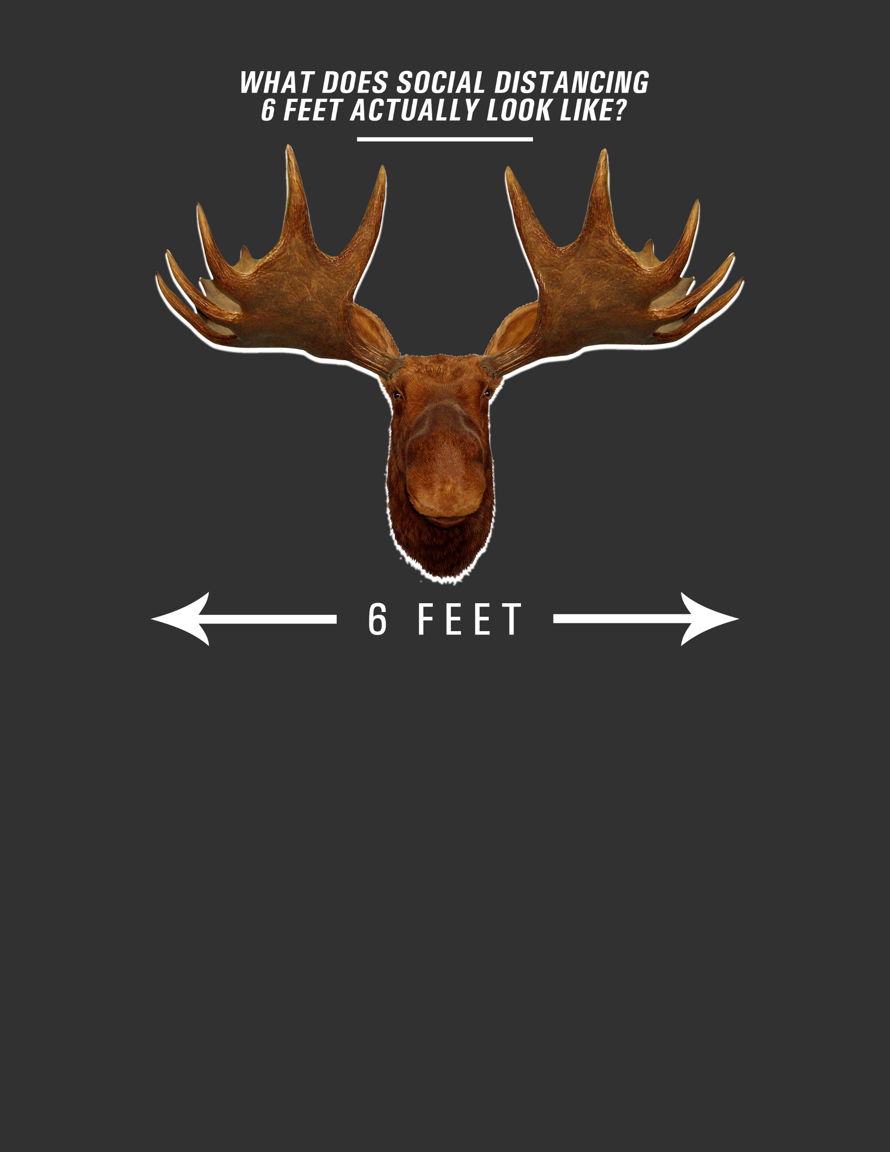
MOOSE ANTLERS
According to National Geographic, Moose antlers measure roughly 6 feet across,.
Be sure to keep that distance from others.

Slide 16
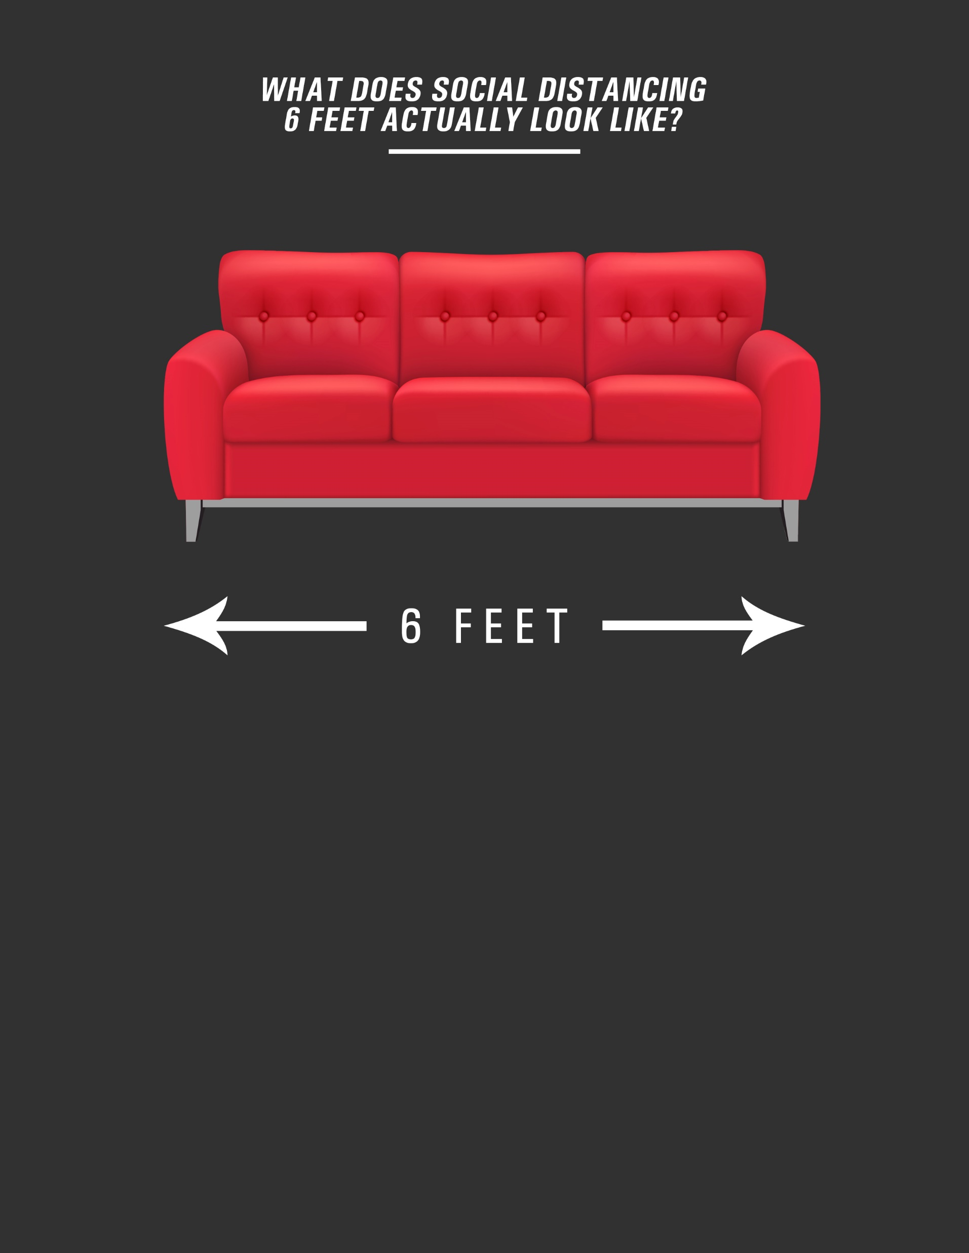
A SOFA
A standard three-seat sofa is roughly 6 feet long. You should not be closer to someone than the length of a sofa.

Slide 17
The average golden retriever has a body length of 37 to 42 inches. Two of these dogs should amount to just over 72 inches, or 6 feet. Keep your distance.

Slide 18
FOR YOUR SAFETY,
THIS FACILITY
IS REGULARLY
DISINFECTED
Make sure you have completed a self-assessment before entering.

Slide 19
THESE TRAYS
ARE REGULARLY
DISINFECTED
Remember to keep a safe distance from others

Slide 20
THIS LUNCH ROOM
IS REGULARLY
DISINFECTED
Remember to keep a safe distance from others

Slide 21
THIS BATHROOM
IS REGULARLY
DISINFECTED
Remember to wash your hands for at least 20 seconds

Slide 22
THIS LUNCH ROOM
IS REGULARLY
DISINFECTED
Remember to keep a safe distance from others

Slide 23
THIS BREAK ROOM
IS REGULARLY
DISINFECTED
Remember to keep a safe distance from others

Slide 24
PLEASE PRACTICE
SOCIAL
DISTANCING
Remember to stand 6 feet apart at all times

Slide 25
VISITORS
TEMPORARILY
NOT ALLOWED
Thank you for understanding

Slide 26
TEMPERATURE
CHECK-POINT
Please stand 6 feet apart.

Slide 27
QUARANTINE
AREA
Authorized personnel only. PPE required beyond this point.

Slide 28
FIRST AID
ROOM
Used only for medical and injury issues not related to COVID-19

Slide 29
THANK YOU FOR
WORKING
SAFELY TODAY
Please continue to practice social distancing, personal hygiene and frequent disinfection

Slide 30
Plug & Play Icons
Template Background Options
Use blue for calming/ wellness messaging, such as sanitized areas
Use red to emphasize guidelines to follow to stay safe
Use green for non COVID-19 related treatment/medical use
Fonts
Header = Arial Narrow - Bold/Italic, size 54
Sub-Header = Arial Narrow, size 24
Body Copy = Arial Narrow, size 22
Copy and paste these PNG icons when creating your own customized sign

