Slide 1
Welcome

Slide 2
Introduction – Steven Baird
Nexteer Automotive’s General Manager of the Central Services group
I have enjoyed a 49-year fun and rewarding career at Nexteer
7 years – Co-op Student
16 years – Manufacturing Engineering
10 years – Product Engineering
10 years – Operations
6 years – Central Services
I represent 5 Generations of Michigan Auto Industry experience
My Grandfather – James Baird
My Father – Wellington Baird
Myself – Steven Baird
My son – John Baird
My Granddaughter – Lexi Martin
There should be no doubt that Michigan Manufacturing runs in my blood

Slide 3
Let’s Talk about the “Great Lakes Bay Manufacturers Association”
Mission Statement:
GLBMA is the regional voice for manufacturing, providing members with access to best practices, talent pipeline development, and educational & networking opportunities
Vision Statement:
A highly engaged and growing membership association recognized for enhancing the visibility and economic vitality of manufacturing in our region

Slide 4
GLBMA History
1906
Saginaw manufacturing rapidly expanded during this time
The Brewster park area became one of the first industrial parks in Saginaw
$212,000 was raised to provide free land for new manufacturers, bringing together various companies that manufactured items such as: matches, plate glass, phonograph cabinets, pianos, automobiles, bicycles and cash registers to name a few
1911
Joseph Tracy assumed the responsibilities of the Merchants and Manufacturers Fund as well as the Board of Trade
He entered into an agreement with the Grand Truck Railway Company of Canada to lease three lots on Brown Street for $1 a year.

Slide 5
GLBMA History Review
1912
The Saginaw Manufacturers Association was born through the joint efforts of:
Harry Wickes – Wickes Boiler Company & Saginaw’s Coal Mining Industry
Theodore Huss – Lufkin Rule Manager
John L. Jackson - Jackson, Church & Wilcox Steering Company & Saginaw Brick Company
A.C. Melze – Founder of Merrill, Michigan
Benton Hanchett – Lawyer & Bank President
Ralph Morley – Hardware Distributor
Max Heavenrich – Clothing Business Owner
Arthur D. Eddy – Salt Works, Flour Mills, Grain Elevators, Coal Washers, and Concrete pipe factory
Delbert E. Prall – Druggist, Founder of D.E. Prall & Co.
James S. Smart – Wholesale Grocer
M. Tanner – Store Owner of Fine Dry Goods
This organization operated for several years under the Saginaw Manufacturers Association and was based out of the Board of Trade, what is now the Saginaw County Chamber of Commerce.

Slide 6
GLBMA History Review
1989
Under the leadership of Grant A. Schaefer with Schaefer Technologies, Inc., the organization once again changed the name and focus of the organization.
The Saginaw Valley Manufacturers' Association began a regional focus to address industry wide needs.
The organization was than moved to the Saginaw Valley's Business & Industrial Development Institute at Saginaw Valley State University.
2012
The organization moved to the Saginaw County Business & Education Partnership and updated the name to the Great Lakes Bay Manufacturers Association.
GLBMA now serves Saginaw, Bay, Midland and Arenac counties with a continued focus on addressing the current needs of manufacturing.

Slide 7
GLBMA History Review
2016
The current board of directors decided to revive the organization
The GLBMA was moved to the Michigan Manufacturing Technology Center at Saginaw Valley State University under the direction of Jeremy Bockelman and Tanya Blehm, helping manufacturing succeed in today's ever-changing world
Fun note: Jeremy’s dad Jim Bockelman, suggested the move of the Association from the Saginaw Chamber to SVSU's Business and Industry Center back in 1989 when Jim served as President of the Chamber
2022
The GLBMA introduced the new “Young Manufacturing Mentors” program. This program is designed to encourage students ages 16 to 35 years to explore career paths and to keep talent in the Great Lakes Bay Region
The GLBMA also relaunched the “Women in Manufacturing” initiative

Slide 8
Fun Facts of members of the GLBMA with us Today
Duro-Last Roofing
Founded by John Burt in 1978
John had founded Tri-City Vinyl to manufacture pool liners for his pool business
One day it occurred to him: If his product can keep water in, it can keep water out.
This led to the formation of Duro-Last roofing
Small world, John Burt Jr and I were good friends during our time together in grade school
Vantage Plastics
Founded in 1996 in Standish, Michigan by a small group of people led by Paul Aultman.
Its humble origins consist of a small existing plastics thermoforming facility of 45,000 square feet and three rotary thermoforming machines
Duperon
In 1985, Duperon Corporation was established and headquartered in a garage near Saginaw
Duperon is the leader in simple, adaptive screening technologies

Slide 9
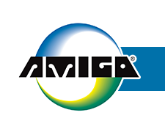
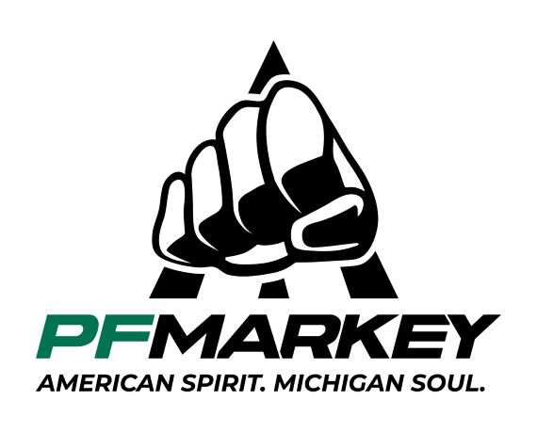
Fun Facts of members of the GLBMA with us Today
Amigo Mobility International
Plumber Allan R. Thieme invented the first power-operated scooter in 1968.
Frustrated with the mobility options available to a family member with multiple sclerosis,
Allan spent nights building the small yellow scooter in his garage in Bridgeport, Michigan.
PF Markey
PF Markey was founded in 1977 by Paul Francis Markey.
He began with a one-man operation, providing innovative tooling solutions for manufacturers in the Saginaw area.
Fullerton Tool Company
Founded in 1942 by Morgan Curry, Fullerton Tool remains a family-owned business now owned by Patrick Curry and Mathew Curry, grandsons of Morgan Curry.
Both Patrick and Mathew share an engrained passion for manufacturing and are great guys.

Slide 10
Fun Facts of members of the GLBMA with us Today
Case Systems
Case Systems began in 1948 as “Normal Wood Products”, a small, regional supplier in Midland, and have grown to become a nationally recognized caseworks producer
In the mid-1990s, Bob Bowden and Dave Clark bought the company and began to build the Case Systems brand.
Endurance Carbide
Endurance Carbide was founded in 1961
In 2015 they were named to the “Michigan 50 Companies to Watch” list
Patrick Curry became Vice President in 1995 and today is the President and sole owner
Erie Custom Signs
Erie Custom Signs began in 1962 as Erie Marking Tool, specializing in industrial tags
In November 2009, Mike and Lisa Shabluk purchased the company and renamed it Erie Custom Signs

Slide 11
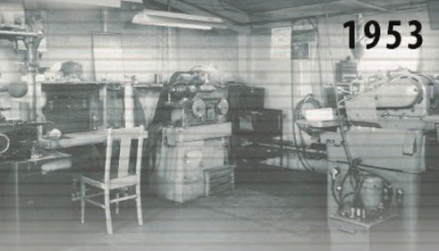
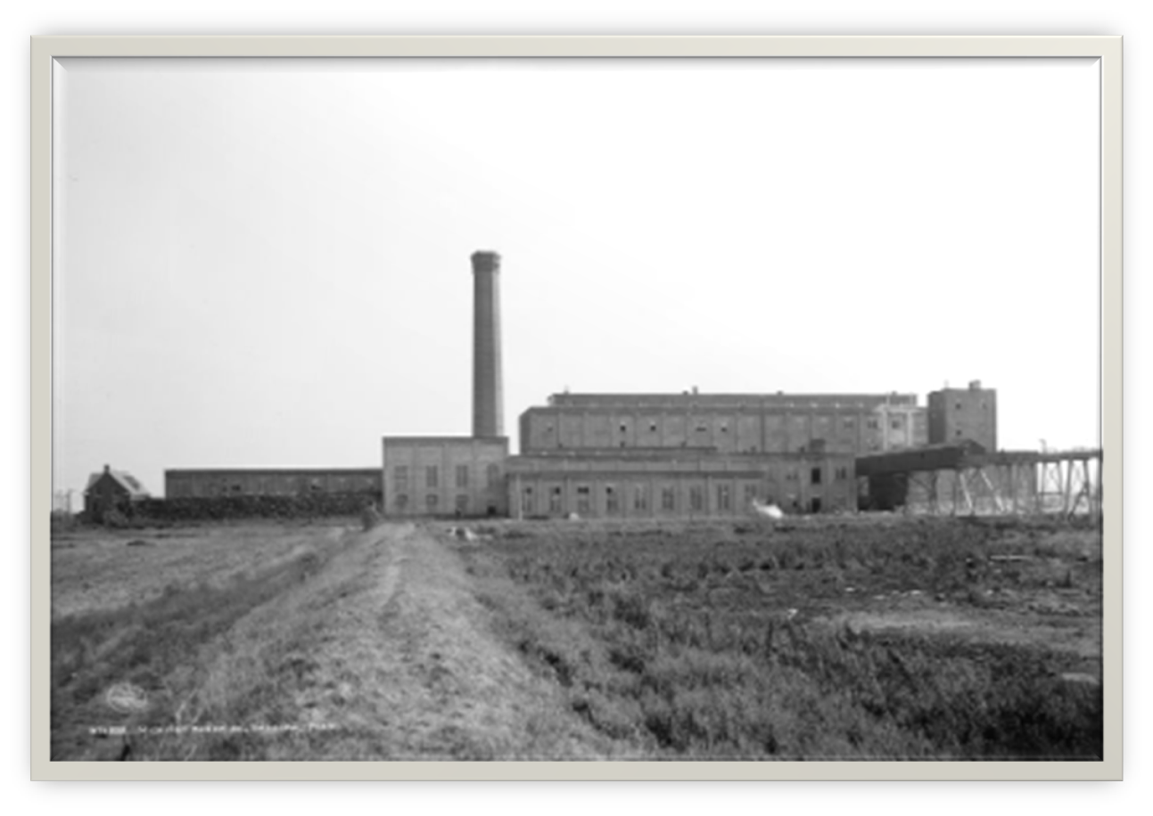
Fun Facts of members of the GLBMA with us Today
Johnson Carbide
Johnson Carbide Products – “JCP” – got its start in 1953 when Frederick E. Johnson started making special carbide tools in his garage in Saginaw, Michigan
Over the next several years, a market for his carbide tools emerged based on their consistent quality
Michigan Sugar
Pioneer Michigan Sugar Company was organized on Dec. 9, 1897
Their first factory was built in the Bay City suburb of Essexville
In 1899, due to the success of the Essexville plant, 8 additional factories will built in different Michigan locations.
In 1906, 6 sugar producing companies in Michigan, including Pioneer Sugar, merged to form the Michigan Sugar Company

Slide 12
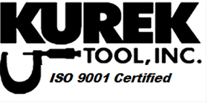
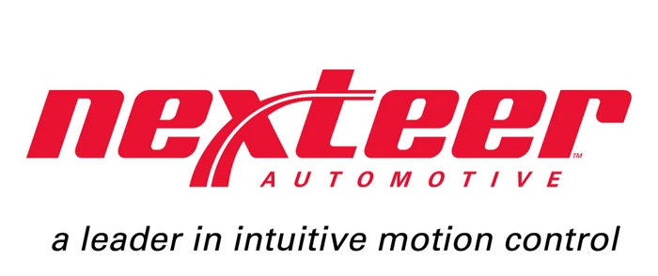
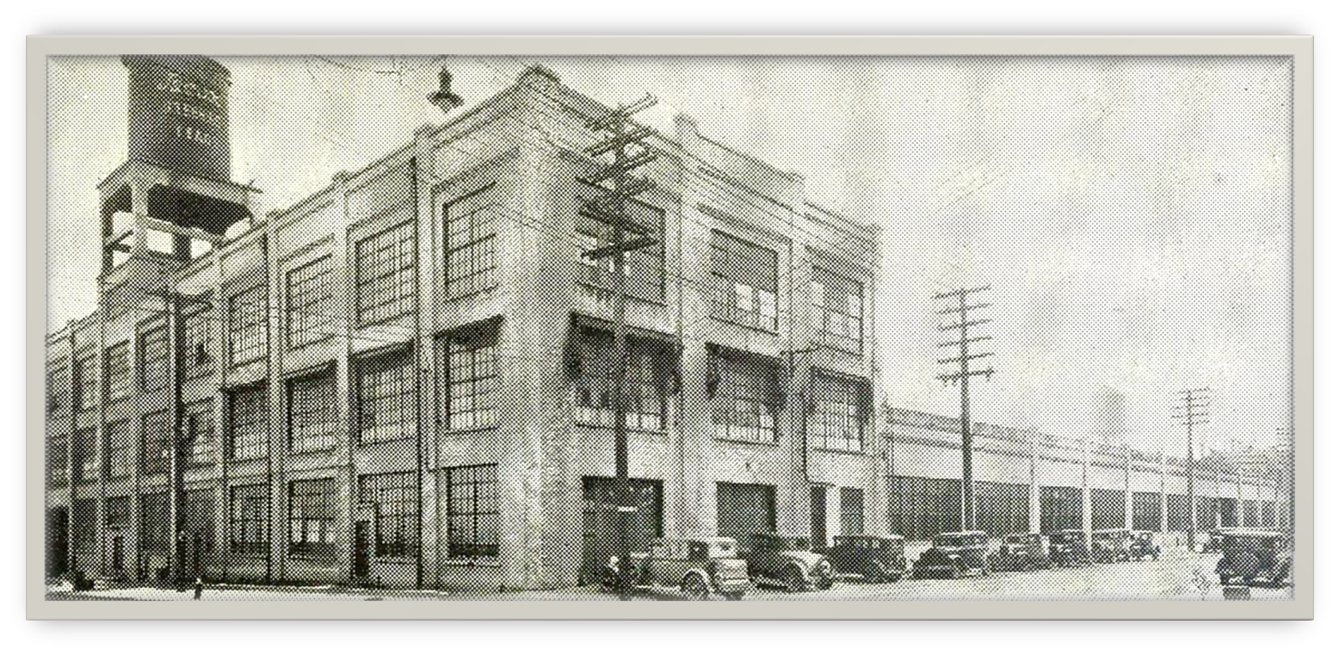
Fun Facts of members of the GLBMA with us Today
Kurek Tool
Established in 1965 by John Kurek Sr. and his sons John Jr. and Jerry
Kurek Tool and Gauge began in a small lean-to building with three simple machines
Kurek Tool Inc. is now a woman-owned business, JoAnn Kurek, specializing in the precision manufacturing of tools, fixtures, prototypes and similar engineered products.
Nexteer Automotive
Established in 1906 by John Jackson, Melvin Wilcox and Edgar Church
Still going strong after 8 name changes and 6 ownership changes
Unlike Kodak cameras and Blackberry phones, Nexteer remains strong today due to their willingness to change with technology advancements
Manual Steering – Hydraulic P/S – Electric P/S – Steer-by-Wire

Slide 13
Let’s travel back in time and look at the history of Industry in the Saginaw Bay Area

Slide 14
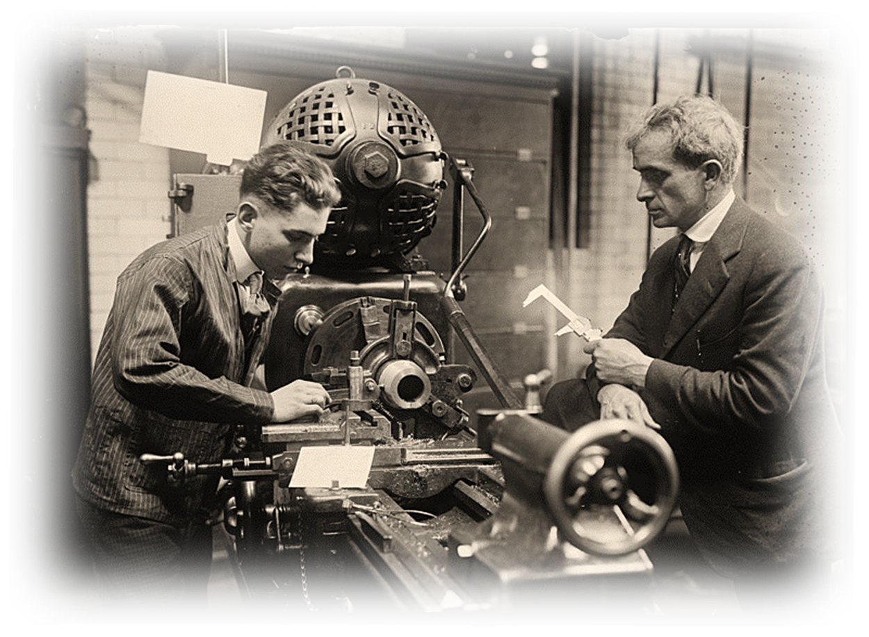
Let’s drop back to the start of the 19th century
The Saginaw Bay Region had become a Manufacturing Mecca
Many new companies were starting up in our region

Slide 15
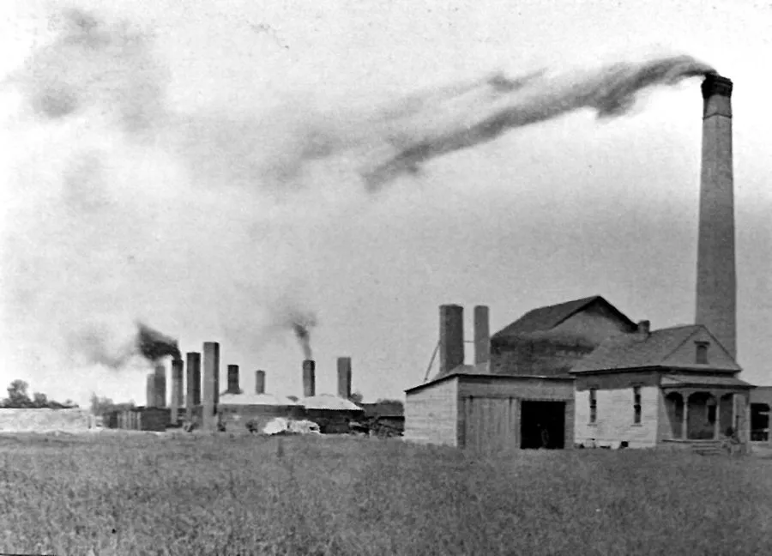
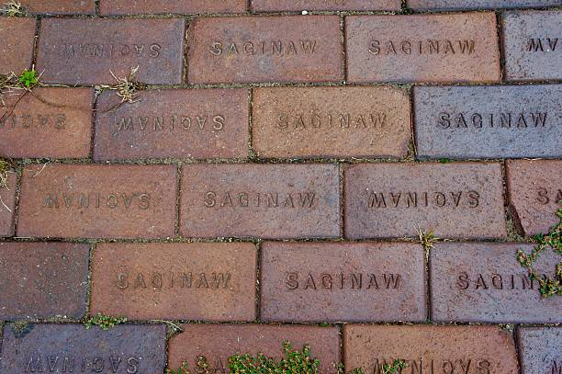
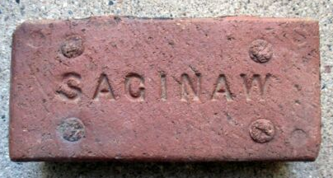
1894 - Saginaw Brick Manufacturing Company
1920 – Plant closed and was sold to Carde Stamping - Carde Stamping evolved into Means Stamping

Slide 16
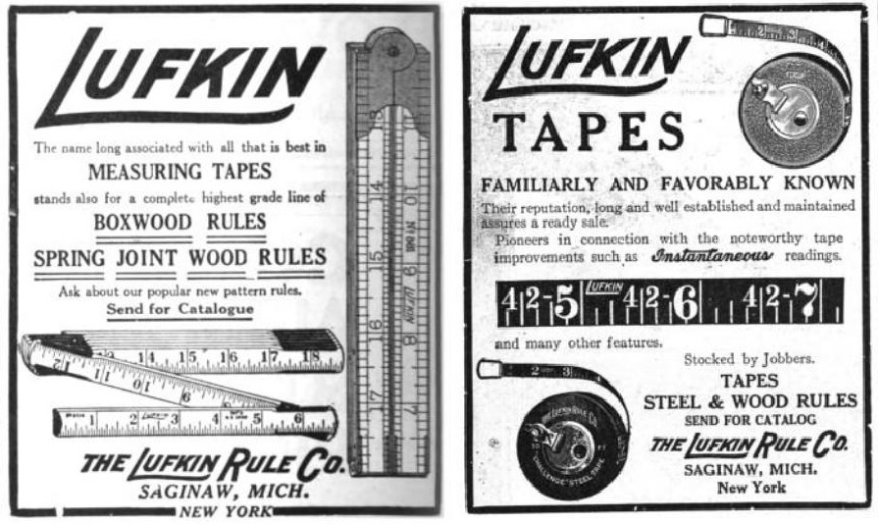
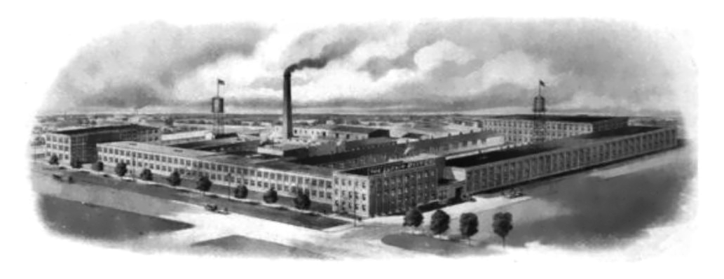
1895: Lufkin Rule Company
1903: Lufkin Rule was the largest Manufacturer of measuring tapes in the U.S.
1967: Saginaw Plant closed 1 year after the company was sold to Pratt & Whitney

Slide 17
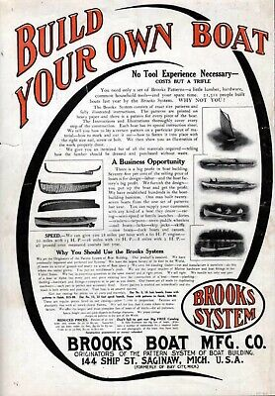
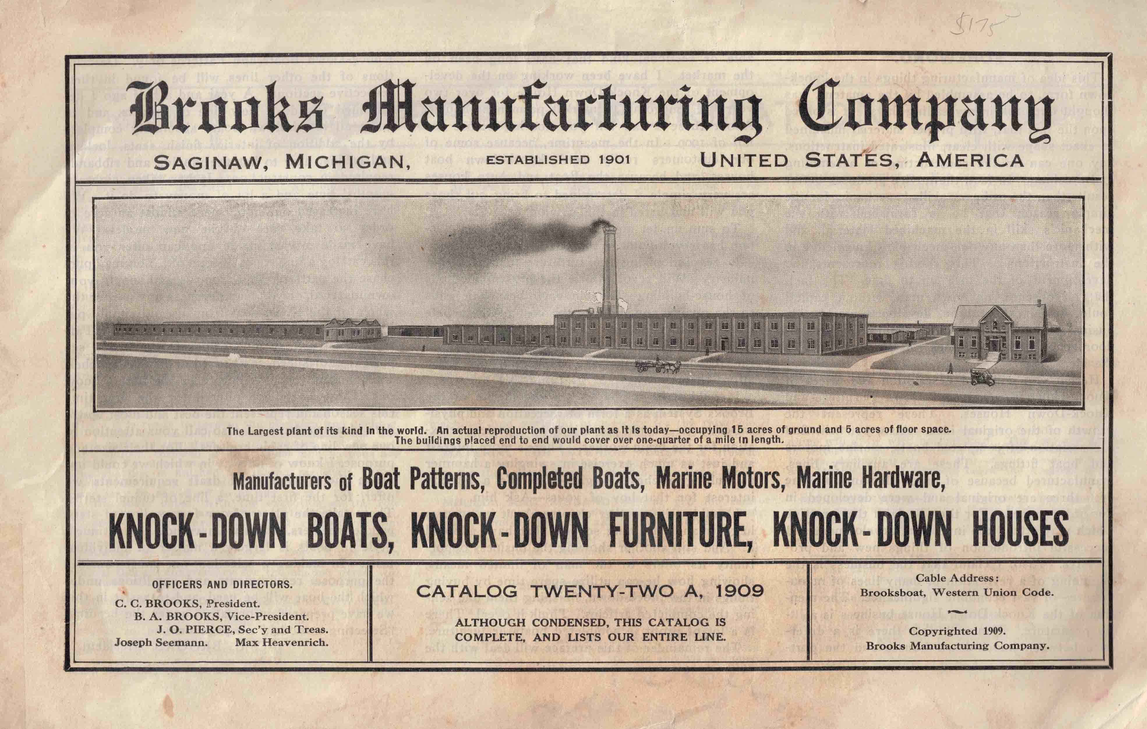
1901 - Brooks Boat Company
1945 – Closed their doors due to reduced sales resulting from WW2

Slide 18
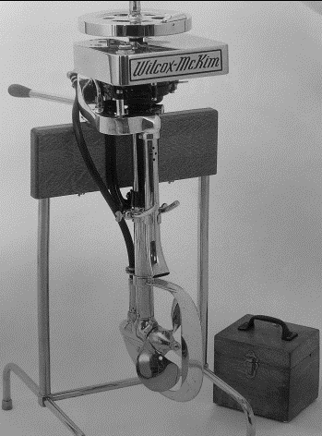
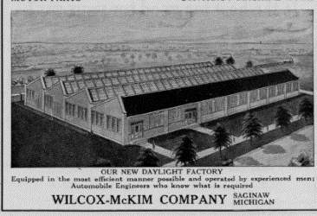
1913 - Wilcox-McKim Motor-Boat Company
1915 – Stopped producing outboards and began producing engine valve
train components, eventually selling out to Eaton Corp.

Slide 19
1915 – Eaton Corporation Manufacturing Engine Valves 2008 – Plant was demolished after being closed a few years earlier

Slide 20
1917 - Saginaw Malleable Iron Company
1919 – Purchased by the Saginaw Products company, a division of GM
2007 – Foundry closed

Slide 21
1917 - Werner plant opened
1930 - Became Baker Perkins
1987 – Plant closed
Manufacturer of Food and Chemical Processing Equipment

Slide 22
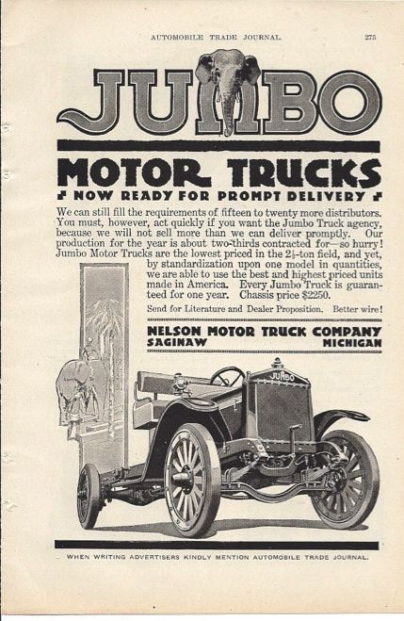
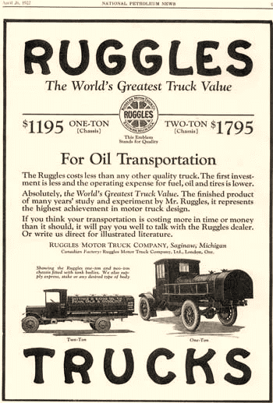
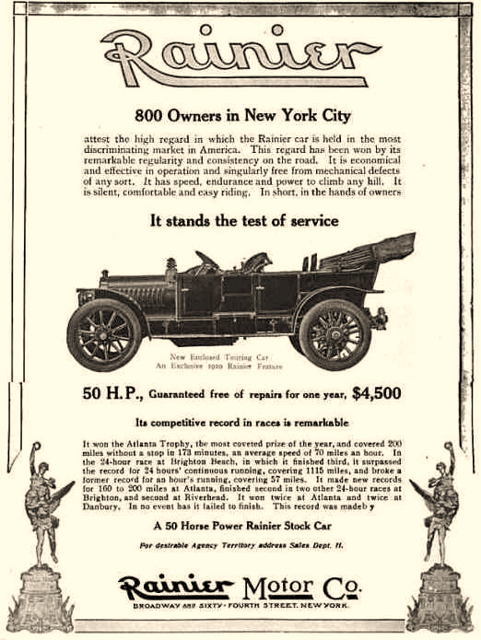
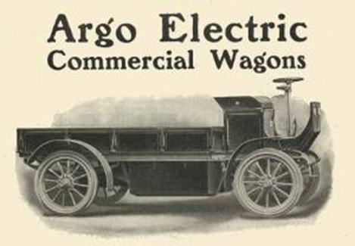
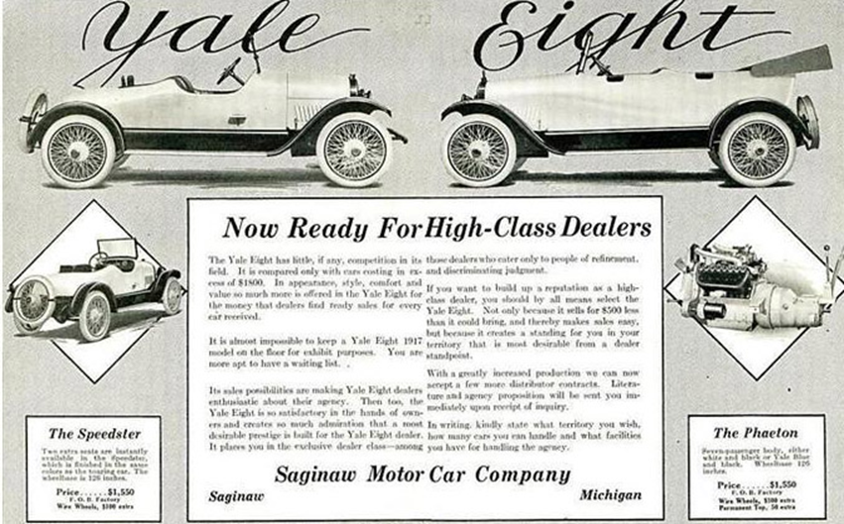
Saginaw had 13 Automobile / Truck Manufacturing Company start-ups
None Survive
Saginaw’s Auto Manufacturers
Ayres Automobile Works
Ranier Car Co.
Marquette Car Co.
Lehr Motor Co.
Saginaw Motor Car Co.
Argo Electric Car Co.
Peninsular” Automobile Co.
Saginaw Cycle Car Co.
Duryea Electric Car Co.
Railsbach Car Co.
Borland-Grannis Electric Car Co.
Nelson Brothers Motor Truck Co.
Ruggles Truck Co.

Slide 23
Great Lakes Bay Region Today
Sad Fact: The companies mentioned on the previous pages are no longer in business in the Great Lakes Bay Region
That is why it is so important we all support the Great Lakes Bay Manufacturing Association
Working together, we can keep the Great Lakes Bay region alive and well

Slide 24
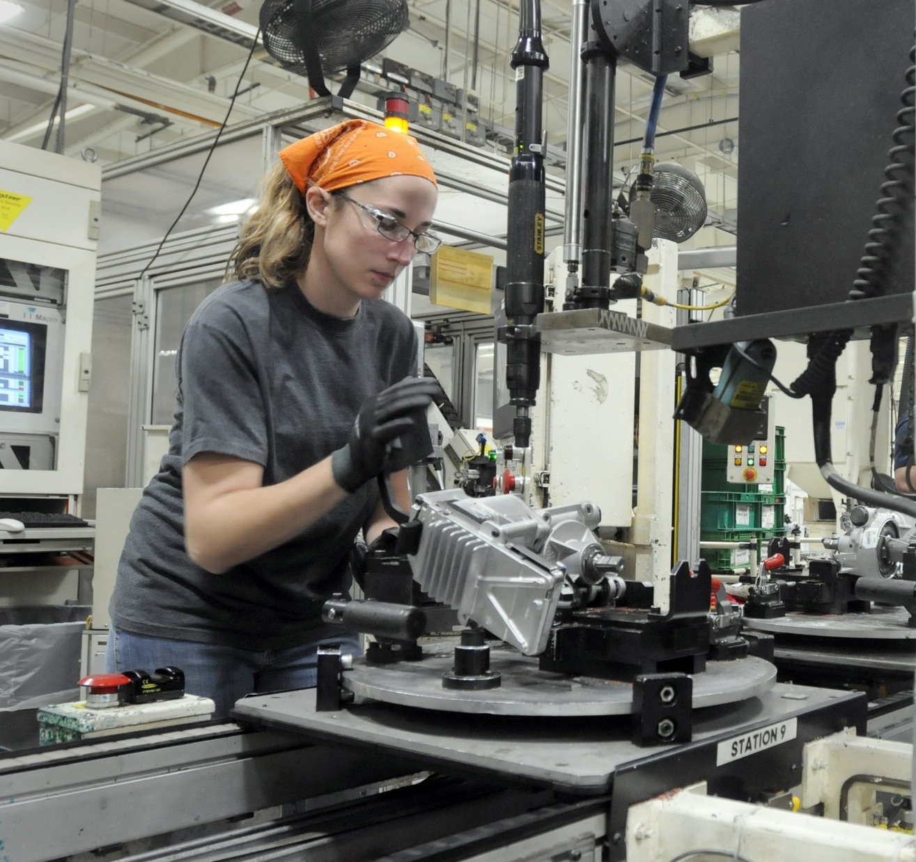
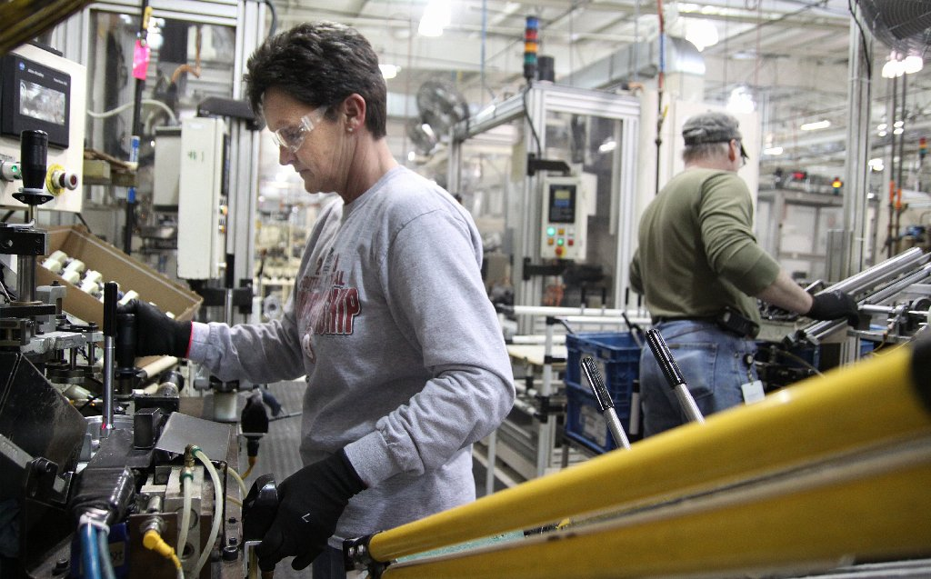
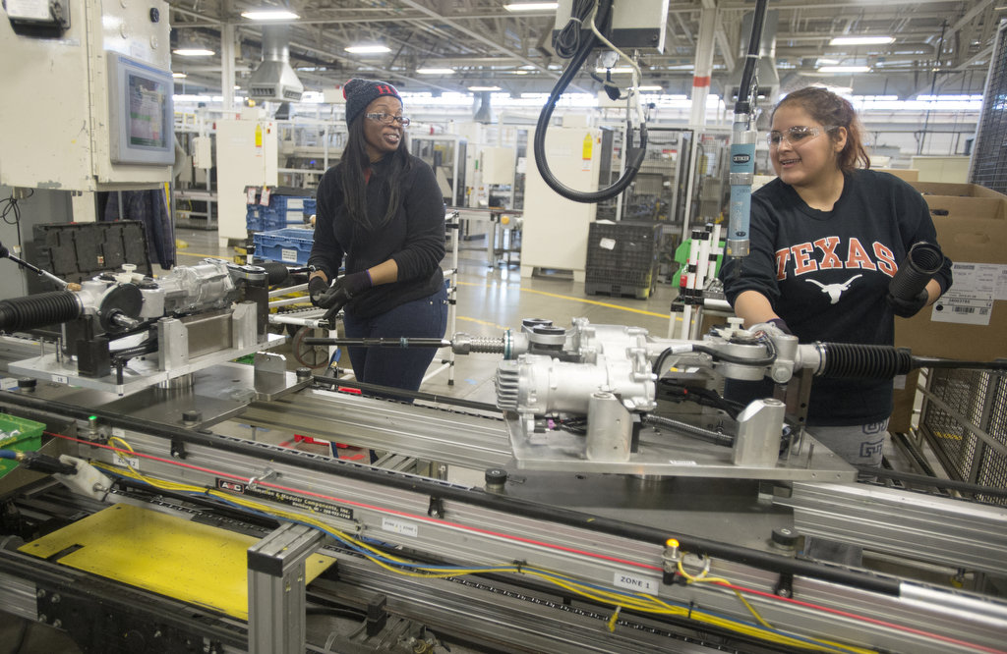
Looking Forward to Tomorrow
We, in this room, are the torch bearers of the future of the Great Lakes Bay Region’s manufacturing sustainability
Let’s all work together to:
Keep this region strong & Competitive
Keep great jobs in the area
Ensure a good future for generations to come

