Slide 1
Adopting Industry 4.0 Technologies in the state of Michigan
SOCIAL MEDIA POSTS TEMPLATE
Presenter Name Presenter Title

Slide 2
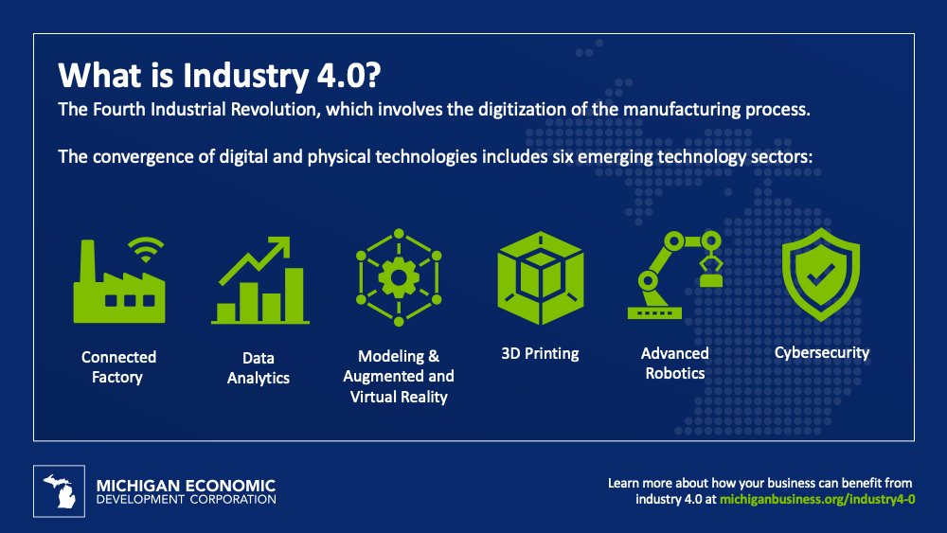
What is Industry 4.0
A revolution in manufacturing technology is changing the way we build things.
Learn more about growing your business by leveraging Industry 4.0 technologies at https://michiganbusiness.org/industry4-0
#MichiganBusiness #Industry40
LinkedIn Post
Twitter Post

Slide 3
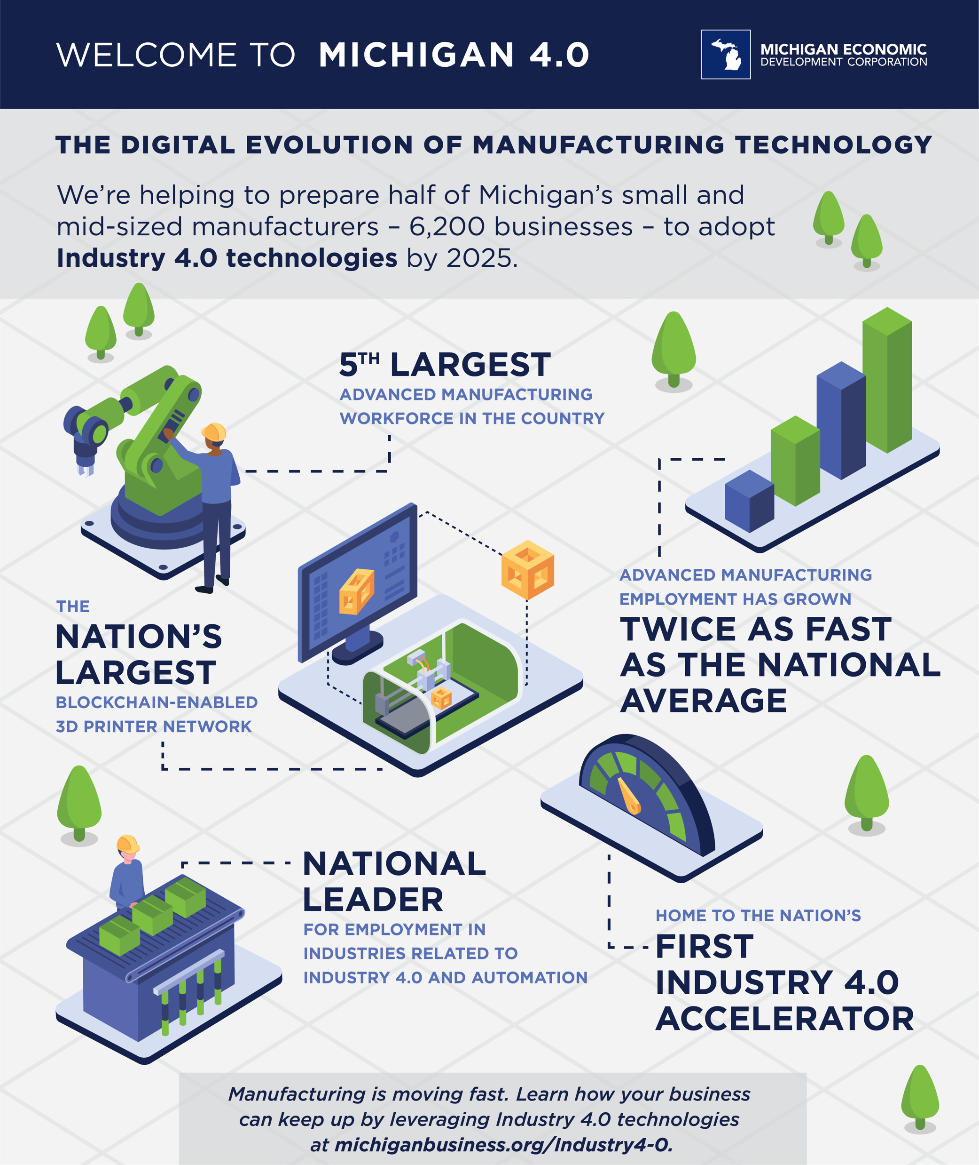
Welcome to Michigan 4.0
We're helping to prepare more than 6,000 Michigan manufacturers to adopt Industry 4.0 technologies by 2025.
Learn how your #MichiganBusiness can grow with #Industry40 at https://www.michiganbusiness.org/industry4-0
#MichiganBusiness #Industry40
LinkedIn Post
Twitter Post

Slide 4
Adopting Industry 4.0 Technologies in the state of Michigan
SOCIAL MEDIA POSTS TEMPLATE
Presenter Name Presenter Title

