Slide 1
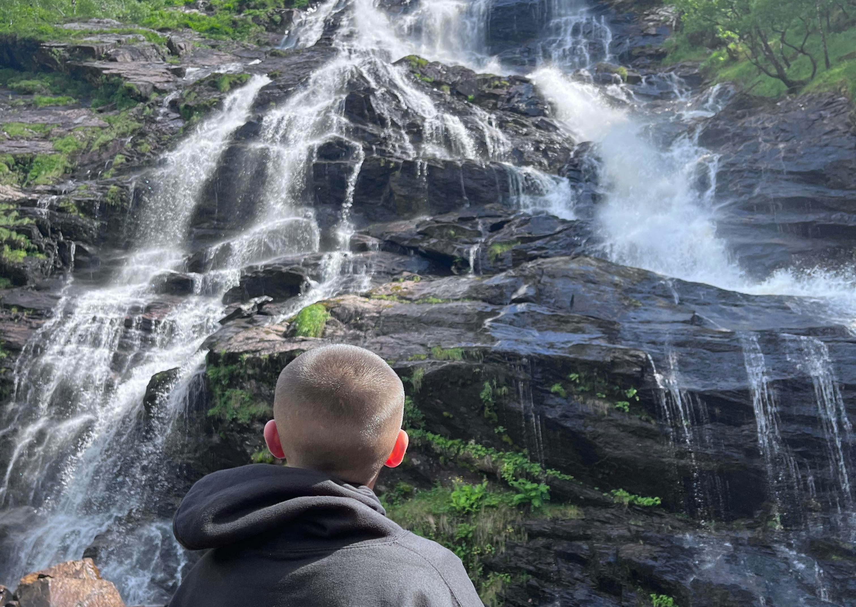

A Collaborative Multi-Agency Approach to Whole Family Support
Laura & Stevan

Slide 2
Hopes for today.

Slide 3
Making it Work for Families
Working together towards your family's future
Partner Organisations
Team Members
Eligibility Criteria
Funding Model

Slide 4
Making it Work for Families
Fife Gingerbread | Clued Up | FIRST | CARF
Support Worker (1 FTE) Family Learning Coordinator (0.8 FTE) | Team Leader (1 FTE) YP Development Worker (1 FTE) YP Project Worker (1 FTE) | Community Rehab Worker (1 FTE) | Income Maximisation Worker (0.6 FTE)

Slide 5

Eligibility
P7-S2 pupil at home struggling to attend and/or engage in Education
Identified catchment areas are Viewforth HS, Levenmouth Academy & St Andrews HS
Families affected by substance use
Low income, lone parent or workless household

Slide 7
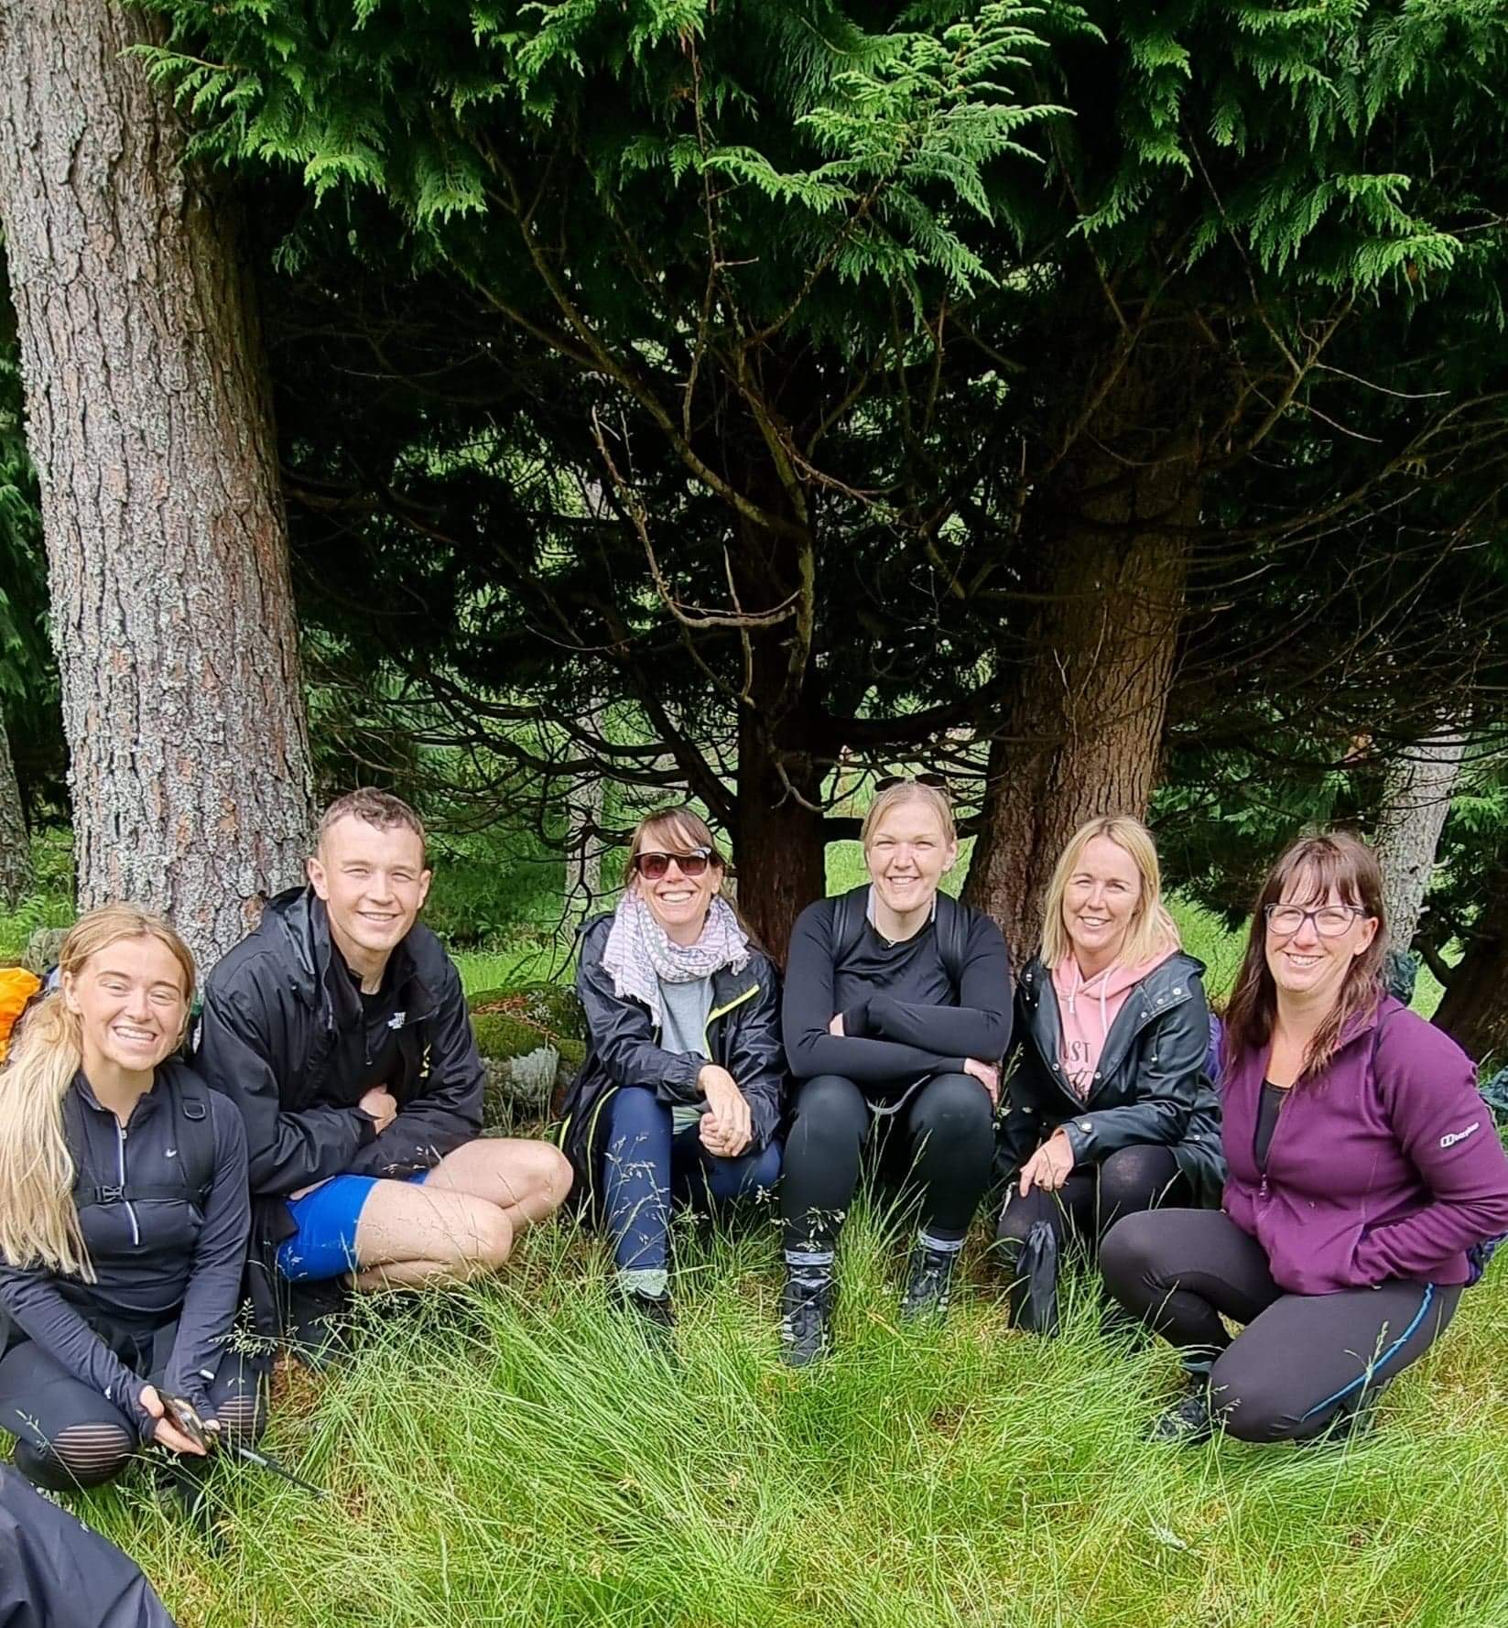
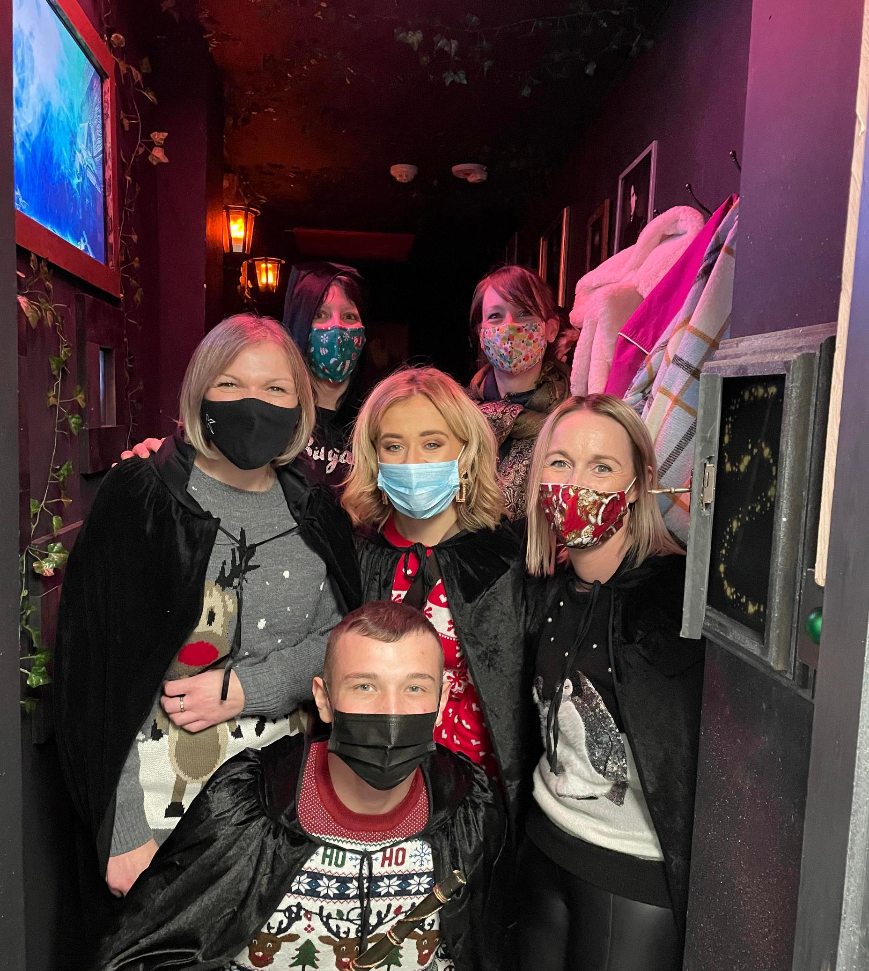
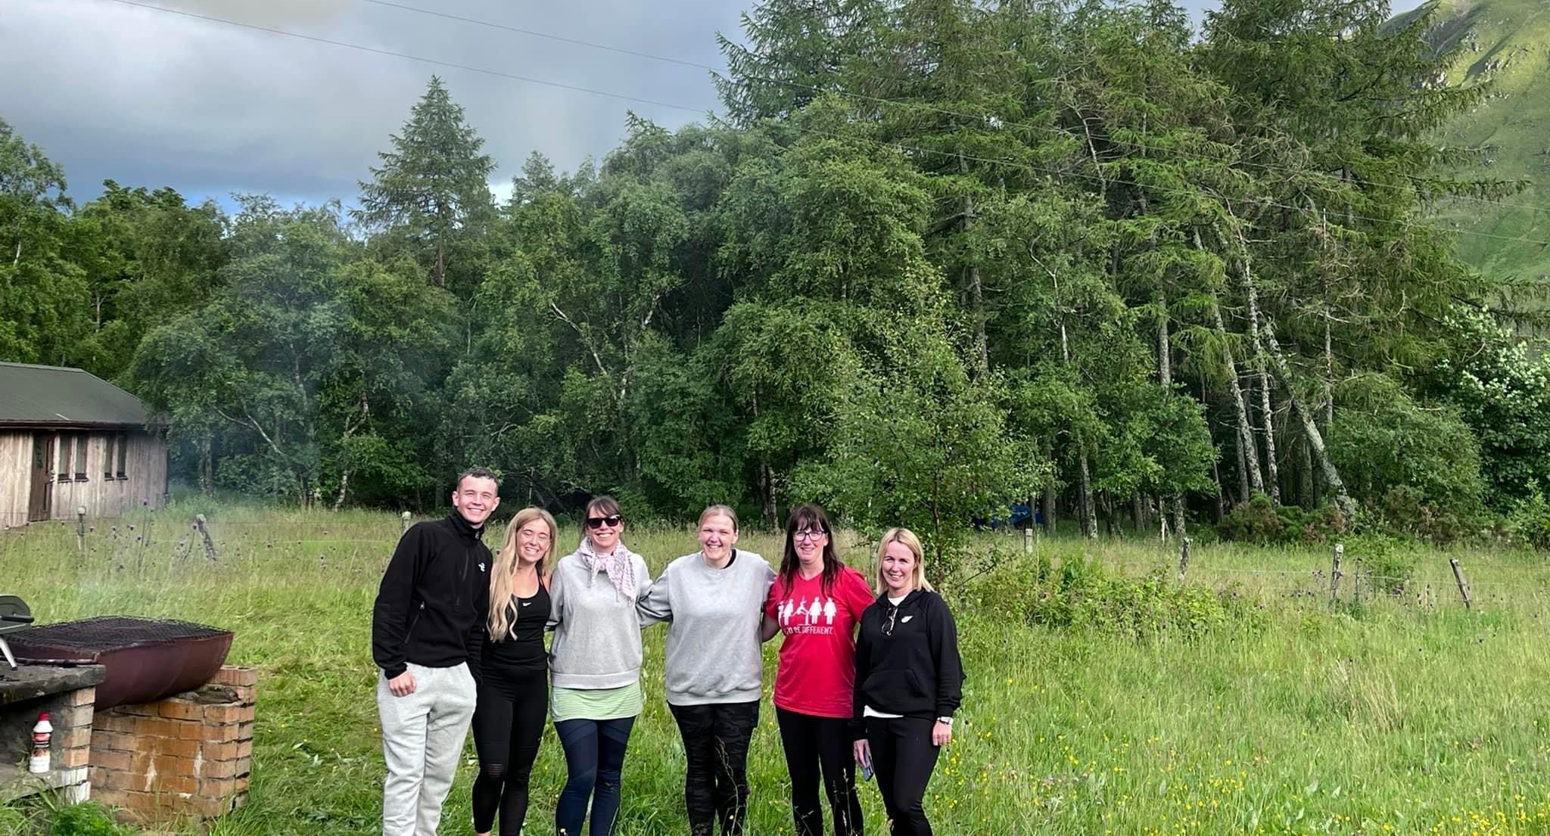
Partnership Approach
Curating the partnership
Multi-disciplinary team
Roles & Responsibilities i.e. specialisms
Relationships
Co-location
External partnerships and collaboration

Slide 8
Key Achievements
Since 2020 we have…
Received 78 family referrals (77.9% from Education)
Engaged 54 families (plus 4 extended households) with 58 adults, 75 young people and 44 children at home
56 parents/carers and 63 young people engaged in intensive 1:1 support with the team
Reported 35 outcomes for young people re-engaging in Education
54 instances where young people felt ‘involved in decision making’ (2022)
Average baseline was 2/10 for young people’s mental health, and average final score was 8/10
66% of adults engaged in Rehab Support have reported improvement in ‘positive choices’
52% of parents have made progress with improving their ‘social networks’
Facilitated family learning including tea time clubs, money heroes and family outings
There’s also been residentials…

Slide 9
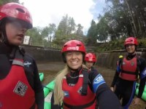

Slide 10
Core Components
Pace
Persistence
Trust
Coordination

Slide 11
Whole Family Support
Partnership case conference
Family action plans
Shared project team leader
Different rates of engagement
Flexible
Creative
Individual journeys and confidentiality

Slide 12
Co-Production
Poverty Alliance Partnership
You Said, We Did approach
Young Person’s Forum
Fife Gingerbread Parent’s Forum
Staff Interviews
Wellbeing Room
Corra Foundation Bids

Slide 13
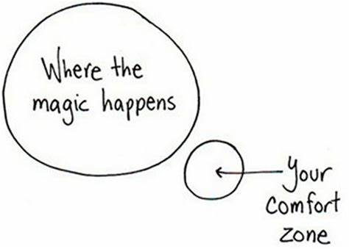
Systems Change
Internal Influence:
Hide the wiring
Empower staff
Adapting & learning
Quality improvement
External Influence:
Flexible timetables
Stigma
Corra Foundation bids
Education Strategic Attendance

Slide 14
Whole Systems Approach
Families
Early Learning & Childcare
Alcohol and Drugs Partnership
Housing
Crisis Support
Social Security Scotland
Education
Children Services & Social Work
Employers
Criminal Justice
DWP
Youth Work
Employability
CAHMS
Third Sector
Foodbanks
Health
Families
Fife Gingerbread
Clued Up
Citizens Advice & Rights Fife
FIRST

Slide 15
Parent’s Perspective
How does your experience of Making it Work for families differ from other projects and organisations you’ve worked with?

Slide 16
Young Person’s Perspective
How does the Making it Work for families project advocate for your rights?

Slide 17
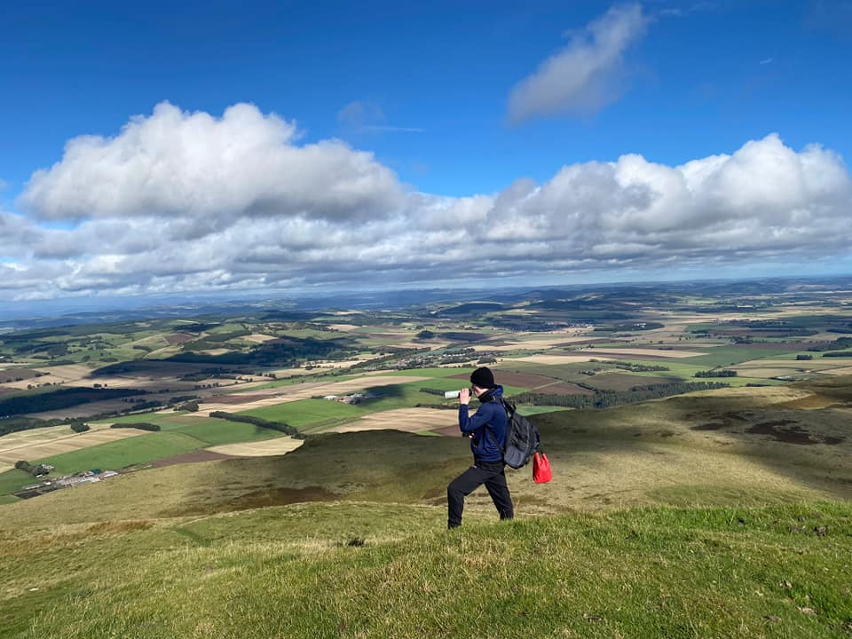
Questions?
Laura Millar, Strategic Manager, Fife Gingerbread
laura.millar@fifegingerbread.org.uk
Stevan Sutherland, Team Leader, Clued Up
stevan@cluedup-project.org.uk

