Slide 1
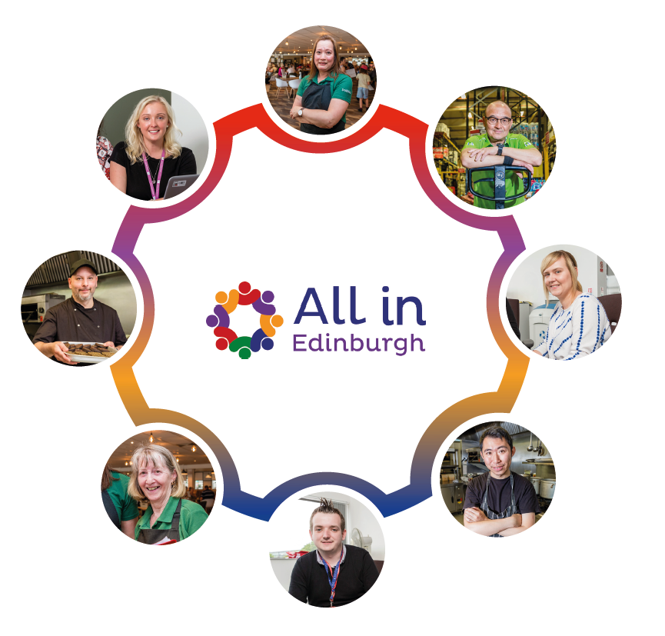
Kristopher Wesencraft, Operations Manager, ENABLE Works

Slide 2
Edinburgh DPESF Network Pilot
All in Edinburgh Parents
The Supported Employment Model
Initial Findings
Q&A

Slide 3
Edinburgh DPESF Network Pilot
Engagement: LIFT, Home Start, Circle, Stepping Stones, Saheliya, Project Esperanza, Passion 4 Fusion
Barrier Removal: OPFS (Childcare), IntoWork (Welfare Advice)
Supported Employment: DPESF - All in Edinburgh Parents, PESF - Access to Industry, Broomhouse and The DataKirk

Slide 5
All in Edinburgh Parents Eligibility
Living in City of Edinburgh
Disability or Long-Term Health Condition (inclusive of mental health)
Parent or Guardian (in the broadest sense)
Notes:
A brief note on Eligibility:
Scottish Government have agreed the term “parent” can be used in the broadest sense, including those who don’t have parental responsibility, pregnant women or guardians.
The key factor is that the person is a parent in some form that has created a barrier to work – this could include a whole variety of factors from struggling with childcare to needing to stabilise home life in order to work towards having children back from care.
And the person must live in Edinburgh and have a disability or long-term health condition (inclusive of mental health).

Slide 6
Individuality
Respect
Self –determination
Informed choice
Empowerment
Confidentiality
Flexibility
Accessibility

Slide 7
Supported Employment Model
Engagement
Vocational Profiling
Job Finding
Employer Engagement
On/Off Job Support

Slide 8
Edinburgh DPESF Network Pilot Early Days
Referral & Engagement
Diversity & Inclusion
Tailored Approach

Slide 9
Phone: 0300 0200 101 Email: parents@allinedinburgh.org.uk Web: www.allinedinburgh.org.uk

