Slide 1


The
Zero-Click
Paradigm
How AI-Mediated Discovery is
Restructuring Digital Commerce
DrewIs Intelligence LLC
"Rebuild. Rewire. Rise."
December 2025

Slide 2

The Digital Commerce Assumption is Broken
The Old Model (2000-2024)
The New Reality
Visibility = Traffic
= Revenue
This assumption is no longer valid.
For two decades, the singular objective was driving clicks to owned properties. The "click" was the fundamental unit of measurement.
Users receive comprehensive answers without navigating. Purchase decisions are influenced by AI recommendations occurring entirely outside traditional analytics visibility.
The click is becoming obsolete as the primary indicator of discovery and influence.

Slide 3


Zero-Click Searches Now Dominate Digital Discovery
The Evolution of Results
58.5%
From simple facts (weather, definitions) to complex informational summaries.
Zero-Click Searches
Contemporary AI results synthesize multiple sources, answering commercial queries directly in the interface.
The user receives synthesized information with citations, but the traditional website visit is eliminated from the discovery process.
Source: SparkToro/Datos, 2024 (US & EU Data)

Slide 4

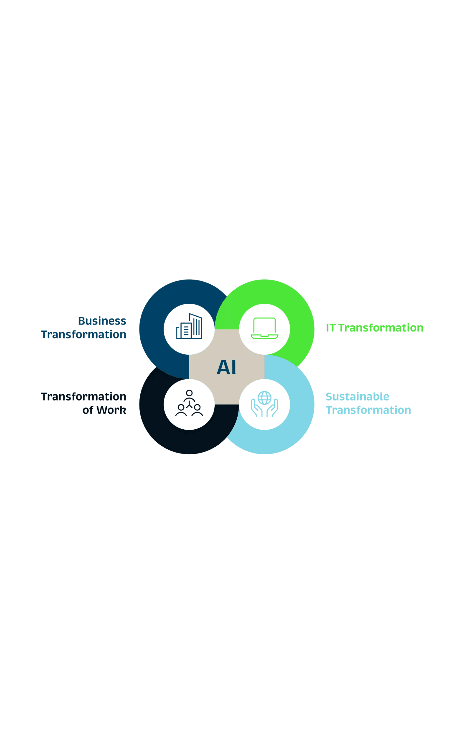
AI Platform Adoption Has Reached Critical Mass
ChatGPT
Perplexity AI
400M+
1 Billion+
Weekly active users globally
Monthly queries processed
Microsoft Copilot
Google
365 Suite
Default
Integrated for millions of enterprise users
AI Overviews for informational queries
THE CONVERGENCE EFFECT
The distinction between "search engines" and "AI assistants" is collapsing. Deloitte projects AI-enhanced search will achieve 3x greater usage than standalone AI tools by 2026.

Slide 5

Traditional Organic Traffic Faces Catastrophic Decline
By 2026
By 2028
-25%
-50%
Projected decline in traditional search volume as users shift to AI interfaces.
Reduction in organic search traffic for brands relying on traditional SEO.
Organizations relying solely on traditional SEO strategies will experience severe competitive disadvantage within the next 36 months.
Source: Gartner, "Predicts 2025: Search and AI-Driven Discovery"

Slide 6
The AI Discovery Ecosystem Operates Fundamentally Differently
Contemporary AI systems employ Retrieval-Augmented Generation (RAG). They retrieve relevant content in real-time and synthesize responses that integrate retrieved information with model knowledge.
Content competes not merely for ranking position, but for retrieval selection.
Citation Selection Factors
Domain Authority Signals
Structural Clarity
Content Recency
Machine Readability
Information Density
Structured Data

Slide 7
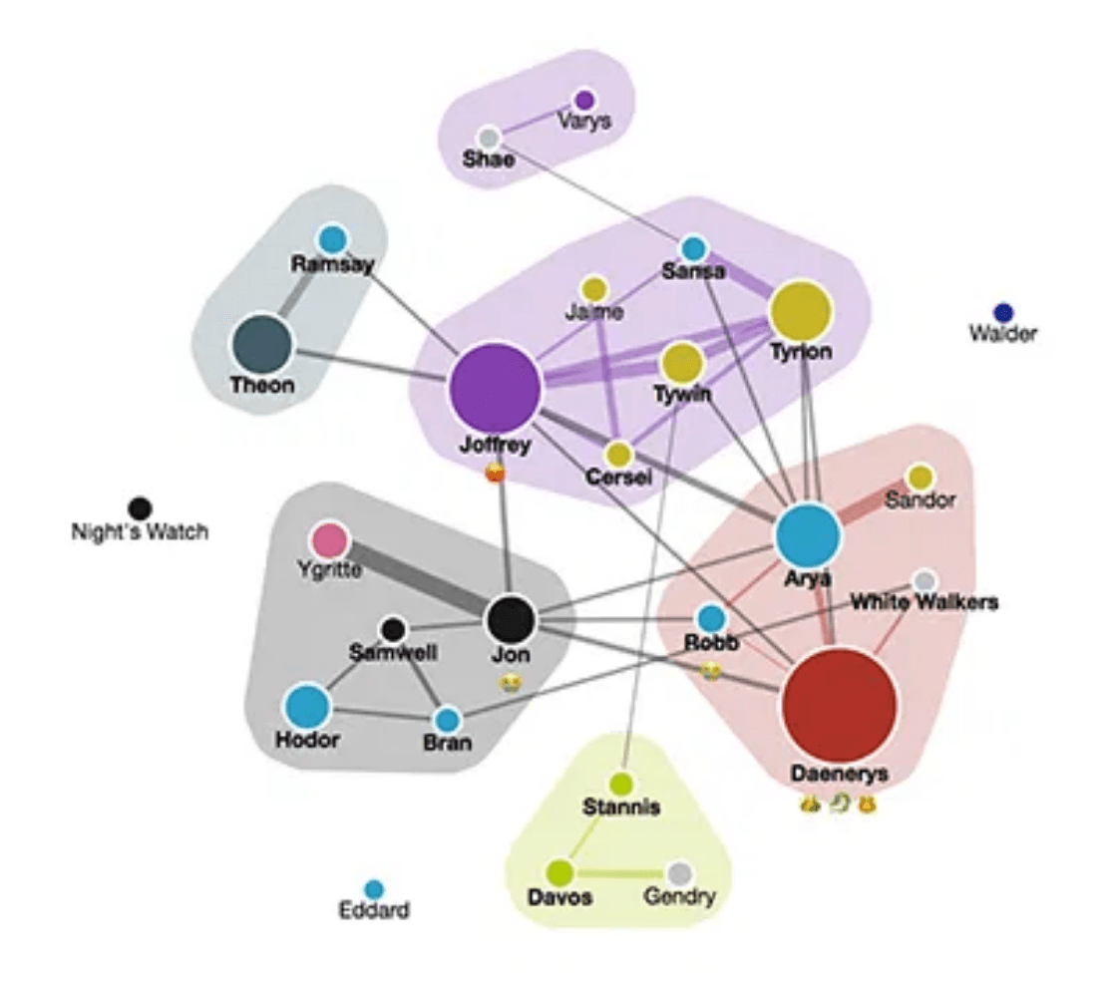
Brand Mentions Function as Algorithmic Endorsements
When an AI system recommends a product by name, that recommendation carries substantial influence—often more than a traditional search result.
Users increasingly trust AI synthesis over manual research. This creates a new competitive dynamic where organizations compete for "default recommendation" status.
The Knowledge Graph: Nodes of Authority
The Old Metric
The New Success Metric
Click-Through Rate (CTR)
Mention Frequency & Sentiment Quality

Slide 8

Optimization for AI Citation Produces Measurable Results
40%+
Visibility Improvement
Achieved through systematic Generative Engine Optimization (GEO) compared to baseline.
Research from Princeton University and Georgia Tech demonstrates that content optimized for machine comprehension significantly outperforms content optimized solely for traditional search ranking.
2.4x
58%
Likelihood of Appearance
Higher Visibility Scores
For pages with comprehensive schema markup in AI summaries.
Correlated with structured data implementation.
Source: Aggarwal et al., 2024 (Princeton/Georgia Tech)

Slide 9

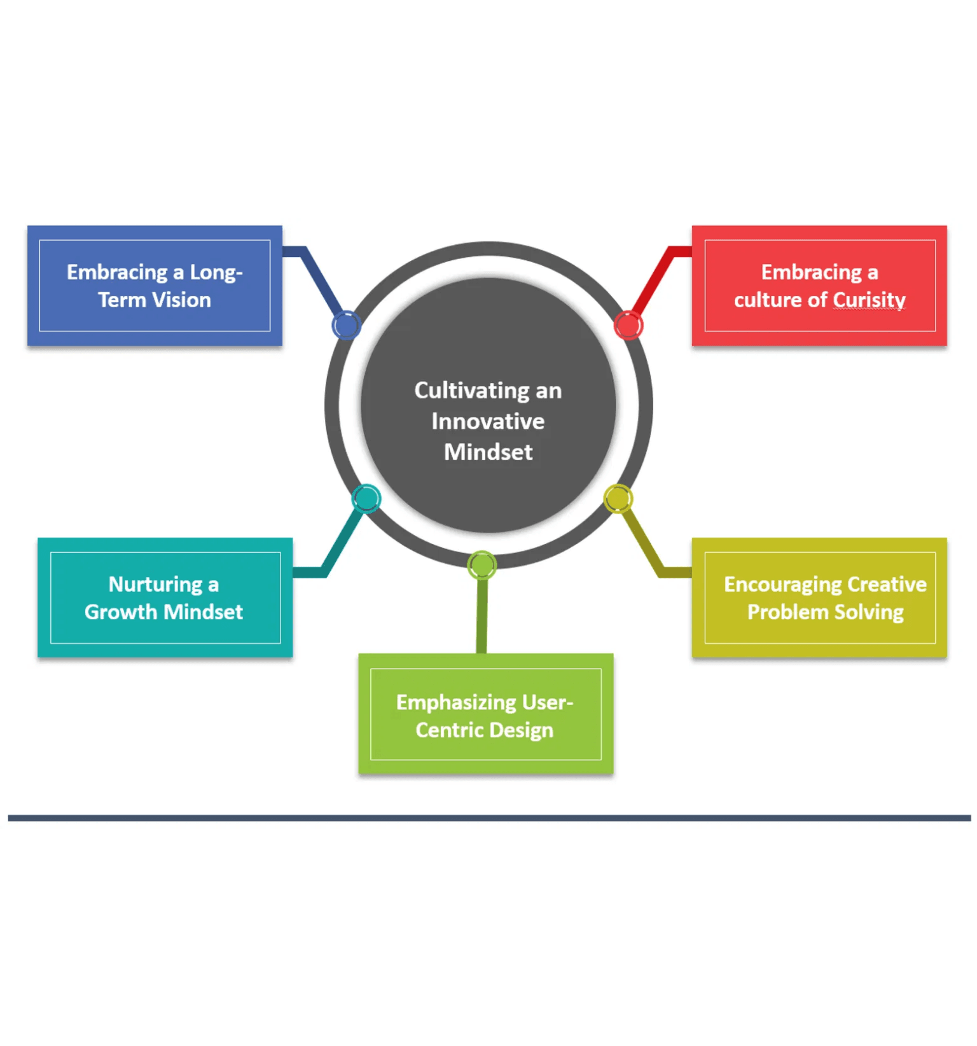
The GEO Framework: Three Pillars of AI Visibility
A strategic response model for the zero-click paradigm requiring coordinated action across three distinct dimensions.
Pillar 1
Generative Engine Optimization (GEO)
Focuses on optimizing content for AI citation through semantic footprint and fact density.
Pillar 2
Answer Engine Optimization (AEO)
Focuses on page architecture, direct answers, and structured data for machine comprehension.
Pillar 3
Trust Architecture
Focuses on authority signals, E-E-A-T, and entity disambiguation to build algorithmic trust.

Slide 10

01
Pillar 1
Generative Engine Optimization (GEO)
Primary Focus
Semantic Footprint
Fact Density
Optimizing content specifically for AI citation and synthesis.
Establishing broad topical authority and context that AI models can map to user intent.
Maximizing the ratio of verifiable facts per sentence to increase citation probability.
Content Fluency
llms.txt Protocol
Structuring language for optimal LLM processing and synthesis.
Implementing the standard for machine-readable content guidance.
Projected Outcome
40%+ Visibility Improvement

Slide 11

02
Pillar 2
Answer Engine Optimization (AEO)
Primary Focus
Direct Answer Leads
Structured Data
Page Architecture for Machine Comprehension.
Structuring content to provide immediate, concise answers to core queries at the start of sections.
Implementing comprehensive schema markup to define entities and relationships explicitly.
Schema Markup
ActionSchema
Using standardized vocabulary (Schema.org) to make content machine-readable.
Defining potential actions (Buy, Reserve) to enable agentic AI interaction.
Projected Outcome
2.4x Likelihood of Appearance

Slide 12
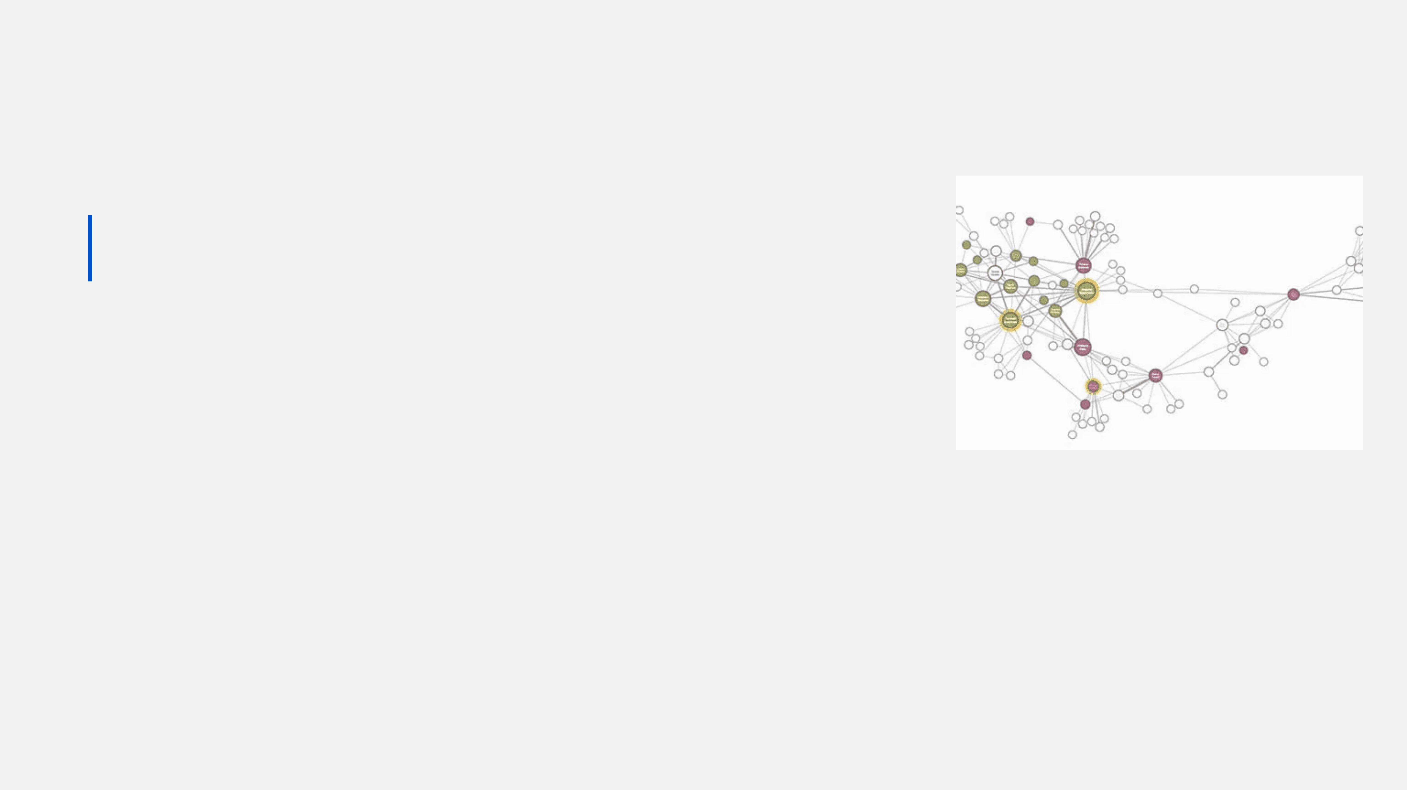
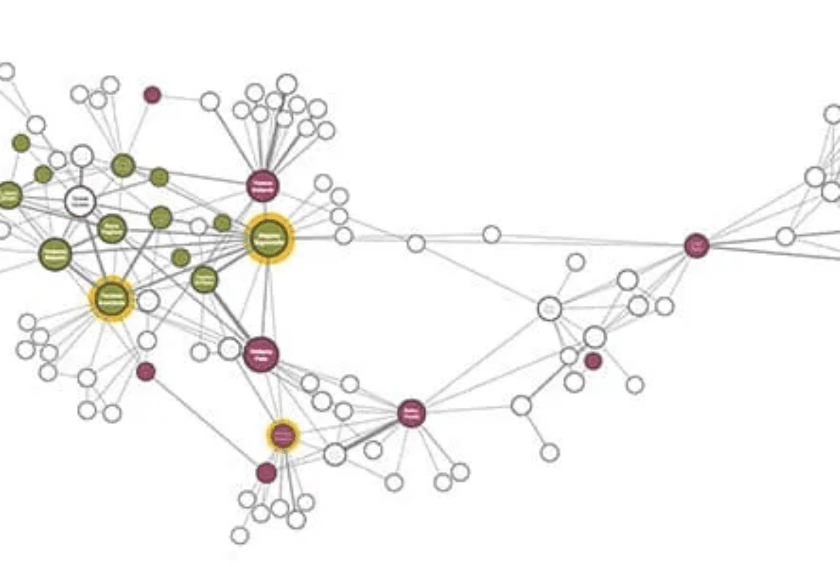




03
Pillar 3
Trust Architecture
Primary Focus
Authority Signals for AI Systems
E-E-A-T Signals
Demonstrating Experience, Expertise, Authoritativeness, and Trustworthiness.
Entity Disambiguation
Clarifying identity for AI knowledge graphs to prevent hallucination.
sameAs Protocol
Linking entities to established knowledge bases (Wikidata, LinkedIn, Crunchbase).
Citation Standards
Formatting references for machine verification and traceability.
Outcome
Algorithmic trust signals that increase citation probability.

Slide 13
Machine-Readable Content Guidance
llms
.txt
An emerging standard for a file placed at a website's root directory that provides AI systems with a structured guide to high-value content resources.
The Functional Shift
Proposed by Jeremy Howard
(Answer.AI)
robots.txt
llms.txt
Restrictive
Promotional
"Do not crawl this."
"Prioritize this content."
Organizations implementing llms.txt signal to AI systems which content should be prioritized for retrieval and synthesis.

Slide 14

ActionSchema Prepares Organizations for Agentic AI
The Mechanism
Implementation of Schema.org Action types that communicate to AI agents exactly what actions are available and how to execute them.
AGENTIC AI MARKET PROJECTION
$8.5B
BuyAction
ReserveAction
SubscribeAction
2026
OrderAction
$35B
2030
The Functional Shift
Organizations implementing ActionSchema will be positioned to receive direct commercial transactions from autonomous AI agents.
AI systems are evolving from answering questions to executing transactions on behalf of users.

Slide 15

The Dark Funnel: 70% of Buyer Journey is Invisible
The Invisible Scenario
70%
A procurement team uses ChatGPT to research solutions, compare technical specs, and shortlist vendors—all before visiting a single website.
of the B2B buyer journey occurs before any trackable engagement.
The Attribution Gap: Traditional models relying on trackable touchpoints are increasingly incomplete. Organizations misunderstand their actual influence dynamics by ignoring this invisible activity.
Source: 6sense, 2024

Slide 16
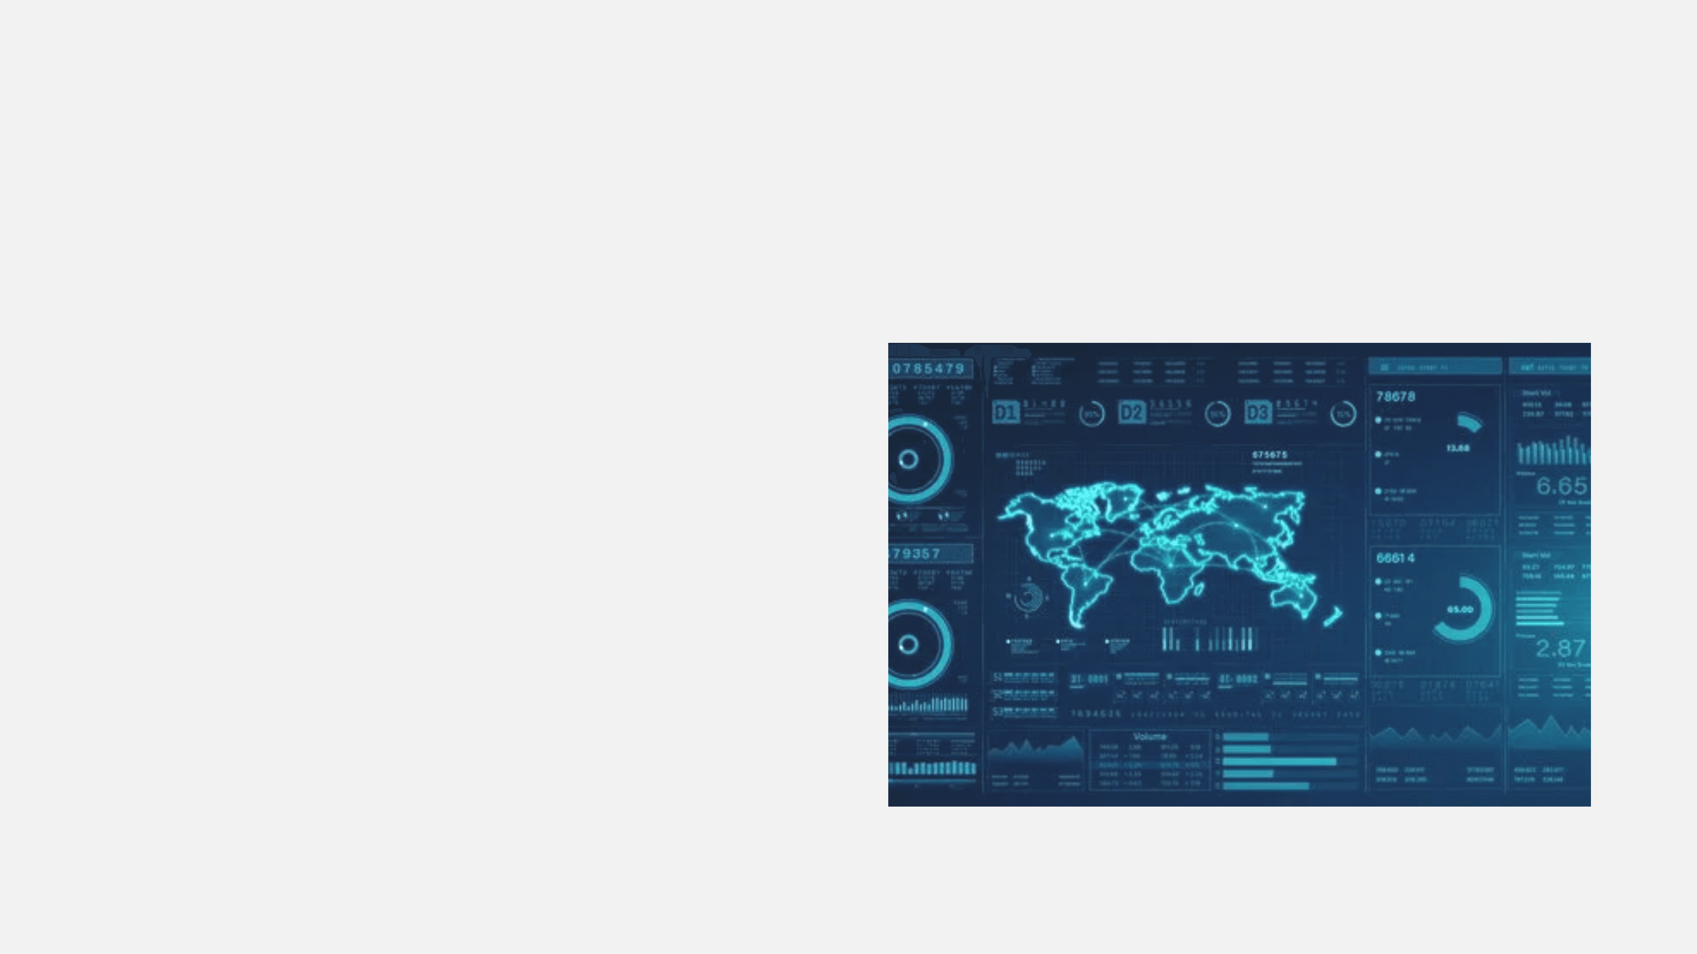
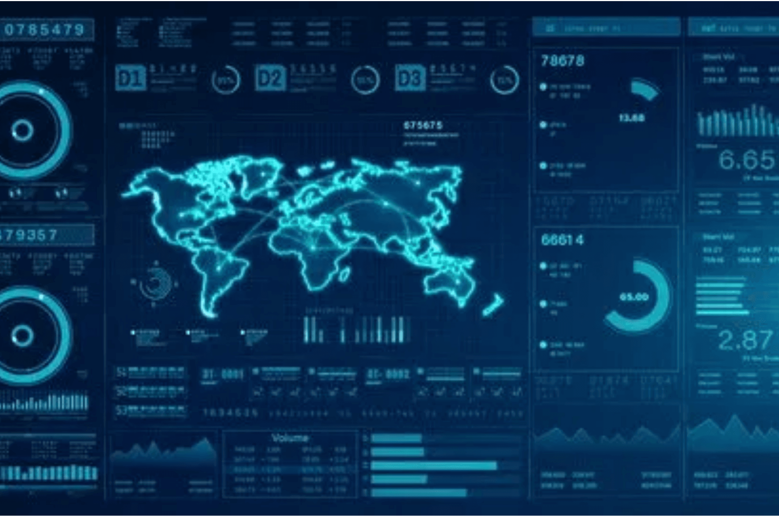

Industry Implications: E-Commerce and Retail
Product discovery is migrating to AI platforms. Consumers ask AI assistants for recommendations, receiving curated suggestions without visiting retailer websites.
The Old Game
Ranking for Keywords
The New Game
Default AI Recommendation
Retailers absent from AI product suggestions face reduced discovery regardless of traditional search ranking or paid advertising investment.

Slide 17

Industry Implications: B2B & Technology
The New Competitive Advantage
"Default Recommendation" Status
Enterprise buyers increasingly consult AI systems for initial vendor evaluation, receiving synthesized comparisons that may not credit original sources.
The traditional "shortlist" is now generated algorithmically before any human contact occurs.
Vendors absent from AI recommendations face reduced discovery regardless of traditional search performance. Being the "AI-preferred" solution is the new SEO ranking.
Strategic Requirement
B2B organizations must optimize technical documentation, case studies, and thought leadership for AI citation—ensuring their solutions appear in AI-generated vendor comparisons.

Slide 18




Industry Implications: Professional Services
Service Commoditization
Selection Influence
Authority Requirement
For complex engagements, AI recommendations of specific firms carry substantial influence. Clients use AI to shortlist firms based on expertise matching and reputation signals.
AI systems increasingly provide guidance previously available only through professional consultation. This potentially reduces demand for basic advisory and informational service categories.
Firms must establish authority within AI knowledge systems through structured case studies and clear service definitions to position themselves for preferential recommendation.
Strategic Imperative: Shift from "Thought Leadership" to "Structured Authority" optimized for machine ingestion.

Slide 19

Forward Projections: The Strategic Window is Closing
2026
2028
2030
Near-Term Horizon
Medium-Term Horizon
Extended Horizon
Search Volume Decline
Organic Traffic Collapse
Agentic Dominance
Traditional search volume drops 25% from 2024 baseline.
Declines of 50% or more for non-optimized brands.
Market reaches $35 billion; agents conduct autonomous transactions.
AI Usage Surge
Transactional Shift
The New Minority
AI-enhanced search achieves 3x usage relative to standalone tools.
AI-mediated transactions become commonplace in B2B and consumer commerce.
Traditional "website visit" model becomes the minority of digital commerce.
Agentic AI Growth
Market reaches $8.5 billion.
Competitive Gap
Authority Rule
Severe disadvantage for organizations without AI visibility.
Advantage determined primarily by AI citation status.

Slide 20
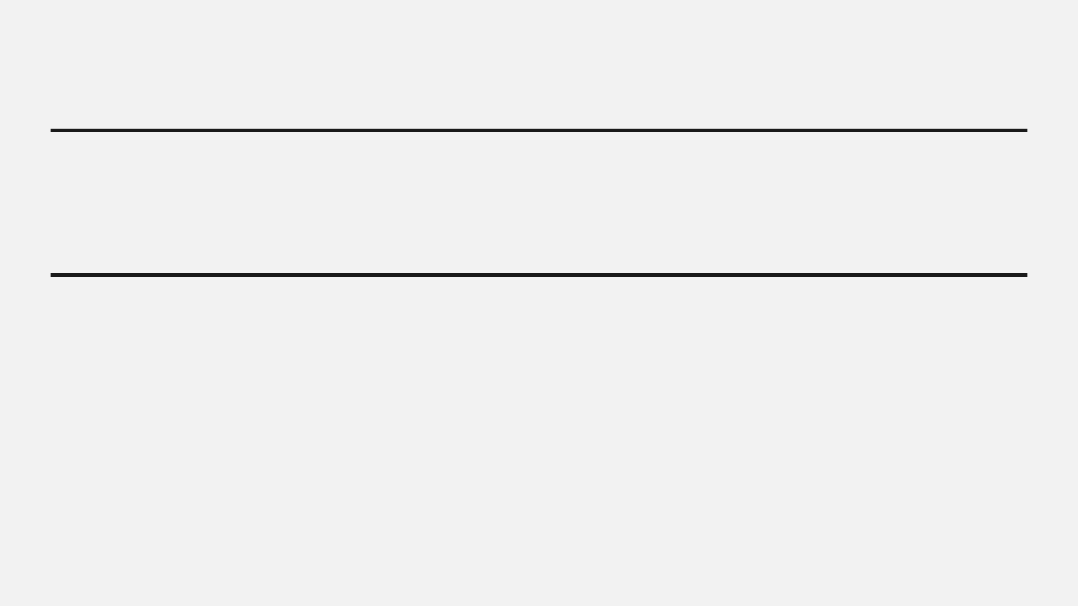
The Critical Strategic Window
2025 — 2027
First-Mover
Advantage
The Opportunity
The Risk
Organizations that establish AI visibility infrastructure during this period will secure structural advantages as market adoption accelerates.
Delaying until transformation is complete guarantees competitive catch-up in an environment dominated by established players.
Digital transformation windows are finite. The AI visibility window follows the same dynamics as the Web (1990s) and Mobile (2010s), but with compressed timelines.
Historical Precedent

Slide 21

The Zero-Click Paradigm Does Not Eliminate Digital Value
It fundamentally restructures how value is distributed, moving from a traffic-based economy to an influence-based economy.
The Old Currency
The New Currency
Traffic Volume
Citation Frequency
Aggregate site visits
Source attribution by AI
Click-Through Rate
Entity Authority
Link engagement
Knowledge graph strength
Ad Impressions
Transactional Trust
Eyeballs on page
Agentic verification
The Economic Reality: You cannot buy what you cannot find. Visibility remains the absolute prerequisite for commerce.

Slide 22



Strategic Response: Organizations Must Act Now
The shift to the Zero-Click Paradigm is structural, not cyclical. Organizations face a binary choice in how they respond to this new reality.
Option A: Inaction
Option B: Adaptation
Defend the Past
Seize the Future
Continue focusing solely on keyword rankings
Audit content for AI readability (GEO)
Ignore structured data and entity optimization
Implement ActionSchema for agents
Rely on traditional attribution models
Build authority through entity disambiguation
Result: Gradual Obsolescence
Result: Default Recommendation Status
THE COST OF INACTION IS DIGITAL INVISIBILITY.

Slide 23

The DrewIs Intelligence Ecosystem
A comprehensive suite of strategic resources and practical tools designed to help organizations navigate the Zero-Click Paradigm.
Strategic Framework
Implementation Guide
The Whitepaper
The Manual
The foundational document outlining the shift to AI-mediated discovery and the core GEO/AEO methodologies.
A tactical, step-by-step guide for implementing the strategies discussed, from technical schema to content structuring.
drewis.ai/whitepaper
drewis.ai/manual
Practical Application
SaaS Platform
The Workbook
AEO Optimizer App
Interactive exercises, audit templates, and worksheets to apply the Zero-Click strategies to your specific organization.
The dedicated software application for analyzing and optimizing your digital footprint for Answer Engines.
drewis.ai/workbook
app.drewis.ai

Slide 24
Strategic Conclusion
Organizations That Act Now Will Define the Future
The transition to the Zero-Click Paradigm is a fundamental restructuring of digital influence. Early adopters who build the infrastructure for AI visibility today will own the default recommendations of tomorrow.

Slide 25

Strategic Framework
drewis.ai/whitepaper
Next Steps
Lead the Transformation
Implementation Guide
drewis.ai/manual
Practical Application
Equip your organization with the strategic framework and practical tools required to thrive in the Zero-Click Paradigm.
drewis.ai/workbook
SaaS Platform
app.drewis.ai
© 2025 DrewIs Intelligence Ecosystem. All Rights Reserved.

