Slide 1


MEDICARE
EXPLAINED
2026

Slide 2
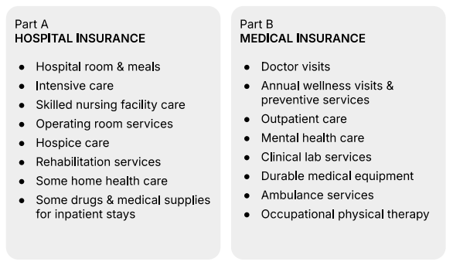
WHAT DOES ORIGINAL MEDICARE COVER?
ORIGINAL MEDICARE CONSISTS
OF PART A & PART B

Slide 3

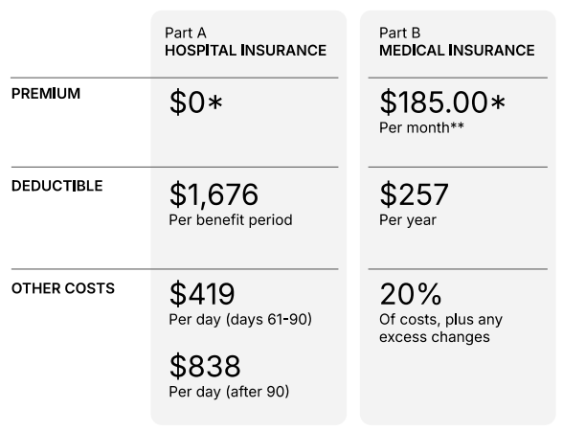

WHAT DOES IT COST?
0*
202.90
ORIGINAL MEDICARE CONSISTS OF PART A & PART B - BUT NO OUT OF POCKET MAX
1,736
283
*PART A IS PREMIUM IS $0 IF YOU OR YOUR SPOUSE WORKED AND PAID TAXES FOR 10+ YEARS. IF YOU DON’T GET PREMIUM FREE PART A YOU MAY PAY UP TO $566 EACH MONTH.
**IF YOU ARE AN ABOVE AVERAGE INCOME EARNER, YOU WILL HAVE TO PAY A HIGHER PART B PREMIUM.
434
20%
868

Slide 4





  Set & Forget
  Pay as you go
TO COVER THESE GAPS,
YOU HAVE 2 OPTIONS!
Enroll in Original Medicare and add 1 or both options below:
Enroll in Original Medicare and select an Advantage Plan:
Medicare Supplement
aka “Medigap” Plan
Covers out-of-pocket costs
AND/OR
Medicare Part D Plan
Helps pay for prescription
drugs
Part C
Combines Part A & B in one
plan along with...
Part D
Helps pay for prescription
drugs
Plus: may offer additional benefits such as:
dental, vision, hearing, etc

Slide 5

OPTION 1:
SUPPLEMENT + PART D

Slide 6
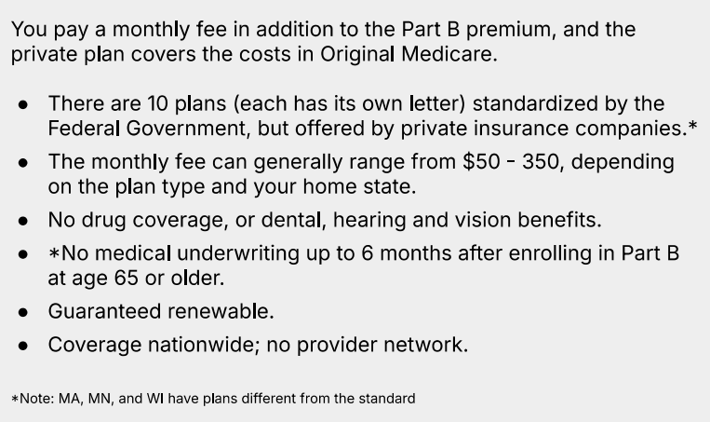
ABOUT MEDICARE SUPPLEMENT PLANS (MEDIGAP)

Slide 7

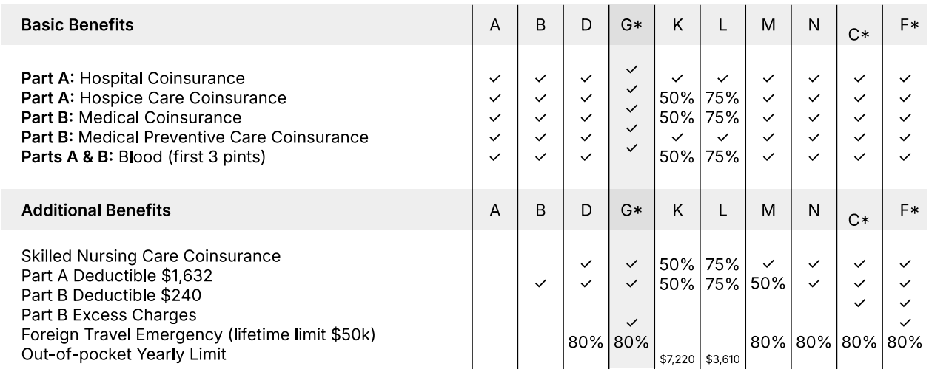




YOUR MEDICARE SUPPLEMENT OPTIONS
NOTE: PLANS WILL BE THE SAME FROM CARRIER TO CARRIER, THE MAIN DIFFERENCE BETWEEN CARRRIERS IS THE PRICE. THE MOST COMMON PLAN TODAY IS PLAN G SINCE IT OFFERS THE MOST COVERAGE.
*PLANS F & G MAY ALSO HAVE HIGH DEDUCTIBLE OPTIONS. HOWEVER, PLANS C & F ARE NO LONGER AVAILABLE TO PEOPLE NEW TO MEDICARE ON OR AFTER JANUARY 1, 2020 AS PLANS CAN NO LONGER COVER THE PART B DEDUCTIBLE.
-

Slide 8
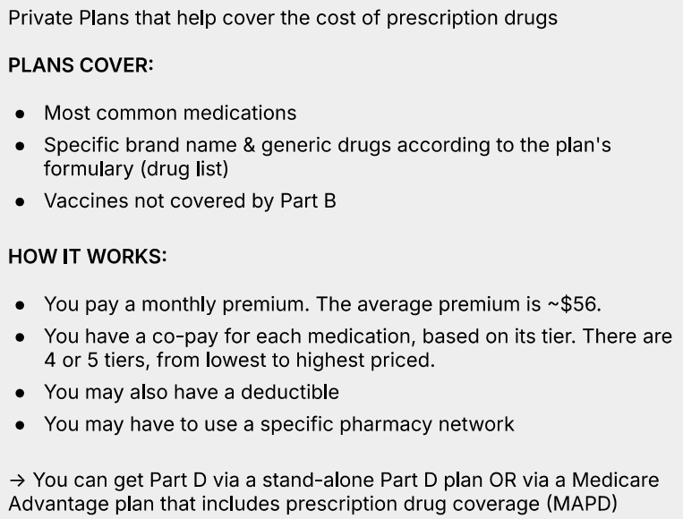
ABOUT
PART D:
MEDICARE PRESCRIPTION DRUG PLAN

Slide 9

OPTION 2:
PART C
MEDICARE ADVANTAGE

Slide 10



  All the benefits of Part A & B. You’re still in the Medicare
Program, but plans are offered by private companies.
  Most plans include Prescription Drug Coverage
  Many plans offer additional benefits:
- Dental - Hearing - Vision - Wellness Programs
ABOUT
PART C
Benefits
  Continue to pay the Part B premium
  Many Part C plans are $0 premium
  You may have out-of-pocket copays and coinsurance
when you use services
  Typically have annual out-of-pocket maximum
“MEDICARE ADVANTAGE PLANS”
Costs
Other
Factors
  You may need a referral to see a Specialist
  Coordinated care support with Provider Network

Slide 11

MEDICARE ADVANTAGE OFFER SPECIAL NEEDS PLANS (SNP’S)
These plans typically offer more benefits with specific care plans. You may qualify if:
  You have a chronic conditions, like diabetes, heart conditions, COPD
  You receive Medicaid assistance from your state

Slide 12

MEDICARE ADVANTAGE OFFER GIVEBACK PLANS
Some Medicare Advantage plans offer a Part B premium reduction, often called a giveback.
⭐ How the Giveback Plan Works:
  The plan sends a rebate to Social Security
  The rebate lowers your monthly Part B premium.
⭐ Important Things to Know:
  A giveback is not extra money—it’s simply a reduction of your Part B premium.
  Plans offering a giveback may have trade‑offs, such as different copays, networks, or drug costs. It’s important to review the full plan details before enrolling.
  Not available in all areas and NOT offered by all Medicare Advantage plans.

Slide 13

MAKING A DECISION

Slide 14


Supplement + Prescription Plan
Medicare Advantage
which
option
should
you
  Works with Part A & B
  $283 Annual Deductible
  No Network/Referrals
  Premium ($100 - $250)
  PDP ($0 - $100
  DVH ($40-$100)
  No Extras
  Standardized
*Know what you’ll pay each month
  Private/Replacement
  Copays/MOOP
  Networks
  Typically $0 Premium
  Built in PDP
  Built in DVH
  Extras included
  Company Specific
*Pay as you go
Choose?
Original Medicare
Part A: $0.00
Part B: $202.90
80%
Consider the differences...

Slide 15
THANK
YOU
WE’RE HERE TO ANSWER ANY QUESTIONS
YOU MAY HAVE

