Slide 1


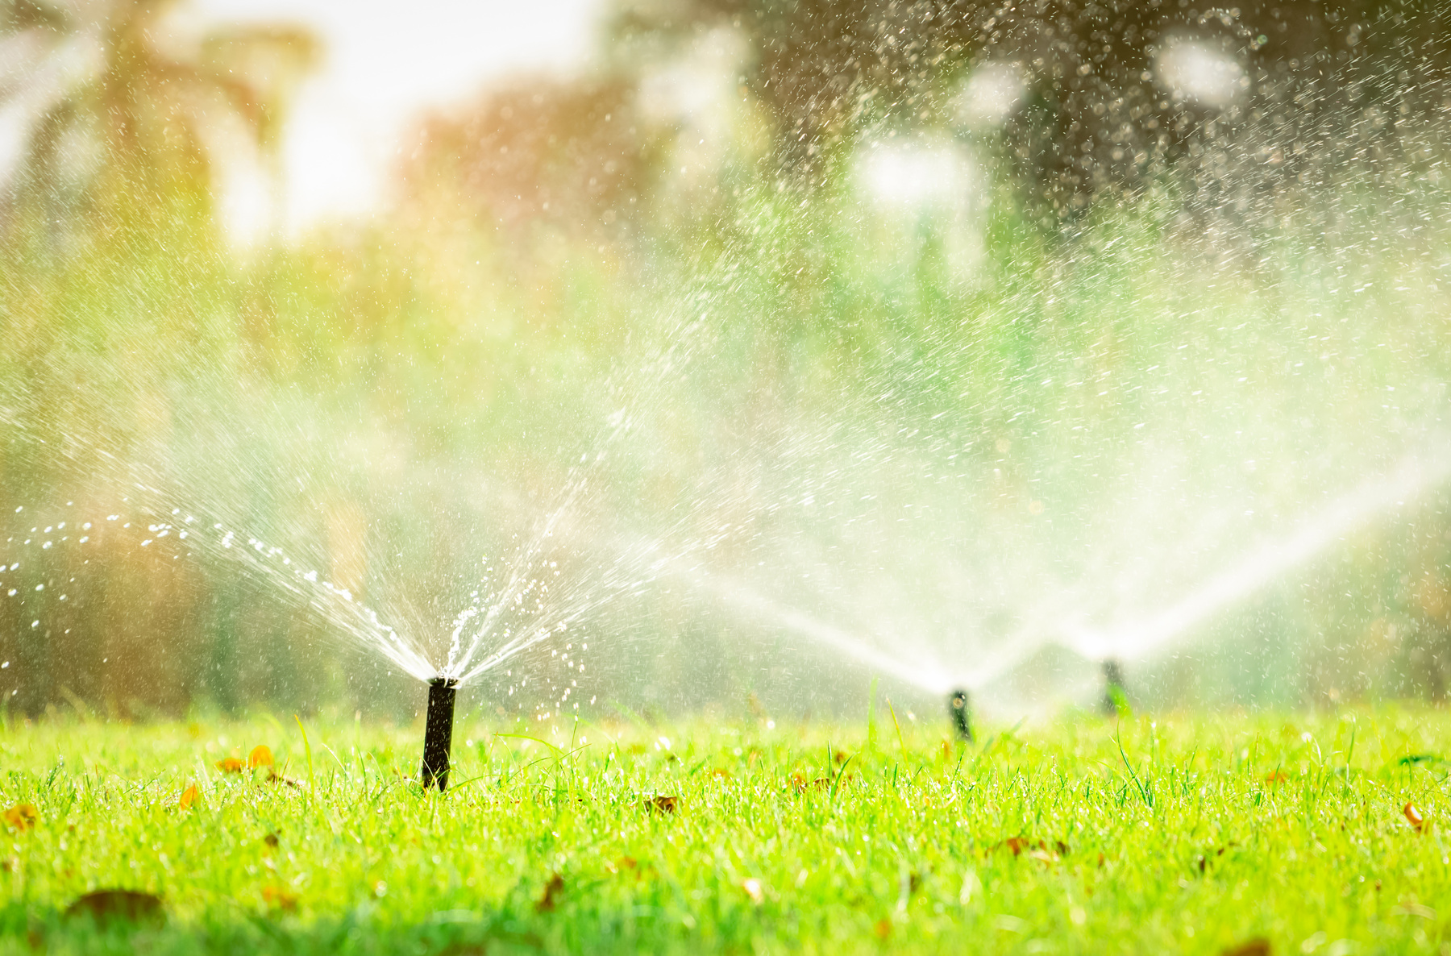


NEWSLETTER
Water-Wise Living: Thirst-Quenching Tips for Thriving Gardens in Dry Heat
Conserving water in dry, hot climates is crucial for both environmental sustainability and efficient water use. Here is a list of ways to conserve water:
  Drip Irrigation: Use drip irrigation systems for plants and gardens. This method delivers water directly to the base of plants, minimizing evaporation and runoff.
  Mulching: Apply a layer of mulch around plants to reduce soil evaporation and maintain moisture. This also helps regulate soil temperature.
  Watering Early or Late: Water your garden early in the morning or late in the evening when temperatures are cooler. This minimizes water loss through evaporation.
  Collect Rainwater: Install rain barrels to collect rainwater during occasional downpours. Use this collected water for plants, gardens, or other non-potable water needs.
  Choose Drought-Tolerant Plants: Opt for native or drought-resistant plant species that require less water to thrive in arid conditions.
  Xeriscaping: Design your landscape using xeriscaping principles, which involve selecting plants that are well-adapted to the local climate and require minimal water.
  Adjust Sprinkler Systems: Ensure that sprinklers are adjusted to water the lawn and plants, not sidewalks or paved areas. Use a timer to control the watering duration.
  Install Water-Efficient Appliances: Upgrade to water-efficient appliances and fixtures, such as low-flow toilets and water-saving washing machines.
  Shade and Windbreaks: Plant trees and shrubs strategically to provide shade and act as windbreaks, reducing evaporation and the drying effects of the wind.
Astronauts can grow up to 3 percent taller in space than they are on Earth because of the weightlessness causes the spine to expand.
Linda Jones, Realtor
website: lindajonesrealtor.homes

Slide 2
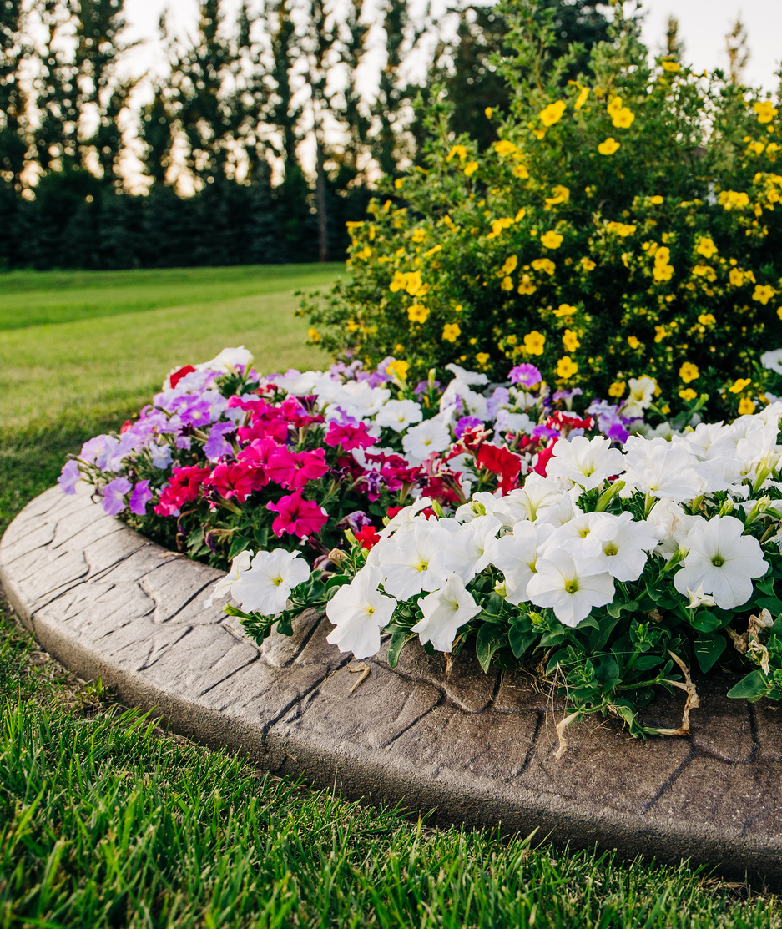



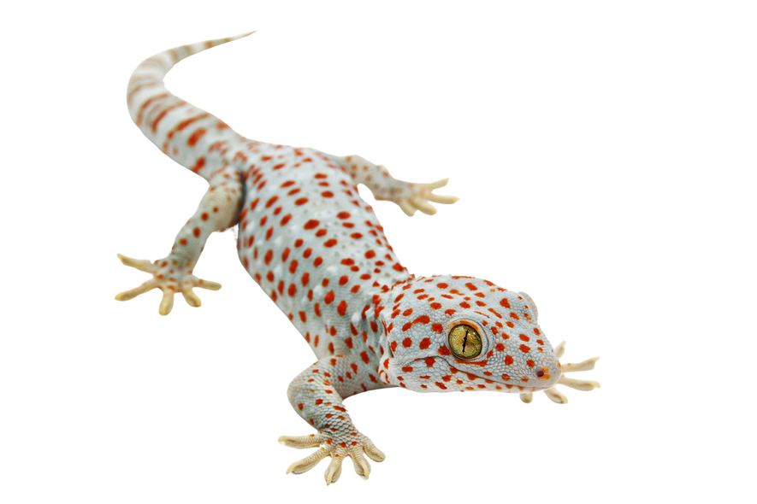




Taking Advantage of the Summer Break To Sell Your Home
Selling your home in the summer can offer several advantages, as the season often brings favorable conditions for both sellers and buyers. Here are some benefits of selling your home in the summer:
  Curb Appeal: Summer is a time when the exterior of homes tends to look its best. Lawns are green, flowers are in bloom, and the overall curb appeal is enhanced.
  Good Weather: Buyers are more likely to attend open houses and viewings when the weather is pleasant. Summer provides longer days, allowing for more flexibility in scheduling showings. Additionally, natural light can make your home look more inviting and spacious.
  School Breaks: Families with children often prefer to move during the summer when school is out. This allows for a smoother transition without disrupting the school year for their kids.
  Outdoor Spaces Shine: Patios, gardens, and outdoor spaces can be showcased to their fullest potential during the summer. Buyers can envision themselves enjoying these spaces, and this can add significant value to your home.
  Positive Vibes: Summer tends to put people in a good mood, and this positivity can influence their perception of a potential new home.
  Easier Moving: The logistics of moving are generally more convenient in the summer. Sellers and buyers alike may find it more convenient to schedule moving trucks, hire movers, and settle into a new home during the warmer months.
  Increased Market Activity: The real estate market often experiences increased activity in the summer. More buyers are actively searching for homes, which can lead to a higher demand for your property.
  Highlighting Seasonal Features: If your home has features that are particularly appealing in the summer, such as a swimming pool, outdoor kitchen, or a well-landscaped garden, showcasing these during the summer can be highly beneficial.
  Faster Sales: With more potential buyers in the market and the overall positive atmosphere, homes often sell more quickly in the summer compared to other seasons.
WEIRD, BUT
Geckos can turn the stickiness of their feet on and off at will.
Linda Jones, Power Agent®
Exit Landmark Realty
Ph. 240-208-7828
Email: Lindajonesatexitlandmark.com
Website: Lindajonesrealtor.homes
(Agent Contact Info / Website Here)

