Slide 1


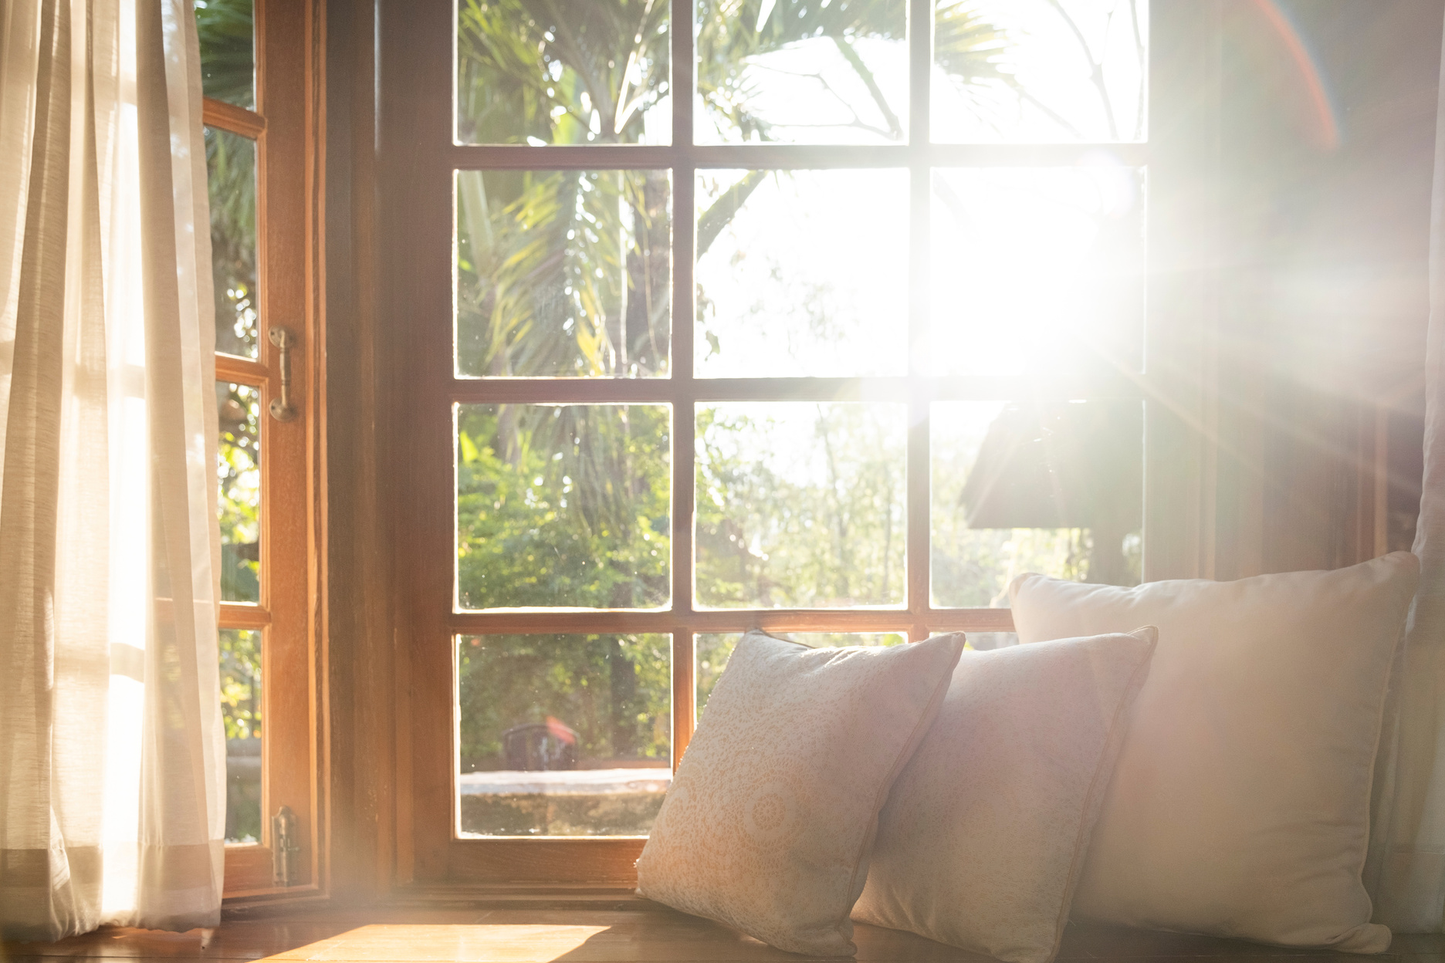
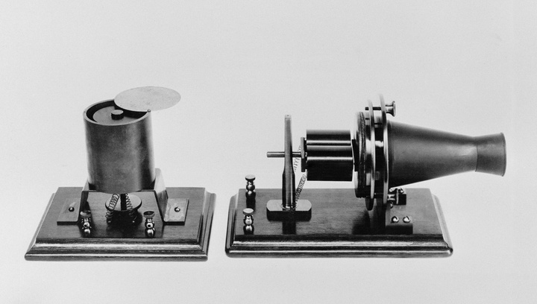

NEWSLETTER
Clever Home Hacks to Cool Your Home Without the A/C Bill
Keeping your house cool in the summer without relying heavily on air conditioning can save energy and make your living space more comfortable. Here are some home hacks to help you keep your house cool:
  Use Light-colored Curtains or Blinds: Light colors reflect sunlight, while dark colors absorb it. Using light-colored curtains or blinds can help reflect the sun's rays and keep your home cooler.
  Install Reflective Window Film: Apply reflective window film (or even tin foil) to windows that receive direct sunlight. This film reflects a significant amount of sunlight, reducing heat gain inside.
  Ventilate at Night: Open windows and doors during the cooler evening and night hours to allow fresh air to circulate through your home. Use fans strategically to enhance airflow.
  Strategically Place Fans: Place box fans or oscillating fans near windows to draw in cool air from outside. Ceiling fans can also be effective in improving air circulation.
  Use Natural Ventilation: Create cross-ventilation by opening windows on opposite sides of your home. This allows for a breeze to flow through, cooling your living space.
  Cooking Strategies: Cook during the cooler parts of the day, or use smaller appliances like a microwave or toaster oven to avoid generating excess heat. Consider grilling outdoors.
  Strategic Planting: Plant trees or tall shrubs on the south and west sides of your home to provide shade and reduce the amount of sunlight reaching your windows.
  Cooling Mats or Towels: Place cooling mats or damp towels in areas where you spend a lot of time, such as your bed or sitting areas. The evaporative cooling effect can be quite effective.
  Create a DIY Air Conditioner: Fill a shallow pan with ice and position it in front of a fan. The fan will blow air over the ice, creating a cooling effect.
In 1878, the first telephone book ever issued contained only 50 names.
Linda Jones, Realtor
website: lindajonesrealtor.homes

Slide 2
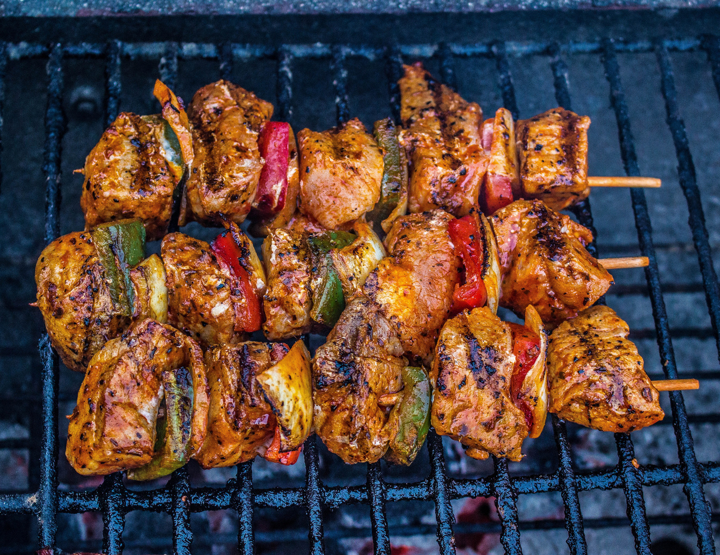





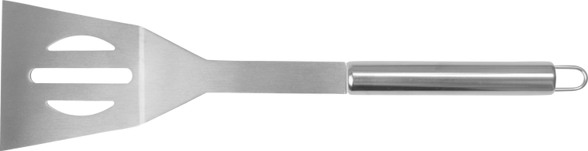



Grill & Chill Fiesta: A Guide to Savory BBQs and Stylish Outdoor Soirees
Grilling and hosting outdoor gatherings can be a lot of fun in the summer. Here's a list of tips to make your grilling sessions and outdoor events a success:
  Add wood chips to the grill for extra flavor. Different woods impart unique tastes to your food.
  Have hot and cooler zones on your grill to control cooking temperatures for various items simultaneously.
  Provide comfortable seating for guests, including options for lounging and dining.
  Set up shade options like umbrellas or canopies, especially if your gathering extends into the hottest parts of the day.
  Use citronella candles or bug repellents to keep mosquitoes and other pests at bay.
  Use outdoor lighting, such as string lights or lanterns, to create a warm and inviting atmosphere for evening gatherings.
  Enhance your outdoor space with decorations, such as cushions, tablecloths, and centerpieces.
  Create signature drinks or a DIY beverage station to keep guests refreshed.
  Curate a playlist of music suitable for the occasion to add to the ambiance.
  Offer a diverse menu that caters to different dietary preferences, including vegetarian and vegan options.
  Prepare food and set up as much as possible in advance to minimize stress during the event.
  Ensure safety by having a first aid kit on hand and being mindful of potential hazards, such as fire safety.
WEIRD, BUT
Originally, the Eiffel Tower was going to be erected in Barcelona, but the project was rejected because citizens thought it was an eyesore.
Linda Jones, Power Agent®
Exit Landmark Realty
Ph. 240-208-7828
Email: Lindajonesatexitlandmark.com
Website: Lindajonesrealtor.homes

