Slide 1
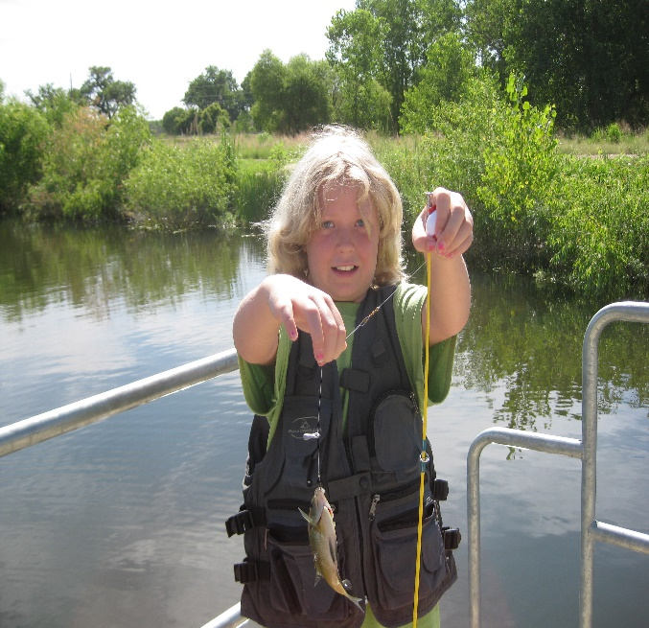
If you are interested in either camp, please contact the Poudre Learning Center
margie’s travel
Science in Nature camps are ongoing outdoor science and research programs encouraging inquiry-based learning for 5th- 8th grade students. All activities are created to promote career awareness, mentorship, and the development of 21st century skills. After completing the camp, we hope to have helped all campers better appreciate their natural surroundings and take active roles in the future towards the stewardship of our environment.
To make a tax-deductible donation to sponsor a young scientist, send a check to the Poudre Learning Center with your name, address, phone number, and email address.
www.margiestravel.com
Sign up NOW:
Space is limited!
Science in Nature Camps at the Poudre Learning Center
Fill out an application online at
PoudreLearningCenter.org

Slide 2
Boys’ Science in Nature
July 9th-13th
Science in Nature Camp summer programs combine the study of science with other relating areas. This year’s theme will be the investigation of
Science Through Natural Resources
Girls’ Science in Nature
June 18th-22nd
The focus of the program for 5th-8th grade boys is to help them develop leadership and character skills that will allow these young men to explore nature as well as the world of being a scientist.
This summer science research program is designed for 5th-8th grade girls to be able to see themselves as scientists. During this weeklong adventure, girls will explore nature, experience investigations, and answer questions of their own inception.
Cost is $150 for the entire week, including breakfast, lunch, snacks, and all materials.
Partial and full scholarships are available,
Please contact the Poudre Learning Center for more information.
8313 West F Street
Greeley, CO 80631
(970) 352-1267
Info@Plcoutdoors.org
Opportunities at the Poudre Learning Center exist for these young men such as teambuilding, problem solving, and development of scientific inquiry involving the Cache la Poudre River.
Throughout the program, girls will build new friendships, meet great role models, learn about a variety of careers and develop 21st century skills.

