Slide 1
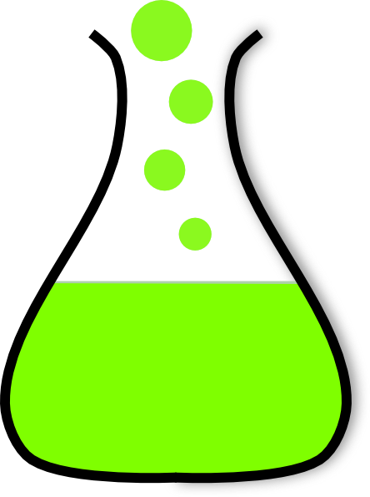
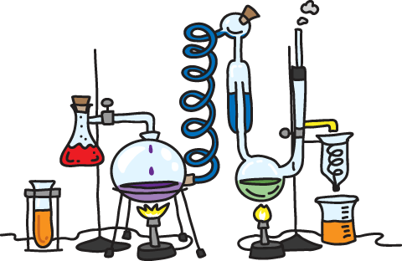
Welcome to Chemistry

Slide 2
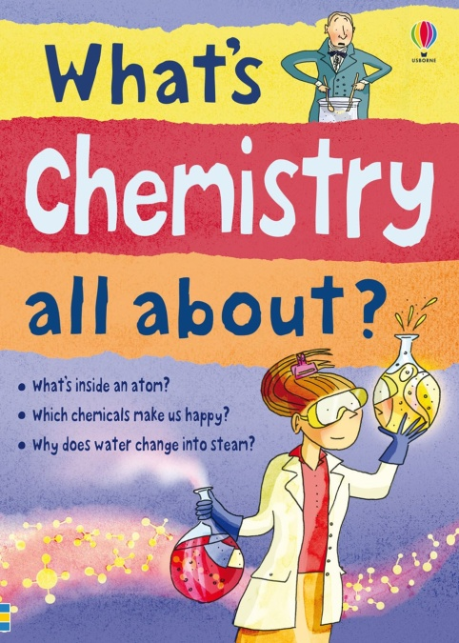
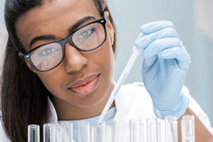
What is Chemistry?
Chemistry is the natural science that involves the study of matter and the chemical reactions between substances. It is also the study of matter’s composition.

Slide 3
What is Matter?
Matter is anything that has mass and takes up space. It exists in three distinct forms solid, liquid and gas.

Slide 4
What is Mass?
The mass of anything is a measure of the number of atoms in it. The basic unit of measurement for mass is the kilogram, kg.
Atoms give rise to elements and elements give rise to compounds.
Elements consist of the same types of atoms for example oxygen, O₂, helium, He and hydrogen, H. There are approximately 103 elements known to man, 92 of which are natural.
Compounds consist of different types of atoms for example water, H₂O, table salt also known as sodium chloride, NaCl and sugar also known as glucose, C₆H₁₂O₆.

Slide 5
What is the Goal of Chemistry?
The main goal of chemistry is to understand matter and the chemical reactions which take place in everyday life.
Chemists use chemistry to make sure standards are maintained and to solve real world problems of pollution.

Slide 6
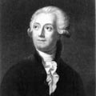
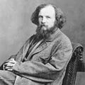
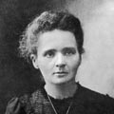
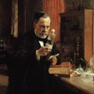
Who Made Up Chemistry?
No one person made up chemistry. However, the experimental works of many scientists, via their common goal to understand what matter is and how it behaves via chemical reactions have contributed to the science as we know it today.
Here are some early scientists: Antoine Lavoisier (1743–1794) Famous For: Being the “Father of Modern Chemistry” Lavoisier was able to show the relationship between oxygen and metal, resulting in rust. He also was able to show the role of oxygen in plant respiration and in animals. It was he who showed that water was made of hydrogen and oxygen, and that air was composed mainly of oxygen and nitrogen in its gaseous state. Dmitri Mendeleev (1834–1907) Famous For: Creating the table of elements used in chemistry and physics In addition to the creation of the periodic table, Mendeleev work on the spectroscope and the capillarity of liquids, both of which continue to be used to this day. Politics got in the way of Dmitri from receiving the Nobel Prize in 1906. Marie Curie (1867–1934) Famous For: Discovery of Radium and Polonium Marie Curie received the Nobel Prize in Chemistry in 1911 for her discovery of radium and polonium. She was able to isolate and study the compounds and nature of radium. Louis Pasteur (1822–1895) Famous For: The process of Pasteurization and creation of Vaccines for Rabies and Anthrax In addition to developing the process of Pasteurization, Louis Pasteur discovered the assymetrical molecular structure on certain crytals. He made some of the earliest vaccines for rabies and anthrax, and the reduction of a bacterial infection in what is known as puerperal fever.

Slide 7
Some Common Areas of Employment for People with Chemistry
Areas of Employment | Types of Jobs available | Average Annual Salary quoted in USD | Jobs available in St. Kitts or Caribbean
Engineering | Chemical engineer at Oil Gas Plastic & Water companies | 60 K - 100 K | Yes
Health care | Laboratories where you may be involved in Blood analysis Urine analysis Detection of dieseases | 40 K - 140 K | Yes
Education | High School Educator University Professor/Lecturer | 60 K - 170 K | Yes
Research and Technical | Data Analyst Lab Technician Research Associate Technical Specialist | 50 K - 60 K | Yes
Medicine | Doctor Nurse | Doctor base salary 140 K Orthopedic surgeon 519 K Cardiologist 512 K Urologist 461 K Nurse 67 K | Yes
Something completely different | Discover your own niche | Depends on what you are selling and where you are selling | Yes
* ALL quoted salaries are based on the American market, your ability, your level and the employer. If employed in St. Kitts the actual numbers will be similar however the value will not be the same. For example, 100 K US will be 100 K EC. Therefore a person working in America will be working for approximately 270 K EC.

Slide 8
CSEC Chemistry Topics
It takes approximately 2 years to learn all of the high school topics listed in the CSEC syllabus. However, it may take 5 + years to truly understand chemistry.
SECTION | Category | Year in which they should be attempted and or completed
A | Principles of Chemistry | Year 1
B | Organic Chemistry | Year 2
C | InOrganic Chemistry | Year 3

Slide 9
Suggestions/Requirements for Chemistry
Math: (Transposition and Graphing)
English: (Good writing skills for recording and interpreting lab results for the practical component of this course. You would be executing about 18 labs over the course of 3 years)
Physics: (Strongly suggested as it is closely related to Chemistry)
Time: (4 hours per week dedicated to study time)

