Slide 1
Welcome to Physics

Slide 2
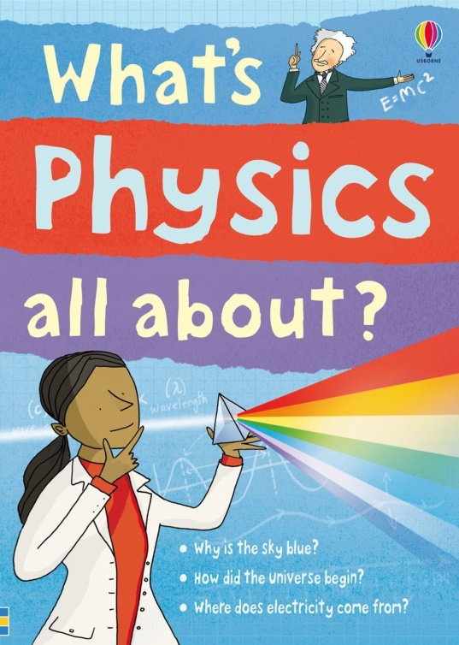
What is Physics?
Physics is the natural science that involves the study of matter and its motion and behavior through space and time, along with related concepts such as energy and force.

Slide 3
What is Matter?
Matter is anything that has mass and takes up space. It exists in three distinct forms solid, liquid and gas.
What is Energy?
Energy enables useful jobs to be done and exists in various forms such as mechanical, thermal, electrical and nuclear.
What is a Force?
Force is a push, pull or twist due to physical action or movement.

Slide 4
What is Mass?
The mass of anything is a measure of the number of atoms in it. The basic unit of measurement for mass is the kilogram, kg.
Atoms give rise to elements and elements give rise to compounds.
Elements consist of the same types of atoms for example oxygen, O₂, helium, He and hydrogen, H. There are approximately 103 elements known to man, 92 of which are natural.
Compounds consist of different types of atoms for example water, H₂O, table salt also known as sodium chloride, NaCl and sugar also known as sucrose, C₆H₁₂O₆.

Slide 5
What is the Goal of Physics?
The main goal of physics is to understand how the universe behaves.
Engineers and technologists use physics to solve practical problems, though in solving them other problems such as unemployment and pollution of the environment may arise.

Slide 6
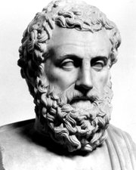
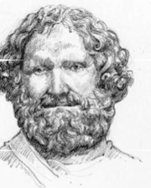
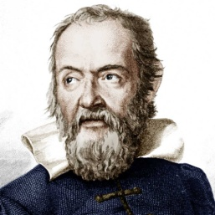
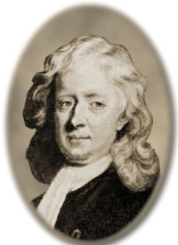
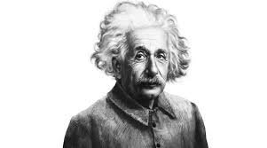
Who Made Up Physics?
No one person made up physics. However, the experimental works of many scientists, via their common goal to understand how the universe works, contributed to the science as we know it today.
Early scientists such as the Greek philosopher Aristotle (384 – 322 B.C.) tried to explain the way things move. Another ancient Greek scientist was Archimedes (287 – 211/212 B.C.), who invented and explained many simple machines, like levers and pumps. Several hundred years ago two other scientists, an Italian, Galileo (1564 – 1642) and an Englishman, Newton (1642 – 1727) both discovered important laws about gravity. Newton used Galileo’s findings to aid him in developing his own theories. And last century, probably the most famous scientist from Germany was Albert Einstein (1879 – 1955). His "Theory of Relativity" talks about all the strange things that happen when you're moving almost as fast as light, and a lot of other cool stuff.
Aristotle
Archimedes
Galileo
Sir Isaac Newton
Albert Einstein

Slide 7
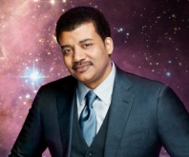
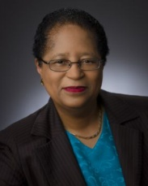
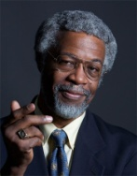
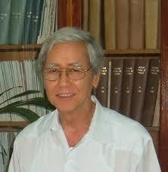
Current Day Physicists
Neil DeGrasse Tyson is an American Astrophysicist, author, actor and science communicator. He was born the 5th of October, 1958. Tyson's professional research interests are broad, but include star formation, exploding stars, dwarf galaxies, and the structure of our Milky Way.
Shirley Ann Jackson is an American theoretical physicist, and the eighteenth president of Rensselaer Polytechnic Institute. She was born the 5th of August, 1946. She is considered a leading developer of Caller ID and Call Waiting on telephones. Jackson was also both the first African American and the first woman to chair the U.S. Nuclear Regulatory Commission.
Sylvester James Gates Jr., known as S. James Gates Jr. or Jim Gates, is an American theoretical physicist and author known for work on supersymmetry, supergravity, and superstring theory. He was born on the 15th of December, 1950.
Professor Abraham Anthony Chen is one of the Caribbean’s most distinguished sons. He is Professor Emeritus in the Department of Physics at The University of the West Indies, Mona, Jamaica. As a professor, Chen conducted extensive research in the areas of Atmospheric Physics & Meteorology, Environmental and Energy Studies and General Physics.
Neil DeGrasse Tyson
Shirley Ann Jackson
Slyvester James Gates Jr.
Abraham Anthony Chen

Slide 8
Some Common Areas of Employment for People with Physics
Areas of Employment | Types of Jobs available | Average Annual Salary quoted in USD | Jobs available in St. Kitts or Caribbean
Engineering | Laser Engineer Optical Engineer Applications Engineer Design Engineer | 60 K - 100 K | Yes
Computer Hardware and Software | Software Developer Systems Analyst Web Developer IT Consultant Data Analyst | 40 K - 140 K | Yes
Education | High School Educator University Professor/Lecturer | 60 K - 170 K | Yes
Research and Technical | Data Analyst Lab Technician Research Associate Technical Specialist | 50 K - 60 K | Yes
Medicine | Doctor Nurse | Doctor base salary 140 K Orthopedic surgeon 519 K Cardiologist 512 K Urologist 461 K Nurse 67 K | Yes
Something completely different | Discover your own niche | Depends on what you are selling and where you are selling | Yes
* ALL quoted salaries are based on the American market, your ability, your level and the employer. If employed in St. Kitts the actual numbers will be similar however the value will not be the same. For example, 100 K US will be 100 K EC. Therefore a person working in America will be working for approximately 270 K EC.

Slide 9
CSEC Physics Topics
It takes approximately 2 years to learn all of the high school topics listed in the CSEC syllabus. However, it may take 5 – 10 + years to truly understand physics.
SECTION | Category | Year in which they should be attempted and or completed
A | Mechanics | Year 1
B | Thermal Physics and Kinetic Theory | Year 2
C | Waves and Optics | Year 2
D | Electricity and Magnetism | Year 3
E | Physics of the Atom | Year 3

Slide 10
Equations Used in Physics
There are approximately 70+ equations used to explain how the world works in high school physics. All of them will be used.
Each equation has been tabulated and categorized based on the section it plays an integral part in. This is demonstrated in the next section.

Slide 11
Suggestions/Requirements for Physics
Math: (Transposition and Graphing)
English: (Good writing skills for recording and interpreting lab results for the practical component of this course. You would be executing about 18 labs over the course of 3 years)
Chemistry: (Strongly suggested as it is closely related to Physics)
Time: (4 hours per week dedicated to study time)

