Slide 1
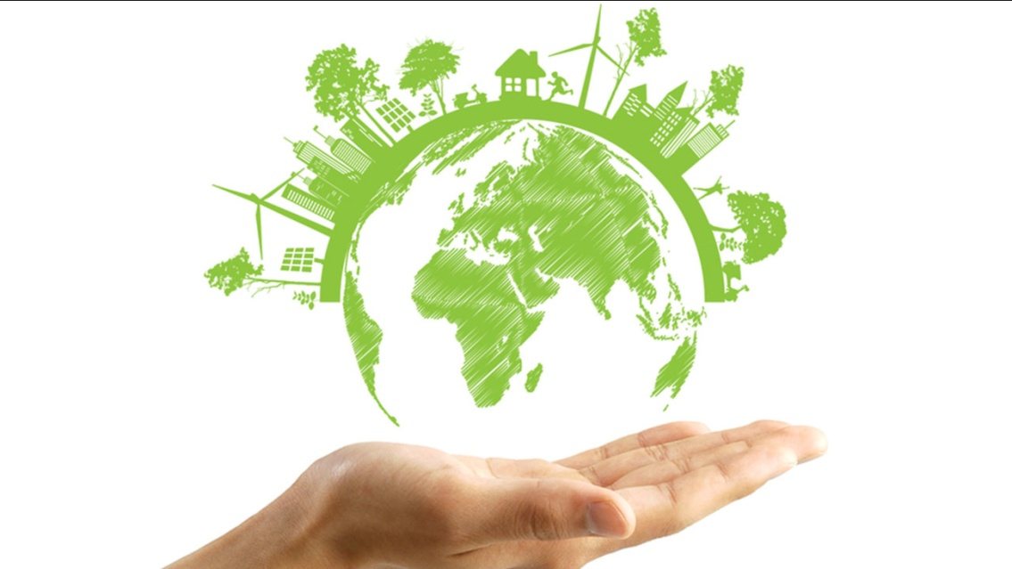
Earth’s Place in the Universe
Without science we would not know how to explain the behaviour of the universe.

Slide 2
The Universe and our Solar System
Our place in the Universe
The Universe is made up of billions of galaxies.
Each single galaxy can contain billions of stars.
The stars such as our SUN, can have planets orbiting them and planets can have moons orbiting them in turn.
The Earth has one orbiting moon and orbits one star which we call the SUN.

Slide 3
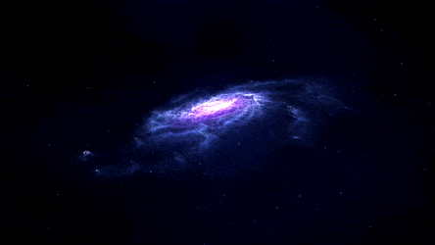
The Universe and our Solar System
Our place in the Universe
The SUN is just one of the billions of stars in the galaxy called the Milky Way.
The Milky Way is
like a massive disc,
spinning as it
travels through
space, with four
arms spiraling
out from its centre.

Slide 4
The Universe and our Solar System
Our place in the Universe
The Earth and our Solar System are a tiny part of one of these arms.
The Milky Way is so large that it takes light about 100,000 years to travel right across it and it is just ONE of billions of OTHER galaxies in the Universe.

Slide 5
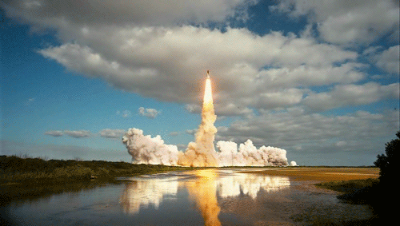
Exploring Space
Human exploration of space started in the late 1950s with the first manned rocket sent into orbit around the Earth.

Slide 6
Exploring Space
The first men landed on the Moon in 1969 followed in 1981 by the first launch of the space shuttle STS-1 (a spacecraft that could land back on Earth on a runway, like an aeroplane).
The space shuttle was able to take men to and from a space station that constantly orbits the Earth.
Scientists can conduct experiments that can only be carried out in the weightless conditions on the space station.

Slide 7
Exploring Space
There have been no manned space flights to other planets, but there have been many unmanned spacecraft sent to other planets and beyond.
These ‘probes’ are loaded with sensors and analytical instruments to send back data to Earth.

Slide 8
Exploring Space
In the 2014 Rosetta mission, a probe was actually landed on the surface of a comet.
Scientists can collect data from these unmanned flights that would be impossible to gather from Earth.
Human exploration of space is expensive to fund, but has resulted in many new scientific discoveries.

Slide 9
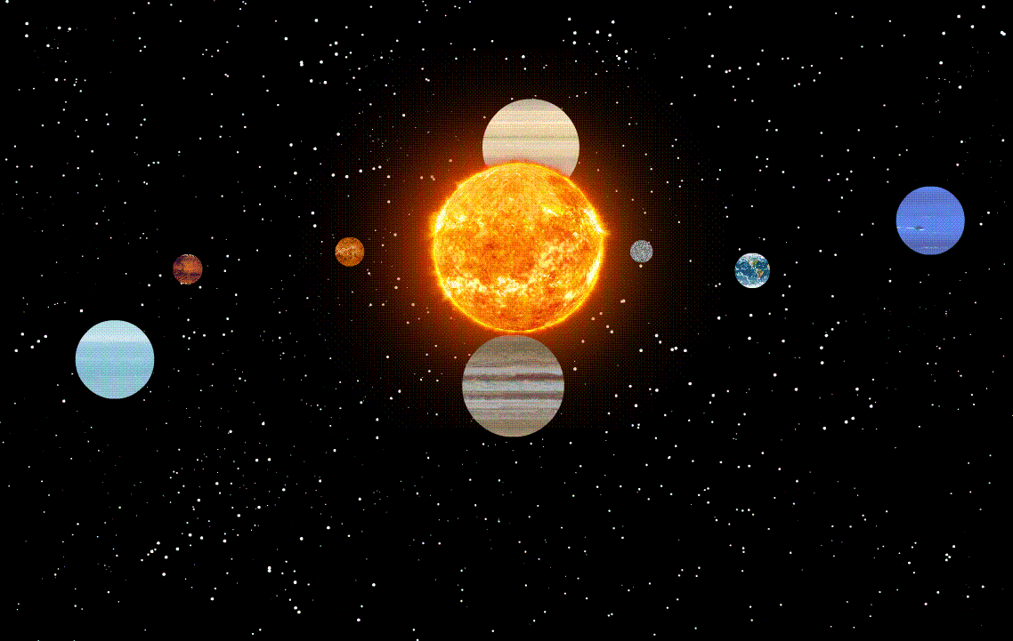
The Solar System

Slide 10
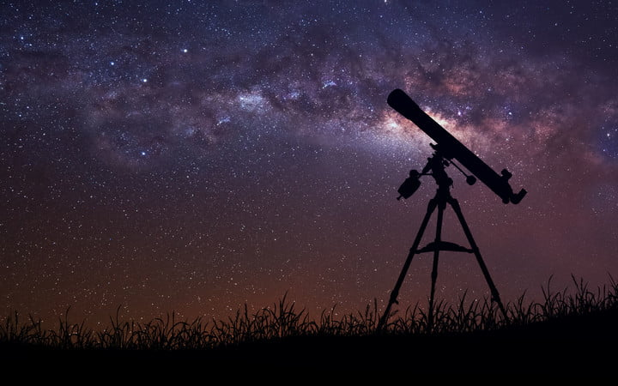
General Information
The Sun is at the centre
of the Solar System.
The Solar System consists of our Sun plus a very large number of differently-sized objects that orbit around it.
Of the larger objects, there are eight planets that orbit the Sun.
We can observe the planets with telescopes using reflected light from the Sun.

Slide 11
The Planets
THE INNER PLANETS
The four planets nearest the Sun are called the ‘inner planets’.
They are Mercury, Venus, Earth and Mars.
These planets all have surfaces made up of solid rock, of they are also known as the ‘terrestrial planets’.

Slide 12
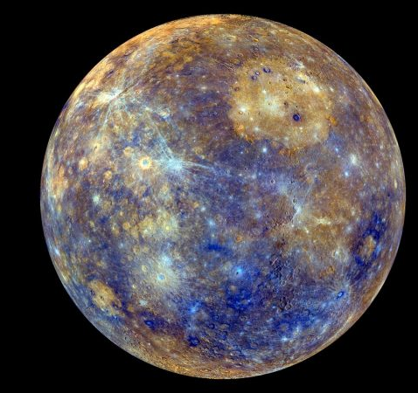
The Inner Planets
Mercury
Mercury is the nearest planet to the Sun and is the smallest of all 8 planets.
It has a very high temperature at its surface because of its position close to the Sun.

Slide 13
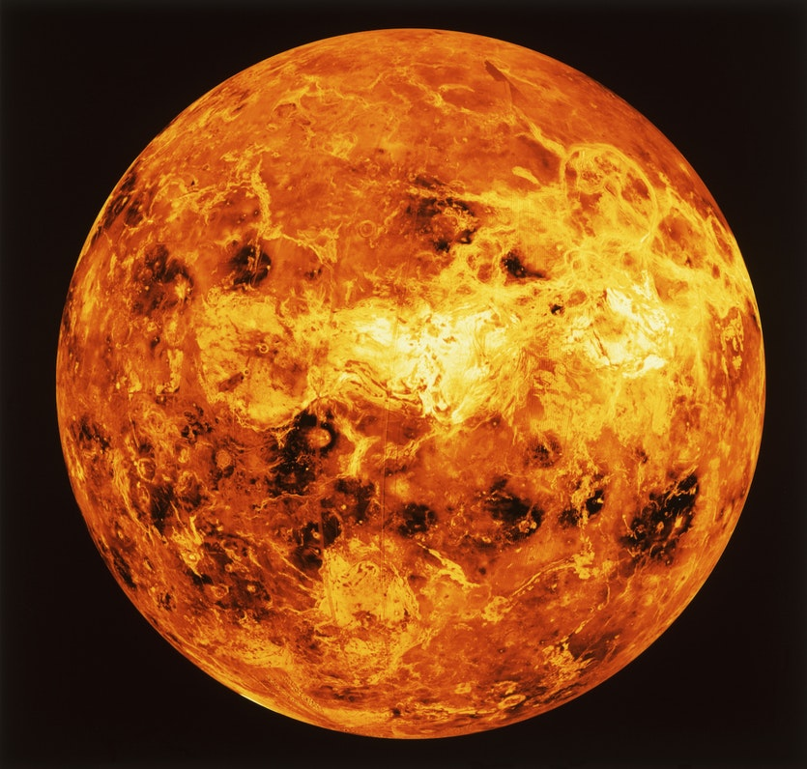
The Inner Planets
Venus
Venus is similar in size to the
Earth. Its atmosphere contains
a much higher proportion
of carbon dioxide, CO₂ than
Earth’s atmosphere.
The CO₂ traps energy through a process called the greenhouse effect.
This makes Venus the hottest planet even though it is further from the Sun than Mercury.

Slide 14
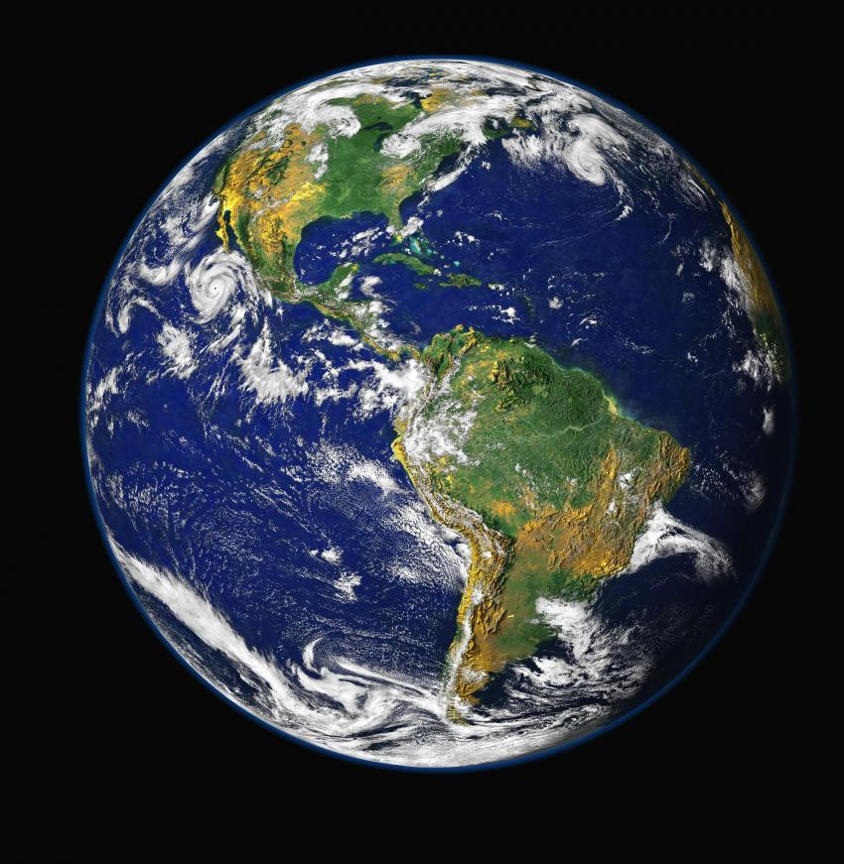
The Inner Planets
Earth
Earth is the planet we inhabit.
It is just the right distance
from the Sun to have
temperatures which are
between the freezing and
boiling points of water.
Hence we have liquid
water covering most of the Earth’s surface.
Water as a liquid is essential for life here on Earth.

Slide 15
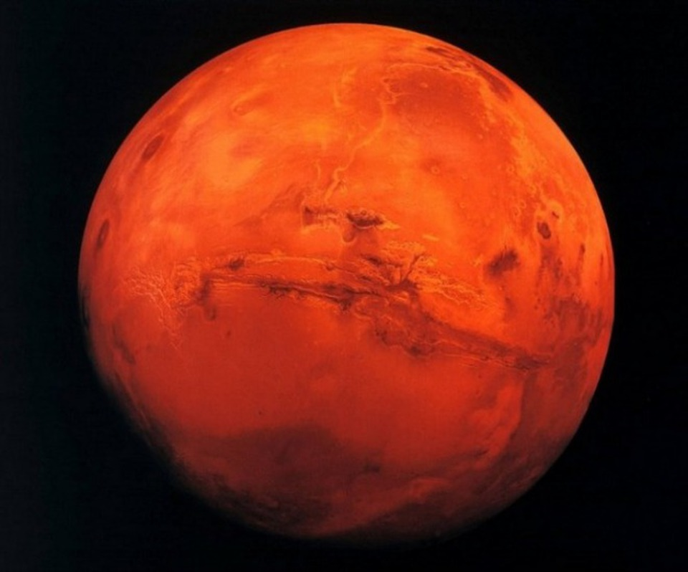
The Inner Planets
Mars
Mars is not as big as
the Earth. It appears
reddish in colour and
is known as the
‘red planet’.
Its colour is caused by
the iron(III) oxide in its
soil. It is a planet that
has had many unmanned
probes from Earth on its surface.
The robotic probes can collect mineral samples and test them, relaying the results back to Earth.

Slide 16
The Outer Planets
The four outer planets are larger than the inner planets and unlike the inner planets which are made up of mostly rocks they are made up of mostly gas. We call these the Jovian planets.
The gases are very cold which include hydrogen (H₂) or helium (He), super-cool liquids such as ammonia (NH₃) (which is a gas at temperatures found on Earth).

Slide 17
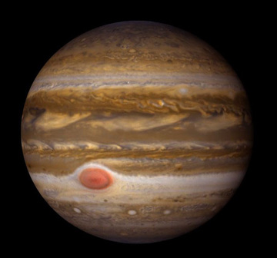
The Outer Planets
Jupiter
Jupiter is the largest
planet in the Solar
System, with a surface
made up of bands of
turbulent gases.
These cause huge storms.
The red spot observable on Jupiter is a storm that has lasted for three hundred years.
The largest of the planets has 67 known moons.

Slide 18
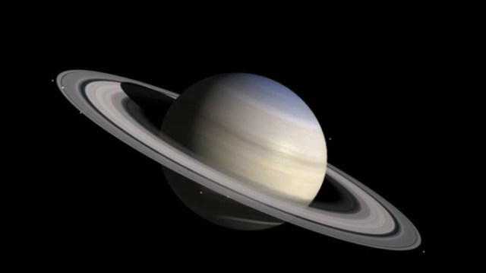
The Outer Planets
Saturn
Saturn is another
‘gas giant’ like
Jupiter, but it is
famous for its ‘rings’.
The rings are made up of tiny particles of dust and ice that orbit around the planet.
Saturn has 62 known moons.

Slide 19
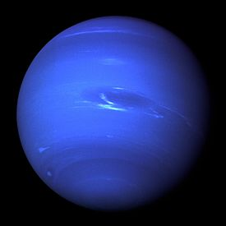
The Outer Planets
Uranus
Uranus is smaller gas giant.
It is much colder than Jupiter
or Saturn because it is further
from the Sun.
Its atmosphere is so cold it contains solid ammonia.
It looks like a smooth blue sphere.

Slide 20
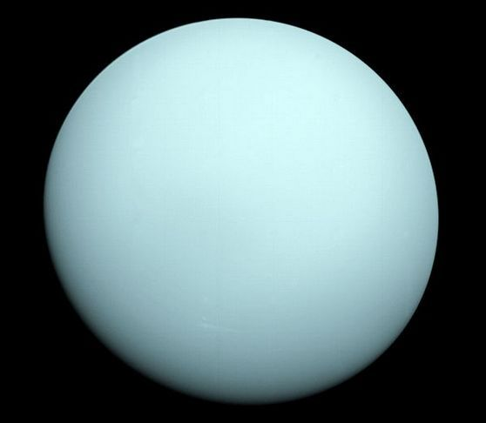
The Outer Planets
Neptune
Neptune is the furthest
planet from the Sun
and it has the coldest
surface of all eight
planets.
It is very similar the Uranus, but its atmosphere shows evidence of a more turbulent environment, with its white ‘clouds’ and dark spots caused by storms.

Slide 21
Planetary Data
The planets in the Solar System rotate around the Sun in elliptical orbits (like slightly squashed circles).
The time it takes a planet to travel one complete orbit around the Sun is the length of the planet’s ‘year’.

Slide 22
Planetary Data

Slide 23
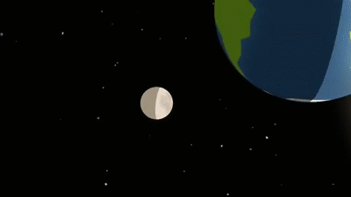
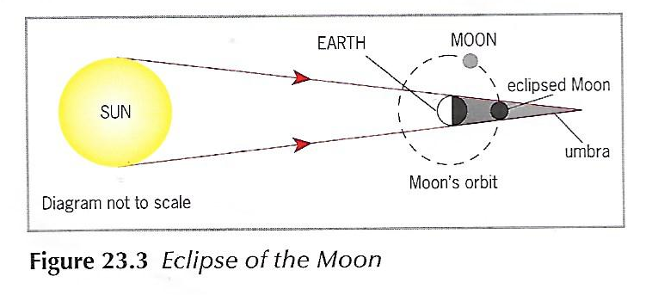
Eclipse of the Moon
The moon is a
non-luminous
body. It reflects
light from the
Sun.
An eclipse of the moon occurs when the Earth is between it and the SUN (SEM).
An eclipse
of the moon
is referred to
as a lunar eclipse.

Slide 24
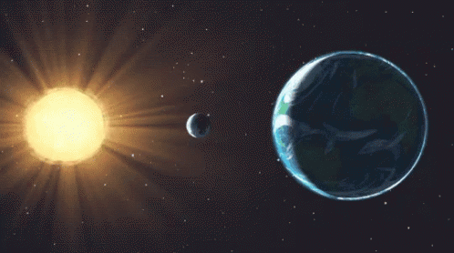
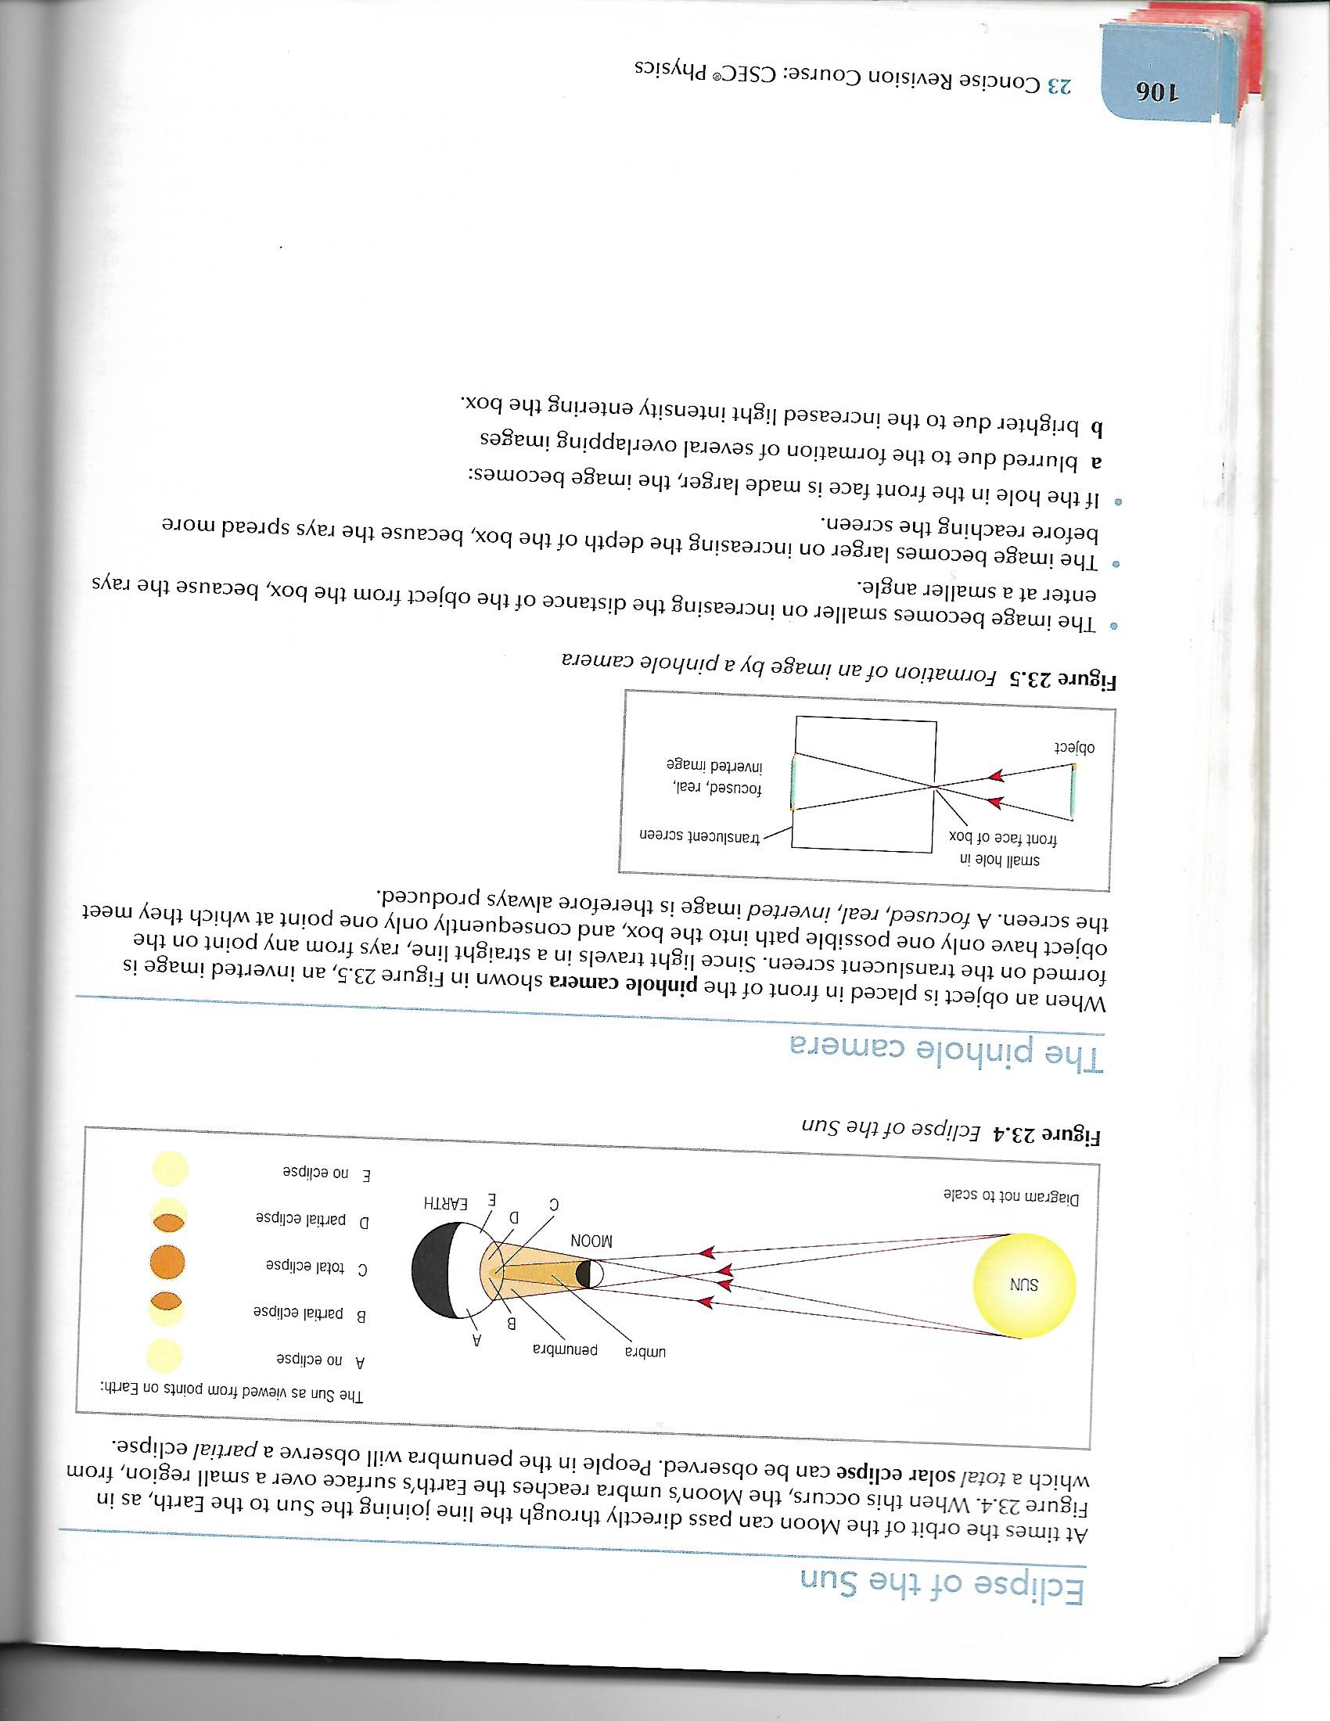
Eclipse of the Sun
The Sun becomes
eclipsed when the
Moon passes
between it and Earth
(SME).

