Slide 1
Science in Everyday Life
Science & Scientists

Slide 2
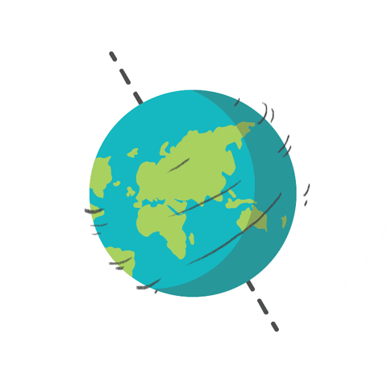
What is Science?
Produce your best definition of what you think science is.

Slide 3
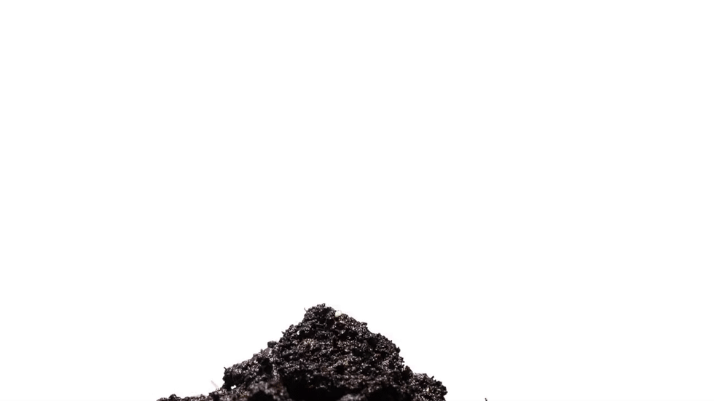
What is Science?
Science is the study of our environment or the world we live in.

Slide 4
What is the Importance of Science?
Why do you think science is important?

Slide 5
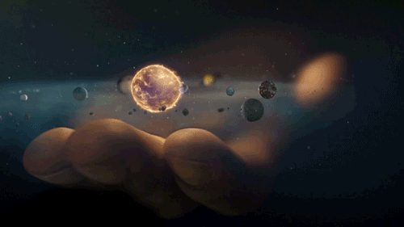
What is the Importance of Science?
Science is important because it helps us to understand the world by adding to our current knowledge.

Slide 6
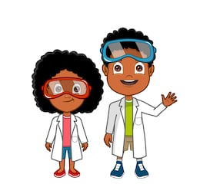
Scientists
Scientists are people like me and you who have dedicated their time to researching how things work and interact with each other.
Do you know of any scientists?
Are the scientists you know local, in the Caribbean (regional) or from other parts of the world (international)?

Slide 7
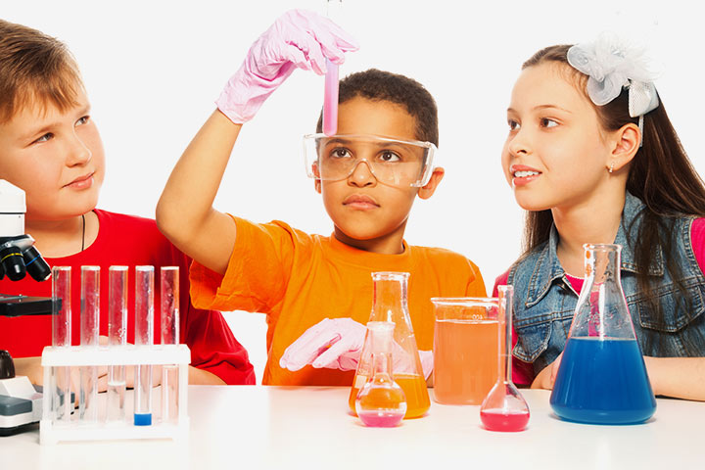
Scientists
Scientists ask questions such as who, what where, how, why and ‘what-if’ to get information from our environment.

Slide 8
Summaried Work of Some Scientists
 | Name | Profession | Study
Local | Dr. Lincoln Carty St. Kitts and Nevis | Science Teacher | teaching of science
 | Dr. Milton Whittaker St. Kitts and Nevis | Agriculturist | medicinal plants in St. Kitts and Nevis
Regional or Caribbean | Dr. Avril Siung-Chang (Trinidadian) | Marine Zoologist | sea pollution
 | Dr. Louis Leakey (Jamaican) | Farmer | cattle breeding
International | Albert Einstein (German) | Nuclear Physicist | mass and energy
 | Thomas Edison (American) | Inventor | electric light bulb, storage battery, … etc

Slide 9
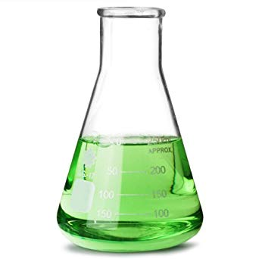
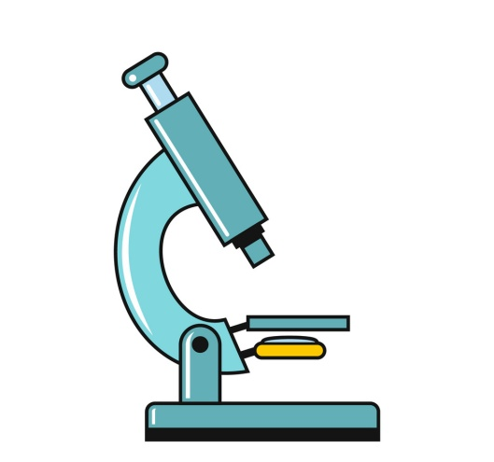
Science in Everyday Life
Science & Tools

Slide 10
Skills of a Scientist
What skills do you think a scientist possess?

Slide 11
Skills of a Scientist
Skills of a scientist include, but are not limited to: Observing Measuring Classifying Communicating Inferring Predicting Collecting Data Experimenting Interpreting Data & Manipulating Variables

Slide 12
How are Observations Made?
People as well as scientists use their senses to make observations.
There are five human senses. What do you think they are?

Slide 13
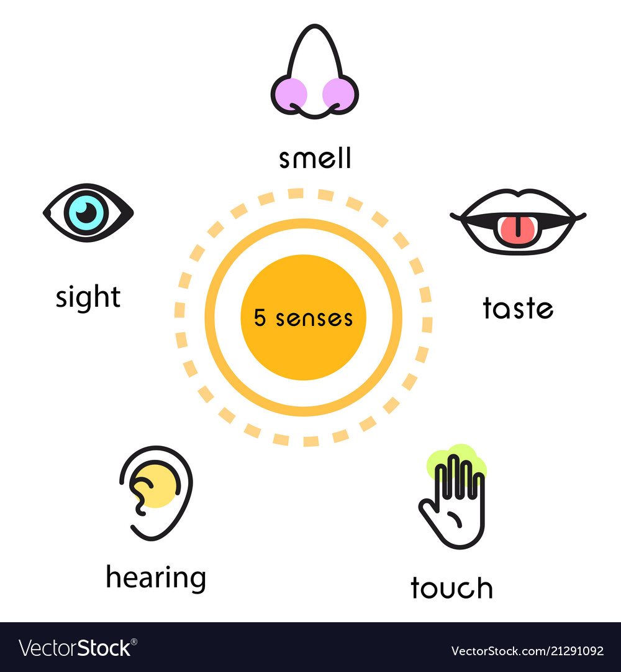
The FIVE human senses
The five human senses are:

Slide 14
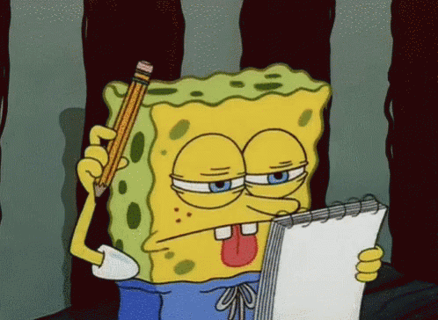
Trusting our Senses
Do you think that we can ALWAYS trust our senses?
Should scientists always trust their senses?

Slide 15
Trusting our Senses
We cannot always trust our senses.
Scientists use tools to help them figure stuff out along with using their senses.
Tools are special instruments or apparatus which can make work easier and more accurate. Such tools are used to help our senses make observations.

Slide 16
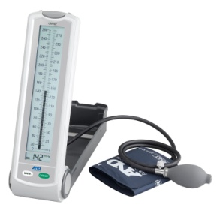
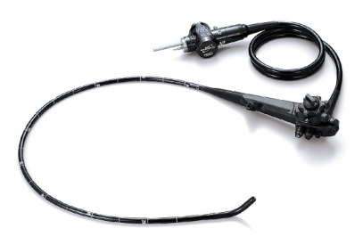
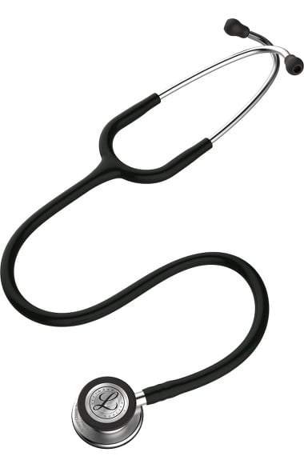
Special Instruments Used by Scientists
Computer
Stethoscope
Sphygmomameter
Endoscope * Try to MATCH the names of the instruments to their pictures then try to say what the instruments are used for.

Slide 17
The Uses of the Special Instruments Used by Scientists
Special Instrument | Used by | Function
Computers | All Scientists | To analyze a lot of detailed information in a very short time
Endoscope | Doctors Engineers | To pass through very narrow openings
Sphygmomanometer | Doctors | To measure blood pressure
Stethoscope | Doctors | To listen to the heartbeat and breathing of patients

Slide 18
Science in Everyday Life
Science & Safety

Slide 19
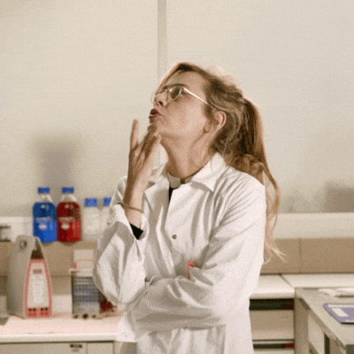
Good Safety Practices
What do you think are good safety practices that should be utilized when performing experiments?

Slide 20
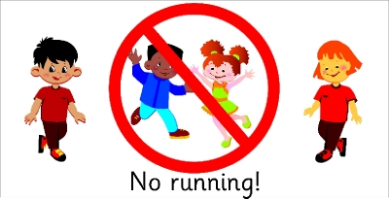
Things you MUST NOT do in the lab
In science you need to follow laboratory safety rules and know the common hazard symbols.
Here is a list of some typical laboratory rules: YOU MUST NOT: 1. enter the lab unless a teacher is present 2. run in the laboratory 3. touch any chemicals 4. leave experiments unattended

Slide 21
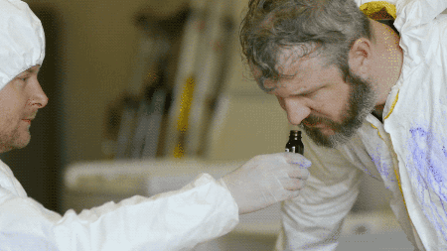
Things you MUST NOT do in the lab
Here is a list of some typical laboratory rules: YOU MUST NOT: 5. smell gases directly 6. point the mouth of a test tube towards anyone when heating 7. eat or drink in the laboratory 8. put solids in the sink

Slide 22
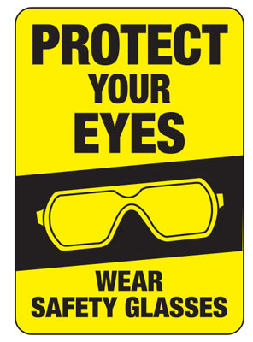
Things you SHOULD ALWAYS do in the lab
In the lab you should ALWAYS: 1. follow the instructions given 2. wear eye protection 3. read the labels on any bottle correctly 4. note any hazardous substance

Slide 23
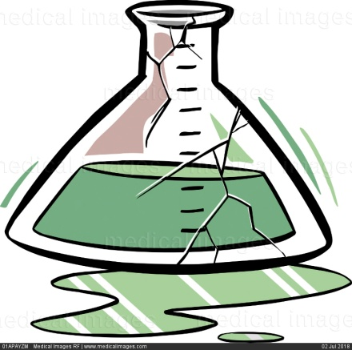
Things you SHOULD ALWAYS do in the lab
In the lab you should ALWAYS: 5. report any accidents or breakages to your teacher. 6. Leave Bunsen burners with a luminous (yellow) flame when not in use or turn it off 7. tie up long hair 8. wash your hands after experiments

Slide 24
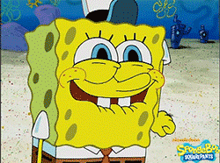
Colours of Safety
There are three international colours of safety.
Can you guess what they are?

Slide 25
Colours of Safety
DANGER
HAZARD
SAFE
These are some of the international colours of safety.

Slide 26
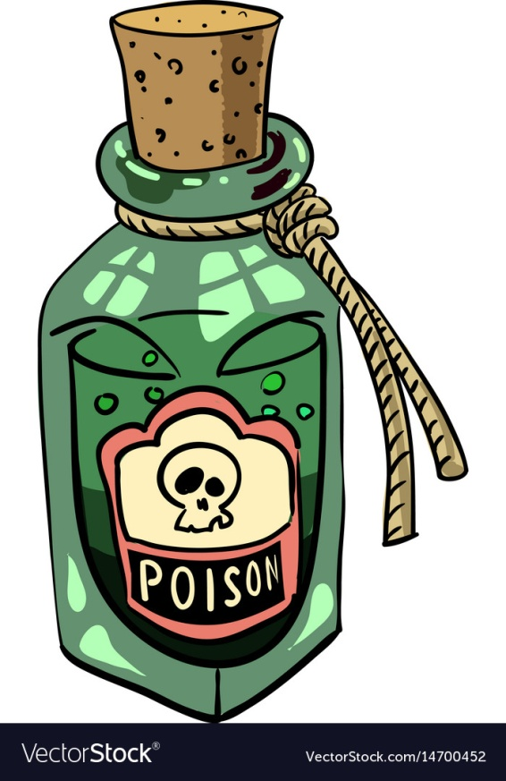
International Warning Signs
What do you think are warning signs?
How do you think they benefit us?

Slide 27
International Warning Signs

Slide 28
Science in Everyday Life
The Scientific Method

Slide 29
The Scientific Method
An experiment can be planned or it can happen purely by accident/discovery.
However, it is the inquisitive nature of a scientist that brings life to an experiment.
Executing an experiment often begins from an observation. This leads to questions being asked and eventually an idea of how to carry out that experiment.

Slide 30
The Scientific Method
Once a scientist has established what they would like to explore or experiment on usually they may have already come up with an educated guess of what the problem might be, what may be the solution for the problem or the reason for the problem.
An educated guess is referred to as a hypothesis.

Slide 31
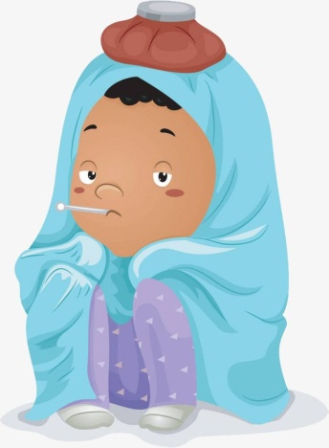
Determining a Hypothesis
Below are a set of observations or statements. Read them and try to determine a suitable hypothesis. 1. All of the students in grade three contracted a cold. Rumi, a student of the class, is home, sick, she sits in the second row. Ex. 1: Rumi spread the cold before going home to get better. Ex. 2: Rumi is a popular students who made body contact with all of her friends Ex. 3: Cold is an air borne disease and Rumi spread it before going home.

Slide 32
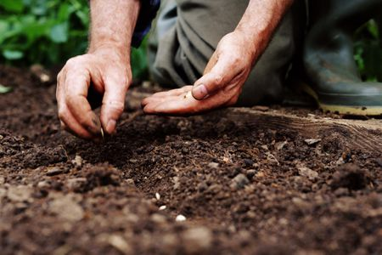
Determining a Hypothesis
Below are a set of observations or statements. Read them and try to determine a suitable hypothesis. 2. The cucumber seeds Cora planted near the river produced larger cucumbers than the ones she planted in pots.

Slide 33
Determining a Hypothesis
Below are a set of observations or statements. Read them and try to determine a suitable hypothesis. 3. Miranda, Jules and Bianca are very flexible and so they are able to split naturally while Efron and Stephanie have to practice theirs.

Slide 34
Observations and Inferences
During an experiment observations are made. This includes the use of your senses but it is not all of the time they can be trusted.
An inference is something written down based on tests carried out to prove whether it is present or not.

Slide 35
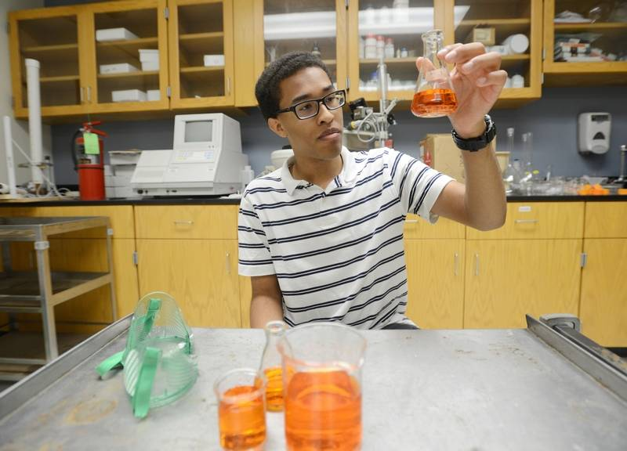
Stages of the Scientific Method
When scientist wish to perform an experiment there are some steps they would take to execute one. 1. Asking Questions 2. Forming a hypothesis 3. Designing an experiment to test the hypothesis 4. Collecting data 5. Analyzing data 6. Making inferences 7. Asking more questions

