Slide 1

Working like a Scientist

Slide 2


Scientists at Work
Science is a way of finding out about the natural world, including how materials and living things behave.
It covers a wide variety of areas of study such as:
Biology Chemistry Physics
Geology Astronomy

Slide 3



Technology
Technology can be thought of as the ‘application of science’.
Technologists provide society with solutions to problems in everyday life, using the ideas developed by scientists.
So, science provides the ‘tools’ that technologists use in their work.

Slide 4

Application of Scientific Knowledge
Scientists have many different ways to find the answers to scientific questions. These include:
a. Observing and exploring
b. Researching by using secondary sources of information
c. Fair testing by controlling variables
d. Seeking patterns by carrying out surveys and finding links
e. Using models to explain things
f. Identifying and classifying materials, objects and living things
g. Using and evaluating a technique or design when solving a problem.

Slide 5

The way Scientists PRESENT their findings
Scientists would first present a hypothesis
Plan
Observe and Measure
Record Data
Analyse and Interpret Data
Evaluate
Work in a team if possible
Communicate their findings to other scientists

Slide 6
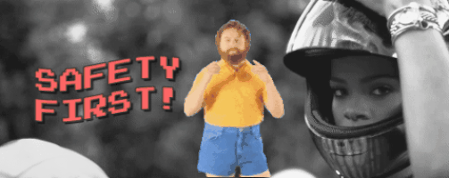
Safety First

Slide 7
Safety in Everyday Life
We come across safety rules and hazard warnings in many aspects of everyday life. Road safety is a good example.
At home we have products that have hazard signs to warn us about harmful, irritant and corrosive substances.
In science laboratories a variety of hazard symbols are used to warn about potential dangers.
You need to know the following symbols in order to work and plan investigations safely in science.

Slide 8
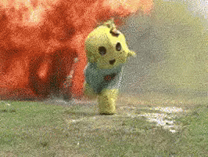
Types of Accidents
Electric shocks
Fires and inhalation
of smoke, e.g. CO
Sprains and broken bones
Cuts from sharp objects
Inhalation of toxic gases
Flammable substances
Corrosive substances
Excessive noise
Food contamination
Heavy machinery
Lifting heavy objects
Infection of pathogens

Slide 9
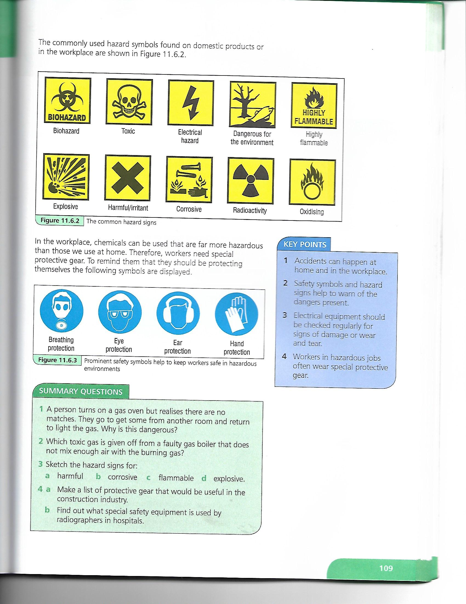
Avoiding Accidents
Safety Symbols
In the workplace to avoid accidents you will see safety signs and symbols.

Slide 10
Avoiding Accidents
Hazard Signs

Slide 11
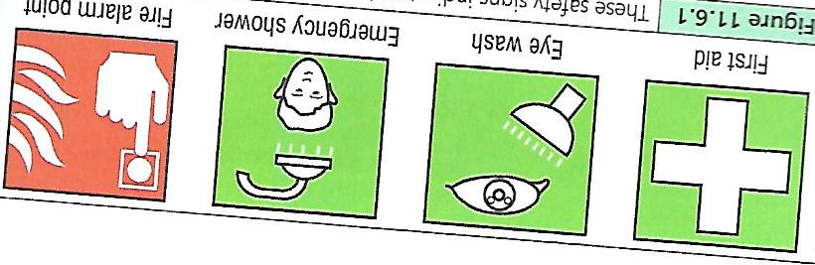
Avoiding Accidents
Safety Signs

Slide 12
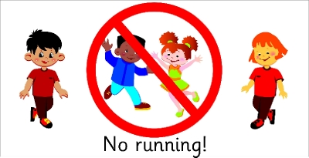

What NOT to do in a lab
In science you need to follow laboratory safety rules and know the common hazard symbols.
Here is a list of some typical laboratory rules:
YOU MUST NOT:
1. enter the lab unless a teacher is present
2. run in the laboratory
3. touch any chemicals
4. leave experiments unattended

Slide 13

What NOT to do in a lab
Here is a list of some typical laboratory rules:
YOU MUST NOT:
5. smell gases directly
6. point the mouth of a test tube towards anyone when heating
7. eat or drink in the laboratory
8. put solids in the sink

Slide 14

What SHOULD be done in a lab
In the lab you should ALWAYS:
1. follow the instructions given
2. wear eye protection
3. read the labels on any bottle
correctly
4. note any hazardous substance

Slide 15

What SHOULD be done in a lab
In the lab you should ALWAYS:
5. report any accidents or breakages to your teacher.
6. Leave Bunsen burners with a luminous (yellow) flame when not in use or turn it off
7. tie up long hair
8. wash your hands after experiments

Slide 16
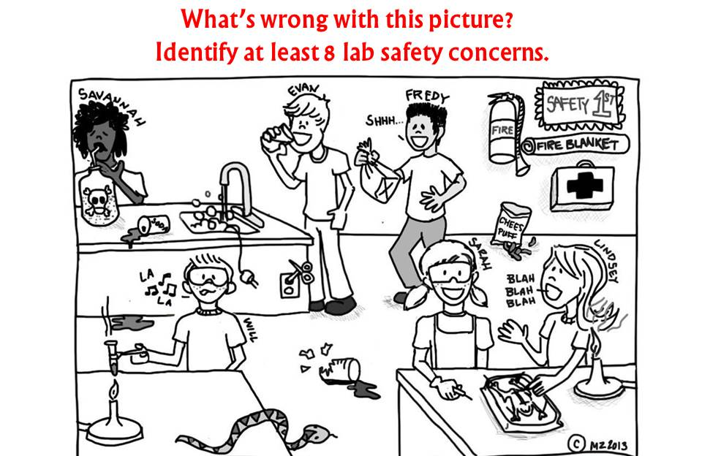

Slide 17
How scientists work
The scientific method describes the steps that a scientist goes through in order to investigate a question. It can be summarized by the steps below:
1. Identify a problem 2. Develop a hypothesis
3. Plan an investigation 4. Carry out experiments
5. Record results 6. Draw conclusions
7. Evaluate 8. Communicate results

Slide 18
Scientific Method
The scientific method does NOT always follow the order as suggested on the previous slide.
In scientific investigations you will have a chance to plan how to answer a question yourself.
You design you own method, making sure any tests you plan are safe and fair.

Slide 19
Scientific Method
Planning a whole investigation can be difficult so it is a good idea to use:
1. An investigation planner to remind you of the questions you should be thinking about.
2. A planning grid to help you deal with the variables involved.

Slide 20
Scientific Method
Investigation Planner
Ask yourself these questions to help you plan your investigations:
1. What am I trying to find out?
2. a. What do I think will happen (predict)?
b. Why do I think this will happen?
3. What am I going to change each time? This is your independent variable.

Slide 21
Scientific Method
Investigation Planner
Ask yourself these questions to help you plan your investigations:
4. What am I going judge or measure each time? This is your dependent variable.
5. What will I keep the same each time to make it a fair test? These are your control variables.

Slide 22
Scientific Method
Investigation Planner
Ask yourself these questions to help you plan your investigations:
6. a. How will I carry out my tests?
b. How many values for my independent
variable will I choose to test?
7. a. Is my plan safe?
b. Could anything go wrong and somebody
get hurt?

Slide 23
Scientific Method
Investigation Planner
Ask yourself these questions to help you plan your investigations:
8. What equipment will I need?
9. a. How many readings will I need to take?
b. Do I need to repeat tests?
10. What is the best way to show my results? A table or a bar chart or a line graph?

Slide 24
Plan and Design Layout
Question
Hypothesis
Aim
Materials and Apparatus
Method
Variables
Independent
Dependent
Controlled
Expected Results
Assumptions, Precautions OR Limitations

Slide 25
Example of a Plan and Design
Question:
Do iron objects close to the sea rust faster than those inland?
Hypothesis:
Iron objects closer to the sea rust faster than those inland
Aim:
To determine if iron objects closer to the sea rust faster than those inland.
Materials and Apparatus:
two iron objects, sea water, two test tubes
Method:
1. Place a nail in an uncovered container near the ocean.
2. Place another nail in an uncovered contained in an area away from the ocean.
3. Observe both nails over a period of a week.
4. Record all observations in an appropriate table.
Variables:
Independent – Period of time
Dependent – Amount of rust on the nail
Responding – Nail
Expected Results:
TABLE SHOWING RESULTS FROM LAB
Assumption:
The nail closest to the ocean will rust
Area in which nail was placed | Condition of nail
On the beach | A
Away from the beach | B

Slide 26
Group Work
You might be working as part of a group in project work.
When you start on a project you must be clear about the question you are investigating.
As a group you should discuss this together and sort out the different aspects of the problem. Then you can divide the work up between the member of the group.

Slide 27
Activity – Planning and Designing
Pick any one of the two below and Plan and Design an experiment for it. You will be working in groups.
1. Does green fruit wrapped in newspaper ripen faster than unwrapped green fruit?
2. Do objects painted black dry faster than objects painted white?

Slide 28
Activities
Executing and Writing up a Lab Report
1. Execute and write up a lab on osmosis (see video)
2. Execute and write up a lab on how temperature affects the rate of reaction of yeast (see video)
3. Execute and write up a lab on how the length of a pendulum affects its periodicity. (see video)

Slide 29
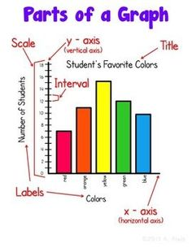
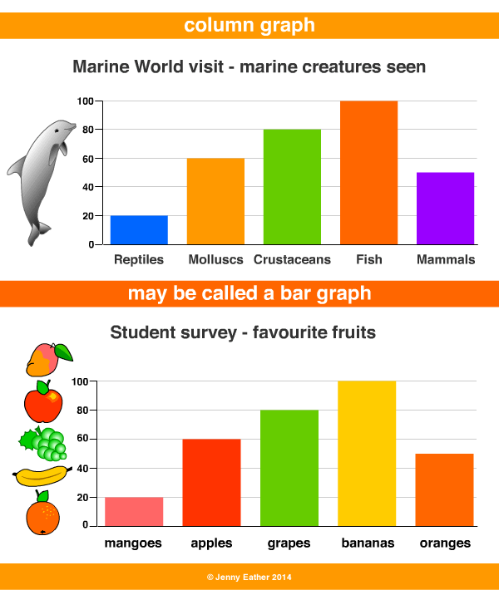
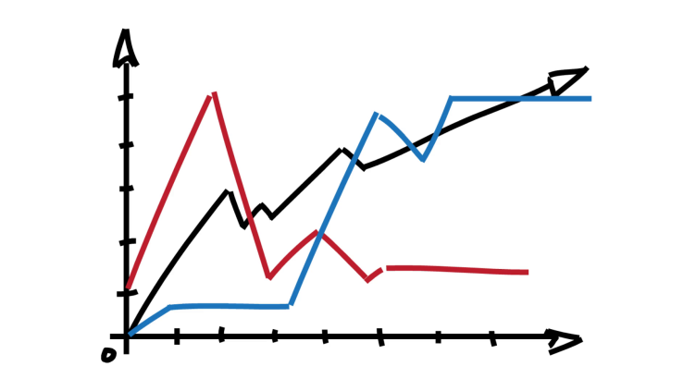
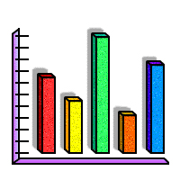
Representing Data on Coordinate Graphs

Slide 30
Parts of a Graph
A graph should:
1. have an appropriate title
2. have labels on each axis
4. be properly calibrated (intervals of 2, 5 or 10)
5. have points that are properly plotted

Slide 31
Presenting Results/Data
Graphs are useful for presenting numerical results.
It is plotted on special paper referred to as graph paper.
Graphs communicate information more effectively than tables because they make it easy to see how the independent (x – axis) and dependent (y – axis) variables of an experiment are related.

Slide 32
Presenting Results/Data
The table below shows values for the x and y coordinates.
Follow the video as
your guide and plot
all of your points on
graph paper.
Use a ruler to connect
the points then name
the instrument that is
outlined by the graph.
X coordinate | Y coordinate
3 | 2
4 | 1
3 | 6
4 | 6
1 | 18
7 | 18

Slide 33
More Graphing
When plotting you should use crosses or dots.
Using the values in the
table try to plot the
following graph.
Find your best fit curve
or line
Table showing the temperature increase of water over a period of time
Temperature ºC | Time (min)
15 | 0
26 | 1
36 | 2
47 | 3
57 | 4
67 | 5
78 | 6
88 | 7
98 | 8
100 | 9
100 | 10

Slide 34
Gradient/Slope of a Graph
The gradient/slope of a graph can be determined by using values along a straight line.
The values may be plugged into the following equation:
gradient/slope = Δy ÷ Δx = (y₁ – y₂) ÷ (x₁ – x₂)

Slide 35
Gradient/Slope of a Graph
Using the values in the table try to plot the following graph.
Give the graph its
appropriate labels
and title.
Determine the
gradient/slope of
the graph.
Table showing the results obtain for the how
the length of a spring is affected by the force
applied to it
Force (N) | Length (cm)
0 | 0
1 | 1.5
2 | 3.0
3 | 4.5
4 | 6.0
5 | 7.5

Slide 36
Gradient/Slope of a Graph
The slope of a graph no matter how large the triangle or far apart the points, should always be the same.
For any point on the graph, dividing y by x always gives the same number which we call m.
Scientists and mathematicians use the letter m to show that this result, called a quotient, is constant.
The whole graph can be represented by one mathematical equation, y/x = m. From this equation comes another one, y = mx.

Slide 37
Gradient/Slope of Graph
A straight line graph that passes through zero represents the mathematical relationship of
y = mx. The graph is said to be proportionate.
If you get a straight line graph that does not pass through zero but crosses the y-axis instead represent the general equation of
y = mx + c. m represents the slope and c represents the point where the line crosses or intercepts the y-axis. The graph is said to be linear.

Slide 38
Activity 1
Determine the Mystery Shape
Let’s have fun plotting these coordinates
Table showing the x and y coordinates to be used to determine the mystery shape
x | y | x | y
0 | 24 | 8 | 16
1 | 21 | 10 | 20
2 | 24 | 10 | 16
2 | 20 | 10 | 8
2 | 12 | 11 | 10
2 | 10 | 12 | 22
3 | 19 | 12 | 19
4 | 24 | 12 | 14
4 | 18 | 12 | 12
4 | 14 | 14 | 24
4 | 8 | 14 | 20
6 | 22 | 16 | 24
6 | 16 | 16 | 22
6 | 6 | 18 | 24
8 | 20
Activity 2
Determine the gradient of the line
Table showing the x and y coordinates for obtaining a straight line graph
x | y
1 | 1
2 | 2
3 | 3
4 | 4
5 | 5
6 | 6

Slide 39
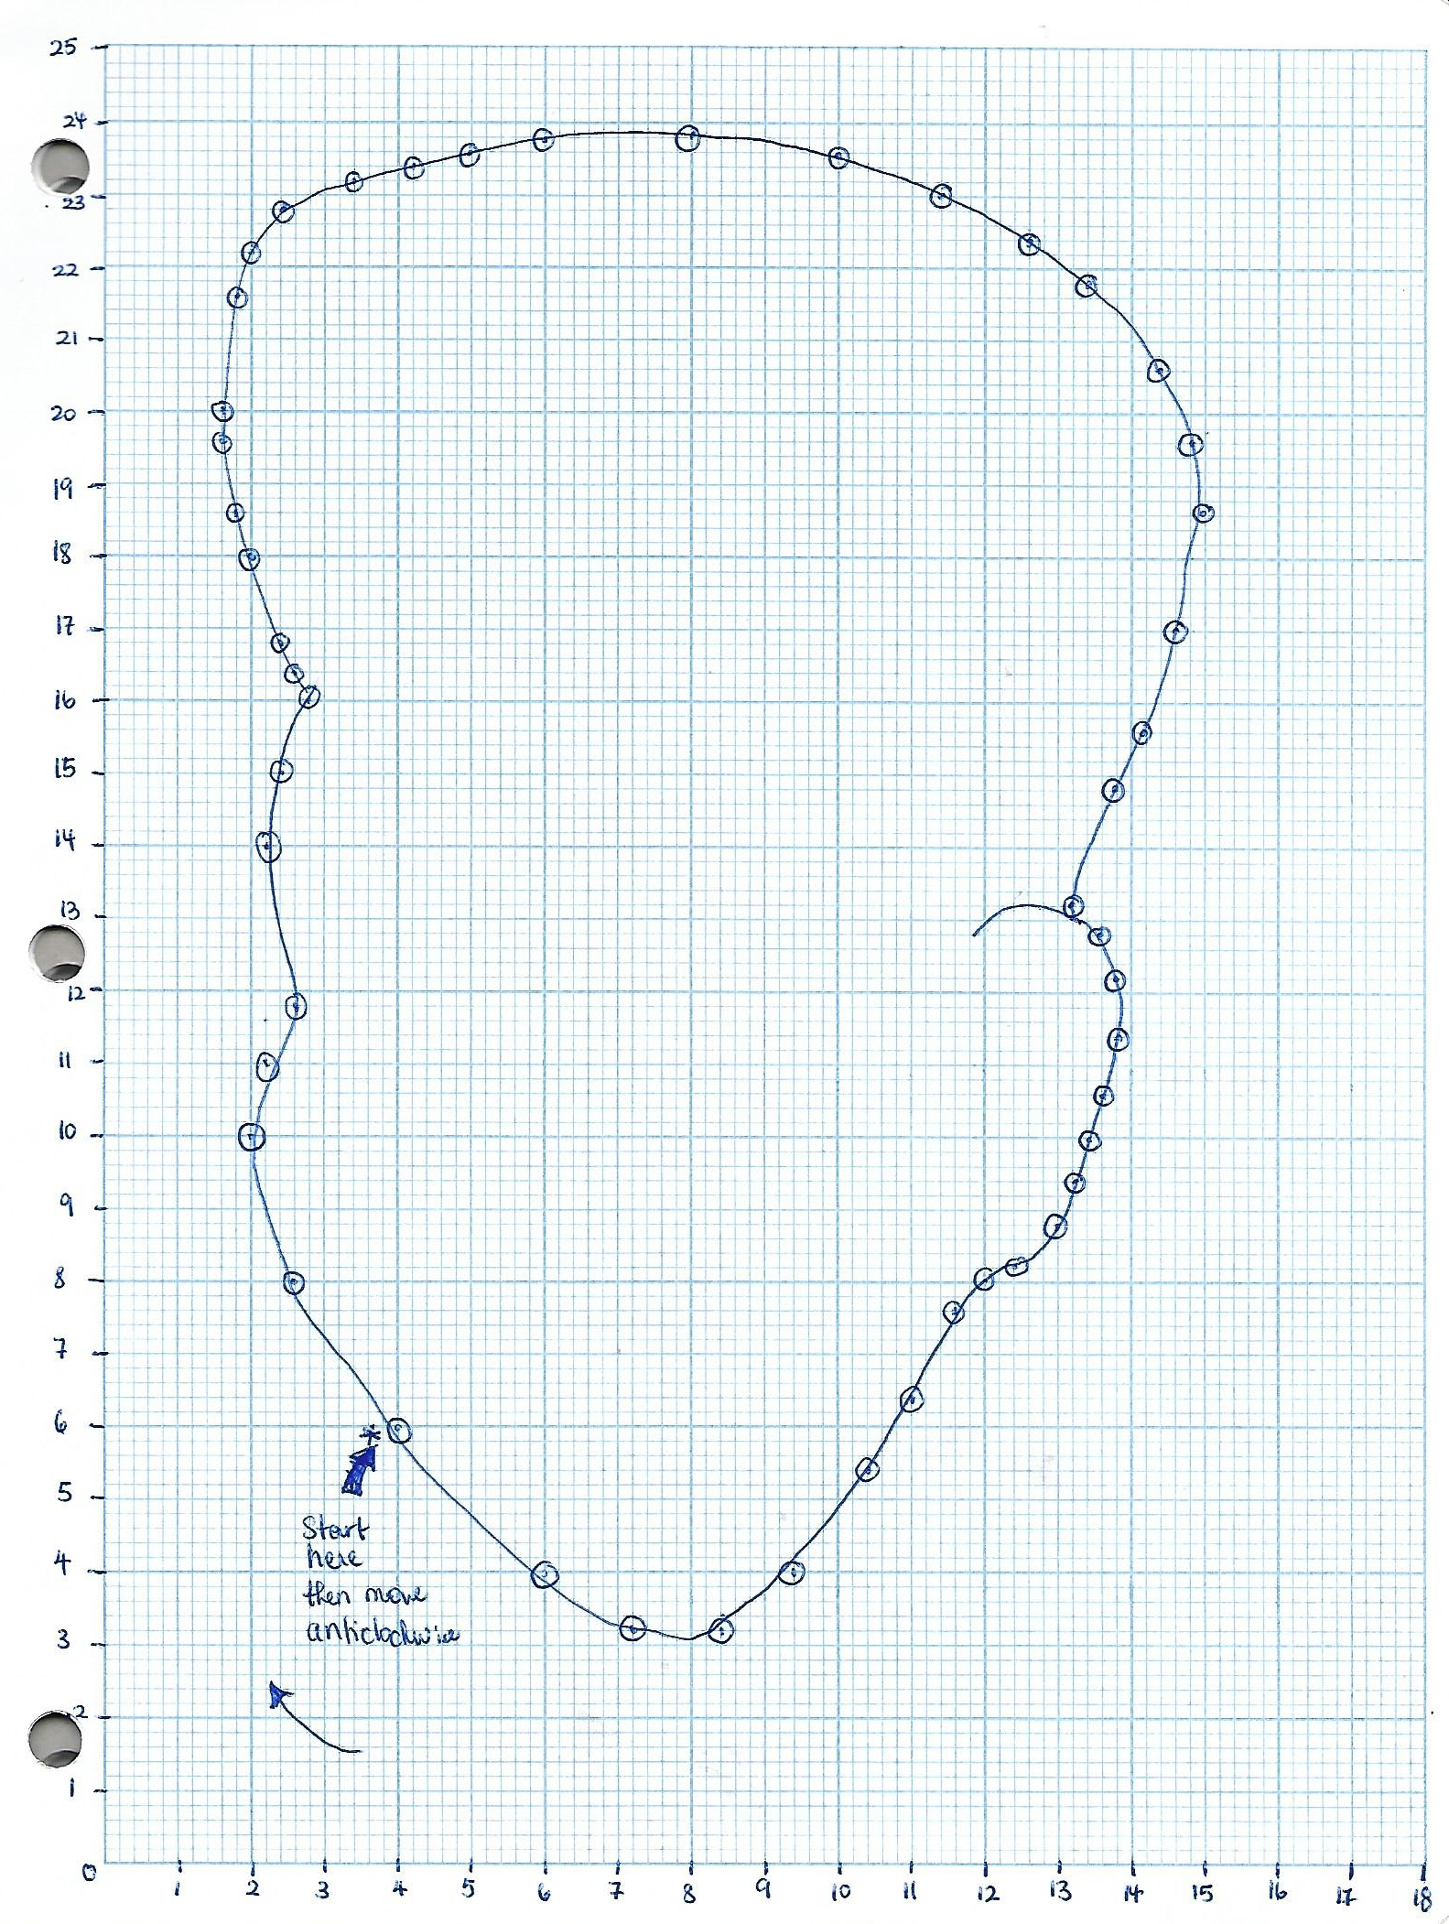
Activity 3
Determine the Points used to Produce the Mystery Shape
Let’s have fun locating these coordinates
Table showing the x and y coordinates to be used to determine the mystery shape
x | y | x | y | x | y | x | y
*4 | *6

Slide 40
Investigations Involving Graphs
Periodicity (How the length of a pendulum affects its period)
Bounces (How the height a ball is dropped from affects the number of bounces)

