Slide 1

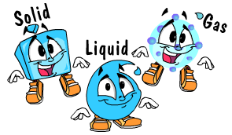
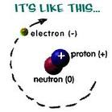
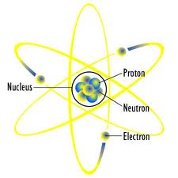
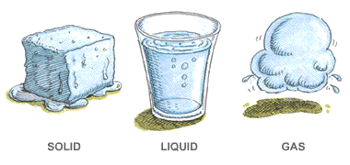
1. The Three States of Matter

Slide 2
Solids, Liquids and Gases
Matter is any and every thing that has mass and occupies space.
Matter is made up of particles.
Matter exists in 3 distinct states:
A. Solids
B. Liquids
C. Gases
The temperature and pressure of an environment determine the states of matter at any particular time.

Slide 3
The Particulate Theory of Matter
All matter is made up of particles.
The particles either vibrate or move from place to place.
Attractive and repulsive forces exist between the particles
The particles that make up matter can be atoms, molecules or ions.

Slide 4
What’s An Atom?
An atom is the smallest particle known to man.
It can NOT be broken down by chemical means.
It comprises of protons, neutrons and electrons.

Slide 5
What’s A Molecule?
A molecule is a particle that contains one or more atoms.
When a molecule contains the same types of atoms it is referred to as an element. For example, oxygen (O₂), hydrogen (H₂), chlorine (Cl₂) etc.
When the molecule contains different types of atoms it is referred to as a compound. For example, water (H₂O), glucose (C₆H₁₂O₆), carbon dioxide (CO₂) etc.

Slide 6
What’s An Ion?
A ion is an atom or a group of atoms with either a positive of negative charge.
Positive ions are referred to as cations.
Negative ions are referred to as anions.
Examples of ions are:
Na⁺, the sodium cation
O²⁻, the oxygen anion
NO₃⁻, the nitrate anion which is polyatomic (meaning it contains more than one atom)

Slide 7
The Arrangement of particles in a Solid
The particles are arranged very closely.
They have a regular pattern.
The particles vibrate around a fixed point but do not move from place to place.
The attractive force between particles are strong.
Solids can NOT be compressed.

Slide 8
The Arrangement of particles in a Liquid
The particles are arranged very closely.
They have an irregular pattern.
The particles slide over each other slowly.
The attractive force between particles are weaker that those in a solid but stronger than those in a gas.
Liquids can NOT be compressed.

Slide 9
The Arrangement of particles in a Gas
The particles are arranged very far apart.
They have an irregular pattern.
The particles move everywhere rapidly.
There are almost NO attractive force between the particles.
Gases can be compressed.

Slide 10
Transitioning Between Phases
The states of matter are also referred to as phases.
Substances can be described as being in a solid, liquid or gaseous phase.
When substances gain or give off energy in the form of heat they are expressed as transitioning from one phase to another.

Slide 11
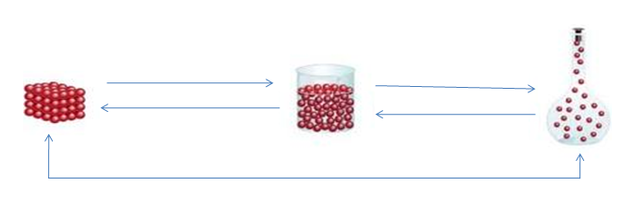
Transitioning Between Phases
When a substance transitions from the solid phase to the liquid phase it is melting.
See the picture below and try to determine the other transitions which take place.
melting
b. __________
c. _________
d. __________
e. ____________

Slide 12
Gain OR Loss of HEAT Energy
& Sublimation
Heat energy is lost via the freezing and condensation transitions.
Heat energy is gained via the melting and evaporation transitions.
Sublimation is a transition which skips the liquid phase. Because it is a transition that can go directly from solid to gas and vise versa heat is lost and heat can be gained depending on which direction the physical change is going from.
Examples of substances which sublime are:
carbon dioxide (dry ice)
naphthalene (moth balls)

Slide 13
Diffusion
The idea that particles are in constant motion is called the kinetic particle theory.
Diffusion is the movement of particle from an area where they are at their highest concentration to an area where they are less concentrated.
Diffusion occurs in gases and liquids.
The rate of diffusion in gases is faster than that of liquids.
An example of diffusion is smelling the sweet fragrance of a perfume from a room probably 20 metres away.

Slide 14
Osmosis
Osmosis is a special case of diffusion.
Osmosis is the movement of water molecules from and area where they are at their highest concentration to an area where they are at least concentration across a partially permeable membrane.
An example of osmosis is placing a peeled potato with a groove filled with sugar into a petri dish of water. The water on the outside of the potato will cross into the groove of the potato eventually dissolving the sugar crystals.

