Slide 1
Measurements & units

Slide 2
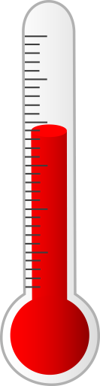
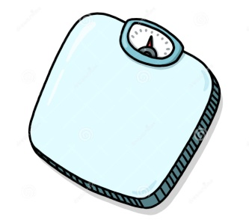

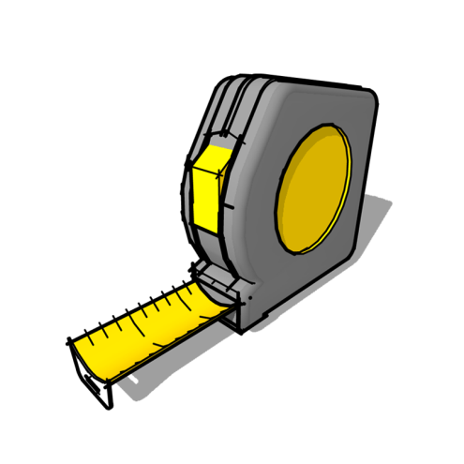
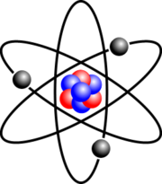
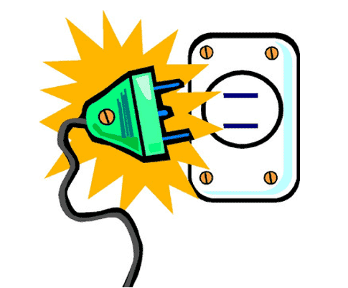

Why do measurements and units matter in Physics?
Measurements and units matter because they enable us to gauge, track and compare information necessary for understanding
this universe.
Recording measurements give us INSIGHT while stating units gives an idea of WHAT is being measured.

Slide 3
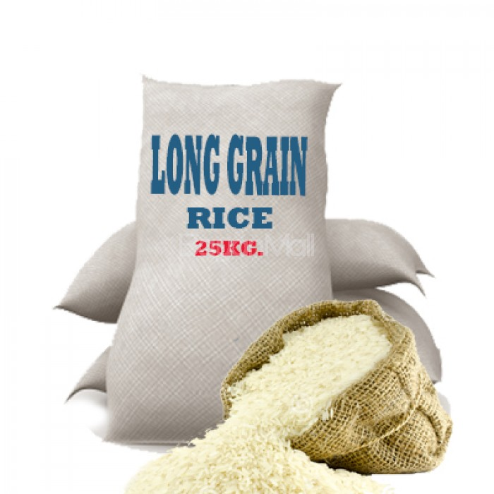
Physical Quantities
A physical quantity is one which can be measured.
Physical quantities have numerical magnitude and unit.
For example, in the picture, the mass of the
Long Grain Rice bag is 25 kg. Here, 25 is the
numerical magnitude and kg is the unit.
It would be meaningless to state one
without the other in this case.
A unit is a quantity chosen as a standard in terms
of which other quantities may be expressed.
There are TWO types of physical quantities:
1. BASE quantities and
2. DERIVED quantities

Slide 4
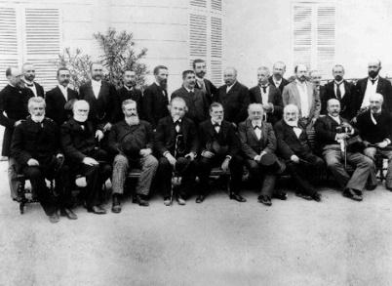
Base quantities and units
The 11th General Conference on Weight and Measures
held in Paris in 1960 adopted a world-wide system
of measurements called International System of Units
referred to as the SI system.
In physics there are seven basic quantities which
use units based on the SI system. They are depicted
in the table on the right.
The SI system is the modern form of the metric system
since it is convenient to use the multiples and
fractions of the number 10.
The SI System is the world’s most widely used system
of measurement. The USA is the only industrialized
nation that does NOT use it as its primary system of
units for commercial activity but USES it in the
scientific fields.
Base quantity |  | Unit
Name | Symbol | Name | Symbol
length | l | metre | m
mass | m | kilogram | kg
time | T | second | s
temperature | K | Kelvin | K
electric current | I | ampere | A
amount of substance | - | mole | mol
Luminous intensity | - | candela | cd

Slide 5
Derived quantities & units
From the 7 base quantities mentioned earlier, ALL other quantities are obtained.
These other quantities are referred to as derived quantities where their units are obtained from the base units via multiplication or division.
Derived quantity |  | Unit |  | Which base quantity or quantities is this derived quantity from?
Name | Symbol | Name | Symbol
Area | A | square metre | m²
Volume | V | cubic metre | m³
Density | ρ | kilogram per cubic metre | kg/m³
Velocity | v | metre per second | m/s
Acceleration | a | metre per second squared | m/s²
momentum | p | kilogram metre per second | kg m/s

Slide 6
MORE Derived quantities & units
Some base units of derived quantities are complicated and so were named after famous scientists.
Some of the unit symbols all have capital letters in these cases.
Derived quantity |  | Unit |  | Which base quantity or quantities is this derived quantity from?
Name | Symbol | Name | Symbol
Force | F | newton | N or (kg m)/s²
Pressure | P | pascal | Pa or (kg s²)/m
Energy, work | E, W | joule | J or kg/s²
Power | P | watt | W or kg/s³
Frequency | f | hertz | Hz or 1/s
Electric charge | Q | coulomb | C or As
Resistance | R | ohm | Ω or kg/(s³A²)
Electromotive force | E | volt | V or kg/(s³A)
potential | V | volt | V or kg/(s³A)

Slide 7
Dimensionless Quantities
Dimensionless quantities do NOT have units.
Two examples of dimensionless quantities are:
1. relative density, ρ_{r}
2. magnification, m
and
3. refractive index, n.

Slide 8
SI Prefixes – Multiple and Submultiple units
A prefix is a word or set of letters that
is used in front of another word to make
a whole new word.
For example, in the word unimportant the
prefix used is un and the stem word is
important. The words important and
unimportant are two different words with
very different meanings.
The multiples and submultiples of SI units
can be expressed in term of prefixes. The
table on the right depicts some prefixes.
These prefixes are often coined with basic
or derived quantities for example;
kilometre, nanosecond, milligram etc.
Coining is done to express large numbers
as smaller ones for example:
1000 g = 1 × 10³ g = 1 kg
0.002 s = 2 × 10⁻³ s = 2 ms
Table of Multiples and Submultiples
Type | Prefix | Symbol | Represents
M u l t I p l e s | tera | T | 10¹² = 1,000,000,000,000
 | giga | G | 10⁹ = 1,000,000,000
 | mega | M | 10⁶ = 1,000,000
 | kilo | k | 10³ = 1,000
 | hecto | h | 10² = 100
 | deko | da | 10¹ = 10
S u b m u l t i p l e s | deci | d | 10⁻¹ = 0.1
 | centi | c | 10⁻² = 0.01
 | milli | m | 10⁻³ = 0.001
 | micro | µ | 10⁻⁶ = 0.000001
 | nano | n | 10⁻⁹ = 0.000000001
 | pico | p | 10⁻¹² = 0.000000000001

Slide 9
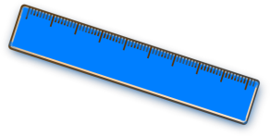
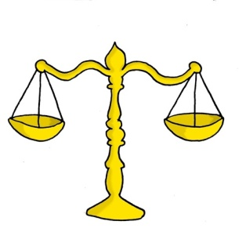
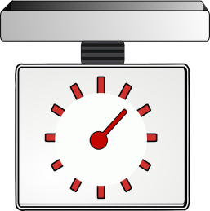
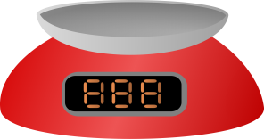
Instruments and scales
Range, sensitivity, accuracy
Quantities are measured using instruments.
The choice of instrument for a particular job depends on the size of the quantity to be measured and the range over which it might vary.
An ordinary ruler is not the best instrument for measuring the thickness of a wire or the length of a cricket pitch or tennis court.
A sensitive instrument responds to small changes in the quantity being measured and an accurate one gives correct readings.
Scales that can weigh packets of sugar are NOT sensitive enough for weighing individual sugar grains.

Slide 10
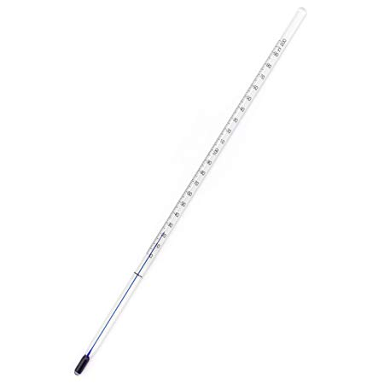
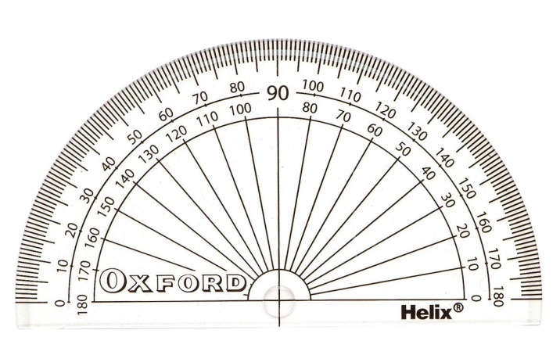
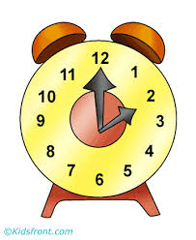
Instruments and scales
Linear and non-linear scales
What are linear scales?
What do you think are non-linear scales?

Slide 11
Errors that take place during an experiment/practical
Every measurement is subject to errors. These can be due to:
1. the apparatus, e.g. the scale of an instrument may be incorrectly calibrated,
2. the experimental conditions changing, e.g. a quantity such as temperature varying when it should be constant,
3. the experimenter, e.g. when an estimate has to be made of a reading between two marks on a scale.
Errors arising from the first two causes may not always be easy to eliminate but experimenters can reduce such problems by:
(i) taking, several readings of each quantity and calculating the average (mean),
(ii) avoiding parallax. What does this mean?

Slide 12
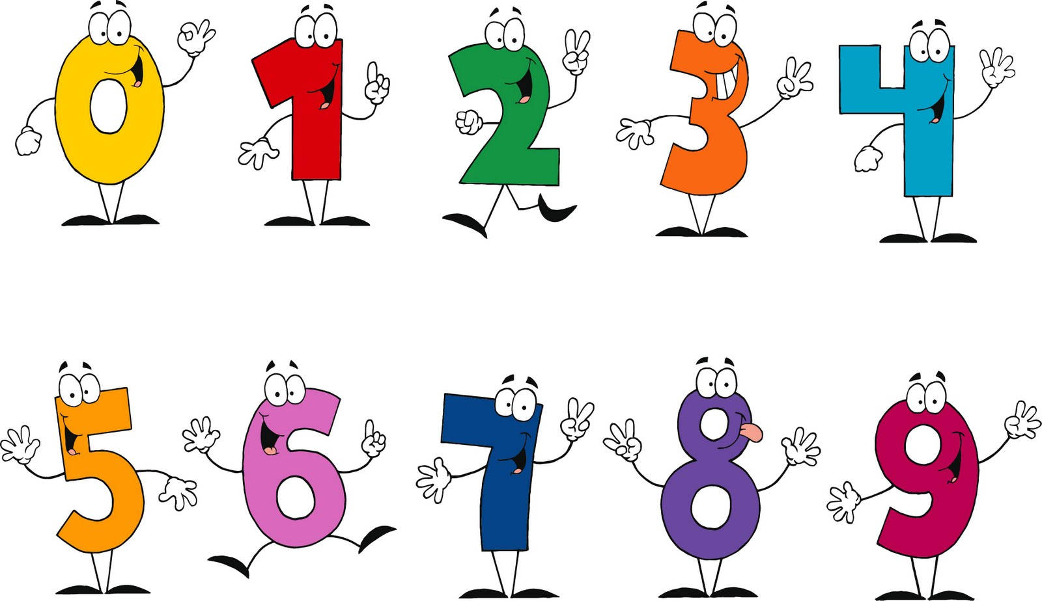
Math in Physics

Slide 13
Transposition
The art of transposing is a fundamental building block in physics. Without it a student can become easily confused and deterred during normal class and practical/lab sessions.
The application of physics involves the use of many formulas.
Many of the formulas used in physics are often re-worked throughout the subject.
Additionally, many of the symbols can be substituted with other types of symbols.
Owing to this, a student must know how to transpose properly and with confidence.

Slide 14
Transposition
Addition & Subtraction
If A – B = C find A
The above is another simple transposition problem. To find the variable A, B must be added from both sides this time. See below for the demonstration.
A – B + B = C + B
:. A = C + B
This is so because – B + B, if they were numbers would equal to zero and so they cancel out.
If A + B = C find A
The above is the simplest of any transposition problem. To find the variable A, B must be subtracted from both sides as demonstrated below.
A + B – B = C – B
:. A = C – B
This is so because B – B, if they were numbers would equal to zero and so they cancel out.
Solve the following equations
a. A + C = E solve for A
b. A + C = E solve for C
c. A – C = E solve for A
d. A – C = E solve for C

Slide 15
Worked Problems
A + C = E Solve for A
A + C – C = E – C
A = E – C
b. A + C = E solve for C
A – A + C = E – A
C = E - A

Slide 16
Worked Problems
A – C = E solve for A
A – C + C = E + C
A = E + C
A – C = E solve for C
A – C + C = E + C
A - E = E - E + C
C = A - E

Slide 17
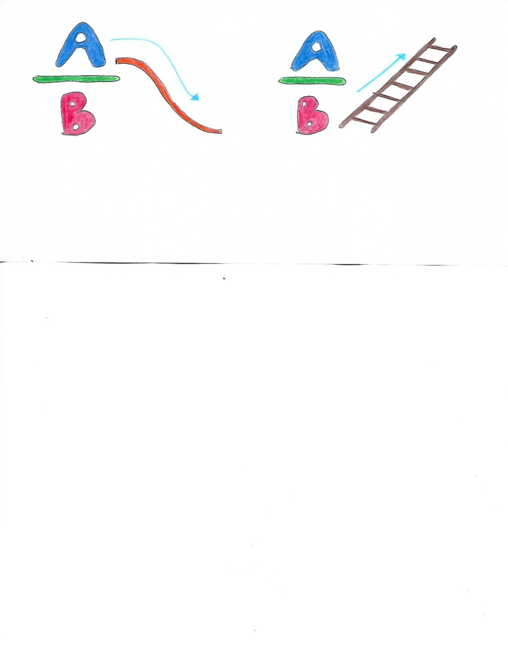
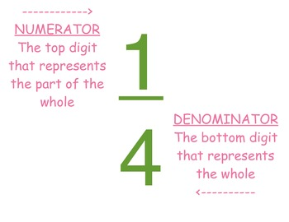
Transposition
Fractions
A fraction has a numerator and a denominator.
The Numerator is always on TOP and the denominator is always at the BOTTOM.
When transposing fractions that look like A/B = C/D or A = BC, numerators always SLIDE down
…while denominators CLIMB up across the equal sign.
This is always true once there are NO addition or subtraction within the fractions facing off each other.
For example the rules above are not the only ones which would apply for such a fraction as depicted below if you were solving for A or B:
(A + B)/ C = D/F

Slide 18
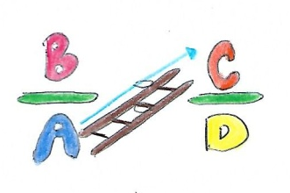




Transposition
Fractions
Example 1
Look at the following equation:
A/B = C/D
To solve for A, then B has to climb up the ladder across the equal sign as displayed below.
To get: A = BC/D
Example 2
Look at the following equation:
B/A = C/D
When what you need to solve for is in the denominator, which in this case is A, then move it into the numerator first then get rid of all of the other variables, which are C and D in this case..
To solve for A, because it is in the denominator, it must climb up the ladder first to become a numerator.
After that, to get rid of all of A’s friends, C must slide down across the equal sign to find its new position under B. Then D must climb the ladder to find its new position beside B.
To get:

Slide 19
Transposition
Fractions
In actuality these are the operations taking place when transposing fractions without addition or subtraction signs.
Example 1
A/B = C/D
If we wanted to solve for A, then both sides must be multiplied by B so that A can be by itself.
B/1 × A/B = B/1 × C/D
:. A = BC/D
Example 2
B/A = C/D
When what you need to solve for is in the denominator then move it into the numerator first then get rid of all other variables around it.
To solve for A, both sides must be multiplied by A then both sides must be divided by C and multiplied by D to get A by its self. See below.
= A/1 × B/A × 1/C × D/1 = A/1 × C/D × 1/C × D/1
:. A = BD/C

Slide 20
Work Sheet
P/E = S/A
a. P
b. E
c. S
d. A
P = ES/A
E = PA/S
S = PA/E
A = ES/P

Slide 21
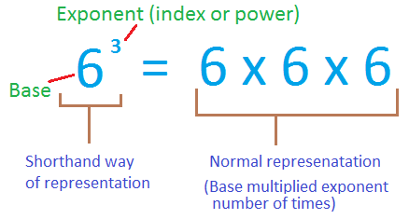
Exponents
An exponent is a quantity representing the power to which a given number or expression is to be raised, usually expressed as a raised symbol beside the number or expression. For example A², 2⁴, C⁸, 10³ etc… The superscripts in red are the exponents while those in blue are referred to as the variable or number.
When the same variables are being multiplied their exponents are added.
A⁴ × A³ = A⁴⁺³ = A⁷
A⁴ × A³ × B⁴ × A³ = A¹⁰ B⁴
When the same variables are being divided their exponents are subtracted.
A⁴/A³ = A⁴⁻³ = A¹ = A
A⁴ /A³B = A⁴⁻³ /B = A¹ /B = A/B

Slide 22
Exponents
The equation below demonstrates how to solve for a variable by getting rid of its exponent.
A² = B + C
A^{2 × ½} = (B + C) ^{½}
:. A = sq rt (B + C)
The above is a rule that must be committed to memory. If the variable A above had been a cubed the exponent of A would have been multiplied by 1/3 and so would have the sum of (B + C). For example:
A³ = B + C
:. A^{3×1/3} = (B + C)^{1/3}
A = (B + C)^{1/3}

Slide 23
Comprehension Using Actual Physics Equations
a. E = mc² (c)
b. E_{k} = mv²/2 (v)
c. P = V²/R (R)
d. P = I²R (I)
e. E = V²t/R (t)
f. v² = u² + 2as (s & u)
g. s = at²/2 (a & t)

Slide 24
Significant Figures
Accuracy and Precision
Physics is a science based on fact via math. Accuracy and preciseness are often exercised and encouraged when such math is executed.
Being precise is to achieve figures similar in quantity after completing 3 or more trials of an experiment requiring the tabulation of numbers.
Meanwhile, being accurate is to achieve figures as close to an actual literature value as possible. Obtaining accurate numbers end up proving facts that are being tested.

Slide 25
Significant Figures
Rules
Rule 1. All numbers, 1 – 9 are SIGNIFICANT.
Rule 2. All zeroes to the left of a non-zero number are INSIGNIFICANT and do not matter.
Rule 3. All zeroes to the right of a non-zero number are INSIGNIFICANT unless there is a decimal point present.
Rule 4. All zeroes sandwiched between any numeral 1 – 9 is recognized as a SIGNIFICANT figure.
Rule 5. When multiplying, the number that has the least amount of significant figures controls the amount of significant figures the answer will have.
Rule 6. When dividing, the number that has the least amount of significant figures controls the amount of significant figures the answer will have.

Slide 26
Significant Figures
Exercise
How many significant figures are in the following numbers?
0.003 = ____________ sig fig
3.2 × 10³ = ____________ sig fig
302 = ____________ sig fig
320 = ____________ sig fig
0.0400 = ____________ sig fig
3000. = ____________ sig fig
3000 = ____________ sig fig

Slide 27
Standard Notation
Numbers are shortened via a process known as standard notation.
For example:
The number 4000 may be written as = 4 x 10 x 10 x 10 = 4 x 10³
The number 0.4 may be written as = 4/10 = 4/10¹ = 4 x 10⁻¹
The small figures -1 and 3, are called a power of ten or exponents and gives the number of times the number has to be multiplied by 10 if the power is GREATER than 1, and the number of times it has to be divided by 10 if the power is LESS than 1.
Please note that any number to the power of zero is equal to 1.
For example:
10⁰ = 1 OR 2⁰ = 1

Slide 28
Standard Notation
10⁻³ = 0.001 ~ This is saying 1 is to be divided by 10 × 10 × 10 = 1000.
10⁻² = 0.01 ~ This is saying 1 is to be divided by 10 × 10 = 100
10⁻¹ = 0.1 ~ This is saying 1 is to be divided by 10.
10⁰ = 1 ~ This is saying 1 has nothing to be multiplied by.
10¹ = 10 ~ This is saying 1 is to be multiplied by 10 only once.
10² = 100 ~ This is saying 1 is to be multiplied by 10 twice.
10³ = 1000 ~ This is saying 1 is to be multiplied by 10 three times.

Slide 29
Standard Notation
Exercise
Write the following in standard notation.
800 000 = _______
7 952 = _______
320 = _______
20 136 = _______
3 026 = _______

Slide 30
Standard Notation
Exercise
Write the following in standard notation.
0.62 = _______
893.8 = _______
7.40 = _______
0.080052 = _______
60.01 = _______

Slide 31
Performing Conversions
Sometimes quantities may need to be converted from one unit to another in order to:
a. make the quantity neater to look at or smaller for example 1000 g may be written as 1 kg
OR
b. relate it to any given situation for example instead of saying 20 miles per hour (mil/h) one might want to say approximately 32 kilometers per hour (km/h).

Slide 32
Performing Conversions
Converting from a quantity with a coined unit to another quantity with an un-coined unit with the same base is simple.
A quantity with a coined unit is one which is preceded by a prefix for eg. cm, mm, ns, MW, ps etc.
A quantity with an un-coined unit is one which is NOT preceded by a prefix for eg. m, W, s, mol etc.

Slide 33
SI Prefixes – Multiple and Submultiple units
Do you remember these?
They will come in handy
for the upcoming
exercise.
It is best if you commit
these to memory.
Table of Multiples and Submultiples
Type | Prefix | Symbol | Represents
M u l t i p l e s | tera | T | 10¹² = 1,000,000,000,000
 | giga | G | 10⁹ = 1,000,000,000
 | mega | M | 10⁶ = 1,000,000
 | kilo | k | 10³ = 1,000
 | hecto | h | 10² = 100
 | deko | da | 10¹ = 10
S u b m u l t i p l e s | deci | d | 10⁻¹ = 0.1
 | centi | c | 10⁻² = 0.01
 | milli | m | 10⁻³ = 0.001
 | micro | µ | 10⁻⁶ = 0.000001
 | nano | n | 10⁻⁹ = 0.000000001
 | pico | p | 10⁻¹² = 0.000000000001

Slide 34
Performing Conversions
Coined to Un-Coined
To convert from a quantity with a coined unit to a quantity with an un-coined unit all you have to do is multiply.
2 cm → ______ m
2 cm = 2 × 10⁻² m
4 ps → _______ s
4 ps = 4 × 10⁻¹² s
Try the following:
9 nm → ______ m
1 ms → ______ s
6 MW → ______ W
12 mA → ______ A
4 kg → ______ g

Slide 35
Performing Conversions
Un-coined to Coined
1/a = a⁻¹
aº = 1
a = a¹
1/a = aº/a¹
a^{o – 1} = a ⁻¹
(2 × 10⁰) / 10⁻³
2 × 10⁰⁻⁽⁻³⁾
2 × 10³
To convert from a quantity with an un-coined quantity to another quantity with a coined quantity with the same base, all you have to do is divide by the unknown’s prefix.
2 m → ______ mm
2m = 2 ÷ 10⁻³ mm
2 m = 2 × 10³ mm
5 W → ______ MW
5 W = 5 ÷ 10⁶ MW
5 W = 5 × 10⁻⁶ MW
Try the following:
8 A → ________ mA
2 m → ________ µm
7 g → ________ kg
3 s → ________ ns
1 W → ________ MW

Slide 36
Worked Examples
8 A → ________ mA 8 /10⁻³ = 8 * 10³ mA
2 m → ________ µm 2/10⁻⁶ = 2 * 10⁶ µm
7 g → ________ kg 7/10³ = 7 * 10⁻³ kg
3 s → ________ ns 3/10⁻⁹ = 3 * 10⁹ ns
1 W → ________ MW 1/10⁶ = 1 * 10⁻⁶ MW

Slide 37
Performing Conversions
Coined to Coined
One could also convert from a quantity with a coined unit to another quantity with a coined unit.
1000 kg can be converted to mg.
All that needs to be done is to note the root unit which is grams, g.
First convert 1000 kg to g = 1000 × 10³ g
If 1 mg = 1 × 10⁻³ g
Then x = 1000 × 10³ g
Simply cross multiply
(1 mg × 1000 × 10³ g) ÷ (1 × 10⁻³ g)
= (10³ mg × 10⁻³ g) ÷ 10⁻³ g
= 10³ mg
A trend worth noting: You can first get rid of the number’s prefix then divide it by the unknown’s prefix.

Slide 38
Coined to Coined
Work Sheet
Try the following:
3 ps = ______ ms
if
3 ps = 3 × 10⁻¹² s
if
1 ms = 10⁻³ s
:. x = 3 × 10⁻¹² s
1/x ms = 10⁻³/(3 × 10⁻¹² )
(1 × 3 × 10⁻¹²)/(10⁻³ ) ms = x
3 × 10^{-12 – (-3)} ms = x
3 × 10⁻⁹ ms = x
20 nm = _____ mm
if
20 nm = 20 × 10⁻⁹ m
if
1 mm = 10⁻³ m
:. x = 20 × 10⁻⁹ m
1/x mm = 10⁻³ / 20 × 10⁻⁹
(1 × 20 × 10⁻⁹)/ (10⁻³)mm = x
20 × 10^{-9 –(-3)}mm = 20 × 10⁻⁶ mm
2 × 10¹ × 10⁻⁶ mm = 2 × 10⁻⁶⁺¹ mm
2 × 10⁻⁵ mm

Slide 39
Coined to Coined
Work Sheet
Try the following:
1 kg = ______ mg
1 kg = 1000 g
if
1 mg = 10⁻³ g
x = 1000g
(1 mg * 1000g)/10⁻³ g
10³/10⁻³ mg = 10³⁻⁽⁻³⁾ mg
10⁶ mg
2.3 mm = _____ cm
2.3 mm = 2.3 * 10⁻³ m
if
1 cm = 10⁻² m
x = 2.3 * 10⁻³ m
(1 cm * 2.3 * 10⁻³m)/10⁻² m
2.3 * 10⁻³⁻⁽⁻²⁾ cm
2.3 * 10⁻¹ cm

Slide 40
Uncoined to Coined
Worksheet
2 ms = _______ ps
2 ms = 2 * 10⁻³ s
if
1 ps = 10⁻¹² s
x = 2 * 10⁻³ s
(1 ps * 2 * 10⁻³ s)/10⁻¹² s
2 * 10⁻³⁻⁽⁻¹²⁾ ps
2 * 10⁹ ps
5 cm = _______ mm
5 cm = 5 * 10⁻² m
if
1 mm = 10⁻³ m
x = 5 * 10⁻² m
(1 mm * 5 * 10⁻² m)/10⁻³ mm
5 * 10⁻²⁻⁽⁻³⁾ mm
5 * 10 mm
7mg = _________ kg
7 * 10⁻³/10³ kg
7 * 10 kg

Slide 41
Graphing
Graphing is a great way of depicting how two quantities relate with each other.
The student will be able to visually comprehend how such quantities interact with each other.
It is a vital tool in physics and a wonderful way for students to learn calibration as well as simple calculation corresponding to graphing.

Slide 42
Graphing
Types of axis
1. At this level there are two axis, x and y
a. The y axis is referred to as the rise or the vertical axis
b. The x axis is referred to as the run or the horizontal axis

Slide 43
Graphing
Size of graph
a. Your graph should be large whether in portrait or landscape
b. Determine the best way to depict your graph if you have considerably less numbers for your y axis than your x you may have to turn your graph paper landscape.
Other than that it is common practice to have your graph in portrait.

Slide 44
Graphing
Calibration of axes
a. axis x and y can be calibrated
b. It is best to calibrate your x and y scales in multiples of 1, 2, 5 and or 10 however there are exceptions to the rule.
c. Sometimes both x and y scales may be equal in size when it comes to the scale of numbers provided.

Slide 45
Graphing
Plotting of data
a. Each point plotted has an x and a y coordinate.
b. To plot a point an x or a dot encircled must be used.
c. A sharpened dark lead pencil should be used or a mechanical pencil may be used.
d. Try your best to use a graph paper which is light blue in colour.

Slide 46
Graphing
Types of variables
a. There are two types of variables in graphing
i) The independent variable &
ii) The dependent variable

Slide 47
Graphing
Types of variables
A dependent variable is what you measure in the experiment and what is affected during the experiment.
The dependent variable responds to the independent variable. It is called dependent because it "depends" on the independent variable.
In a scientific experiment, you cannot have a dependent variable without an independent variable.

Slide 48
Graphing
Types of variables
An independent variable is changed or controlled within the scientific experiment. Time is almost always an independent variable. Things are often affected by it.
Example:
You are interested in the time it takes to melt a candle. Your independent variable would be the time and the dependent variable would be the temperature. You can directly manipulate the temperature applied to the wax of the candle and observe how the wax melts over time.

Slide 49
Graphing
y versus x relationships
If the points plotted produce a straight line graph that passes through zero or the origin of the axis, this indicates that x is proportional to y.
If the points plotted produce a straight line graph that does NOT pass through zero or the origin of the axis then this indicates that y is linear with respect to x.

Slide 50
Graphing
y vs x relationships
Instead of plotting a graph of y versus x variables directly, functions such as plotting y² or 1/y against x may show the relationship more clearly.
Sometimes the points on a graph may follow a curve.

Slide 51
Graphing
Practical points
1. The axes should be labelled, giving the quantities being plotted and their units.
2. If possible the origins of both scales should be on the graph and the scales chosen so that the points are spread out along the graph.
3. Mark the points with a dot or cross.
4. If the points appear to lie along a straight line, draw the best fit so that they are equally distributed about the line. (Points plotted from actual measurements may not lie on a smooth curve, e.g. a straight line, due to experimental errors.) This automatically gives the best average of the results.

Slide 52
Graphing
Practical points
5. When calculating the gradient, choose a sufficiently large triangle – one that uses at least half of the ‘line of a best fit’.
The units of the gradient are found by dividing the units of y by those of x. For example if y represents lengths measured in metres and x represents times measured in seconds then the gradient will have units of m/s
6. When possible, quantities should be plotted which give a straight line graph: the relationship between the quantities is then linear.

Slide 53
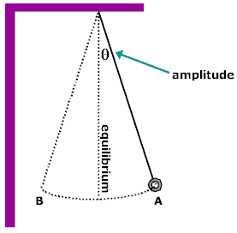
Simple Pendulum
A simple pendulum is a simple device that can be used to measure time.
A mass is tied to the end
of a string, referred to as
the plumbline, and is
allowed to swing/oscillate
freely from side to side.
One complete oscillation is a swing
back and forth to the same position.
The length of the string or the plumbline affects the period of a pendulum. The shorter the plumbline the more frequent the oscillation/swing whereas the longer it is the slower it oscillates/swings. Changing the mass of the bob or angle/amplitude of the swing does not affect a pedulum’s period.
A plumbline can be used to determine the acceleration of the bob due to gravity.

Slide 54
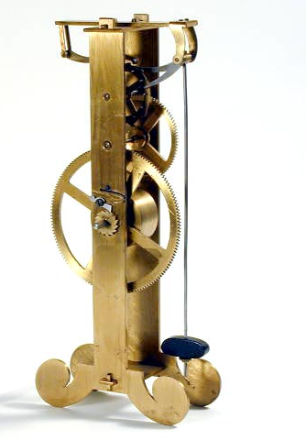
History of the Simple Pendulum
Galileo’s Contribution
Galileo is often credited with having discovered the principles of the pendulum when he observed the swinging chandeliers in Pisa cathedral.
The story may be no more
than a myth but the great
scientist certainly contributed
to the world’s knowledge and
understanding of pendulums.

Slide 55
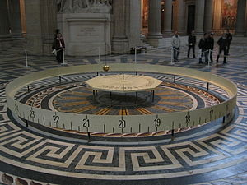
Foucault's Pendulum
Earth Spins
A great example of Foucault's Pendulum is located in the Musee Des Arts Et Metiers and the Panthéon in Paris, France.
The Pendulum is used
to prove that the Earth
rotates about its axis.
Foucault's Pendulum Video

Slide 56
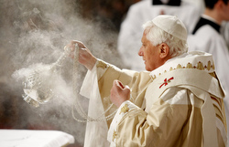
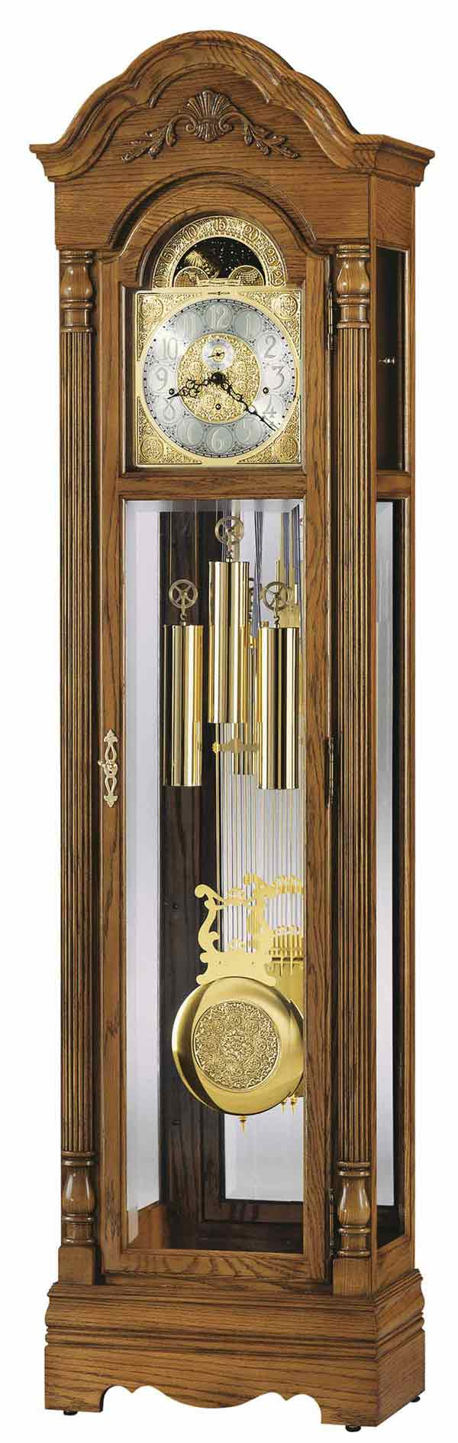
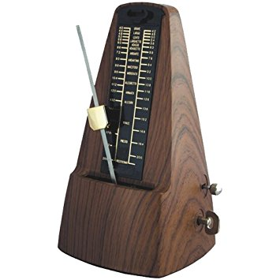
Uses of Pendulums
Pendulums are used in:
1. Grandfather and Grandmother clocks to regulate the movements of the escape wheel to accurately measure seconds.
2. Magic Shows in order to hypnotize volunteers.
3. Accelerometers to measure speed.
4. Seismometers to measure earthquakes.
5. Metronomes which are used to ensure musicians keep proper timing.
6. In religious practices such as the burning of incense.

Slide 57
Questions
What are the basic SI units of length, mass, time?
What do the following symbols stand for: km, mg, m², ms⁻¹?
Write the following in standard form:
100 000 =
428 000 000 =
504 =
27 056 =

Slide 58
Questions
Write the fractions in standard form:
1/1000 =
7/100 000
Write out the following in full:
10³ =
2 X 10⁶ =
1.34 X 10² =

Slide 59
Questions continued
Express the following decimals in standard form:
0.5 =
0.084 =
0.00036 =
0.00104 =
What is the number of significant figures in each of the following measurements?
3.52 m = ___________ sig fig
2.7 X 10³ m = ____________ sig fig
0.018 m = ______________ sig fig
1234 m = ____________ sig fig
6 X 10⁻² m = _____________ sig fig

Slide 60
Questions continued
Calculate the volume of a rectangular block with dimensions 3.1 cm X 5.5 cm X 2.0 cm, giving your answer to an appropriate number of significant figures.
In adding 2.631 m to 6.1 m a pupil wrote the sum as 8.731 m. What should the pupil have written?
Round off 4.362 m to
one sig fig = ________________________ m
two sig fig = _________________________ m
three sig fig = _________________________ m

Slide 61
Questions continued
The distance s (in meters) travelled by a car at various times t (in seconds) are shown below.
Draw graphs of
a. s against t
b. s against t²
What can you conclude?
t (s) | 0 | 1 | 2 | 3 | 4 | 5
s (m) | 0 | 2 | 8 | 18 | 32 | 50

Slide 62
Measurements

Slide 63
Common Measurements
We take measurements all of the time, some of which are quite common to us.
Common measurements include:
a. Length b. Time
c. Mass d. Volume

Slide 64
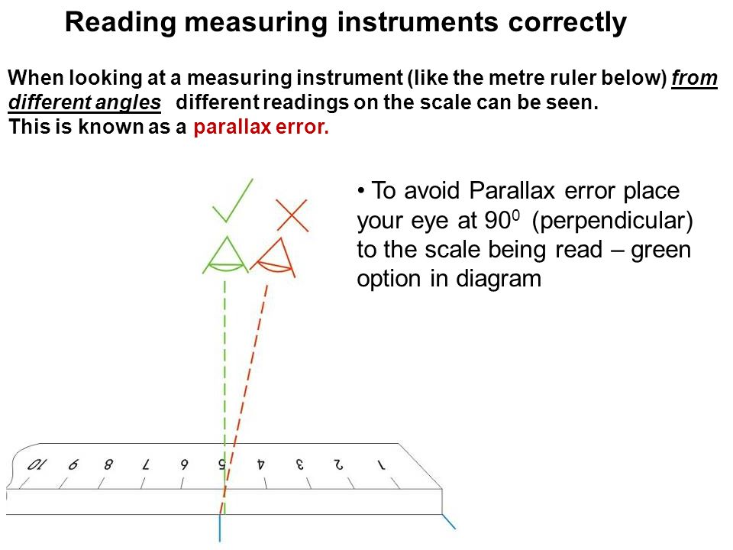
Length
There are many instruments used to measure length.
In the lab a ruler, tape measure and sound are often used to do so.
The correct way to read
a measurement is to look
directly at the instrument
being used to measure it.
The SI unit for length is metre, m. However, smaller measurements require smaller units such as, cm, mm, µm etc.

Slide 65
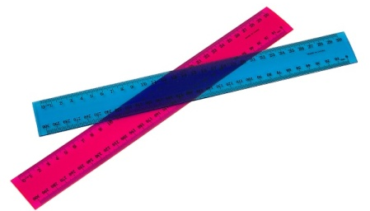
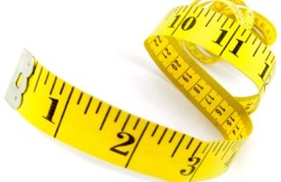
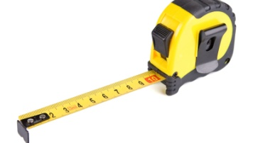
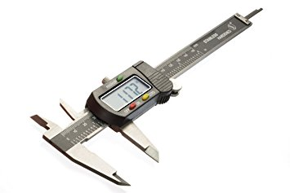
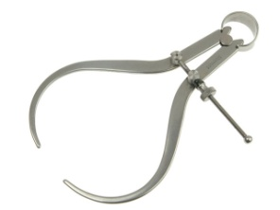
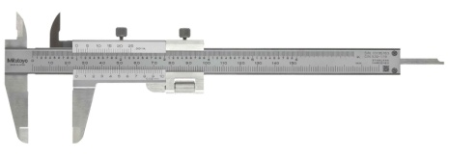
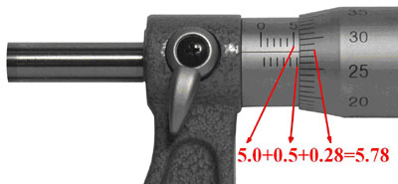
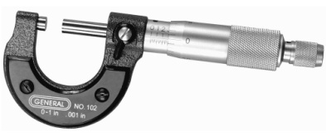
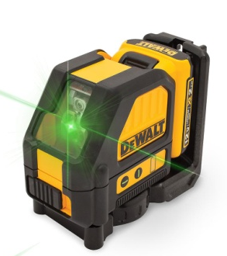
Length
The following tools may be used to measure length:
a. ruler
b. measuring Tape
c. caliper
d. micro-screw gauge
e. Laser

Slide 66
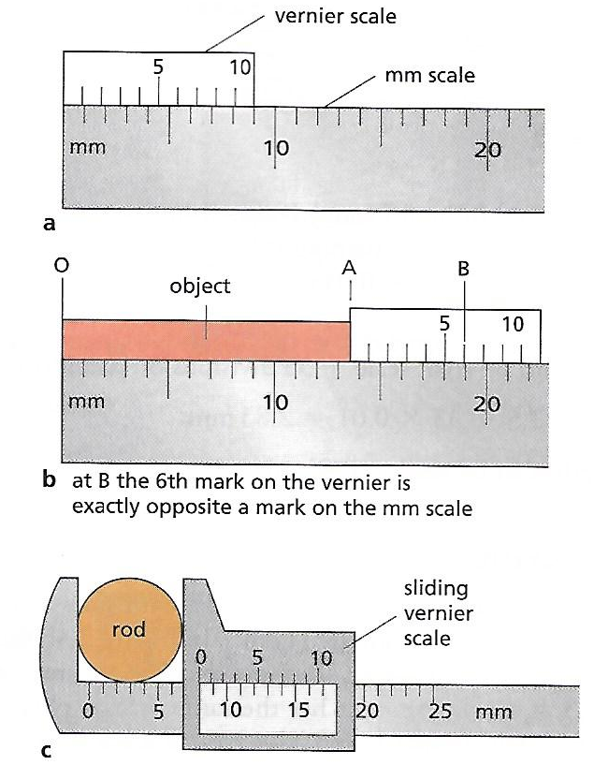
Length
Vernier Calipers
Vernier calipers are often
used to measure the
diameter of round objects.
and very short objects.
Lengths are read in units
of millimeters to one
decimal place, 0.1 mm.
What is the diameter of the
rod in the figures:
b. _______________ and
c. _______________

Slide 67
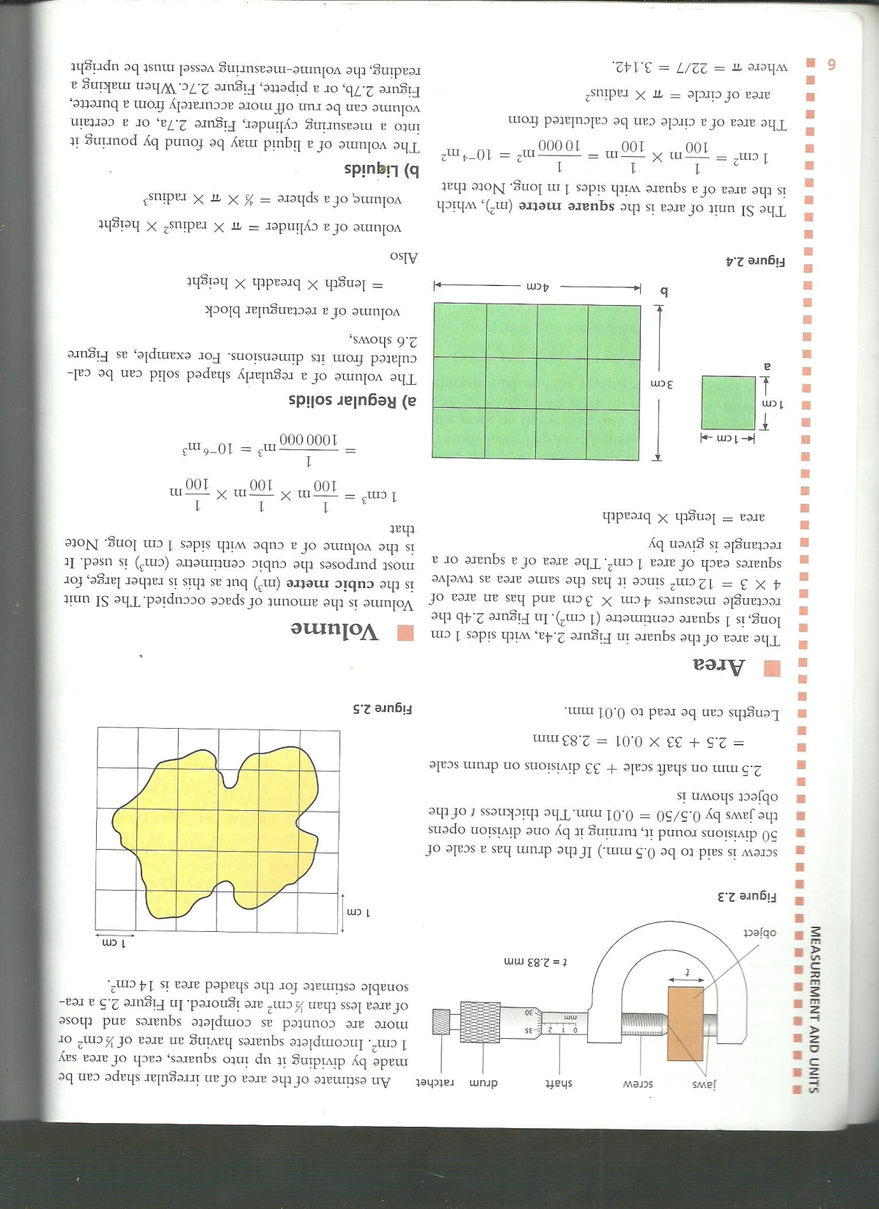
Length
Micrometer Screw Gauge
Micrometer screw gauges measure
very small lengths such as the
diameter of a wire.
The reading is taken when the
ratchet turns without closing the
jaws.
The micrometer uses units of
millimeters and gives readings
to two decimal places, 0.01 mm.
The thickness, t, of the object shown in the picture may be found by the following:
2.5 mm on shaft scale + 33 divisions on drum scale = 2.5 + (33 X 0.01) = ________________mm

Slide 68
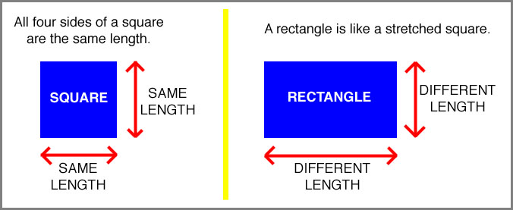
Length
Area of a Square & of a Rectangle
Length can be used to determine
the area of regular and irregularly
shaped objects.
The SI unit of area is the square
metre (m²).
Regular shaped objects include
squares, rectangles, triangles,
circles etc.
The area of a square and a rectangle can be found using the formula:
length × width
A square with sides of 1 cm can be found by applying the formula given above:
1 cm X 1 cm = 1 cm²
What is the area of a rectangle with a length of 4 cm and a width of 3
cm? _______________

Slide 69
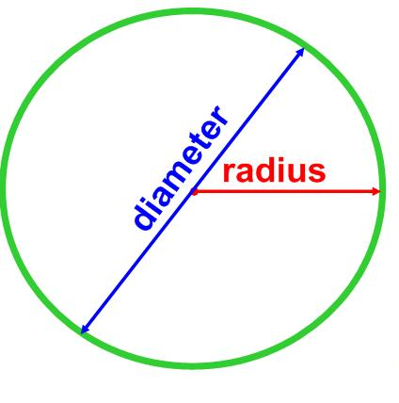
Length
Area of a Circle
The area of a circle can be calculated from the formula πr².
π = 22/7 or 3.14
r = The radius of the circle.
It is half the reading of the
circle’s diameter.
What is the area of a circle that has a diameter of 4 cm?

Slide 70
Area
Irregular Shaped Object
An estimate of the area of an irregular shape can
be made by dividing it up into squares, each of
area 1cm².
Incomplete squares
having an area of ½ cm²
or more are counted as
complete squares and those
of area less than ½ cm²
are ignored.
What is the estimated area of the irregular shaped object in the picture above? ___________

Slide 71
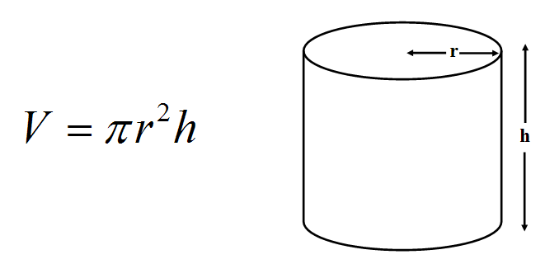
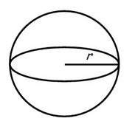
Volume
Regular Shaped Objects
Volume is the amount of space occupied.
It is measured in units of cubic meters, m³.
For regular shaped objects, such as a block, its volume may be determined via dimensions using the formula:
length × width × height
The volume of other regular shaped objects include those of:
a. Cylinder = π × radius² × height
b. Sphere = 4/3 × π × radius³

Slide 72
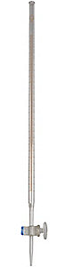
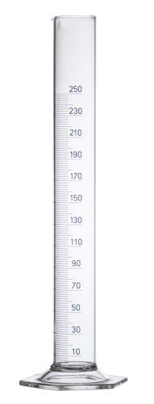
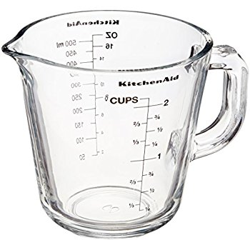
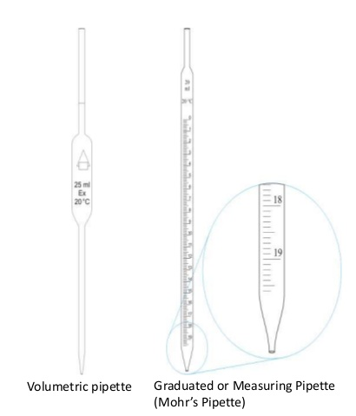
Volume
Liquids
The volume of a liquid may be found by pouring it into a calibrated vessel.
Such vessels may include
a measuring cup,
graduated measuring
cylinder, burette or
pipette.

Slide 73
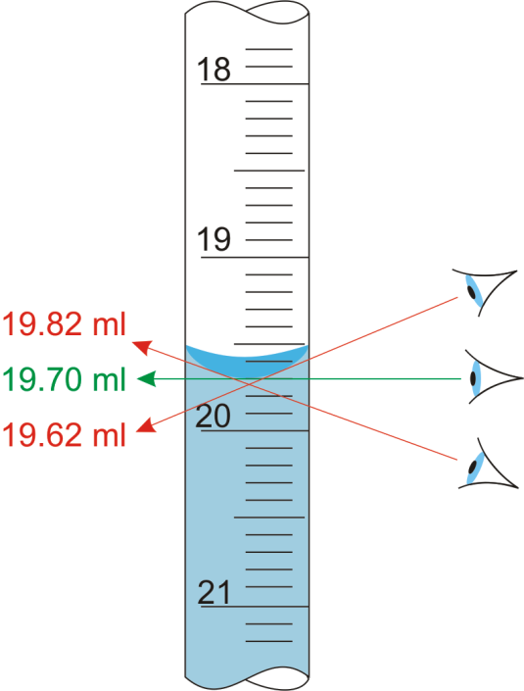
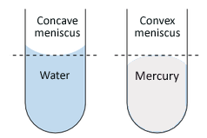
Volume
Liquids
When making a reading,
the volume-measuring vessel
must be upright and the eye
must be level with the bottom
of the curved liquid surface
called the meniscus.
The meniscus formed by
mercury is curved oppositely
to that of other liquids and the
top is read.

Slide 74
Volume
Liquids
The volume of liquids are expressed in:
a. Litres where 1 L = 1000 cm³
&
b. Millilitres where 1 mL = 1 cm³

Slide 75
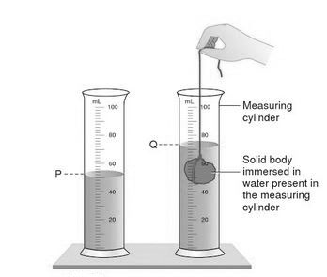
Volume
Irregular Shaped Solid
The volume of an irregular shaped solid, e.g. a pebble, can be measured by displacing water in a measuring cylinder.
The object is sub- merged
into a known volume of
water and its volume is
determined by subtracting
the final volume from the
initial volume of water.
As per the picture Q – P.

Slide 76
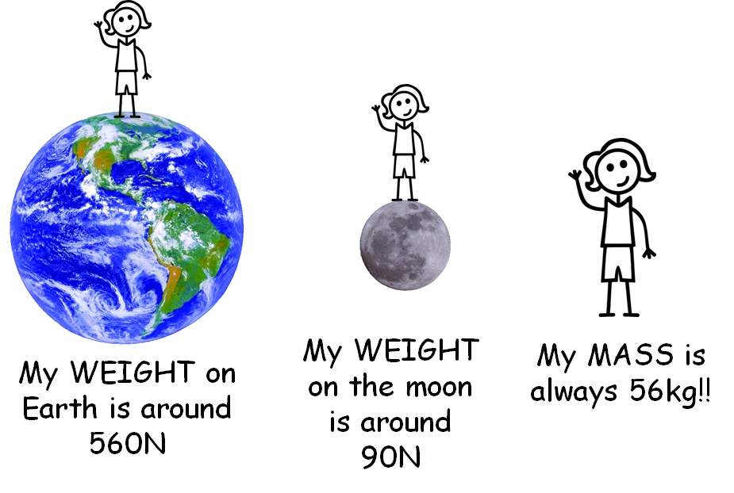
Mass
The mass of an object is the measure of the amount of matter in it.
The unit of mass is the
kilogram, kg.
The term weight is often
used when mass is really meant.
In science the two ideas are distinct
and have different units.
The confusion is not helped by the fact that mass is found on a balance by a process we unfortunately call ‘weighing’!
It might be better to call it ‘massing’.

Slide 77
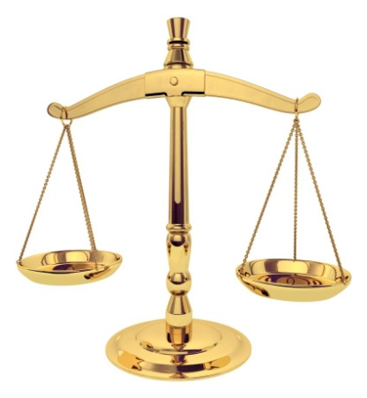


Mass
Measuring Devices
There are several kinds of balance:
a. beam balance
(the unknown mass in one pan
is balanced against known masses
in the other pan)
b. lever balance
(a system of levers acts against
the mass when it is placed in the
pan. A direct reading is obtained
from the position on a scale of a
pointer joined to the lever system)

Slide 78


Mass
Measuring Devices
c. top-pan balance
(this is a digital instrument which has discrete rather than a continuous
scale and the accuracy of a reading is determined by the scale setting
used based on the sensitivity of the balance)

Slide 79


Time
Measuring Devices
What is the unit of time?
Time measuring devices rely
on some kind of constantly
repeating oscillations.
In many clocks and watches a
small wheel (the balance wheel)
oscillates to and fro; in modern
clocks and watches the vibrations
are produced by a tiny quartz crystal.
A swinging pendulum controls a grandfather clock.

Slide 80
Density
Density is the mass per unit volume of a substance and is calculated from:
density (ρ) = mass (kg) ÷ volume (m³)
The SI units of density are kg/m³ but can be converted into g/cm³ which are more suitable units for measuring smaller measurements.

Slide 81
Density
Solid
The density of an irregularly shaped solid may be determined by first obtaining its mass and then its volume by displacement where the object is submerged into a known volume of water.
The density of a regularly shaped solid may be determined the same way except it doesn’t have to submerged into water to obtain its volume. Its volume can be determined via dimensions or a formula specific to its shape.

Slide 82
Density
Solid
The density of copper is 9 g/cm³:
a. Find the mass of 5 cm³ of copper.
b. Find the volume of 63 g of copper.

Slide 83
Density
Liquid
Below are 3 steps for determining the density of a liquid:
1. The density of a liquid may be determined by measuring its volume, v_{liquid}, in any instrument that measures volumes of liquids, example a burette or pipette.
2. The liquid would then be transferred to a beaker of known mass, m₁. Now that it is filled its mass would then be taken again, m₂.
3. m₂ – m₁ = mass of liquid, m₃. m₃ would then be divided by its volume to obtain its density. Therefore
ρ_{liquid} = m₃ ÷ v_{liquid}
The density of water is 1000 kg/m³ or 1 g/cm³.

Slide 84
Density
Air
The density of air may be determined via the following steps:
1. The mass of the container would first be obtained, m₁, then air would be added to it and corked and again its mass would be taken, m₂.
m₂ – m₁ = m₃ would give the mass of air.
2. To find the volume of the container it would be filled to the brim with water. The water would then be thrown into a device used to measure liquids, v_{air}.
3. ρ_{air} = m₃ ÷ v_{air}
The actual density of air is about 1.3 kg/m³

Slide 85
Relative Density
The relative density (ρ_{r}) tells you how many times a substance is denser than water where:
a. ρ_{r} = density of substance ÷ density of water
b. ρ_{r} = mass of substance ÷ mass of same volume of water

Slide 86
Quality Control
Consumer Protection
Measurements and tests of many kinds are needed to control the quality of food and manufactured items supplied to the public.
Density measurements are used to ensure that milk and beer have the correct strength.
Electrical appliances have to meet safety standards and the weights and measures used by shops require checking.

Slide 87
Questions
How many millimeters are there in:
a. 1 cm b. 4 cm c. 1 m
A metal block measures 10 cm × 2 cm × 2 cm. What is its volume? How many blocks each 2 cm × 2 cm × 2 cm have the same volume as this?
How many blocks of ice cream each 10 cm × 10 cm × 4 cm can be stored in the compartment of a deep-freeze measuring 40 cm × 40 cm × 20 cm?
If the density of wood is 0.5 g/cm³, what is the mass of:
a. 2 cm³ of wood b. 10 cm³ of wood?

Slide 88
Questions
The density of gold is 19 g/cm³. Find the volume of
a. 38 g of gold b. 95 g of gold
What is the mass of 5 m³ of cement of density 3000 kg/m³?
What is the mass of air in a room measuring 10 m × 5.0 m × 2.0 m if the density or air is 1.3 kg/m³?

Slide 89
Adding Forces

Slide 90
Vectors & Scalars
All of the quantities in physics fall into two categories:
a. a SCALAR quantity
&
b. a VECTOR quantity

Slide 91
Scalar Quantities
A scalar quantity has magnitude (size) but NO direction
Examples of scalar quantities are:
a. Distance b. Mass c. Volume
d. Speed e. Density f. Pressure
g. Energy h. Work i. Temperature
Scalar quantities can be simply added or subtracted from each other.

Slide 92
Vector Quantities
A vector quantity has size AND direction.
Examples of vector quantities are:
a. Velocity b. Displacement c. Force
d. Lift e. Momentum f. Drag
g. Thrust h. Acceleration i. Weight
Vector quantities cannot be simply added together. To find the resultant of vectors they are added geometrically by the parallelogram law which ensures that their directions as well as their magnitudes are considered.

Slide 93

Parallel Vectors
Vectors are represented as arrows.
If vectors are parallel to
each other then they can
be added if they are going
in the same direction or
subtracted if they are going
in different directions.

Slide 94
Non - Parallel Vectors
Parallelogram Rule
The parallelogram rule states that if two forces acting at a point are represented in size and direction by the sides of a parallelogram drawn from the point then their resultant is represented in size and direction by the diagonal of the parallelogram drawn from the point.

Slide 95
Non - Parallel Vectors
Parallelogram Rule
Using a scale of 1 cm to represent 10 N draw from an origin, O, a force P of 5 kilograms pulling away from it. From that same origin, O, another force Q of 10 kilograms is pulling in the opposite direction at a 45º degree angle. What is the resultant force?
Tom, Joanna and Michael are pulling a metal ring. Tom pulls with a force of 100 N and Joanna with a force of 140 N at an angle of 70º to Tom. If the ring does not move, what force is Michael exerting?

Slide 96
Non - Parallel Vectors
Parallelogram Rule
Forces of 4.0 N and 5.0 N act at the same point.
a. What is the largest resultant they can produce?
b. What is the smallest resultant they can produce?
c. If they act at 45º to each other, find by a scale drawing the size and direction of their resultant.

Slide 97

Non - Parallel Vectors
Vectors acting at right angles to each other
A vector can be split up or resolved into two components at right angles to each other.
Pythagoras’ Theorem may be used in such a case where:

Slide 98
Non - Parallel Vectors
Vectors acting at right angles to each other
1. Using a scale of 1 cm to represent 10 N, find the size and direction of the resultant of forces 30 N and 40 N acting at right angles to each other.
2. What is the resultant of forces 3 N and 4 N acting at a point and at 90º to each other?
Try this question without drawing your forces out.
What do you have to use?

Slide 99
Forces

Slide 100
Forces
How are they represented?
Forces are represented as arrows.
The direction of the arrow gives the direction of the force.
The length of the arrow represents the size of the force.
The unit of force is the newton, N.

Slide 101
Types of Forces
There are two types of forces:
a. Contact Forces
&
b. NON – Contact Forces

Slide 102
Contact Forces
When objects need to touch for the force to exist then these forces are categorized as contact forces.
Examples of contact forces are:
a. Friction b. Upthrust c. Push
d. Pull e. Twist f. tension

Slide 103
Non-Contact Forces
When objects are not in direct contact but forces still exist between them they are categorized as non-contact forces.
Examples of non-contact forces are:
a. Gravitational b. Magnetic
c. Electrical d. Nuclear

Slide 104
Resultant Force
The combination of all of the forces acting on an object is called the resultant force.
In many situations the resultant force may be zero.

Slide 105
Weight
Weight is a force which
acts on an object
because of the
gravitational attraction
between the object
and the Earth.

Slide 106
Weight
The weight of an object depends on:
a. The mass of the object
&
b. And the gravitational field strength
Where W (N) = m (kg) × g (N/kg)
W = weight; m = mass; g = gravity (10 N/kg)

Slide 107
Questions
The lunar landing module which visited the Moon had a mass of 15 000 kg. What would this weigh on the Earth and on the Moon?
(gravity on the moon, g_{moon} = 1.6 N/kg)
If the largest mass you could lift on the Earth is 150 kg. What is the largest mass you could lift when standing on the Moon?

Slide 108
Weight and springs

Slide 109
Force
A force is a push, pull or twist.
It can cause a body at rest to move or, if the body is already moving, it can change its speed or direction of motion.
It may also change its shape or size.
The SI unit of force is the newton, (N).
The newton is based on the change of speed a force can produce on a body.

Slide 110
Types of Forces
There are many forces catergorized into two groups, contact forces and non-contact forces.
List examples of contact forces?
List examples of non-contact forces?

Slide 111
Weight
Weight is the force exerted by gravity on the body.
Weight is measured in newtons, N.
The weight of a body can be measured by hanging it on a spring balance which would be marked in newtons. The pull of gravity acts upon that body and causes the spring in the balance to stretch. The greater the pull, the _________ does the spring _____________.
Weight = mass X gravitational field strength
where W = mg

Slide 112
Weight
Weight = mass × gravitational field strength
where W = mg
If 1kg = 10N and 1 g = 0.01N OR 100 g = 1 N
1. What is the weight of an apple having the mass of 2 g?
2. What is the weight of a brick having the mass of 2 kg?

Slide 113
Mass
The mass of a body is the same wherever it is and does not depend on the presence of the Earth like weight does.
Mass is measured by a lever, beam or top-pan balance; weight is measured by a spring balance.

Slide 114
Gravity
Gravity is the force that the body exerts on a body.
On the earth the gravitational field strength g is about
10 N/kg or 10 m/s²
The nearer a body is to the centre of the earth, the more the earth attracts it. Since the earth is not a perfect sphere the weight of a body varies over the earth’s surface.
The pull of gravity is greater at the poles than at the equator.

Slide 115


Springs
Springs were investigated by Hooke about
350 years ago. He found that the extension
was proportional to the stretching force so
long as the spring was not permanently stretched.
With springs, doubling the force doubles the extention,
trebling the force trebles the extension and so on.
Therefore Hooke’s Law can be expressed by
the following relationship:
extension α stretching force
*The above relationship is only true if the elastic limit of the spring is not exceeded, that
is if the spring returns to its original length when the force is removed.
*The following graph demonstrates where Hooke’s Law is obeyed and the bend in the graph
demonstrates where and when the elastic limit is approached. At this place Hooke’s Law is no
longer obeyed.

Slide 116
Worked example:
When a mass of 20 g is hung on a spring the length of the spring is 16 cm. Adding another 10 g increases the length to 19 cm. What is the unstretched length of the spring?
The extra 10 g increases the length from 16 cm to 19 cm, hence 10 g cause an extension of 3 cm. By Hooke’s law, 20 g cause an extension of 6 cm. The spring was 16 cm long with a 20 g load.
:. Unstretched length of spring = (16 -6) cm = 10 cm

Slide 117
Questions:
1. If a body of mass 1 kg has weight 10 N at a certain place, what will be the weight of
a. 100 g
b. 5 kg
c. 50 g
2. The force of gravity on the moon is said to be one-sixth of that on the earth. What would a mass of 12 kg weigh
a. On the earth,
b. On the moon?

Slide 118
Questions:
3. A spring is fitted with a scale pan and the pointer points to the 30 cm mark on the scale. When some sand is placed in the pan the pointer points to the 45 cm mark. When a 20 g mass is placed on top of the sand the pointer points to the 55 cm mark.
a. Draw this scenario out.
b. What extension is produced by the sand?
c. What extension is produced by the 20 g mass?
d. What is the mass of the sand?

