Slide 1
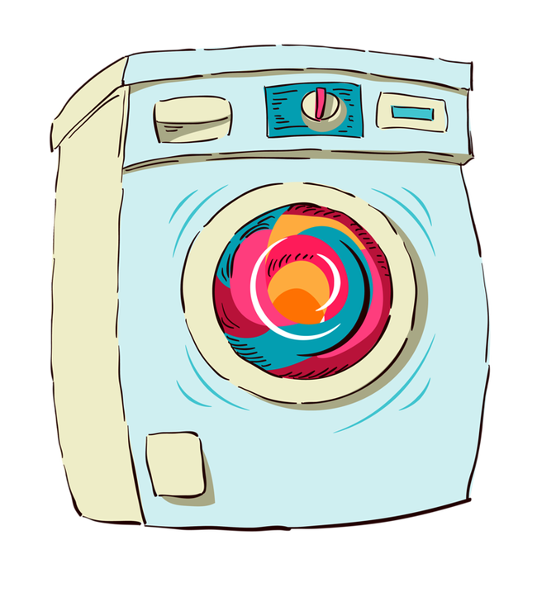

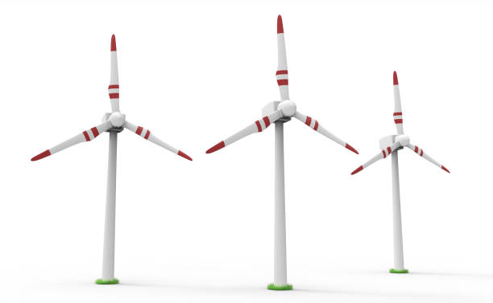
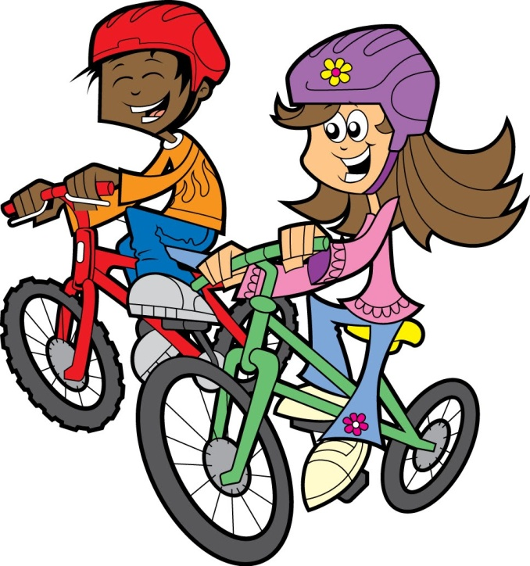
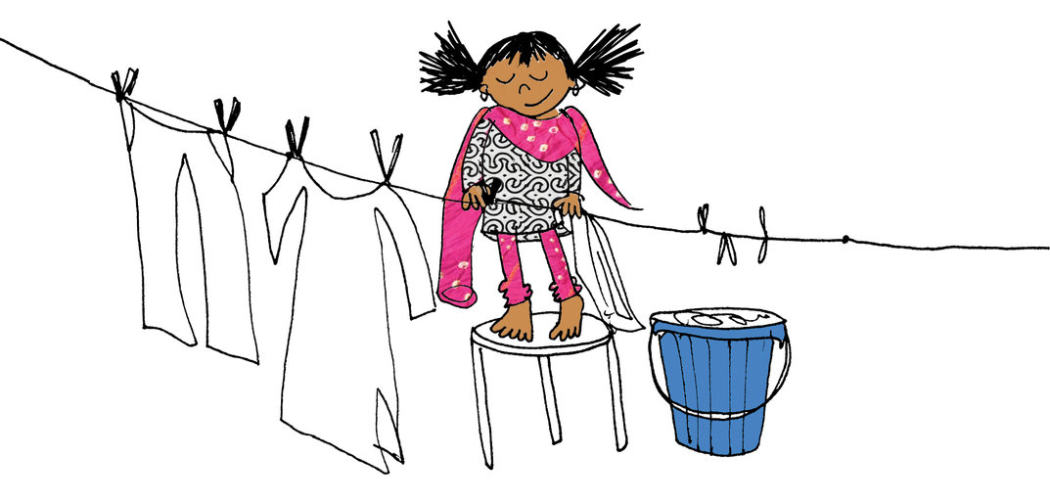
Conservation of Energy

Slide 2
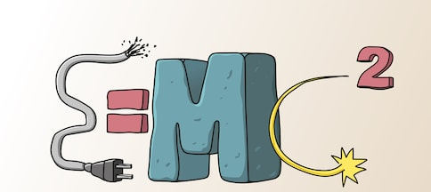
Energy
Energy makes things happen.
There are different forms of energy which can be converted to each other during changes.
The amount of energy before the change is the same amount of energy after the change. This is referred to as conservation of energy.

Slide 3
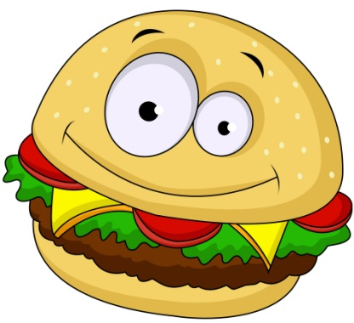

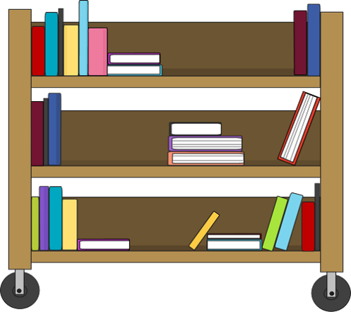
Forms of Energy
Chemical Energy
This is the energy stored in chemicals such as fuels and foods. This chemical energy is released during any chemical reaction.
Kinetic Energy
This is the energy and object
has because of its movement
Gravitational Potential Energy
This is the energy stored by
an object because of its position

Slide 4
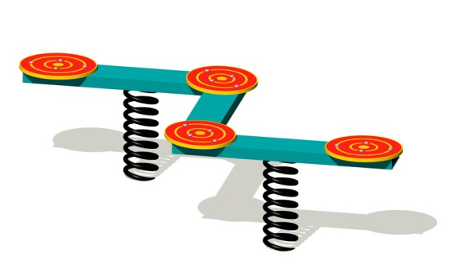
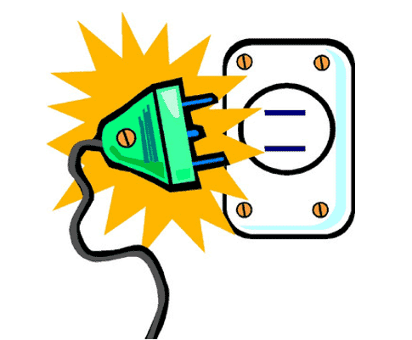

Forms of Energy
Elastic Energy
This is the energy stored in a material under stress, for example a stretched rubber band or a string.
Electrical Energy
This is the energy transferred by the movement of electrons in an electric current.
Heat Energy
This is the energy of an object due to its temperature

Slide 5


Forms of Energy
Light Energy
This energy is given off by the Sun, light bulbs and bioluminescent animals.
Sound Energy
This energy is as a result of mechanical energy.

Slide 6
Examples of Energy Inter-conversions
A battery operated radio
chemical → electrical → sound
In a computer
electrical → sound → light → heat
Nuclear power stations
nuclear → heat (steam) → kinetic (energy from turbines in generator) → electrical

Slide 7
Energy Inter-conversions
Solar energy is produced on the Sun by nuclear reactions.
They are fusion reactions in which small atoms join to make larger atoms.
In nuclear power stations large atoms are split into smaller atoms. At the end of the reaction the mass of the particles are slightly less than before due to heat loss.

Slide 8
Unit of Energy
The unit of energy is the Joule, J.
1 J ~ 1 N/m
1 000 J = 1 × 10³ = 1 kJ since a kilo = 10³
1 000 000 = 1 × 10⁶ = 1 MJ since a mega = 10⁶

Slide 9
Comprehension
1. Show the energy conversions (transformations) in the following:
a. A swing in action at the park
b. A TV set
c. A moving car
d. Photosynthesis

Slide 10
Comprehension
2. In chemical reactions the mass of reactants before the reaction equals the mass of products after the reaction.
Explain why this is not the case in a nuclear reaction.

Slide 11
Comprehension
3. If the conservation of energy is true, why should we bother to conserve energy in our everyday lives?
4. How many joules are there in:
a. 5.2 kJ b. 75 MJ

Slide 12
Energy on the Move and Momentum

Slide 13
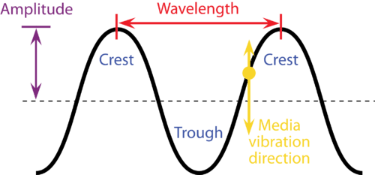
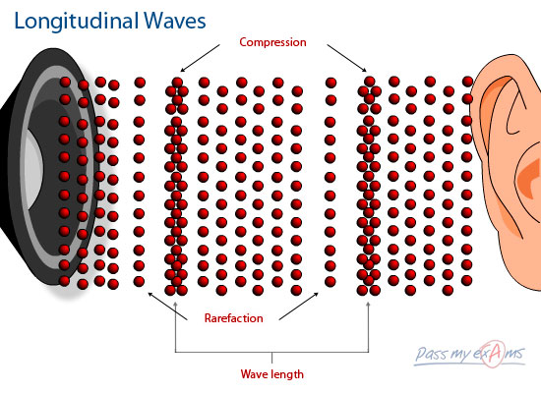
Moving Energy
Besides conduction, convection and radiation, waves are another way of transferring energy from place to place.
Sound and light travel as
waves. Therefore both are
able to transfer energy.
Sound travels as a
progressive longitudinal
wave while light travels
as a progressive transverse
wave.

Slide 14
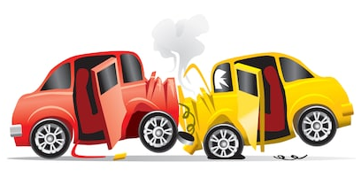
Momentum
Any object that is moving has momentum. The more momentum it has the harder it is to stop.
Objects with a lot of momentum have a large mass and/or a large velocity.
Momentum (kg m/s) = mass (kg) × velocity (m/s)

Slide 15
Momentum
In any collision the momentum is the same before and after the collision.
This is called the conservation of momentum.
The conservation of momentum can be viewed via the use of Newton’s Cradle.
The quantity momentum has both size and direction just like velocity.

Slide 16
Comprehension
1. Give 3 examples of how energy is transferred from place to place using waves.
2. Describe how a solar cooker works.
3. a. What is meant by the ‘conservation of momentum’?

Slide 17
Comprehension
3. b. i.
Which of these three cars has the greatest momentum when travelling at 20 m/s?
Car A of mass 1000 kg
Car B of mass 1100 kg
Car C of mass 1200 kg
3. b. ii.
Which car would have the greater momentum – car A travelling at 20 m/s or car B travelling at 40 m/s? Explain your answer.

Slide 18
Comprehension
4. A railway truck travelling down the track at 4 m/s bumps into an identical truck that is stationary.
In theory, at what speed should both trucks continue down the track following the collision?
5. Calculate the momentum of a truck of mass 2500 kg moving at a velocity of 15 m/s.

