Slide 1
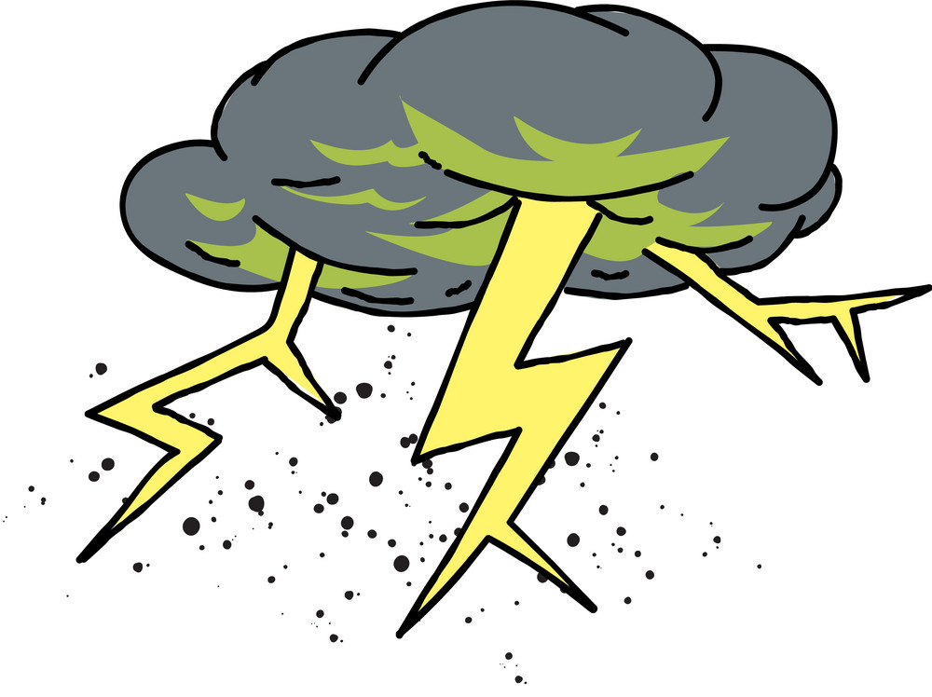
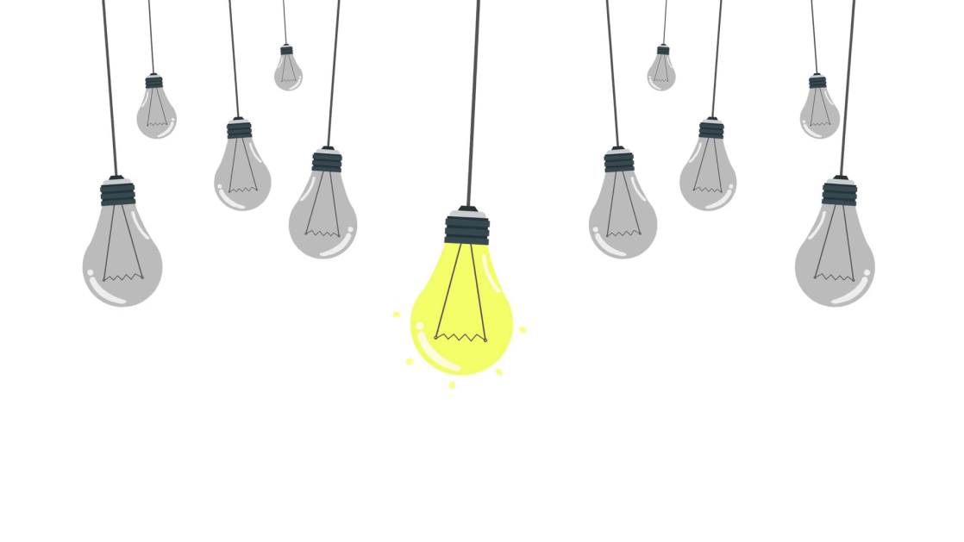
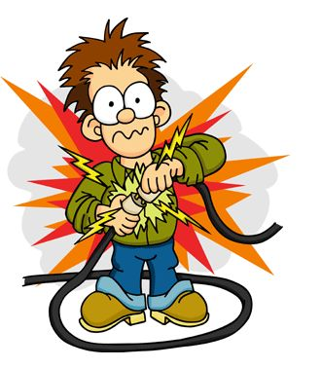
Electricity and Lighting

Slide 2
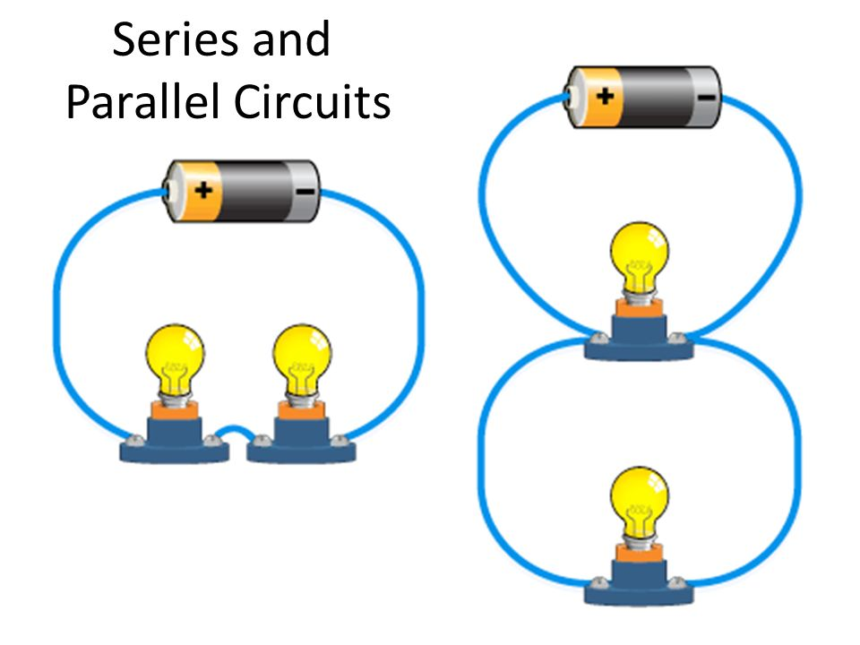
Electricity
Electricity is the flow of electrons.
It can only flow if there is a complete pathway called a circuit.

Slide 3
Electricity
Conductors and insulators
Conductors allow electricity to pass through them because they contain mobile electrons.
Examples of conductors are metals and graphite.
Insulators do NOT allow electricity to pass through them because they do not contain mobile electrons.
Examples of insulators are wood, wool and rubber.

Slide 4
Electricity
Semi-conductors
There are some materials which are able to conduct electricity slightly.
They fall in between conductors and insulators and are referred to as semi-conductors.
Examples of semi-conductors include silicon, boron and germanium.
They are used to make components for computers.

Slide 5
Series and Parallel Circuits
Table comparing series and parallel circuits
Series Circuit | Parallel Circuit
One direct pathway for current to flow | Many pathways for current to flow
If there are more than one lamp in the series circuit and one blows or is unscrewed then all will cease to work | If there are more than one lamp in the parallel circuit and one blows or is unscrewed the rest bulbs will continue to work unaffected

Slide 6

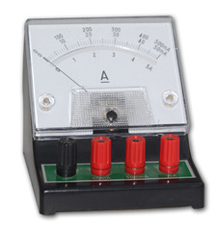
Ammeter
Current can be measured using an ammeter.
An ammeter connected into a series circuit in any position gives the same reading.
This shows that the current is the same at any point in a series circuit.

Slide 7
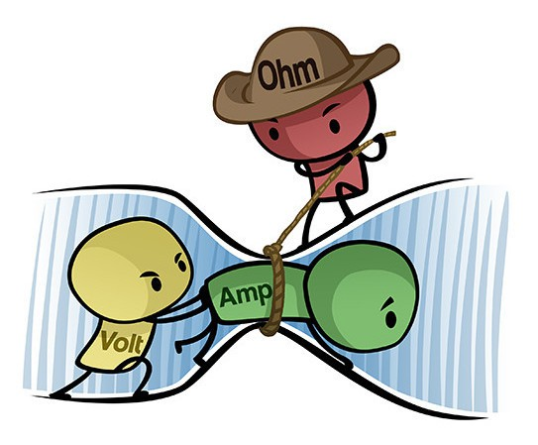
Current, Voltage and Resistance
Electrical current is the rate of flow of charge around a circuit.
It is measured by an ammeter (connected in series)
Its units are amperes, A.

Slide 8
Current Voltage and Resistance
Electromotive force (e.m.f.) is a measure of the ‘pushing power’ of a cell or battery.
It is measured by a voltmeter (connected in parallel across the cell)
Its units are volts, V.

Slide 9

Current Voltage and Resistance
The electrons, pushed around by the cell, carry energy transferred from the chemicals in the cell.
As they pass through the thin wire in a lamp this electrical energy is transferred to heat and light is released by the lamp.
There is a difference in energy before and after each electron passes through the lamp. This is called potential difference (p.d.) which is measured in volts.

Slide 10
Current Voltage and Resistance
The resistance of a component is a measure of how difficult it is for current to pass through it.
Resistance can be calculated using the following equation:
Resistance (Ω) = Voltage (V) ÷ Current (A)
The equation is often written as V = IR known as Ohm’s Law.

Slide 11
Comprehension
A current of 0.05 A, supplied by a 3 V battery, passes through a resistance wire.
What is the resistance of the wire?

Slide 12
Comprehension
A. Draw a circuit diagram with one cell and three lamps connected in parallel.
B. What would happen if the middle lamp blew and went out? Explain your answer.

Slide 13
Comprehension
A wire is connected to a 1.5 V cell and has a 0.2 A current passing through it. What is the resistance of the wire?

Slide 14

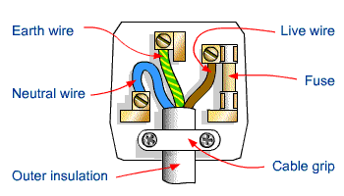
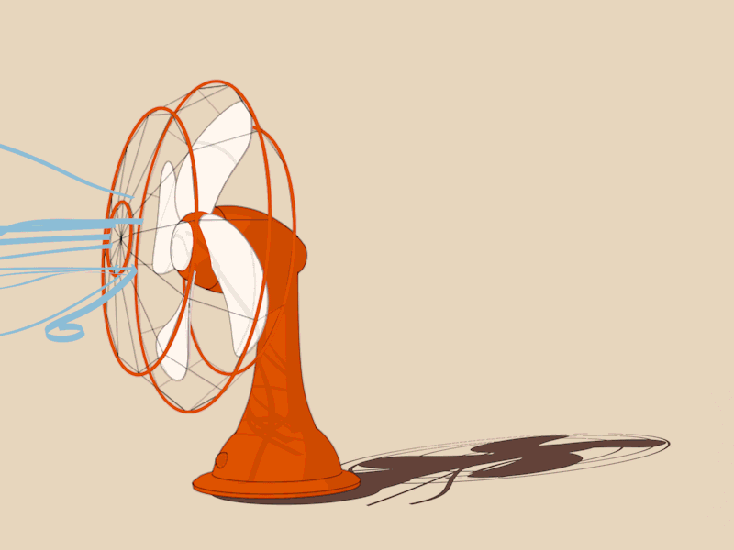
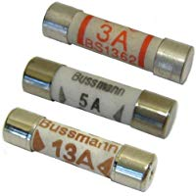
Fuses and Cables (Flexes)

Slide 15
The Fuse
A fuse contains a thin wire that melts and snaps if too much current passes through it.
The are included into circuits as a safety measure to avoid overheating and fires.

Slide 16
The Fuse
Fuses may have ratings of 3A, 5A or 13 A.
The current rating may be calculated using the equation:
I = P ÷ V
which is derived from the equation:
P = I × V
Where P = power in Watts (W), I = current in amperes (A) and V = volts in (V)

Slide 17
Plugs
Appliances with metal cases will be attached to their plugs by three wires:
a. The LIVE wire (brown)
b. The NEUTRAL wire (blue)
c. The EARTH wire (yellow and green)

Slide 18
Plugs
Appliances with plastic casing, such as a hairdryer, only need a two-core cable and in their plug there is no connection to the earth pin.
The earth wire is needed for metal-cased appliances. The earth pin is attached via the socket circuit to the ground in case the live wire touches the metal casing.
Incorrect wiring of a plug can lead to severe shock or electrocution.

Slide 19
Plugs
Thick wires allow more current to pass through therefore less resistance is experienced and less heat energy is lost.

Slide 20
Comprehension
A. If you have an appliance that has a power rating of 250 W on an island with a 110 V mains supply, what current will the appliance use?
P = 250 W = 250 J/s V = 110 V I = x
I = P / V = 250 J/s / 110 V = 2.3 A
B. Based on your answer above what fuse should be used with this appliance?

Slide 21
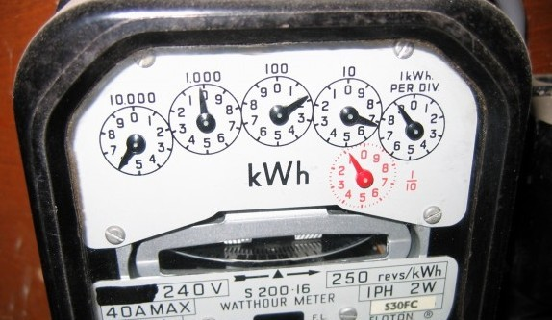
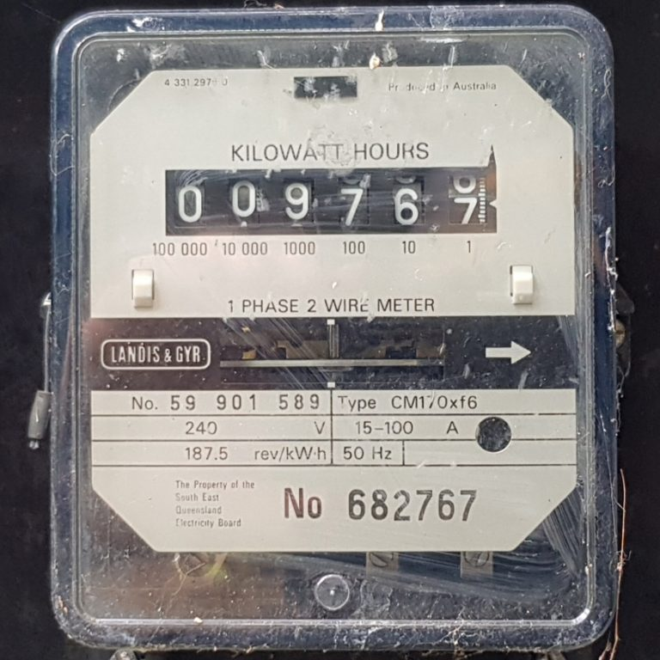
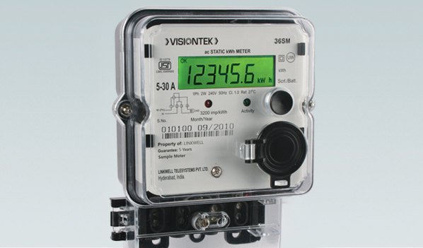
Energy Consumption

Slide 22
Energy Consumption
The electrical energy we use has to be paid for.
Therefore the less energy we consume the lower our electricity bills.
Using less energy can also benefit the environment since the energy we use is typically generated from fossil fuels.

Slide 23
Energy Consumption
Energy consumption (J) = Power (W) × Time (s)
Usually energy consumption is recorded in kJ since the amount of energy a home needs is very large.
Where 1 kJ = 1000 J

Slide 24
Energy Consumption
Since using kilojoules is still a large number on a bill electricity boards find it better to use a unit of energy called a kilowatt-hour (kWh)
Where 1 kW = 1000 W
kWh is the unit shown on your electricity bill.

Slide 25
Energy Consumption
Meters
To determine how much energy you would have used for a period of time your electricity supplier will read your meter, preferably every month.
There are different types of meters
a. Analogue (dial)
b. Digital
c. Electronic

Slide 26
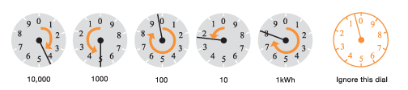
Energy Consumption
How to Read Your Dial Meter
Here's a typical electricity dial meter:
Each dial turns in the opposite direction to the one before it. Before you read your dial meter, check the direction of your dials. They may not be exactly as those illustrated above. Every dial on every meter revolves from 0-1 and on through to 9 before continuing to 0 again.
To read correctly:
Read the dials from left to right
If the pointer is between two numbers, always take the lower number
If the pointer is directly over a number, write down that one
If the pointer falls between 9 and 0, write down 9 and reduce the reading you've already taken for the dial on it's left by one. For example, if you originally recorded 5, reduce it to 4
Don't read the last dial on the right
What is the reading on the meter above: ___ ___ ___ ___ ___

Slide 27
Energy Consumption
Charges
Other charges that may apply to your bill are:
a. Standing charge (money you pay even if you did not use any energy/electricity)
b. A fuel surcharge
c. Value Added Tax (VAT) (15% to pay on any units consumed over 100 kWh)

Slide 28
Energy Consumption
Energy Conservation
There are many ways in which you can lower the amount of energy or electricity you use in your home.
To conserve electricity you may:
a. Turn off appliances when not in use
b. Use energy saving light bulbs instead of filament lamps

Slide 29
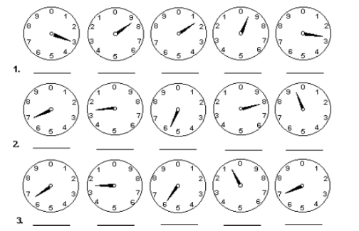
Comprehension
Give the meter reading for the meters below.

Slide 30
Comprehension
A 70 W light bulb is left on for 5 minutes. How much energy does it use?
E = P × t
P = 70 W = 70 J/s
t = 5 mins * 60s = 300 s
E = Pt = 70 J/s * 300 s = 21 000 J = 21 kJ

Slide 31
Comprehension
Calculate the energy consumption in joules for a 500 W electrical heater left on for 10 minutes.
P = 500 W = 500 J/s
t = 10 mins = 10 * 60 = 600 s
E = P t = 500 J/s * 600 s = 300 000 J = 300 kJ

Slide 32
Comprehension
An electricity meter read on 1st October was 1108 units.
When it was read a month later it was 1192 units.
The cost of the first 50 units was 55 cents per kWh and any units over that, up to 100 units, was 65 cents per kWh.
Calculate the cost of the electrical energy consumed during that month.
(1192 – 1108) units = 84 units were used for the month of October
1 kW = 1 unit
:. 84 units = 84 kWh
50 units * 0.55 c = $27. 50
84 – 50 = 34 units * 0.65 c = $ 22.10
Total cost for electricity used = 27.50 + 22.10 = $ 49.60

Slide 33
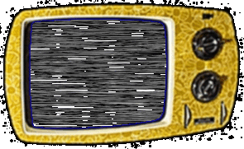

Efficient Lighting

Slide 34
More Efficient Display Screens for Televisions and Computers
The traditional cathode ray tubes (CRT) which was used for screens on your TV and Computer screens are now being replaced by more efficient:
light emitting diode (LED)
plasma screens or a
liquid crystal display (LCD) screens
In general, LED screens are more efficient in saving energy and thus money.

Slide 35

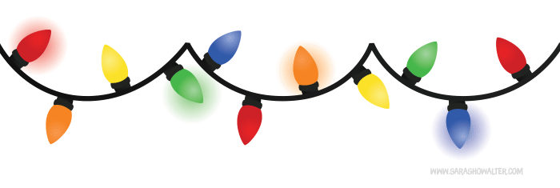
Filament Bulbs
Filament bulbs come in 40, 60 and 100 W sizes.
The greater the power rating the greater the light intensity. So 100 W would produce the most amount of light.
However, although filament light bulbs give off a lot of light they are not efficient because they give off a lot of heat. This makes it expensive to use.

Slide 36
Filament Bulbs
The reason why filament bulbs give off so much heat is because the tungsten wire in the light bulb itself is quite thin and this produces a small passage way for the movement of electrons hence resistance is high.
This causes the wire to glow white-hot.
As much as 95 J of heat energy is produced for every 5 J of light given out.

Slide 37
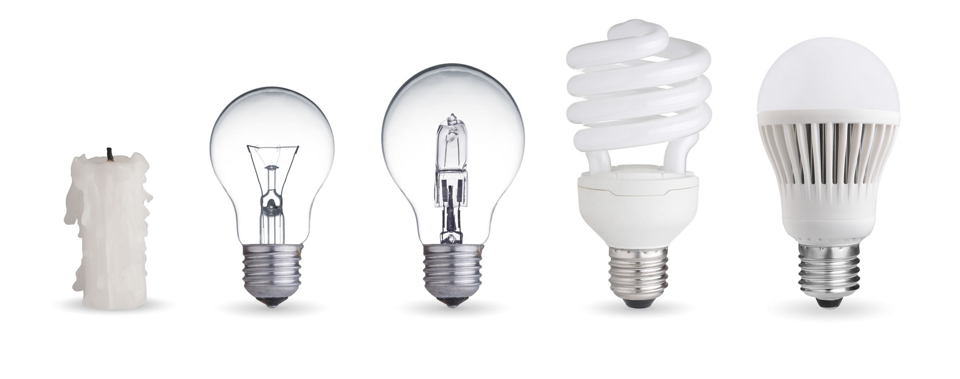
Phasing out of Filament Lamps for Fluorescent Tube Lighting
Filament lamps are now being phased out by more energy saving bulbs which are derived from fluorescent tube lighting.

Slide 38
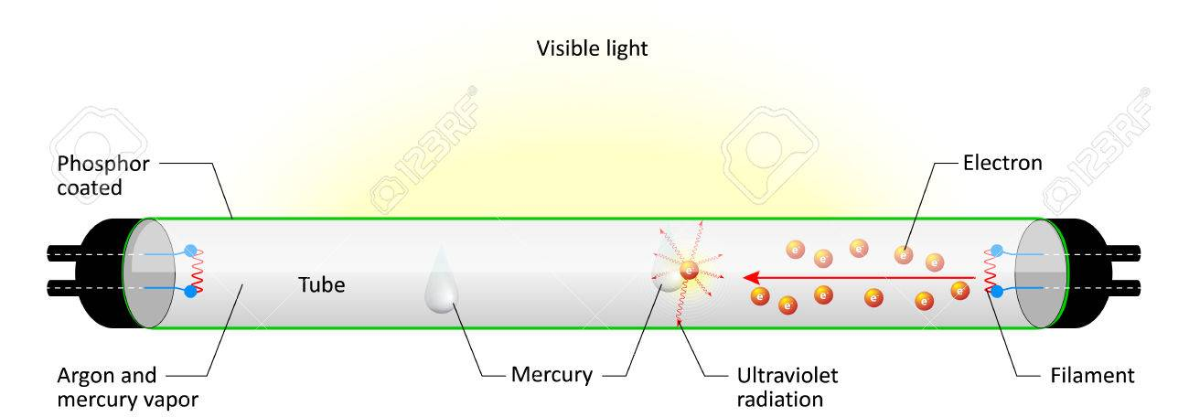
Phasing out of Filament Lamps
Fluorescent tubes
have electrodes at each
end with electrons jumping between them.
These pass energy onto the mercury atoms inside the long tube.
When the mercury atoms go back to their original energy they release ultraviolet light.
This interacts with the lining of the long tube, which gives off visible light energy.

Slide 39
Comprehension
Which one of the following types of display screen is generally considered the most energy efficient to use?
A. Plasma B. CRT
C. LED D. LCD

Slide 40
Comprehension
How does a filament lamp give out light?
How does fluorescent tube lighting give off lighting?
Draw a table comparing the benefits and drawbacks of filament lamps compared with fluorescent tube lighting or compact fluorescent lighting.

Slide 41
Be Prepared in an Emergency

Slide 42
Fire Fighting
For a fire to keep on burning it must have three things present:
FUEL
OXYGEN
HEAT ENERGY

Slide 43
Fire Fighting
A fire started by paper can be put out by
A. Spraying water on it
B. Covering it with a heat proof cover to cut off its oxygen supply.
However not ALL fires can be put out with water due to how it started.

Slide 44
Different Ways to Extinguish a Fire Based on How they started
Fires cause by gas can be extinguished by turning off the gas
Fires caused by electricity can be extinguished by carbon dioxide, CO₂.

Slide 45
In case of Electric Shock
If someone is being shocked them turn off the mains switch.
DO NOT TOUCH THE PERSON if they are still in contact with the electricity supply as you can be shocked or electrocuted. Electrocution is fatal.
If you are unable to turn off the mains switch then try to use an insulator like a wooden stick to dislodge the person from the faulty appliance.
Phone the emergency services immediately.

Slide 46
In Case of Electric Shock
In severe cases a person might stop breathing and you may have to administer mouth to mouth or mouth to nose resuscitation. This is often referred to as cardio-pulmonary resuscitation, CPR.
Sometimes persons suffer from burns. In this case hold the affected area under cold running water for 10 minutes. Then cover it with cling film.

Slide 47
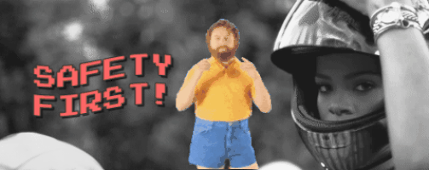
Safety First

Slide 48
Safety in Everyday Life
We come across safety rules and hazard warnings in many aspects of everyday life. Road safety is a good example.
At home we have products that have hazard signs to warn us about harmful, irritant and corrosive substances.
In science laboratories a variety of hazard symbols are used to warn about potential dangers.
You need to know the following symbols in order to work and plan investigations safely in science.

Slide 49

Types of Accidents
Electric shocks
Fires and inhalation
of smoke, eg CO
Sprains and broken bones
Cuts from sharp objects
Inhalation of toxic gases
Flammable substances
Corrosive substances
Excessive noise
Food contamination
Heavy machinery
Lifting heavy objects
Infection of pathogens

Slide 50
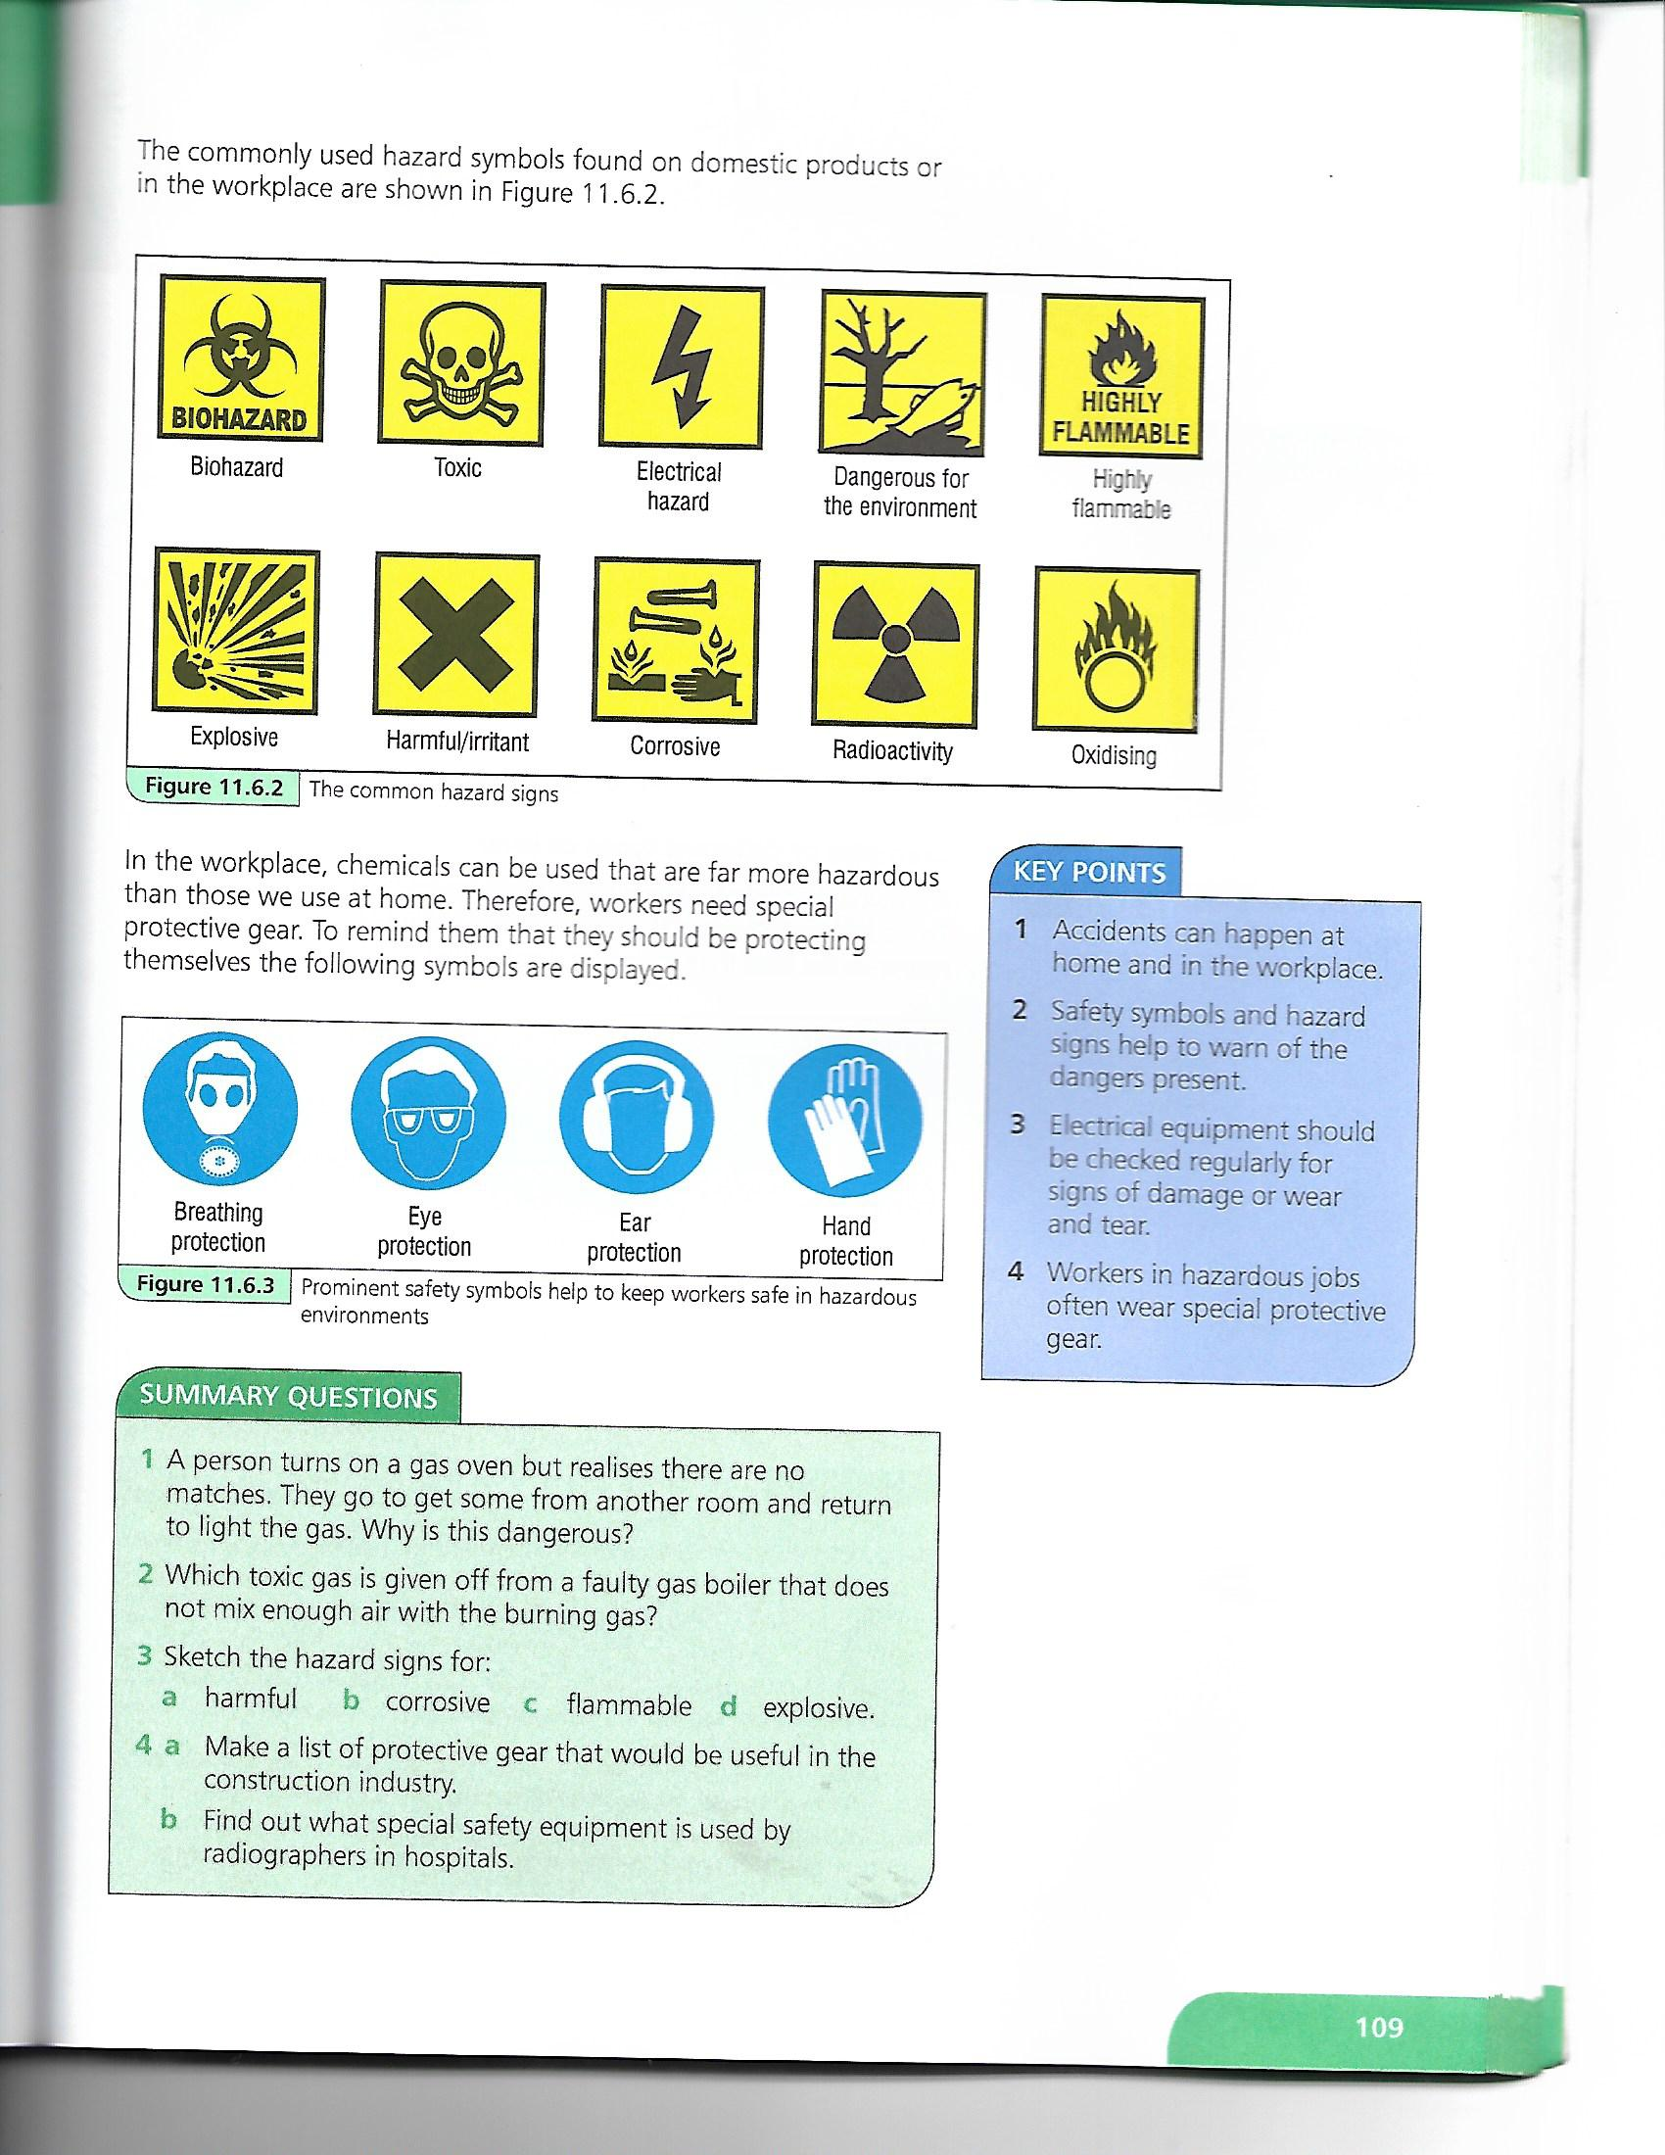
Avoiding Accidents
Safety Symbols
In the workplace to avoid accidents you will see safety signs and symbols.

Slide 51
Avoiding Accidents
Hazard Signs

Slide 52
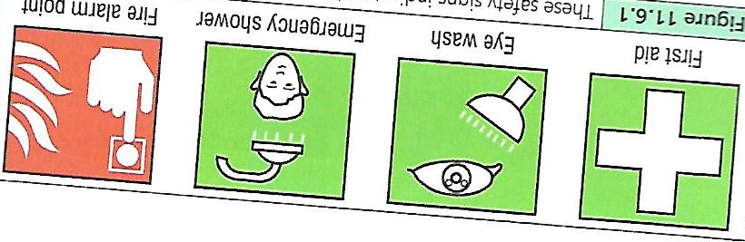
Avoiding Accidents
Safety Signs

Slide 53
Safety in the Science Laboratory
In science you need to follow laboratory safety rules and know the common hazard symbols.
Here is a list of some typical laboratory rules:
YOU MUST NOT:
1. enter the lab unless a teacher is present
2. run in the laboratory
3. touch any chemicals
4. leave experiments unattended

Slide 54
Safety in the Science Laboratory
Here is a list of some typical laboratory rules:
YOU MUST NOT:
5. smell gases directly
6. point the mouth of a test tube towards anyone when heating
7. eat or drink in the laboratory
8. put solids in the sink

Slide 55
Safety in the Science Laboratory
In the lab you should ALWAYS:
1. follow the instructions given
2. wear eye protection
3. read the labels on any bottle correctly
4. note any hazardous substance

Slide 56
Safety in the Science Laboratory
In the lab you should ALWAYS:
4. note any hazardous substance
5. report any accidents or breakages to you teacher.
6. Leave Bunsen burners with a luminous (yellow) flame when not in use or turn it off
7. tie up long hair
8. wash you hand after experiments

Slide 57
