Slide 1
Moments and levers

Slide 2
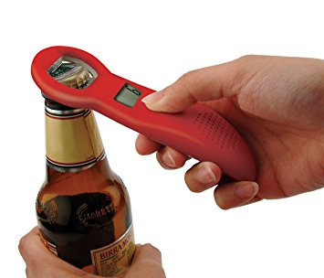
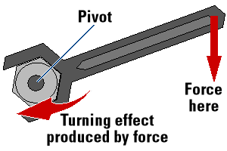
Levers
A lever is a simple device/machine which makes work easier.
When a force is applied (effort) levers turn about a pivot when doing work to move the resisting force (load).
This is referred to as the turning effect.

Slide 3
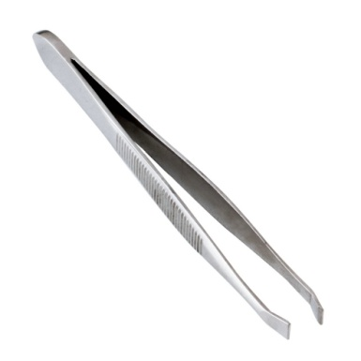
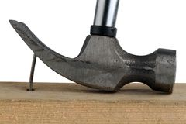
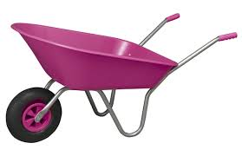
Levers
Some examples of levers are: Scissors, bottle openers, crowbars, pliers, see-saws, tweezers, wheel barrows, spanners, a hammer removing a nail etc…
Levers can be classified into 3 classes: a. 1st class levers b. 2nd class levers c. 3rd class levers

Slide 4
Levers
1st class levers are machines where the fulcrum or pivot is nearer to the load than the effort. (crowbar lifting a load)
2nd class levers are machines where the load and effort force are shared out by the fulcrum so the force needed to lift the object is less than the load force. 2nd class levers act as force multipliers. (wheel barrows)
3rd class levers are machines where the fulcrum is nearer the effort than the load. In 3rd class levers the effort is greater than the load so these levers are used where you want to pick up delicate or small objects. (tweezers)

Slide 5
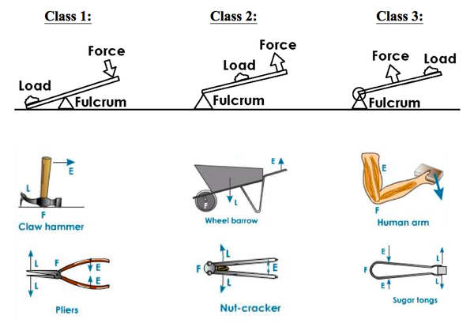
Codes for rem
1st LFE 2nd FLE 3rd FEL
L – Load E – Effort F – Fulcrum

Slide 6
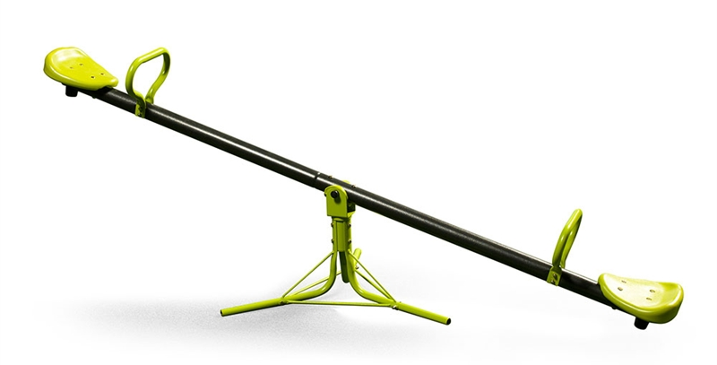
The Turning Effect of a Force
When a force acts on an object it may cause a turning effect, known as the moment of the force.
The turning effect depends on: a. the SIZE of the force applied b. the DISTANCE of the force from the pivot/fulcrum or point of rotation.

Slide 7
Calculating Moments
Turning moment (Nm) = Force (N) × Distance (m)
The unit of moment of a force is the newton metre (Nm). It is NOT equivalent to a joule because the distance measured is perpendicular to the force and not in the direction of the force.

Slide 8
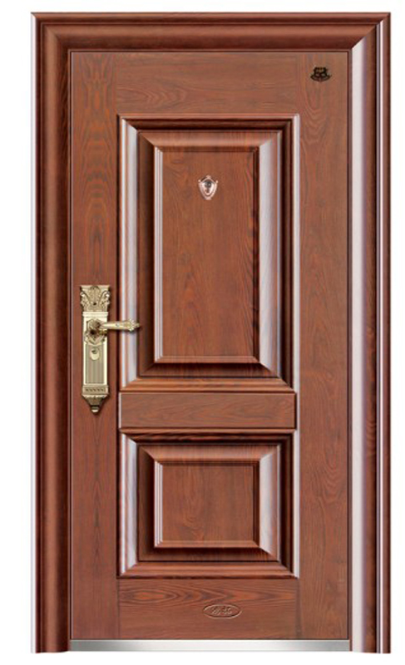
Calculating Moments
Why is the handle on a door at the outside edge?
Why doesn’t it make sense to put the door handle in the centre of the door?

Slide 9
Calculating Moments
Scenario A Scenario B
What is the moment of force on the gate in scenario A? What is the moment of force on the gate in scenario B?
Fulcrum or Pivot
3 m
1.5 m
1.5 m
Fulcrum or Pivot
F = 5 N
F = 5 N

Slide 10
Calculating Moments Clockwise and Anti-Clockwise
When describing the action of moments, the terms clockwise and anticlockwise are used to describe the direction of action. F₁ is trying to turn the ruler anticlockwise. F₂ is trying to turn the ruler clockwise. When the ruler is balanced or at equilibrium the results should show that the anticlockwise moment F₁ × d₁ equals the clockwise moment F₂ × d₂.

Slide 11
Calculating Moments Moments and Equilibrium
When an object is in equilibrium it is not accelerating or rotating. The two equilibrium conditions are: a. There is NO resultant force acting on the object. b. The clockwise moment is equal to the anticlockwise moment. This is known as the principle of moments.

Slide 12
Try this yourself: A uniform plank of 10 m long is balanced on a pivot 2 m from one end by applying a force of 30 N at the end. What is the weight of the plank?
In the figures below the distance AC = CB. Calculate in each case the force P which will keep the system stationary. Scenario A Scenario B
2 m
8 m
30 N
P
P
A
C
B
A
C
B
10 N
10 N
10 N

Slide 13
Calculating Moments Clockwise and Anti-Clockwise
Here’s a worked example: The see-saw below balances when Joanna of weight 320 N is at A, Tom of weight 540 N is at B and Michael of weight W is at C. Find W. Taking moments about the fulcrum O: anticlockwise moment = (320 N X 3 m) + (540 N X 1 m) = 1500 Nm clockwise moment = (W X 3) Nm = 3W Nm Clockwise moments = Anticlockwise moments 3 W = 1500 Nm W = 500 N
2 m
1 m
3 m
A
B
O
C
fulcrum or pivot
320 N
540 N
W

Slide 14
Exercises

Slide 15
As an example consider two decorators of weights 500 N and 700 N standing at A and B on a plank resting on two trestles. The whole weight of the plank, 400 N, may be taken to act vertically downwards at its centre, O.
If P and Q are the upwards forces exerted by the trestles on the plank, called reactions, then we have the sum of the forces in one direction equals the sum of the forces in the opposite direction: P + Q = (500 + 400 + 700) N = 1600 N Moments can be taken about any point, but taking them about C eliminates the moment due to Q: clockwise moment = P X 4 m anticlockwise moment = ( (700 X 1) + (400 X 2) + (500 X 5) ) = 4000 Nm Since the plank is in equilibrium we have from (2) on the previous page where the law of moments must apply: 4 P m = 4000 Nm p = 1000 N From the first equation we can now substitute where: P = 1000 Nm and P + Q = 1600 N then Q = 1600 N - 1000 N = 600 N

Slide 16
Centres of gravity

Slide 17
Centre of Gravity
A body behaves as if its whole weight were concentrated at one point, called its centre of gravity (c.g.), even though the earth attracts every part of it.
The c.g. of a ruler is at its centre, and when supported there it balances. If it is supported at any other point it topples because the moment of its weight W about the point of support is not zero.

Slide 18
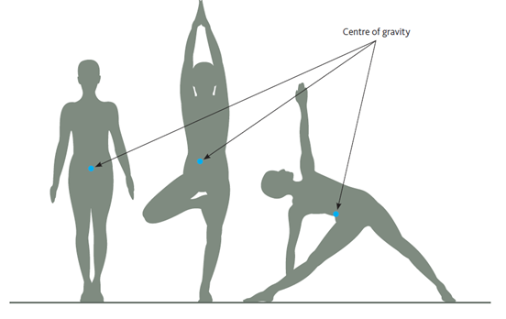
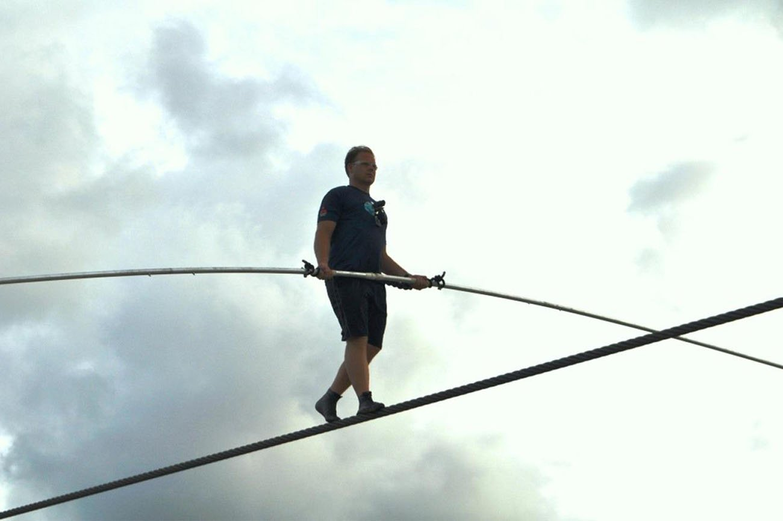
Centre of Gravity
Your centre of gravity is near the centre of your body and the vertical line from it to the floor must be within the area enclosed by your feet or you will fall over.
A tight-rope walker has to keep their c.g. exactly above the rope. Why does a tight-rope walker have to do this? What do some tight-rope walkers use in order to keep their balance?

Slide 19
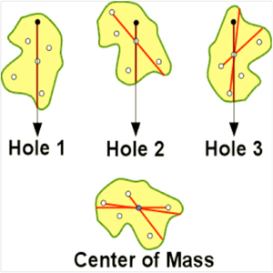
Centre of Gravity Of an Irregular Shape Object
The c.g. of a regular shaped object or body of the same density all over is at its centre. In other cases it can be found by experiment.
A plumb line can be used to find the centre of gravity of an irregularly shaped object. One can do this by punching a hole at any point about the edge of the object and placing it to hang upon a nail. From there a plumb line is to be fitted onto the nail and allowed to hang. A line is then drawn along the plumb line. The same procedure is to be repeated when another hole is punched into the same irregularly shaped object’s edge but at a different place. Eventually, where all lines intersect is exactly were that object’s centre of gravity is.

Slide 20
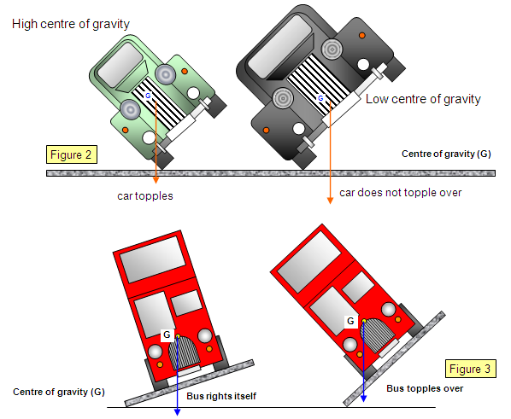
Centre of Gravity
The position of the centre of gravity of a body affects whether or not it topples over easily. This is important in the design of such things as tall vehicles which tend to overturn when rounding a corner, race cars, reading lamps and even tea-cups. Why do you think a body topples?
The stability of a body is therefore increased by: a. Lowering its centre of gravity b. Increasing the area of its base Racing cars have a low centre of gravity and a wide wheel base.

Slide 21
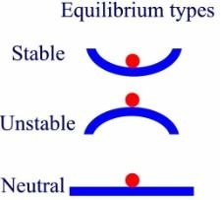
Centre of Gravity Types of Equilibrium
Three terms are used in connection with stability: 1. A body is in stable equilibrium if when slightly displaced and then released it returns to its previous position. Its centre of gravity rises when it is displaced. 2. A body is in unstable equilibrium if it moves farther away from its previous position when slightly displaced. Its centre of gravity falls when it is displaced slightly. 3. A body is in neutral equilibrium if it stays in its new position when displaced. Its centre of gravity does not rise or fall.

Slide 22
Centre of Gravity Types of Equilibrium
The diagram below demonstrates the 3 types of equilibriums. Think of the red circle as a ball in each depiction. In the stable picture think of the blue curve as a bowl. In the unstable picture think of the blue curve as the same bowl but upturned. In the neutral picture think of the blue line as the floor.

Slide 23
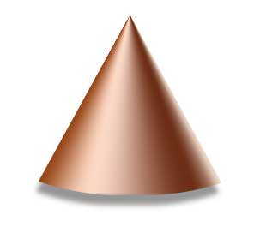
Questions: 1. The figure below shows three different positions of a cone. State in which position it is in: a. stable equilibrium b. unstable equilibrium c. neutral equilibrium
2. The weight of the uniform bar in the figure below is 10 N. Does it balance, tip to the right or tip to the left? (remember weight is at the centre of a body)
1
2
3
10 cm
40 cm
50 cm
100 cm
3 N

Slide 24
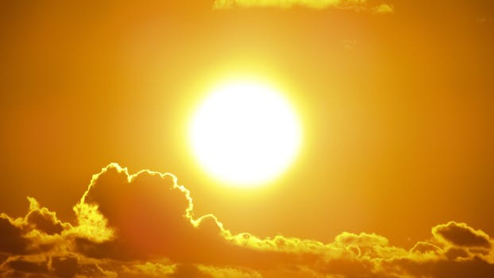
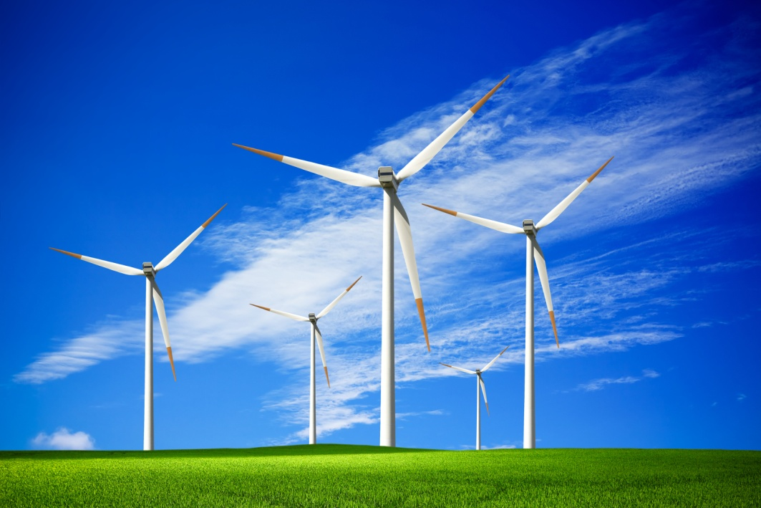
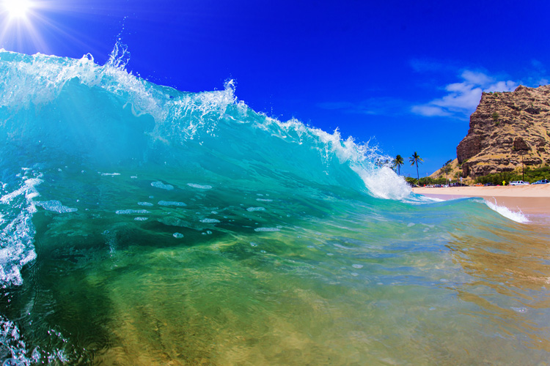
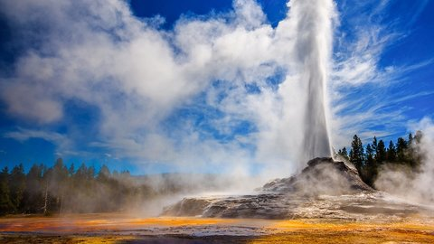
Work, energy, power

Slide 25
Energy and Energy Transformations
Energy is defined as the capacity to do work.
The unit of energy is the Joule, J. Sometimes kilojoule, kJ is used as well.
All events occur due to a transfer or transformation of energy.
Energy is sometimes referred to as being in different forms. A change in form of energy is referred to as a transformation.

Slide 27
Kinetic & Potential Energy
Kinetic energy, E_{k} = ½ mv² or E_{k} = (mv²) ÷ 2 where m: mass (kg), v: velocity (m/s)
Potential energy, E_{p} = mgh where m: mass (kg), g: gravity (9.86 – 10 m/s²) and h: height (m)
E_{p} = E_{k} OR E_{k} = E_{p}

Slide 28
Kinetic & Potential Energy
Try the following questions: a. Calculate the speeds a 1.0 kg mass and then a 2.0 kg coconut will reach when falling to the ground from 25 m. What do you notice?

Slide 29
Kinetic & Potential Energy
Try the following questions: b. An Airbus A380 jet aircraft has a fully loaded mass of 550 000 kg. It can travel at a height of 12 km with a speed of 250 m/s. (i) How much kinetic energy does it have? (ii) How much gravitational potential energy does it have?

Slide 30
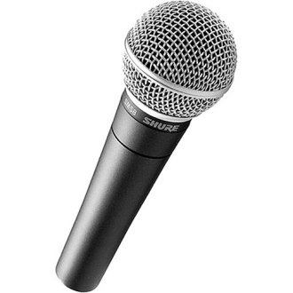
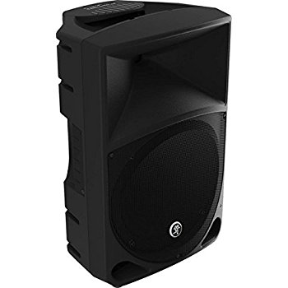
Energy Transformations
Energy can be transferred from one form to another which makes it so useful.
Microphones have been invented to achieve this. They change sound energy into electrical energy. A loudspeaker does the reverse. Belts, chains or gears are used to transfer energy between moving parts.

Slide 31
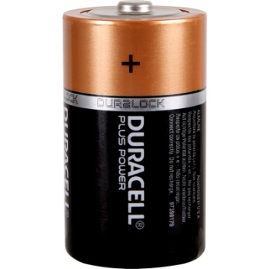
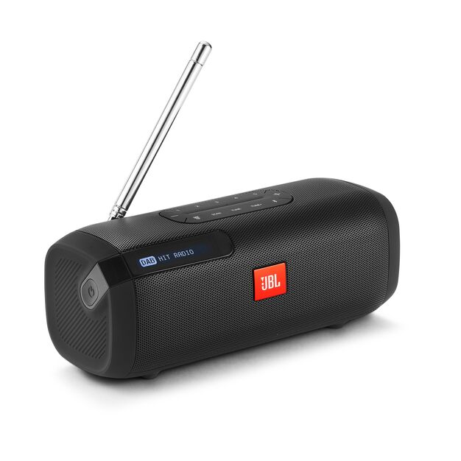
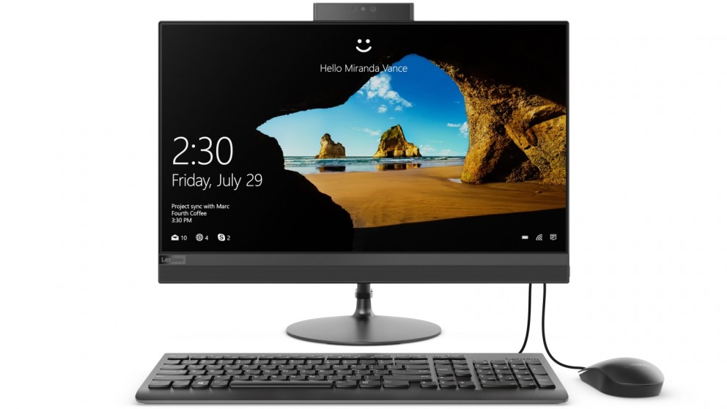
Examples of Energy Inter-conversions
A battery operated radio chemical → electrical → sound
In a computer electrical → sound → light → heat

Slide 32
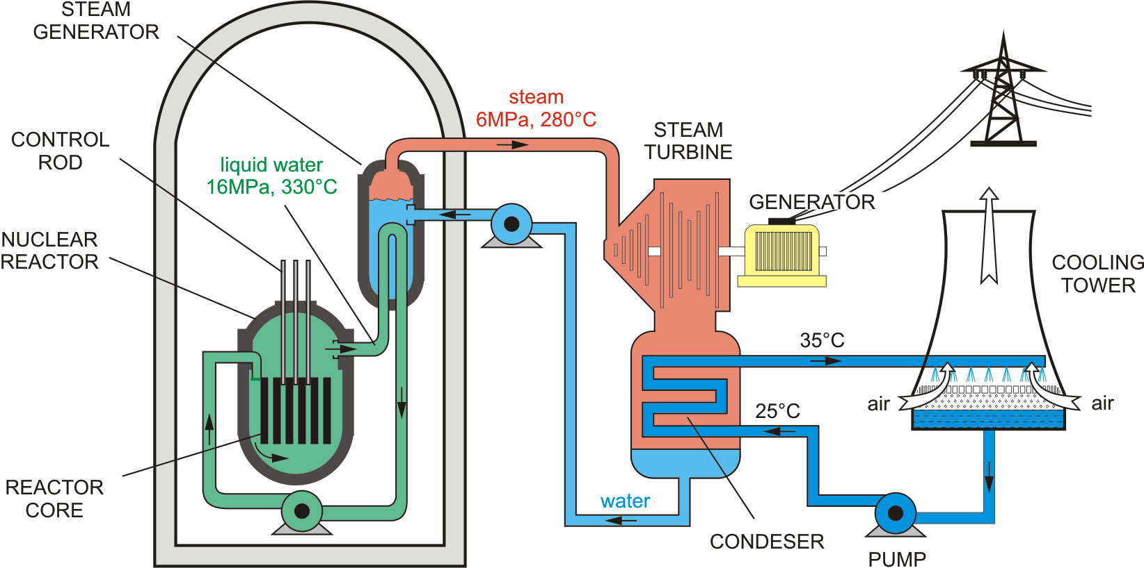
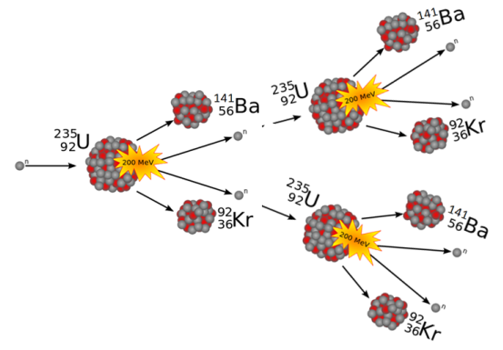
Examples of Energy Inter-conversions
nuclear → heat (steam) → kinetic (energy from turbines in generator) → electrical

Slide 33
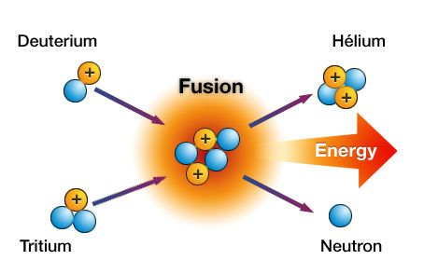
Energy Inter-conversions
Solar energy is produced on the Sun by nuclear reactions. They are fusion reactions in which small atoms join to make larger atoms.

Slide 34
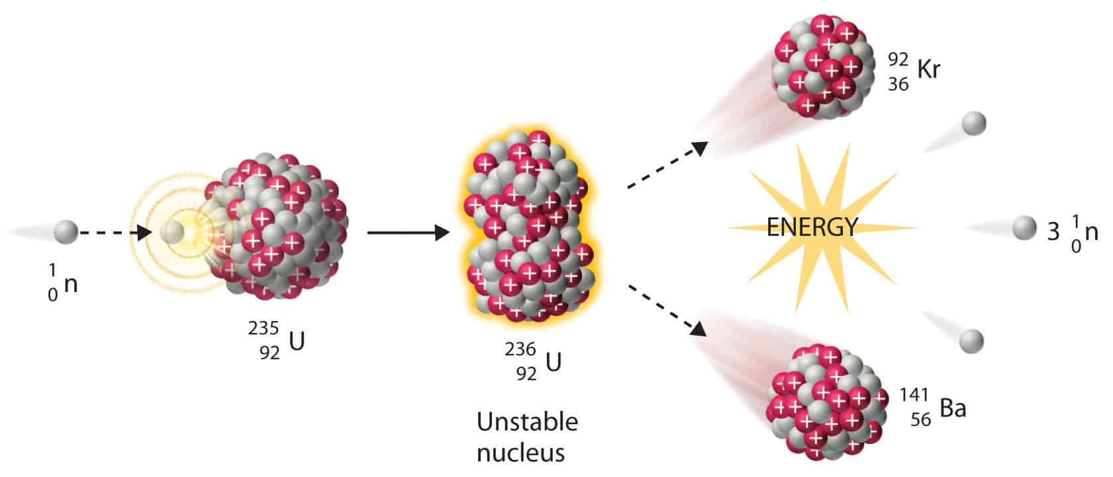
Energy Inter-conversions
In nuclear power stations large atoms are split into smaller atoms. At the end of the reaction the mass of the particles are slightly less than before due to heat loss.

Slide 35
Conservation of Energy
In all energy changes the principle or law of conservation of energy is found to be true. It is stated as follows: Energy cannot be created or destroyed but it can be transferred from one form into another.

Slide 36
Conservation of Energy
If it seems in a transfer that some energy has disappeared, the ‘lost’ energy is often converted into thermal energy. When a brick falls its p.e. becomes k.e.. As it hits the ground, its temperature and that of the ground rises and thermal energy (and a little sound energy) is produced. In practice, some thermal energy is produced in all energy transformations.

Slide 37
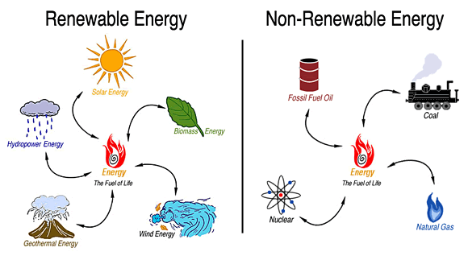
Sources of Energy
There are many sources of energy as it is a necessary ‘raw material’ in the modern world.
From the list above what are non-renewable sources of energy and what are renewable sources of energy?
Nuclear energy has the ability to produce energy at much cheaper prices than fuel or coal. However, there are some problems associated with it. What are the problems?

Slide 38
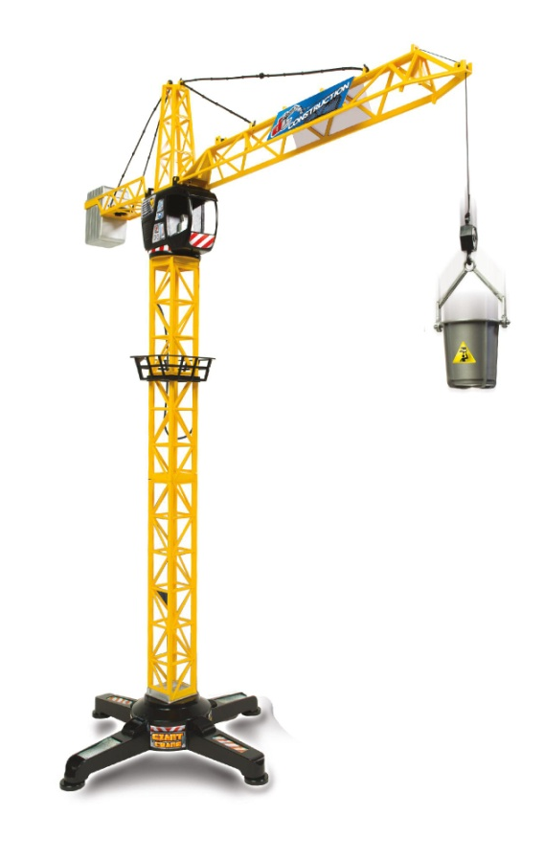
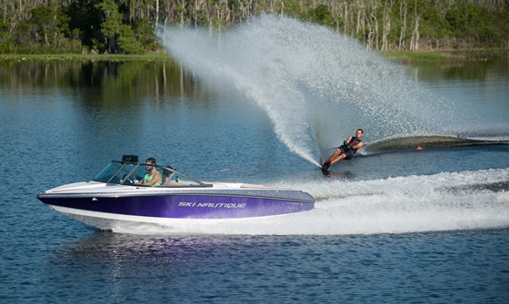
Work

Slide 39
Work
Work is done when a force moves. A boat pulling a water skier does work as does a crane when it lifts a load. However, NO work is done in the scientific sense by someone holding a heavy pile of books; an upwards force is exerted but no motion results.

Slide 40
Work
If a building worker carries ten bricks up to the first floor of a building he does more work than if he carries only one brick. Why is this so?
The amount of work done depends on the size of the force applied and the distance it moves. :. work = force x distance moved in direction of force

Slide 41
Work
The unit of work is the joule (J) and is the work done when a force of 1 newton (N) moves through 1 metre (m). :. joules = newtons x metres where 1 J = 1 Nm = 1 kg m² / s²
If you lift a mass of 3 kg vertically through 2 m how much work has been done?

Slide 42
Power
The more powerful a car is the faster it can climb a hill, that is the faster it does work.
The power of a device is the work it does per second, that is the rate at which it does work. This is the same as the rate at which it transfers energy from one form to another. P = E/t Power = work done / time taken (eq. 1) = energy transfer / time taken (eq. 2) = (mass*gravity*height)/time (eq. 3)

Slide 43
Power
The unit of power is the watt (W) and is a rate of working of 1 joule per second, that is 1 W = 1 J/s. Larger units are the kilowatt (kW) and the megawatt (MW) where: 1 kW = 1000 W = 10³ W and 1 MW = 1 000 000 W = 10⁶ W

Slide 44
Efficiency
During energy transfer some energy is wasted and lost to the environment. This wasted energy depends on the specific device but there is always some heat lost. The efficiency of a transfer is a measure of how much energy is transferred usefully. Efficiency = output value ÷ input value × 100% Therefore, no machine is ever 100% efficient.

Slide 45
Power
If a machine does 500 J of work in 10 s its power is: 500 J / 10 s = 50 J/s = 50 Js⁻¹ = 50 W where 1 J/s = 1 W A small car develops a maximum power of about 25 kW or 25, 000 W.

Slide 46
Power
Try the following questions: A 500 kg load is lifted through a vertical height of 10 m in 25 s by a crane. Calculate the power of the crane.
How long will it take an electric motor of power output 25 kW to lift a mass of 1000 kg through 20 m?
Before you attempt the question write out everything that you have and then proceed.

Slide 47
Horsepower
Get someone with a stop watch to find the time, t, you take to run up a flight of stairs, the longer the better. Find your weight mg (in newtons). Calculate the total vertical height h (in meters) you have climbed by measuring the height of one stair and counting the number of stairs. The work you do (in joules) in lifting your weight to the top of the stairs is (your weight in, N) x (vertical height of stairs, m). Calculate your power P (in watts) from the equation: P = mgh/ t About 0.5 kW is good. (1 horse power = 0.75 kW.)

Slide 48
Friction
Friction is the force that opposes one surface moving, or trying to move, over another. It can be a help or a hindrance.
We could not walk if friction did not exist between the soles of our shoes and the ground. Why?

Slide 49
Friction
However, engineers try to reduce friction to a minimum in the moving parts of machinery by using lubricating oils and ball bearings.
When work is done against friction, the temperature of the bodies in contact rise (as you can test by rubbing your hands together) and thermal energy is produced.

Slide 50
Try it yourself questions: 1. How much work is done when a mass of 3 kg is lifted vertically through 6 m?

Slide 51
Try it yourself questions: 2. In loading a lorry, a man lifts boxes each of weight 100 N through a height of 0.50 m. a. How much work does he do in lifting one box? b. If he lifts six boxes per minute, at what power is he working?

Slide 52
Try it yourself questions: 3. An escalator carries 60 people of average mass 70 kg to a height of 5 m in one minute. Find the power needed to do this.

Slide 53
Machines

Slide 54
Machines
A machine is any device which enables a force (the effort) acting at one point to overcome another force (the load) acting at some other point.

Slide 55
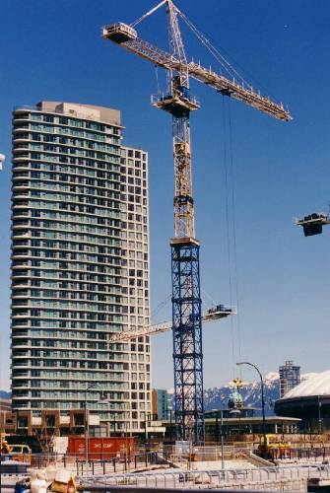
Levers
A lever is a simple machine, as are pulleys, gears, wedges, screws and inclined planes.
Such simple machines are used to build more complicated machines such as a crane as seen in the picture on the right.

Slide 56
Levers Force Multipliers & Distance Multipliers
Levers can be force multipliers or distance multipliers.
With a force multiplier the effort applied is farther from the fulcrum than the load. Examples of force multipliers are crowbars and wheelbarrows.

Slide 57
Levers Force Multipliers & Distance Multipliers
With a distance multiplier the effort applied is nearer the fulcrum than the load and so has to be greater but the load moves farther than the effort. Examples of distance multipliers are biceps lifting something and a pair of tweezers

Slide 58
Levers Efficiency of a Machine
Machines make work easier but they do not reduce the amount of work that has to be done for a particular job.
Machines are NOT perfect because they are not frictionless and the moving parts are not weightless.
With machines some work has to be done in overcoming friction and moving parts of the machine itself. What does this mean?

Slide 59
Levers Efficiency of a Machine
Efficiency, η , pronounced ‘eta’, is defined as follows: efficiency = (work done on load/work done by effort) × 100 ALSO efficiency = (energy output/energy input) × 100
Efficiency is usually expressed as a percentage and is always less than 100%.

Slide 60
Levers Types of Pulleys
There are 3 types of pulleys: a. Single fixed pulley b. Single moving pulley c. Block and tackle

Slide 61
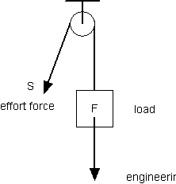
Levers Single Fixed Pulley
Single fixed pulley: A single fixed pulley enables us to lift a load, L, more conveniently by applying a downwards effort, E. The effort, E, needs only to be slightly greater than L if friction in the pulley bearings is negligible.
E

Slide 62
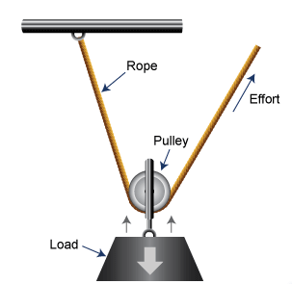
Levers Single Moving Pulley
Single moving pulley: If the effort applied to the free end of the rope is E the total upward force on the pulley is 2E since two parts of the rope support it. A load of L = 2E can therefore be raised if the pully and rope are frictionless and weightless. The force multiplication is 2. To raise the load by 1 m requires each side of the rope to shorten by 1 m. The free end has therefore to take up 2 m of slack.

Slide 63
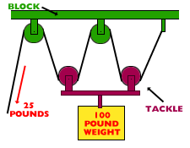
Levers Block and Tackle
Block and tackle: This type of pulley system is used in cranes and lifts. It consists of two blocks each with one or more pulleys. The total upward force on the lower block is 4E or four times the effort since it is supported by four parts of the rope and a load of L = 4E can be raised. The force multiplication is = 4 if the pulleys are frictionless and weightless. However, E has to move four times as far as L does.

Slide 64
Questions
A load of 500 N is raised 0.2 m by a machine in which an effort of 150 N moves 1 m. What is a. The work done on the load, b. The work done by the effort, c. The efficiency?

Slide 65
Questions
An effort of 250 N raises a load of 1000 N through 5 m in a pulley system. If the effort moves 30 m, what is a. The work done in raising the load, b. The work done by the effort, c. The efficiency?

Slide 66
Questions
A load of 40 N is raised 0.5 m by a pulley system when the effort of 10 N moves 2.5 m. What is the efficiency? (Remember that efficiency is usually a percentage)

Slide 67
Questions
Is a bicycle a ‘distance – multiplier’ or a ‘force-multiplier’? Explain your answer.

