Slide 1

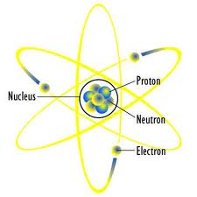
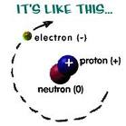
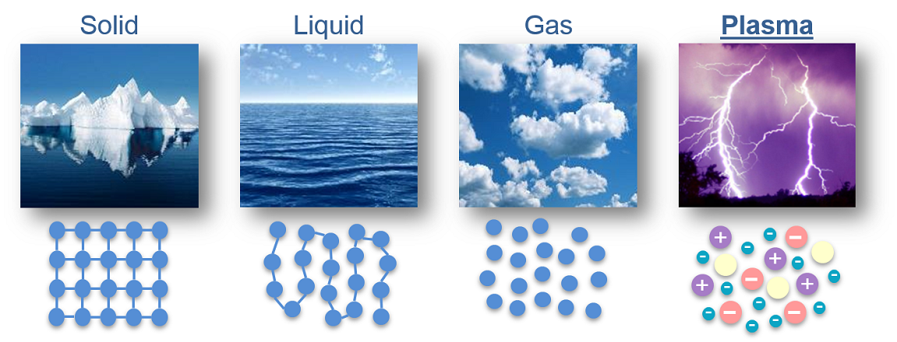
The Four States of Matter

Slide 2
Solids, Liquids and Gases
Matter is any and every thing that has mass and occupies space. It is made up of very tiny particles called atoms.
Matter exists in 4 distinct
physical states:
A. Solids
B. Liquids
C. Gases
D. Plasma
The temperature and pressure of an environment determine the states of matter at any particular time.

Slide 3
What is an Atom?
An atom is the smallest particle known to man.
It can NOT be broken down by chemical means.
It comprises of protons, neutrons and electrons.

Slide 4
What is a Molecule?
A molecule is a particle that contains one or more atoms. It is the smallest part of a compound.
When a molecule contains the same types of atoms it is referred to as an element. For example, oxygen (O₂), hydrogen (H₂), chlorine (Cl₂) etc.
When the molecule contains different types of atoms it is referred to as a compound. For example, water (H₂O), glucose (C₆H₁₂O₆), carbon dioxide (CO₂) etc.

Slide 5
What is a Compound?
Elements combine in particular ratios to form compounds.
Magnesium + Oxygen → Magnesium Oxide
2Mg _{(s)} + O₂ _{(g)} → 2MgO _{(s)}
Heating is needed for some compounds to form.

Slide 6
What is a Compound?
Table 1 below shows the names and formulae for some compounds below
Table 2 below shows the common names for some chemicals
Common Name | Chemical Name
Baking soda | Sodium hydrogen carbonate
Table salt | Sodium chloride
Vinegar | Acetic acid
Washing Soda | Sodium carbonate
Compound | Formula
Ammonia | NH₃
Carbon dioxide | CO₂
Glucose | C₆H₁₂O₆
Methane | CH₄
Water | H₂O

Slide 7
What is a Compound?
The breakdown of a substance is known as decomposition.
Compounds may be broken down/decomposed into simpler substances via
a. Heating or
b. Electrolysis
Electrolysis is the breakdown of a compound in solution by using electricity.

Slide 8
What’s An Ion?
A ion is an atom or a group of atoms with either a positive of negative charge.
Positive ions are referred to as cations.
Negative ions are referred to as anions.
Examples of ions are:
Na⁺, the sodium cation
O²⁻, the oxygen anion
NO₃⁻, the nitrate anion which is polyatomic (meaning it contains more than one atom)

Slide 9
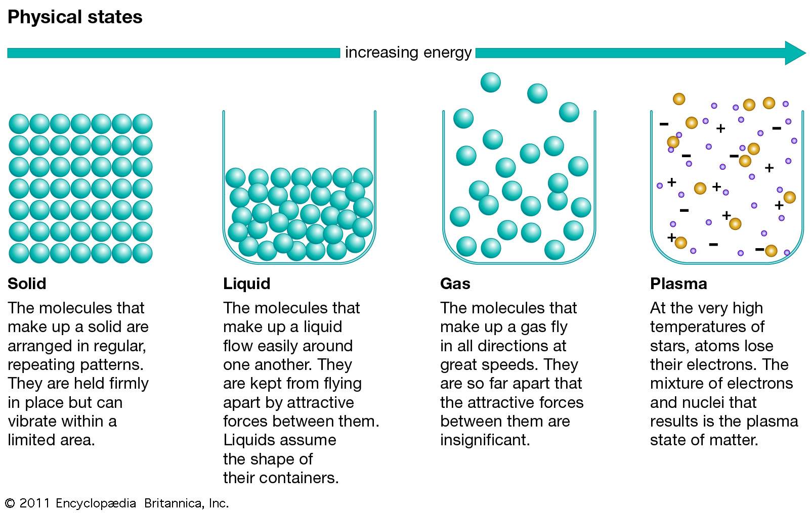
The Four States of Matter

Slide 10
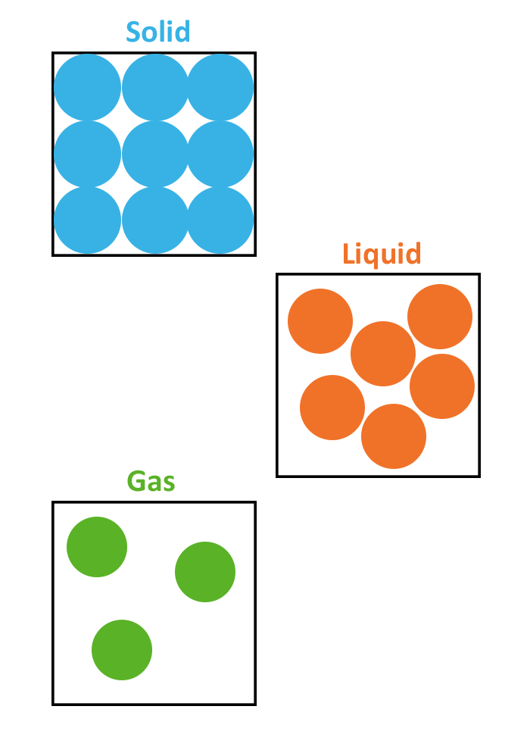
The Arrangement of particles in a Solid
The particles are arranged very closely.
They have a regular pattern.
The particles vibrate around a fixed point but do not move from place to place.
The attractive force between particles are strong.
Solids can NOT be compressed.
Examples include: plastic, metal
glass, marble, wood

Slide 11
The Arrangement of particles in a Liquid
The particles are arranged very closely.
They have an irregular pattern.
The particles slide over each other slowly.
The attractive force between particles are weaker that those in a solid but stronger than those in a gas.
Liquids can NOT be compressed.
Examples include: kerosene,
vinegar and water

Slide 12
The Arrangement of particles in a Gas
The particles are arranged very far apart.
They have an irregular pattern.
The particles move everywhere rapidly.
There are almost NO attractive force between the particles.
Gases CAN be compressed.
Examples include: helium,
hydrogen and oxygen

Slide 13
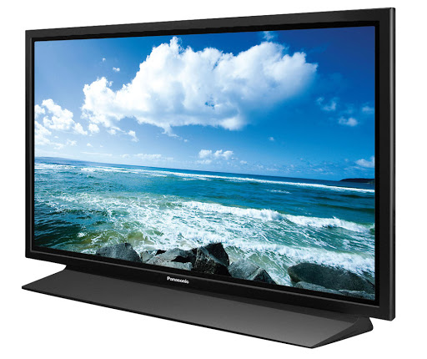

Plasma
Plasma is ionized gas that
contains mobile electrons.
It can conduct electricity.
Examples of plasma include:
a. The Northern lights (Aurora Borealis)
b. Neon signs
c. Plasma screen televisions
d. Lightning
e. Fluorescent light bulbs
f. Stars

Slide 14
Table 1 Comparing and Contrasting the Physical Properties of Solids, Liquids and Gases
Property | Solid | Liquid | Gas
Arrangement | Regular pattern | No regular pattern | No regular pattern
Movement of Particles | Vibrates slowly about a fixed point | Moves throughout the liquid in all directions | Moves quickly in all directions
Spacing of Particles | Very closely packed | Fairly closely packed | Widely spaced apart from each other
Bonds Between Particles | Very strong forces of attraction between them | Medium forces of attraction between them | Very weak forces of attraction between them (move freely)
Shape of Substance | Has a fixed shape | Takes the shape of its container | Fills any available space
Volume of Substance | Has a fixed volume | Has a fixed volume | Has no fixed volume
Examples | Plastic, metal, glass, wood, rubber, wood | Water, alcohol, vinegar, orange juice | Helium, Oxygen, Neon, Argon, Carbon Dioxide

Slide 15
Transitioning Between Phases
The states of matter are also referred to as phases.
Substances can be described as being in a solid, liquid or gaseous phase.
When substances gain or give off energy in the form of heat they are expressed as transitioning from one phase to another.

Slide 16
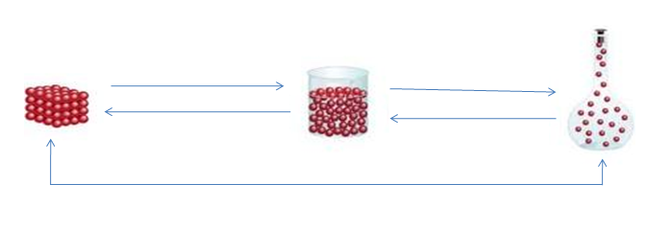
Transitioning Between Phases
When a substance transitions from the solid phase to the liquid phase it is melting.
See the picture below and try to determine the other transitions which take place.
melting
b. __________
c. _________
d. __________
e. ____________ (solid → gas)
f. deposition (gas → solid)

Slide 17
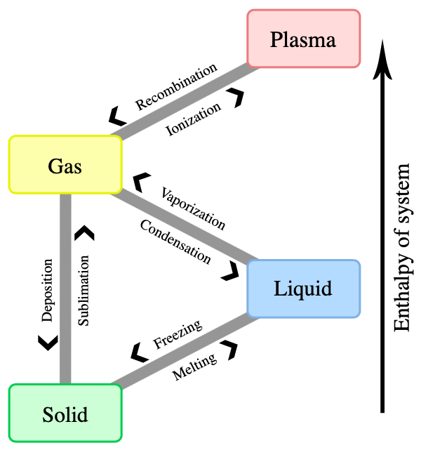
Transitioning Between Phases including the gas to plasma phase

Slide 18
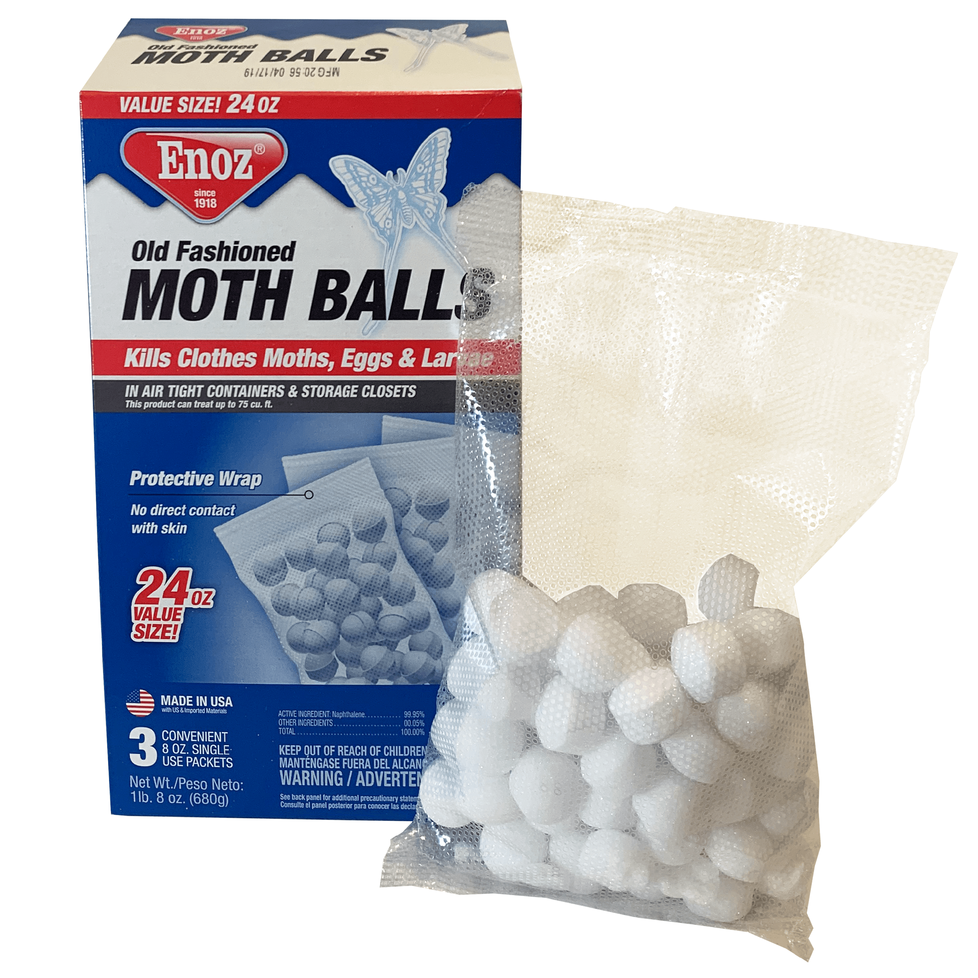
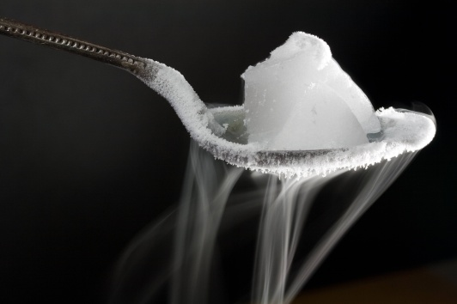
Gain OR Loss of HEAT Energy, Sublimation and Deposition
Heat energy is LOST via the freezing and condensation transitions.
Heat energy is GAINED via the melting and evaporation transitions.
Sublimation is a transition which skips the liquid phase. Because it is a transition that can go directly from solid to gas. Heat is gained during this transition.
Deposition is the reverse of sublimation where a gas transforms directly into a solid without passing through the liquid phase. Heat is lost during this transition.
Examples of substances which
sublime are:
carbon dioxide (dry ice)
naphthalene (moth balls)

Slide 19
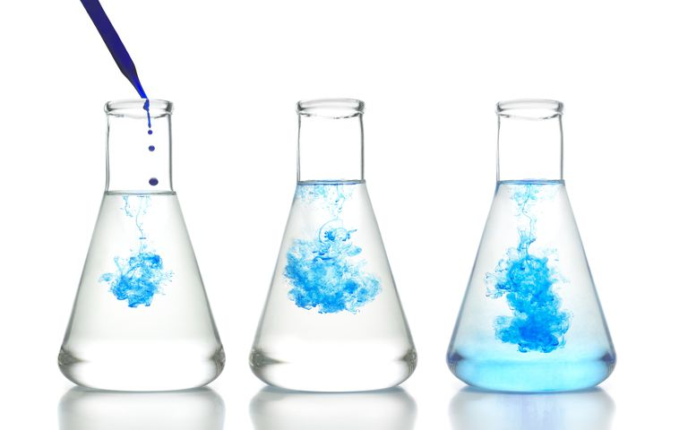
Diffusion
The idea that particles are in constant motion is called the kinetic particle theory.
Diffusion is the movement of particle from an area where they are at their highest concentration to an area where they are less concentrated.
Diffusion occurs in gases and liquids.
The rate of diffusion in gases are faster than that of liquids.
An example of diffusion is smelling the sweet fragrance of a perfume from a room probably 20 metres away.

Slide 20
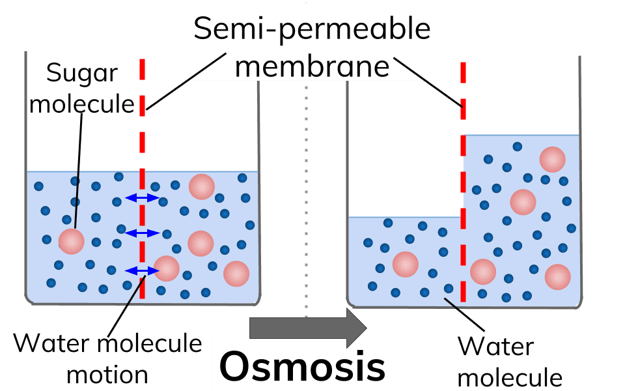
Osmosis
Osmosis is a special case of
diffusion.
Osmosis is the movement of water molecules from and area where they are at their highest concentration to an area where they are at least concentration across a partially permeable membrane.
An example of osmosis is placing a peeled potato with a groove filled with sugar into a petri-dish of water. The water on the outside of the potato will cross into the groove of the potato eventually dissolving the sugar crystals.

Slide 21
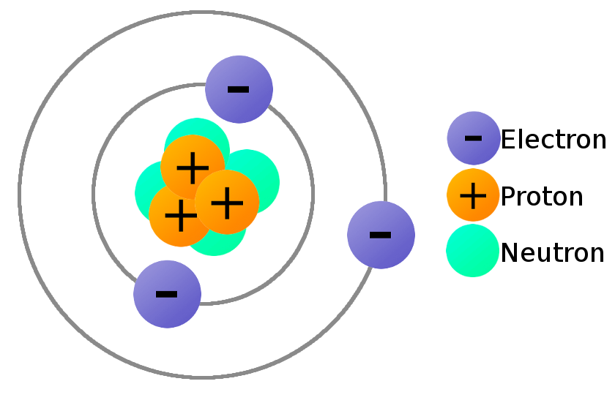
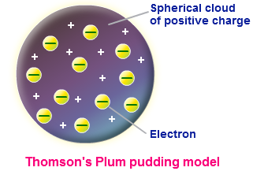
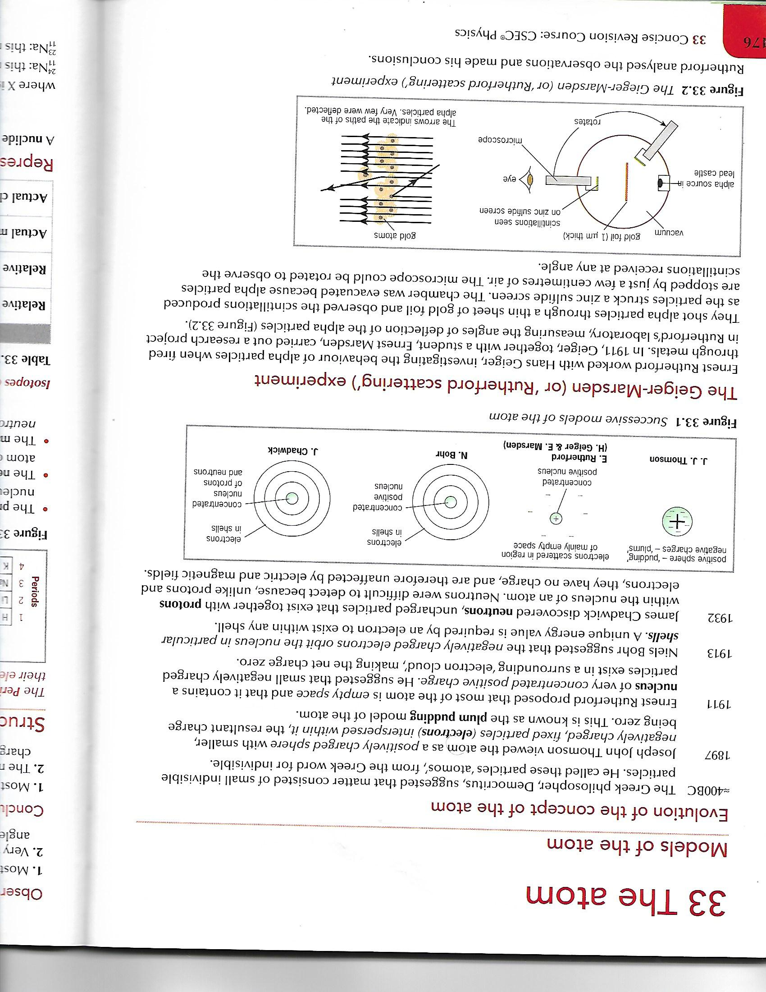
Discovery of the Atom & its Parts

Slide 22
The Greeks
In about 400 BC the Greek philosopher, Democritus, suggested that matter consisted of small indivisible particles.
He called these particles ‘atomos’, from the Greek word for indivisible.

Slide 23
J. J. Thomson
Plum Pudding Model
In 1897 Thomson discovered that heating metal could release small particles (electrons).
He proposed that the electrons were released from inside the atoms and therefore the atom was not the smallest possible particle.
Thomson also realised that electrons were charged particles since they could be deflected by magnetic and electric fields. He then proposed a model where electrons in an atom were trapped inside a positively charged ‘sponge’.
This was known as the __________________________ model of the atom.

Slide 24
Rutherford
Nucleus
In 1911 Ernest Rutherford proposed that most of the atom is empty space and that it contains a nucleus of very concentrated positive charge.
He suggested that small negatively charged particles exist in a surrounding ‘electron cloud’, making the net charge zero.

Slide 25
Bohr
Energy Levels & Electrons
In 1913 Niels Bohr suggested that the negatively charged electrons orbit the nucleus in particular shells.
A unique energy value is required by an electron to exist within any shell.
All previous models of the atom could not explain the behaviour of the electrons and why they did not fall into the nucleus due to electromagnetic forces.

Slide 26
Chadwick
Neutrons
In 1932 James Chadwick discovered neutrons, uncharged particles that exist together with protons within the nucleus of an atom.
Neutrons were difficult to detect because, unlike protons and electrons, they have no charge and therefore can not be affected by electric and magnetic fields.

Slide 27
COMPREHENSION
1. In the ‘plum pudding’ model:
a. What charge do electrons have?
b. What is the remainder of an atom composed of?
c. What force holds the electrons in place?

Slide 28
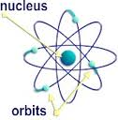
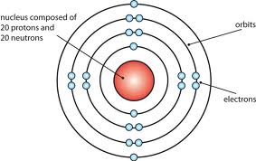
Electrons, the nucleus and the periodic table

Slide 29
Experiments have now shown that there are three types of different particles. They are:
1. ________________________________
2. ________________________________
3. ________________________________
Neutral atoms have the same number of electrons and protons.
Protons and neutrons together in the nucleus are referred to as nucleons.
Particle | Location in the atom | Mass | Electric charge
Proton |  | 1.67 × 10⁻²⁷ kg
Neutron |  | 1.67 × 10⁻²⁷ kg | 0
electron |  | 9.11 × 10⁻³¹ kg

Slide 30
Experiments have now shown that there are three types of different particles. They are:
1. ________protons_________________
2. ________electrons________________
3. ________neutrons________________
Neutral atoms have the same number of electrons and protons.
Protons and neutrons together in the nucleus are referred to as nucleons.
Particle | Location in the atom | Mass (kg) | Electric charge
Proton | nucleus | 1.67 × 10⁻²⁷ | +1
Neutron | nucleus | 1.67 × 10⁻²⁷ | 0
electron | Energy level/shell/orbital | 9.11 × 10⁻³¹ | -1

Slide 31
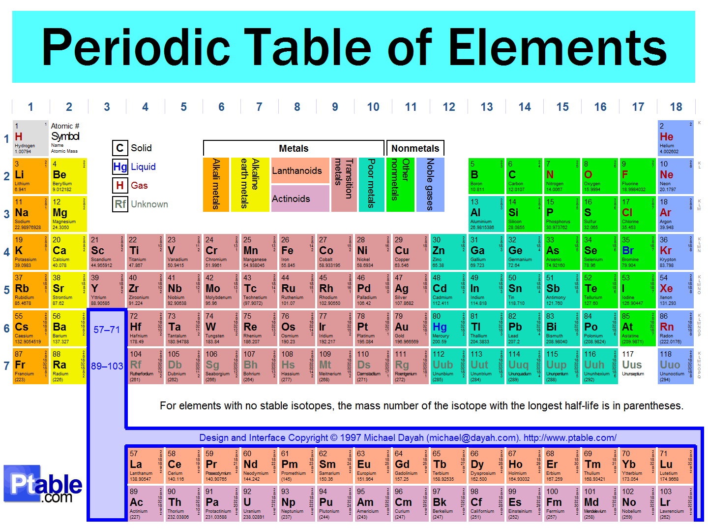
Periodic Table

Slide 32
NUCLEAR NOTATION
The proton number may be referred to as the atomic number and is represented by the capital letter Z.
The total number of protons and neutrons (nucleons) is equal to a neutral atom’s mass number and is often represented by the capital letter A.
The number of neutrons, the neutron number, is represented by the capital letter, N.
Given above the atomic notation for any given symbol represented here as X may be represented as: ^{A}_{Z}X.
The neutron may be determined by
# of neutrons = mass number – atomic number where (N = A – Z)

Slide 33
Nuclear Notation Questions
Write out the atomic notation for the following:
a. Magnesium which has an atomic number of 12 and a mass number of 24.
b. Boron which has an atomic number of 5 and a mass number of 10.
c. Iron which has an atomic number of 26 and a mass number of 56.
d. For the above determine how many protons are present in each of the elements stated above.

Slide 34
Nuclear Notation Answers
Write out the atomic notation for the following:
a. Magnesium which has an atomic number of 12 and a mass number of 24.
²⁴₁₂Mg
b. Boron which has an atomic number of 5 and a mass number of 10.
¹⁰₅B
c. Iron which has an atomic number of 26 and a mass number of 56.
⁵⁶₂₆Fe
d. For the above determine how many protons are present in each of the elements stated above.
(i) # of protons in Mg = 24 – 12 = 12
(ii) # of protons in B = 10 – 5 = 5
(iii) # of protons in Fe = 56 – 26 = 30

Slide 35
Periodic Table
All elements in their neutral state are represented within a Periodic Table.
They are categorized based on their Groups and Periods.
Groups run vertically while Periods run horizontally within the Periodic Table.

Slide 36
Periodic Table
Groups indicate the number of valence electrons an atom has while Periods indicate how many energy levels an atom has.
For example the sodium atom, Na, is in group 1 and period 3 therefore Na has 1 valence electron and 3 energy levels.
Valence electrons are those electrons available for bonding. In other words they make bonding between atoms possible.

Slide 37
The First 20 Elements
Element | Symbol | State at Room Temperature | Metal or Non – Metal | Element | Symbol | State at Room Temperature | Metal or Non - Metal
1. Hydrogen | H | Gas |  | 11. Sodium | Na | Solid
2. Helium | He | Gas |  | 12. Magnesium | Mg | Solid
Lithium | Li | Solid |  | 13. Aluminium | Al | Solid
Beryllium | Be | Solid |  | 14. Silicon | Si | Solid
5. Boron | B | Solid |  | 15. Phosphorus | P | Solid
6. Carbon | C | Solid |  | 16. Sulphur | S | Solid
7. Nitrogen | N | Gas |  | 17. Chlorine | Cl | Gas
8. Oxygen | O | Gas |  | 18. Argon | Ar | Gas
9. Fluorine | F | Gas |  | 19. Potassium | K | Solid
10. Neon | Ne | Gas |  | 20. Calcium | Ca | Solid

Slide 38
The First 20 Elements
Element | Symbol | State at Room Temperature | Metal or Non – Metal | Element | Symbol | State at Room Temperature | Metal or Non - Metal
1. Hydrogen | H | Gas | NM | 11. Sodium | Na | Solid | M
2. Helium | He | Gas | NM | 12. Magnesium | Mg | Solid | M
Lithium | Li | Solid | M | 13. Aluminium | Al | Solid | M
Beryllium | Be | Solid | M | 14. Silicon | Si | Solid | NM
5. Boron | B | Solid | NM | 15. Phosphorus | P | Solid | NM
6. Carbon | C | Solid | NM | 16. Sulphur | S | Solid | NM
7. Nitrogen | N | Gas | NM | 17. Chlorine | Cl | Gas | NM
8. Oxygen | O | Gas | NM | 18. Argon | Ar | Gas | NM
9. Fluorine | F | Gas | NM | 19. Potassium | K | Solid | M
10. Neon | Ne | Gas | NM | 20. Calcium | Ca | Solid | M

Slide 39
Some Other Common Elements
Element | Symbol | State at Room Temperature | Metal or Non – Metal | Element | Symbol | State at Room Temperature | Metal or Non - Metal
Copper | Cu | Solid |  | Mercury | Hg | Liquid
Gold | Au | Solid |  | Silver | Ag | Solid
Iron | Fe | Solid |  | Zinc | Zn | Solid

Slide 40
Some Other Common Elements
Element | Symbol | State at Room Temperature | Metal or Non – Metal | Element | Symbol | State at Room Temperature | Metal or Non - Metal
Copper | Cu | Solid | M | Mercury | Hg | Liquid | M
Gold | Au | Solid | M | Silver | Ag | Solid | M
Iron | Fe | Solid | M | Zinc | Zn | Solid | M

Slide 41
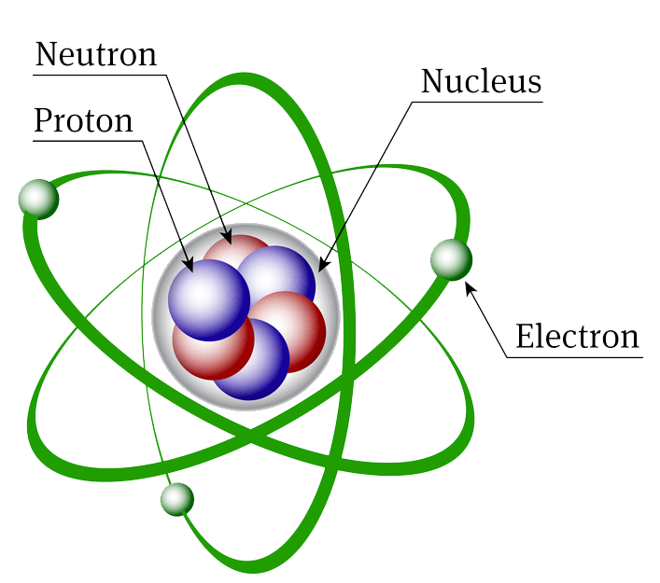
The Atom

Slide 42
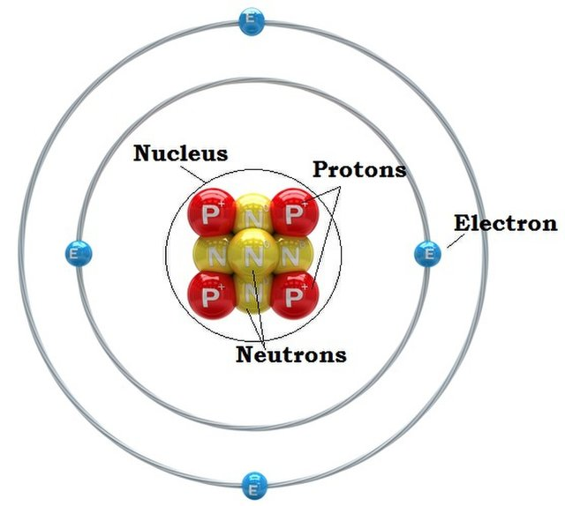
The Atom
An atom is the smallest indivisible particle of matter which can exist on its own.
It has a nucleus which contains
only protons and neutrons.
Electrons are part of the atom
but they occupy areas of the
atom called energy levels/shells.

Slide 43
The Atom
Each energy level can hold a certain number of electrons.
Energy Level | Maximum amount of electrons
1 | 2
2 | 8
3 | 8
4 | 18 (8, 10)

Slide 44
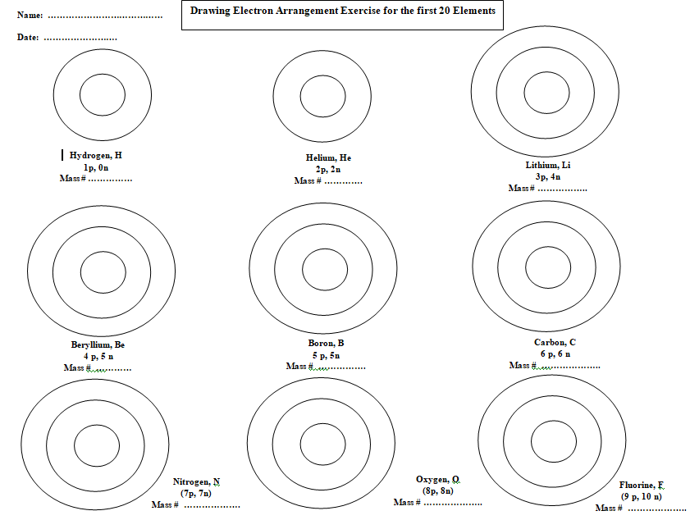
The Arrangement of Electrons in the First 20 Elements

Slide 45
The Arrangement of Electrons in the First 20 Elements

Slide 46
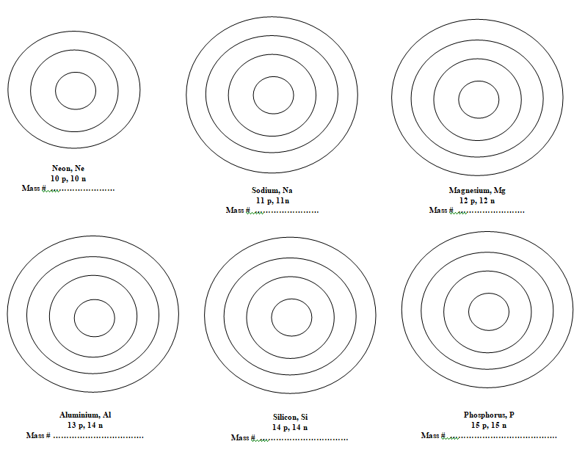

Slide 48
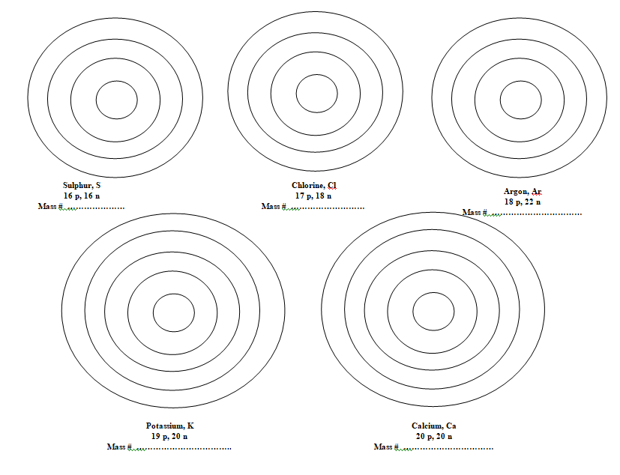

Slide 50
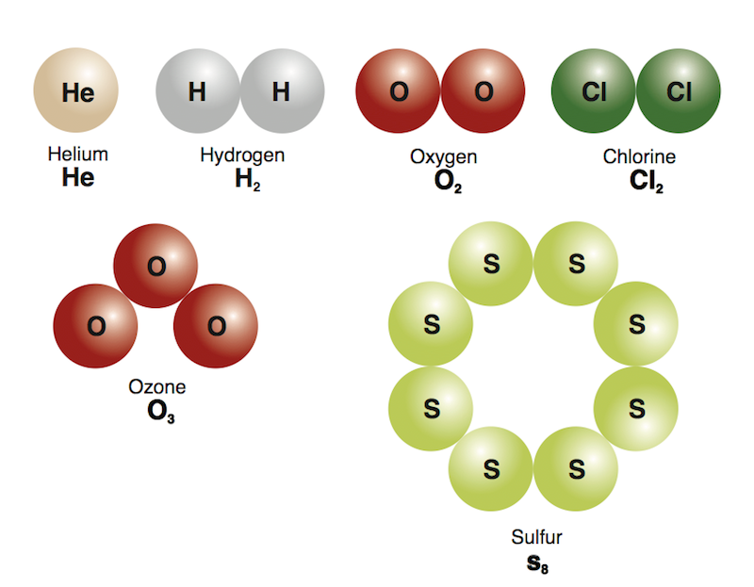
Elements
An element is a substance made up of one type of atom, and it cannot be broken down into any simpler substance.
Examples of elements include:
H₂, O₂, Cl₂ O₃ and S₈ , they are also referred to as molecules as well.

Slide 51
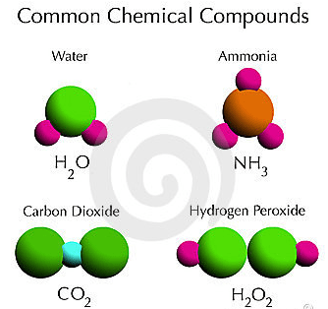
Molecules and Compounds
A molecule is formed when two or more atoms are joined together covalently. Molecules are also compounds.
Compounds are substances made up of two of more elements that may be the same or different.
Examples of
molecules
and compounds
include:

Slide 52
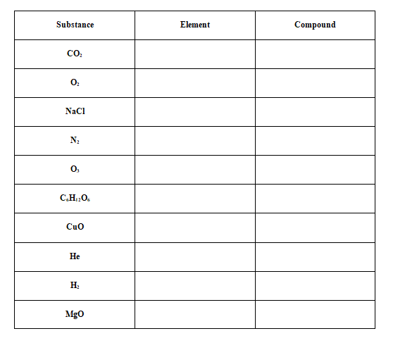
Elements and Compounds Exercise

Slide 53
Elements and Compounds Exercise

Slide 54
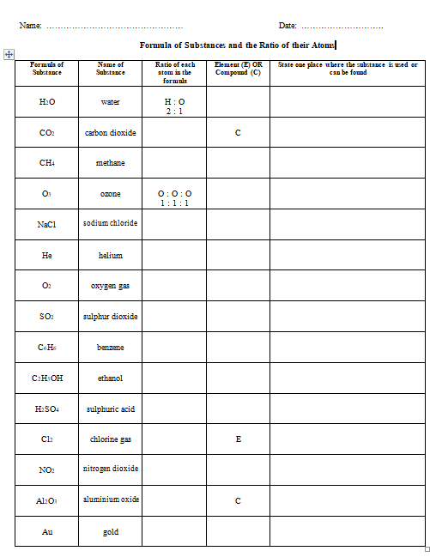
Another Element and Compound Exercise

Slide 55
Another Element and Compound Exercise

Slide 56

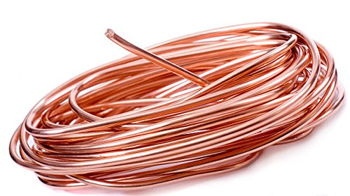
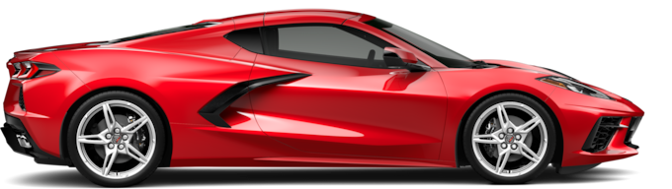
Metals and Non-Metals

Slide 57
Metals and Non - Metals
Metals are electrical and thermal conductors. Usually they are shiny, malleable, ductile and sonorous.
Non-metals do NOT conduct electricity or heat. Usually they are dull and brittle.

Slide 58
Comparing and Contrasting Metallic and Non-Metallic Elements
Property | Metals | Non metals
Examples of elements | Cu, Au, Fe, Ag, Na, Zn, Hg | Br, N, C, Cl, H, Ne, S
Appearance | Shiny/Lustre | Dull – may be black, coloured or colourless
Conductivity | Conducts heat and electricity | Does not conduct heat or electricity (except for carbon, C, which conducts electricity)
Capacity for shaping | Malleable – can be hammered into thin sheets Ductile – can be drawn into thin wires | Brittle – easily shattered when struck with a hammer
Physical state at room temperature | Solids (except for mercury, Hg, which is a liquid at rtp) | Solids, liquids and gases
Strength | Very strong and can hold heavy loads without breaking | Not usually strong

Slide 59
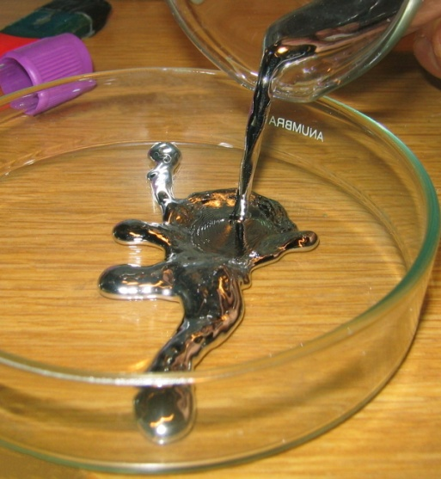
Some EXCEPTIONS of Metals
Not ALL metals are solid at room temperature nor are all of them hard to the touch.
Li, Na and K are metals which are soft enough to be cut.
Hg, however, is a liquid at
room temperature.

Slide 60
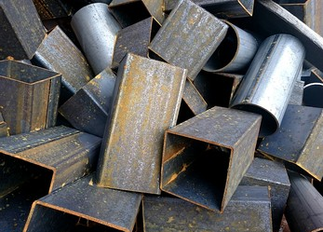
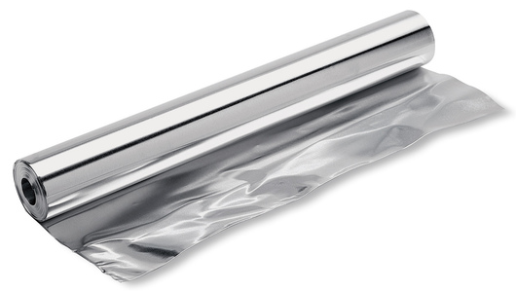
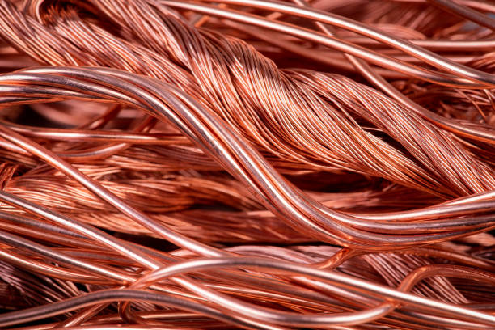

Uses of SOME Metals
Fe is used for making cookware
appliances, electromagnets etc.
Al is a very light metal so it is used
in making the body of aircrafts.
Cu is used for making electric
wires.
Ag is used for
making jewelry

Slide 61
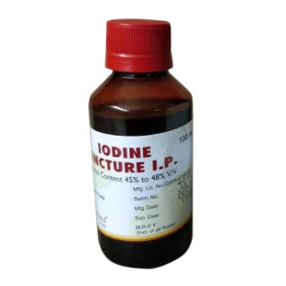
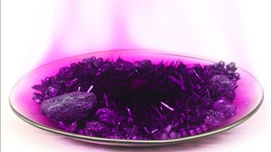
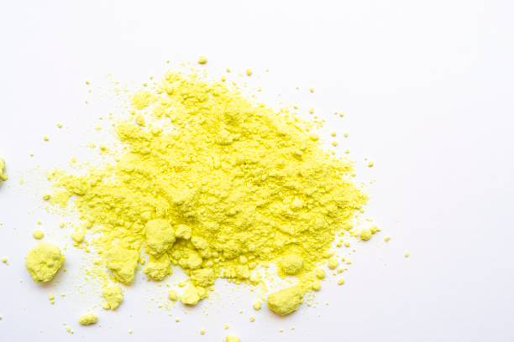
Uses of SOME Non-Metals
Iodine, I, is used as antiseptic
S is used for making fire
crackers, gun powder
and sulphuric acid.
Hg is used in the
laboratory thermometer

Slide 62
Alloy
Man-made Metals
Some metals that we use today are man-made.
They are mixtures of metals referred to as ALLOYS.
Alloys are stronger than pure metals.
Examples of alloys are:
a. Bronze
b. Brass
c. Duralumin

Slide 63
Comprehension
Give 2 more examples of alloys.
Choose a metal. (10 marks)
Using between 100 and 120 words, discuss one use of this metal.
Give three reasons why it is suitable for this use.

Slide 64

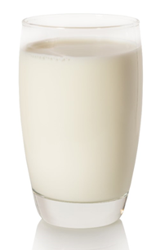

Mixtures

Slide 65
Mixtures
A mixture is a combination of two or more substances which are NOT chemically combined

Slide 66
Solutes and Solvents
Mixtures consist of a solute and a solvent.
The solvent is in greater amount while the solute is in the lesser amount. Example, salt in water, where salt is the solute and water is the solvent.
There are two types of mixtures:
a. Homogeneous b. Heterogeneous

Slide 67
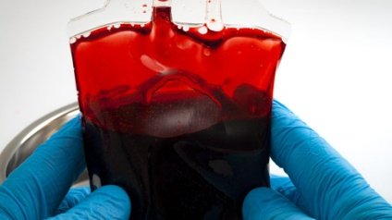
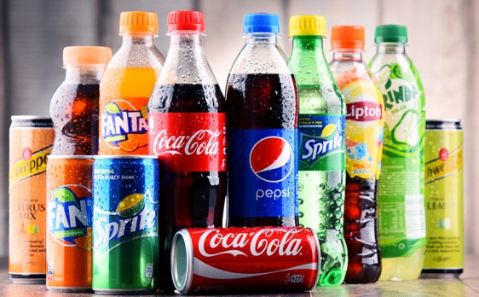
Homogeneous Mixtures
A homogeneous mixture appears to be one substance for example:
a. Sugar water b. Crude oil
c. Air d. Drink
e. Alcohol and water f. Blood
g. Alloy h. Soda
A homogeneous mixture
is one in which the solute
dissolves completely
within the solvent.

Slide 68
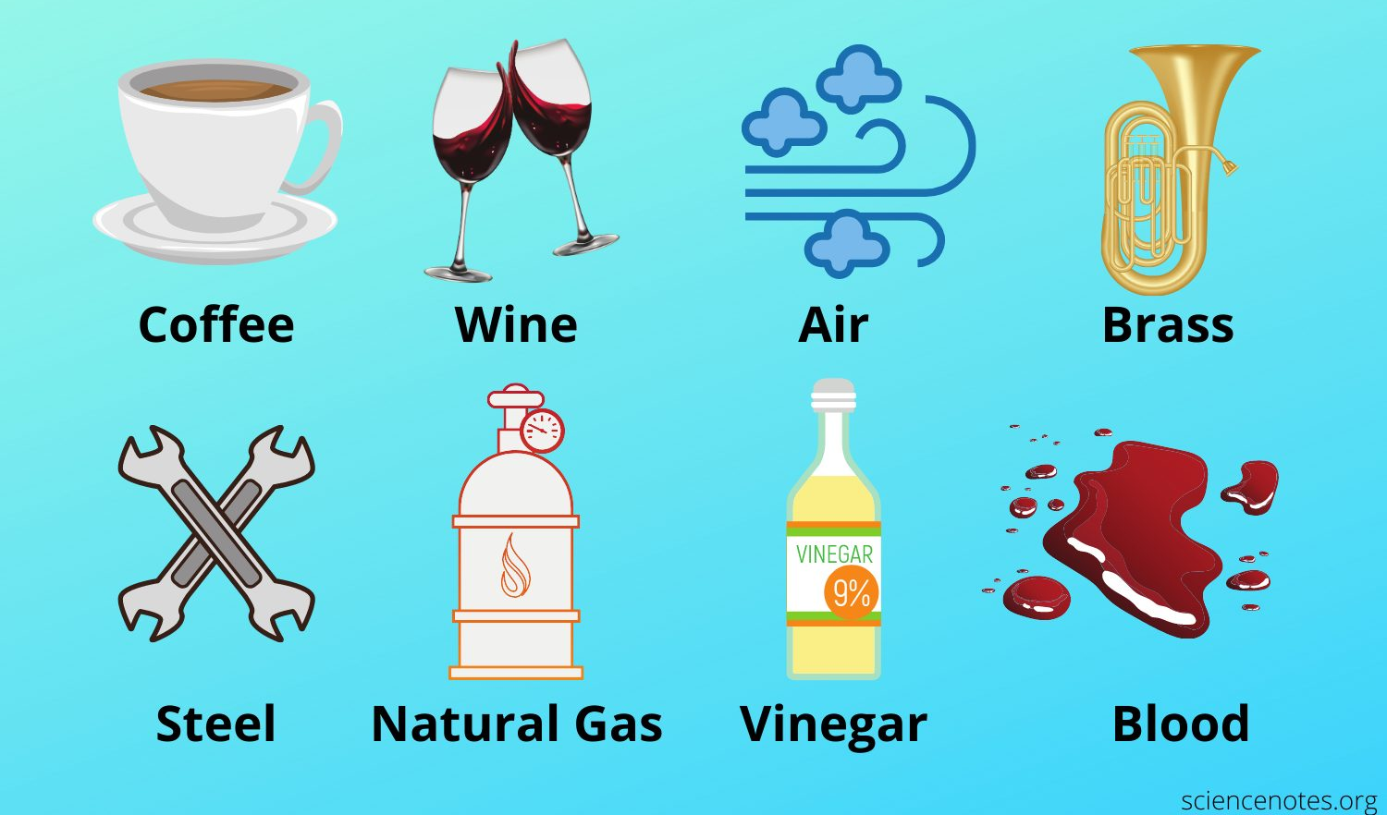
Examples of Homogeneous Mixtures

Slide 69
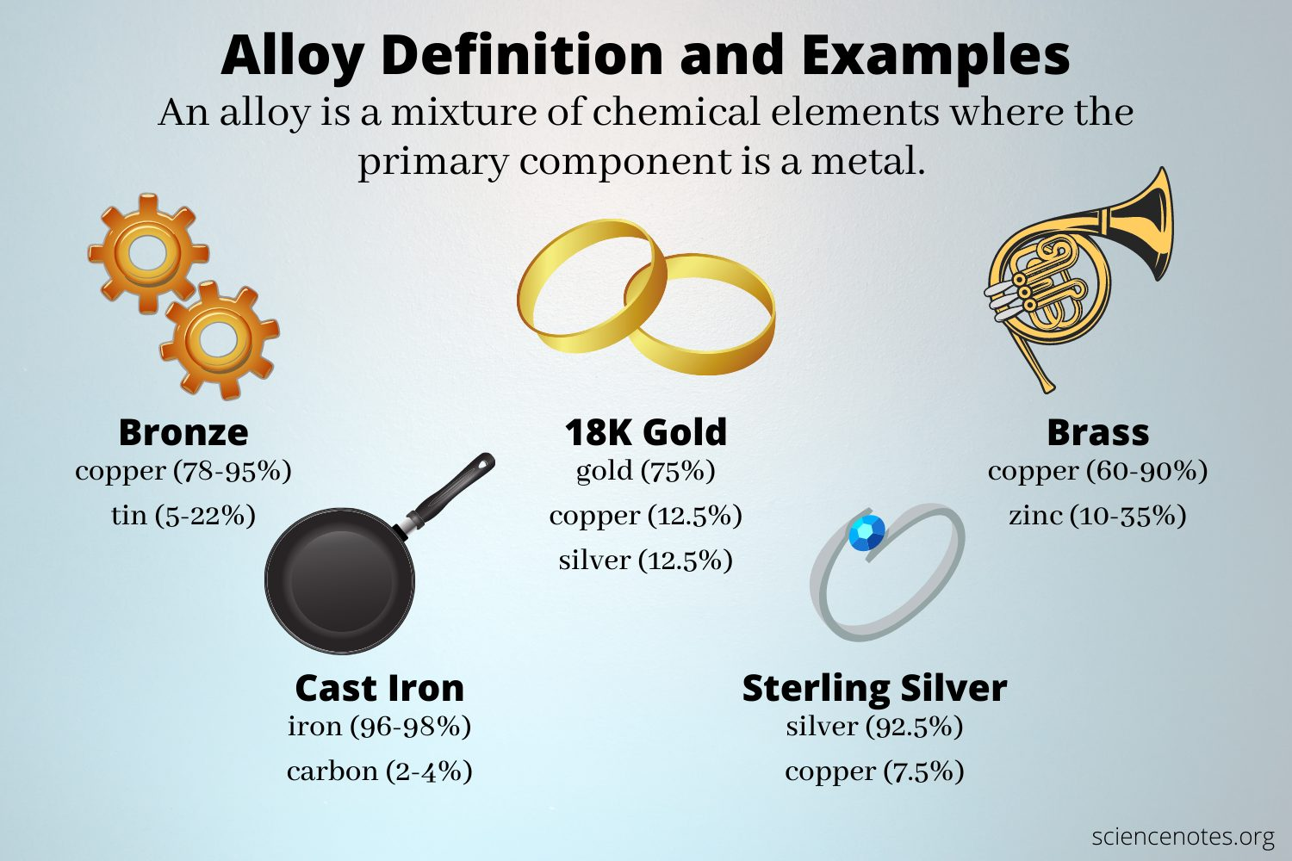
What is an ALLOY?

Slide 70
Heterogeneous Mixtures
A heterogeneous mixture show the separate parts quite easily for example
1. sand and water 2. mud and salt
3. oil and water 4. soil
5. rice and peas
A heterogeneous mixture is one in which the solute does NOT dissolve within the solvent. All components of the mixture can be distinguished.

Slide 71
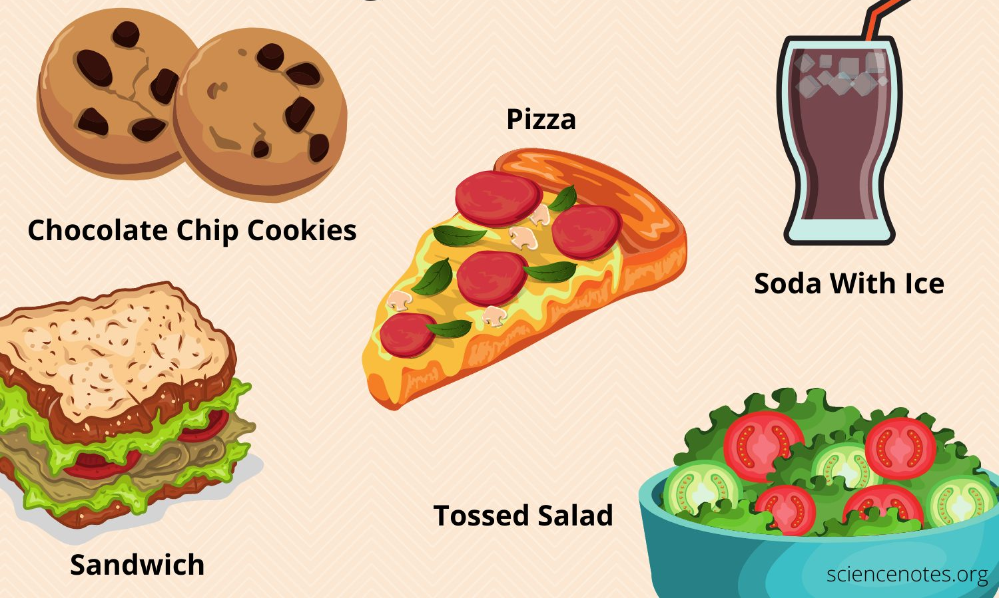
Examples of Heterogeneous Mixtures

Slide 72
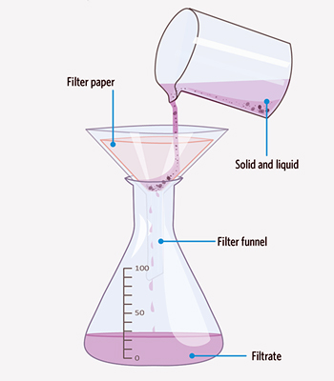
Methods Used to Separate Mixtures
Filtration: a solution from an insoluble substance (sand in water, muddy water)

Slide 73
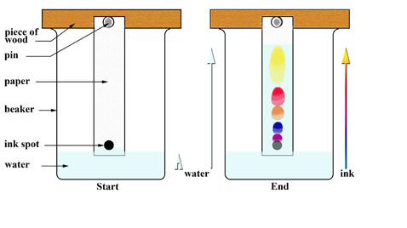
Methods Used to Separate Mixtures
Chromatography: complex chemicals (dyes, inks)

Slide 74
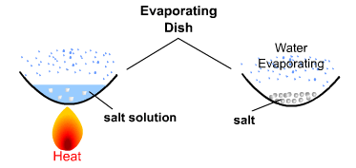
Methods Used to Separate Mixtures
Evaporation: only the solute (solid) is obtained (sea water)

Slide 75
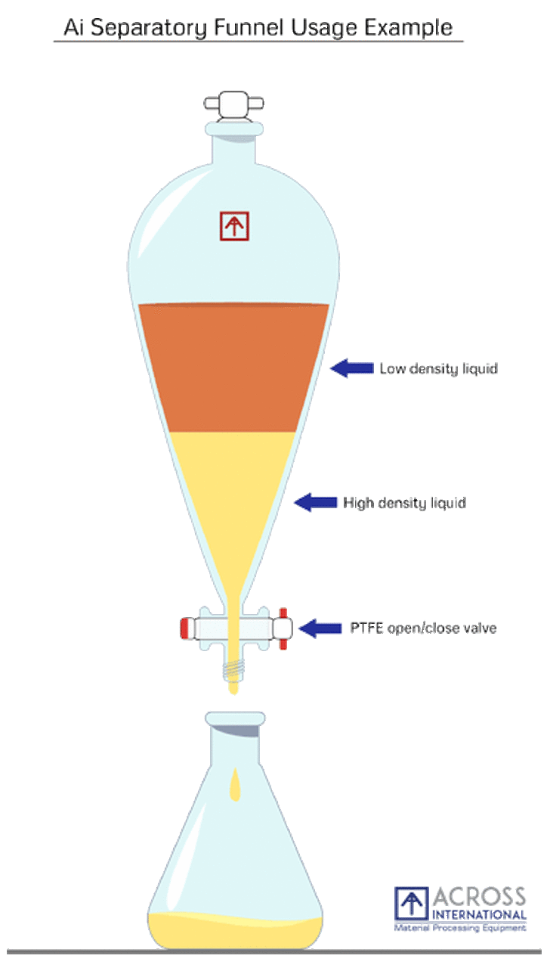
Methods Used to Separate Mixtures
Separating Funnel: Liquids of different densities may be separated in this way. Both the solvent and solute are obtained: (oil may be separated from water in this way)

Slide 76
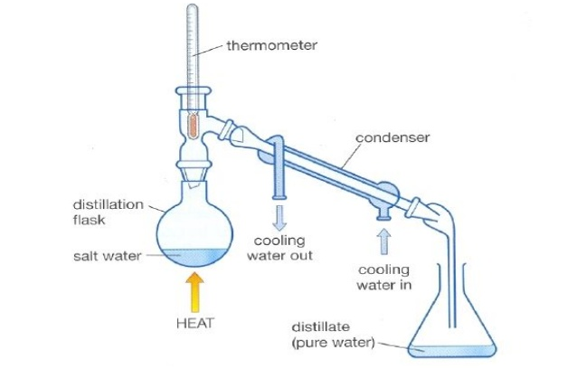
Methods Used to Separate Mixtures
Distillation: evaporation then condensation. Both the solvent and solute are obtained: (salt AND water can be obtained from mixtures of saltwater)

Slide 77
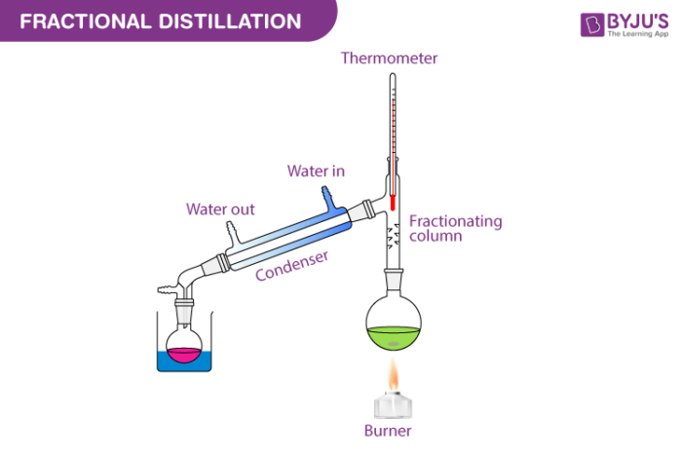
Methods Used to Separate Mixtures
Fractional distillation: liquids which do not mix well. These liquids boil at different temperatures but there boiling points are very close. (crude oil, alcohol and water)

Slide 78
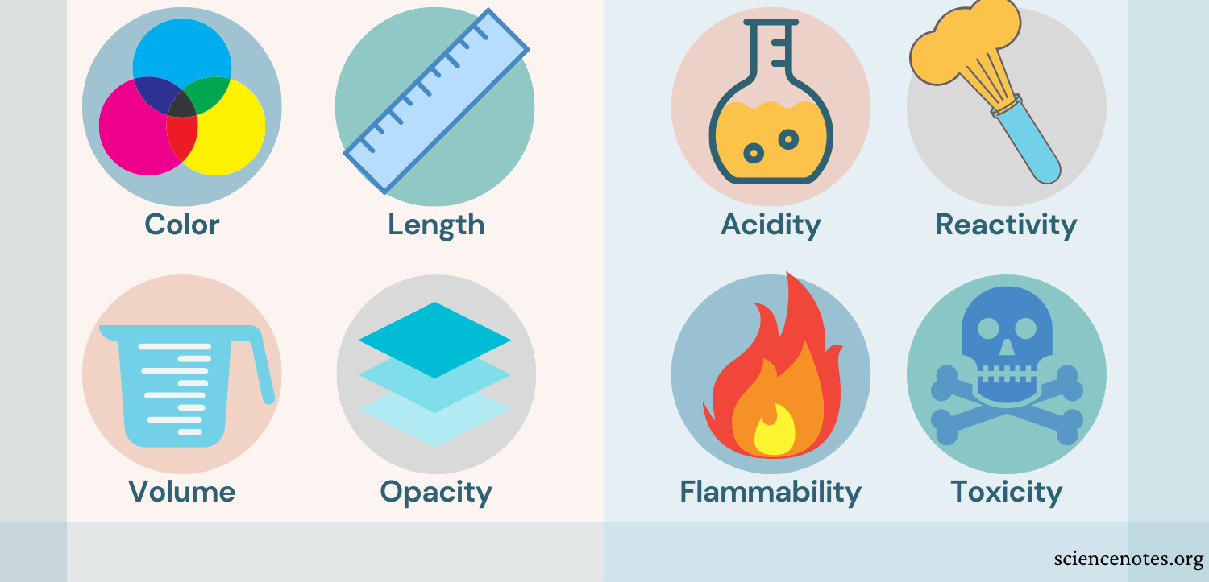
Properties of Matter
Physical properties are easily observed.
Chemical properties describe how the
substance reacts with other substances.

Slide 79
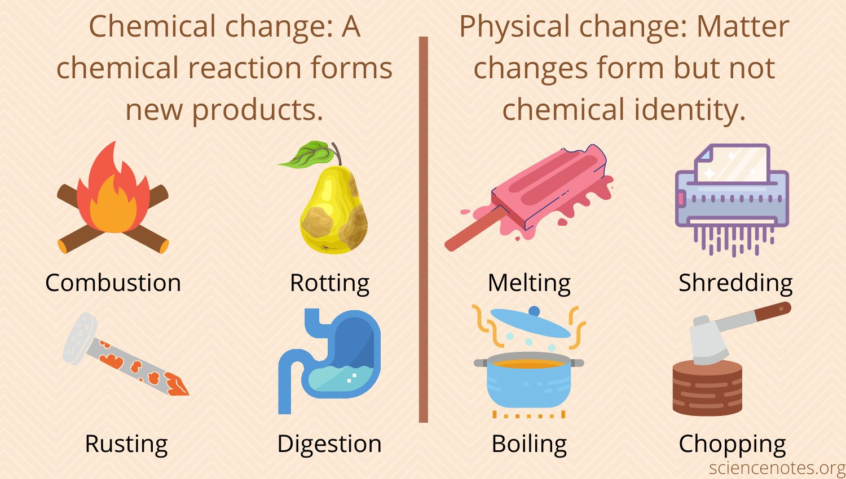
Chemical Change versus Physical Change

Slide 80

More Examples of Chemical Change

Slide 81

More Examples of Physical Change

Slide 82
Comparing Mixtures and Compounds
Mixtures | Compounds
Mixtures are made by physically combining substances. (For example salt mixed in water to make salty water) | Compounds are formed when elements combine chemically. (For example magnesium burned in/reacted with oxygen to produce magnesium oxide)
Mixtures are separated easily into its separate parts. The process is easily reversible. (Salt can be separated from water via evaporation while sand can be separated from water via filtration.) | Compounds can not be easily separated into its individual elements. The process is NOT easily reversible. (Separating magnesium or oxygen from magnesium oxide would not be a simple process)

Slide 83
Comparing Mixtures and Compounds
The properties of a compound are very different from the individual substances used to make it.
Magnesium is a metal that is silver in colour while oxygen is a colourless gas. Magnesium oxide, the product of both magnesium and oxygen when burned together, is a white powdery substance which does not have any metal characteristics nor is it a gas.

Slide 84
Activity 1
Substance | Filtration | Chromatography | Distillation | Fractional distillation
Curry water
Alcohol and water
Muddy water
Black ink
Salt water
Sand and water
Sugar and water
In the table place a tick in the appropriate column to indicate the
best method to separate each mixture.

Slide 85
Activity 1
Substance | Filtration | Chromatography | Distillation | Fractional distillation
Curry water
Alcohol and water
Muddy water
Black ink
Salt water
Sand and water
Sugar and water
In the table place a tick in the appropriate column to indicate the
best method to separate each mixture.

Slide 86
Activity 2
Substance | homogeneous | heterogeneous
Curry water
Alcohol and water
Muddy water
Black ink
Salt water
Sand and water
Sugar and water
In the table place a tick in the appropriate column to indicate
which type of mixture is homogeneous or heterogeneous

Slide 87
Activity 2
Substance | homogeneous | heterogeneous
Curry water
Alcohol and water
Muddy water
Black ink
Salt water
Sand and water
Sugar and water
In the table place a tick in the appropriate column to indicate
which type of mixture is homogeneous or heterogeneous

Slide 88
Matter Map
Matter
(atoms)
Substances
Mixtures
Elements
Compounds
Homogeneous
Heterogeneous

