Slide 1
Negative
Numbers

Slide 2
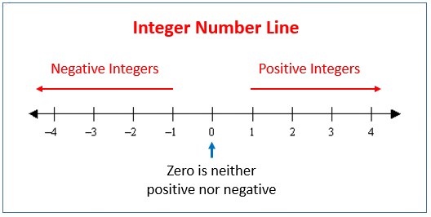
Negative numbers are integers.
On the number line they are located to the left of zero.

Slide 3
Using the Number line to Add
To ADD you simply move to the RIGHT of the number line

Slide 4
Using the Number line to Substract
To SUBTRACT you simply move to the LEFT of the number line

Slide 5
Let's use the number line to solve some problems
a. -2 + (-2) = ________________________________________
b. 3 + (-5) = _________________________________________
c. -3 + 5 = ___________________________________________

Slide 6
Here are some helpful rules about positive and negative numbers
a. positive + positive = positive
b. negative + negative = negative
c. positive x positive = positive
d. positive x negative = negative
e. negative x negative = positive

Slide 7
Here are some helpful rules about positive and negative numbers
f. positive / positive = positive
g. positive / negative = negative
h. negative / positive = negative

Slide 8
Here are some more helpful rules about positive and negative numbers
i. positive + negative
gives a POSITIVE number if the positive number itself is larger than the negative number example
10 - 3 = 7

Slide 9
Here are some helpful rules about positive and negative numbers
j. positive + negative
gives a NEGATIVE number if the negative number itself is larger (ignoring the sign) than the positive number, for example
- 10 + 3 = - 7

Slide 10
Let's Divide Using Negative Numbers
a. -8/4 = ................
b. 8/-4 = ...............
c. -8/-4 = ...............

Slide 11
Let's Divide Using Negative Numbers
a. - 8/4 = - 2
b. 8/- 4 = - 2
c. - 8/- 4 = 2

Slide 12
Let's Multiply Using Negative Numbers
a. 8 x - 4 = ...............
b. - 8 x 4 = ...............
c. - 8 x - 4 = ................

Slide 13
Let's Multiply Using Negative Numbers
a. 8 x - 4 = - 32
b. - 8 x 4 = - 32
c. - 8 x - 4 = 32

