Slide 1
Reproduction and Growth

Slide 2
Types of Reproduction
There are two types of reproduction a. Asexual (only one parent is required) b. Sexual (two parents are required)

Slide 3
Asexual Reproduction
In asexual reproduction the parent organism has cells that can divide in two, multiplying to give identical organisms called clones.

Slide 4
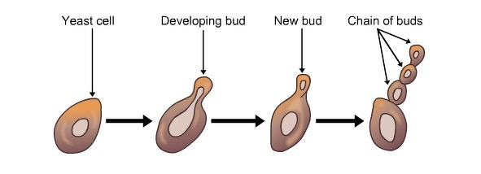
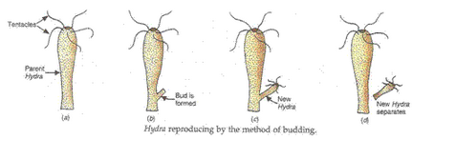
Examples of Asexual Reproduction
Budding: Formation of identical/clone cells. 1. Yeast which is a fungus. 2. Hydra which is a water animal.

Slide 5
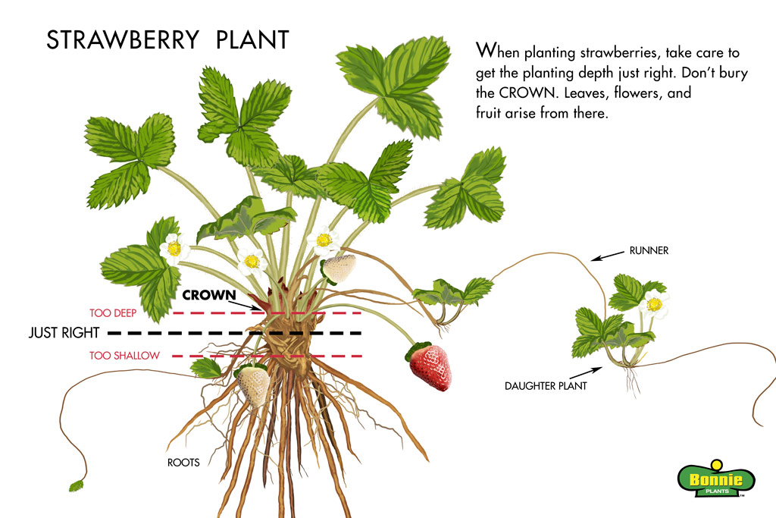
Examples of Asexual Reproduction
Runners: These grow from plants. If the plant dies the runners become the independent plant. 1. Strawberries

Slide 6
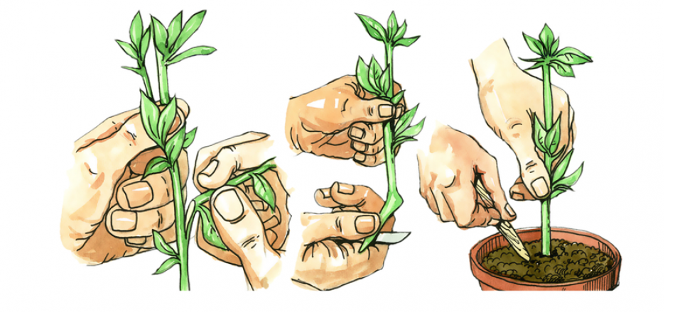
Examples of Asexual Reproduction
Cuttings: This is where stems of plants are planted in rooting compost.

Slide 7
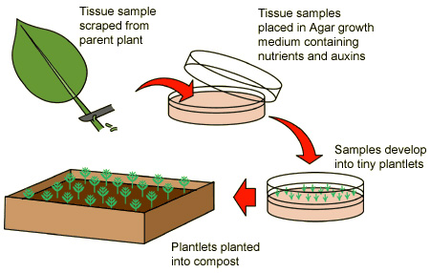
Examples of Asexual Reproduction
Tissue culture: Plant cells are used and placed within special hormone mixture.

Slide 8
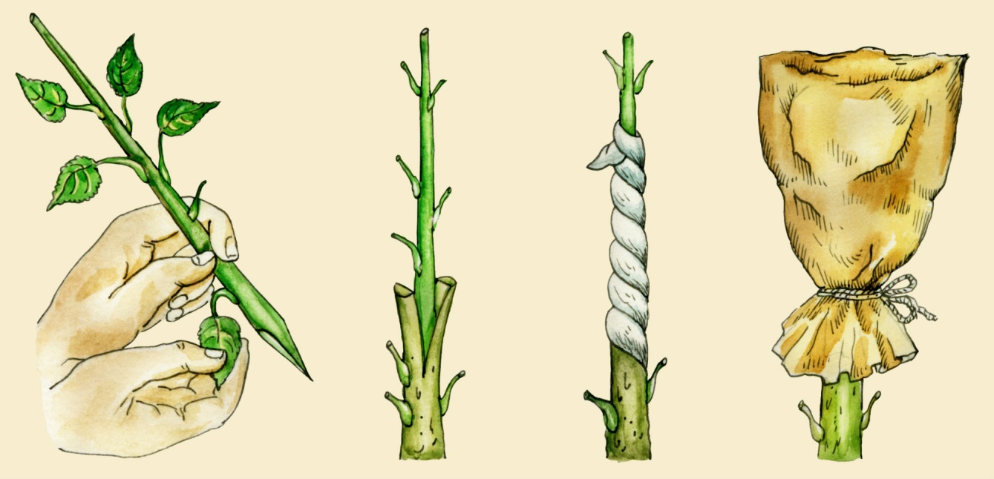
Examples of Asexual Reproduction
Grafting: A new tree is made by grafting a cutting from one tree into a notch cut into a different tree. Once the two plants are bound they will grow together to form one tree. 1. mango trees 2. citrus trees

Slide 9
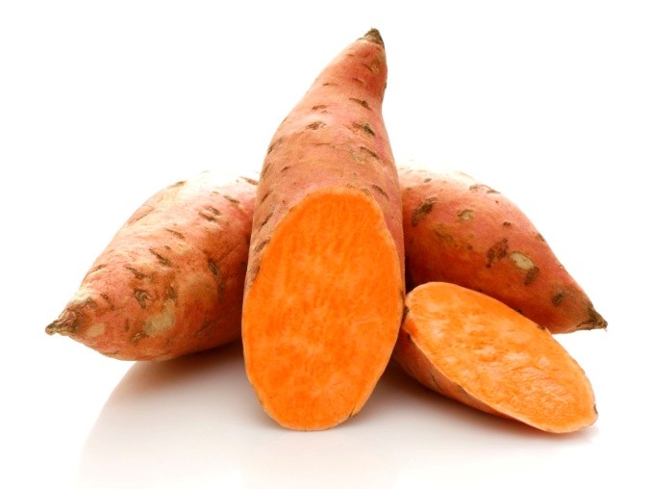
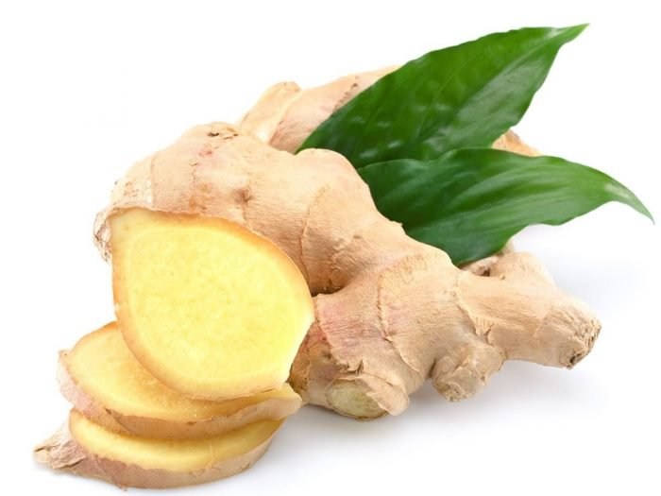
Examples of Asexual Reproduction
Storage organs: If the plant dies the storage organ can use its store of energy to grow into a new plant. 1. bulbs (onions, garlic, lilies) 2. corms (dasheen, eddo, crocus, gladiolus) 3. rhizomes (iris, ginger) 4. tubers (sweet potato, yam)

Slide 10
Advantages of Asexual and Sexual Reproduction
Asexual reproduction: a. Does not need a partner. b. Many offspring are produced in a shorter time span.
Sexual reproduction: a. Variation ensures stronger offspring.

Slide 11
Disadvantages of Asexual and Sexual Reproduction
Asexual reproduction: a. Lack of genetic variation so puts species in danger of extinction if parent easily catches diseases.
Sexual reproduction: a. Two parents are needed. Time is wasted looking for a suitable partner. b. Production of offspring takes longer.

Slide 12
Sexual Reproduction
Sexual reproduction needs male and female sex cells called gametes, to meet and fuse together. This is called fertilisation.

Slide 13
Sexual Reproduction in Plants
In plants the male organs (stamens) make pollen containing the male sex cells.
The female parts (carpels) make the ova (eggs) inside an ovule.

Slide 14
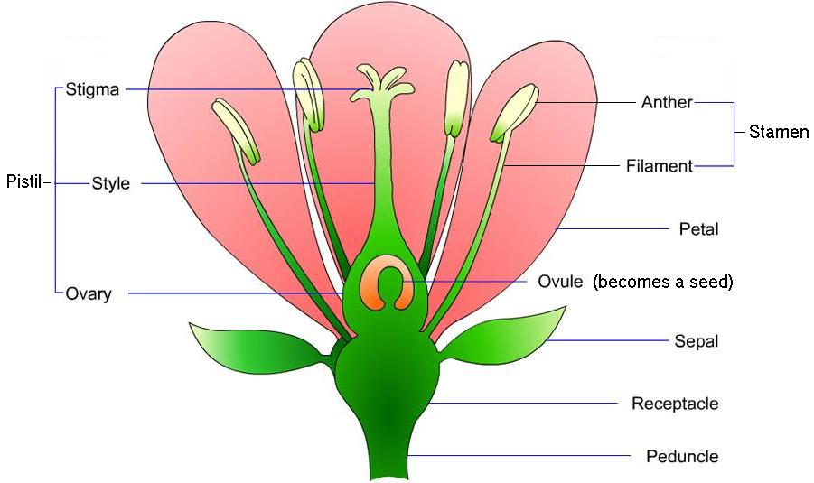
Sexual Reproduction in Plants Parts of a Flower

Slide 15
Sexual Reproduction in Plants Functions of the Different Floral Structures
Sepals: Protects the flower in the bud stage
Petals: 1. Bright coloured petals attract insects and birds that aid in pollination. 2. They protect the reproductive structures located in the centre of the flower.
Stamen: 1. Anther contains pollen sacs in which the pollen grains are made and stored. 2. Pollen grains contain the male sex cells.

Slide 16
Sexual Reproduction in Plants Functions of the Different Floral Structures
Pistil: 1. Stigma has a sticky surface for pollen grains to land on. 2. Style connects the stigma to the ovary. 3. Ovary contains ovules. The ovules contain the female sex cells. The wall of the ovary is very thick to protect the ovules and sex cells.

Slide 17
Sexual Reproduction in Plants Pollination
There are two types of pollination: 1. self: Pollen grains are deposited on the stigma of the same flower or of a different flower on the same plant. 2. cross: Pollen grains are transferred from the anther of one flower to the stigma of a different flower.

Slide 18
Advantages of Cross Pollination
Greater variety of offspring because two parents are involved.
Greater change of survival if environmental conditions change.
Offspring may be stronger and less susceptible to diseases that may have affected the parents.

Slide 19
Agents of Pollination
Insects/Animal referred to as insect or animal pollination.
Wind referred to as wind pollination.

Slide 20
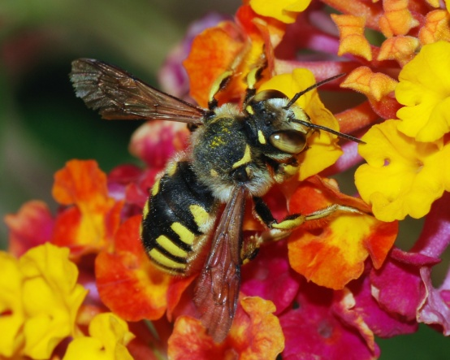
Insect Pollination
In insect pollination plants: a. have flowers with brightly large and brightly coloured petals. b. the flowers have a sweet scent and usually produce nectar. c. their pollen grains are large, heavy and sticky so that they can easily stick to the bodies of insects that visit them.

Slide 21
Insect Pollination
In insect pollination plants: d. stigmas and anthers are usually inside or partly closed in the flower. e. Stigmas are rigid and smooth, and sticky at the tip.

Slide 22
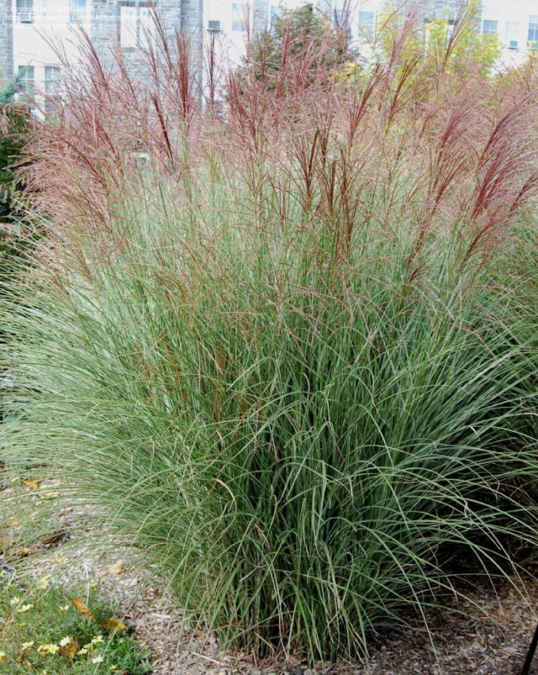
Wind Pollination
In wind pollination plants: a. their flowers are small and do NOT have brightly coloured petals. b. their flowers are odourless and hang down. c. Pollen grains are small, light and smooth.

Slide 23
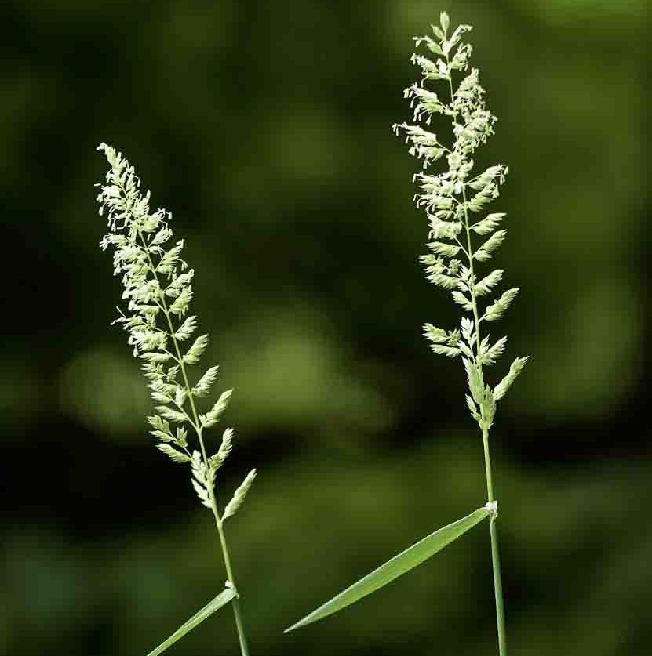
Wind Pollination
In wind pollination plants: d. have lots of pollen which is light enough to be blown onto other plants of the same species by the wind. e. have long feathery stamens which hang outside of the flower for easy shaking in the wind. f. Have long feathery stigmas to catch air-borne pollen grains.

Slide 24
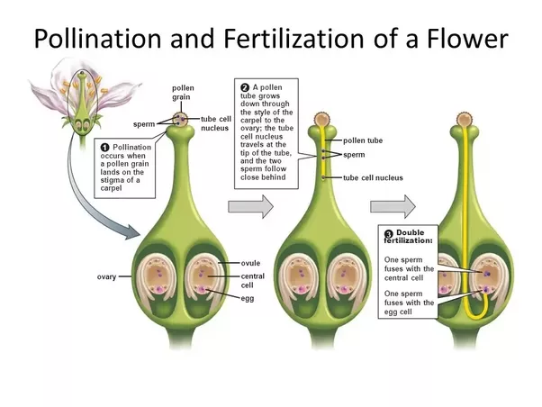
Fertilisation In Plants

Slide 25
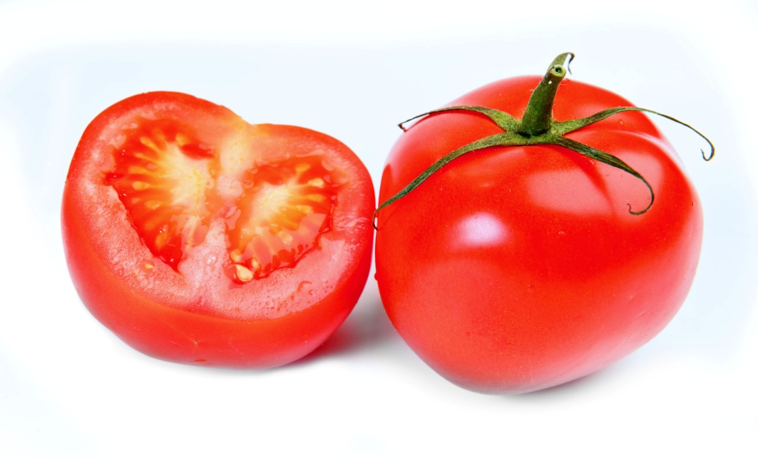
Fertilisation In Plants
The fertilised cell starts the process of division to produce a seed and the ovary turns into a fruit.
In a tomato, seeds are embedded inside the fleshy fruit that was once the ovary in a tomato plant.

Slide 26
Sexual Reproduction in Humans
In humans the male and female sexual organs are in different individuals.
Male gametes, sperm, are produced in the testes and stored there. Sperms are always replenished.
Female gametes, eggs, are located in the ovaries and stored there. A female is born with the exact amount of eggs she will ever have in a lifetime. They are never replenished.

Slide 27
Sexual Reproduction in Humans Puberty
A human being changes over from childhood to adulthood due to puberty.
Puberty causes biological changes in a human being and occurs around 8 – 16 yrs of age in a female and around 10 – 17 yrs of age in males.
Puberty is triggered by hormones releases from the pituitary gland.

Slide 28
Sexual Reproduction in Humans Puberty in Females
Enlarged breasts
Hair growth in armpits and genitalia
Wider hips to give a curvier shape
Menstrual cycle begins when ovary starts to release ova (ripe egg)
Perspiration begins and body odour is noticeable
Acne may develop in some persons

Slide 29
Sexual Reproduction in Humans Puberty in Males
Rapid increase in height
Shoulders widen and voice deepens as Adam’s apple enlarges
Hair grows on face, armpits, genitals and sometimes chest
Erections become more frequent when sexually aroused and are often accompanied with wet dreams when asleep
Testes are now able to produce sperm
Perspiration and body odour are noticeable
Acne may result in some individuals

Slide 30
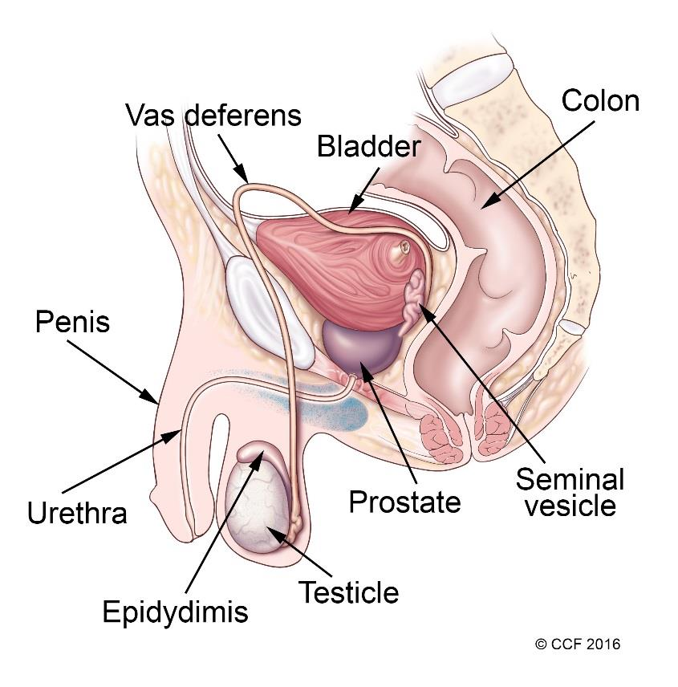
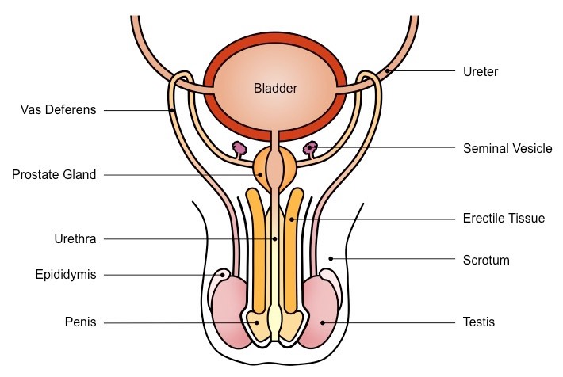
Human Male Reproductive Organ

Slide 31
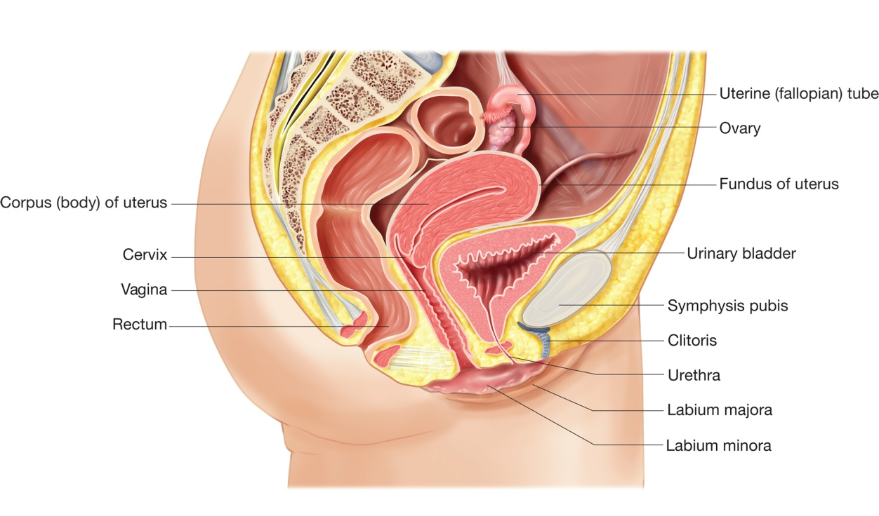
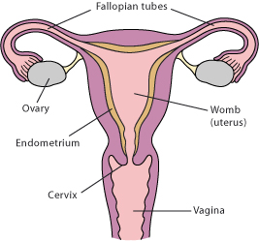
Human Female Reproductive Organ

Slide 32
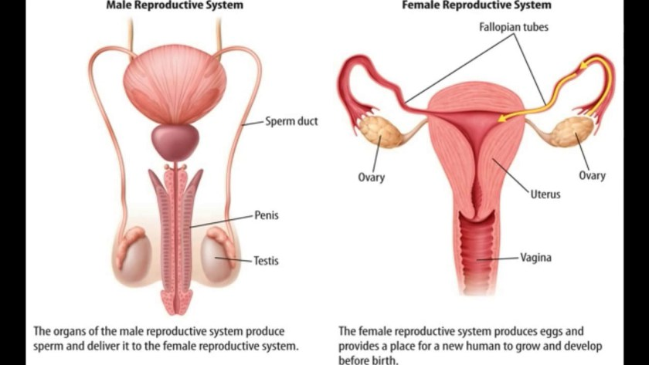
Male and Female Reproductive Systems Side by Side

Slide 33
Human Sexual Reproduction
The penis, while erect, enters the vagina during copulation or sexual intercourse.
Sperm is released down the sperm duct and out the penis during ejaculation in fluids given off by: a. The seminal vesicles where the fluid is thick and sticky and provides nourishment to keep the sperms alive. b. The prostate gland where the fluid is thin and milky.

Slide 34
Human Sexual Reproduction
Fertilisation takes place when the sperm meets the egg (ovum).
Millions of sperm are ejaculated but only one will be able to fuse with an egg.

Slide 35
Human Sexual Reproduction
The sperm have flagella (tails) which they use to navigate through the cervix and then into the uterus.
Once the sperm penetrates the outer layer of the ovum fertilisation would take place.

Slide 36
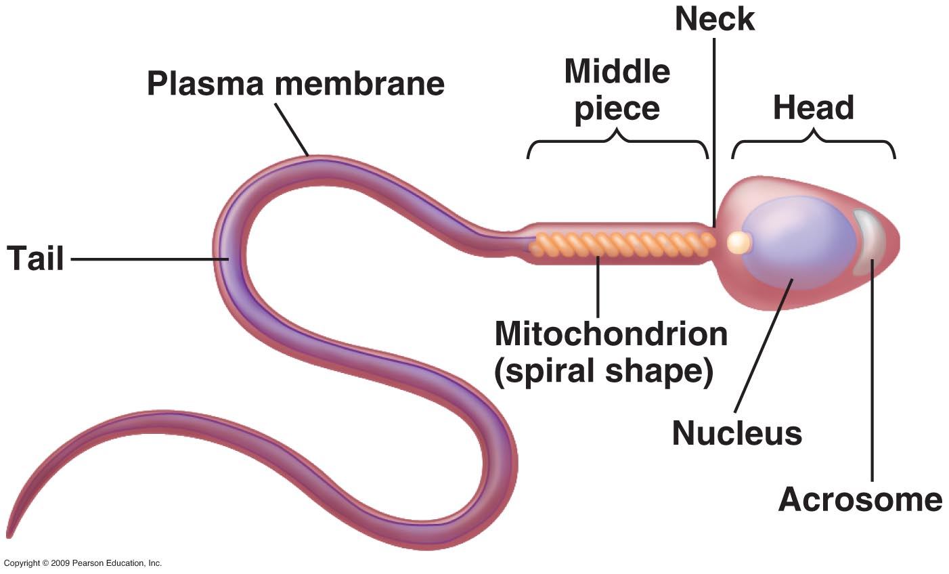
Male Sex Gamete

Slide 37
Female Sex Gamete

Slide 38
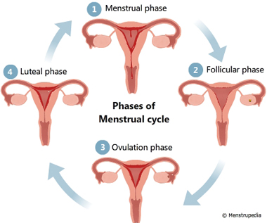
Menstrual Cycle
Menstruation is the discharge of blood and tissue from the vagina.
The discharge comes from the lining of the uterus and happens at approximately 4 week intervals or every 28 days.
Menstruation starts at puberty and lasts until the menopause. It is often referred to as a girl’s period.

Slide 39
Menstrual Cycle
The menstrual cycle is controlled by four hormones: a. Follicle stimulating hormone (FSH) b. Oestrogen c. Luteinising hormone (LH) d. Progesterone

Slide 40
Follicle Stimulating Hormone
It is released by the pituitary gland and starts the monthly cycle.
It stimulate an egg to mature in a follicle within the ovary.

Slide 41
Oestrogen
Once FSH has been released oestrogen is released by the ovaries.
When its levels rise it causes the thickening of the uterus lining. This is done in preparation for a fertilised egg.

Slide 42
Luteinising Hormone
This hormone is produced by the pituitary gland as oestrogen levels fall.
LH stimulates the release of the egg from the ovary into the fallopian tube. This is called ovulation and occurs at about day 14 of the cycle. You are most likely to get pregnant at this time if you are having unprotected sex.
The cycle starts the same day you get your period. So on the 14 day of your cycle an egg would be along its way in the Fallopian tubes in preparation for fertilisation and later implantation if fertilisation was successful.

Slide 43
Progesterone
About a week later progesterone is released.
It causes the lining of the uterus to thicken but if a fertilised egg does not implant its self into the lining then progesterone decreases and the lining begins to shed.
Shedding of the lining from the uterus via the vagina is the period a woman experiences. It lasts between 2 – 7 days depending on the person’s biological make up.

Slide 44
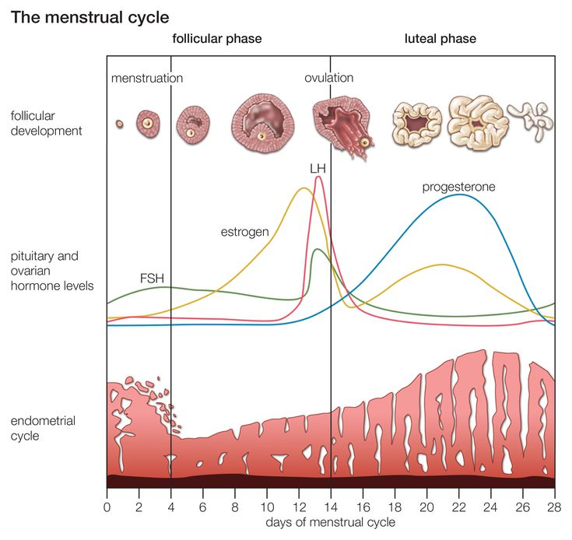
Diagram o

Slide 45
Video Time – Reproduction 1

Slide 46
Video Time – Reproduction 2

Slide 47
Menopause
Menopause occurs between the ages of 45 and 55.
This is the time that a woman stops having her period.
Menopause happens because low levels of oestrogen cause the ovaries to cease functioning.

Slide 48
Menopause
Symptoms of menopause include: hot flushes irritability dry skin and muscle aches
These symptoms only happen for a short time until the body becomes accustomed to not having a period.

Slide 49
Pregnancy
Pregnancy comes with responsibility and consequences.
It is the time between fertilisation and birth. This time is called the gestational period.
Pregnancy lasts for approximately 39 – 40 weeks or 9 – 10 months in humans.

Slide 50
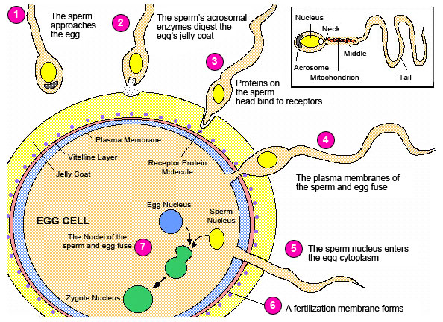
Fertilisation

Slide 51
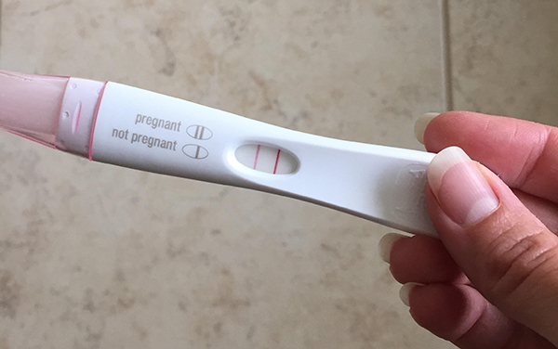
Pregnancy
During pregnancy the egg travels down the fallopian tube and implants itself into the lining of the uterus.
The embryo grows there, attached to the mother via the placental and umbilical cord and develops into a foetus.

Slide 52
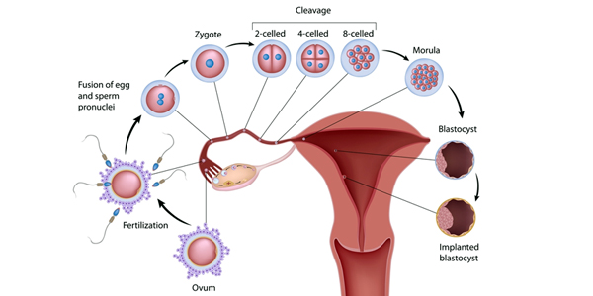
Implantation

Slide 53
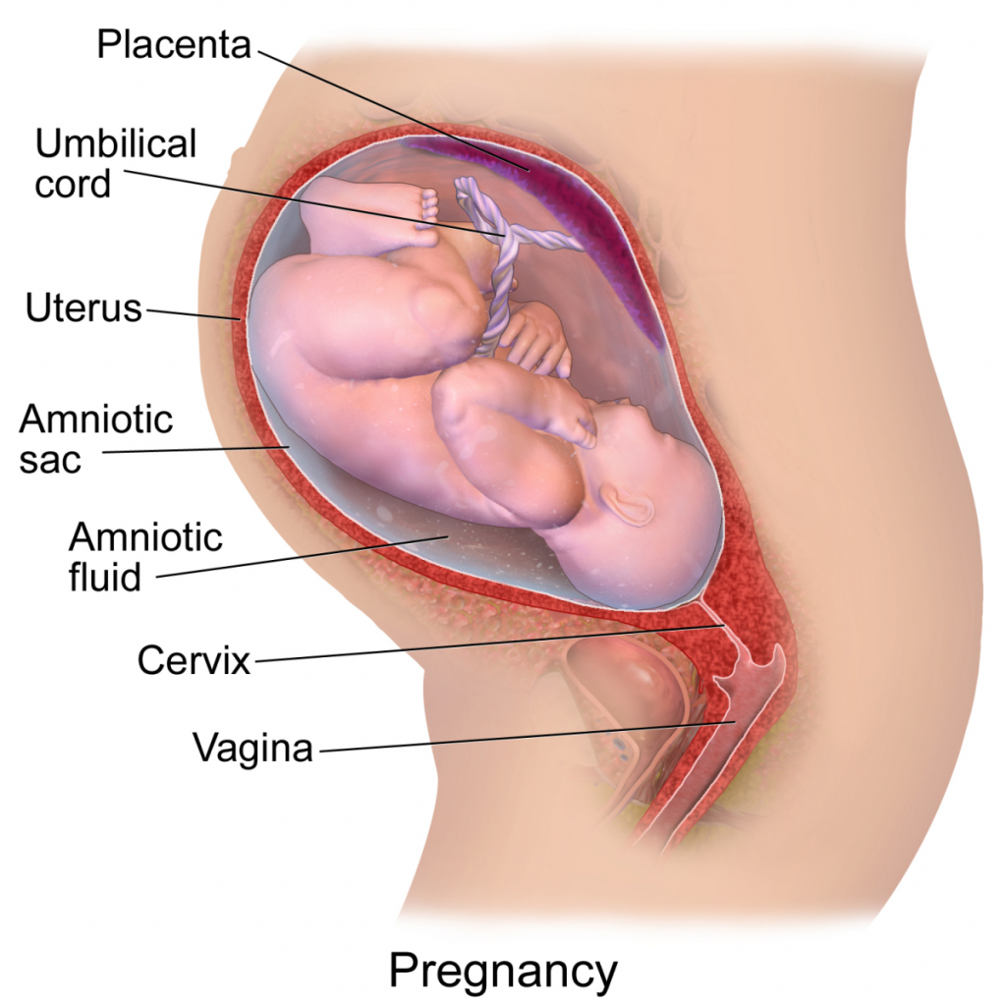
Pregnancy
The foetus is protected in the uterus from shock by a bag of amniotic fluid.

Slide 54
Stages of Pregnancy Gestational Period
Week 1: Embryo is 12 mm
Week 5: Embryo is about 0.5 cm long. Head, body and main features can be seen: brain, nervous system, heart and blood vessels
Week 8: Embryo is about 6 cm long. Reproductive organs start to develop. Eyelids and ears form.
Week 9 - 12: Embryo is about 25 cm long. All structures are developing. Bones and muscles allow movements. The baby begins to hear sounds. The embryo is now called a foetus.
Week 37 - 40: The baby is approximately 50 cm long, fully developed and ready for birth.

Slide 55
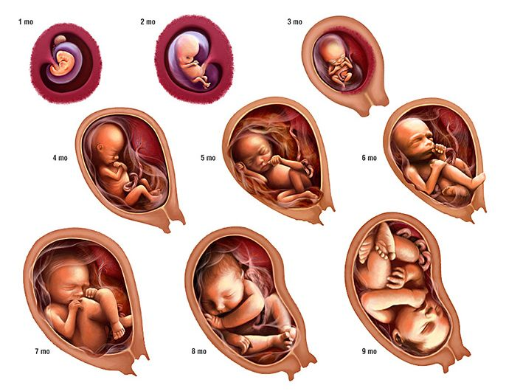
Stages of Pregnancy Gestational Period

Slide 56
Video Time – Reproduction 3

Slide 57
Pregnancy
The mother’s blood provides nutrients and removes waste products from the blood of the embryo/foetus. Hence it is important for the mother to eat properly and avoid smoking, alcohol or drugs.
Babies born from drug addicts end up being addicted to drugs and have bad withdrawal symptoms. They are often underweight as well.

Slide 58
Pregnancy
Labour can be induced or can happen naturally. However, the majority of the time it occurs spontaneously.
Labour can vary between minutes to hours to days depending on the nature of the person.

Slide 59
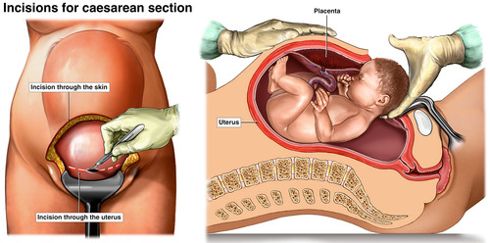
Pregnancy to Birth Caesarean Section
A baby may be delivered vaginally or via caesarean section.
Caesarean section is done only if mother or baby or both are in danger.
This involves anaesthetising the mother and making a cut through her lower abdomen and the wall of the uterus to remove the baby.

Slide 60
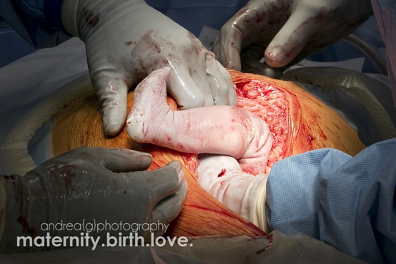
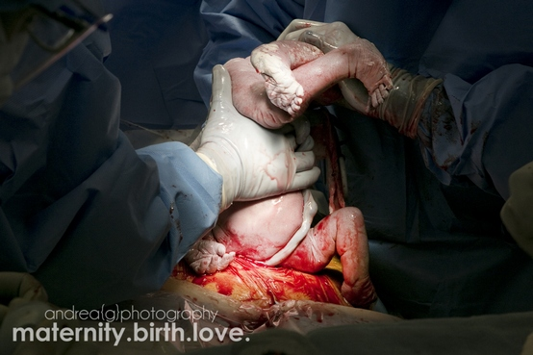
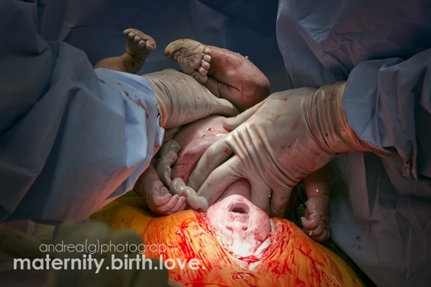
Pregnancy to Birth Ceasarean Section

Slide 61
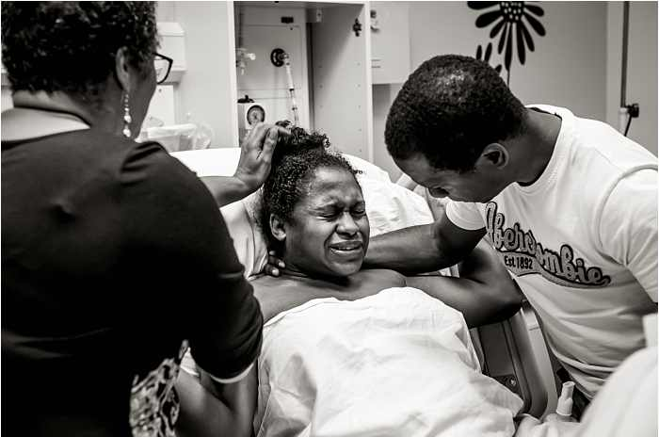
Pregnancy to Birth First Stage of Labour Vaginal Birth
During the first stage of labour the muscles of the uterus start to contract. This is caused by the hormone, oxytocin, which is released by the pituitary gland. This hormone also cause the membrane or amnion around the baby to break releasing the amniotic fluid. The cervix becomes thinner and widens (dilates)

Slide 62
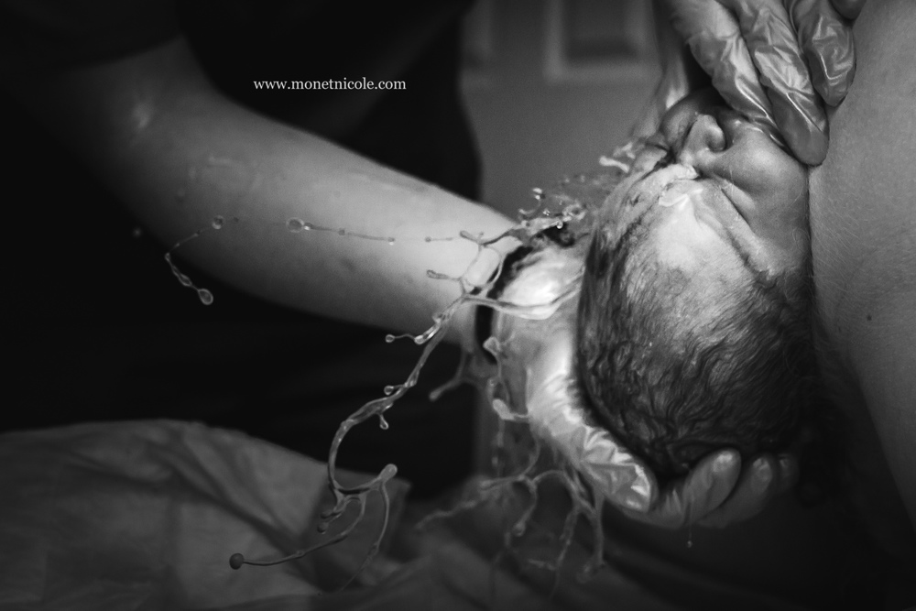
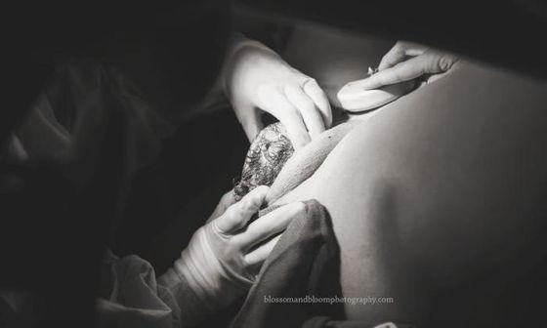
Pregnancy to Birth Second Stage of Labour Vaginal Birth
The second stage of labour commences when the cervix is fully dialated and the baby’s head is delivered from the vagina.

Slide 63
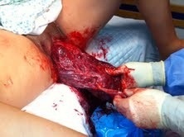
Pregnancy to Birth Third Stage of Labour Vaginal Birth
The third stage involves the placenta separating from the wall of the uterus and being delivered as the afterbirth.

Slide 64
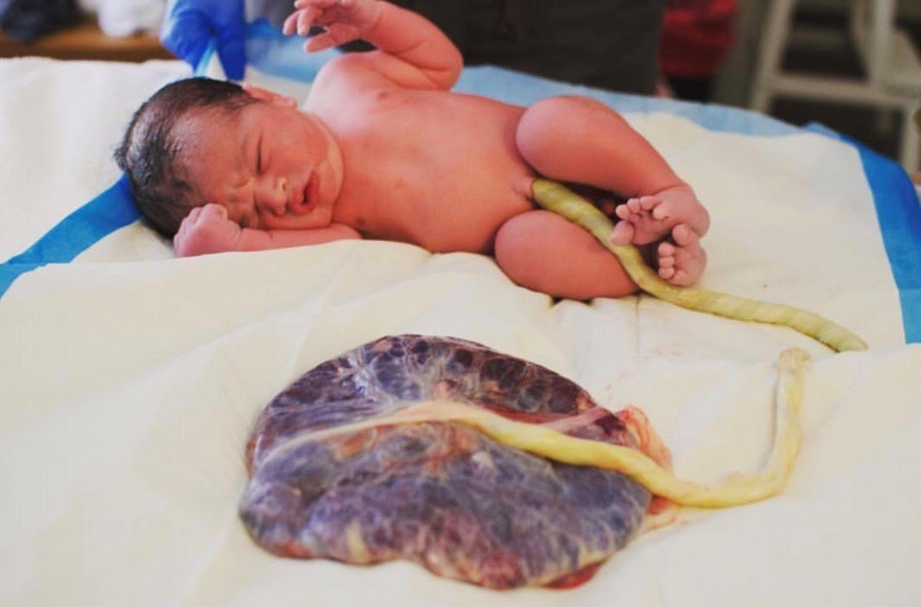
Pregnancy to Birth Third Stage of Labour Vaginal Birth
Once the placenta is delivered, the umbilical cord is clamped and cut and the baby is given to the mother.

Slide 65
Video Time – Vaginal Birth

Slide 66
Birth Control
Babies can be planned however pregnancy is NOT an accident. It may be a surprise but it is NOT an accident.
Once you and your partner are engaged in heterosexual unprotected sex and the female is still of child bearing age a pregnancy may result.

Slide 67
Birth Control
Persons who would like to have a family can plan to do so and they can even determine how large they would like their family to be.
There a various methods that can be used to plan a family: a. Natural b. Barrier c. Hormonal d. Surgical

Slide 68
Birth Control Types of Natural Methods
Withdrawal: The penis is withdrawn before semen enters the vagina. This method is unreliable and there is NO protection against sexually transmitted diseases.
Rhythm: a. Mucus – More mucus is secreted at the time of ovulation so intercourse is avoided at this time. b. Temperature – A rise in body temperature is associated with ovulation so intercourse is avoided at this time. Both methods are unreliable and there is no protection against sexually transmitted diseases.

Slide 69
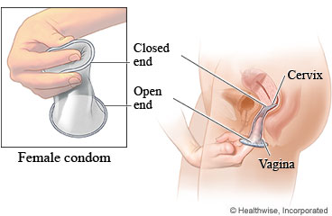
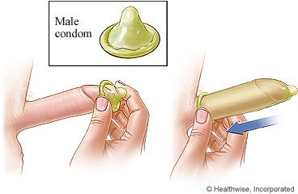
Birth Control Types of Barrier Methods
Condoms This method is very effective. Protects individuals from contracting sexually transmitted diseases eg. HIV.

Slide 70
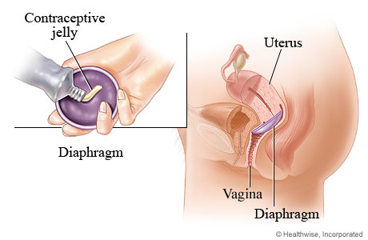
Birth Control Types of Barrier Methods
Diaphragm Spermacide is put onto the diaphragm to kill and stop sperm from meeting the egg.

Slide 71
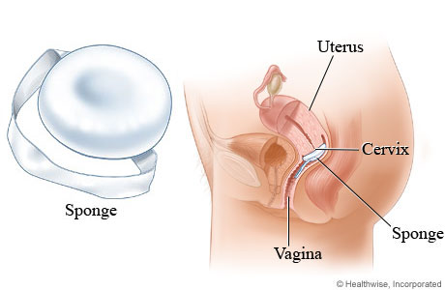
Birth Control Types of Barrier Methods
Sponge This method is also effective at blocking the sperm from meeting the egg.

Slide 72
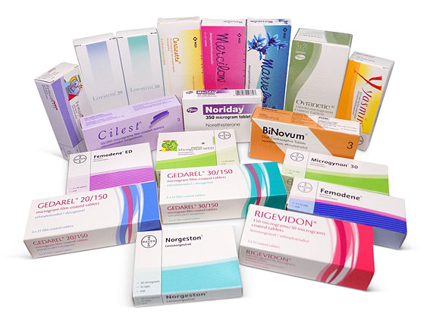
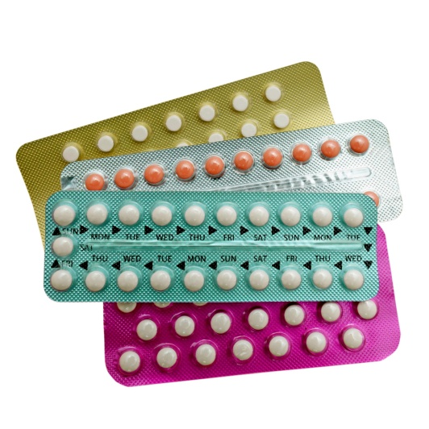
Birth Control Types of Hormonal Methods
Contraceptive pills contain oestrogen and or progesterone. It can thicken cervical mucus to prevent sperm from reaching the egg. It can also prevent implantation as well as ovulation. Contraceptive hormones are also available in patch or injection form. Pills are taken daily Patches are changed weekly Injections last for 12 weeks

Slide 73
Video – Birth Control

Slide 74
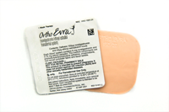
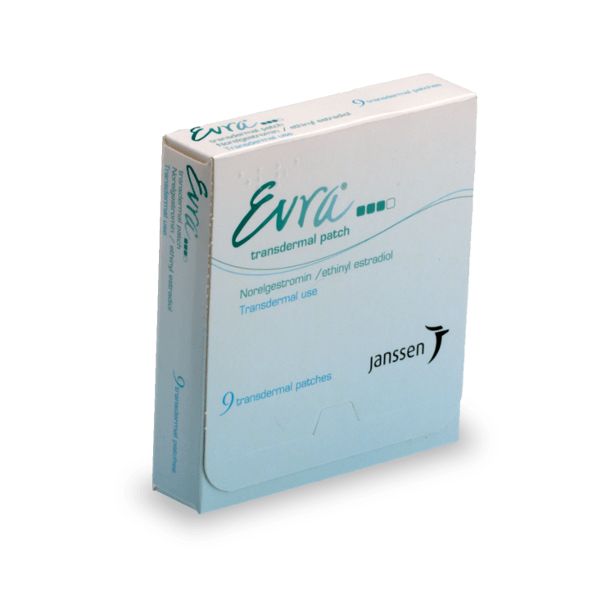
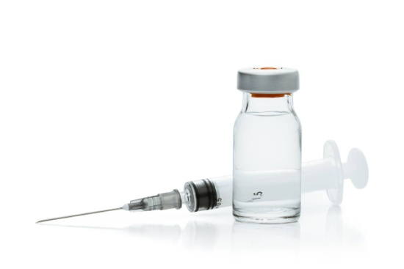
Birth Control Types of Hormonal Methods
Contraceptive pills offer no protection against sexual transmitted diseases.
They have temporary side effects.
There is an increased risk of heart disease and high blood pressure. They are not reliable if vomitting and diarrhoea occurs after taking or if on a course of antibiotics.

Slide 75
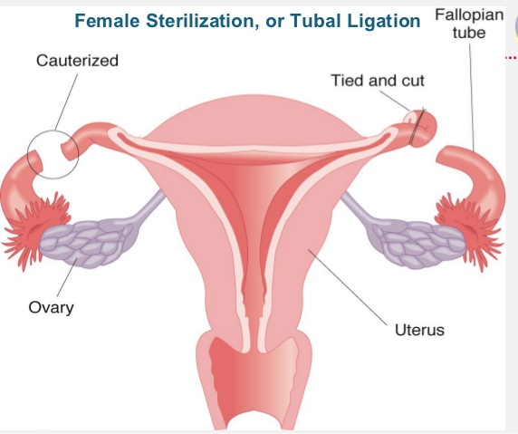
Birth Control Types of Surgical Methods
Female sterilisation
The fallopian tubes are cut, sealed or blocked by an operation. This stops egg and sperm meeting.
Sterilisation is permanent with no long or short term serious side effects.
Once operation is carried out there is no need to think about contraception.

Slide 76
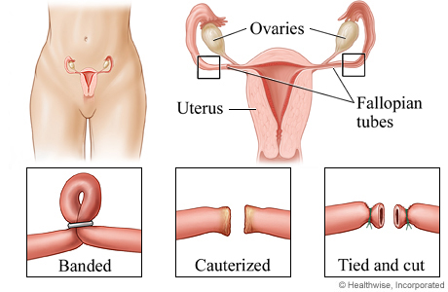
Birth Control Types of Surgical Methods
Female sterilisation

Slide 77
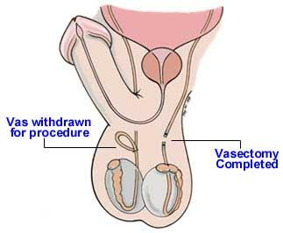
Birth Control Types of Surgical Methods
Male sterilisation
The tubes (ducts) that carry sperm from the testicles to the penis are cut, sealed or blocked.
This method is permanent with no side effects.
Once operation is carried out ther is not need to think about contraception.

Slide 78
Questions
Describe two ways of permanently preventing conception (fertilisation) taking place.
Which method of contraception a. Depends on predicting monthly ovulation. b. Relies on tricking the female body with chemicals c. Prevents sperm from entering the vagina and protects against sexually transmitted infections?

Slide 79
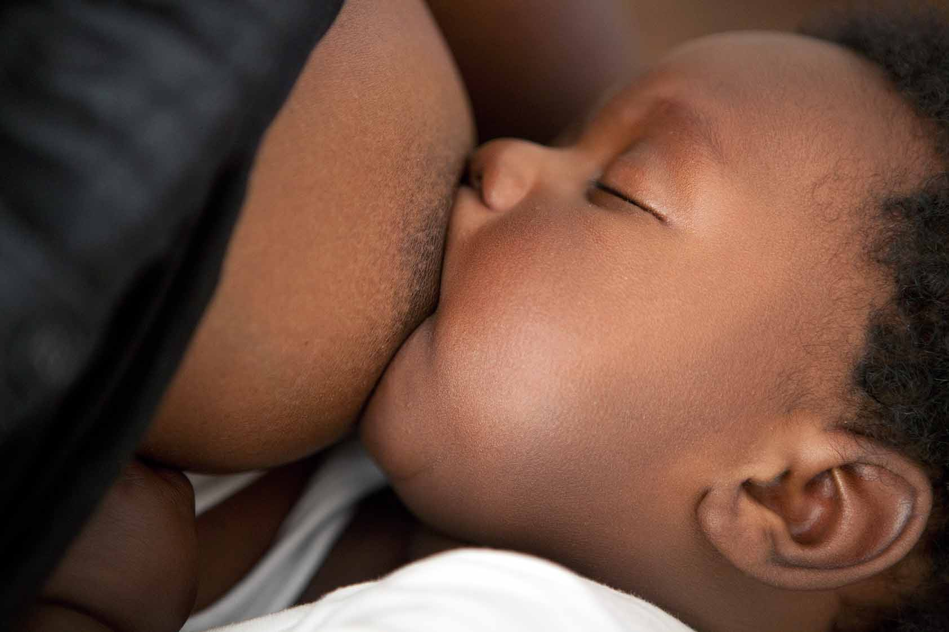
Post-natal care
A woman’s body begins to make breast-milk after giving birth.
Delivery of the placenta (afterbirth) causes a drop in hormones and allows milk production.
When the baby suckles at the breast a hormone, oxytocin, is released into the bloodstream. This stimulates the ‘let down’ or milk ejection reflex.

Slide 80
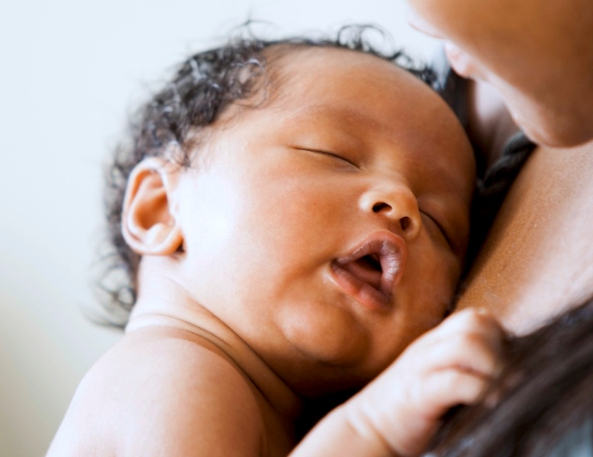
Post-natal care
The production of milk in a mother’s breasts is called lactation.
Colostrum is the milk produced in the first 3 to 4 days of lactation.
It is a concentrated form of breast-milk.
Babies receive protection against infection and help for their immune system from their first feed of colostrum.

Slide 81
Post-natal care Advantages of Breastfeeding
Breast milk: 1. is at the correct temperature for the baby 2. contains antibodies to help the baby fight off any infections 3. contains the correct amount of proteins, carbohydrates, vitamins, minerals and fats in a form that is easy to digest

Slide 82
Post-natal care Advantages of Breastfeeding
Breast milk: 4. Changes as the baby grows to give it the perfect nutrients for each stage or its development 5. Is sterile and does not cost anything 6. helps to form a bond between the mother and baby

Slide 83
Post-natal care Advantages of Breastfeeding
Breast milk: 7. Reduces the risk of having diarrhoea and vomiting, chest and ear infections, constipation, eczema, as well as being obese and developing type 2 diabetes 8. Reduces the risk of sudden infant death syndrome and childhood leukamia 9. Reduces the risk of breast and ovarian cancer and of hip fractures in the mother

Slide 84
Post-natal care What if there is no breast milk?
If mothers are unable to breastfeed sometimes they give their babies powdered milk or formula from a bottle.
If this is done the water must not be contaminated and should be boiled, and bottles and teats should be sterilised.

Slide 85
Pre-natal care
Pre-natal care is also referred to ante-natal care.
Pre-natal care involves the care of a woman during her pregnancy. It covers the health and development of her baby.

Slide 86
Things a pregnant woman should NOT engage in healthwise
Smoking
Drinking Alcohol
Prescribed and Recreational Drugs

Slide 87
Things a pregnant woman should NOT engage in healthwise
Smoking Carbon monoxide from tobacco can restrict the amonunt of oxygen carried by the red blood cells. This can lead to: 1. a miscarriage 2. still birth 3. low birth weight 4. higher risk of foetal abnormalities

Slide 88
Things a pregnant woman should NOT engage in healthwise
Drinking Alcohol Alcohol can damage both sperm and ovum before conception. It can also damage the embryo. This can lead to: 1. mental retardation 2. retarded growth 3. damage to the brain and nervous system

Slide 89
Things a pregnant woman should NOT engage in healthwise
Prescribed and Recreational Drugs Drugs can enter the baby’s blood stream via the placenta. Marijuana affect the normal production of male sperm and effects take 3 – 9 months to wear off. Hard drugs such as cocaine, heroin and morphine can damage the chromosomes in the sperm and ovum leading to abnormalities.

Slide 90
A Pregnant Woman’s Diet
She should have a balanced diet for the baby to grow and develop properly.
Ingesting folic acid is encouraged when trying to get pregnant as well as for the first 12 weeks of pregnancy to avoid conditions such as spina bifida in the baby.

Slide 91
What is Spina Bifida?
Spina bifida is a type of birth defect called a neural tube defect. It occurs when the bones of the spine (vertebrae) don't form properly around part of the baby's spinal cord. Spina bifida can be mild or severe. The mild form is the most common. It usually doesn't cause problems or need treatment.

Slide 92
What is Spina Bifida?
Infants born with a more serious degree of this disorder have open lesions on their spine where significant damage to nerves and the spinal cord has occurred.

Slide 93
Diseases in Pregnancy
Pathogens can be viruses or bacteria.
They can pass from mother to baby.
German measles (rubella) is caused by a virus that can cross the placental. It causes abnormalities such as deafness and heart defects.

Slide 94
Diseases in Pregnancy
The HIV virus that causes AIDS may cross the placenta. Therefore a baby may be born HIV positive if the mother is infected.
Listeriosis and salmonella are bacterial infections. They can be picked up by eating certain foods. These include mould-ripened cheeses, such as camembert and brie as well as raw eggs.

Slide 95
Immunisation of the Baby
During the first year of life, babies are immunised against certain dangerous diseases because they could cause death or lasting damage.
Such diseases include: measles rubella mumps tetanus polio whooping cough

Slide 96
X-rays
During pregnancy women should avoid taking or being around x-rays.
X-rays are high-energy electromagnetic waves. They are dangerous in high doses as they can interfere with body cells, causing cancers.
X-rays are dangerous to the developing foetus. Because of this they can not be used to monitor the development of the baby.
Instead of x-rays hospitals use ultra-sound for scanning.

Slide 97
Questions
Why is breast-milk beneficial for the development of the newborn baby?
Why do some mothers choose to feed their babies on formula milk mixtures?
Make a list of diseases that babies can be immunised against.
Besides diseases, make a list of other factors that can harm the unborn baby.

Slide 98
Sexually Transmitted Infections (STIs)
Sexually transmitted infections are passed from one person to another during unprotected sexual activity.
An STI can be caused by viruses, bacteria, or parasites such as fungus.

Slide 99
STIs caused by Bacteria
Chlamydia
Gonorrhoea
Syphilis The STIs above are usually curable with antibiotics.

Slide 100
STIs caused by Viruses
Human papilloma Virus (HPV)
Genital herpes
Hepatitis B
Human Immunodeficiency Virus (HIV) The STIs above can NOT be cured.

Slide 101
Fungal Infections
Candida often referred to as a yeast infection can be passed from an infected person to another during sexual intercourse.
It can be cured with anti-fungal drugs like canesten.

Slide 102
Growth in plants, humans and population

Slide 103
Germination and growth in plants
Germination is the process that occurs when a seed begins to develop into a new plant.
A seed is a food store so that the new plant can grow and develop until it has produced its own leaves, then it can photosynthesise.

Slide 104
Germination and growth in plants
To germinate and grow into a plant, the seed needs: a. Energy b. Oxygen c. Warmth d. Water
From a seed the radicle (root) begins to grow downwards into the soil and then the plumule (shoot) grows upwards towards light.

Slide 105
Growth in humans
From birth, babies grow and develop quickly.
At Age 1: babies are able to sit up, feed themselves and some are able to walk. Age 2: babies start to communicate by talking. Ages 10 – 14: By this age the child would have been developing steadily and would be arriving at puberty.

Slide 106
Growth in Humans Puberty
By puberty children experience another growth spurt and sex organs become active.
The start of puberty varies from person to person. However, girls usually develop earlier than boys.
Puberty occurs because of the presence of hormones. This is also accompanied by mood swings, physical changes and increased sexual urges.
Girls usually finish growing at 18 yrs of age whereas boys finish growing at 21 yrs of age.

Slide 107
Population Growth
The rate at which a population grows is largely dependent on the rates at which new individuals are born and old or sick ones die.
The rate at which new individuals are born are called birth rate and the rate at which they die is called the death rate.
A population grows when the birth rate exceeds the death rate the same will occur if the birth rate is constant but the death rate decreases.

Slide 108
Population Growth
When the population size exceeds the environment’s ability to support that number of individuals living in it then it is called overpopulation.
Overpopulation can cause many social, economical and environmental problems.

Slide 109
Human Population Growth
The world’s population is about 7 billion and it is growing.
The world’s human population increased slowly until about 1800 when there was a sudden rapid rise in growth rate.
This rapid growth in population has resulted from two factors:
a. Increased population of food and the introduction of new farming techniques which has increased the birth rate. b. Better sanitation and health care and the introduction of medicines to combat infection which have reduced the death rate.

Slide 110
Human Population Growth Problems Arising from Overpopulation
This number of people makes great demands on the Earth’s limited resources.
These demands are fulfilled by the use of Crude oil which is a non-renewable source of energy and it is dwindling.
We also depend on Earth’s mineral resources which we obtain from our metals. This too is dwindling.

Slide 111
Human Population Growth Problems Arising from Overpopulation
The Earth’s natural resources cannot support its growing population.
The quality and quantity of the following can be affected by overpopulation: a. Food b. Water c. Employment d. Overcrowding e. Increase in pollution f. More children to look after

Slide 112
Human Population Growth Birth Control & Education
To keep human populations down people must be educated on how to plan pregnancies and families.
Birth control is the major way to keep our populations manageable.

