Slide 1
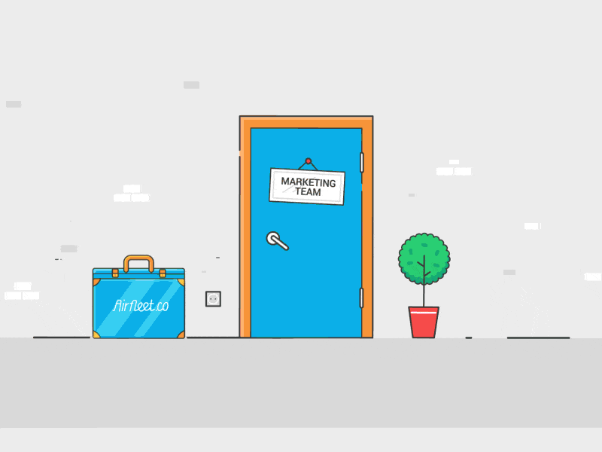
Science and Technology

Slide 2
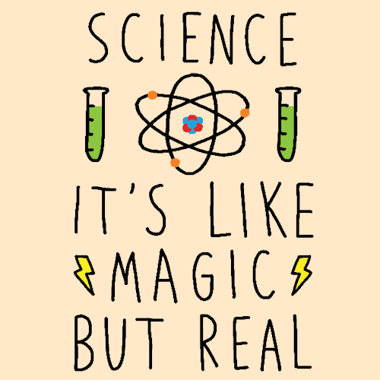
What is Science?
Science is the study of the world around us.
Learning science removes skepticism and propels us to want to learn more about ourselves, the environment and how we interact with it.

Slide 3
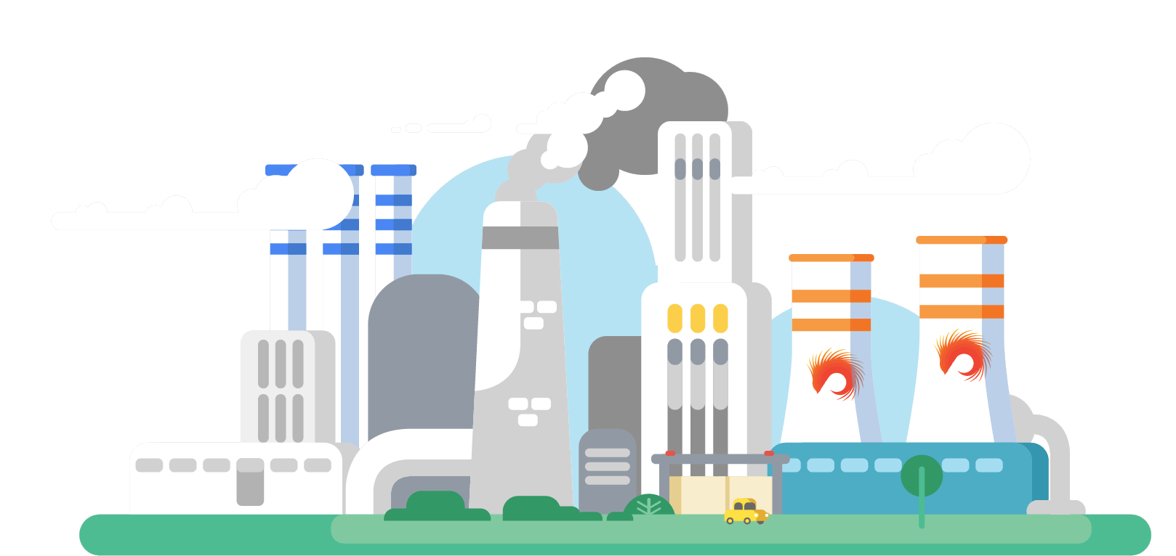
What is Technology?
Technology is the application of scientific knowledge.

Slide 4
Advantages and Disadvantages of Science and Technology
 | Benefit/Advantage | Burden/Disadvantage
Chemical Fertilizers and Pesticides | Farmers are able to produce more and better crops | Pollution of underground waters
Oil | Fuel available to use | Destruction of coral reefs by oil spillage
Landfills for garbage disposals | Removal of garbage away from the community | Breeding ground for pests such as cockroaches, flies, mosquitoes and rats.
The use of the products of technology such as plastics and metals | Used to make a variety of tools | 1. These materials do not decompose easily 2. Poisonous gases are given off when these materials are burnt
Vehicles | Used for transportation | Release fumes that form acid rain which falls and kills aquamarine plants and animals

