Slide 1

21. The World’s Energy Resources

Slide 2
What do you think is a renewable energy source?
A non-renewable energy resource are those energy supplies that cannot be replaced once they are used up.
Try to name some types of renewable energy resources::
Try to name some types of non-renewable energy resources::
A fuel is a substance that can be used to produce energy. Fuels can be classified into
(a) solid fuels
(b) liquid fuels and
(c) gaseous fuels
Photosynthesis, occuring millions of years ago, produced the plants that were changed into the fossil fuels – oil, coal and natural gas. In a sense the energy of the sun was trapped by photosynthesis, then stored in fossil fuels and we release it again when we burn the fuel.
Coal is the most important solid fuel although it is difficult to mine. Its bulk means it requires a lot of storage space.
It is the most abundant fossil fuel and is composed largely of carbon

Slide 3
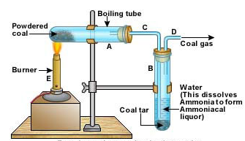
How do you think coal was formed?
Coal contains mainly carbon, little hydrogen, nitrogen, oxygen and ash.
Anthracite is the form of coal which has the highest percent of carbon.
When coal is burnt in excess air what do you think is produced including by-products?
The SO₂ produced during combustion of coal does what to the environment? Owing to this smokeless fuel which is smokeless treated coal is often used instead of coal.
When coal gas is heated at about 1000ºC in the absence of air it does not burn. It splits up and forms four main products::
coal gas
ammonia
coal tar and
coke
Coal gas is used as a household fuel but is now
largely replaced by natural gas. Coal consists of
chiefly H₂ with smaller amounts of CH₄ and CO.
Ammonia is used to make fertilizers
Coal tar can be further separated by fractional
distillation into valuable chemicals eg. Benzene
and toluene
Coke is the solid fluid often used in electricity
generating plants

Slide 4
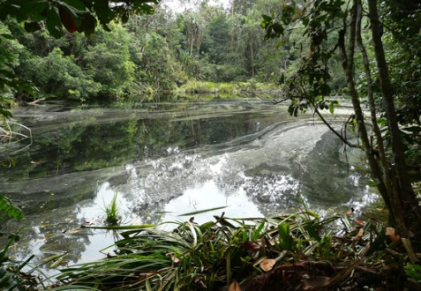
Peat is another type of solid fuel. It is found in swampy areas where plant materials are partly decomposed by water. Although peat is cheap it is not a good fuel. Why do you think this is so?
It is used as a major fuel in some parts of the world and is found in Northern climates such as Ireland and Great Britain and the tropics. Which island in the caribbean do you think peat may be found?
Some examples of liquid fuels are::
Petrol
___________ and
Oil
What do you think petrol is obtained from? __________________
It is a mixture of alkanes including octane. To improve its combustion properties lead compounds such as tetraethyl-lead(IV) is added. What is the formula for this compound and why are alternative compounds other than lead compounds preferred to obtain lead – free petrol?
Where do you think the alcohol comes from?__________________
Cars can be adapted to run on alcohols such as methanol and ethanol.
Where do you think oil is obtained from? ____________________
Fractional distillation is the process whereby oil is obtained as a fraction. Oil is important because it is:
a. An important source of energy
b. Oil fractions improve our standards of living because they can be used to make a wide range of products. Can you suggest some of these products?
Peat deposit

Slide 5
A type of gaseous fuel is Methane, CH₄. It is very important. It is found as natural gas either alone or associated with crude oil.
Natural gas and oil are trapped below ground by layers of rock that do not allow the natural gas to escape.
CH₄ + O₂ → ____________ + ______________
Natural gas is a good fuel because::
a. It has a high enthalpy of combustion
b. It can be readily transported via pipelines from gas fiels to storage plants or directly to companies which use this fuel
c. Oil and natural gas are readily available worldwide and can be extracted by drilling wells
Natural gas::
a. Is the starting material for the production of methanol and ammonia and hence nitric acid and urea
b. is also used in the production of iron from its iron ore.
c. can be compressed and cooled to produce liquefied natural gas (LNG) which is now used as a fuel in some cars instead of regular gasoline.
Pollution is a very serious issue in the world today and sadly, the burning of fossil fuels is a major contributor to this. How does this affect us and the environment?
a.
b.
c.
d.
e.
Additionally, oil can form pollution even without being burnt. Give me an example of this.

Slide 6
What exactly is the greenhouse effect? Do you even truly know?
It is when CO₂ is formed from the burning of fossil fuels. The CO₂ along with water vapour in the air readily absorbs infrared heat which is the energy given off from the earth. This energy causes the molecules of the CO₂ to vibrate and heat up. And where do you think this heat goes?
This phenomenon is called the greenhouse effect. Owing to this, global temperatures are expected to rise by 2 – 5 ºC in the next five decades as a result increased CO₂ concentration in the air. Why do you think the concentration of CO₂ is increasing?
How do you think an increase in global temperatures is going to affect us?
To some extent the carbon cycle keeps the level of CO₂ in the atmosphere to acceptable limits. The earth’s forests and jungles play a crucial role in removing __________ and supplying _________ and hence the destruction of very large areas of heavily forested lands cause for much concern.
Much CO₂ is also absorbed by the vast areas of ocean.
The solution to this is going to depend on an international effort.
atmospheric
sunlight
CO₂, H₂O vapour
Infrared
heat from
Earth
CO₂ molecules
vibrate from
infrared heat &
gives of additional
heat causing it to be
trapped

Slide 7
Another form of energy is Nuclear Energy.
When a uranium – 235 nucleus is bombarded with a neutron::
a. It splits into radioactive fragments
b. Vast amounts of energy (nuclear) energy are released
c. 2 to 3 neutrons are produced
This process is known as nuclear fission. If the neutrons formed, called secondary neutrons, then bombarded other ²³⁵U nuclei, this will eventually results in a nuclear fission chain reaction producing vast amounts of energy in the form of heat. What do you think would happen if this chain reaction is NOT controlled?
Secondary neutrons may be slowed down by moderators, such as graphite or liquid helium or ‘heavy water’, the chain reaction can be controlled to produce readily available energy, as in a nuclear reactor. What exactly is heavy water?
The fission of 1 gram of ²³⁵U produces as much energy as the burning of 3 tonnes of coal. This energy, obtainable from a nuclear reactor can be used to generate electricity.
Fission energy → steam produced → turbines driven → generators turn → ___________________
Try to finish drawing out the schematic for the nuclear fission of ²³⁵U.

Slide 8
What is one major source of renewable energy? Hmmmmm....... Hint
Solar energy comes from the fusion of nuclei at the surface of the sun. These fusion
reactions produce large amounts of energy, some of which reaches the earth.
_______________ is the process by which green plants make their complex carbohydrates from
the simple compounds CO₂ and H₂O.
THE SUN IS ULTIMATELY THE SOURCE OF ALL ENERGY ON EARTH!
We use the energy of the sun indirectly and INEFFICIENTLY when we burn fossil fuels! However, if we used the sun’s energy directly we would have a renewable and non-polluting form of energy. Check out St. Kitts, it’s always hot here like many other tropical countries. How do you think solar energy could be used to our benefit?
a. Crop drying
b. ____________
c. _____________
d. Solar stills to produce pure drinking water by distillation of impure water
e. Solar cells
Solar cells convert solar energy directly into electricity. The present costs for these installations are high, but are likely to fall appreciably in the next two decades. Applications of systems of solar cells include::
a. Pumping of water
b. Refrigeration
c. Air conditioning
Solar cells are already being used to produce electricity in all communications satellites already. Without them such satellites could not function.

Slide 9
Schematic of how the Sun’s Energy is able to provide us with different forms of energy
Biofuels are produced via biomass. It is a type of fuel produced anaerobically. What does this mean?
Biogas is the gas/ fuel produced by anaerobic decay of organic wastes, usually manure or garbage. It is biomass fuel.
Organic wastes + H₂O → biogas
The enzyme involved in the reaction above is methane-active bacteria. Suitable conditions include a pH of 7-8, a temperature of 35 ºC and a carbon to nitrogen ratio of about 25:1. The compostion of biogas varies. It may contain::
CH₄ : 55 – 74% CO₂ : 28 – 44%
N₂ : 0.5 – 3 % H₂ : 1 – 10%
H₂S : a trace
Like natural gas, biogas can be used directly, burnt, stored for future use or compressed to power heat engines.
The sludge, which is a by-product of decay of garbage and manure, contains the elements nitrogen, phosphorus and potassium as well as trace amounts of calcium, iron, magnesium and sulphur. What do you think the sludge is used for?
a.___________________________ b. In hydroponic – the practice of growing plants in nutrient
solution and not soils
c. In aquaculture to stimulate the growth of _________ c. In methane production where the algae grown in sludge
are dried and used to produce ____________
Solar radiation
Wave power
caused by the
motion of the
wind over water
Hydro-power
caused by the
evaporation
of seawater
Wind power
results from
uneven heating
of the earth’s
atmosphere
Heat
Light
Photocell
Photosynthesis → biomass(biofuels)

Slide 10
Charcoal and Firewood are also other forms of biomass energy sources.
Charcoal has an energy value similar to that of coal. It is almost smokeless when burnt which is an advantage over coal. However, just like coal, it takes up lots of space which causes storage and transportation issues.
How do you think charcoal is produced?
It is produced by burning wood in kilns in insufficient oxygen for it to burn away completely.
When building a kiln special attention should be paid to:
a. The airhole – it should be on the side away from the wind, why?
b. Stacking – the more densely the wood is packed the slower the combustion and the better the charcoal
c. Covering – good covering of the wood does what?
Wind is another source of energy so coined Wind Energy.
The earth’s surface and atmosphere are unevenly heated. Winds result from this uneven heating. In the past, in many countries, wind energy was used to irrigate crops by driving pumps to pump water into irrigation channels. Wind energy is also used to produce electricity::
wind turbine→DC generator→batteries→inverters→AC generator→AC power
What do you think::
DC means? ___________________ and
AC means? ____________________?
Wind energy can lessen many nations’ dependence on imported fossil fuels. It may also be used to::
a. Circulate air for cooling and for crop drying b. To generate electricity
c. To run irrigation pumps d. In refrigeration

Slide 11
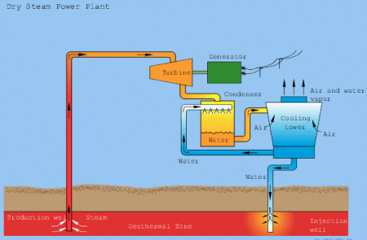
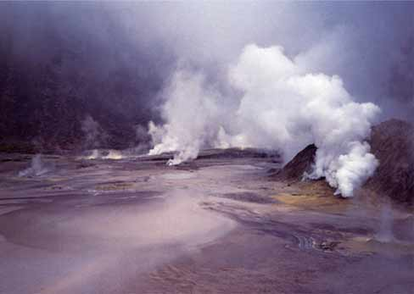
Another form of energy is Geothermal Energy. It is the heat energy found in sub-surface rocks and fluids, usually at depths varying from 500 metres to 2000 metres.
The basic requirements of a geothermal steam field are::
a. A source of natural heat of great output
b. An adequate water supply
c. An aquifer or permeable reservoir rock
d. A cap rock
The source of heat is a magmatic intrusion in the earth’s crust, having a
temperature of 600-900 ºC, often at the depths in the order of 7 – 15 kilometres.
Where do you think most geothermal fields may be found?
Any permeable rock can serve as a good geothermal reservoir. Cap rocks have
low permeability. It is believed that these cap rocks have been formed by either
a. Deposition of minerals from solution e.g. Silica
b. The action of heat and water which altered the nature of the rock and lead to
the formation of kaolinite which is the main constituent of china clay.
Geothermal energy is used in countries such as Italy, Iceland, New Zealand, USA
and El Salvador. Volcanic islands in the Caribbean chain are known to have a geo-
thermal potential but, to date, only St. Lucia has accessed its usefulness. How can
geothermal energy be used?
a. __________________ b. Desalination
c. To process valuable minerals d. In pulp & paper processing
e. To obtain salts from sea water f. ______________________
g. ________________________
General Schematic of a geothermal steam field
Actual view of how a geothermal steam field looks

Slide 12
Hydroelectric energy, another source of energy, is energy stored in water as gravitational potential energy and kinetic energy. How do you think this energy is collected?
Hydroelectric power provides an enormous amount of electricity in countries like Egypt eg. The Aswan dam.
Give one advantage of this type of energy:: ___________________________
Experts estimate that we waste up to about 25% of the energy we use. List some ways in which we waste energy::
a.
b. Leaving pilot light of the gas stove on all the time
c.
d. Using a high heat setting throughout when cooking or using excess water when cooking and using an open flame to cook instead of an oven
e.
f. Running the washing machine/dryer at less than maximum efficiency
g. Running the car at less than maximum efficiency

Slide 13
Oil fractions and their uses
Fraction | Range of boiling temperatures (ºC) | Uses
Petroleum gas | -10 – 0 | Industrial gas; camping gas
Gasoline | 10 – 70 | Gasoline; petrochemicals; plastics
Naphtha | 70 – 150
Kerosine | 150 – 250 | Aviation fuel; domestic heating oil
Gas Oil | 250 – 350 | Industrial heating oil; diesel oil; protein food
Residue | Above 350 | Fuel oil; bitumen; lubricating oil; waxes
Primary pollutants and their effects on the environment
Primary Pollutants | Source/how produced | Effects
SO₂ | Electrical power plants, H₂SO₄ plants, smelters using sulphide ores; when coal and oil are used in the homes and in industry; automobiles burning gasoline with high sulphur content | SO₂ + H₂O → H₂SO₃ 2H₂SO₃ + O₂ → 2H₂SO₄ H₂SO₄ is a major constituent of acid rain which damages vegetation and destroys marble and limestone in buildings: CaCO_{3(s)} + H₂SO₄ → CaSO_{4(s)} + CO_{2(g)} + H₂O_{(g)} this occurs in marble or limestone
NO₂, NO and N₂O | Nitrogen is a major constituent of the air, so combustion of fuels produces these oxides especially in car engines N_{2(g)} + O_{2(g)} → 2NO_{(g)} 2NO_{(g)} + O_{2(g)} → 2NO_{2(g)} | NO₂ dissolves in H₂O to produce nitric acids which are constituents of acid rain and are pollutants which cause respiratory illnesses such as bronchitis, it also stimulates algae growth causing the death of aquatic organisms. Oxides of nitrogen causes photchemical smog
CO₂ | A product of the combustion of all fossil fuels fuel + O_{2(g)} → CO_{2(g)} + H₂O_{(g)} | An excessive build up of this may lead to the greenhouse effect
CO | Formed when fossil fuels are incompletely burnt | This is poisonous to us as it combines with haemoglobin in the blood preventing the uptake of O₂
Pb²⁺ compounds | Realeased when leaded gasoline is burnt | Cumulative poison; conc. In marine organisms and H₂O which affects cell metabolism. The use of leaded gasoline is banned in some countries

