Slide 1
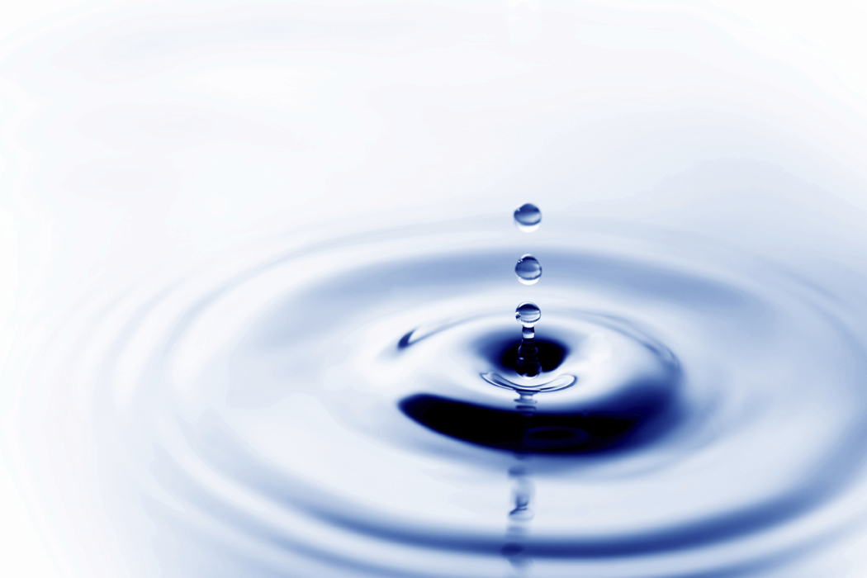

Water – A Precious Resource

Slide 2
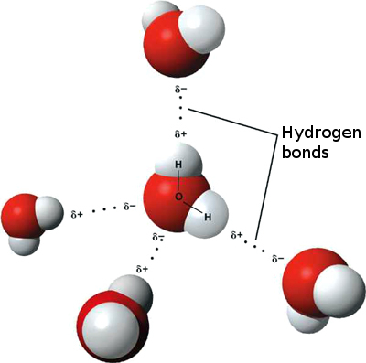
Because of water’s abundance we tend to take it for granted and how important it is for our daily sustainance.
What are some properties of water?
Below is a schematic representation of how water molecules interact with each other while in solution:
Judging from the above schematic why do you suppose that water mixes completely with ethanol?
From your explanation above it can be deduced that water, H₂O , is able to dissolve both ionic and polar covalent compounds. Can water dissolve non-polar covalent compounds too?

Slide 3
When water dissolves an ionic crystal lattice it goes through a series of stages:
Water separates ions within the ionic crystal lattice via attractive forces known as hydrogen bonding
Upon the crystal lattice breaking apart water molecules surround these freely moving ions referred to as ‘free’hydrated ions. An example is shown below:
Soap lathers easily with distilled water, but it is sometimes difficult to get a lather with tap water or water from natural resources. Why is this so? Hint – what is the difference between distilled and natural/tap water?
Here distilled water is described as being soft and tap water is seen as hard.
The hardness of tap/natural water is a direct result of water’s excellent solvent properties. Hardness is primarily caused by the presence of dissolved calcium and magnesium salts. However, the hardness of a water sample is usually expressed in terms of the calcium ions it contains.
The unit of hardness is parts calcium per million parts of water (ppm calcium).
Can you give me an example of how one may detect their water is hard via plain observation?
water molecule
+
-
ions

Slide 4
Rain water is one of the major causes of temporary hard water. Why is this so?
Temporary hardness is hardness which can be removed by boiling. This type of hardness is caused by dissolved calcium and magnesium hydrogencarbonates.
Permanent hardness is hardness which can NOT be removed by boiling. This type of hardness is caused by dissolved calcium and magnesium sulfate.
Besides boiling, list some other methods that may be used to softened temporary hard water:
The following reactions demonstrate how the above methods actually go about softening water:
Boiling:
This method only removes temporary hardness. When water is boiled the soluble calcium hydrogencarbonate is converted to the insoluble calcium carbonate which is responsible for the scale or fur which builds up in kettles and boilers.
Ca(HCO₃)_{2(aq)} → CaCO_{3(s)} + H₂O_{(l)} + CO_{2(g)}

Slide 5
Addition of Sodium Carbonate, Na₂CO₃:
The addition of Na₂CO₃ can remove both temporary and permanent hardness for tap/natural water resources. Its presence causes precipitation of the magnesium and calcium ions, both culprits for hardening of water which are present within tap water, into their respective insoluble carbonates. The equation below demonstrates such a reaction with dissolved Ca²⁺ ions in tap water.
Na₂CO_{3(aq)} + Ca²⁺_{(aq)} → CaCO_{3(s)} + 2Na⁺_{(aq)}
How do you presume magnesium ions, Mg²⁺, will react with sodium carbonate, Na₂CO₃? Present an equation of the suggested reaction.
Use of Ion-Exchange Resins:
These resins do exactly as their name suggests. As hard water passes through their columns, the Ca²⁺ and Mg²⁺ ions present within hard water are exchanged, or displaced with Na⁺ ions which do not contribute to the formation of hard water.
Permutit is a trade mark name of a popular ion-exchange resin column. It contains adsorbed sodium ions, Na⁺. Now, brave soldiers, can you tell me what would happen if hard water was passed through such a device? Try writing an equation for this using either Ca²⁺ or Mg²⁺ ion as one of the reactants interacting with the resin, where the ion present within the column is represented as, Na-Permutit. Na-Permutit is a neutral molecule.
The great thing about Permutit ion-exchange resin columns is that Permutit may be regenerated when it is completely converted to the calcium salt, by pouring concentrated aqueous NaCl through the ‘spent’ resin. Can you devise an equation to depict this recycling act?

Slide 6
The water cycle continually exchanges water between the surface of the earth and the atmosphere. How is this exchange made possible? What essential processes encourage such a cycle?
The water cycle is a self purifying system that can be readily recycled.
In some places rainwater is collected in drums and cisterns whereas in other places sea water and brackish water are desalinated or distilled to provide drinking water.
The water cycle is one of the easiest cycles to recount just from simple everyday experiences. Try filling in the appropriate arrows to complete the water cycle demonstrating where exactly the essential processes take place.
Sun source of energy
Clouds, fog, mist (liquid or solid)
Water vapour
a.
c.
rain, hail, snow
b.
Iceberg
run off
Rain water soaks into ground
Freezing oceans and lakes
Ground water
water table

Slide 7
Water can be broadly classified as Surface Sources and Groundwater or Sub-Surface water. Can you give me some examples of each?
Usually water obtained from natural resources are contaminated. The quality of water varies widely with environmental conditions and levels of human activity. Therefore it is recommended that drinking water be treated before it is ingested making it palatable and potable. What does palatable and potable mean?
Palatable:
Potable:
The diagram below demonstrates how water may be purified:
raw water → coagulation-flocculation → sedimentation → filtration → disinfection → storage → (pumping and distribution)
Raw water is referred to as untreated natural water
Coagulation refers to the aggregation of finely divided suspended matter. It is a chemical process
Flocculation is the completion of the aggregation via mechanical stirring
Sedimentation refers to the settling of debris to the bottom of the tanks (Can you give an example of a settling tank?)
What do you think filtration, disinfection and storage refer to?

Slide 8
How may one conserve water?
Water which has been used for domestic purposes and then discarded is described as sewage or waste water. If they are not treated they pose as a threat to our health. Waste water from the consumer goes to treatment plants, where bacteria break down the contaminants to harmless products. The liquid part is then pumped out and allowed to percolate through filter beds.
Organic matter is further broken down by aerobic bacteria. The water which emerges from the filter bed then flows into settling tanks where dead bacteria settle out. The treated water is then discharged into rivers etc.
The quality of water deteriorates if all of its oxygen gets used up or toxic substances are dumped into it.
List some types of water pollutants:
Describe how fertilizers may pollute our water supply. What does eutrophication mean? Hint – fertilizers contain phosphates and nitrates.

