Slide 1

The Metals

Slide 2
75% of the Earth’s crust is made up of silicon and oxygen which are both non-metals!
On the other hand the most abundant metals are aluminium, iron, calcium, magnesium and titanium which make up only 8%, 5%, 3.6%, 2.1% and 0.6% of the Earth’s crust respectively. WOW!
Widely used metals such as aluminum and iron are relatively abundant and widely used. However, metals such as copper, nickel and lead do not occur widely and there use in technology is necessary.
Semi-conducting elements such as silicon are neither metallic nor distinctly non-metallic.
Metals are obtained via their ores which are buried within the earth’s crust.
The following sequence below demonstrates how a metal may be obtained from its ore:
The ore is concentrated
The ore is then reduced to the crude metal: M^{n+} + ne⁻ → M What is reduction?
The crude metal is then purified or refined. The method used to reduce the ore to the metal depends on::
The nature of the ore
The reactivity of the metal
Earth’s crust→crushed ore conc.→crude metal→purified metal→product used→waste materials
rusting, wastage, litter etc.
1
2
3
waste reclaimed or recycled

Slide 3
Iron is a very popular metal and when it is produced it is turned into steel.
Steel is an alloy of iron and carbon and other elements, especially transition metals.
The raw materials for the iron and steel industry are:
________________?
An energy source
A reducing agent (coke or natural gas)
A flux (limestone to form a slag with silicates and other impurities)
Materials for alloying (could be Carbon, Nickel, Manganese, Chromium, Cobalt, Tungsten, Vanadium and Molybdenum) Which one of these elements is not a transition element?
Traditionally iron is produced in a blast furnace. Modern blast furnaces can run continuously for 10 years and are fully automated.
Iron is extracted from its ore as follows:
Dried, heated iron ore, limestone and coke are fed into the top of the furnace.
Coke burns in the hot air that is blown up the furnace from the bottom to produce CO₂ and heat.
C_{(s)} + O_{2(g)} → CO_{2(g)}
The same CO₂ is then reduced to CO by hot coke. CO_{2(g)} + C(s) → 2CO(g)
The hot iron is then reduced by the CO to molten iron which runs to the bottom of the furnace
Fe₂O_{3(s)} + 3CO_{(g)} → 2Fe_{(l)} + 3CO_{2(g)} or
Fe₃O_{4(s)} + 4CO_{(g)} → 3Fe_{(l)} + 4CO_{2(g)}
Limestone removes all impurities from the iron produced because it breaks down CaCO3(s) → CaO(s) + CO2(g)
The CaO produced then combines with SiO2, the main impurity in iron to form molten slag:
CaO(s) + SiO2(s) → CaSiO3(l) What is silica dioxide?
The slag does not mix with the molten iron as it floats on it.
The molten iron and slag are run off separately.

Slide 4
Iron produced via the blast furnace is an impure form of the metal often referred to as cast iron or pig iron. It is brittle and contains 2-4% of carbon and other impurities such as sulphur, phosphorus and silicon.
What do you think most of the cast iron is converted into?
From the information provided above how would you propose steel be made from cast iron or pig iron. Hint – what was mentioned earlier with the ability to remove impurities from molten iron?
The Midrex process is an alternative method of making iron and steel. Because methane is not a good reducing agent it is first mixed with steam then passed over heated nickel catalyst to form H₂ and CO. Both H₂ and CO are reducing agents. Such a process is referred to as STEAM REFORMING.
Fe₂O_{3(s)} + 3CO_{(g)} → 2Fe_{(s)} + 3CO_{2(g)}
Fe₂O_{3(s)} + 3H2_{(g)} →2Fe_{(s)} + 3H₂O_{(l)}
The following is a schematic of the Midrex process:
Natural gas→REFORMER CH_{4(g)} + H₂O → CO_{(g)} + 3H_{2(g)}→raw materials + CO and H₂→iron→electric arc furnace→steel
The raw materials consist of a mixture of 65-67% iron content. The product contains 92-96% iron.
Some of the iron is fed to the electric arc furnace for conversion to steel as well!

Slide 5
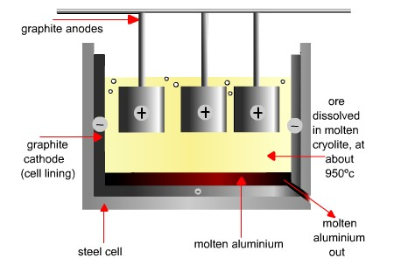
Aluminum can NOT be found in its free state. It’s ore is bauxite.
It occurs chemically combined with other elements, mainly in the form of aluminosilicates, of which bauxite, whose major ingredient is Al₂O₃, is the chief source.
When crude bauxite is mined it is either
Heated to 3000ºC to produce calcined bauxite or
Converted to pure alumina – Al₂O₃
Aluminium is obtained from alumina by electrolysis.
Because pure alumina (aluminum oxide) melts at 2050ºC it is dissolved in molten cryolite, Na₃AlF₆, sodium aluminum fluoride, which lowers the temperature to 950ºC. Why does Na₃AlF₆ manage to lower the temperature of pure alumina as it melts?
Cryolite, Na₃AlF₆, also gives the melt better conducting properties and does not mix with the aluminum metal formed in the electrolysis.
During the electrolysis of alumina:
The electrolyte is a mixture of aluminum oxide and cryolite.
Power requirements are 5 V and 100, 000 A
The electrodes used are graphite for the cathode and graphite
or titanium alloys for the anodes.
Manufacture of aluminum from purified alumina/bauxite
http://ibchem.com/IB/ibnotes/full/ope_htm/hall_cell.htm

Slide 6
Why is bauxite, that was mined in Jamaica, sent to the Unitied states for purification purposes? Hint – how much was your utility bill last month?
Aluminum is produced at the cathode. What would be the half reaction at the cathode as current is being passed through bauxite, Al₂O₃? Is it being reduced or oxidised? Hint – Does its oxidation state increase or decrease.
Great! Now can you deduce the main reaction at the anode if Oxygen is produced at this end? Does its oxidation state increase or decrease.
The exhaust gases from the electrolysis of alumina contains gaseous and solid fluorides. About 98% of these fluorides are scrubbed out and recycled, but even the 2% that escape are dangerous and causes a threat to the environment. How do these gases affect the environment?
Owing to this factories are encouraged not to set up close to agricultural sites.
Please see pages 278 and view both tables 24.2 and 24.3 to learn about the Uses of aluminum, iron, copper and lead linked to their properties and The chemical reactions of selected metals with oxygen, water, dilute acids and dilute sodium hydroxide solution. YOU MAY NEED TO KNOW THESE FOR CXC!

Slide 7
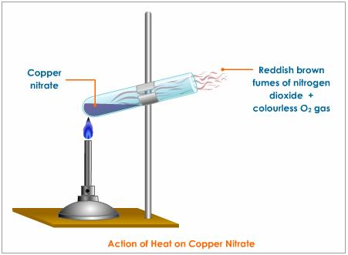
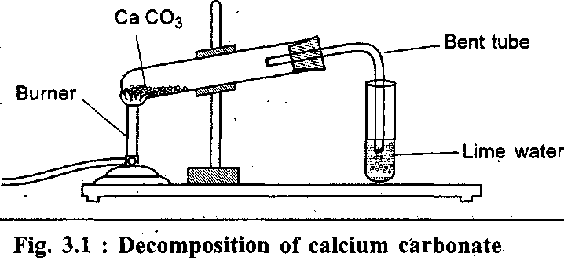
The following table demonstrates the action of heat on metal nitrates, carbonates and hydroxides where M, in the equations represents any metal
The figures below demonstrate the action of heat on a metal nitrate such as copper and a metal carbonate such as calcium:
Propose a way of trapping the pungent fumes of nitrogen dioxide, NO₂.
Why is lime water used in the set up shown on you right?
                H
 | Nitrate | Carbonate | Hydroxide
Potassium Sodium | Nitrate + O₂ 2MNO₃ → 2MNO₂ + O₂ | No reaction | No reaction
Calcium Magnesium Zinc Iron(II) Lead(II) Copper(II) | Oxide + nitrogen dioxide + oxygen 2M(NO₃)₂ → 2MO + 4NO₂ + O₂ | Oxide + carbon dioxide MCO₃ → MO + CO₂ | Oxide + water M(OH)₂ → MO + H₂O
http://www.google.com/imgres?imgurl=http://image.wistatutor.com/content/chemical-reactions-equations/copper-nitrate-on-heating.jpeg&imgrefurl=http://www.tutorvista.com/content/science/science-ii/chemical-reactions-equations/decomposition-reaction.php&usg=__uaNGuRXqSaPtS7WFvyQutiA_77k=&h=331&w=451&sz=15&hl=en&start=0&sig2=1fc0iBZanc71QF7unpH6dg&zoom=1&tbnid=gls6Hx_wRlXg4M:&tbnh=138&tbnw=199&ei=vXakTevJFZP4swPe0dn4DA&prev=/search%3Fq%3Dthe%2Baction%2Bof%2Bheat%2Bon%2Bnitrates%26hl%3Den%26client%3Dfirefox-a%26hs%3DLW1%26sa%3DX%26rls%3Dorg.mozilla:en-US:official%26biw%3D1366%26bih%3D587%26tbm%3Disch%26prmd%3Divns&itbs=1&iact=hc&vpx=338&vpy=96&dur=1&hovh=192&hovw=262&tx=80&ty=149&oei=oHakTcj3MO600QG-kPHPCA&page=1&ndsp=18&ved=1t:429,r:1,s:0
http://www.google.com/imgres?imgurl=http://www.tutornext.com/system/files/u76/Chapter3-1.gif&imgrefurl=http://www.tutornext.com/help/decomposition-of-copper-carbonate&usg=__fkTFl1jg0AneiRyac7fPP93f_R8=&h=337&w=718&sz=7&hl=en&start=20&sig2=t8UQl82PySOrkoyqvUTjow&zoom=1&tbnid=0Gz2RvB4rgx5XM:&tbnh=84&tbnw=179&ei=-XikTZuiFIiasAOq9tT5DA&prev=/search%3Fq%3Daction%2Bof%2Bheat%2Bon%2Bmetal%2Bcarbonates%26hl%3Den%26client%3Dfirefox-a%26hs%3D7f1%26sa%3DX%26rls%3Dorg.mozilla:en-US:official%26biw%3D1366%26bih%3D587%26tbm%3Disch0%2C591&itbs=1&iact=hc&vpx=102&vpy=293&dur=456&hovh=86&hovw=183&tx=151&ty=83&oei=s3ikTf3kI7Gz0QGSxqndCA&page=2&ndsp=23&ved=1t:429,r:15,s:20&biw=1366&bih=587

