Slide 1
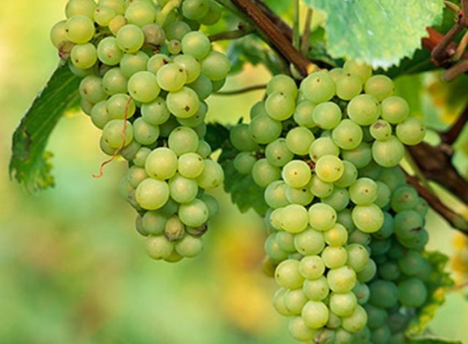

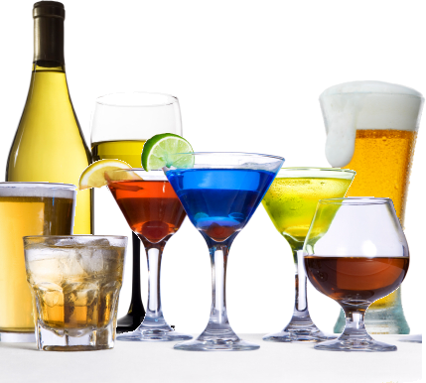
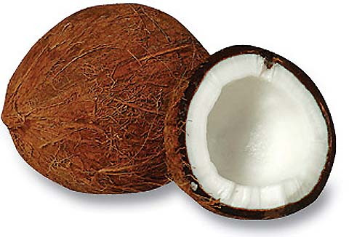
The Alcohols
Grapes used for the manufacturing of rum
http://educationelectivemic2010.wordpress.com/2010/04/09/grapes-everywhere/
Alcoholic Beverages
http://www.planningelegance.com/dilemma-of-the-open-bar/
Coconuts used for manufacturing of rum
http://www.treehugger.com/files/2009/09/coconuts-capture-carbon-maldives.php

Slide 2
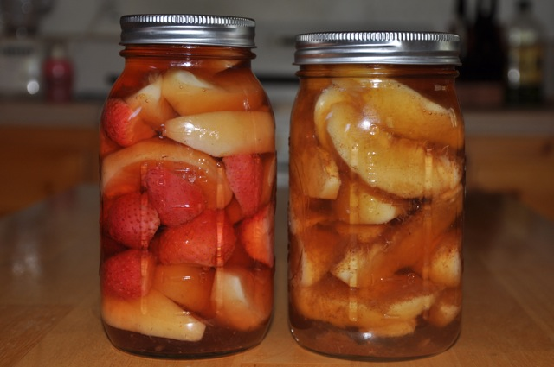
The general formula of an alcohol is C_{n}H_{2n+1}OH.
Sometimes you would see it depicted as R-OH. We learned earlier that R can stand for any particular alkyl group.
Chapter 27 focuses on the properties of ETHANOL.
Such properties include its ability to dissolve stuff easily, its ability to evaporate readily and its use as a fuel.
Ethanol is a major ingredient in thinners, polish, deodorants and colognes.
Have you ever seen anyone store away grapes or fruits in a jar over a very long period of time? No? Yes? This process is known as anaerobic fermentation and ethanol is produced from it. What does anaerobic mean?
Fruits being preserved
http://www.happy-mothering.com/2010/09/10/nourished-kitchen%E2%80%99s-preserving-summer%E2%80%99s-bounty-challenge-4-preserving-in-alcohol/

Slide 3
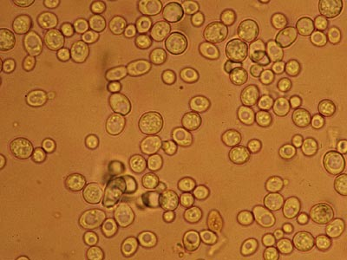
The anaerobic fermentation process can be summarized as follows:
C₆H₁₂O₆ → 2C₂H₅OH + 2CO₂ (conditions include enzymes, 37ºC, right pH in aqueous solution)
The above reaction contains a sugar which is glucose and the products are ethanol and carbon dioxide.
What do you think is the source of the enzymes for the above reaction?
Yeasts are unicellular fungi that grow rapidly and bud freely if sucrose, water, specific nitrogen sources, vitamins and mineral salts are present.
How do you propose rum may be made? What must be involved?
Budding Yeast Cells
http://bugs.bio.usyd.edu.au/learning/resources/CAL/Microconcepts/Diversity/fungi.html

Slide 4
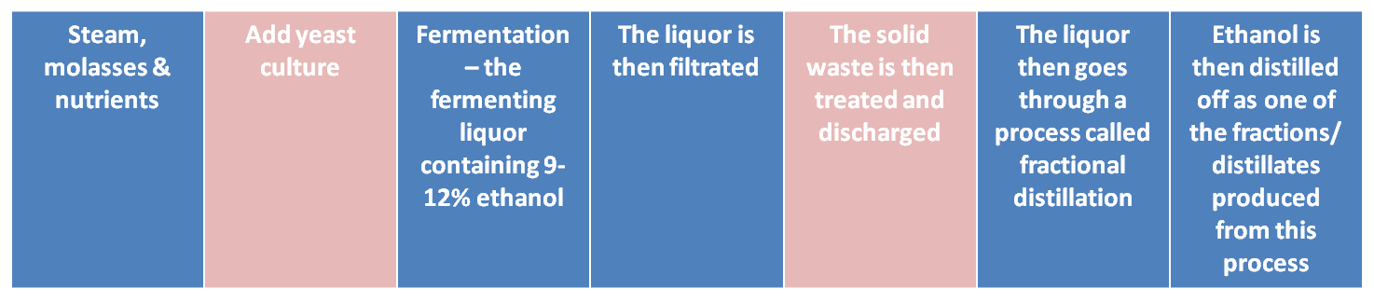
What is the functional group of the alcohol? Because of this functional group alcohols are very reactive. Why do you think this is so?
Ethanol is the primary focus throughout this chapter.
Lower alcohols; methanol, ethanol propanol etc. react with metals high in the electrochemical series: Na, Li, Mg and Ca. This type of reaction yields hydrogen gas and a salt known as an alkoxide.
Alkoxides are salts of alcohols. Can you predict the name of the salt bold printed in red?
2Na(s) + 2CH₃CH₂OH(g) → 2CH₃CH₂ONa(s) + H₂(g)
The stages in the production of rum

Slide 5
Take a look at page 302 to view how wine may be made at home. Try answering the questions.
Alcohols may be oxidized via acidified potassium dichromate(VI) or acidified potassium manganate(VII) into an aldehyde and then further oxidized into a carboxylic acid.
In the above reaction potassium manganate(VII) was used. What colour changes do you think were involved? Can you draw the structures of ethanal and ethanoic acid?
When potassium dichromate(VI) is used instead of potassium manganate the same reaction takes place but the colour changes from orange to green. Why? What type of metals are involved?
CH₃CH₂OH | → KMnO₄/H⁺ warm | H₂O + CH₃CHO (water and ethanal are produced. Ethanal here is an intermediate) | → Add more KMnO₄/H⁺ warm | CH₃COOH (Ethanoic acid)

Slide 6
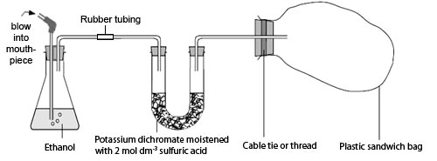
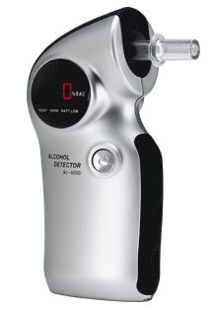
The breathalyser test is a practical application of the oxidation of ethanol the picture below depicts the mechanics of how the apparatus is intended to work. Can you explain from the given picture what you think is going to happen?
Commercial breathalysers look like the one below. Instead of ethanol actually being present within them ethanol is blown into the apparatus via the breath of a person accused of drinking too much. Why is ethanol present in the breath of a drunk person?
Mechanism of how a breathalyser test works
http://www.practicalchemistry.org/experiments/the-breathalyser-reaction,234,EX.html
Digital breathalyser test
http://www.techrific.com.au/2006/06/breathalyser-alcohol-breath-tester-al.html

Slide 7
Alcohols can be dehydrated to form alkenes in two ways:
Via the use of excess concentrated sulfuric acid at 170ºC. This is just the reverse of hydration of an alkene that we learned about in the previous chapter.
By passing ethanol vapour over activated alumina (Al₂O₃) heated to 450ºC.
Ethanol_{(liquid)} → Ethene_{(gas)} + Water_{(liquid)}
Alcohols can also be converted into esters via the use of concentrated sulfuric acid as a catalyst. The reaction is often referred to as a condensation reaction because water is given off as a product when the carboxylic acid and the alcohol combines.
Organic acid_{(aqueous)}+ alcohol_{(liquid)} → ester_{(aqueous)}+ water_{(liquid)}
Alcohols also burn in air. The reaction is highly exothermic. Methanol and Ethanol are used as fuels. Try to write out the combustion reaction of ethanol in air. Ethanol burns with a blue flame which means what?

Slide 8
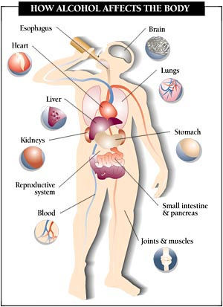
Ethanol is a toxic drug it affects and degrades the body in many ways. If over-consumed it may cause death and because of its affinity for water ethanol can dry out the cell by causing the protoplasm to precipitate out. Ethanol is oxidized within the liver and though it contains energy it does not contain any vitamins, minerals or proteins. Ingesting more ethanol than the body can take on rises the blood-ethanol level which can lead to:
Impaired circulation
Accumulation of toxins
Excessive loss of fluids via urination
Problems with digestion
Partial destruction of the pancreas
Cirrhosis of the liver
Brain cell deterioration
The reason ethanol is able to do this to the body is because:
Its particles are small enough to pass through the lining of the stomach to the blood stream
Its effects can be felt soon after ingestion and also if the person did not eat
The effects of alcohol depends on the type of drink involved and the mass of the person’s body and on the size of the person’s liver
Alcohol is a depressant which promotes sedation.
Over all alcohol is generally bad for the body if abused.

