Slide 1
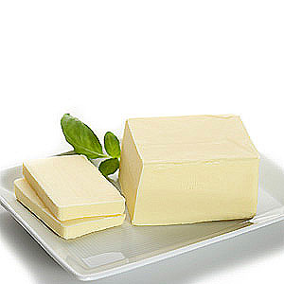

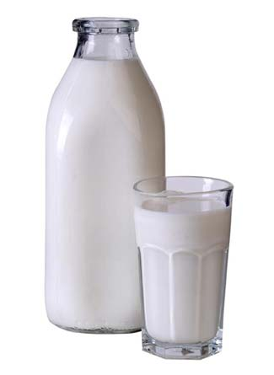
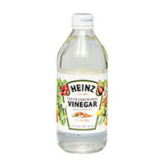
Organic Acids & Esters
Butter contains Butanoic Acid
http://www.esquire.com/features/food-drink/breakfast-ingredients-0309
Vinegar contains Ethanoic Acid
http://coffeeassistant.com/coffee-accessories/cleaning-slow-coffee-maker/
Milk contains Lactic Acid
http://www.chicagoreader.com/TheBlog/archives/2010/01/13/113-free-milk-at-union-station

Slide 2
The general formula of organic acid is C_{n}H_{2n+1}COOH.
The structural formula resembles R-COOH.
COOH referred to as the carboxyl group is the functional group of the organic acid.
The carboxyl group is responsible for the high boiling temperatures and solubility of water. Why?
Organic acids with 3-6 carbon atoms are present in nature as depicted on the cover of this handout. The IUPAC names for lactic and tartaric acid are 2-hydroxypropanoic acid and 2,3-dihydroxybutanedioic acid respectively. Can you draw these?

Slide 3

Longer chained organic acids that contain 12-22 carbon atoms occur combined as esters in fats and oils.
Esters with lower boiling point and molecular mass are responsible for the flavours and fragrances of the flowers and fruits of many plants.
Simple organic acids are weak monobasic acids. What does this mean? Draw the dissociation of ethanoic acid.
Chapter 28 follows ethanoic acid as a nifty guide for carboxylic acid reactions. How do you suppose ethanoic acid may be prepared?
Organic acids undergo reactions with: metals, metal oxides and hydroxides, carbonates and hydrogencarbonates & alcohols.
WITH METALS:
organic acid + metal → salt of the organic acid + hydrogen gas
Eg. 2CH₃COOH_{(aq)} + 2Na⁰_{(s)} → 2CH₃COONa_{(aq)} + H_{2(g)}
In the above reaction ethanoic acid reacts with sodium to produce sodium ethanoate and hydrogen gas.
Frangipani Flower
http://www.briterwebdesign.com/photoblog/15dec07/frangipani.html

Slide 4
What do you expect the reaction of ethanoic acid with magnesium would yield? Give the names of the products.
WITH METAL OXIDES & HYDROXIDES:
metal oxide + organic acid → salt of the organic acid + water
Eg. MgO_{(s)} + 2CH₃COOH_{(aq)} → (CH₃CO₂)₂Mg_{(aq)} + H₂O_{(l)}
What is the name of the main product? Draw out the structural formula.
What products do you think ethanoic acid with sodium hydroxide would yield?
WITH CARBONATES & HYDROGENCARBONATES:
organic acid + carbonate → salt of organic acid + water + carbon dioxide
Eg. 2CH₃COOH_{(aq)} + Na₂CO_{3(aq)} → 2CH₃COONa_{(aq)} + H₂O_{(l)} + CO_{2(g)}
What is the name of the main product? Draw out the structural formula.

Slide 5
What do you think reacting ethanoic acid with sodium hydrogen carbonate (NaHCO_{3(aq)}) would yield?
Carboxylic acids will effervesce in aqueous solutions of sodium carbonate or sodium hydrogencarbonate whereas ethanol would not. (because it gives off a gas such as CO₂)
WITH ALCOHOLS:
organic acid + alcohol → ester + water
Eg. CH₃COOH_{(aq)}+ C₂H₅OH_{(aq)} → C₂H₃O₂C₂H_{5(aq)} + H₂O_{(l)}
Draw the structural formula of the major product and name it.
What do you expect the product would be if ethanoic acid and butanol reacted with each other? Give the structural formula and the name of it.
This reaction is referred to as the esterification reaction because of the ester linkage bond formed. Can you determine where the ester linkage is in the above picture? Circle it.
Because water is lost what type of reaction is this?

Slide 6
Condensation reactions involve the loss of water, ammonia or hydrogen chloride.
Give the name, and write the structure of the ester formed when the following pairs of substances react:
Ethanoic acid and butanol
Methanol and propanoic acid
Butanoic acid and ethanol
Propanol and butanoic acid

Slide 7
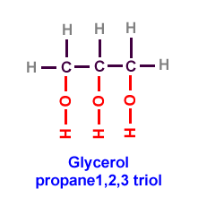
Esters can be hydrolysed.
Since the ester linkage is formed by the elimination of water under acidic conditions it can be broken by the addition of water under alkaline conditions know as hydrolysis. Ethyl ethanoate under alkaline conditions of being refluxed with excess NaOH produces what? Draw it out.
The hydrolysis process may be obtained via a reflux setup followed by distillation.
Esters may be used in the preparation of soap. Soap manufacture is the second most important use of fats and oils.
Fats and oils are esters formed in nature by reaction between the trialcohol propane-1,2,3-triol (commonly called glycerol) and long-chain organic acids.
Glycerol/Propane-1,2,3-triol
http://www.cic-caracas.org/departments/science/Topic2.php

Slide 8
A fatty acid may be represented as :
Where A is derived from glycerol.
B, C and D are derived from long-chain organic (fatty) acids.
B, C and D may be different or the same. They usually contain between 12 and 20 carbon atoms.
Some of the long-chain organic acids commonly combined in fats are:
C₁₅H₃₁COOH – palmitic acid (a saturated acid)
C₁₇H₃₅COOH – stearic acid (a saturated acid)
C₁₇H₃₃COOH – oleic acid (an unsaturated acid)
Do you remember what being saturated and unsaturated means?
When fats are hydrolysed (saponified), the products are glycerol and the sodium salts of the long chain organic acids.
fats/oils + NaOH → glycerol + the sodium salt of the acid (soap)
A
B
C
D

Slide 9
What are detergents used for?
Detergents may be soapy or soapless.
Soapless detergents are also called synthetic detergents or ‘syndets’.
The below figure demonstrates some difference between soapy and soapless detergents.
Detergents
soapy detergents | soapless detergents
Made from hydrolysis of fats | Made from petroleum
Biodegradeable | Many are non-biodegradable
Cause scum formation with hard water | Does not cause scum with hard water
Excellent for laundering if water is soft | Effectiveness and cleaning power are not affected by hard water
Continued use in laundry leads to loss of fabric colour | Industrial uses include: textile cleaning, softening of leather and as a dust suppressing agent in mining.

Slide 10
Water becomes hard in 2 ways:
Hard water is a very dilute solution of calcium sulfate. When rain water runs over gypsum and anhydrite rocks the water slowly dissolves some of the calcium sulfate out of these rocks. Calcium sulfate is the major source of permanent hardness in water because boiling this water can not remove the dissolved calcium ions permanently.
Rain water has a pH of less than 7 because it contains dissolved carbon dioxide and other acidic gases. When rain water falls on chalk, limestone or marble it reacts with some of the materials in it to produce a dilute solution of calcium hydrogencarbonate according to the equation:
CaCO_{3(s)} + H₂O_{(l)} + CO_{2(g)} → Ca(HCO₃)_{2(aq)}
Dissolved calcium hydrogencarbonate is the source of temporary hardness in water. This action is responsible for the formation of caves in limestone areas.
The soap molecule can be represented as NaSt (sodium stearate). Sodium stearate is soluble in water but calcium stearate CaSt₂ is not. When soap (soapy detergent) is first added to water, the reaction which takes place is depicted below:
2NaSt_{(aq)} + Ca²⁺_{(aq)} from the water → CaSt_{2(s)} + 2Na⁺_{(aq)}
The insoluble calcium stearate is formed. When all the calcium ions have been deposited as calcium stearate the water begins to lather. Hard water wastes soap.
By contrast soapless detergents are not affected by the presence of calcium ions. Therefore it is more economical to use soapless detergents if the water for doing laundry is hard.

Slide 11
Why is water, by itself, not an effective cleanser?
Detergents work by lowering the surface tension of water and are able to disperse soilants.
They remove grease and dirt by forming emulsions with grease or oils.
Soapy and soapless detergents can be thought of as having a polar water-loving (hydrophilic) head and a non-polar grease-loving (hydrophobic) tail.
Detergents work because their hydrophilic heads of the detergent are able to attach itself to water whereas the hydrophobic tails attach themselves to the soilants. The soilants are lifted off and is completely surrounded by detergent molecules, and floats away as part of the detergent-grease emulsion.
The hydrophilic heads of the detergent molecule has a dual function:
To make the detergent sufficiently soluble in water
To ensure that the detergent-soilant combination (emulsion) can be washed away by rinsing.
Hydrophobic tail
(think in terms of having a phobia for water)
hydrophilic head
(think in terms of ‘licks’ water)

Slide 12
Excess soap in laundry or industrial effluents can be
Precipitated as calcium and magnesium salts
Degraded by bacteria
Can anyone explain to me why phosphates in detergents at too high a level are not good for the environment?
The 1950’s generation of synthetic detergents were not biodegradable because of the presence of phosphates. What does biodegradable mean?
Bacteria were unable to breakdown the branching on detergent tails. So the hydrocarbon chain was modified to have less branching because this made it more biodegradable. This cause less foaming. Doing this cause consumers to pay more for detergents because more expensive materials were needed for detergent manufacture modification.
Owing to what transpired in the 1950’s it was established that detergents should be 90% biodegradable in sewage treatment plants.

