Slide 1

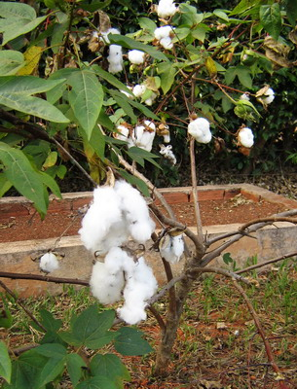
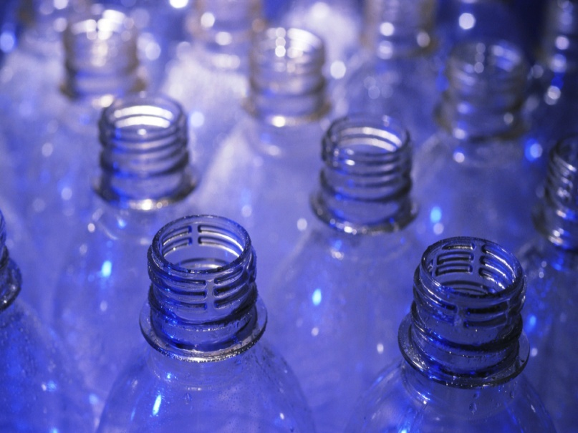
Polymers & Plastics
A cotton tree (a naturally occurring polymer)
http://pt2zxr.com/html/mein_qth.html
Plastic bottles (a man-made polymer)
http://1800recycling.com/2011/03/history-plastic-bottles-recycle/

Slide 2
Polymers exist in two groups: naturally and synthetically as giant molecules. What does this mean?
What does the word polymer mean?
When several thousand monomers link up they form a polymer chain.
Naming polymers are simple. If you have a polymer made from ethene monomers then that chain will be referred to as polyethene. So, if you have a polymer made from styrene monomers what will it be called?
giant molecules (polymers)
synthetic
natural origin
Polyethene, PVC, polystyrene, nylons, polyesters, rubbers(synthetic)...etc
Carbohydrates, proteins, rubbers(natural)

Slide 3
Polymers may be classified according to the type of reaction they were formed from: addition polymers which are formed in addition reactions and condensation polymers that are formed in condensation reactions.
Polymers made via addition reactions include, polyethene, polypropene, polyvinyl chloride and polystyrene.
Polymers made via condensation reactions include nylons, polyesters, carbohydrates and proteins.
What do you think the process by which polymers are formed is called?
Within the process mentioned above many monomer units of the same type or of different types may link up to form a polymer chain.
Your body is a collection of polymer molecules: starch, cellulose and proteins are all polymers.
monomers of the same unit
monomers of different units

Slide 4
ADDITION POLYMERS: this is achieved via the use of alkenes, the application of heat and pressure in the presence of a catalyst. The reaction involves an alkene whose double bond breaks apart into a single bond leaving two highly reactive free electrons to react with another alkene of the same or of a different monomer.
The general representation of a monomer is ₂HC=CHX let’s draw this out:
Where:
if x is | the monomer is | and the polymer is
C₂H₄ | propene | polypropene
chlorine | Vinyl chloride or chloroethene | polyvinyl chloride (PVC) or polychloroethene
a benzene ring | phenylethene or styrene | polyphenylethene or polystyrene
OH | vinylalcohol or ethenol | polyvinylalcohol or polyethenol

Slide 5
The preparation of an addition polymer such as polyethene occurs in two forms:
Low density polyethene: this includes high pressure polymerization at 200ºC and 1000atm.
High density polyethene: this includes low pressure polymerization at 150ºC, 30atm with a Cr₂O₃ catalyst or at low pressure polymerization at 75ºC, 5atm with at Zeigler-type catalyst(Al(C₂H₅)₃)
What do you think would happen if we subject vinyl chloride, chloroethene, to being heated in warm water while subjected to pressure?
Now that you’ve become a pro at drawing out and determining polymerization reactions what do you think would happen if we subject styrene, phenylethene, to boiling and water?

Slide 6
CONDENSATION POLYMERIZATION: involves the loss of water therefore the polymer one ends up with loses atoms it started with. Such reactions produced form either ester (COO) or amide (NHCO)linkages. Can we draw these out?
Polyesters are polymers which contain many ester linkages. They are formed in condensation reactions between diacids and dialcohols/diols. Let’s try to draw benzene-1,4-dicarboxylic acid (terephthalic) and ethane-1,2-diol.
Now let’s react the two together. What’s happening here?
The name of the product you drew above is referred to as Terylene whose molecular mass ranges between 10,000 – 20,000 g/mol

Slide 7
Polyamides are polymers that contain many amide linkages which can also be referred to as a peptide linkage. We drew this out on the previous page.
Nylon is an example of a polyamide and can be prepared via the reaction of the diacid HOOC(CH₂)₄COOH and the diamine H₂N(CH₂)₆NH₂. Can we draw these out? Remember there is a loss of H₂O, water.
Now can we react these two together?

Slide 8
Polymers are usually made into plastics which can be classified as thermoplastics or thermosets depending on their behaviour when heated.
Thermoplastics are pliable and they soften upon warming but do not decompose. They consist of long, thin, flexible polymer chains. Examples include polyethene, nylon and PVC.
Thermosets are stronger and very rigid to the touch. They decompose upon being strongly heated and consist of long chains which are crosslinked or interlinked. Examples include bakelite and urea-formaldehyde.
Plastic | Major uses/comments
Polyethene | Low density: containers (softer) High density: container (rigid)
Polypropene | Car accessories eg, battery housing, making toys, shoe heels, crates and carpets
PVC(polychloroethene) | Artificial leather, records, water pipes, floor tiles and wires
Perspex | Safety glass eg. Windshield glass, lighting fittings, contact lens and traffic signs
Polystyrene | Toys, packaging materials, bottle caps and measuring jugs
Nylon, polyamide | Rope, textiles, carpets and trolley wheels
Terylene, polyester | Clothing and ropes
Poly(ethenol), poly(vinylalcohol) | A water soluble adhesive
Table demonstrating uses of selected plastics

Slide 9
Why are synthetic giant molecules desired in society?
How do synthetic giant molecules affect our society and why?

