Slide 1
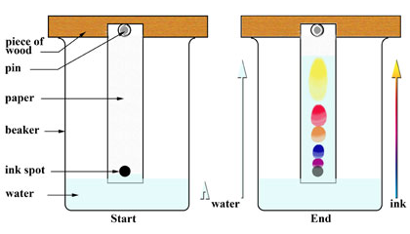
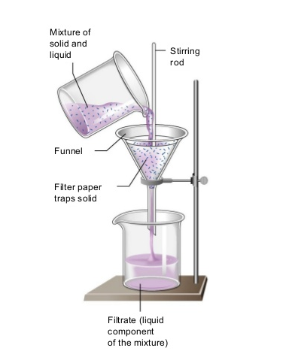
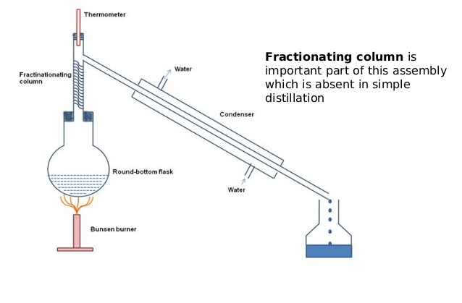
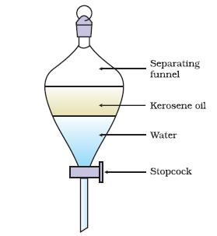
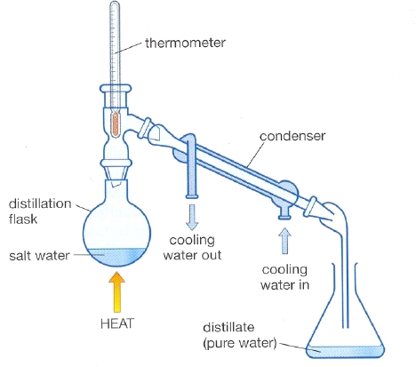
Mixtures and Separations
Simple Paper Chromatography
Filtration
Fractional Distillation
Separating Funnel
Simple Distillation

Slide 2
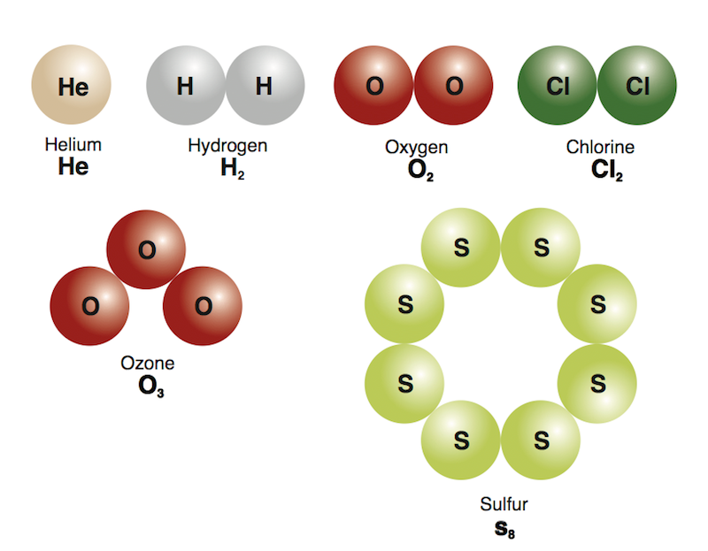
Elements
An element is a substance made up of only one type of atom.
Elements can NOT be broken down into anything simpler by chemical reactions.
Examples of elements include:
Helium, He
Oxygen, O₂
Chlorine, Cl₂

Slide 3

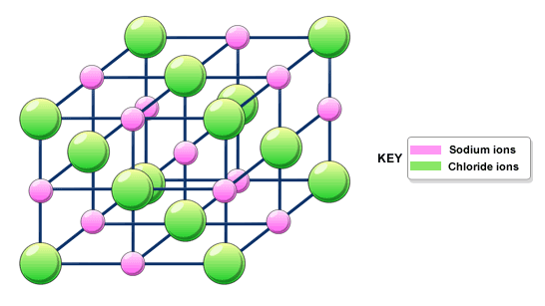
Compounds
A compound is a substance made up of two or more different atom (or ions) joined together by bonds.
There are two main groups of compounds:
1. Molecular or giant molecular (atoms are chemically bonded together covalently)
2. Ionic (positive or negative ions are chemically bonded ionically)
Chemical bonds a strong forces holding the atoms together.

Slide 4
Physical Properties
Physical properties do NOT depend on the amount of substance present.
Examples of physical properties are:
melting and boiling points
density
strength
hardness
electrical and thermal conductivity

Slide 5
Chemical Properties
Chemical properties describe how elements and compounds react with other substances.
Examples of chemical properties are:
1. methane + oxygen → carbon dioxide + water
2. sodium + water → sodium hydroxide + hydrogen

Slide 6
Pure Substances and Mixtures
If a substance is pure it can not be separated into any other parts by physical means.
For example, pure water has ONLY water molecules in it.
If a substance is impure it is referred to as a mixture.
A mixture contains two or more different components.
For example, water mixed with salt would contain water molecules (H₂O), sodium (Na⁺) and chloride (Cl⁻) ions.

Slide 7
Pure Substances
Pure substances have sharp melting and boiling points.
The melting/freezing point of pure water is
0 ºC while its boiling point is 100 ºC.
Impurities in a pure substance:
a. Raises its boiling point eg. 100ºC → 104ºC
&
b. Lowers its melting/freezing point 0ºC → -2ºC

Slide 8
Mixtures
Mixtures can be separated by physical means such as:
a. Filtration
OR
b. Distillation

Slide 9
Comparing Compounds and Mixtures
Compound (pure substance) | Mixture (impure substance)
Fixed composition | Variable composition
Cannot be separated by physical means | Can be separated by physical means
Physical properties are different from the elements from which they are made | Physical properties, e.g. colour and density, are the average of the substances in the mixture

Slide 10
Solutions, Suspensions and Colloids
A solution is a uniform mixture or homogeneous mixture of two or more substances.
A solute is a substance that is dissolved in a solvent. It can be a solid, liquid or a gas.
A solvent is a substance that dissolves a solute. It can also be a solid, liquid or a gas.

Slide 11
Solutions
In solutions the particles can not be seen
The solution is transparent, light passes through them
Particles in a solution can not be separated via filtration nor does the solute separate from the solvent if it is left to stand. However some types of solutions can be separated by simple or fractional distillation.

Slide 12
Types of Solutions
Solute | Solvent | Example
Solid | Liquid | Seawater (salt dissolved in water)
Solid | Solid | Bronze (tin dissolved in copper)
Gas | Liquid | Carbonated water (carbon dioxide dissolved in water)
Liquid | Liquid | Rum (ethanol dissolved in a mixture of liquids)
Gas | Gas | Air (mixture of nitrogen, oxygen and other gases)

Slide 13
Suspensions
A suspension is a mixture of small particles dispersed in another substance. If left to stand the small particles would settle to the bottom of the mixture. This settling is referred to as sedimentation.
The particles are large enough to be seen.
Suspensions are opaque and scatters light.
The particles can be separated by filtration.

Slide 14
Type of Suspensions
Nature of the Suspension | Example
Solid in Liquid | 1. Dirt in water 2. Sand in water 3. Rocks in water 4. Particles in liquid medication

Slide 15
Colloids
Colloids consist of one type of particle (solid, liquid or gas) dispersed throughout another.
In colloids the particles are larger than those of a solution but smaller than those of a suspension.
Colloids are opaque and scatter light.
They can NOT be separated by filtration.
The particles do NOT settle to the bottom of the mixture.

Slide 16
Examples of Colloids
Nature of colloid | Type of colloid | Example
Solid dispersed in gas | Aerosol | Smoke particles in air
Gas dispersed in liquid | Foam | Whipped cream
Liquid dispersed in liquid | Emulsion | Milk (fat in water)
Solid dispersed in liquid | Sol | Paint
Liquid trapped in solid | Gel | Jelly

Slide 17
Quizlet
1. Which one of the following is an element?
a. H₂O b. CO₂ c. O₃ d. H₂S
2. Sublimation is
a. Solid → gas b. Solid → liquid
c. Liquid → gas d. Gas → liquid
3. All of the following are diatomic molecules EXCEPT:
a. O₂ b. Ne c. F₂ d. I₂
4. Which of the following is a colloid?
a. Salty water b. Jelly
c. Carbonated beverage d. Sand in water
5. Bronze is an alloy, which is a mixture of copper and tin and it is a
a. Suspension b. Solution c. Colloid d. Emulsion

Slide 18
Quizlet
6. Filtration can be used to separate the components of a
a. Solution b. Suspension c. Colloid d. Gel
7. All of the following ions are cations EXCEPT
a. Na⁺ b. Ca²⁺ c. Li⁺ d. Cl⁻
8. Which of the following represents a polyatomic ion?
a. NH₄⁺ b. F⁻ c. O²⁻ d. N³⁻
9. When a gas transitions into a liquid it is
a. Melting b. Evaporating c. Condensing d. Freezing
10. Air is a fluid made up of many different types of gases. Which gas has the greatest composition in air?
a. Oxygen b. Neon
c. Carbon dioxide d. nitrogen

