Slide 1
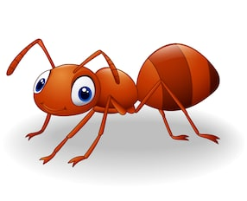
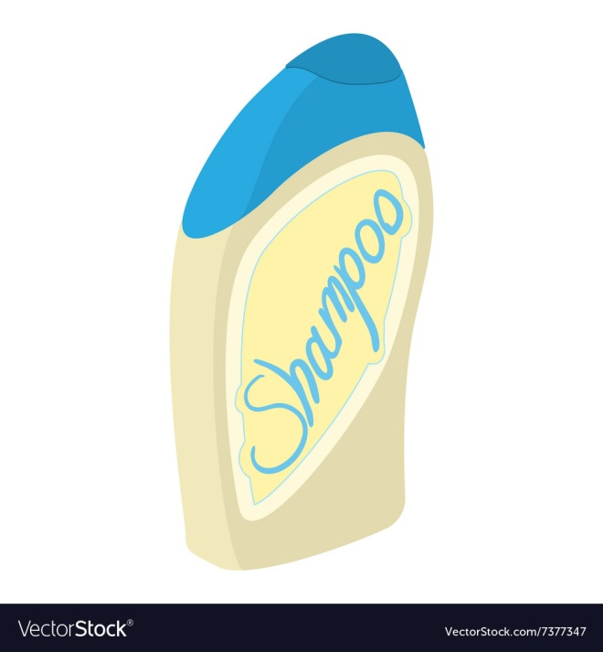
Acids and Alkalis

Slide 2
What’s an ACID?
An acid has a lot of hydrogen ions in it. (H⁺)
Acids exist as a liquid.

Slide 3
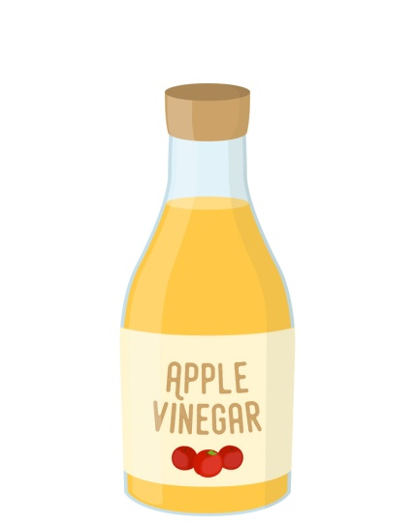
Overview of Acids
Acids are everywhere around us.
Very strong acids are corrosive and they fume which makes them dangerous.
Weaker acids are not dangerous. They are sour tasting and may be found in lemons as citric acid, vinegar as acetic acid and even in rainwater due to high carbon dioxide content.

Slide 4
Properties of Acids
Acids:
1. can be corrosive.
2. turn blue litmus red.
3. have a pH of less than 7.
4. turn universal indicator from green to red, yellow or orange.
5. have a sour taste

Slide 5
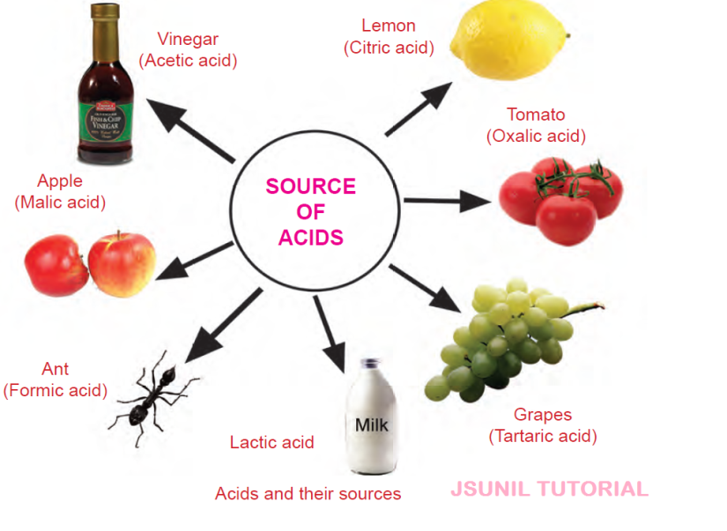
Examples of Acids
Everyday Acids a. Vinegar (ethanoic acid) b. Lemon juice (citric acid) c. Milk (lactic acid) d. Tea (tannic acid) e. Fruit and vegetable (ascorbic acid) f. Stomach (hydrochloric acid)
Laboratory Acids a. Hydrochloric acid (HCl) b. Nitric acid (HNO₃) c. Sulphuric acid (H₂SO₄) *These are very strong acids

Slide 6
What’s an ALKALI
An alkali does not have a lot of hydrogen ions in it.
Alkalis exist as a soluble base.

Slide 7
Overview of Alkalis
Alkalis are also referred to as bases. Bases are referred to as alkalis when they dissolve in water. However, some bases are unable to dissolve in water.
Metal oxides and hydroxides tend to be bases. An example of a metal oxide is sodium oxide while an example of a metal hydroxide is sodium hydroxide.

Slide 8
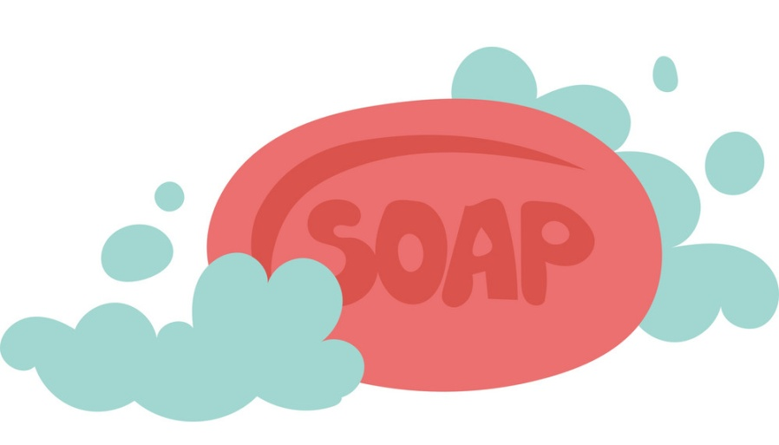
Properties of Alkalis
Alkalis:
1. can be corrosive if concentrated.
2. turn red litmus blue.
3. have a pH of more than 7.
4. turn universal indicator from green to blue or purple.
5. have a bitter taste.
6. feel soapy to the touch.

Slide 9
Examples of Alkalis
Laboratory Alkalis a. Sodium hydroxide (NaOH) b. Ammonium hydroxide (NH₄OH) c. Calcium hydroxide (Ca(OH)₂) d. Magnesium hydroxide (Mg(OH)₂) e. Potassium hydroxide (KOH)

Slide 10
Properties of Neutral Substances
Neutral substances react with neither acids nor bases.
Neutral substances: 1. tend to be harmless. 2. do not affect litmus paper. 3. have a pH value of 7. 4. do not cause any colour change in universal indicator. 5. vary in taste when ingested. (pure drinking water has no taste.

Slide 11
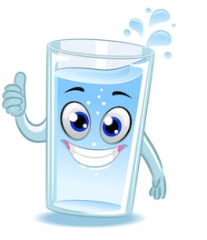
Examples of Neutral Substances
Some examples of neutral substances are: a. water (H₂O) b. sodium chloride solution (NaCl in H₂O) c. sugar solution (C₆H₁₂O₆ in H₂O)

Slide 12
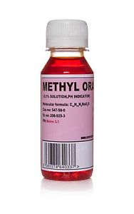
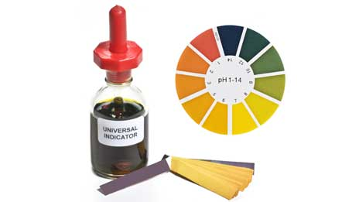
Indicators
Indicators are used to tell whether or not a particular liquid is acidic or alkaline based on colour changes.
Examples of indicators include: a. Litmus paper b. Universal indicators (mixture of dyes) c. Methyl Orange.

Slide 13
Indicators
The table below shows the colour changes of some common indicators
Indicator | Litmus | Methyl Orange | Screened Methyl Orange | Phenolphthalein
Colour with acid | Red | Red | Light red | Colourless
Colour with base | Blue | Yellow | Green | Pink

Slide 14
Indicators Universal
You can find the pH of any solution using universal indicators.
The pH of a solution is the measure of hydrogen ion concentration within a substance. The more hydrogen ions present in a substance the more acidic it is.
Universal indicator changes from green to a different colour depending on the pH of the solution you place it in.

Slide 15
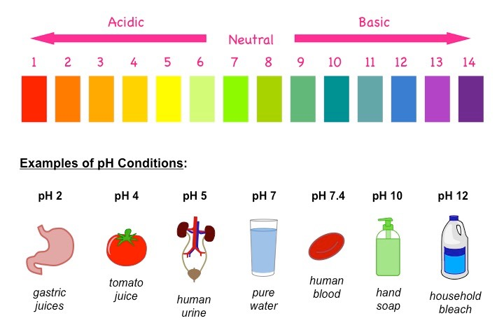
The pH Scale
The pH scale is a number scale, going from 0 – 14, which indicates whether a solution is alkaline, acidic or neutral.

Slide 16
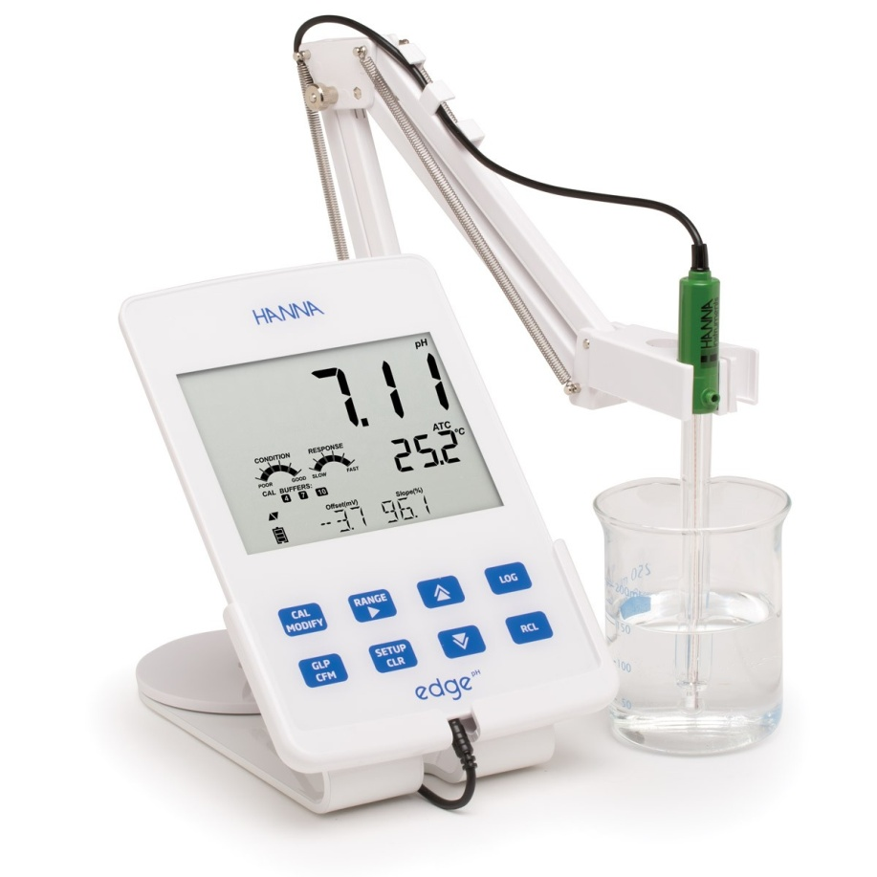
What can be used to measure pH precisely?
The pH meter measures the pH of a solution precisely.

Slide 17
Neutralization
When an acid and an alkali are added together they react to form a salt and water.
The formation of water makes it a neutralization reaction.

Slide 18
Examples of Neutralization Reactions
Anti-acids are used to relieve indigestion.
Farmers add lime to their soil when it is too acidic.
Hair relaxers are alkaline and so the neutralizing shampoo used is acidic.
Tooth pastes are alkaline so that they could neutralize the acid formed from the bacteria on the teeth.
Salts can be made by reacting an acid with an alkali: acid + alkali → salt + water

Slide 19
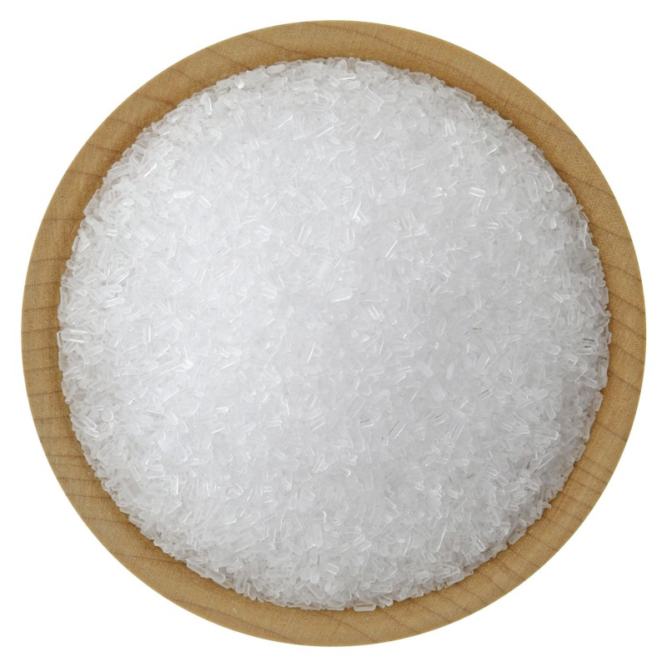
Salts
Salts are present around us.
We use it to add taste to our eggs and chicken. We also taste it when we take a dip within the ocean.
There are many different types of salts; chlorides, nitrates, sulphates, carbonates and phosphates.

Slide 20
Examples of Salts
Examples of salts are: a. Sodium Chloride - NaCl b. Magnesium Sulphate - MgSO₄ c. Calcium Carbonate - CaCO₃ d. Ammonium Nitrate - NH₄NO₃

Slide 21
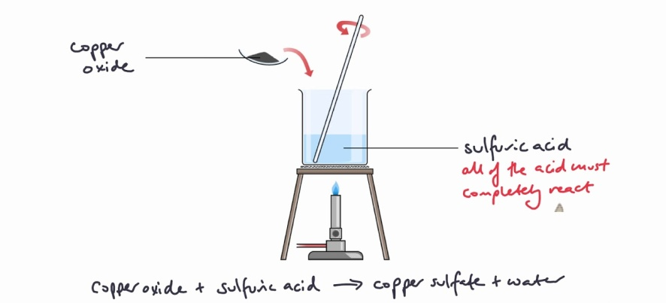
Methods of Making Salt
There a various ways of making salts. Below are some methods: a. acid + alkaline → salt + water b. acid + metal → salt + hydrogen gas c. acid + carbonate → salt + carbon dioxide + water

Slide 22
Acid and Alkali Reaction Map
Name of acid | Type of salt formed
Hydrochloric | Chloride
Sulphuric | Sulphate
Nitric | Nitrate
Phosphoric | phosphate

Slide 23
Examples of Methods of Making Salt
a. acid + alkaline → salt + water hydrochloric acid + sodium hydroxide → sodium chloride + water
b. acid + metal → salt + hydrogen gas hydrochloric acid + sodium → sodium chloride + hydrogen gas
c. acid + carbonate → salt + carbon dioxide + water hydrochloric acid + sodium carbonate → sodium chloride + carbon dioxide + water

Slide 24
Comprehension
Give 2 examples of acids.
Give 2 examples of alkalis.
Give 2 examples of neutral substances.
What type of acid is present in: a. Lemons? b. Vinegar? c. Milk? d. Grapes?

Slide 25
Comprehension
What can be used to detect an acid?
What colour does litmus paper turn in tannic acid?
Name an indicator.
What is an: a. Acid b. Alkali
Define pH?

Slide 26
Comprehension
Complete the following word equations to show the formation of salts. a. Hydrochloric acid + zinc → ______ + ______ b. Nitric acid + _____ → potassium nitrate + water c. magnesium carbonate + ______ → magnesium sulphate + carbon dioxide + water

