Slide 1
Exploring the Environment

Slide 2
Using our Senses to Observe & Explore
Scientists use their senses to observe. Today you will be given words to describe which senses you may use for that word.
Word | Sense(s) used
Rough | Sight, touch
Square | Touch
Heavy | Touch
Cloudy | Sight
Soft | Touch
Sticky | Touch

Slide 3
Using our Senses to Observe & Explore
Write the name of five objects and describe their properties.
Name of Object | Description using sense of touch only | Description using sense of sight alone
Ball | Soft, Smooth | Green, round, old

Slide 4
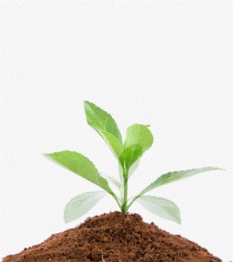
Using our Senses to Observe and Explore a Plant
Observe a plant carefully and record date using a table.
Parts of a Plant | Question(s) to ask | Observations
Leaves | What colour are they?
 | Is the upper surface the same colour as the lower surface?
 | How many leaves are there?
Stem | Is the stem soft or hard?
 | How long is the whole plant?
Root | How long is the root?
 | What colour is it?
 | Are the roots all the same thickness?

Slide 5
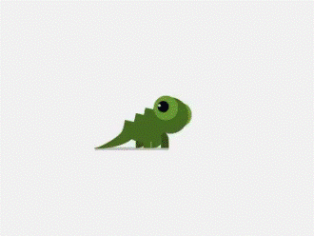
Using our Senses to Observe and Explore an Animal
Observe an animal carefully and record date using a table.
Parts of a Animal | Question(s) to ask | Observations
Whole animal | How many different parts can you find?
 | What colour is the animal?
Head | What shape is the head?
 | Is there a head?
 | Are there eyes? Where? Are there any other parts on the head?
Body or Abdomen | How long is it?
 | Is it divided into parts? How many?
Legs | How many legs does it have?
 | On what part of the body are they found?
 | How many parts does each leg have?

Slide 6
Using our Senses to Observe a Growing Plant
Here is an activity you can do at home in your spare time.
Collect 5 red beans and 5 maize/corn grains.
Soak them in some water overnight.
Dampen a tissue and place it in a container.
On the dampened tissue place the soaked seeds.
Write down what you observe over time.

Slide 7
Measuring

Slide 8
Measuring Length
We use special tools or instruments to measure quantities accurately while exploring the environment.
Standard units have the same value in any part of the world.

Slide 9
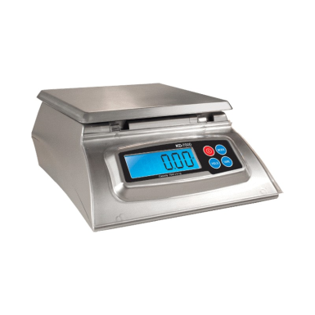
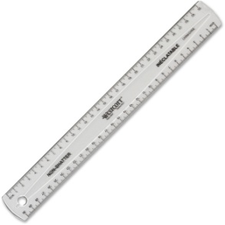
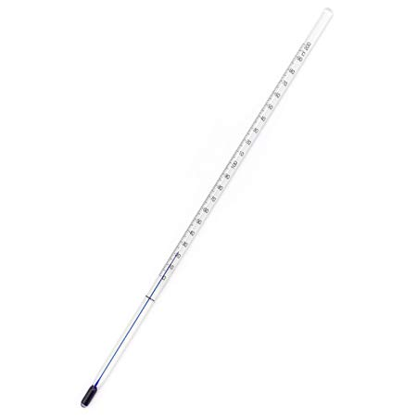
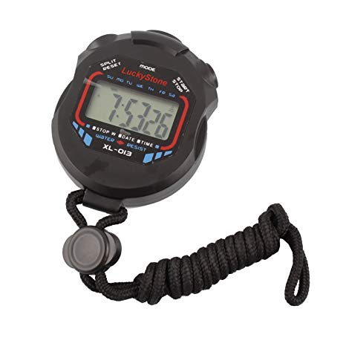
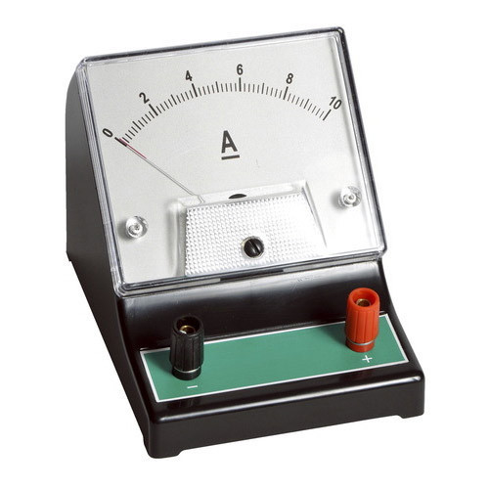
Basic Quantities
There are seven basic quantities: 1. Mass 2. Length 3. Temperature 4. Time 5. Current 6. Luminosity 7. Amount of Substance

Slide 10
Basic Quantities
Basic Quantity | SI Unit | Other types of units that can be used
Mass | kilogram (kg) | grams (g), pounds (lbs), tonnes, ounces (oz.)
Length | meter (m) | centimeters (cm), inches (in), miles (ml), millimeters (ml), kilometers (km), hectometers (hm)
Temperature | kelvin (K) | Fahrenheit (ºF), Celcius (ºC)
Time | seconds (s) | minutes (mins), hours (hrs), years (yrs), nanoseconds (ns), days (dys), weeks, centuries, decades
Current | amperes (A) | milliamperes (mA)
Luminosity | candela (cd) | -
Amount of Substance | mole (mol) | millimoles (mM)
Each quantity has it own unit. Units indicate what you are measuring.

Slide 11
Basic Quantities
Basic Quantity | SI Unit | Other types of units that can be used
Mass | kilogram (kg) | grams (g), ounce (oz.), pounds (lbs), milligrams (mg)
Length | meter (m) | Centimeters (cm), kilometers (km), feet (ft.), inches (in.), miles (ml), millimeters (mm)
Temperature | kelvin (K) | Celcius (ºC), Fahrenheit (ºF)
Time | seconds (s) | Minutes (mins), hours (hrs), days, years (yrs.), nanoseconds (ns), milliseconds (ms)
Current | amperes (A) | Milliamps (mA)
Luminosity | candela (cd)
Amount of Substance | mole (mol) | Millimoles (mmols)
Each quantity has it own unit. Units indicate what you are measuring.

Slide 12
Measuring Length
Rulers, measuring tapes or meter rules are used to measure length.
A meter is the same length in any part of the world.
The other units of length are all related to the metre. For example:
1000 meters (m) = 1 kilometer (km) 100 centimeters (cm) = 1 meter (m) 1000 millimeters (mm) = 1 meter (m)

Slide 13
Measuring Height Using a Metre Rule
Table 1. Height of Students in Form ______
Name of Student | Height of Student (cm)
1. Who is the shortest person in the class? 2. Who is the tallest person in the class? 3. How many persons have the same height? 4. What is the average height of the: a. BOYS? b. GIRLS? 5. Which sex was experimentally determined to be taller?

Slide 14
Measuring Mass
Matter is everything around us and takes up space. It is made up of atoms.
Mass is the measure of the amount of matter in an object.
Mass may be measured by using an electrical balance, beam balance and platform scale.
A kilogram (kg) is the base unit of mass.

Slide 15
Measuring the Mass of Students
Table 2. Mass of Students in Form ______
Name of Student | Mass of Student in (kg) | Mass of Student in (lb)
1. Fill the table with all of the names of the students in your class. 2. Record the mass of each student in units of kilograms (kg) in column 2. 3. Convert the mass of each student from kilograms to pounds if: 1 kg = 2.205 lbs 4. What is the average mass of the: a. GIRLS b. BOYS 5. Which sex was heavier?

Slide 16
Measuring Volume
Volume is the amount of space occupied by an object.
To measure the volume of a liquid we use a measuring cylinder, beaker, burette and pipette.
The litre (L) is the base unit of volume. The other units of volume are related to the litre for example: 1000 millimetres (mL) = 1 litre (L) 1000 cubic centimetres (cm³) = 1 litre (L) 1 mL = 1 cm³
To find the volume of a regular shape object the following formula may be used: length × width × height

Slide 17
Measuring Time
The SI unit of time is the second, s.
Instruments used to measure time are clocks, watches and stop watches.
Other units that are related to the second are: 60 seconds (s) = 1 minute (min) 60 minutes (mins) = 1 hour (hr)

