Slide 1
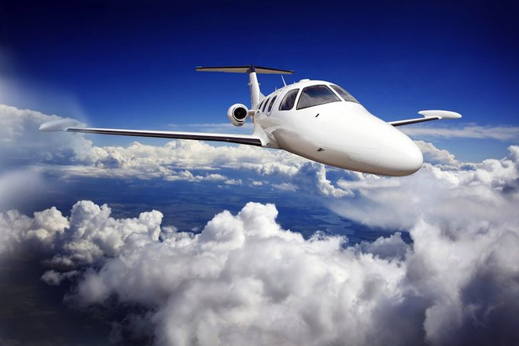
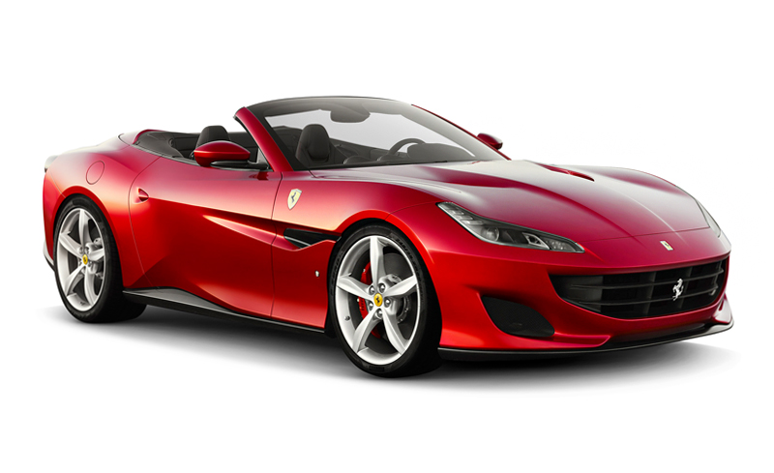
Speed, Velocity and Acceleration

Slide 2
Speed
Speed is the distance moved in the time taken.
It has units of metres per second m/s. Average Speed = distance moved ÷ time taken
The distance moved is measured in metres while the time taken is measured in seconds.
What is the average speed of a car which travels 1000 m in 100 s?

Slide 3
Speed
A car’s average speed changes once traffic and other obstacles are involved . However, a car can maintain its average speed on a straight, traffic-free road. What is meant by other obstacles?

Slide 4
Velocity
While speed is the distance travelled in unit time; velocity is the distance travelled in unit time in a stated direction.
Velocity is a vector quantity because it has size and direction while speed is a scalar quantity because it only has size.

Slide 5
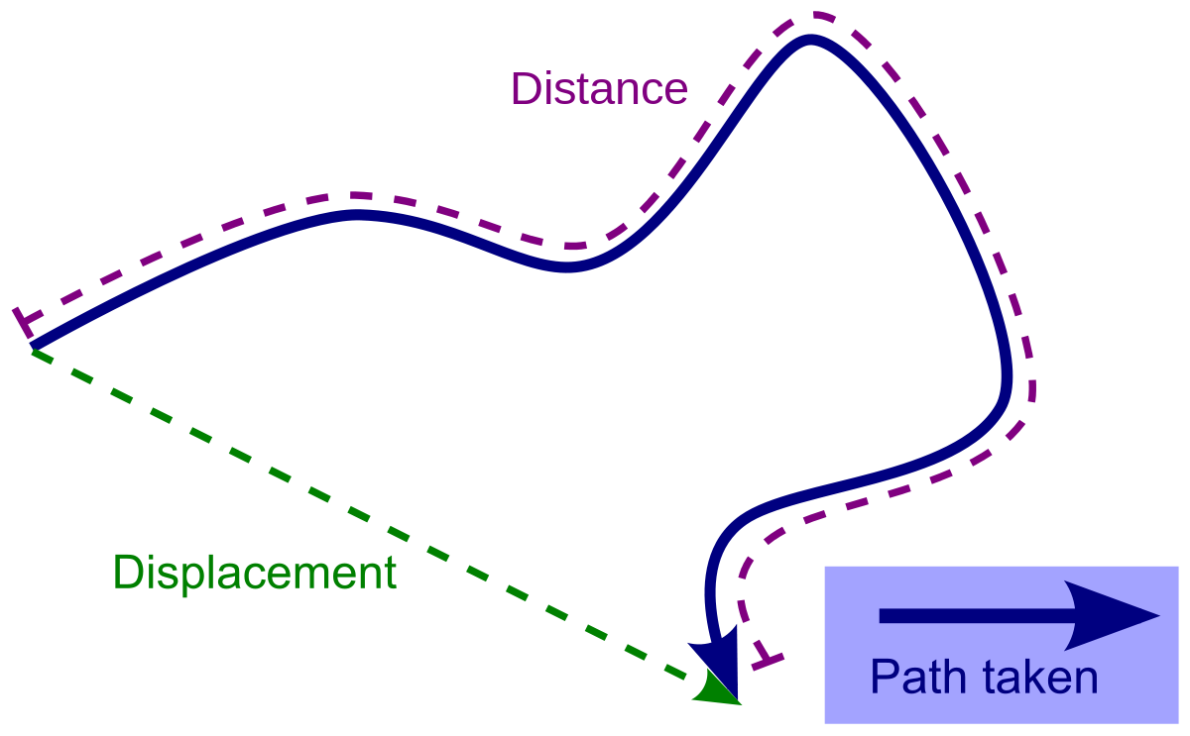
Velocity
The unit of velocity is metres per second, m/s. Velocity = distance moved in stated direction ÷ time taken Velocity = displacement ÷ time taken
Displacement is the shortest distance between two points.
Distance moved in a stated direction is also referred to as displacement.

Slide 6
Velocity
If two cars travel due north at 20 m/s they have the: same speed of 20 m/s and the same velocity of 20 m/s due north
The velocity of a body is uniform or constant if it moves with a steady speed in a straight line.

Slide 7
Speed and Velocity
The units of speed and velocity are the same: meters per second, m/s or m s⁻¹ OR kilometers per hour, km/h or km h⁻¹ *To convert from km/h to m/s simply multiply by (5/18) *To convert from m/s to km/h simply divide by (5/18)

Slide 8
Acceleration
Acceleration is the increase of velocity in unit time.
An object accelerates when its velocity increases and also when direction changes.
It has units of metres per second squared, m/s² or ms⁻²
Acceleration = increase of velocity ÷ time taken

Slide 9
Acceleration
The speeds of an accelerating car after successive seconds are given in the following table. Acquaint yourself with the table and answer the following questions below.
Every second the speed increases by ______
Is the acceleration uniform? _______
If the speed of the car decreased by 5 m/s every second, it would have a deceleration or retardation of _______
Time (s) | 0 | 1 | 2 | 3 | 4
Speed (m/s) | 0 | 5 | 10 | 15 | 20

Slide 10
Devices Used to Analyse Motion
There are a number of different devices that are useful for analysing motion in the laboratory.
Such devices include: 1. Motion Sensors 2. Tickertape Timers 3. Photogate timers

Slide 11
Motion Sensors
Motion sensors use an ultrasonic technique to determine the distance of an object for the sensor.
Connection of a data logger and a computer to the motion sensor then enables a distance-time graph to be plotted directly.
Further data analysis by the computer allows a velocity-time graph to be obtained.

Slide 12
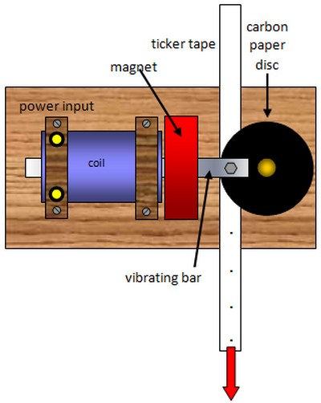
Tickertape Timers
A tickertape timer enables us to measure speeds and hence accelerations.
One type of tickertape timer has a marker which vibrates 50 times a second. A dot is made at 1/50 s intervals on the paper tape being pulled through it.
A 1/50 s is referred to as a tick.

Slide 13
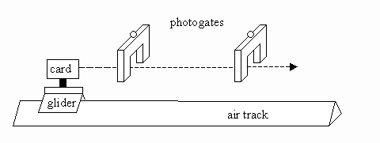
Photogate Timers
Photogate timers may be used to record the time taken for a trolley or glider to pass through the gate.
If the length of the ‘interrupt card’ on the trolley is measured, the velocity of the trolley can then be calculated.
Photogates are most useful in experiments where the velocity at only one or two positions is needed for example in measurements of momentum.

Slide 14
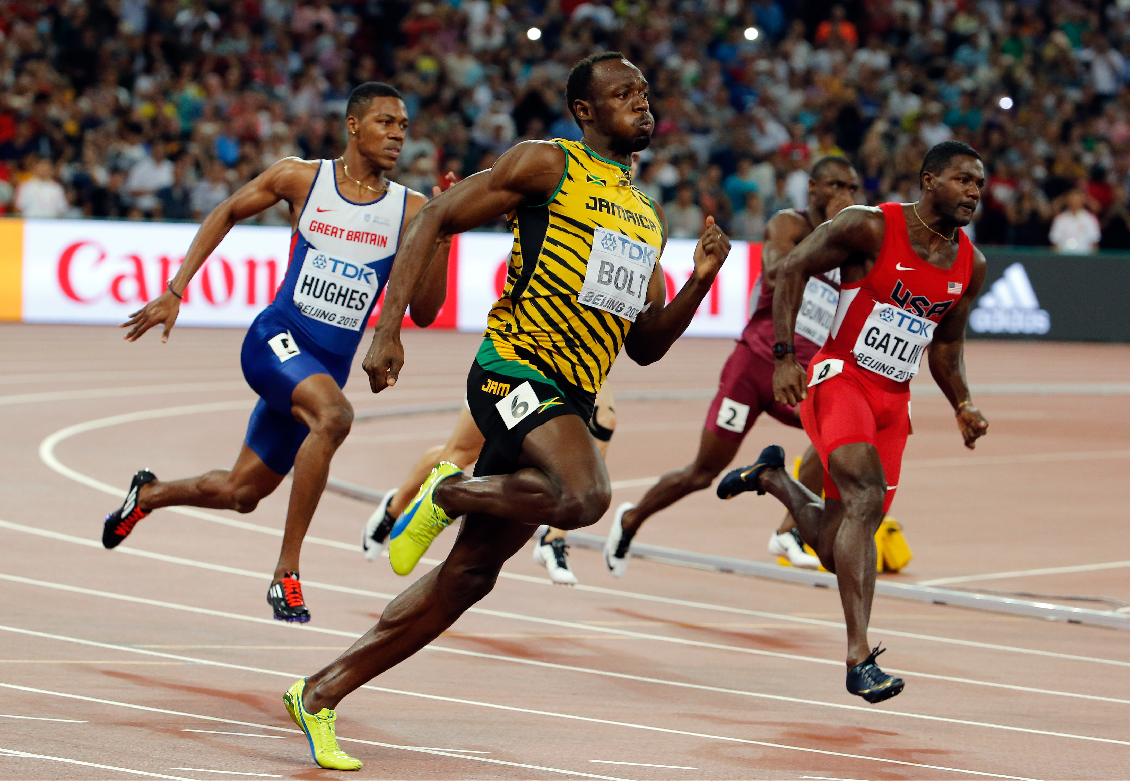
Class Work
Bolt’s top speed was 10.43 m/s in a male 100 m dash.
Using the information above determine how much time it took Bolt to complete the male 100 m dash.

Slide 15
Classwork
What is the average speed in m/s of (put the answers in SI units): a. a car which travels 400 m in 20 s? b. an athlete who runs 1500 m in 4 minutes?

Slide 16
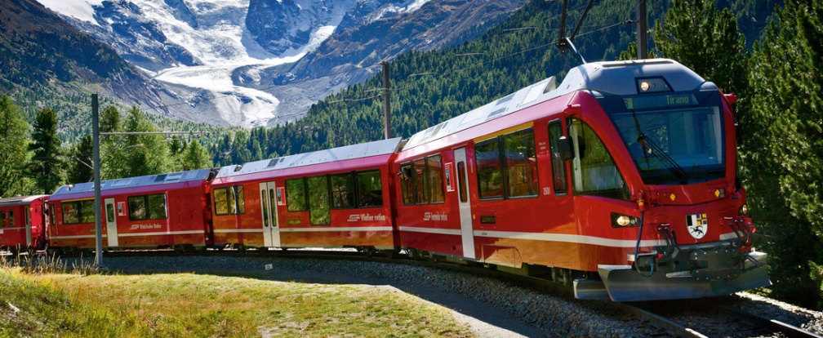
Classwork
A train increases its speed steadily from 10 m/s to 20 m/s in 1 minute. a. what is its average speed during this time in m/s? b. how far does it travel while increasing its speed?

Slide 17
Classwork
The tape in Figure 11.8 was pulled through a timer by a trolley travelling down a runway. It was marked off in tentick lengths. a. what can you say about the trolley’s motion? b. find its acceleration in cm/s². Remember acceleration = change of speed ÷ time taken

Slide 18
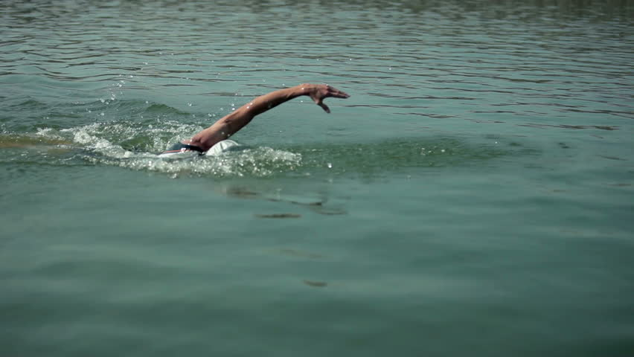
Classwork
Two velocities can be added by using the parallelogram law that was used in adding forces. A swimmer swims across a river at a velocity of 0.8 m/s in a direction perpendicular to the river banks. The water flows down the river at 0.6 m/s. Find the resultant velocity of the swimmer.

Slide 19
Classwork
Velocities can also be added in a straight line as well. An aircraft flies at 800 km/h in stationary air. The distance travelled is 3000 km. What was the wind speed if the journey actually takes 4.0 hours?

Slide 20
Equations of motion

Slide 21
Velocity – Time Graphs Depicting Uniform Velocity
If the velocity of a body is plotted against time, a velocity-time graph will be obtained.
Such a graph provides another way of solving motion problems.

Slide 22
Velocity – Time Graphs Depicting Uniform Velocity
The area under a velocity-time graph measures the distance travelled by an object.
The velocity-time graph depicts that of a moving body at uniform velocity of ____________ m/s.
Looking at the graph what is the distance that the body has moved after 5 s since distance = average velocity x time? ______ m. *The distance is the area of the shaded region under the graph.

Slide 23
Velocity – Time Graphs Depicting Uniform Velocity
The gradient or slope of a velocity-time graph represents the acceleration of the body. Given that information find the acceleration of the moving body that the graph is depicting.

Slide 24
Velocity – Time Graphs Depicting Uniform Acceleration
The velocity-time graph depicts that of a moving body at uniform acceleration.
At the start of the timing the velocity is _____ m/s and it increases steadily to _____ m/s after _____ s.
How do you propose one may find the area of the shaded region of the graph below?
The gradient or slope of a velocity-time graph represents the acceleration of the moving body. Given that information find the acceleration of the moving body that the graph above is depicting.

Slide 25
Displacement – Time Graphs Depicting Uniform Velocity
A body travelling with uniform velocity covers equal distances in equal times.
Its displacement-time graph is a straight line.
The gradient or slope of a displacement-time graph represents the velocity of the body. Given the information above determine the velocity of the moving body that the graph depicts below.

Slide 27
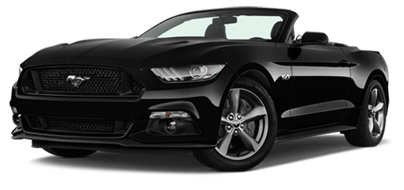
Classwork
A car starting from rest with uniform acceleration reaches a velocity of 10 m/s in 10 s and travels with this velocity for 20 s. It then decelerates steadily and comes to rest 50 s after starting. Find from the given graph: a. the acceleration b. the deceleration c. the total distance travelled

Slide 28
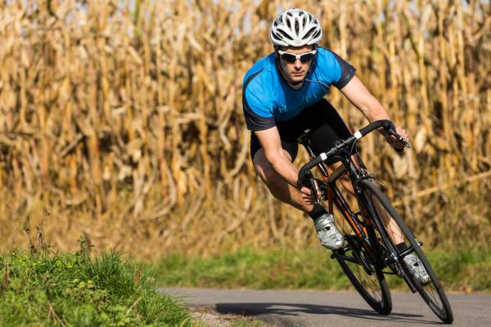
Classwork
A cyclist starts from rest and accelerates at 1 m/s² for 20 seconds. He then travels at a constant speed for 1 minute and finally decelerates at 2 m/s² until he stops. a. Find the maximum speed of the cyclist. b. Determine the time it takes for the cyclist to decelerate. c. Try to draw this scenario out as if it were a graph then determine the total distance the cyclist covered in meters.

Slide 29
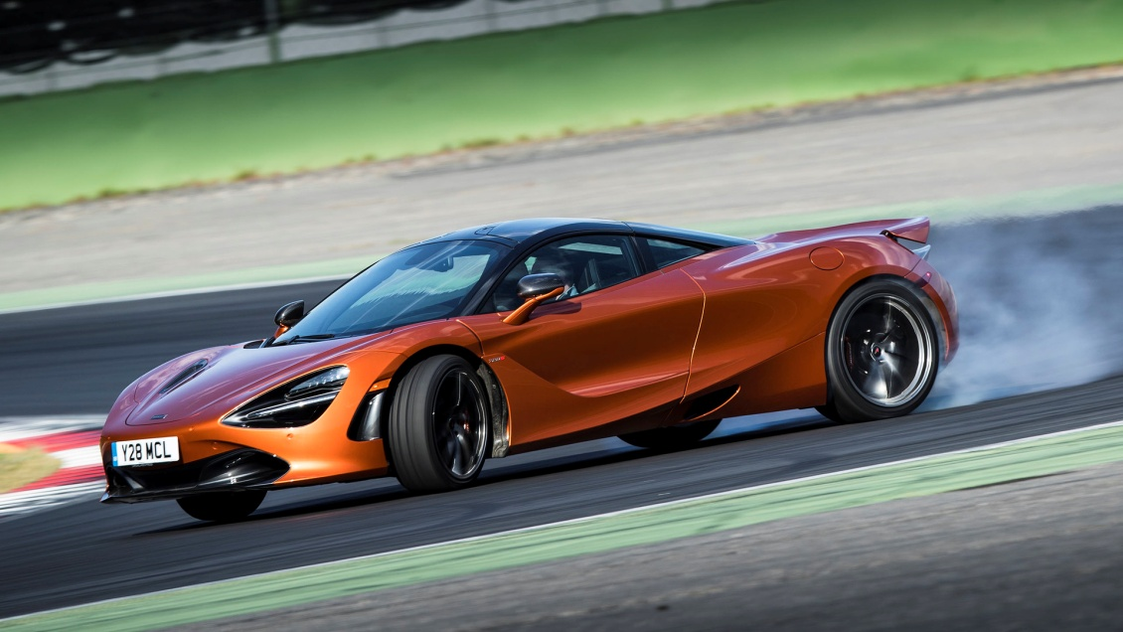
Classwork
A car accelerates from 4 m/s to 20 m/s in 8 s. How far does it travel in this time?

Slide 30
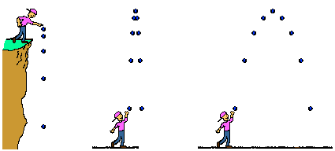
Falling bodies

Slide 31
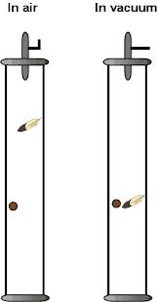
Which one falls faster?
In air which one falls faster, a coin or a piece of paper?
In a vacuum both the coin and the piece of paper falls at the same time. The cause of this is due to air resistance which has a much greater effect on lighter bodies than heavier ones. What is a vacuum?

Slide 32
Acceleration Due to Gravity
All bodies falling freely under the force of gravity do so with uniform acceleration if air resistance is negligible (if there is NO air).
This acceleration, called the acceleration due to gravity, is denoted by the italic letter g.
The value of gravity varies over the earth. In the Caribbean it is 9.78 m/s² or near enough to 10 m/s².

Slide 33
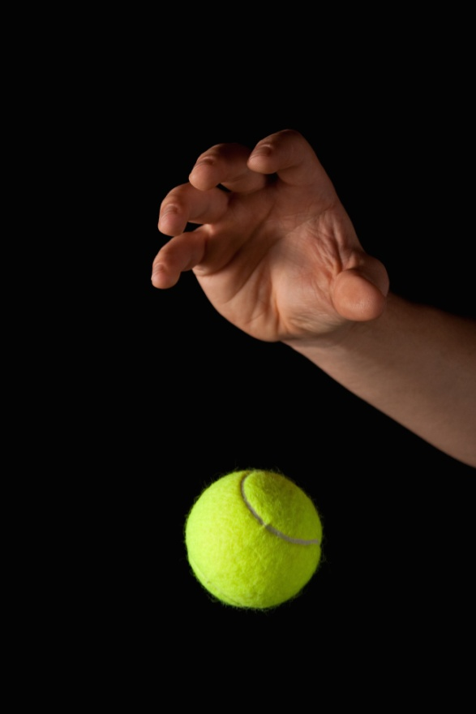
Acceleration Due to Gravity
The velocity of a free falling body therefore increases by 10 m/s every second because there are NO other forces acting on it but gravity.
Hence ALL free falling objects fall towards earth with an acceleration of 10 m/s² once air resistance is negligible.
On earth lighter objects fall slower than heavier objects because of the presence of air. Without air the previous point can be observed.

Slide 34
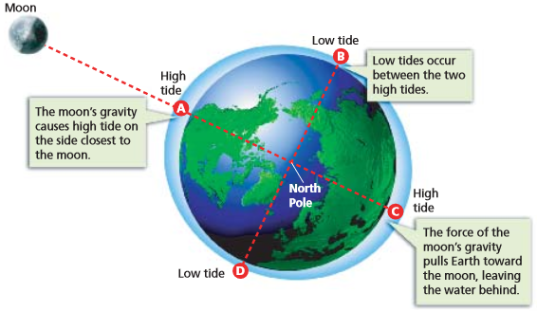
Acceleration Due to Gravity
Lots of places state that the Earth's gravity is stronger at the poles than the equator for two reasons: 1. The poles are closer to the center of the Earth due to the equatorial bulge. This strengthens gravitation at the poles and weakens it at the equator. 2. The Earth is rotating, so an Earth-bound observer sees a centrifugal force. This has no effect at the poles and weakens gravitation at the equator. In physics, centrifugal force is the force that makes objects move outwards when they are spinning around something or travelling in a curve.

Slide 35
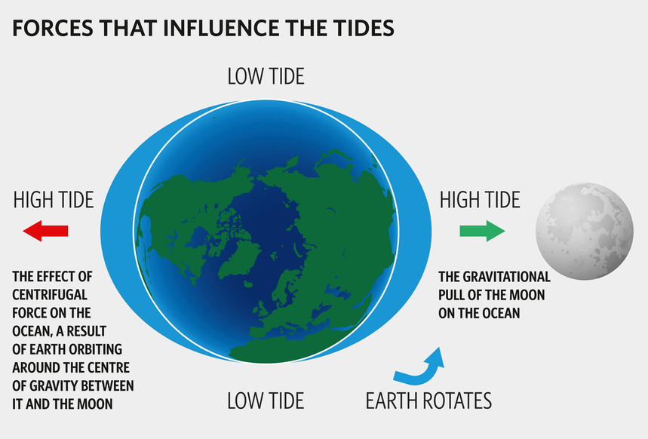
Acceleration Due to Gravity

Slide 36
Acceleration Due to Gravity
In calculations using the equation of motion, gravity replaces acceleration. Gravity is given a positive sign for falling bodies and therefore a ______________ sign of rising bodies since they are decelerating.

Slide 37
Measuring gravity, g
To measure g the following equation may be used: s = ½ gt² or g = ? Where: s is the distance fallen in metres(m), t is the time taken in seconds (s) and a, acceleration = g, gravity in metres per squared seconds (m/s²)

Slide 38
Distance – Time Graphs
For a body falling freely from rest we have : s = ½ gt² A graph of s against t gives a curved graph going upwards and a graph of s against t² produces a straight line, g being constant at one place.

Slide 39
Projectiles
If a ball is thrown horizontally from the top of a cliff and takes 3 s to reach the beach below, we can calculate the height of the cliff by considering the vertical motion only. We have: u = 0 (since the ball has no vertical velocity initially) a = g = +10 m/s² and t = 3 s The height s of the cliff is given by: s = ut + ½ at² = ______________________
The horizontal and vertical motions of a body are independent and can be treated separately.

Slide 40
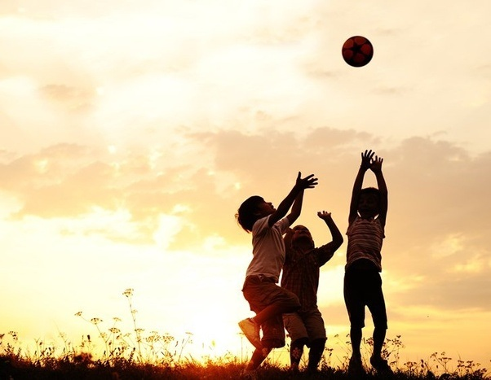
Classwork
A ball is thrown vertically upwards with an initial velocity of 30 m/s. Find: a. Its maximum height b. The time taken to return to its starting point. Neglect air resistance and take g = 10 m/s

Slide 41
Newton’s laws of motion

Slide 42
Newton’s Three Laws of Motion
1st Law: A body stays at rest, or if moving it continues to move with uniform velocity, unless an external force makes it behave differently.
2nd Law: One newton is defined as the force which gives a mass of 1 kg an acceleration of 1 m/s² where F = ma F stands for force in units of Newton, N m stands for mass in units of kilogram, kg a stands for acceleration in units of metres per second squared, m/s²
3rd Law: If a body A exerts a force on body B, then body B exerts an equal but opposite force on body A.

Slide 43
Explaining Newton’s First Law of Motion
What two things cause a car to come to rest when the engine is switched off?
If those two forces were absent it is believed that a body once set in motion would go on forever with a constant speed in a straight line.
The smaller the external force opposing a moving body the smaller is the force needed to keep it moving with uniform velocity.

Slide 44
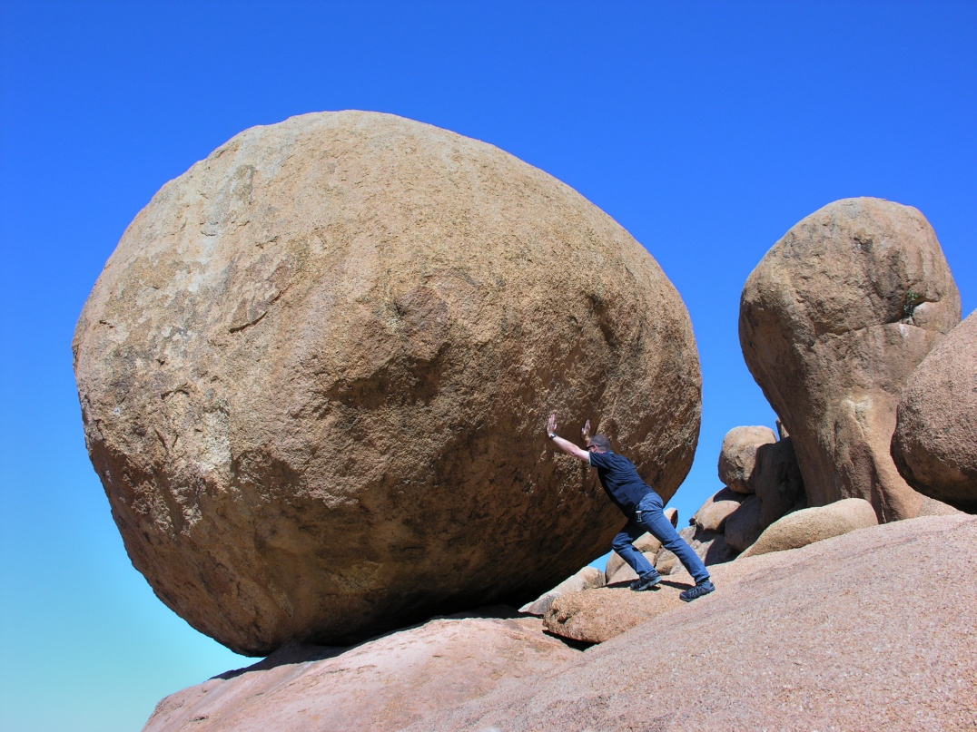
Explaining Newton’s First Law of Motion
Mass and inertia The first law is also another way of saying that all matter has a built-in opposition to being moved if it is at rest or if it is moving, to having its motion changed. This property is called inertia. Inertia is from the Latin word for laziness.
Give an example of inertia occurring.
The larger the mass of a body the greater is its inertia. Why?
The mass of a body measures its inertia. The mass of a body is also the amount of matter it contains.

Slide 45
Explaining Newton’s Second Law of Motion
F = ma is the equation which describes the second law of motion where a is (i) directly proportional to the applied force F for a fixed mass, that is a α F, and (ii) inversely proportional to the mass m for a fixed force, that is a α 1/m
One newton is defined as the force which gives a mass of 1 kg an acceleration of 1 m/s².
When using Newton’s second law of motion one must always note: 1. F is the resultant or unbalanced force causing the acceleration a. 2. F must be in newtons, m in kilograms and a in metres per second squared.

Slide 46
Explaining Newton’s Second Law of Motion
CLASSWORK ☺ 1. A block of mass 2 kg is pushed along a table with a constant velocity by a force of 5 N. When the push is increased to 9 N what is a. the resultant force b. the acceleration
2. A car of mass 1200 kg travelling at 72 km/h is brought to rest in 4 s. Find a. the average deceleration b. the average braking force c. the distance moved during the deceleration.

Slide 47
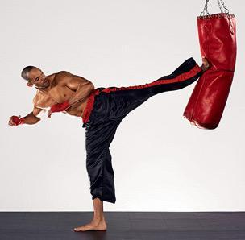
Explaining Newton’s Third Law of Motion
Third Law This law states that forces never occur singly but always in pairs as a result of the action between two bodies. Try giving three examples of this law that occurs in everyday life.

Slide 48
Comprehension
1. What is the speed of an ant if it covers 2 metres in 1.5 minutes? Give answer in SI units. 2. What is the difference between velocity and speed?

Slide 49
Comprehension
3. What is Newton’s second law of motion? 4. Complete the following equations on forces in motion below:
(a) v = ______ + at (b) _______ = u² + _______as (c) s = u_____ + ½ at² (d) 2s = (u + v) ______

Slide 50
Gravitational Field
Gravity is an invisible, action at-a-distance force (non-contact force).
Earth is surrounded by a gravitational field which exerts a force on any body in the field.
The strength of a gravitational field is defined as the force acting on unit mass in the field.

Slide 51
Gravitational Field
Gravity is either measured in N/kg or m/s² it has a value of approximately 10.
Measurement shows that on the earth’s surface a mass of 1 kg experiences a force of 10 N, that is its weight is 10 N. The strength of the earth’s field is therefore 10 N/kg.
There are two ways of regarding g: (i) when considering bodies that are falling freely it then has an acceleration of 10 m/s² (ii) when the body of known mass is at rest and we wish to know the force of gravity (in N) acting on it we think of g as the earth’s gravitational field strength of 10 N/kg

Slide 52
Fluid Friction Terminal Velocity
Fluid friction is the opposition to an object when it moves in a liquid or gas.
In air, fluid friction is negligible for small dense objects, example ball-bearings falling a short distance. And as we have read, these fall with a constant acceleration of 10 m/s².

Slide 53
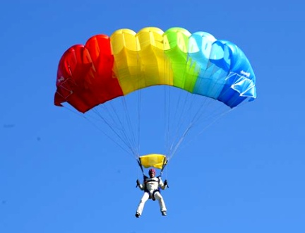
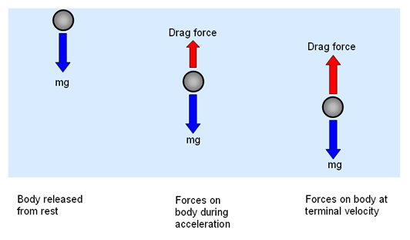
Fluid Friction Terminal Velocity
Terminal velocity is easily observed for objects that are light, example, raindrops, or have a large surface area example parachutes or sky divers in free fall. In these cases, as the falling object speeds up, air friction increases and reduces its acceleration. Eventually the upward frictional force equals the weight of the object acting downwards. The resultant force is then zero and the object falls with a constant velocity called its terminal velocity. Objects moving in viscous liquids, example, motor oil, behave similarly.

Slide 54
Who were Aristotle, Galileo and Newton?
In your spear time research: a. Aristotle (384 – 322 B.C.) b. Galileo (1564 – 1642) c. Newton (1642 – 1727) (Make sure this is done as you will be tested on such material)

Slide 55
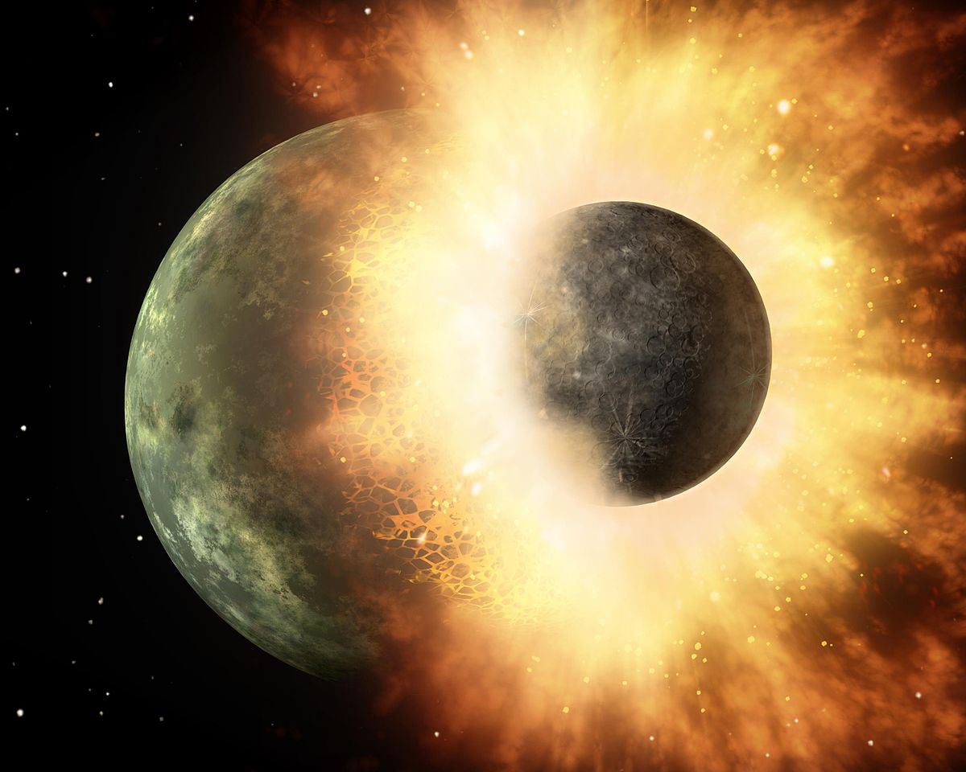
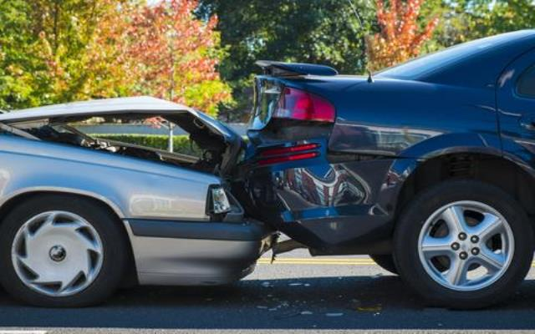
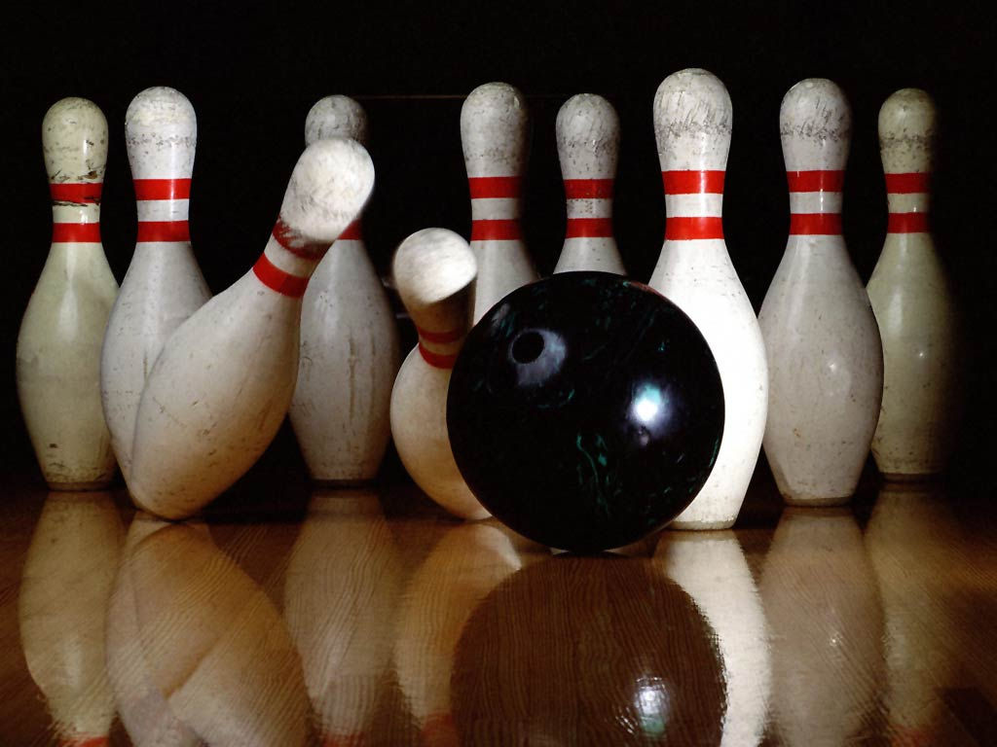
Momentum

Slide 56
Momentum
Momentum is a useful quantity to consider when bodies are involved in collisions and explosions.
Momentum (kg m/s) = mass (kg) × velocity (m/s)
It is defined as the mass of the body multiplied by its velocity and is measured (kg m/s) where 1 kg m/s = 1 N/s
What is the momentum of a 2 kg mass moving at 10 m/s?

Slide 57
Conservation of Momentum
When two or more objects act on one another, as in a collision, the total momentum of the bodies remain constant, provided no external forces act on it, for example friction.
The above statement is called the principle of conservation of momentum: m₁v₁ + m₂v₂ = (m₁+m₂)v_{f}

Slide 58
Conservation of Momentum
If a truck of mass 60 kg moving with a velocity of 3 m/s collides and couples with a stationary truck of mass 30 kg the two move off together. What is their final velocity?

Slide 59
Two Types of Collision
A perfectly elastic collision is defined as one in which there is NO loss of kinetic energy in the collision.
An inelastic collision is one in which part of the kinetic energy is changed to some other form of energy in the collision.

Slide 60
Momentum
Momentum like velocity, is a vector since it has both magnitude and direction.
Vectors can not be added by ordinary addition unless they act in the same direction.
If they act in exactly opposite direction, example east and west, the smaller subtracts from the greater; if they are equal they cancel out.

Slide 61
Rifles and Explosions
Momentum is conserved in an explosion such as occurs when a rifle is fired. Before firing, the total momentum is zero since both rifle and bullet are al rest.
During firing, the rifle and bullet receive equal but opposite amounts of momentum so that the total momentum after firing is zero.
For example if a rifle fires a bullet of mass 0.01 kg with a velocity of 300 m/s then: Forward momentum of bullet = 0.01 kg x 300 m/s = _______________ :. Backward momentum of rifle = _____________________ If the rifle has mass m, it recoils (kicks back) with a velocity v such that mv = 3 kg m/s Taking m = 6 kg gives v = _______________.

Slide 62
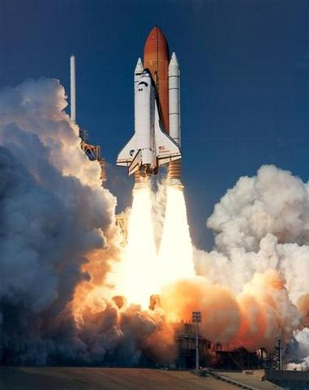
Rockets and Jets
Rockets and jets If you release an inflated balloon with its neck open what will happen?
This is the principle of rockets and jet engines. In both, a high-velocity stream of hot gas is produced by burning fuel and leaves the exhaust with large momentum. The rocket or jet engine itself acquires an equal forward momentum.

Slide 63
Classwork
Using the following equation: m₁v₁ + m₂v₂ = (m₁ + m₂)v_{f} solve the following question: A trolley of mass 2 kg collides with a stationary trolley of mass 1 kg and sticks to it. If they move off together with a velocity of 4 m/s, what was the original velocity of the 2 kg trolley?

Slide 64
Kinetic and potential energy

Slide 65
Kinetic Energy
Kinetic energy Kinetic energy is the energy a body has because of its motion. Kinetic energy = E_{k} = ½ mv² Where: m means mass and has units of kg v means velocity and has units of m/s k.e., E_{k} means kinetic energy, has units of J CLASSWORK ☺ What is the kinetic energy of a cricket ball that has a mass of 200 g which has a moving velocity of 20 m/s?

Slide 66
Potential Energy
Potential energy Potential energy is the energy a body has because of its position or condition. Potential energy = ΔE_{p} = mgh Where: m means mass and has units of kg g means gravity and has units of N/kg or m/s² h means height and has units of m p.e., E_{p} means potential energy, has units of J CLASSWORK ☺ If g = 10 N/kg what is the p.e. gained by the system when a 100 g mass is raised vertically by 1 m.

Slide 67
Conservation of Energy
Explain in terms of kinetic and potential energy what happens when a ball falls from your hand to the ground.
If an object that falls starts from rest and air resistance is negligible, its k.e. on reaching the ground equals the p.e. lost by the mass. k.e. = p.e. where ½ mv² = mgh :. loss of p.e. = gain of k.e. This is the principle of conservation of energy
In a pendulum, k.e. and p.e. are interchanged continually. The energy of the bob is all p.e. at the end of the swing and all k.e. as it passed through its central position. In other positions it has both p.e. and k.e. Eventually all the energy is changed to heat as a result of overcoming air resistance.

Slide 68
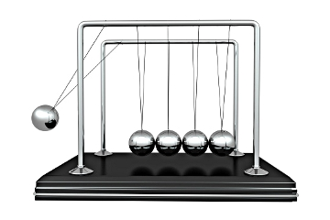
Elastic and Inelastic Collisions
Elastic and inelastic collisions In all collisions (where no external force acts) momentum is conserved but there is normally a loss of k.e. Where do you think this k.e. goes? The greater the proportion of k.e. lost the less elastic is the collision, that is the more inelastic it is. In a perfectly elastic collision kinetic energy is conserved.

Slide 69
Questions
1. A boulder of mass 4 kg rolls over a cliff and reaches the beach below with a velocity of 20 m/s. a. What is the k.e. of the boulder just before it lands? b. What is its p.e. on the cliff? c. How high is the cliff?

Slide 70
Questions
2. A 100 g steel ball falls from a height of 1.8 m on to a plate and rebounds to a height of 1.25 m. Find: a. the p.e. of the ball before the fall, b. its k.e. as it hits the plate, c. its velocity on hitting the plate d. its k.e. as it leaves the plate on the rebound, e. its velocity of rebound.

Slide 71
Questions
3. It is estimated that 7 x 10⁶ kg of water pours over the Niagara Falls every second. If the Falls are 50 m high, and if all the energy of the falling water could be harnessed, what power would be available?

Slide 72
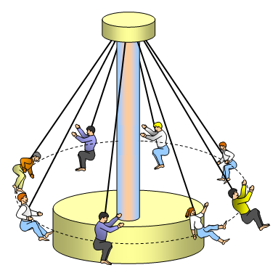
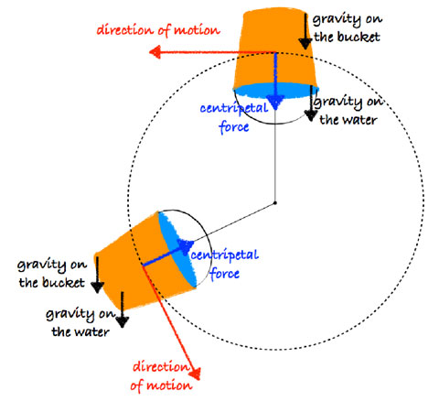
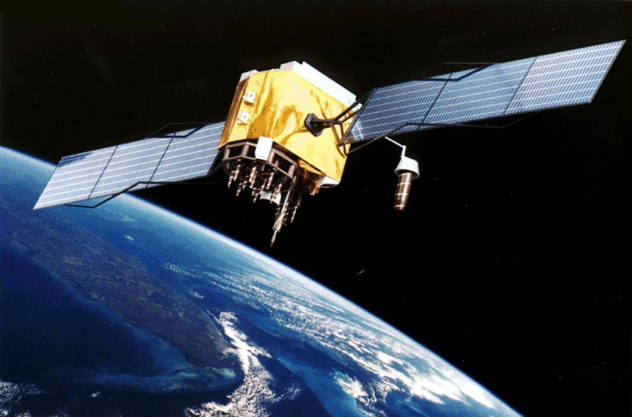
Circular motion

Slide 73
Circular Motion
Give some examples of everyday things that go in circular motion.
Objects moving in a circular motion do this due to a centripetal force acting on it.
From Newton’s first law of motion, if a body is moving in a circle then it is accelerating, so there must be an unbalanced force acting on it to cause the acceleration.

Slide 75
More on Centripetal Force
A Centripetal force is not a unique type of force.
Centripetal forces always arise from other forces.
You can always identify the real force which is causing the centripetal acceleration.
Nearly any kind of force can act as a centripetal force.
Centripetal forces cause objects to move in a circular path.

Slide 76
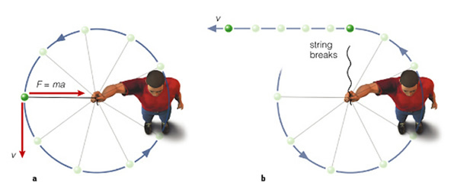
Circular Motion Ball on a Rope
In the case of the whirling ball it is reasonable to say the force provided by the string, tension, pulls inwards on the ball. Like the acceleration, the force acts towards the centre of the circle and keeps the body at a fixed distance from the centre. If the ball is swung round faster or has a greater mass, a larger force is need. What will happen to the string if the force is greater than it can bear?

Slide 77
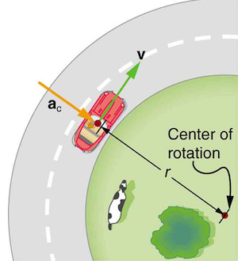
Circular Motion Rounding a Bend
When a car rounds a bend a frictional force is exerted inwards by the road on the car’s tyres so providing the centripetal force needed to keep it in its curved path. Here friction acts as an accelerating force, towards the centre of the circle, rather than a retarding force.

Slide 78
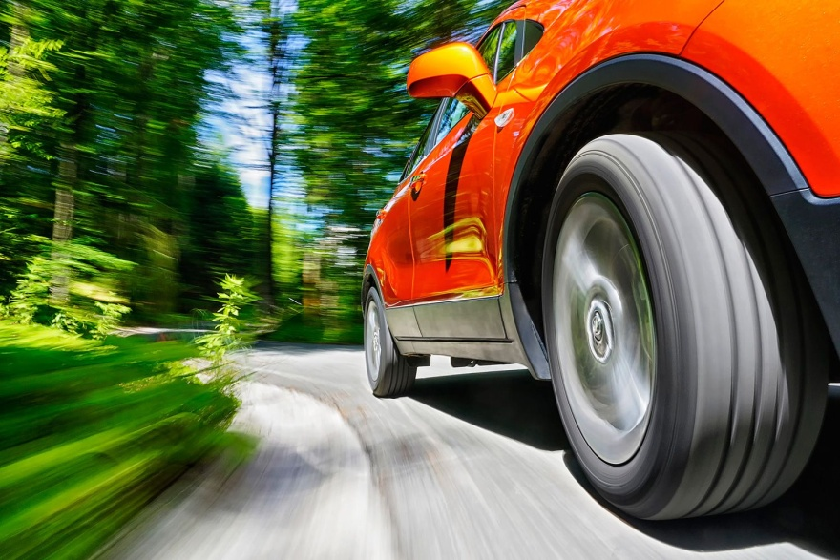
Circular Motion
Rounding a bend The successful negotiation of a bend on a flat road therefore depends on the tyres and the road surface being in a condition that enables them to provide sufficiently large frictional force otherwise skidding occurs. Safe cornering that does not rely entirely on friction is achieved by ‘banking’ the road. Some of the centripetal force is then supplied by the contact force N from the road surface on the car which acts horizontally.

Slide 79
Normal Force

Slide 80
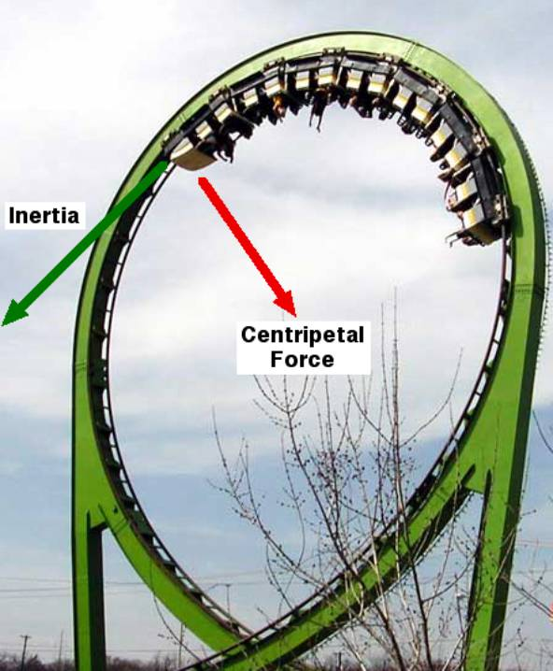
Circular Motion Looping the Loop
A pilot who is not strapped into his aircraft can loop the loop without falling down- wards while at the top of the loop. A bucket of water can be swung round in a vertical circle without spilling.

Slide 81
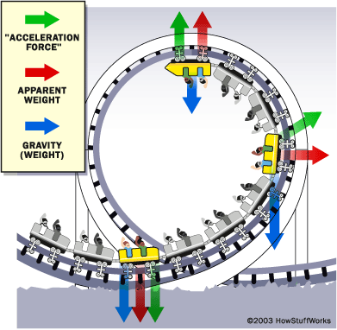
Forces that keep a roller coaster in a circular path
In a roller coaster ride the gravitational force is always downward. This and inertia are the centripetal force which keeps the roller coaster in its circular path.
At the bottom of the loop, the normal force due to the track acting on the car will be upward.
Inertia also keeps people from falling out of the carts.

Slide 82
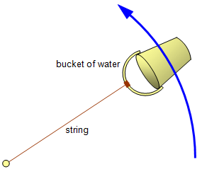
Forces that keep water inside of bucket being swung overhead in a circular path
A bucket that is swung overhead in a circular path remains in this path because a net force called the centre seeking/centripetal force pulls the bucket towards the centre of the circle. The centripetal force is the tension on whatever is holding the bucket, in this case it is the string.
Water does not leave the bucket due to inertia. The force of laziness. This force is often referred to as the centre fleeing force/apparent centrifugal force.

Slide 83
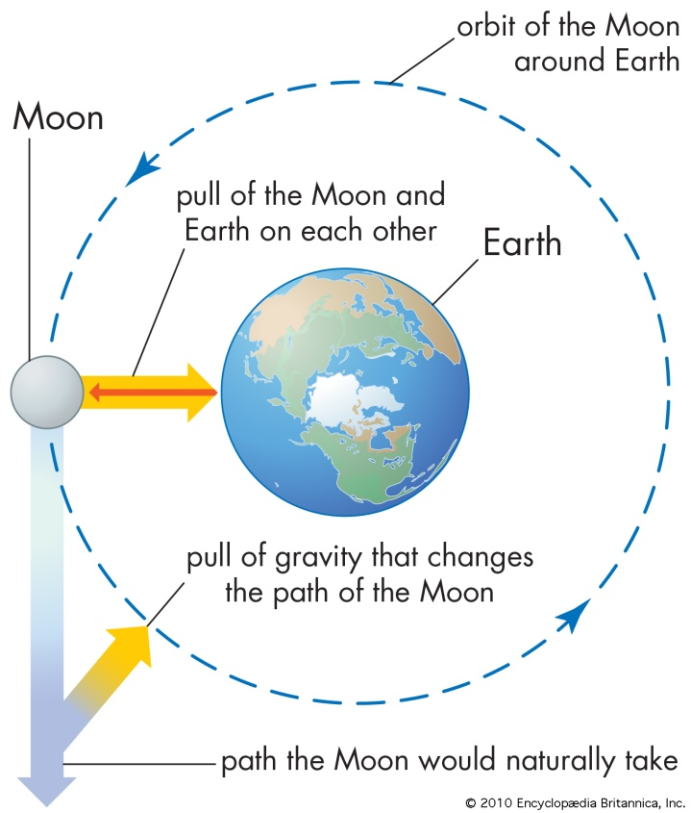
Circular Motion
Universal gravitation Newton proposed that all objects in the universe attract each other with a force he called gravitation. Newton regarded gravity as the gravitational attraction of the earth for nearby objects. He saw it as being responsible for holding the moon in its orbit round the earth.

Slide 84
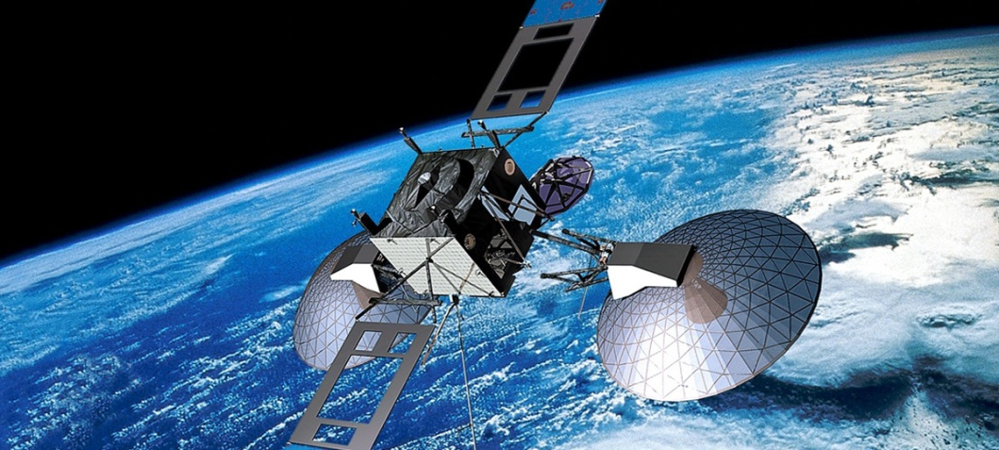
Circular Motion
Satellite motion To put an artificial satellite in orbit at a certain height above the earth it must enter the orbit at the correct speed. If it does not, the force of gravity, which decreases with height, will not be equal to the centripetal force needed for the orbit. Geostationary satellites go round the equator at the same rate as the earth spins, and so appear at rest from the ground.

Slide 85
Classwork
CLASSWORK ☺ 1. An apple is whirled round in a horizontal circle on the end of a string which is tied to the stalk. It is whirled faster and faster and at a certain speed the apple is torn from the stalk. Why?
CLASSWORK ☺ 2. What provides the centripetal force for a. A coin placed on a rotating turntable, b. A space capsule circling the earth?

