Slide 1
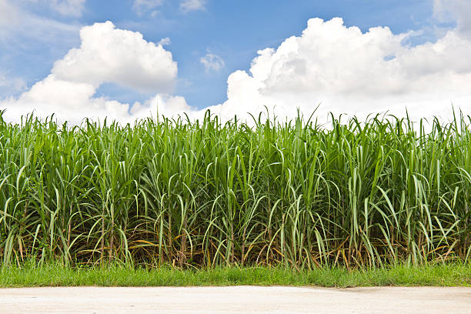

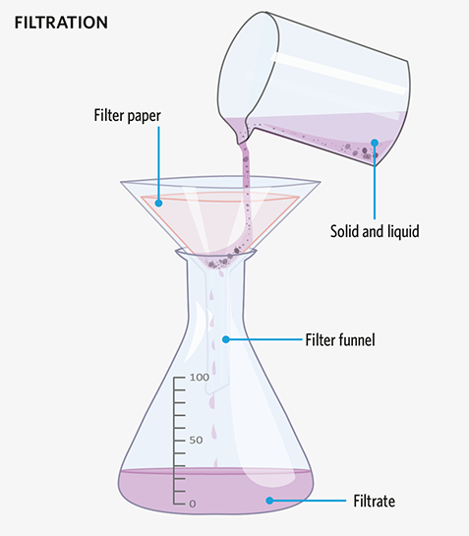
Purifying Matter – Separating Mixtures

Slide 2
Filtration
Filtration separates undissolved solids from a solution or liquid.
The solution passing through
the filter paper is called the
filtrate.
The solid remaining on the
filter paper is called the residue.

Slide 3
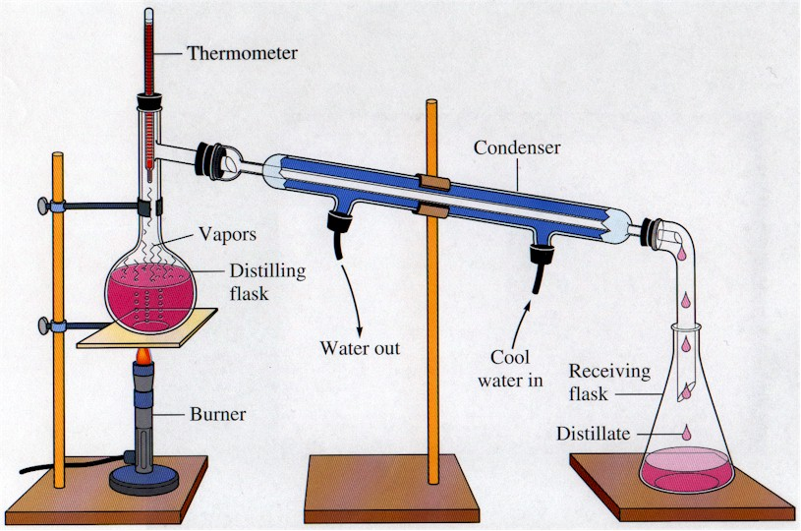
Simple Distillation
Simple distillation is used to separate a liquid from a solid.
Distillation involves the
processes of boiling and
condensation.
It works because the
components to be
separated have very
different boiling points.

Slide 4
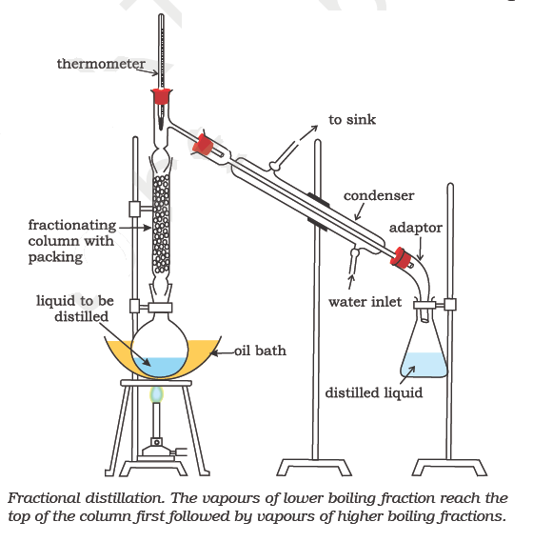
Fractional Distillation
Fractional distillation is used to separate two or more liquids with different boiling points from each other.
This method is used
to separate petroleum
fractions and to purify
alcohol from a mixture
of water and alcohol.

Slide 5
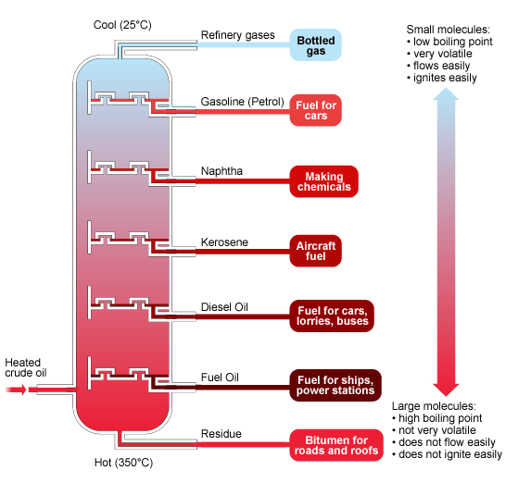
Fractional Distillation on an Industrial Scale

Slide 6
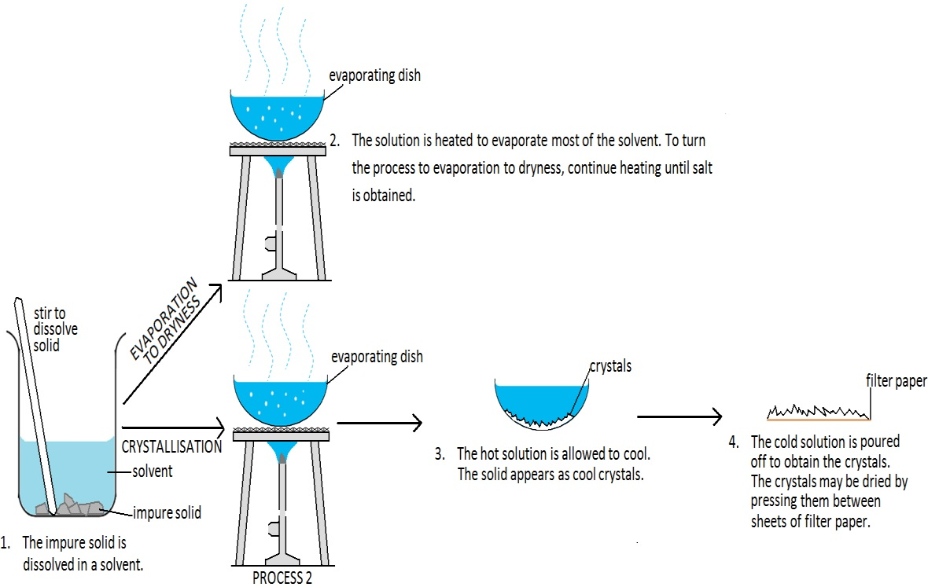
Crystallisation

Slide 7
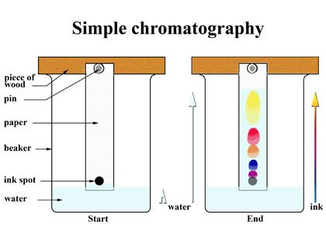
Paper Chromatography
Paper chromatography is used to separate a mixture of different dissolved substances.
The method is often
used to separate the
different pigments
present in food
colourings and inks.

Slide 8
Paper Chromatography
The Importance of the R_{f} Value:
Each substance can be recognized by a value known as a R_{f} value, which is a constant for a given type of chromatography paper and a given solvent system.
The R_{f}, retention factor, values give the ratio of the distance travelled by the separated spot to the distance travelled by the solvent. It is a precise value, like melting temperature or density and can be used to identify substances.
R_{f} = distance travelled by the separated spot ÷ distance travelled by the solvent
The diagram below depicts an example of
chromatography, known as thin layer. Can
you determine which colour arrow represents the
distance travelled by the separated spot and
the distance travelled by the solvent?
Red –
Green –
Determine the R_{f} value
of this particular solute.
R_{f} =
10 cm
6.9 cm
origin/baseline

Slide 9
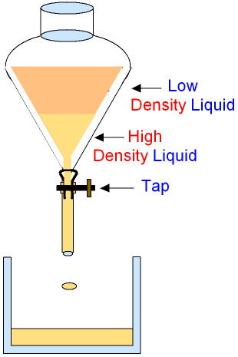
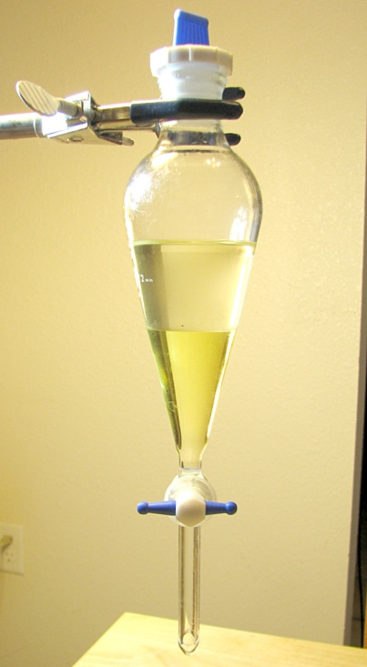
Separating Funnel
A separating funnel is used to separate immiscible liquids that have different densities.
Immiscible liquids
are liquids which
do not mix.
A separating funnel
may be used to separate
oil from water.

Slide 10
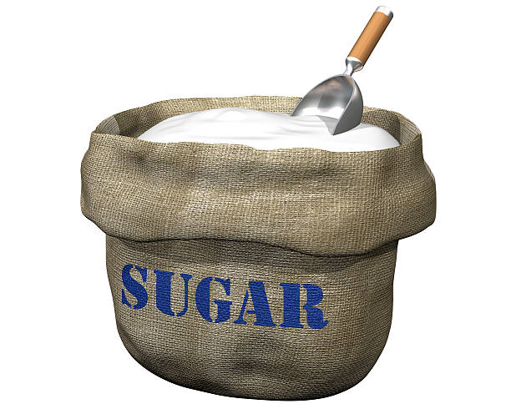
Extracting Sucrose from Sugar Cane
This is done on an industrial scale since it is difficult to accomplish in a school lab.
Juice is extracted from sugar juice via a shredder and a crusher. bagasse is removed and calcium hydroxide is added to neutralise the acidity of the juice and to remove impurities.
The juice is then filtered continuously
to remove non-sugar impurities.
Next the juice is made into a syrupy
concentrate by using four
boilers (evaporators).
Under vacuum in a crystallisation
pan the syrup is evaporated. A few
crystal of sugar are added to encourage
crystallisation. Molasses is present here.
The mixture is then centrifuged to separate
raw sucrose from molasses.

