Slide 1
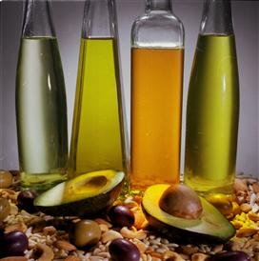

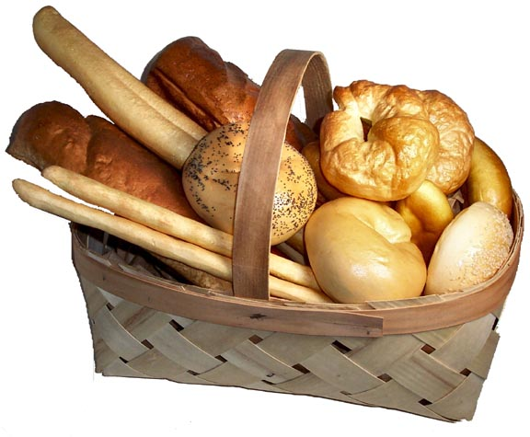
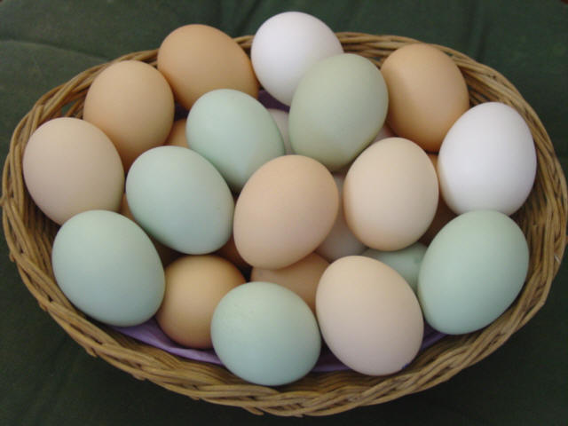
Carbohydrates, Proteins and Fats
Vegetable & Olive oil and Pears are a good source of essential fats and oils
http://longvibrantlife.com/?p=44
Bread is a good source of carbohydrates
http://www.diabetes1.org/forum/Eating_and_Dieting/Bread-19447
Eggs are a good source of protein
http://blog.sierratradingpost.com/health-exercise-workout-fitness-tips-tips/omelet-lovers-rejoice-eggs-are-healthier-than-previously-thought/

Slide 2
Carbohydrates, proteins and fats are essential for our daily diets.
Fats are formed by condensation reactions but they are NOT polymers. What does this mean? They are tri-esters formed in nature from reaction between the trialcoholglycerol and long-chain fatty (organic) acids. Glycerol is better known as propan-1,2,3-triol. Draw the molecule out and try reacting it with three carboxylic acids, R-COOH, R’-COOH and R”-COOH.
fats
carbohydrates
proteins
Energy for movement, warmth and growth
Growth and repair of tissue
Control of life processes in the body

Slide 3
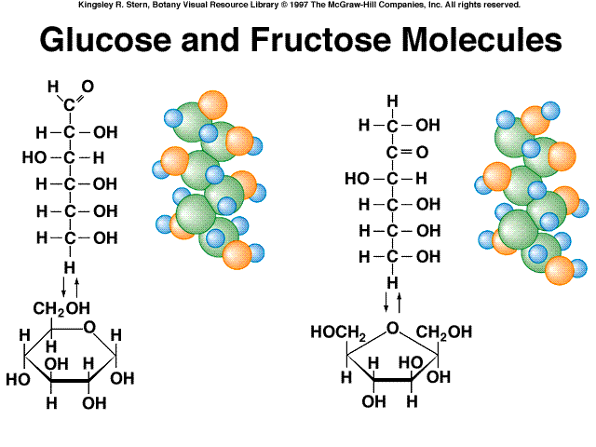
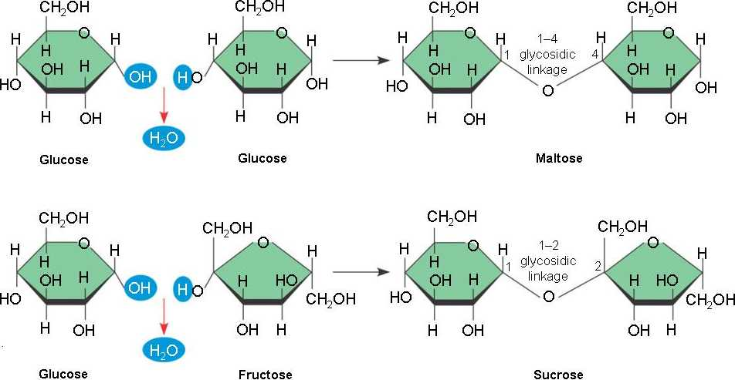
Proteins are condensation polymers which are formed in nature when amino acid molecules link up. What are these types of links/bonds called?
Carbohydrates are compounds that occur naturally. Their general formula is C_{x}(H₂O)_{y}. They are hydrates of carbon.
Glucose and fructose (C₆H₁₂O₆) and sucrose and maltose (C₁₂H₂₂O₁₁) are simple carbohydrate sugars. What are glucose and fructose examples of? Sucrose and maltose are examples of the same thing. Can you tell me?
Glucose and Fructose Molecule http://www.mhhe.com/biosci/pae/botany/uno/graphics/uno01pob/vrl/
Mechanisms and Structures of Maltose and Sucrose
http://www.nicerweb.com/bio1151b/Locked/media/ch05/

Slide 4
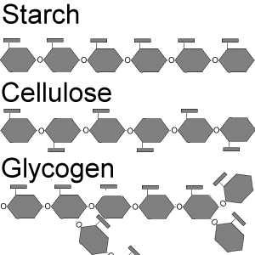
More complexed carbohydrates like glycogen, starch and cellulose are termed polysaccharides which are condensation polymers. What does condensation polymerization mean again?
CARBOHYDRATES:
Polysaccharides are made up of monosaccharide units where mono means one and saccharide means sugar. The units are mainly glucose.
Two monosaccharides can condense to yield a disaccharide as depicted below:
C₆H₁₂O₆ + C₆H₁₂O₆ → C₁₂H₂₂O₁₁ + H₂O
Disaccharides and polysaccharides contain the ether linkage, the –C – O – C – linkage better known as the glycosidic linkage in biology.
Schematic of Starch, Cellulose and Glycogen
http://bioweb.wku.edu/courses/biol115/wyatt/biochem/carbos.htm

Slide 5
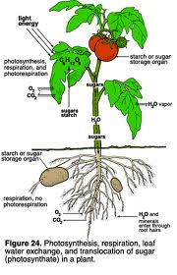
Disaccharides have two very reactive end OH groups.
Disaccharides are able to undergo further condensation reactions to produce/yield trisaccharides and eventually polysaccharides.
Glucose is polymerized by plants into starch and cellulose.
Starch is the food reserve of plants and cellulose is the major building block in plants which makes up the fibrous framework of plant structure.
Glucose is the primary product of photosynthesis where leaves containing chlorophyll, the green substance, absorbs energy from sunlight and converts this energy into simple sugars and O₂ from CO₂ and H₂O.
6CO_{2(g)} + 6H₂O_{(l)} → C₆H₁₂O₆ + 6O_{2(g)}
(conditions include light and chlorophyll)
Mechanism of photosynthesis
http://bioweb.wku.edu/courses/biol115/wyatt/biochem/carbos.htm

Slide 6


Plants utilize sugar produced in a number of ways:
It is converted to starch and stored
It is converted to cellulose
It provides energy needed by growing plants and animals which feed on the plants. This energy is released during respiration which is in some senses a reverse of the photosynthesis reaction.
Animals store carbohydrates in the liver as glycogen. Glycogen contains more than 5000 glucose units and because of its size is not water soluble. Owing to this they are not directly available as a source of energy and nutrients. However, they can be broken down easily into disaccharides → monosaccharides → CO₂, H₂O and energy.
Can anyone tell me how they would go about testing for starch in food? How would you know starch is present within that article of food?
I knew that you were super smart! So, tell me how you would go about testing for a reducing sugar and how would you know that the article of food contains that reducing sugar?
Star
http://www.advocacysouthwest.org.au/
Bulb
http://sites.google.com/site/perspectivesmagazine/suggestions

Slide 7
In Human Digestion:
In the body: Larger starchy molecules → smaller molecules (conditions include enzymes)
In the mouth: maltose (non-reducing sugar) → simpler sugar (reducing sugars) in the small intestine and stomach
In nose or mouth (act of respiration): simple sugars → CO₂ + H₂O + energy
PROTEINS:
Proteins perform a variety of functions. They are biologically large molecules.
As enzymes:
Papain is an enzyme used to tenderize meat.
As structural proteins:
Muscles are made up of the proteins myosin and collagen.
Wool is made up of the protein keratin and silk is made up of the protein fibroin.
As nutritive proteins:
Egg contains the protein albumin.
Milk contains the protein casein.
Flour contains the protein gluten.
As physiologically active proteins that regulate body processes:
Insulin is a protein hormone that regulates sugar levels in the blood.
Haemoglobin is protein component of blood.
The building blocks of all proteins use amino acids.

Slide 8
Let’s consider the amino acid glycine or aminoethanoic acid. Can we draw the structural formula out? What are the 2 functional groups present?
Can we react glycine/aminoethanoic acid with alanine/2-aminopropanoic acid? What is happening here? What is the name of the bond that has formed?
More than 80 amino acids are known. 26 of these occur naturally 20 of which are frequently combined in proteins.
Protein structures are very complicated. For example, Insulin has the molecular formula C₂₅₄H₃₇₇N₆₅O₇₅S₆. A small part of the amino acid sequence is depicted below:
In how many ways can these five amino acids above be arranged? Try working it out.
Glycine
Alanine
Valine
Isoleucine
Serine

Slide 9

So, since we’ve all read, how would you go about testing for proteins in food? Describe what you would see.
Now, how would you go about testing for amino acids in food? Describe what you would see.
Each protein is made from a different amino acid sequence. Some proteins contain as many as 3000 amino acid units.
Our digestive system breaks down the proteins we eat into amino acids. These amino acids are then circulated throughout our bodies to cells which join them up again but in combinations that our body needs.
Unfortunately, our body is unable to make eight of the essential amino acids that our body needs. What is done to compensate for this dilemma?

Slide 10

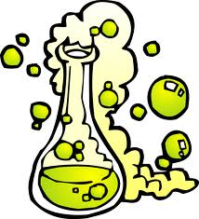
We are made up of about 15-20% protein. Can we name some?
FATS:
They are an essential part of cell membranes.
They provide the highest energy per gram of all food nutrients.
They serve as energy storage reservoirs in the body.
They insulate many organs of the body.
They serve as protective packing for organs.
Fats are triesters. What does this mean? Do they go through condensation reactions? What type of molecules are involved?
Fats are NOT polymers! Why?
When fats are digested in the body glycerol and fatty acids are produced.
Give me two tests for fats.

