Slide 1
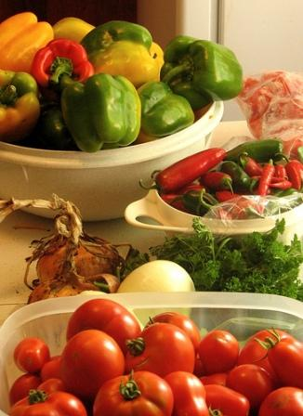
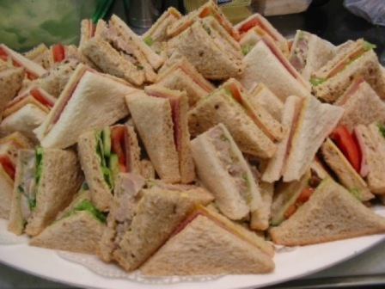

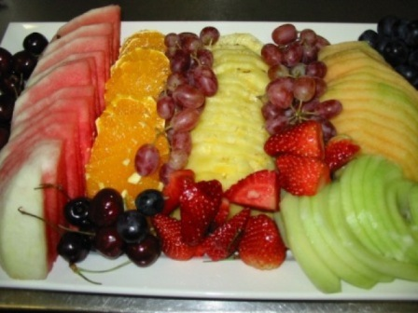
What is Food?
Sandwiches
http://www.gourmetdelish.com.au/Contact.html
Vegetables
http://eatdrinkbetter.com/2009/08/30/three-stuffed-vegetable-dishes-fetty-tomatoes-pepper-pies-rainbow-eggplant-wonder/
Fruits
http://www.gourmetdelish.com.au/Contact.html

Slide 2
What are some of the basic functions of food?
The chemical components of food which performs these functions are called nutrients. These nutrients are called:
Proteins
Carbohydrates
Fats..... Do you know of any others?
Roughage or fibre is an essential component of a healthy diet even though it is not considered a nutrient. Can you give me some examples of where fibre may be obtained in food?

Slide 3
Can we fill out the Suitable Sources section?
Key Nutrients | Their Functions | Suitable Sources
Carbohydrates | Supply energy Help the body use fats more efficiently
Proteins | Build and maintain body tissue Found in enzymes, hormones and body fluids May also serve as energy source
Fats | Help the body use some other nutrients e.g. Fat-soluble vitamins, more efficiently Supply essential fatty acids Supply food energy in a concentrated form
Water | Carries nutrients to, and wastes from cells Helps in the digestion and absorption of foods Regulates body temperature A constituent of cells and body fluids
Minerals e.g. Calcium and Iron | Calcium: builds bones and teeth; helps in blood clotting Iron: helps cells use oxygen; combines with proteins in heamoglobin
Vitamins | Serve a variety of functions Some are water-soluble others are fat-soluble
Chart Depicting Key Nutrients, Their Functions & Sources

Slide 4
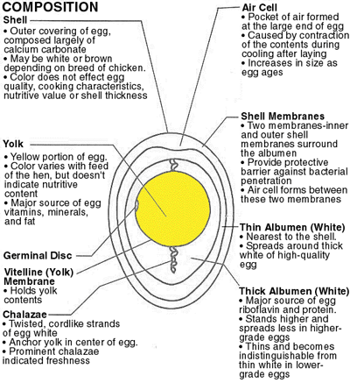
EGGS:
They supply the human body with:
Valuable proteins
Some fats
Iron
Phosphorus
Vitamin A & D
Calcium
However, an egg is not a complete source of food for humans because it does not contain carbohydrates.
Carbohydrates
Fats and Oils
Proteins
Minerals
Vitamins
Water
Energy
Growth and Repair
Control and Regulation
Diagram depicting food nutrients and their functions
Composition of an Egg
http://www.chemicalbiological.net/the%20egg.html

Slide 5
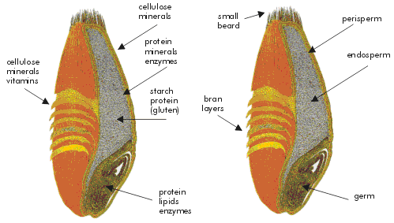
When an egg is cooked it denatures. What does denaturing mean?
Egg can be used in a variety of ways for food preparation. Why is this so and name some ways?
FLOUR:
Wheat flour is the most widely used type of flour. The table below shows the approximate nutrient content of wheat flour.
Nutrient | % Composition by Mass
Carbohydrate | 70
Moisture | 14
Protein | 13
Fats & Minerals | 3
Longitudinal section of a wheat grain
http://www.plantsciences.ucdavis.edu/beckles/wheat.html
The Composition of Wheat Flour

