Slide 1

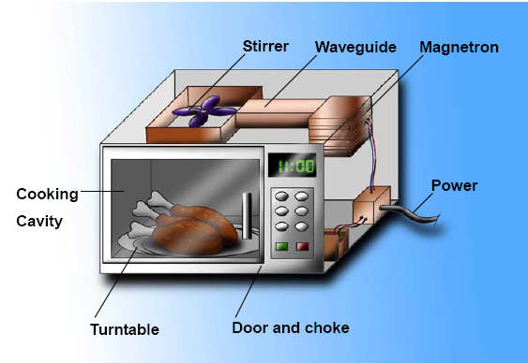
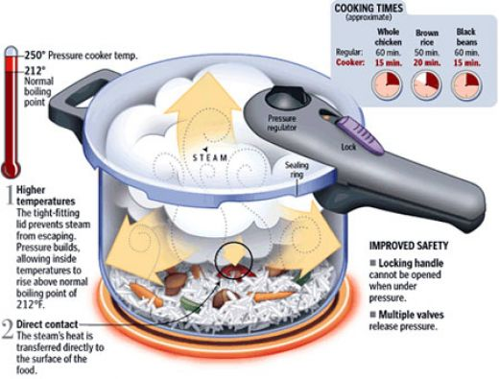
Some reactions involved in food preparation
Microwave
http://www.cfs.gov.hk/english/programme/programme_rafs/programme_rafs_ft_01_02_mcfs.html
Pressure Cooker
http://hubpages.com/hub/stainless-steel-pressure-cooker

Slide 2
What is so lovely about cooking?
Cooking involves the use of heat. Can we name the three types heat involved in the cooking process?
The microwave is a wonderful device used for cooking. Have you ever wondered how food manages to get cooked within it. Trick question - What type of waves are involved in cooking when one uses this device?

Slide 3
I am sure everyone in here has cooked at some point in time. While cooking have you ever used a pressure cooker? Yes? No? Maybe so? What ever the case may be can any of you tell me how you think a pressure cooker works?
Suggest the three methods by which heat can be passed on to foods.
Can we explain how each method operates?

Slide 4
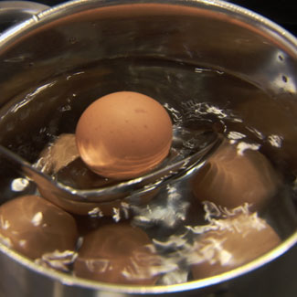
Can we explain the way that an egg is boiled using any of the suitable heating methods we deduced earlier?
Oh my! You all are so smart. Now, let’s try to identify the heat transfers that take place in the following situations:
A steak is grilled:
Fish is fried:
Vegetables simmer in your favourite sauce:
Bread is baked:
Before starchy foods are cooked the cell walls containing pectin are tough and insoluble. Upon further cooking the cell walls start getting softer however, the pectin is still somewhat insoluble as the starch granules swell and eventually gelatinize. When the starchy foods become fully cooked the pectin in the cell walls becomes soluble which enables cell separation and complete gelatinization. Let’s try to draw the schematic out.
Hard boiled egg
http://www.goodhousekeeping.com/food/cooking/how-hard-boil-egg

Slide 5

The heating of proteins cause them to be denatured. What does denaturing mean? What else causes proteins to denature?
At what temperature do you presume eggs and meats start to denature?
Although proteins are sensitive to heat proteins do not suffer significant loss of nutritive value when heated unless high temperatures are used.
Surprise me with your knowledge! How does fat breakdown upon heating? What kind of reaction is this? What molecule, essential for life on Earth, is lost via this reaction?
Frying is a type of cooking which involves the use of fat as a medium. Give me an example of this medium. We use it daily.
Deep frying involves higher temperatures of 175ºC-200ºC. Is cooking time shorter or longer here? Under these conditions why is the loss of minerals and nitrogeneous substances small?

Slide 6
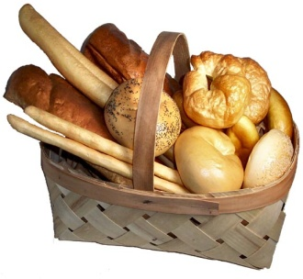
As glycerol loses water it contributes to the unpleasant scent of stale oil. Acrolein is mainly responsible for the smell of stale oil.
So, you’re in love with your belly and you love when you put bread into it. Have you ever tried to bake bread? Have you ever even considered how this Caribbean delicacy is achieved?
Yeasts have been used for thousands of years in bread-making, wine-making and beer-making. When sugar and moisture are added to yeast, fermentation begins and energy is released. What is fermentation? The yeast cells then use this energy to grow and reproduce.
Bread is widely made from wheat flour. What does flour contain and how does it react upon mixing it with water? What is gluten?
When yeast is added to the dough meant for making bread they grow aerobically. What does aerobically mean?
C₁₂H₂₂O₁₁ + H₂O → 2C₆H₁₂O₆
The above reaction shows glucose being made from sucrose

Slide 7

The second step involved in making the bread is kneading of the dough which causes :
Enzymes to convert the starch in the flour to maltose
The fibres of the gluten then stretch enabling the formation of an elastic framework which manages to trap the CO₂ formed. Why is CO2 important for the process of bread making.
The cells then respire anaerobically. What is anaerobic respiration again?
Maltose → Glucose (maltose is broken down via the enzyme maltase which is present in flour)
Glucose → CO₂ + Ethanol (glucose is broken down via zymase an enzyme found in yeast cells)
The final step towards making bread is baking. What happens to the yeast in bread dough?
What happens to the CO₂ that gets trapped within the dough as it is heated?
The starch grains absorb so much water that they burst. And the bread dough begins to harden as gluten loses its elasticity and sets a crisp brown crust.
What do you think the alcohol produced during bread baking is responsible for?

Slide 8
Let’s investigate the use of raising agents. They cause food mixtures to rise. List three types of raising agents other than baking soda.
Did you notice something about them all? What state are they in and what happens to them as heat is added to them? Can you see why they are considered rising agents?
How is air introduced into food? List some methods for me.
Carbon dioxide is introduced into food mixtures in two ways:
When yeasts ferment and grow
Through the use of sodium hydrogencarbonate or baking powder. Below is the following reaction for this:
2NaHCO_{3(s)} → Na₂CO_{3(s)} + H₂O_{(g)} + CO_{2(g)}

Slide 9
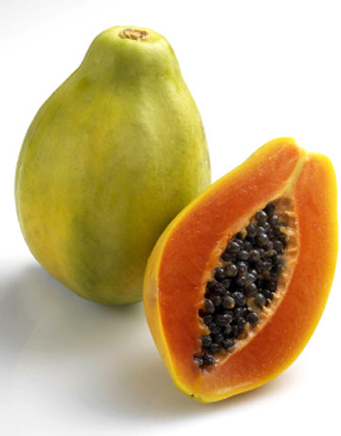
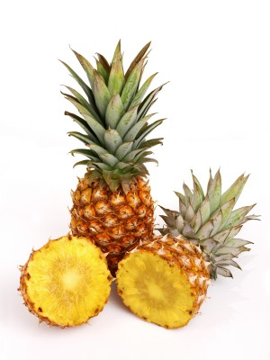
How do you like your meat? Tough or Tender? Hmmm...
Meat that has been cooked is more tender than when it is uncooked. But there are instances when cooking meat doesn’t accomplish tenderizing. What do you suggest as a resolution for this?
There’s also an unconventional way for tenderizing meat. This is referred to as mechanical tenderizing. Ever played tennis or cricket with the same ball? What happens to the ball overtime? Well it is the same concept here.
Enzymes can also be used to tenderize meat. Did you know that papaya and pineapple can aid in the tenderization of meat? How is this so?
The tenderizing action results from the hydrolysis of the amide linkages of the protein in meat.
Papaya
http://www.sharingsustainablesolutions.org/papaya-planting-tips-for-seed-variety-selection-germinating-growing-and-harvesting/
Pineapple
http://www.google.com/images?q=pineapple&hl=en&prmd=ivnsue&source=lnms&tbs=isch:1&ei=fEeVTb34JqST0QGU7KWJDA&sa=X&oi=mode_link&ct=mode&cd=2&sqi=2&ved=0CBQQ_AUoAQ&biw=1366&bih=587

Slide 10
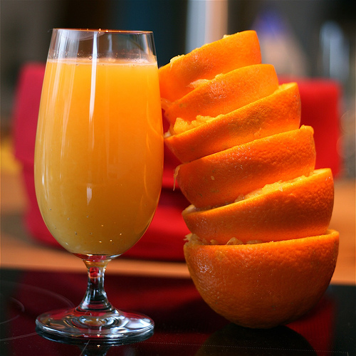
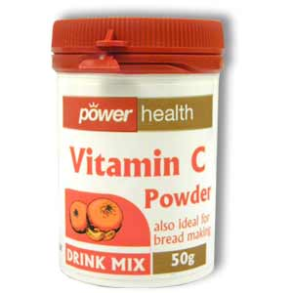
Ascorbic acid better known as vitamin C, C₆H₈O₆, can be obtained via various fruits such as cherries, citrus fruits or black currents. It also aids us in quelling the common cold.
Vitamin C is water soluble and easily oxidized. How may oxidation be increased?
Can you explain why bananas or any kind of citrus fruits turn brown once their skins have been peeled?
Vitamin C gets lost when fruits and vegetables are stored. Cooking is also a culprit here as it causes vitamin C to break down.
Vitamin C controls the formation of dentine, cartilage and bone. Where is dentine found in the body?
Oranges contain a natural source of Vitamin C
http://www.flickr.com/photos/voetmann/345453004/
Artificial source of vitamin C
http://www.google.com/images?hl=en&biw=1366&bih=587&tbs=isch%3A1&sa=1&q=vitamin+c&aq=f&aqi=g10&aql=f&oq=

