Slide 1
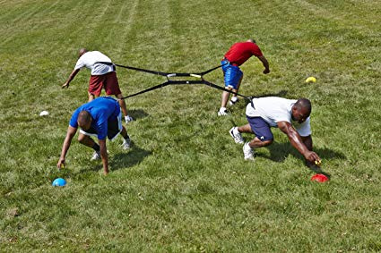
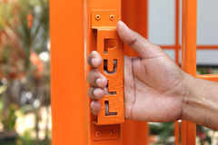
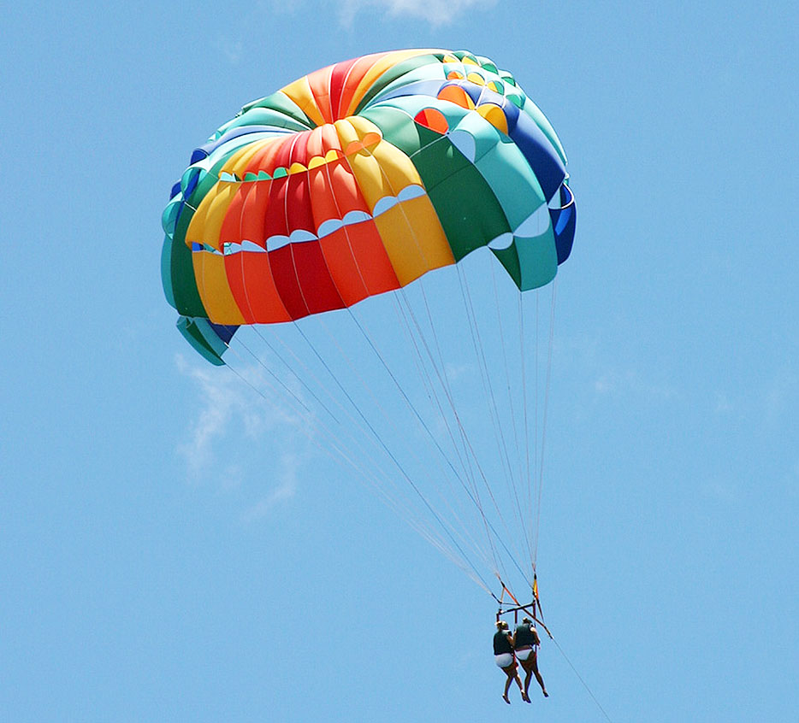
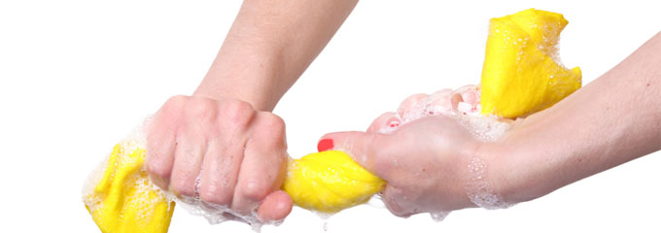
Forces

Slide 2
What is a Force?
A force is a PUSH, PULL or TWIST.
The unit of force is the newton, N. Example 5 N, 10 N etc.
A spring balance is used to measure force.

Slide 3
What is a Force
A force has both size/magnitude and direction hence it is a vector quantity. For example: A force of 4 N is acting to the right (east).
4 N

Slide 4
How Are Forces Represented?
Forces are represented as arrows.
The direction of the arrow gives the direction of the force.
The length of the arrow represents the size of the force.

Slide 5
Types of Forces
There are two types of forces: a. Contact Forces & b. NON – Contact Forces

Slide 6
Contact Forces
When objects need to touch for the force to exist then these forces are categorized as contact forces.
Examples of contact forces are: a. Friction b. Upthrust c. Push d. Pull e. Twist f. tension

Slide 7
Non-Contact Forces
When objects are not in direct contact but forces still exist between them they are categorized as non-contact forces.
Examples of non-contact forces are: a. Gravitational b. Magnetic c. Electrical d. Nuclear

Slide 8
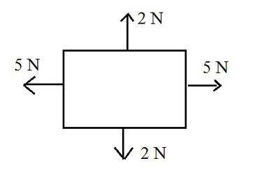
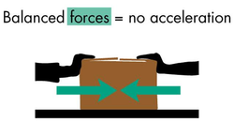
Why Do Objects Move?
Objects are stationary when all forces acting on it are equal but are in opposite directions to each other.
An object moves if there is an unbalanced force acting on it.

Slide 9
Forces that cause a plane to move

Slide 10
Friction
Friction is a type of force that opposes motion. It occurs when two surfaces move over each other.
Friction increases if the surfaces are: a. ROUGH b. CLOSER TOGETHER

Slide 11
Friction
Heat energy is produced as a result of friction.
You can create your own friction by rubbing your hands together. You will find that your palms are getting hotter and hotter the more you rub them together.
A fire can be started by rubbing two sticks together.
In drag racing automobiles are constantly spun around in grand style and this causes the wheels to smoke.

Slide 12
Benefits of Friction
The benefits of friction are: 1. Walking: Friction holds your shoe to the ground, preventing falls. 2. Writing: The pen would slip out of the hand when you tried to hold it to write. 3. Erasing: Rubbing the eraser on the lead removes it from the paper. 4. Washing: Rubbing hands against the clothes removes dirt from clothes. 5. Driving: Without friction between the tires and the road, the wheels would just spin. Likewise, you could not stop without the friction of the brakes and the tires.

Slide 13
Problems from Friction
Friction can make movement difficult. For instance friction makes it difficult to: a. Push a box across a floor b. Walk through deep snow
Friction can also wastes heat energy. In vehicles, extra fuel must be used to power vehicles.
Friction cause parts to heat up if they are not lubricated properly.
Friction causes wear and tear. For example, the soles of your shoes and a pencil eraser.

Slide 14
Ways in Which Friction may be Reduced
Friction may be reduced by: a. Using ball bearings or wheels b. Using grease, lubricants or oils c. Using fluids which are not as thick (viscous) d. Making cars and planes more streamlined e. Using smoother surfaces f. Using air cushions in hovercrafts

Slide 15
Weight
Weight is a force which acts on an object because of the gravitational attraction between the object and the Earth.

Slide 16
Weight
The weight of an object depends on: a. The mass of the object & b. And the gravitational field strength

Slide 17
Mass
The mass of a body is the same wherever it is and does not depend on the presence of the earth like weight does.
Mass is measured by a lever, beam or top-pan balance; weight is measured by a spring balance.

Slide 18
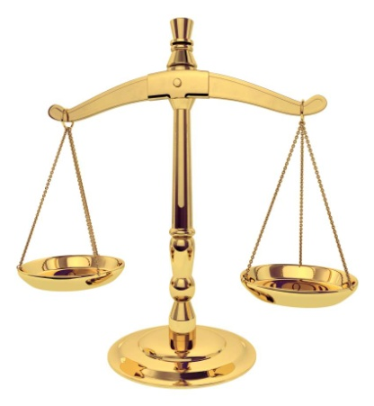
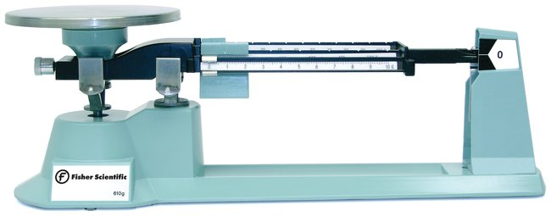
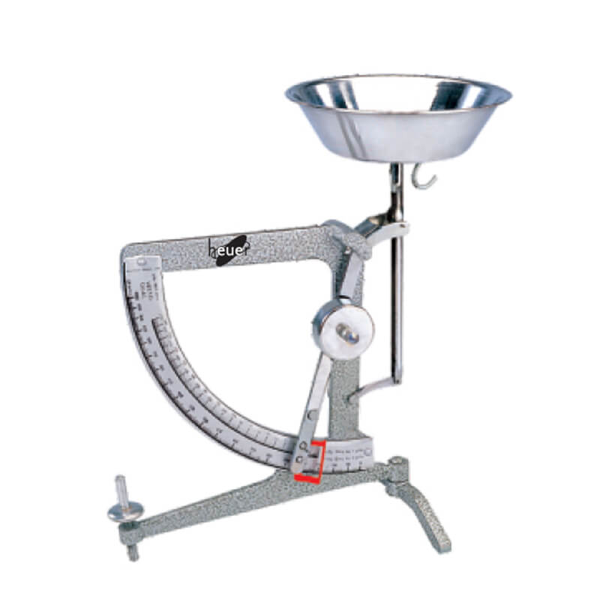
Mass Measuring Devices
There are several kinds of balance: a. beam balance (the unknown mass in one pan is balanced against known masses in the other pan) b. lever balance (a system of levers acts against the mass when it is placed in the pan. A direct reading is obtained from the position on a scale of a pointer joined to the lever system)

Slide 19
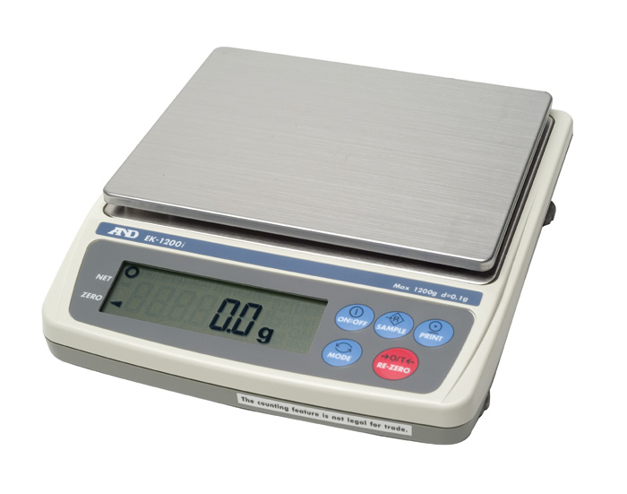
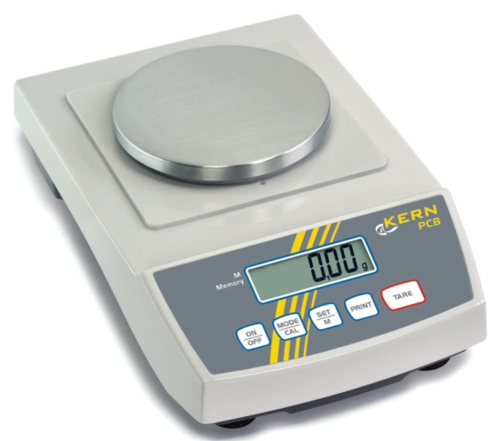
Mass Measuring Devices
c. top-pan balance (this is a digital instrument which has discrete rather than a continuous scale and the accuracy of a reading is determined by the scale setting used based on the sensitivity of the balance)

Slide 20
The Difference Between Mass and Weight
The mass of an object remains the same but its weight changes depending on where it is.
On the earth a mass of 100 g = 1 N and 1 kg = 10 N
And object taken to the moon has the same mass but its weight is less.
Gravity on the moon is one sixth of that on the Earth. This is so because the Moon has a smaller mass.

Slide 21
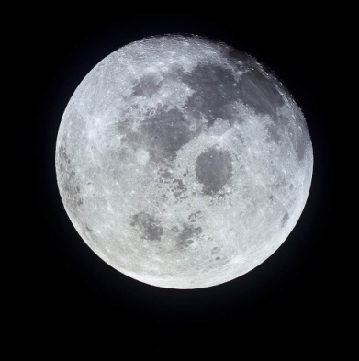
Fun Facts about the Moon
1. One day on the moon is equivalent to one month on earth. 2. Gravity on the moon is one sixth of that on the earth. 3. Meteorites hit the moon every day. 4. It was formed billions of years ago when a giant asteroid struck the Earth and sent debris into Earth’s orbit. It is earth’s natural satellite.

Slide 22
Fun Facts about the Moon
5. It is slowly drifting away from the earth. 6. There is not air. Components of air are made up of biological life forms. There is NO life. 7. Temperatures can dip down to -153 ºC during the night and rise to 107 ºC in the day. 8. Almost all of the minerals on earth can be found on the moon etc.

Slide 23
Gravity
Gravity is the force that the body exerts on a body.
On the earth the gravitational field strength g is about 10 N/kg or 10 m/s²
The nearer a body is to the centre of the earth, the more the earth attracts it. Since the earth is not a perfect sphere the weight of a body varies over the earth’s surface.
The pull of gravity is greater at the poles than at the equator.

Slide 24
Machines
Work is done when a force moves. Work (Nm) = Force (N) × Distance (m)
If there is no movement no work is being done. For example holding an object.
Work is also done when there is a change in energy.

Slide 25
Machines
A machine is a device used to make work easier.
A force being applied is called the effort and the object being moved is called the resistance or load.

Slide 26
Types of Machines
There are different types of machines: 1. gears: found in clocks 2. inclined plane: ladder, ramp, steps 3. lever: broom, scissors, shovel, tweezer 4. screw: car jack, lids of jars 5. Pulleys: cranes 6. Wedges: door stop 7. Wheel and axle: rolling pin, steering wheel

Slide 27
Complex or Compound Machines
A complex or compound machine has two or more simple machines working together. Examples of these are: a. Bicycle b. Car c. Crane d. Wheelbarrow

Slide 28
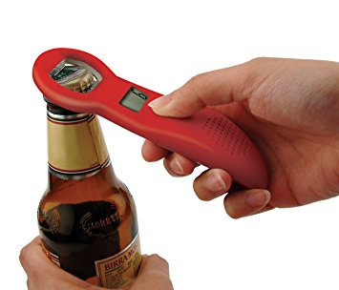
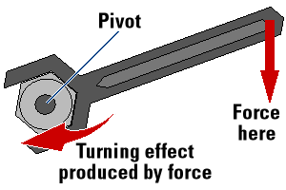
Levers
A lever is a simple device/machine which makes work easier.
When a force is applied (effort) levers turn about a pivot when doing work to move the resisting force (load).
This is referred to as the turning effect.

Slide 29
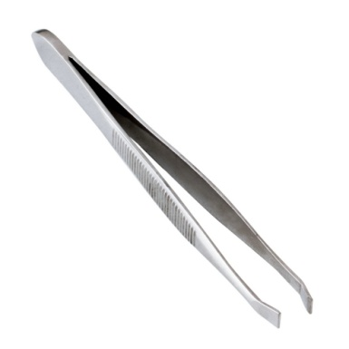
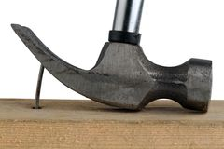
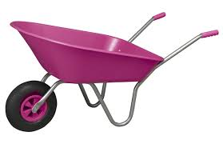
Levers
Some examples of levers are: Scissors, bottle openers, crowbars, pliers, see-saws, tweezers, wheel barrows, spanners, a hammer removing a nail etc…
Levers can be classified into 3 classes: a. 1st class levers (LFE) LiFE b. 2nd class levers (FLE) c. 3rd class levers (FEL) F: Force L: Load E:Effort

Slide 30
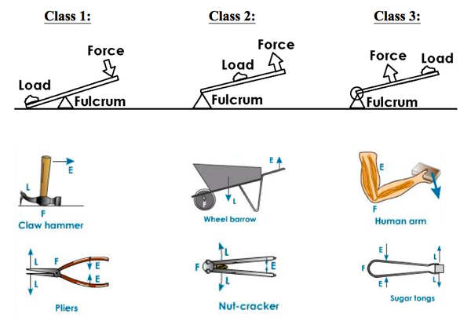
Codes for rem
1st LFE 2nd FLE 3rd FEL
L – Load E – Effort F – Fulcrum

Slide 31
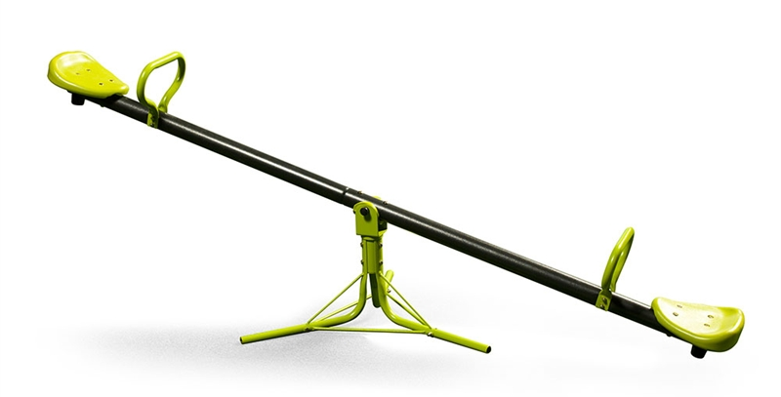
The Turning Effect of a Force
When a force acts on an object it may cause a turning effect, known as the moment of the force.
The turning effect depends on: a. the SIZE of the force applied b. the DISTANCE of the force from the pivot/fulcrum or point of rotation.

Slide 32
Calculating Moments
Turning moment (Nm) = Force (N) × Distance (m)
The unit of moment of a force is the newton metre (Nm). It is NOT equivalent to a joule because the distance measured is perpendicular to the force and not in the direction of the force.

Slide 33
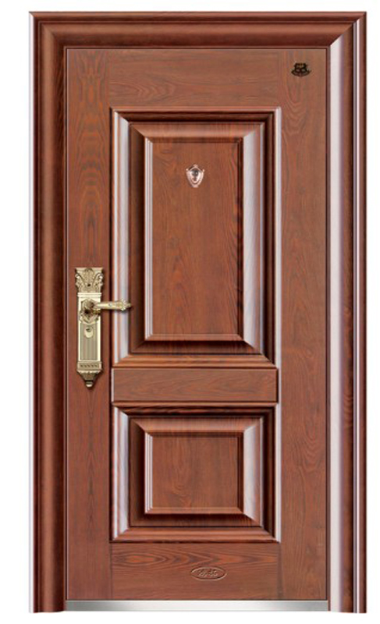
Calculating Moments
Why is the handle on a door at the outside edge?
Why doesn’t it make sense to put the door handle in the centre of the door?

Slide 34
Calculating Moments Clockwise and Anti-Clockwise
When describing the action of moments, the terms clockwise and anticlockwise are used to describe the direction of action. F₁ is trying to turn the ruler anticlockwise. F₂ is trying to turn the ruler clockwise. When the ruler is balanced or at equilibrium the results should show that the anticlockwise moment F₁ × d₁ equals the clockwise moment F₂ × d₂.

Slide 35
Calculating Moments Moments and Equilibrium
When an object is in equilibrium it is not accelerating or rotating. The two equilibrium conditions are: a. There is NO resultant force acting on the object. b. The clockwise moment is equal to the anticlockwise moment. This is known as the principle of moments.

Slide 36
Calculating Moments
Scenario A Scenario B
What is the moment of force on the gate in scenario A? What is the moment of force on the gate in scenario B?
Fulcrum or Pivot
3 m
1.5 m
1.5 m
Fulcrum or Pivot
F = 5 N
F = 5 N

Slide 37
Try this yourself: A uniform plank of 10 m long is balanced on a pivot 2 m from one end by applying a force of 30 N at the end. What is the weight of the plank?
In the figures below the distance AC = CB. Calculate in each case the force P which will keep the system stationary. Scenario A Scenario B
2 m
8 cm
30 N
P
P
A
C
B
A
C
B
10 N
10 N
10 N

