Slide 1
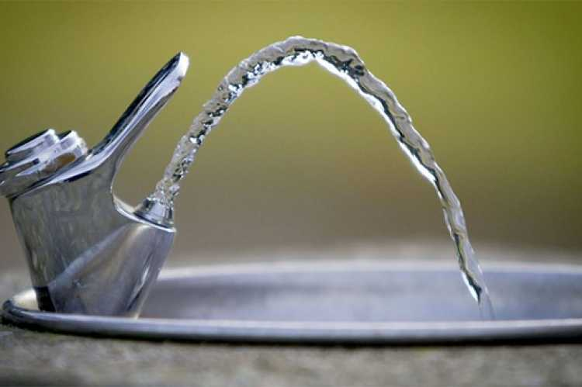
Pressure in liquids

Slide 2
What is Pressure?
Pressure is the force or thrust acting on unit area, 1 m².
pressure (P) = force (F) / area (A)

Slide 3
What is Pressure?
The S.I. unit of pressure is the pascal, Pa.
1 Pa = 1 N/m²
^{1 kPa = 1000 Pa}
The greater the area over which a force acts, the less is the pressure.

Slide 4
What is Pressure?
How is it possible that walnuts can be broken in the hand by squeezing two but not one?

Slide 5
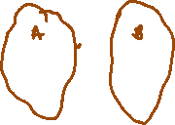

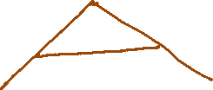



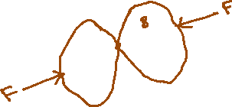



What is Pressure?
How is it possible that walnuts can be broken in the hand by squeezing two but not one?

Slide 6
What is Pressure?
Why do you think that wearing skis prevent you from sinking into soft snow?

Slide 7





What is Pressure?
Why do you think that wearing skis prevent you from sinking into soft snow?

Slide 8
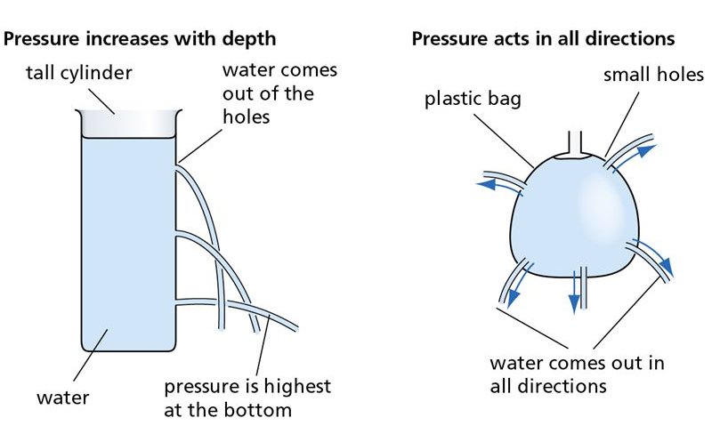

Pressure in Liquids
Pressure in liquids increases with depth.
Pressure at one depth acts equally in all directions.

Slide 9
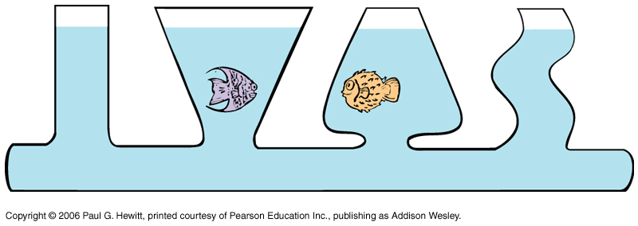
Pressure in Liquids
A liquid finds its own level.
Pressure depends on density. Why?

Slide 10
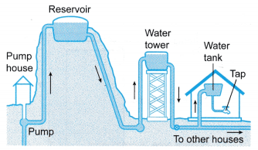
Pressure in Liquids
Reservoirs and Tall Buildings
A town’s water supply often comes from a reservoir on high ground. Why?
The water flows
from the reservoir
via pipes to any tap
or storage tank that
is below the level of
water in the reservoir.
The lower the place
supplied the greater
the water pressure.

Slide 11
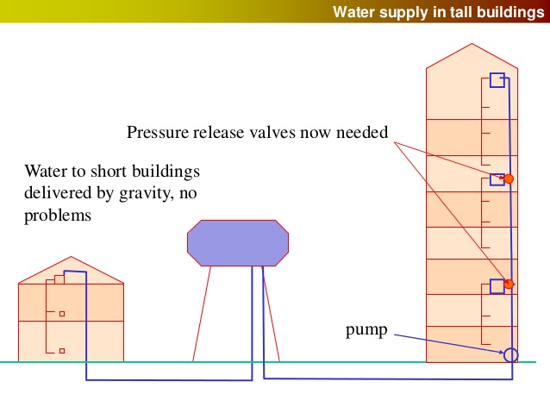
Pressure in Liquids
Reservoirs and Tall Buildings
In very tall buildings it
may be necessary
first to pump
the water
to a large
tank in
the roof.
Why?

Slide 12
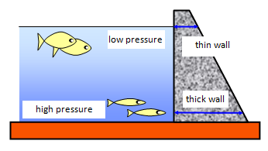
Pressure in Liquids
Reservoirs and Tall Buildings
Reservoirs for water
supply or for hydro-
electric power stations
are often made in
mountainous regions by
building a dam at one
end of a valley.
Why must a dam, when built, have a much thicker base?
What are some forces acting on the wall of a dam?

Slide 13
Pressure in Liquids
Hydraulic Machines
Liquids are almost incompressible. What do you think this means?
However, they are able to pass on any pressure applied to them and use of this fact is applied to how hydraulic machines work.

Slide 14
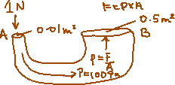
Pressure in Liquids
Hydraulic Machines
Suppose a downwards force of 1 N acts on a piston A of
area 1/100 m². What is the pressure transmitted through the liquid if pressure = force/area?
This pressure acts on piston B of area ½ m². What is the total upwards force or thrust on B if force = pressure x area.
Therefore a force of ________ N applied on piston A thus produces a force of ________ N on piston B.

Slide 15
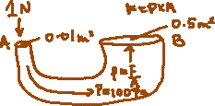


Pressure in Liquids
Hydraulic Machines
Suppose a downwards force of 1 N acts on a piston A of
area 1/100 m². What is the pressure transmitted through the liquid if pressure = force/area?
This pressure acts on piston B of area ½ m². What is the total upwards force or thrust on B if force = pressure x area.
Therefore a force of ________ N applied on piston A thus produces a force of ________ N on piston B.

Slide 16
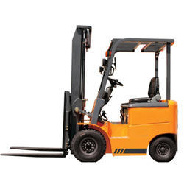
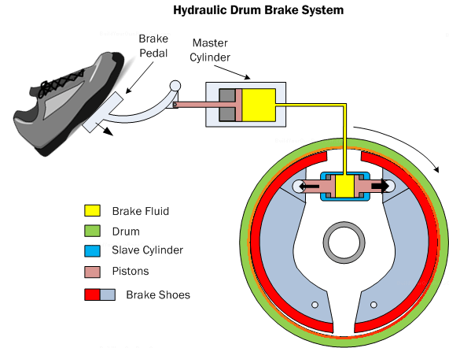
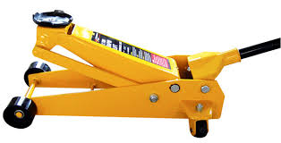
Pressure in Liquids
Hydraulic Machines
Hydraulic jacks, hydraulic fork-lift trucks and hydraulic car brakes use this very same principle.
Hydraulic Jack
Hydraulic fork-lift Truck
Hydraulic Drum Brake System

Slide 17
Pressure in Fluids
In Liquids:
Pressure (P) = density (ρ) x gravity (g) x height of liquid (h)
This pressure acts equally in all directions at depth h and depends only on height and density. Its value will be in Pascals, Pa, if height is in meters (m) and density is in kilogram per cubic metre (kg/m³).
The expression above also applies to gases.

Slide 18
Pressure in Liquids
Within a fluid the difference in pressure between points separated by a depth in change of height can be written as
ΔP = ρgΔh
The symbol, Δ, means difference in.

Slide 19
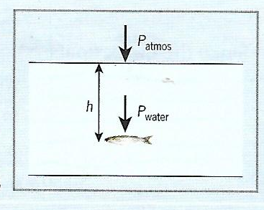
Pressure in Liquids
The figure shows a fish at a depth of h = 40 m in a lake where the density of the water is 1000 kg/m³.
Determine:
a. The pressure due to
the water on the fish
b. The total pressure on
the fish if the atmospheric
pressure is 1.0 × 10⁵ Pa.
Gravitational field strength = 10 N/kg

Slide 20
Pressure in Liquids
Answers:
a. P_{water} = hρg
P_{water} = 40 m × 1000 kg/m³ × 10 N/kg
= 400 000 Pa
b. P_{total} = P_{atmosphere} + P_{water}
P_{total} = 1.0 × 10⁵ Pa + 400 000 Pa = 5.0 × 10⁵ Pa

Slide 21
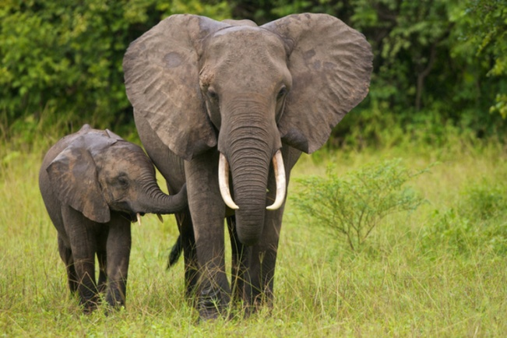
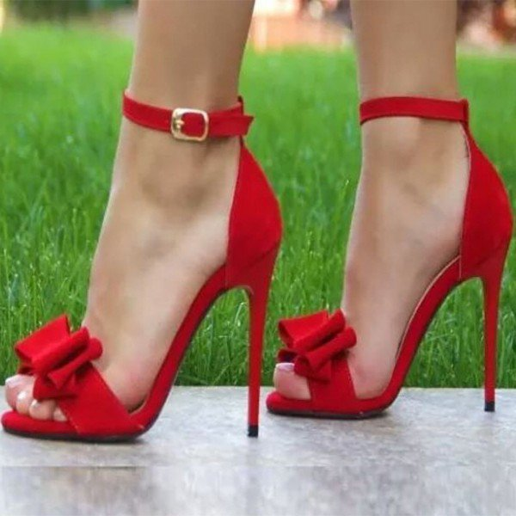
QUESTIONS
Answer the following questions. Where:
atmospheric pressure = 10⁵ Pa
gravity = 10 N/kg
A girl in stiletto heels is more likely to damage a wooden floor than an elephant is. Why?

Slide 22
QUESTIONS
i. What is the pressure on a surface when a force of 50 N acts on an area of
a) 2 m²
b) 100 m²
c) 0.5 m²?
ii. A pressure of 10 Pa acts on an area of 3 m². What is the force acting on the area?
A block of concrete weighs 900 N and its base is a square of sides
3 m. What pressure does the block exert on the ground?

Slide 23
QUESTIONS
In a hydraulic press a force of 20 N is applied to a piston of area 0.2 m². The area of the other piston is 2 m². What is:
a) the pressure transmitted through the liquid
b) the force on the other piston?
What is the pressure 100 m below the surface of sea water of density 1150 kg/m³? (gravity = 10 N/kg)

Slide 24
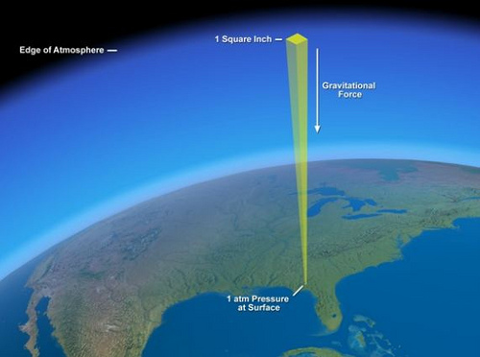
Atmospheric
Pressure

Slide 25
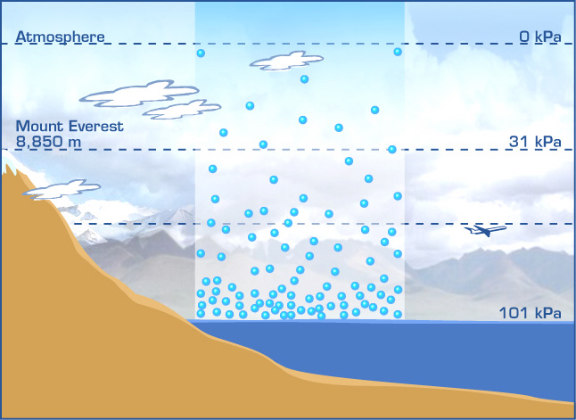
Atmospheric Pressure
The air forming the earth’s
atmosphere stretches
upwards a long way.
Its weight exerts
a large pressure at sea level,
about 100 000 N/m² = 10⁵ Pa = 100 kPa.
This pressure acts equally
in all directions.
The gas molecules closest to earth
are packed together very closely.
Pressure is lower the higher up you go
into the atmosphere hence gas
molecules are not as tightly packed.

Slide 26
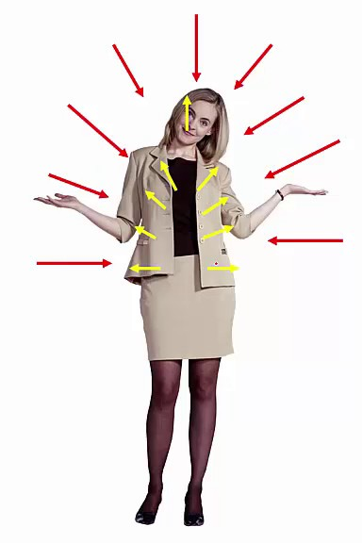
Atmospheric Pressure
Why don’t we usually feel atmospheric pressure?
We don’t feel atmospheric pressure
because the pressure inside of our
bodies is similar to the atmospheric
pressure outside of our bodies.
Therefore, it balances out.

Slide 27
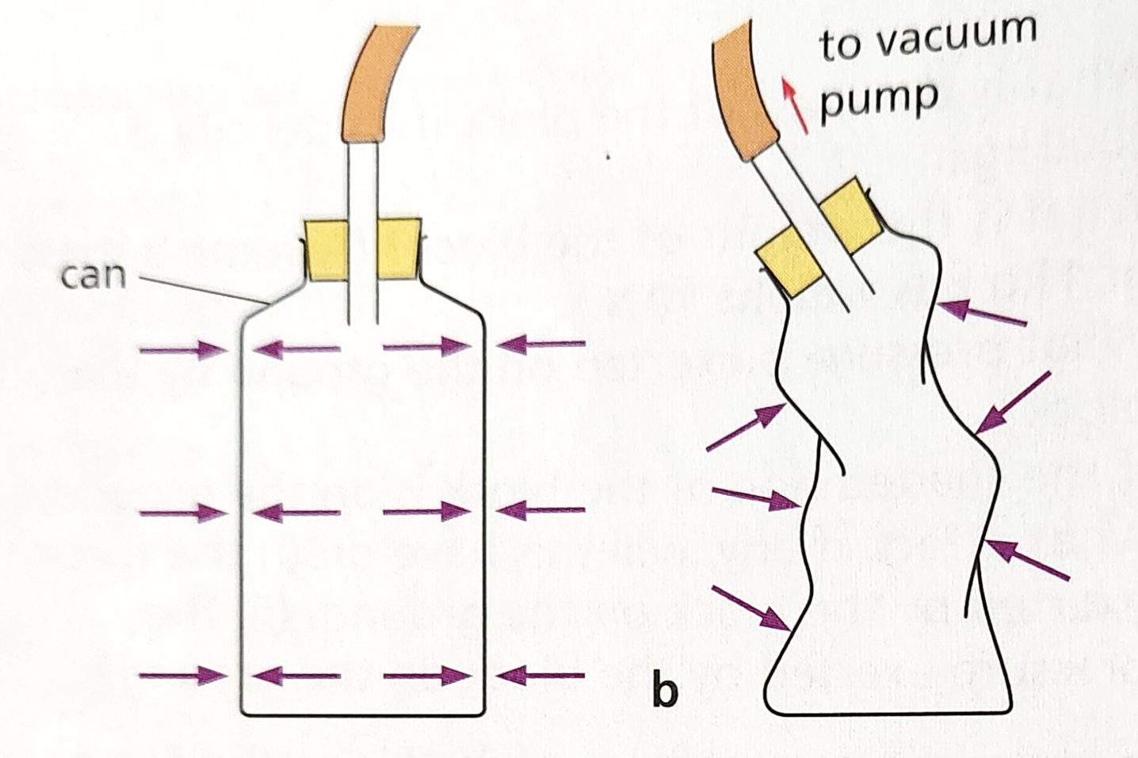
Examples of Atmospheric Pressure
Collapsing Can & Magdeburg Hemispheres
We often experiment
or observe atmospheric
pressure in action for
example:
Collapsing can
What do you think is
happening when air is
being sucked out of a
plastic canister?
Why does the canister
deform or shrivel in shape?

Slide 28
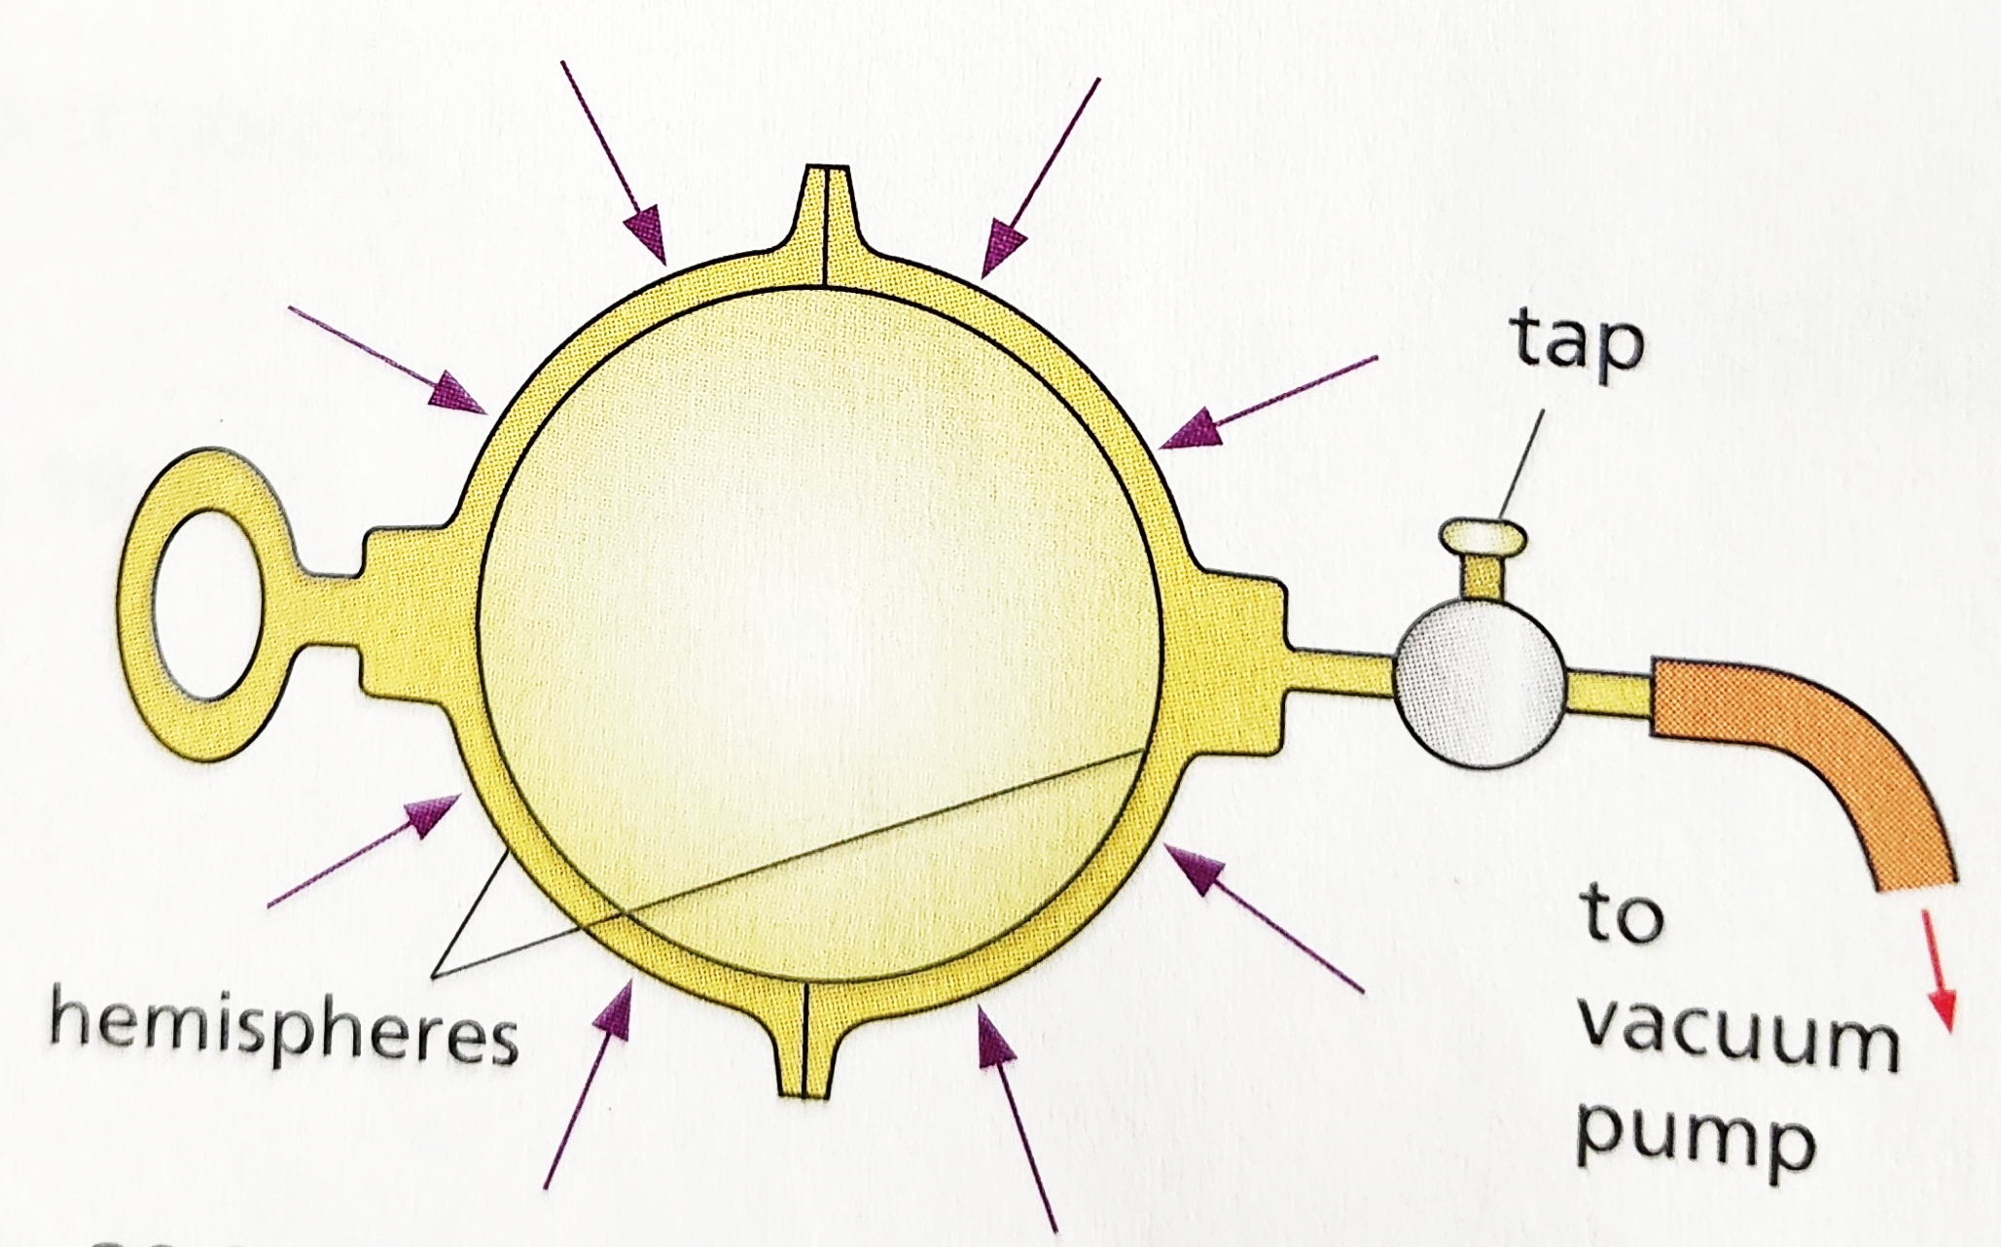
Examples of Atmospheric Pressure
Collapsing Can & Magdeburg Hemispheres
The Magdeburg hemispheres
The vacuum pump was invented
by von Guericke, the mayor of
Magdeburg.
About 1650 he used it to
remove the air from
two large hollow metal
hemispheres, fitted together
to give an airtight sphere.
So good was his pump that
it took two teams, each of
eight horses, to separate
the hemispheres.

Slide 29
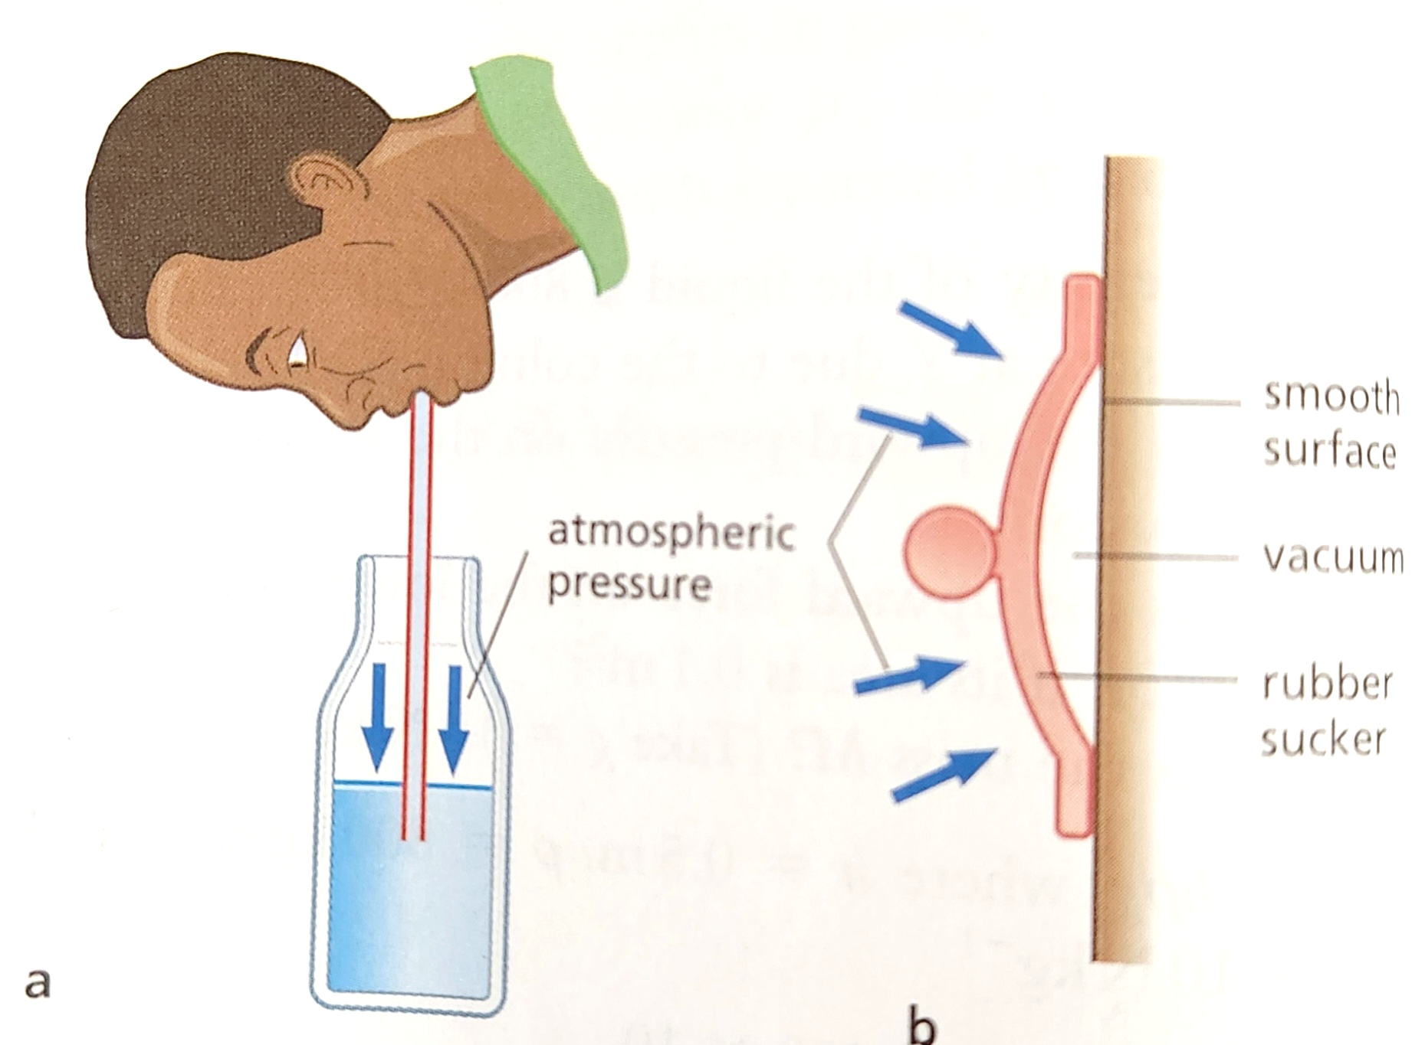
Examples of Atmospheric Pressure
Drinking Straw & Rubber Sucker
Drinking straw
When you suck, your lungs expand
and air passes into them from the
straw.
Atmospheric pressure pushing
down on the surface of the liquid in
the bottle is now greater than the
pressure of the air in the straw
and so forces the liquid up into
your mouth.

Slide 30
Examples of Atmospheric Pressure
Drinking Straw & Rubber Sucker
Rubber sucker
When a sucker is moistened and
pressed on a smooth flat surface,
the air inside is pushed out.
Atmospheric pressure then holds it
firmly against the surface.
What are suckers used for?
Atmospheric pressure

Slide 31
Measuring Atmospheric Pressure
Pressure Gauges
Pressure gauges measure the pressure exerted by a fluid.
Fluids are either liquid or a gas.

Slide 32
Measuring Atmospheric Pressure
Pressure Gauges
Let’s explore 4 types of Pressure Gauges:
1. Bourdon Gauge
2. Mercury Barometer
3. U-Tube Manometer
4. Aneroid Barometer

Slide 33
Measuring Atmospheric Pressure
Pressure Gauges
A Bourdon Gauge measures car oil pressure as well as the pressure in gas cylinders.
A Mercury Barometer is used to measure atmospheric pressure.
A U-tube Manometer is used to measure the pressure of oil of specific gravity 0.85 flowing in a pipeline.
Aneroid Barometers are used in airplanes to determine the change in altitudes the vessel experiences. They are often referred to as altimeters.

Slide 34
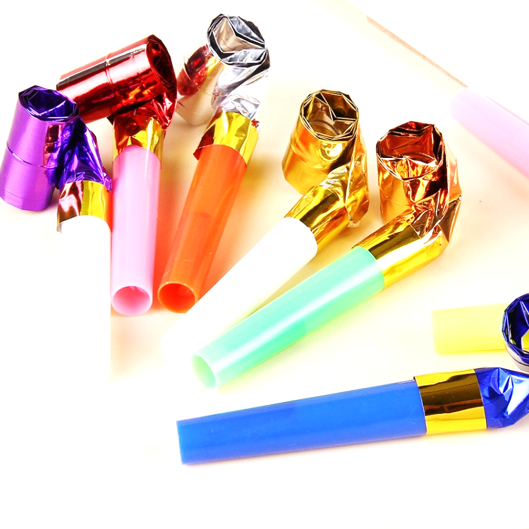
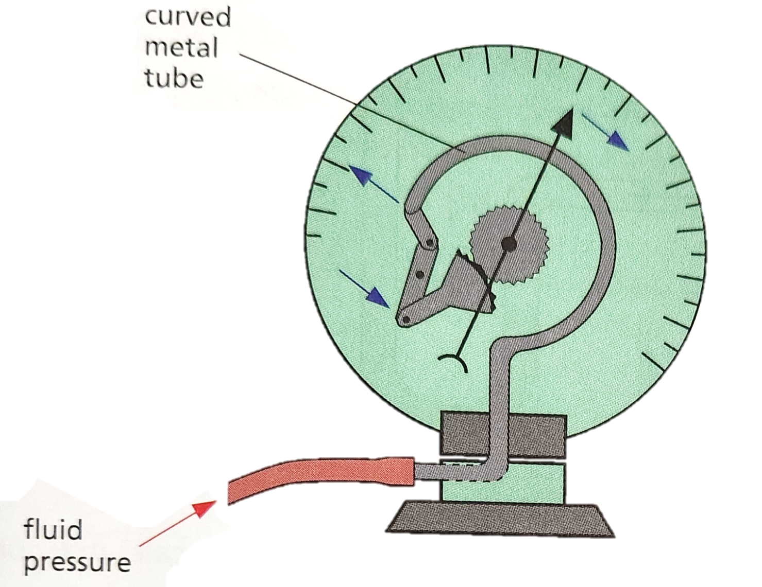
Measuring Atmospheric Pressure
Pressure Gauges
Bourdon gauge
This works like the blow toy. The
harder you blow into the paper tube,
the more it uncurls.
In a Bourdon gauge, when a fluid pressure is applied,
the curved metal tube tries to straighten
out and rotates a pointer over a scale.
Car oil pressure gauges and the gauges
on gas cylinders are of this type.

Slide 35
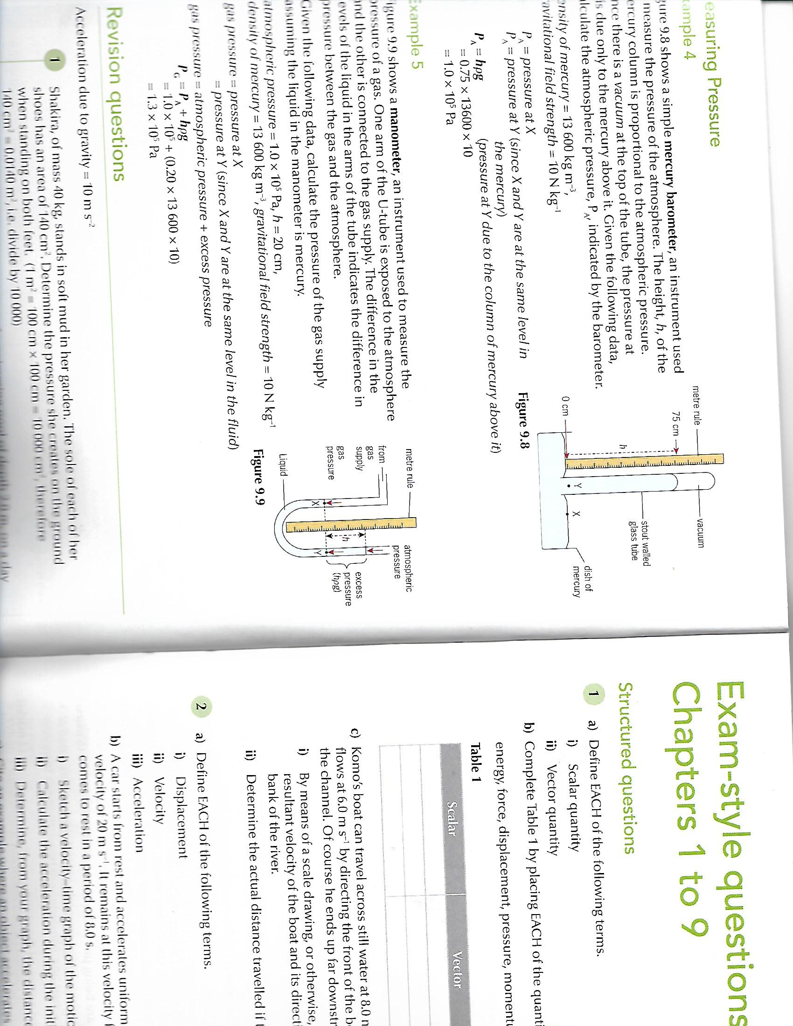
Measuring Atmospheric Pressure
Pressure Gauges
Mercury barometer
This is a simple instrument
used to measure the
pressure of the atmosphere.
The height, h, of the mercury column is proportional to the atmospheric pressure.
Since there is a vacuum at the top of the tube, the pressure at Y is due only to the mercury above it.

Slide 36

Measuring Atmospheric Pressure
Pressure Gauges
Mercury barometer
Given the following data,
calculate the atmospheric
pressure, P_{A}, indicated by
the barometer.
density of mercury = 13, 600 kg/m³
gravitational field strength = 10 N/kg
if P_{A} = pressure X
then P_{A} = pressure at Y since
X and Y are at the same level
in the mercury.
:. P_{A} = ρgh (pressure at Y due to the column of mercury above it)

Slide 37
Measuring Atmospheric Pressure
Pressure Gauges
Manometer
This is an instrument used to
measure the pressure of a gas.
One arm of the U-tube is exposed to the
atmosphere and the other is connected
to the gas supply.
The difference in the levels of the liquid in
the arms of the tube indicates the difference
in pressure between the gas and the atmosphere.
Where:
pressure of gas = atmospheric pressure + pressure due to liquid column h

Slide 38
Measuring Atmospheric Pressure
Pressure Gauges
Manometer
Given the following data, calculate the pressure of the
gas supply assuming the liquid in the manometer is
mercury.
Atmospheric pressure (P_{A}) = 1.0 × 10⁵ Pa
Height (h) = 20 cm
Density of mercury (ρ) = 13, 600 kg/m³
gravitational field strength (g) = 10 N/kg
gas pressure = pressure at X
gas pressure also = pressure at Y since X and Y
are at the same level in the fluid
gas pressure (P_{G}) = atmospheric pressure + excess pressure
P_{G} = P_{A} + hρg
Calculate P_{G} using the equation and information above.

Slide 39
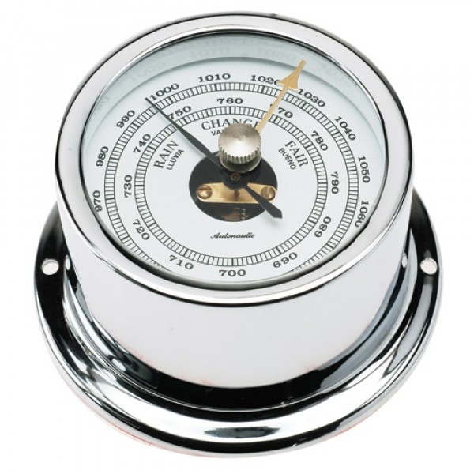
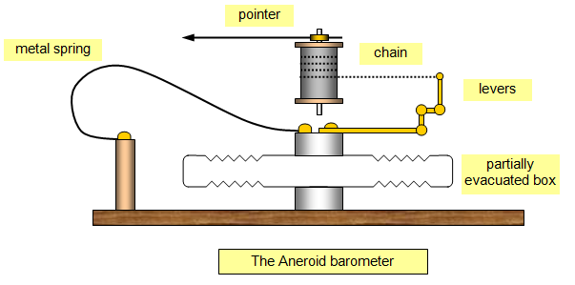
Measuring Atmospheric Pressure
Pressure Gauges
Aneroid barometer:
An aneroid (no liquid) barometer consists of a partially evacuated, thin metal box with corrugated sides to increase its strength.

Slide 40
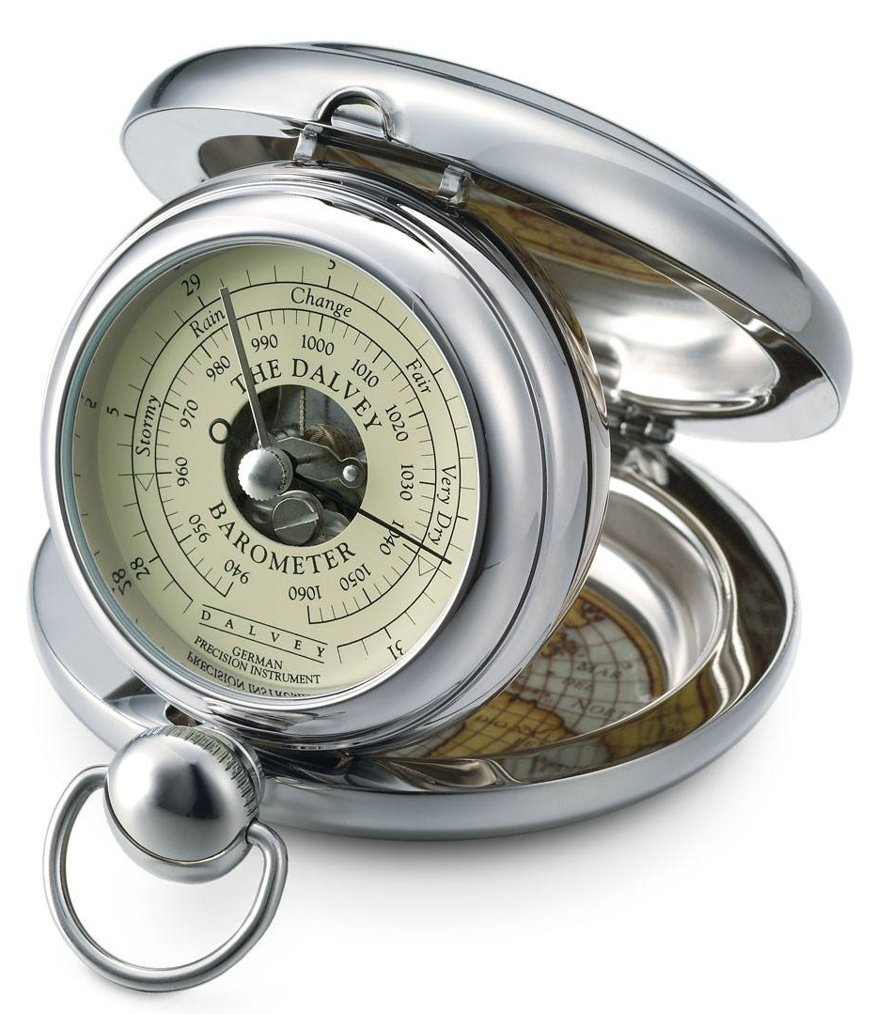
Measuring Atmospheric Pressure
Pressure Gauges
Aneroid barometer:
The box is prevented from collapsing by a strong spring.
If the atmospheric pressure increases, the box caves in
slightly; if it decreases, the spring pulls it out.
A system of levers magnifies this movement and
causes a chain to move a pointer over a scale.
Aneroid barometers are used in aircrafta as altimeters.

Slide 41
Atmospheric Pressure and Weather
Hurricanes
Regions of high atmospheric pressure, called anticyclones, are accompanied by clear skies and sunny weather.
When one has formed, it often does not move for several days and covers a wide area.

Slide 42
Atmospheric Pressure and Weather
Hurricanes
On the other hand a cyclone or depression is associated with a region of low pressure and usually brings widespread rain.
A hurricane is a severe cyclone with winds of 75 miles per hour (33 m/s) or more which spiral inwards towards the storm centre.

Slide 43
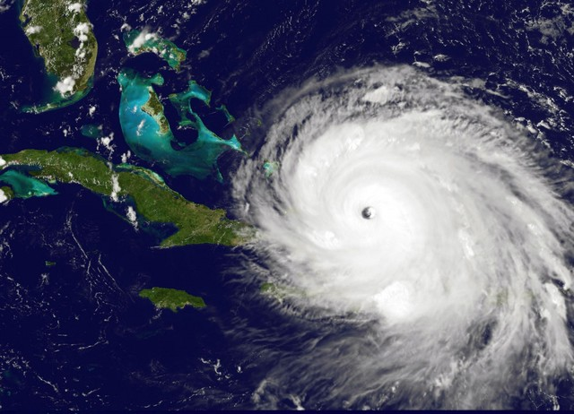
Atmospheric Pressure and Weather
Hurricanes
The centre of the storm is
called the eye which is
anticlockwise in the
northern hemisphere and
clockwise in the southern
hemisphere (due to wind
patterns).
The pressure decreases
rapidly towards the eye.

Slide 44
Atmospheric Pressure and Weather
Hurricanes
Rainfall and wind speed increase but fall off suddenly on reaching the eye, where the temperature may be 10 ºC higher than in the main body of the storm.
Large amounts of energy are released as the hurricane
forms.
On average there are 8 hurricanes in the Caribbean
annually.

Slide 45
How Atmospheric Pressure
Affects Aviation and Diving
Our bodies are designed to work at normal atmospheric pressure.
At high altitudes breathing is difficult and aircrafts have pressurized cabins in which the air pressure is increased sufficiently above than outside to safe-guard the crew and passengers.

Slide 46
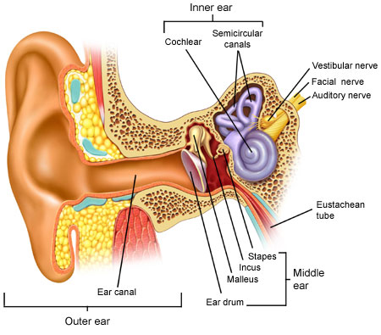
How Atmospheric Pressure
Affects Aviation and Diving
Why does our ear pop at high
altitudes?
Inside your ear there is a pocket
of air. This pocket is normally at
the same pressure as the air
outside your ear to help you hear,
but if the air pressure around you
changes, you feel the air pushing
on your eardrum.
Your ear has a small tube for equalising
the pressure between the inside and
outside of the ear that is opened when
you swallow and when the pressure is
equalised you often feel a pop.

Slide 47
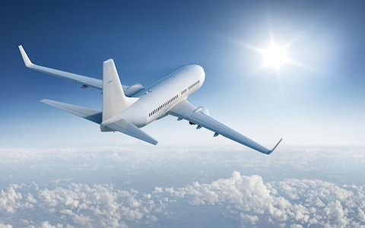
How Atmospheric Pressure
Affects Aviation and Diving
In a plane, the high altitude means the air is thinner and although planes are pressurized, the air pressure is still much less than on the surface.
This difference in air
pressure can be felt
by the ears, particularly
on takeoff and landing
when changes in
altitude make the
pressure difference
happen more quickly.

Slide 48
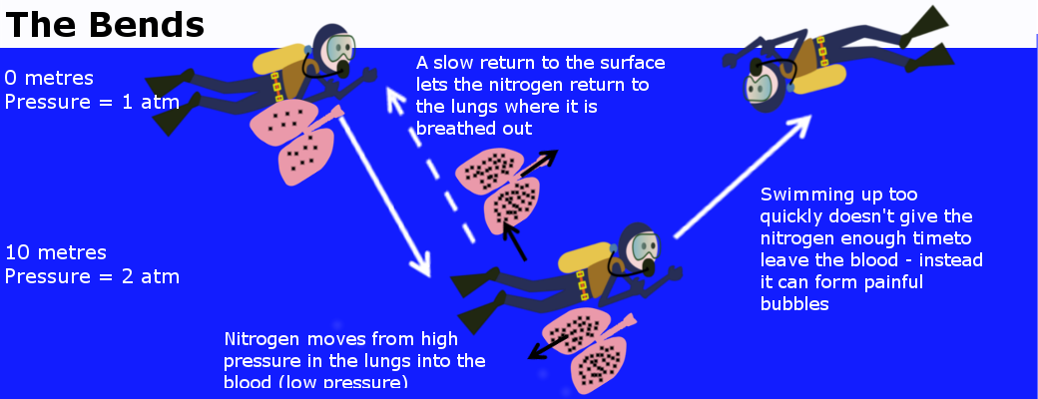
How Atmospheric Pressure
Affects Aviation and Diving
A scuba diver meets high
pressures and different
dangers.
At high pressures
nitrogen dissolves
in the blood and on
returning to the surface
too fast he would suffer
the painful and
sometimes fatal
condition called
‘THE BENDS’.
This is when the nitrogen gas forms bubbles of nitrogen in the blood vessels.

Slide 49
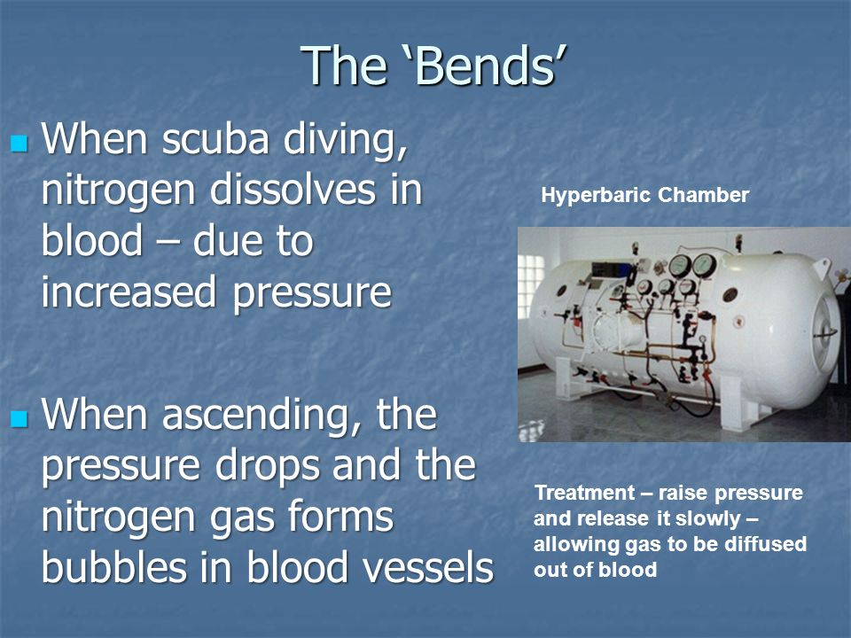
Atmospheric Pressure
Pressure, Aviation and Diving

Slide 50
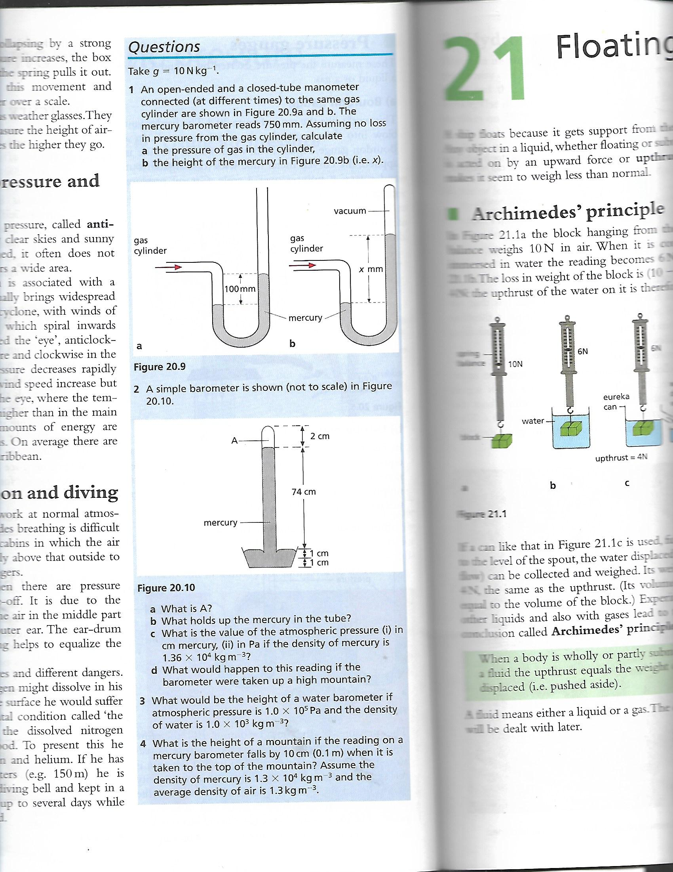
Pressure Questions

Slide 51
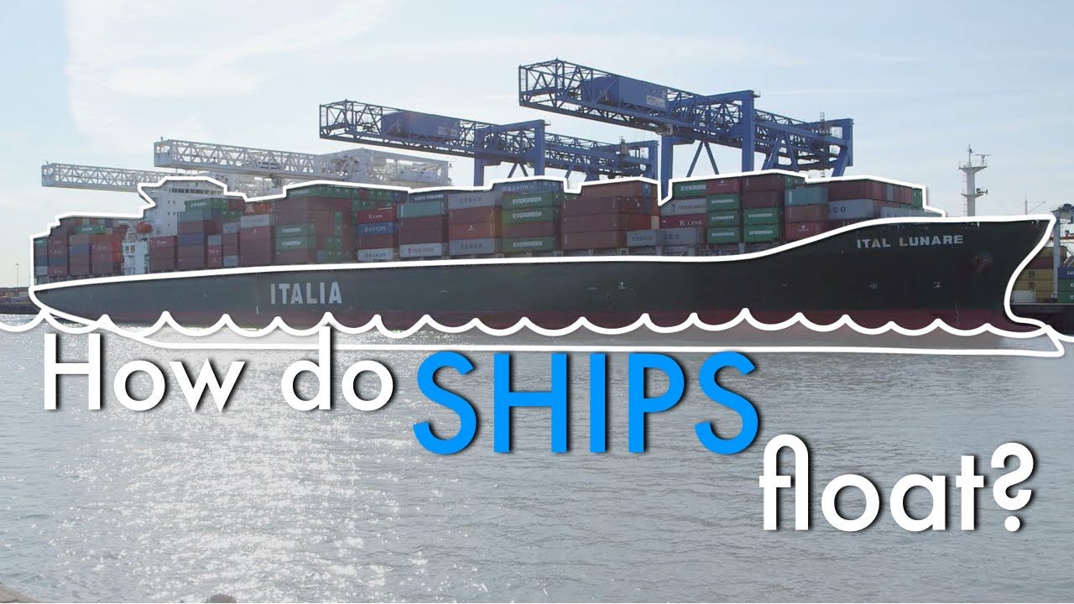
Floating, sinking and flying

Slide 52
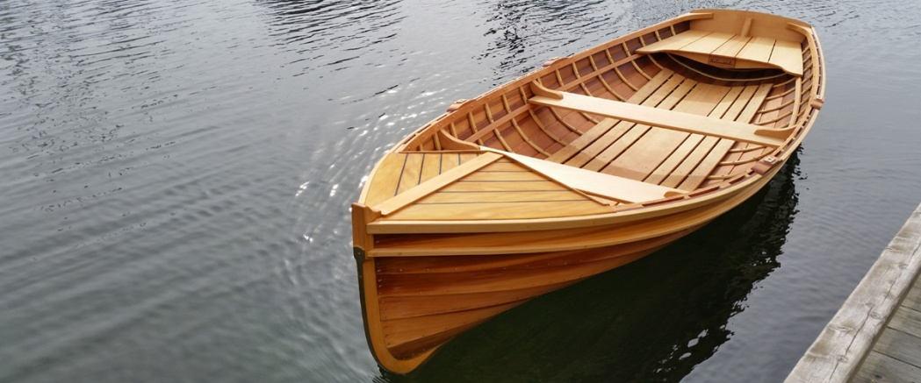
Archimedes’ Principle
A ship floats because
it gets support from
the water.
Any object in a liquid, whether floating or submerged, is acted on by an upward force or buoyant force.
This force makes it seem to weigh less than normal.

Slide 53
Archimedes’ Principle
Archimedes’ Principle states that:
When a body is wholly or partly submerged in a fluid the upthrust equals the weight of fluid displaced or pushed aside.
The word fluid refers to a liquid or a gas.
The case of gases will be dealt with later.

Slide 54
Floating
The principle of floatation states:
When a body floats in water the upthrust equals the weight of the body. The net force on the body is zero, this is the case of the principle of floatation .
A floating body displaces its own weight of fluid.

Slide 55
Floating
Ships, Submarines, Balloons
Ships
A floating ship displaces a weight of water equal to its own weight including that of the cargo.
The load lines called the Plimsoll mark on the side of a ship show the levels to which it can legally be loaded under different conditions.
Why is a boat allowed to take a greater load in summer than in winter?

Slide 56
Floating
Ships, Submarines, Balloons
Ships
A floating ship displaces a weight of water equal to its own weight including that of the cargo.
The load lines called the Plimsoll mark on the side of a ship show the levels to which it can legally be loaded under different conditions.
Why is a boat allowed to take a greater load in summer than in winter?
Colder water is more dense than warmer or hot water. The warm water allows a boat to carry more cargo because the ship would have less buoyant force to overcome.

Slide 57
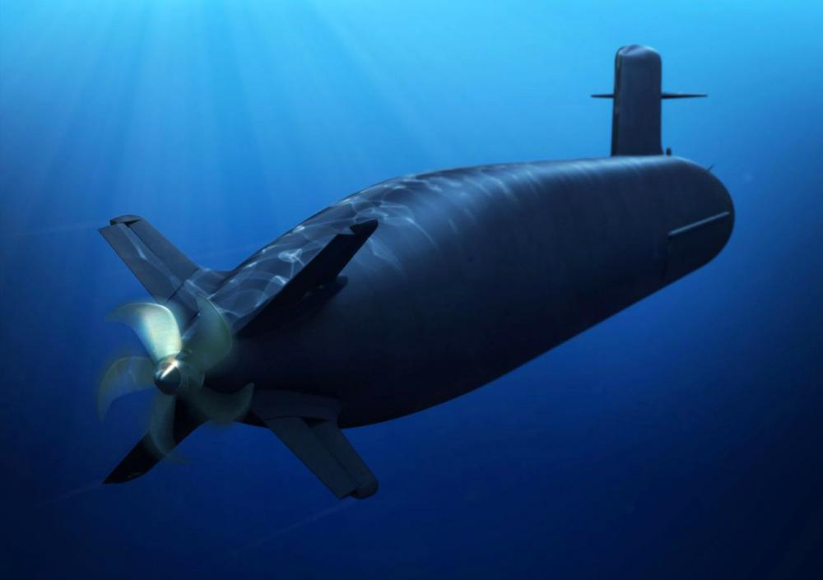
Floating
Ships, Submarines, Balloons
Submarines
How do you think a submarine sinks?
Once a submarine is submerged the
upthrust is unchanged but the weight
of the submarine increases with
the inflow of water and it sinks
faster.
How do you think a submarine resurfaces?

Slide 58
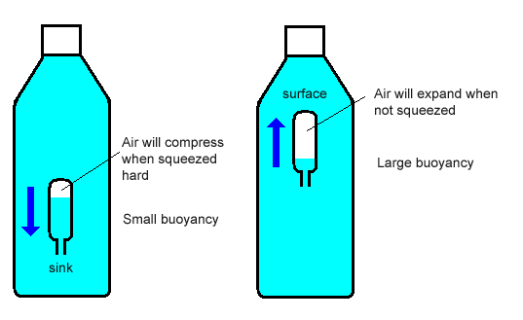
Floating
Ships, Submarines, Balloons
Cartesian Diver
In the Cartesian diver, the
pressure on the cork forces
more water into the bulb.
The diver’s weight increases
and he sinks.
The Cartesian diver mimicks
the behaviour of a submarine.
What do you think would happen if the pressure were decreased?

Slide 59

Floating
Ships, Submarines, Balloons
Balloons
A balloon filled with hydrogen weighs less than
the weight of air it displaces.
The upthrust force is therefore greater than its
weight and the resultant upwards force on the
balloon causes it to FLOAT.

Slide 60
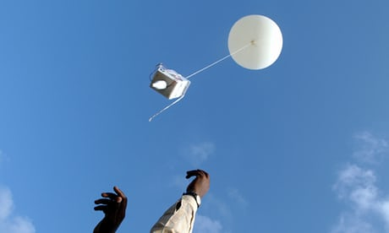
Floating
Ships, Submarines, Balloons
Balloons
Meteorological balloons carry
scientific instruments called
radiosondes, and are sent into
the upper atmosphere.
A small radio transmitter sends
signals back to earth which
contain information about the
temperature, pressure and humidity.
They are tracked by radar to give data on wind direction and speed.

Slide 61
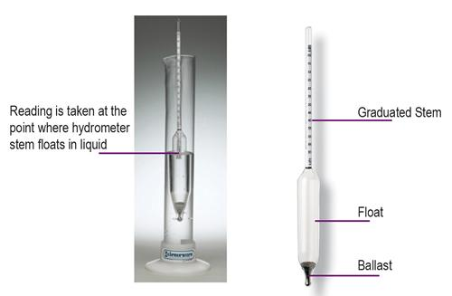
Floating
Ships, Submarines, Balloons
Hydrometer:
This is an instrument for measuring
rapidly, the relative density of a liquid.
The hydrometer is placed in the
liquid and the scale is read at the
level of the liquid surface.
The denser the liquid, the higher
it floats. The numbers on the
scale increase downwards.

Slide 62
Floating
Ships, Submarines, Balloons
Hydrometer
The large bulb gives the instrument buoyancy, and the small weighted bulb makes it float upright.
The narrow stem gives greater sensitivity, that is a small density change causes the instrument to
float much higher or lower.
Hydrometers enable the state of a car battery to be checked.
Where else are hydrometers used?

Slide 63
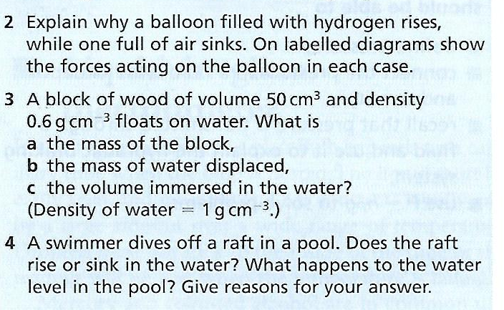
Floating, Sinking & Flying Questions

