Slide 1
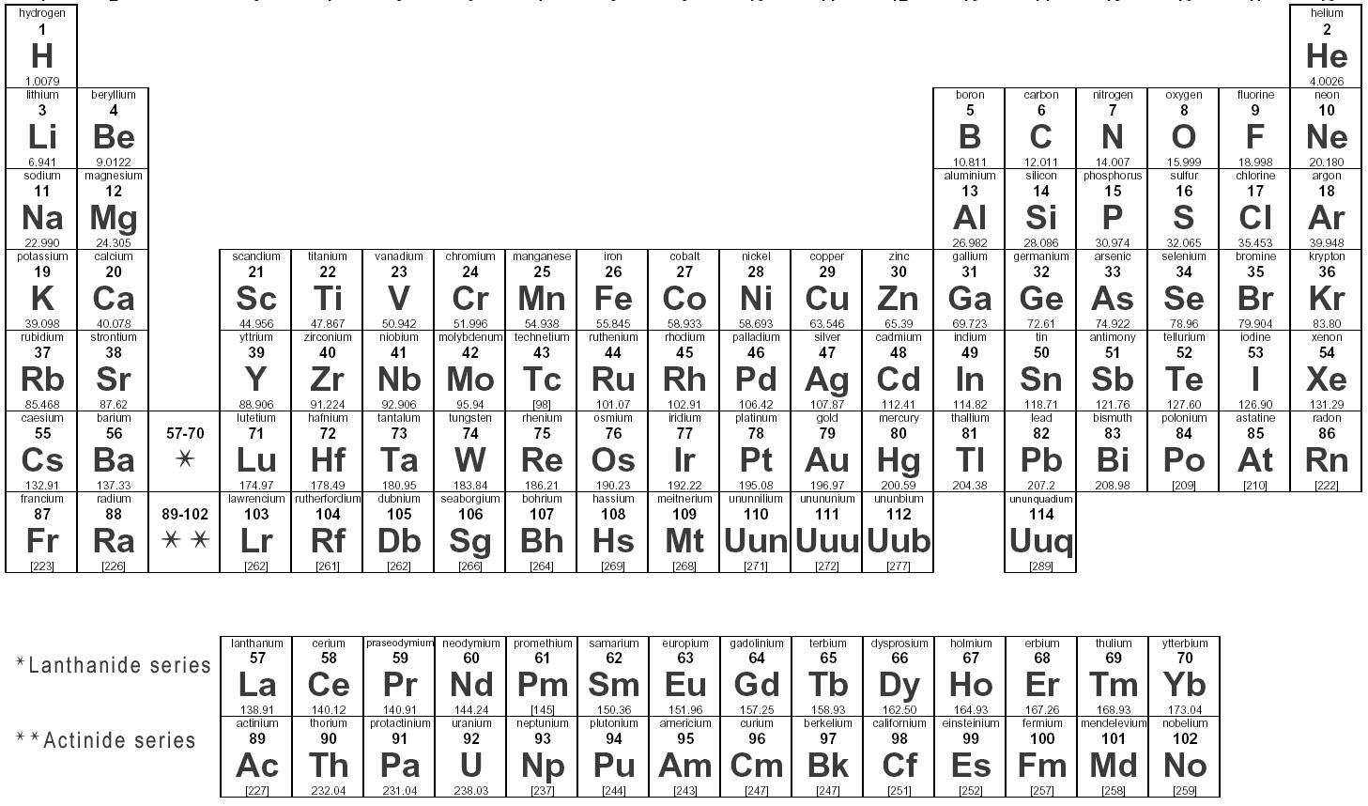
Introducing the Periodic Table

Slide 2
How Does the Periodic Table Help Us in Chemistry
The periodic table simplifies chemistry for us. It helps us to: a. Identify patterns in the chemistry of elements b. Formulate theories to explain these patterns & c. Predict the chemistry of unfamiliar elements

Slide 3
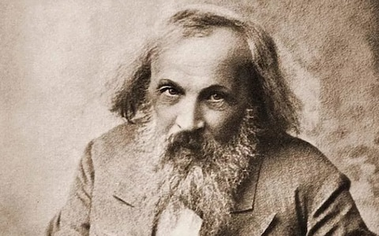
The Incredible Mendeleev
In 1869, Mendeleev proposed that a definite relationship existed between the chemical properties of elements and their atomic masses.
His observations made the Periodic Table what it is today. He even left gaps wherever the order of his classification suggested an element should exist there, even though it was not known. Amazingly enough he correctly predicted the properties of these ‘missing’ elements.
Of course with every discovery there are imperfections in that some of the atomic masses of some elements did not fit the pattern. These problems were later cleared up by Moseley in 1913.
He did this by arranging the elements by their atomic/proton number instead of their atomic masses.

Slide 4
Periods & Groups
On the cover of this handout is the modern version of the Periodic Table.
You need to learn the symbols, atomic masses and atomic numbers of at least the first 20 of the elements, Hydrogen (H) – Calcium (Ca).
The Periodic Table divides elements into: a. Horizontal ROWS or PERIODS (Periods refer ENERGY LEVELS) b. Vertical COLUMNS or GROUPS (Groups refer to VALENCE electron count)

Slide 5
De-Coding the Periodic Table
The Periodic Table divides the elements into metals, non-metals and semi-metals.
Groups 1 and 2 contain only metals. These are found on the LEFT hand side of the Periodic Table.

Slide 6
De-Coding the Periodic Table
Group 1 is often referred to as ALKALI Earth metals. These metals are called alkali metals because they form alkalis ( i.e. strong bases capable of neutralizing acids) when they react with water.
Group 2 is often referred to as ALKALINE Earth metals. Group II elements are referred to as Alkaline earth metals because these are derived from alkaline minerals such as slake, limestone etc. that are naturally found on earth. The oxides of these metals give basic alkaline solution. These oxides requires very high temperature to melt and can remain solid (earth)in fires.

Slide 7
De-Coding the Periodic Table
Group 3 contains metals with the exception for Boron.
Group 7 is referred to as The Halogens.
Group 8, which is sometimes depicted as Group 0, is referred to as The Noble Gases.

Slide 8
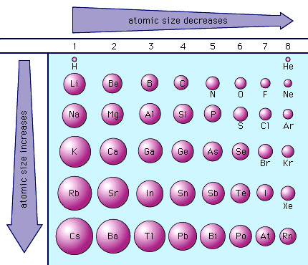
De-Coding the Periodic Table
The size/diameter of an atom is referred to as atomic radii.
a. Atomic radii DECREASE across the Period because there is a greater attraction of the nucleus for the electron shells. Simply put, the electrons are pulled closer to the nucleus due to nuclear charge.
b. Atomic radii INCREASE down the Group because there are more electron shells as one goes down the Group. Simply put, the attraction between the nucleus and outer shell becomes weaker, because of electron/electron repulsion and this increases the atomic radii. In the picture the transition metals have been left out.

Slide 9
De-Coding the Periodic Table
Electronegativity measures the ease with which an atom attracts the electrons in a covalent bond.
In general, small atoms with high nuclear charge or high atomic number have the highest electronegativities. Which set of elements are more electronegative? Non-metal or metals? a. Electronegativity increases across the Period from LEFT to RIGHT b. Electronegativity decreases on moving down the Group c. Elements with high electronegativity values are OXIDIZING AGENTS d. Elements with low electronegativity values are REDUCING AGENTS

Slide 10
De-Coding the Periodic Table
Between the metals and the non-metals are the elements that have some properties of both.
These are called metalloids.
Silicon, Arsenic, Boron, Germanium etc. are examples of metalloids.

