Slide 1
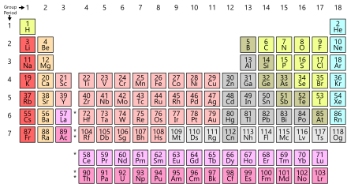
Trends in Group II

Slide 2
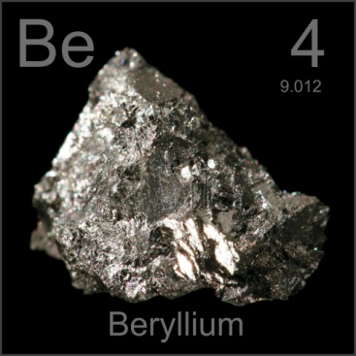
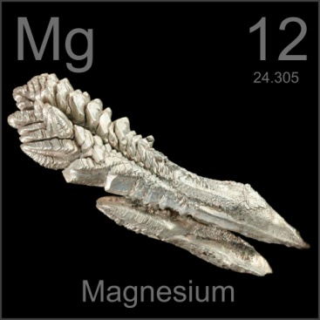
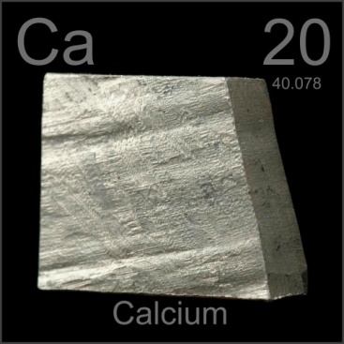
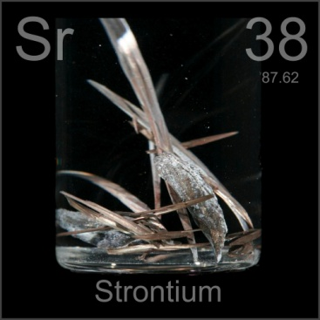
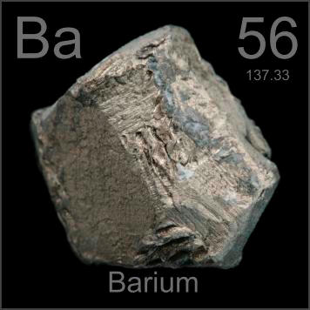
The Elements of Group II
The elements of Group II in order of first to last are: a. Beryllium (Be) b. Magnesium (Mg) c. Calcium (Ca) d. Strontium (Sr) e. Barium (Ba)

Slide 3
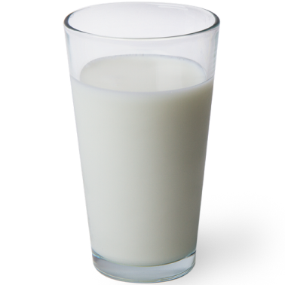
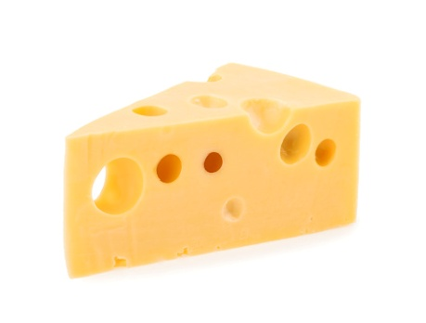
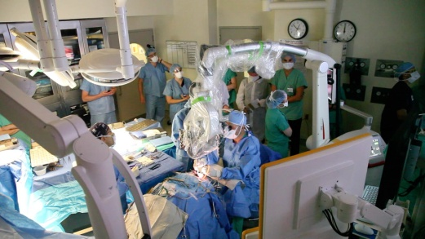
Uses of Group II’s Elements
Magnesium is used in fireworks or to build airplane body parts.
Calcium is present in milk, cheese, bones etc.
Strontium is also used in fireworks and can be found in toothpaste.
Barium is used in medical procedures.

Slide 4
Physical Properties of Group II metals
They are found as minerals in the Earth.
They are so reactive that they can not exist by themselves. They are often combined with another element such as oxygen, chlorine or phosphorus.

Slide 5
The Reactivity of Group II’s Elements
Group II’s metals get more reactive going down the group.
Barium (Ba) is the most reactive while Beryllium (Be) is the least reactive metal in Group II.

Slide 6
Some Reactions of Group II’s Elements
They react with oxygen to produce oxides of themselves. Example: magnesium oxide produced from Mg and O₂ 2Mg_{(s)} + O_{2(g)} → 2MgO_{(s)} calcium oxide produced from Ca and O₂ 2Ca_{(s)} + O_{2(g)} → 2CaO_{(s)}
They react with water to produce hydroxides of themselves and give off hydrogen gas. Example: magnesium hydroxide produced from Mg and H₂O Mg_{(s)} + H₂O_{(l)} → Mg(OH)_{2(aq)} + H_{2(g)} calcium hydroxide produced from Ca and H₂O Ca_{(s)} + H₂O_{(l)} → Ca(OH)_{2(aq)} + H_{2(g)}

Slide 7
Some Reactions of Group II’s Elements
They react with hydrochloric acid (HCl) to form chlorides of themselves and give off hydrogen gas. Example: magnesium chloride produced from HCl Mg_{(s)} + 2HCl_{(aq)} → MgCl_{2(aq)} + H_{2(g)} calcium chloride produced from HCl Ca_{(s)} + 2HCl_{(aq)} → CaCl_{2(aq)} + H_{2(g)}
Chlorides are often referred to as salts.

Slide 8
Reactivity & Ease of Ionisation
The reactions of Group II’s metals are based on losing their valence electrons to form ionic bonds.
The energy needed to remove an electron from an atom or ion is called its ionisation energy.
When Group II metals lose their valence electrons they become ions and carry a charge of 2+ since they lost two electrons. Example Mg²⁺ or Ca²⁺

Slide 9
Factors that Affect Ionisation
Size of atom (atomic radii)
Nuclear charge
Electron/Electron Shielding

Slide 10
Quizlet II
The options below refer to questions 1, 2 and 3: a. Filtration b. Simple distillation c. Fractional distillation d. Simple paper chromatography Which separation technique is most appropriate for separating the components in a mixture of:
1. A sand and water? A
2. Pen ink? D
3. Alcohol and water? C
4. Oil is poured into a container half filled with water and shaken. The mixture is left to sit for about 15 minutes. An observation is made where oil is recorded as floating on top of the water. Which of the following options is incorrect? a. Water is less dense than the oil b. The oil is less dense than the water c. The oil can be removed from the mixture using a separating funnel d. Oil is referred to as the non-aqueous layer
5. Which of the following is a compound? a. H₂O b. He c. S d. O₂

Slide 11
Quizlet II
6. Iodine crystals can transition directly from a solid to a gas. What is the name of the transition? a. Melting b. Evaporation c. Sublimation d. Freezing
7. Calcium has a mass of 40 g and its nucleus contains 20 protons. How many neutrons are there within the nucleus? a. 60 b. 30 c. 10 d. 20
8. All of the following elements are present in group II. Which of them below is most reactive? a. Ba b. Be c. Sr d. Mg
9. Elements found in group VII are referred to as a. Alkaline Earth Metals b. Nobel Gases c. Metalloids d. Halogens
10. In the Periodic Table electronegativity increases a. From right to left b. From top to bottom c. Diagonally d. From left to right

Slide 12
Quizlet II
11. Isotopes like Cl-35 and Cl-37 have all of the following except a. Same amount of protons b. Different mass numbers c. Same symbol d. Same amount of neutrons
12. Which of the following is the only non-metal present in Group III? a. Al b. B c. Ga d. S
13. Atomic radii decreases from left to right in the Periodic Table because of a. Electron-electron repulsion b. Density c. Mass d. Nuclear charge
14. The missing element in the following chemical equation: Mg_{(s)} + 2HCl_{(aq)} → _______ + H_{2(g)} is a. MgCl b. Mg²⁺ c. Cl₂Mg d. MgCl₂
15. The missing element in the following chemical equation: Ca_{(s)} + H₂O_{(l)} → _______ + H_{2(g)} is a. OH₂Ca b. CaOH c. Ca(OH)₂ d. Ca₂OH
16. Calcium can be found in all of the following EXCEPT a. Bones b. Cheese d. Limestone d. Fireworks

Slide 13
Quizlet II
17. Silicon is a a. Metalloid b. Metal c. Non-metal d. Nobel Gas
18. Of the following elements below which one is most electronegative? a. I b. F c. Br d. Cl
19. What is the symbol for sodium? a. S b. K c. Na d. So
20. This element may be found in period 2 group 1 a. Li b. Be c. Cl d. Ne

