Slide 1

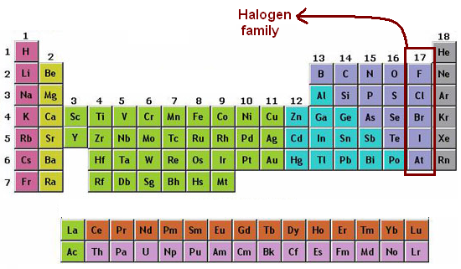
Group VII – The Halogens

Slide 2
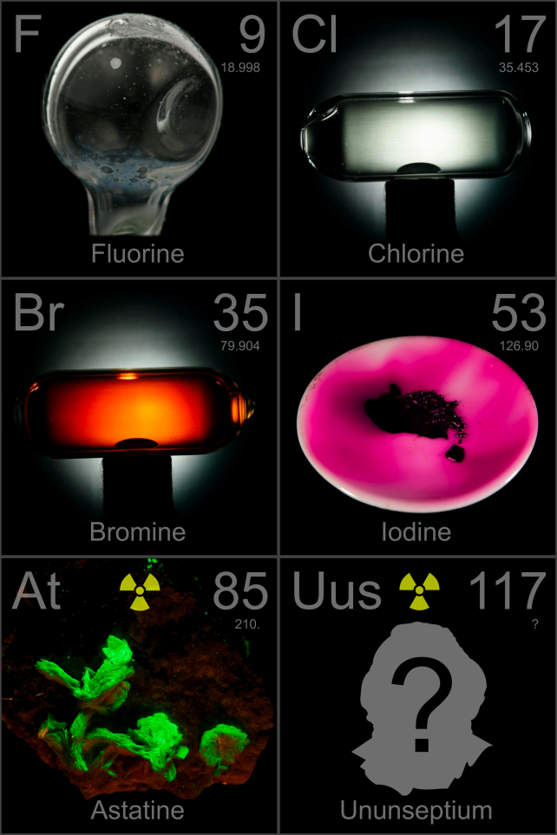
Elements of Group VII
The elements of Group VII in order of first to last are:
a. Fluorine (F)
b. Chlorine (Cl)
c. Bromine (Br)
d. Iodine (I)
e. Astatine (At)

Slide 3
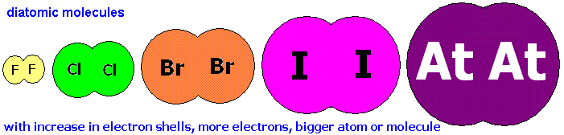
Elements of Group VII
The Group VII elements are called HALOGENS.
They all exist as diatomic molecules in nature. For example, F₂, Cl₂, Br₂, I₂ and At₂.

Slide 4
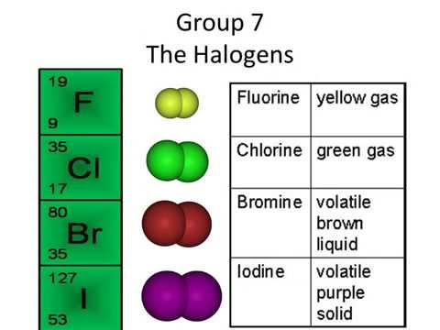
Properties of Group VII
Their colours get darker as you go down the group.

Slide 5
Properties of Group VII
Going down the group:
Their melting and boiling points increase.
Reactivity of the elements decrease.
The radius of the halogen atom increases.

Slide 6
Oxidising Agents
Halogens are referred to as STRONG oxidising agents.
This means that they are willing to accept electrons.
Fluorine is the strongest oxidising agent of the halogens (due to strong nuclear charge) while Astatine is the weakest halogen (due to weak nuclear charge).

Slide 7
Displacement reactions
Halogens are involved in displacement reactions.
A displacement reaction is a reaction in which one type of atom or ion has replaced another in a compound.
In displacement reactions fluorine can displace all of the halogens below it. Chlorine can displace all of the halogens below it except fluorine and so forth.

