Slide 1
Periodic Trends in Period III of the Periodic Table

Slide 2
Periodicity
Periodicity is the regular occurrence of similar properties of the elements in the periodic table so that elements in a given group have similar properties, or a trend in properties.

Slide 3
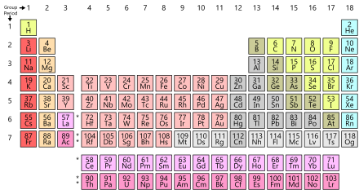
Period III’s Population
In Period III there are:
Sodium (Na)
Magnesium (Mg)
Aluminum (Al)
Silicon (Si)
Phosphorus (P)
Sulphur (S)
Chlorine (Cl)
Argon (Ar)

Slide 4
Changes that take place
As we move along Period III there is a change from:
a. metallic to non-metallic.
b. solid to gas.
c. high to low boiling points.
d. conductor to insulator

Slide 5
Reactions with H₂O
Sodium reaction violently with water
Magnesium reacts very slowly
Aluminum only reacts if there it is heated
Silicon, phosphorus and sulphur do not react
Chlorine forms an acidic solution

Slide 6
Using the Periodic Table Wisely
Once you have familiarized yourself with the trends that occur in the Periodic Table it could be used to deduce the properties of elements that you are not familiar with.

